Slide 1
Simulation of Superconducting
Qubits Using COMSOL
Workshop on Microwave Cavity Design
for Axion Detection
Nick Materise
August 25, 2015

Slide 2
Outline
Review of Cavity QED and Circuit QED
COMSOL RF Modeling
Noise Parametrization in COMSOL
Connections to ADMX Models
Summary
Future Work

Slide 3
Review of Cavity QED Systems
Cavity QED: two level atomic system trapped in a mirrored resonant cavity
Follows the Jaynes-Cummings Hamiltonian¹:
¹ D. I. Schuster, Circuit Quantum Electrodynamics. PhD thesis, Yale University, 2007.
² R. J. Schoelkopf and S. M. Girvin, “Wiring up quantum systems,” Nature, vol. 451, pp. 664–669, 02 2008.
Atom trapped in a cavity with photon emission, atomic-cavity dipole coupling, and atom transit time shown².

Slide 4
Superconducting Qubits and Circuit QED
Circuit QED ~ Cavity QED
  Harmonic Oscillator as a first circuit model approximation¹
  Add non-linear inductance with Josephson Junction, anharmonicity
“Artificial Atom” or qubit replaces atom from Cavity QED
  Two lowest energy levels form a two level system (TLS)
  Qubit = TLS formed by Josephson Junction and other circuit elements³
LC harmonic oscillator circuit
¹ D. I. Schuster, Circuit Quantum Electrodynamics. PhD thesis, Yale University, 2007.
³ William D. Oliver and Paul B. Welander. Materials in superconducting quantum bits. MRS Bulletin, 38:816–825, 10 2013.

Slide 5
Cavity QED—Circuit QED Comparison
Parameter | Symbol | Cavity QED¹ | Circuit QED^{1,4}
Resonator, Qubit Frequencies | ω_{r,} ω_{q} / 2π | ~ 50 GHz | ~ 5 GHz
Transition Dipole Moment | d / ea₀ | ~ 1 | ~ 10⁴
Relaxation Time | T₁ | 30ms | 60 μs
Decoherence Time | T₂ | ~1 ms | ~10-20 μs
Large dipole moment couples the qubit well to the cavity in superconducting qubits: coupling strength and energy levels are tunable
Trapped atoms in cavities have longer coherence times, not tunable, weakly coupled to the cavity for measurement
¹ D. I. Schuster, Circuit Quantum Electrodynamics. PhD thesis, Yale University, 2007.
⁴ Hanhee Paik, D. I. Schuster, Lev S. Bishop, G. Kirchmair, G. Catelani, A. P. Sears, B. R. Johnson, M. J. Reagor, L. Frunzio, L. I. Glazman, S. M. Girvin, M. H. Devoret, and R. J. Schoelkopf. Observation of High Coherence in Josephson Junction Qubits Measured in a Three-Dimensional Circuit QED Architecture. Phys. Rev. Lett., 107:240501, Dec 2011.

Slide 6
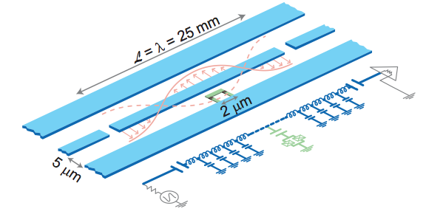
Superconducting Qubit Design
Implemented as Josephson Junction and large capacitance coupled to transmission line resonator (coplanar waveguide, CPW)
  Transmission Line Resonator ~ Cavity
  2D Planar or 3D cavity couples qubit to readout hardware
Coplanar waveguide resonator and lumped circuit element reproduced from⁵.
Dipole Moment, resonator modes, energy levels—all tunable in microwave and Josephson Junction design
⁵ Alexandre Blais, Ren-Shou Huang, Andreas Wallraff, S. M. Girvin, and R. J. Schoelkopf. Cavity quantum electrodynamics for superconducting electrical circuits: An architecture for quantum computation. Phys. Rev. A, 69:062320, Jun 2004.

Slide 7
Superconducting Qubit Design—COMSOL Modeling
Key advantage of Circuit QED is its tunability through fabrication
Emphasis on design microwave circuitry calls for detailed classical and quantum models of noise
COMSOL and other modeling tools provide a means to parameterize noise sources

Slide 8
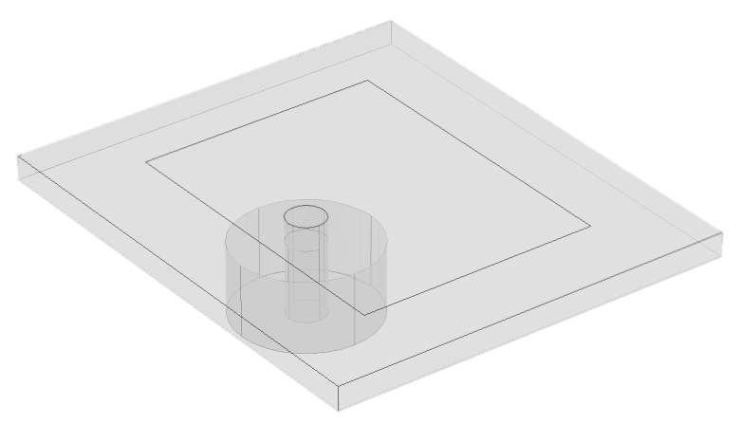
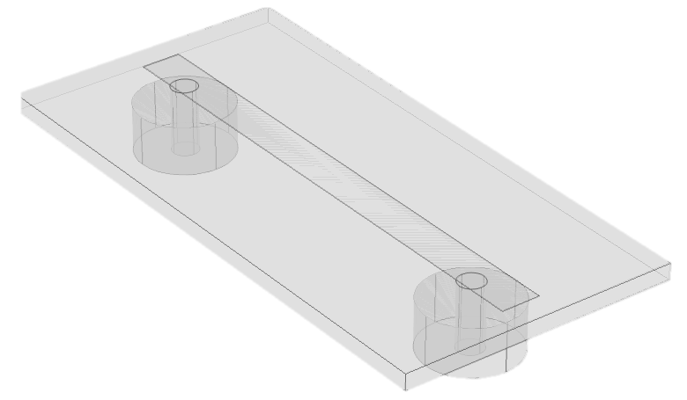
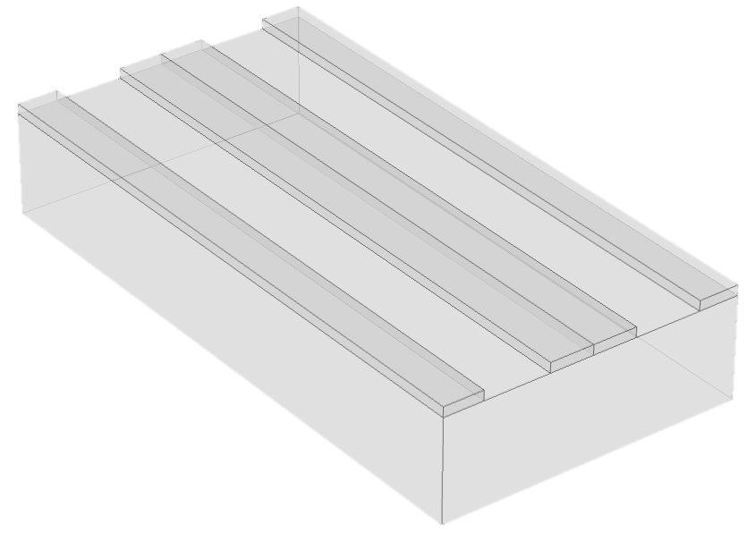
COMSOL RF Simulation Studies
Model systems used to develop more accurate descriptions of the microwave circuits that constitute a qubit
Model Progression
  Microstrip Patch Antenna (MPA)
  Microstripline Antenna
  Coplanar Waveguide (CPW)

Slide 9
Microstrip Patch Antenna
Simple geometry, application in consumer antenna designs, military devices, and other areas where space is premium
We used a simple coaxial excitation to reproduce the return loss results from⁶ to verify our COMSOL model
⁶ J. Kaur and R. Khanna. Co-axial Fed Rectangular Microstrip Patch Antenna for 5.2 GHz WLAN Applica- tion. Universal Journal of Electrical and Electronic Engineering, 1(3):94–98, 2013.

Slide 10
Microstripline Resonator
Two port extension of the MPA used to probe a substrate by measuring S₂₁
Characteristic Impedance given by:
Electric field plot at resonance

Slide 11
Microstripline Resonator
S₁₁, S₂₁ measured for PTFE substrate with dielectric constant ε_{r} = 2.5 and loss tangent tanδ = 0.0009

Slide 12
Coplanar Waveguide
Coplanar waveguide used as a resonant coupling structure, i.e. cavity with the qubit
Characteristic Impedance from conformal mapping⁷:
⁷ Rainee N Simons. Coplanar Waveguide Circuits, Components, and Systems, chapter 2. Wiley Series in Microwave and Optical Engineering. Wiley, 2001.

Slide 13
Noise Parametrization
Goal: develop parametrized models of microscopic noise that are measurable in macroscopic observables
Two approaches to injecting noise in our COMSOL models:
  Discrete Noise Sources
    Lumped circuit elements
    Point defects
    Other discrete atomic / mesoscopic imperfections
  Continuous Noise Sources
    Analytical models of material properties,
    i.e. ε_{r}(x,y,z,t ), μ_{r}(x,y,z,t ), σ(x,y,z,t )
    Noise power spectral density function S(f )
Lumped circuit model of discrete LC-oscillators dispersed throughout the bulk of a material / substrate to model discrete harmonic oscillator noise.

Slide 14
Spatially Varying Permittivity
Noise injected into COMSOL models via bulk parameters
Permittivity expressed as a function of space (time):
Surface plot of spatially varying permittivity as an analytic
function in COMSOL. Color intensity reflects the relative
magnitude of the function in the z-direction.

Slide 15
Spatially Varying Permittivity COMSOL Study, 1
Microstripline resonator used as the model system
Progression of S₂₁ for different scaling values, A

Slide 16
Spatially Varying Permittivity COMSOL Study, 2
Microstripline resonator used as the model system
Progression of S₂₁ for different frequencies, w_{x}, w_{y}

Slide 17
COMSOL Modeling—ADMX Contributions
Microwave cavity simulation: COMSOL Blog post by Bjorn Sjodin

Slide 18
Summary
Circuit QED allows us to emulate Cavity QED systems in solid state devices, affording tunability and exploring new physics on chip
Qubits in the Circuit QED architecture require microwave engineering and involve microscopic noise sources
COMSOL allows for rapid design of RF circuits and flexible modeling of underlying physics in materials
Noise sources are conveniently modeled by discrete or continuous distributions
COMSOL models provide a means to test macroscopic manifestations of microscopic noise in subsequent experiments

Slide 19
Future Work
Continue to develop more descriptive COMSOL models that incorporate bulk parameters with various dependencies
Simulate designs that more closely resemble those in existing superconducting qubits
Develop methods of modeling dissipation to predict relaxation and coherence times
Design and run experiment (s) to validate more comprehensive models

Slide 20
Acknowledgements
Vince Lordi, Scott Nelson, Jonathan Dubois
Quantum Simulations Group
This work was funded by the LLNL Laboratory Directed Research and Development (LDRD) program, project number 15-ERD-051.

