Slide 1
Novel Aluminum-based High-Q Cold RF Resonators for ADMX
Katsuya Yonehara
ADMX RF resonator workshop at LLNL
24-28th August, 2015

Slide 2
Attractive metal, high-purity Aluminum
Improved aluminum refining techniques now provide high-quality, cost effective high-purity aluminum samples
High-purity aluminum shows extremely low electric resistivity at low temperatures in strong magnetic fields
High energy physics opportunities now at hand motivate a targeted R&D program to fabricate and evaluate resonating cavities using very high purity aluminum at low temperatures in strong magnetic fields
Axion detector resonator

Slide 3
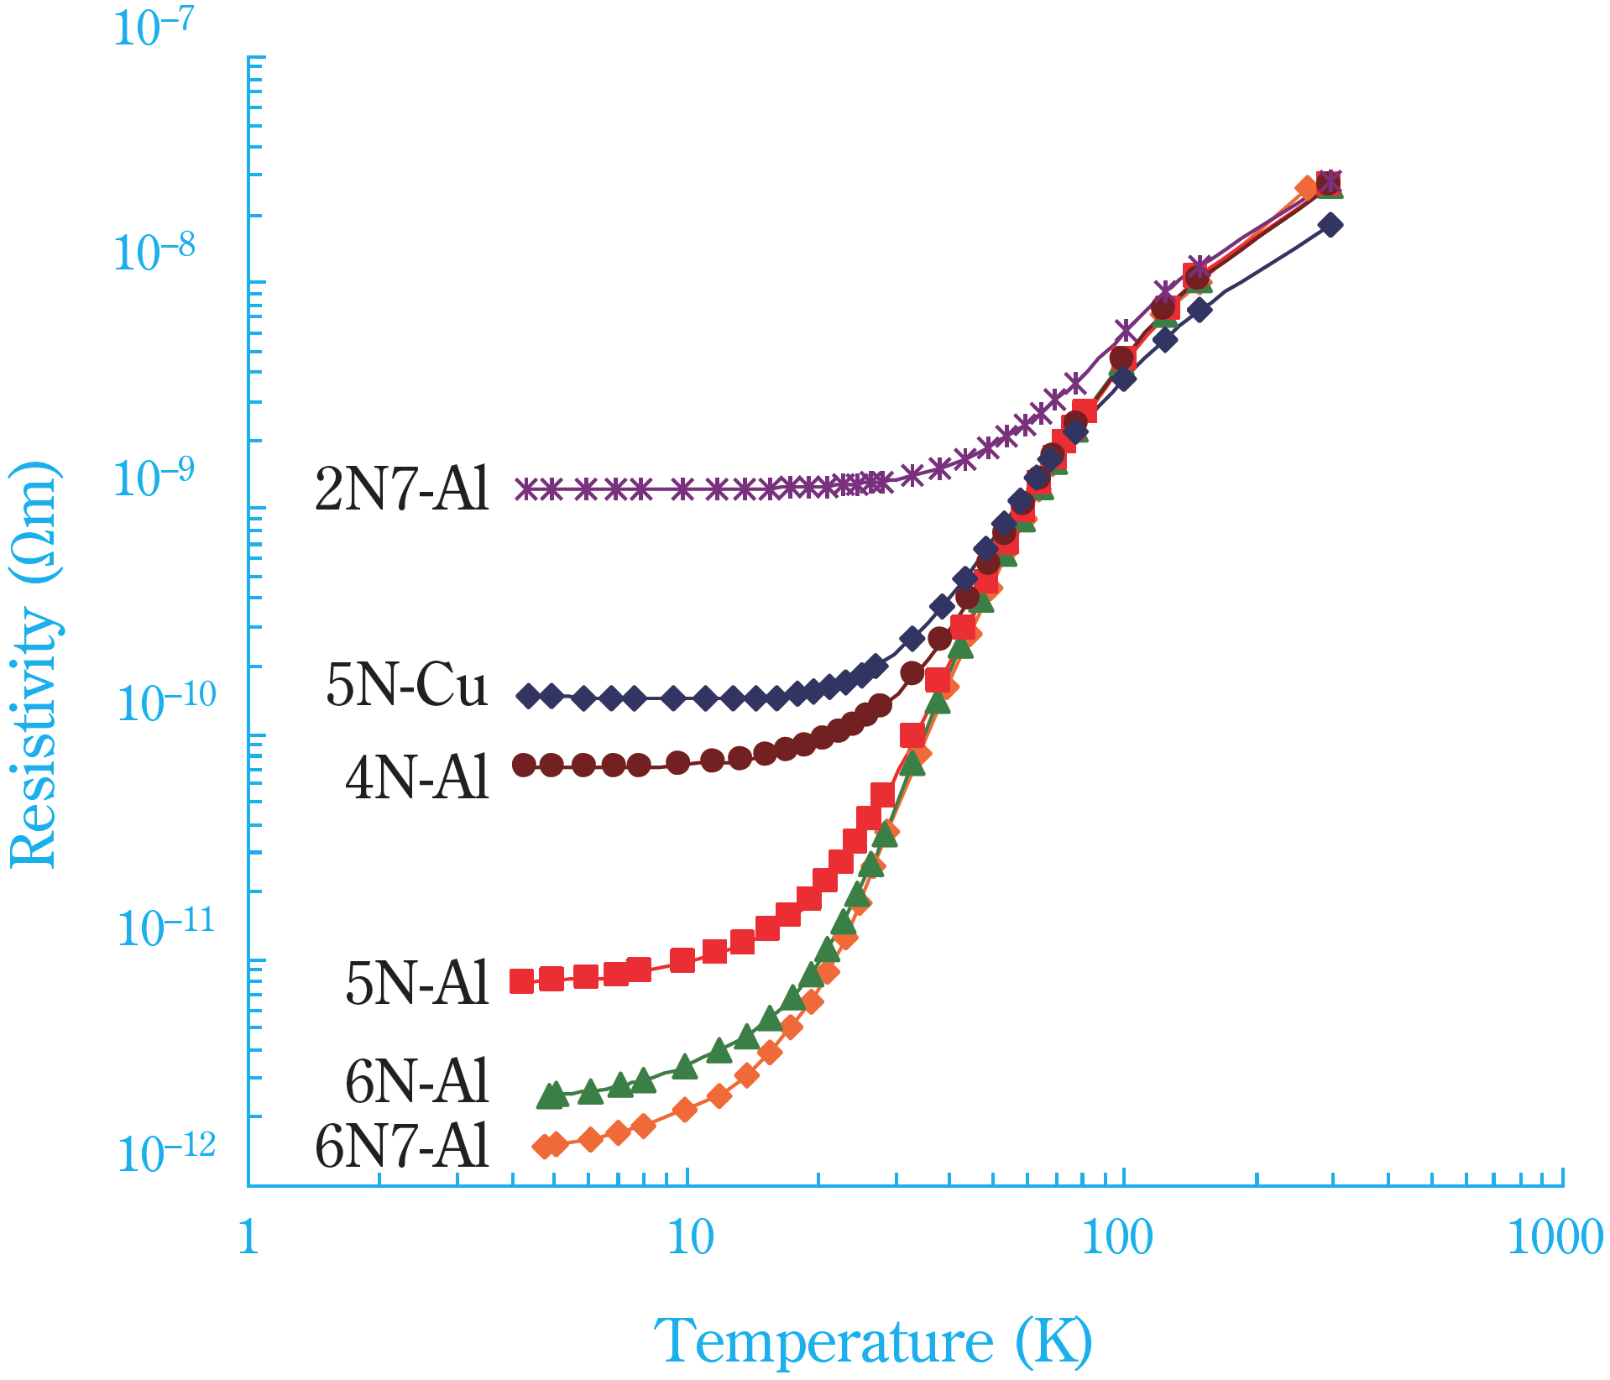
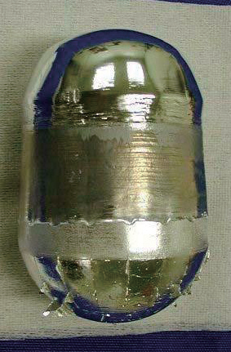
DC electric resistivity of Aluminum and Copper
H. Hoshikawa et al., “Refining Technology and Low Temperature
Properties for High Purity Aluminum”, R&D report, Sumitomo Kagaku
Vol. 2013.
• Resistivity of 5N-Al is one order of magnitude smaller than 5N-Cu
• 6N7-Al is available as a commercial product that shows two orders of magnitude lower resistivity than 5N-Cu
• Al cost about half from the same
purity Cu
Al ingot purified through
ultra-high vacuum melting
5N = 99.999 %
6N7 = 99.99997 %

Slide 4
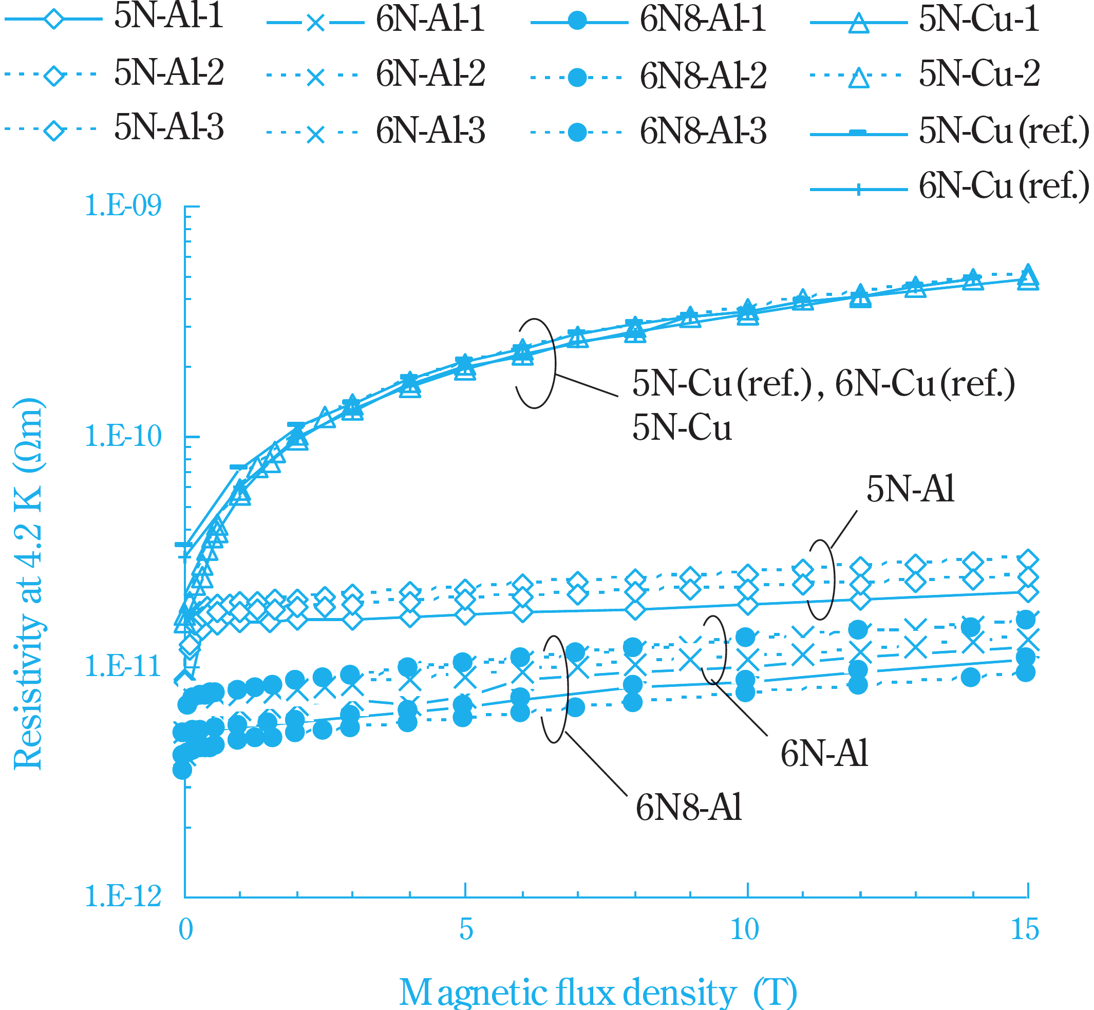
DC electric resistivity of Al and Cu in strong magnetic fields
H. Hoshikawa et al., “Refining Technology and Low Temperature
Properties for High Purity Aluminum”, R&D report, Sumitomo Kagaku
Vol. 2013.
• Resistivity of copper increases quadratic as a function of external magnetic field strength
• It is called magneto-resistivity
• Magneto-resistivity of aluminum is saturated in a strong magnetic field

Slide 5
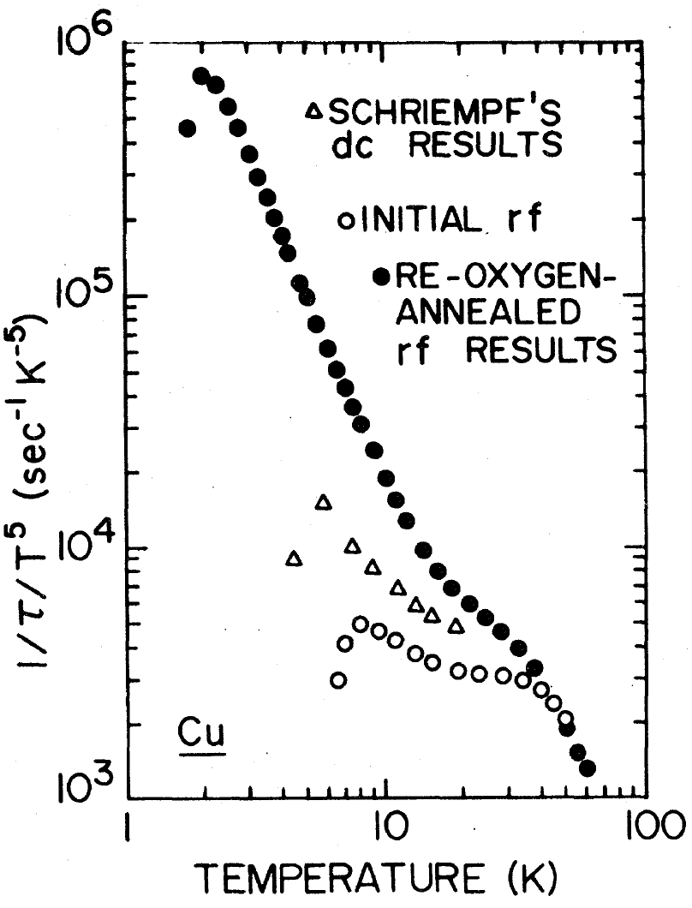
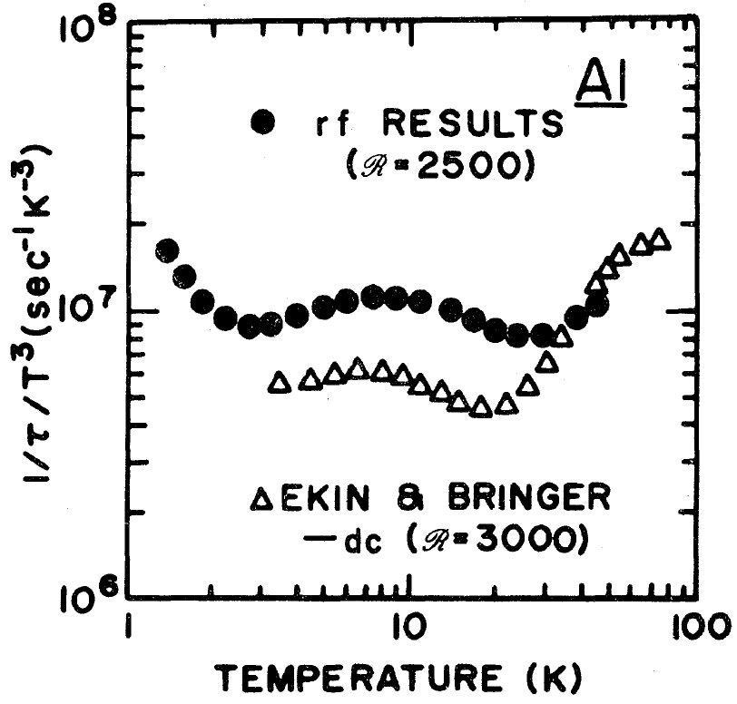
AC electric resistivity of Al and Cu
D. Movshovitz et al., Phys. Rev. B41, 10503, 1990
• This is only experimental result I found
• 1/τ (∝ resistivity in Drude theory) of Cu significantly increases (take a part from the DC measurement) at low temperature which shows an anomalous skin effect
• While 1/τ is a constant (close to the DC measurement) in Al conductor

Slide 6
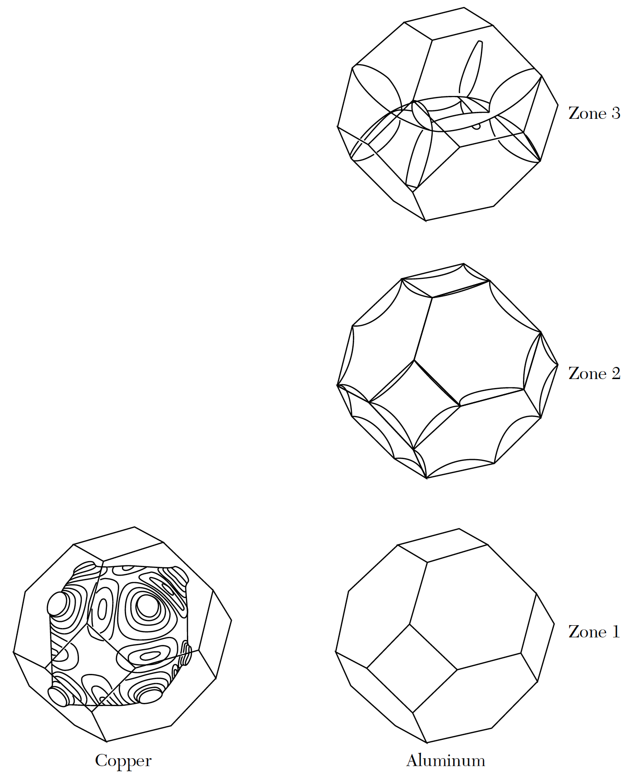
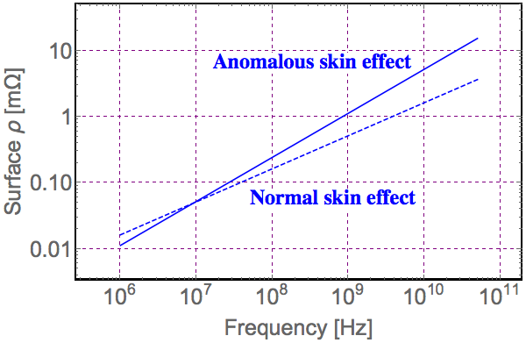
Electron conductivity model
• Most characteristics of metal is represented
by Fermi surface (k-space)
• Cu has one conductive electron while Al has
three
• Since the Fermi surface of Cu is close to
a sphere some properties can be estimated
analytically
Example: surface resistivity of Cu conductor
Assume DC resistivity = 6.6 nΩ

Slide 7
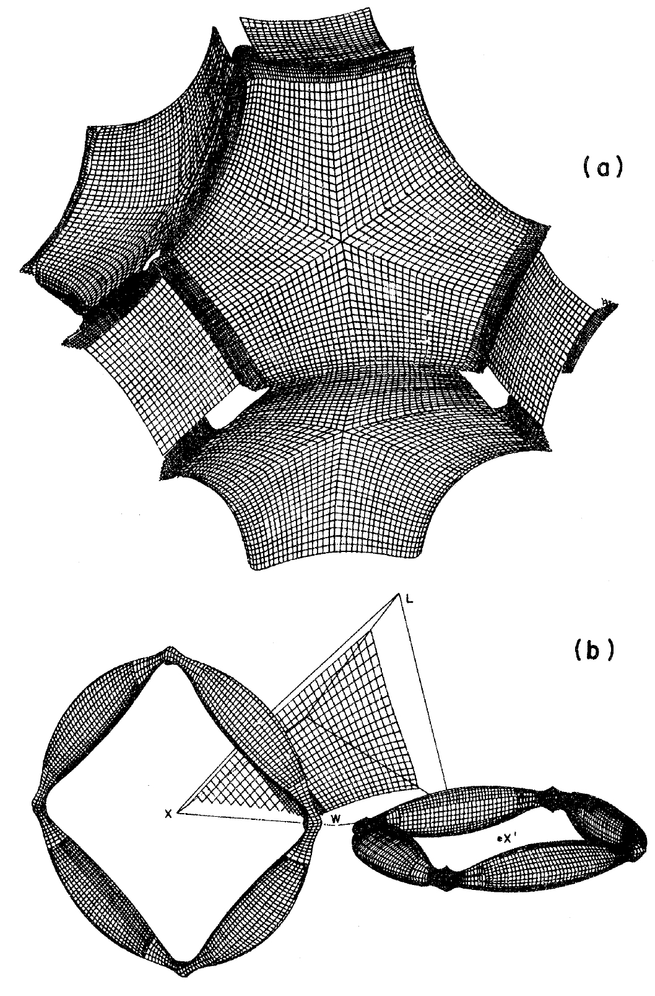
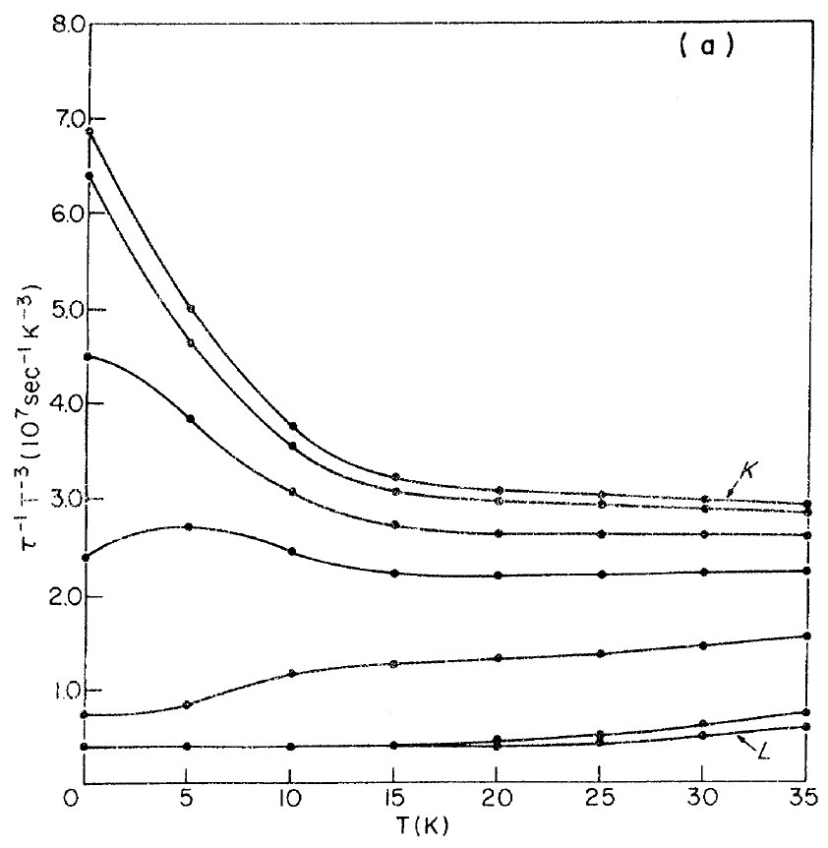
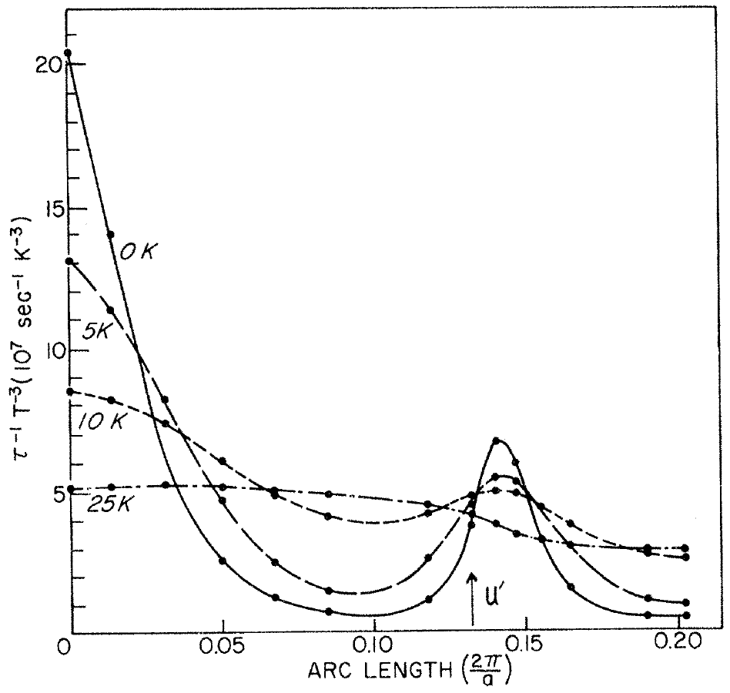
Theoretical investigation of conductivity in Aluminum
• Electron conductivity of Al is more complicate
• Relaxation rate due to an electron-phonon interaction
Scattering amp
Density function
Relaxation rate in second
zone Fermi surface
Relaxation rate in third
zone Fermi surface
Meshed second-zone Fermi surface
Meshed second- and third-zone Fermi surface in computer simulation
D.P. Love et al., Phys. Rev. B26, 5577, 1982
• Model shows qualitative agreement with experiment

Slide 8
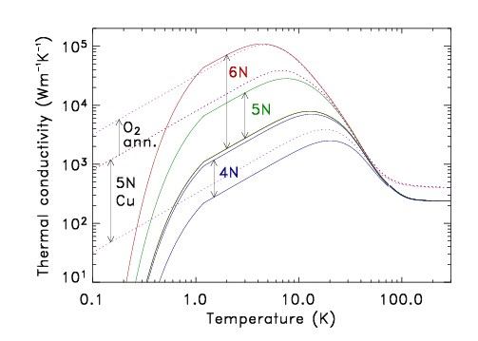
Thermal conductivity of Aluminum and Copper
A.L. Woodcraft, Cryogenics 45(9) 626-636, 2005
• 6N-Al shows the highest thermal conductivity
• Kink point at 1.2 K is because Al becomes superconducting
• Thermal conductivity of copper will be worse in stronger magnetic fields according to the Wiedemann-Franz law

Slide 9
High-Q cold RF resonator for ADMX
The present ADMX resonator is made of copper. It operates at 100 mK in an 8-Tesla solenoid field with resonant frequencies 0.5-2 GHz. Because the magneto-resistivity and the anomalous skin effect are prominent in the copper resonator, the available Q-factor is <10⁵.
If the AC resistivity of high-purity aluminum in strong magnetic fields is kept as low as previous measurements imply, the Q-factor could be an order of magnitude higher than the copper resonator, resulting in an order of magnitude reduction in the integration time required to detect the axion signal.

Slide 10
Proposed 3-yrs project for studying of material properties of high-purity aluminum
DC electric resistivity and thermal conductivity test
AC electric resistivity test
Prototype High-Q cold RF resonator
Time table (3 year plan)
Dark blue: Preparation
Orange: Cold test
Light blue: Contingency

Slide 11
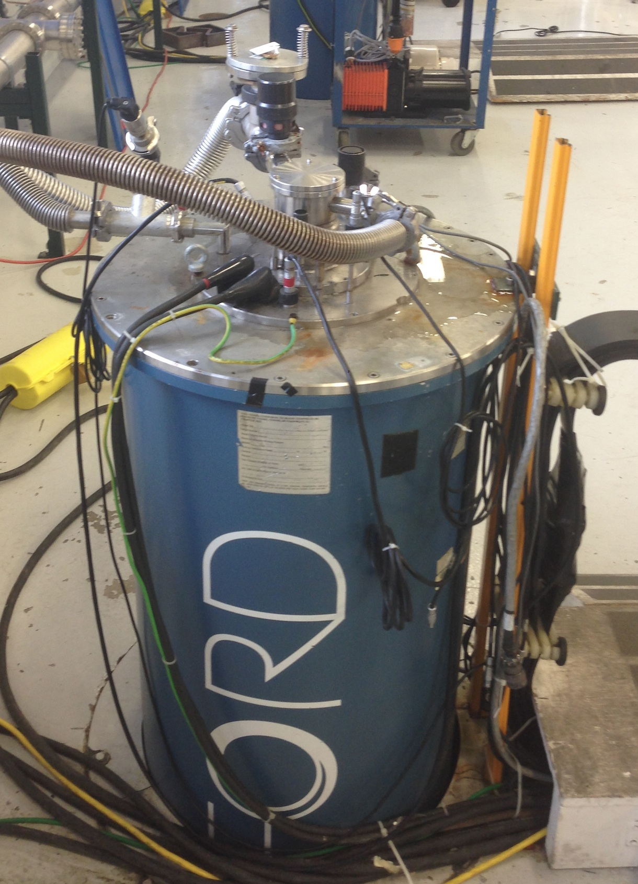
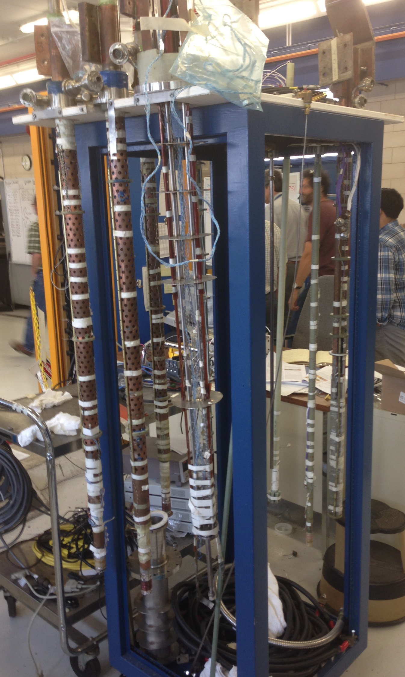
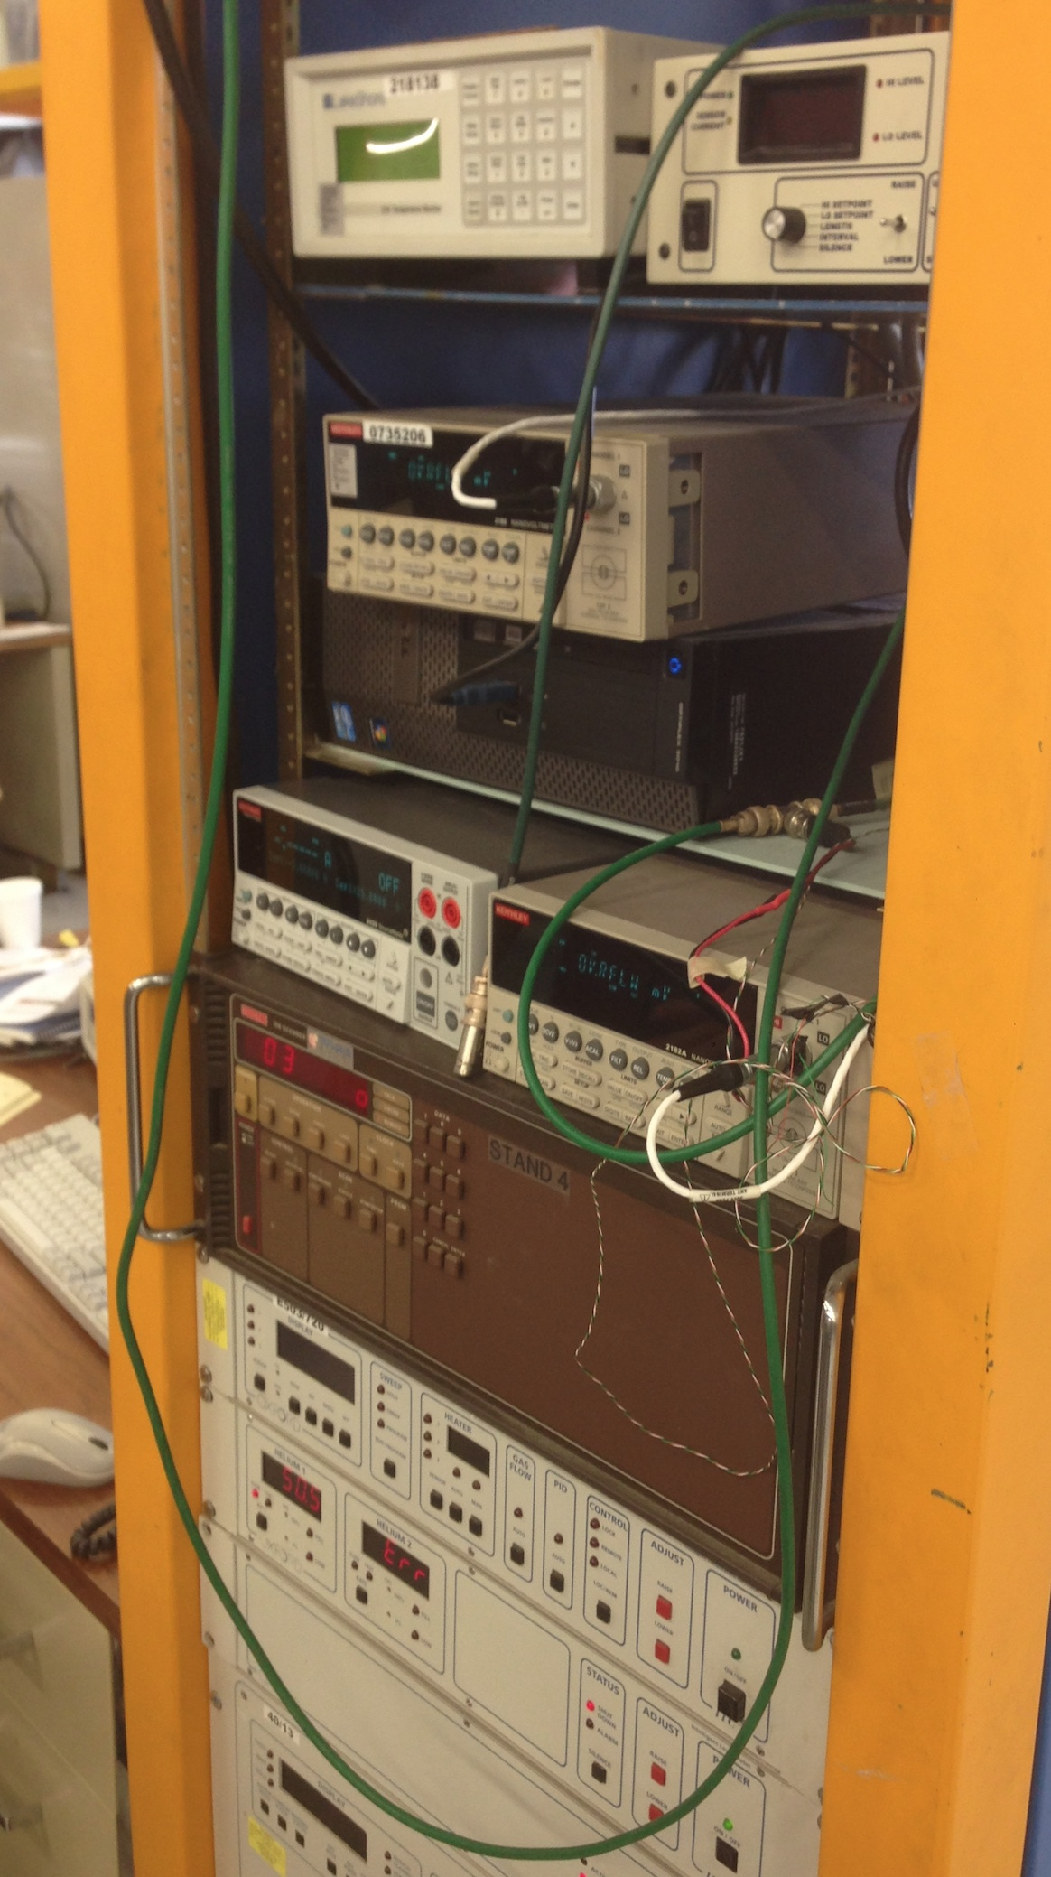
DC electric resistivity and thermal conductivity tests
DC electric resistivity measurements are required to check the sample quality and to use
the result for theoretical investigations of electron conductivity compared with the AC result
High-field cold facility in Technical Division at Fermilab
Teslatron
(0-14 Tesla)
Inserts for DC resistivity test
(300 – 1.9 Kelvin)
Instruments
(nano-voltmeter,
low jitter current source,
temperature sensor)

Slide 12
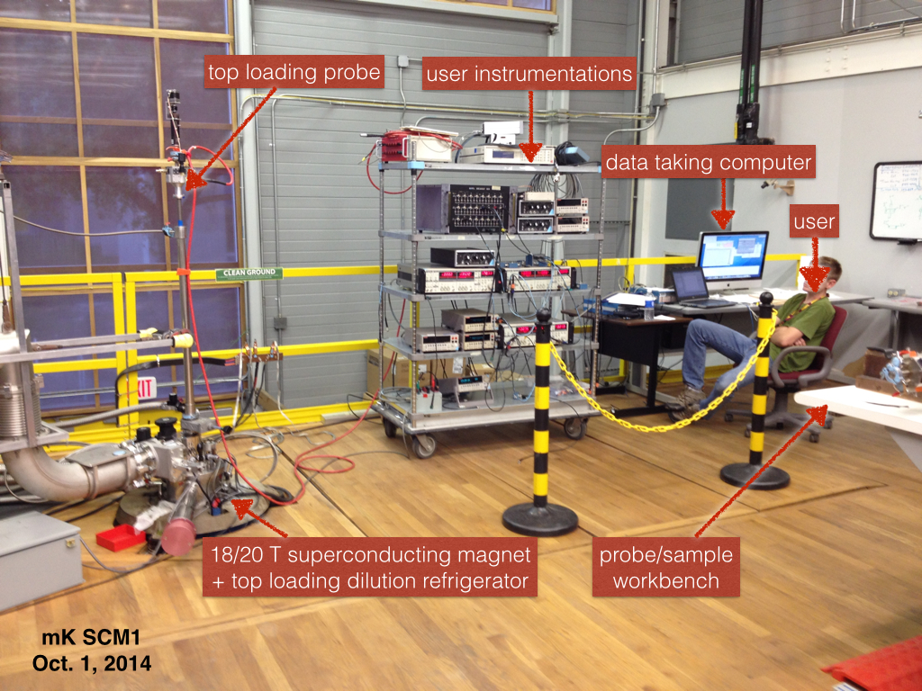
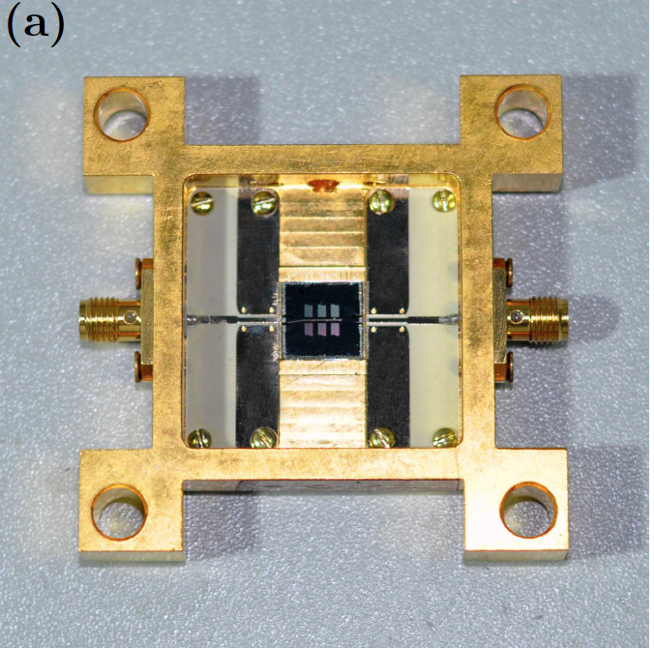
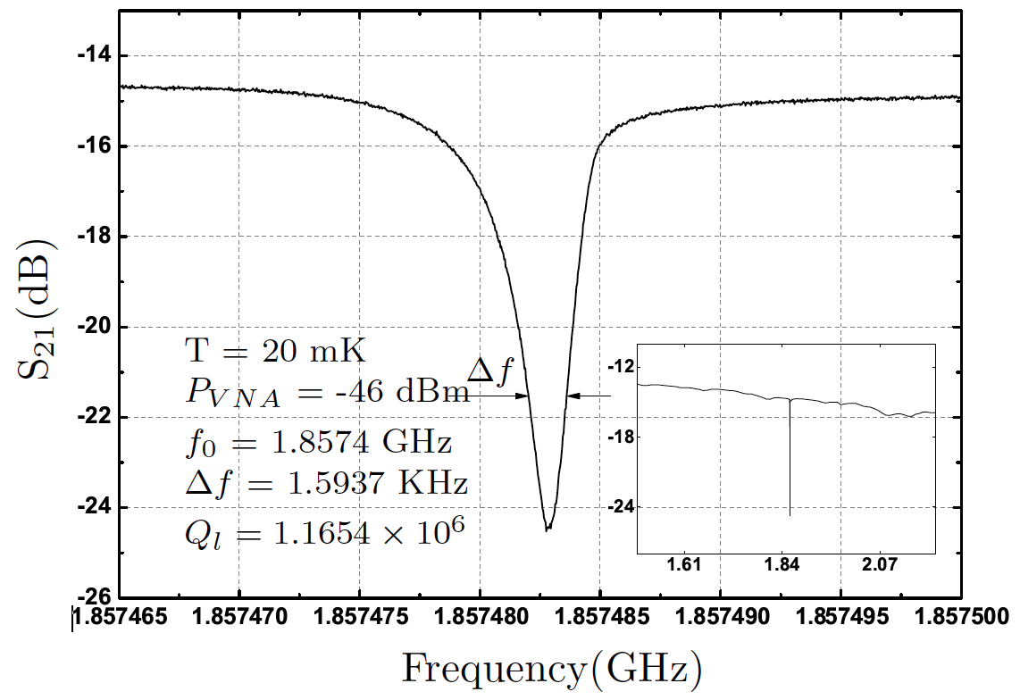
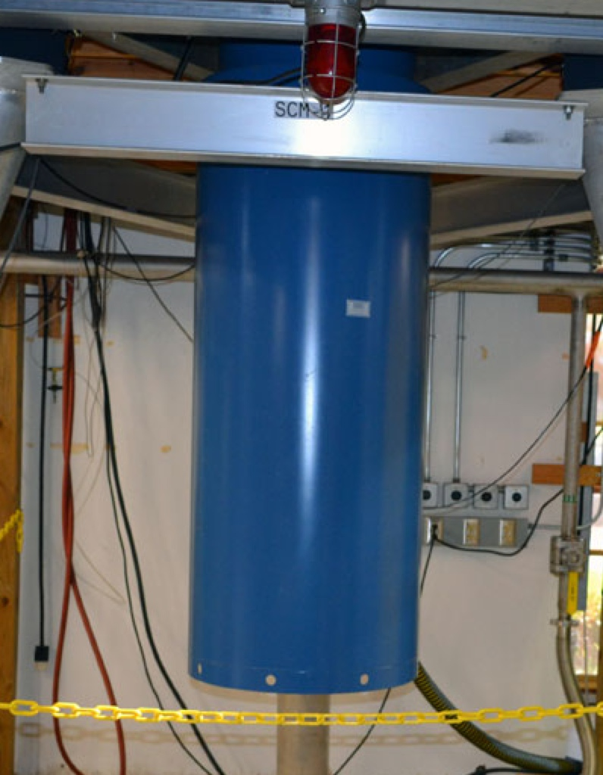
AC electric resistivity
• Preliminary AC electric resistivity measurement will be done in Teslatron at Fermilab
• In order to meet the ADMX operation parameter, other AC electric resistivity measurement will be carried out at the National High Magnetic Field Lab in Florida
SCM-1
(0-20 Tesla
300-0.01 Kelvin)
• A compact resonator will be made
• Above pictures are a superconducting 1.86 GHz Coplanar Waveguide Resonator
• Size of resonator part is only a few mm

Slide 13
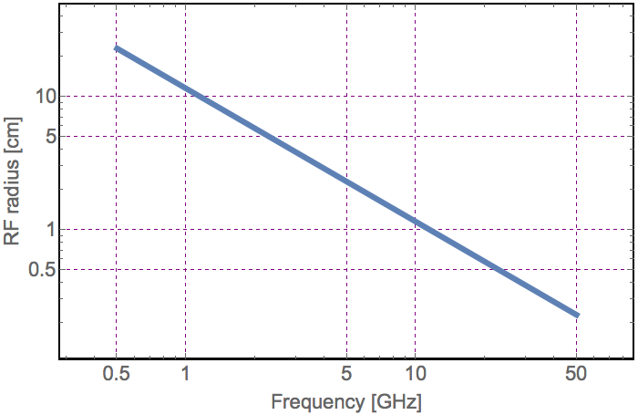
Make prototype cold RF resonator
Make a prototype resonator in which the resonant frequency can be 2 GHz – 20 GHz
Demonstrate feasibility of a large volume high-Q resonator
Develop surface treatment technologies including with metallic coat, SRF surface polishing, and annealing processes
Test will be done at NHMFL and/or Mucool Test Area
Radial size of pillbox cavity

Slide 14
Require systematic investigation of surface condition
• Surface condition is particularly important to reduce the
surface resistivity (when the mfp of electron is longer than
surface roughness)
Conductor surface
Incident electron
Randomly scattered from surface
• Control roughness
- Make smooth by annealing at 773 K (melting point of Al 993 K)
- Electro-polishing, chemical rinsing, etc
• Thickness

Slide 15
Two possible ways to fabricate Al-based resonator
Use a thin aluminum sheet and form a resonator shape
Make a thin aluminum film by vacuum deposition

Slide 16
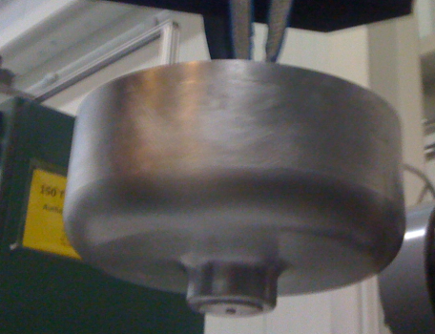
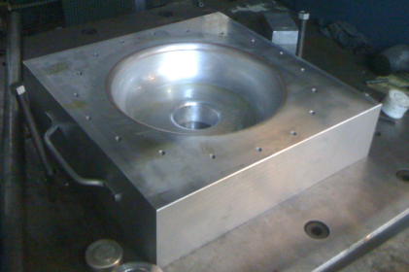
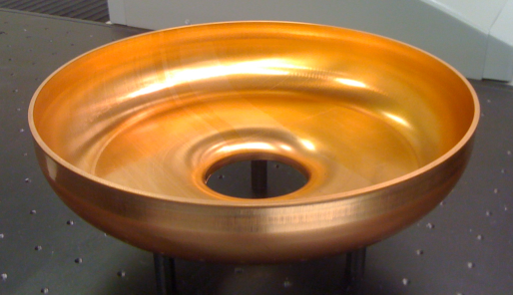
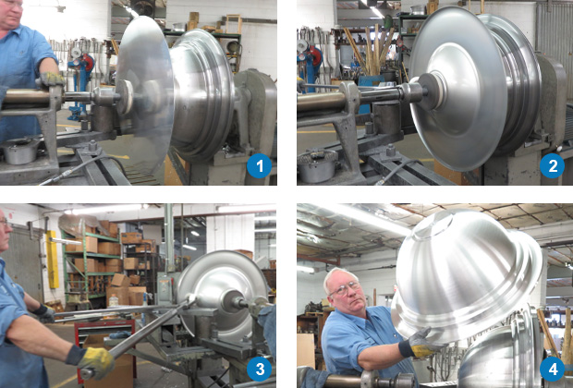
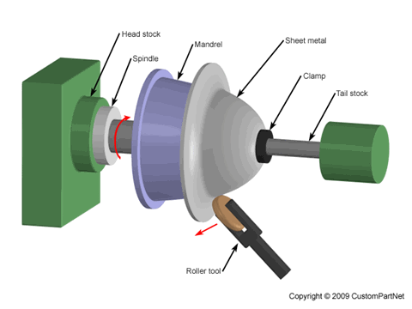
Fabricate Al-base RF resonator by using SRF technique
Conceive manufacturing as for SRF cavities, i.e. using deep-drawing to produce half cells
Tune half cell by trimming equator
Join half cells by EBW
Or, since high purity aluminum is soft (like gold) we can apply metal spinning formation
→ Advantage for seamless shape

Slide 17
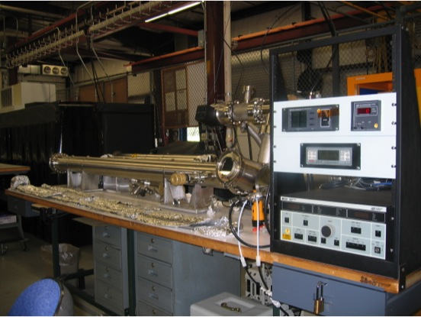
Vacuum Deposition Thin Film Coatings Facility at Lab 7
Thin Film Coating Facility in Particle Physics Department in Lab 7 at Fermilab
Available thickness will be limited

Slide 18
Possible applications by using high-purity Al resonators
Accelerator cavity
High Secondary Emission Yield (SEY) induces a multipactoring in the resonator
It sucks up a huge RF power
Multipactoring may prevent by a thin-film-coating or putting buffer gas in the resonator
Stabilizer for SC magnet
Substrate for SRF
Quantum electric circuit

Slide 19
Summary
Propose high-purity aluminum resonator
High-purity aluminum has excellent property, particularly at low temperatures in strong magnetic fields
May be the best material for the axion detector resonator
There are many uncertainties to design for the resonator
Propose 3-yr project to find out material properties of high-purity aluminum
Look for more collaborators

