Slide 1
Cavity Learning Curve at CAPP
Harry Themann
Center for Axion and Precision Physics
Daejeon, Rep of Korea

Slide 2
Outline
Cavities
  Design/Machining
  End cap treatment
  Internal walls
Antennas
  design
  grounding and coupling
Tuning
  actuation
  artifacts

Slide 3
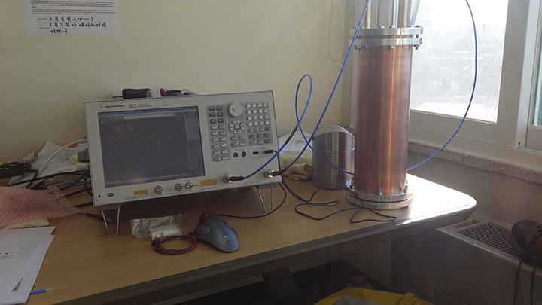
"Wuensch Cavity"

Slide 4
First Measurement
Calculated Frequencies (GHz)
TE113 1.811
TM010 1.855
TM011 1.892
TM012 2.001
TM013 2.169
TE115 2.352
Measured Frequencies (GHz)
1.804
1.847
1.883
1.991
2.162
2.378

Slide 5
Squatters' Rights
60mm ID of magnet -> Owner allows 50mm OD cavity
Limited access to top -> all actuators have to be near dilution refrigerator and possible high B field
4-6 GHz cavity, 140mm length to match B field puts (D/L)^2 at about 0.1
Piezo actuators

Slide 6
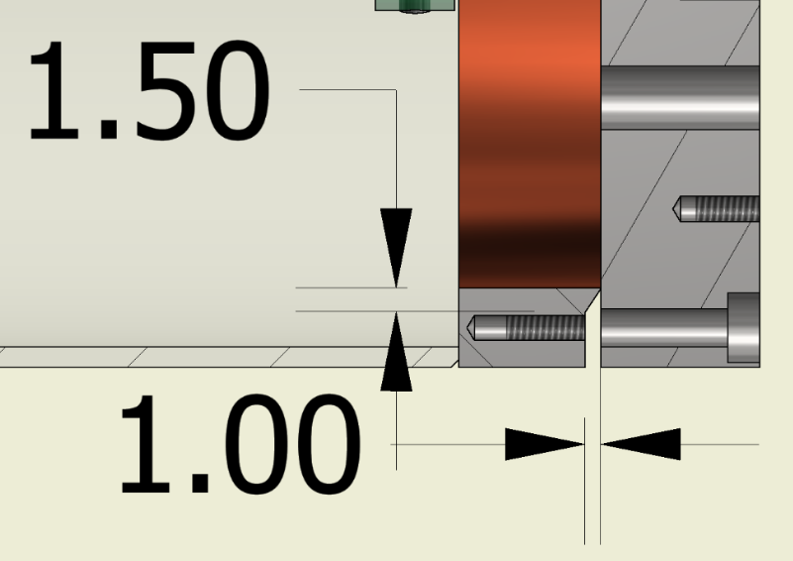
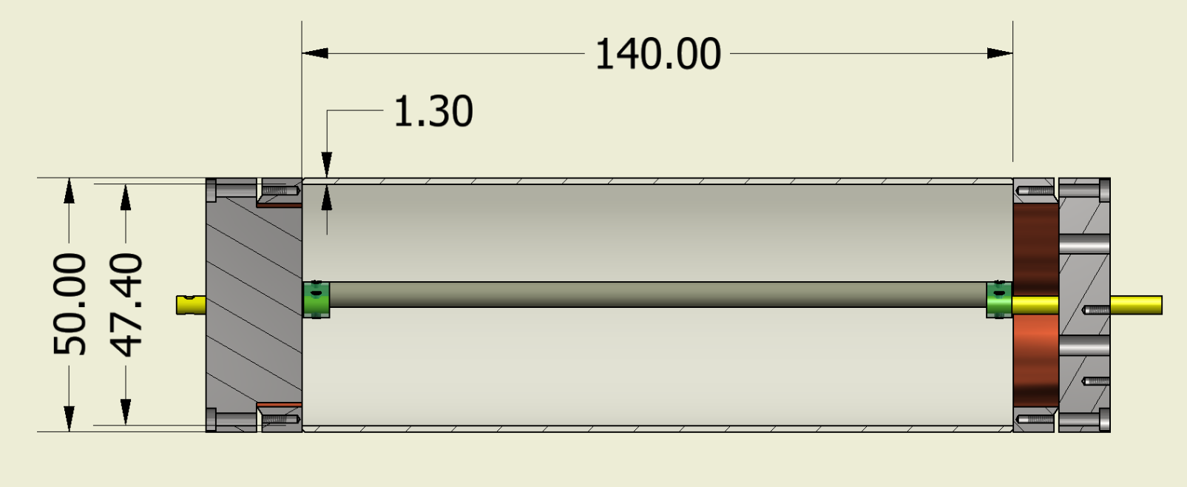
Welded Collar
Weld on outside only
Knife edge
What will be the effect of this gap?

Slide 7
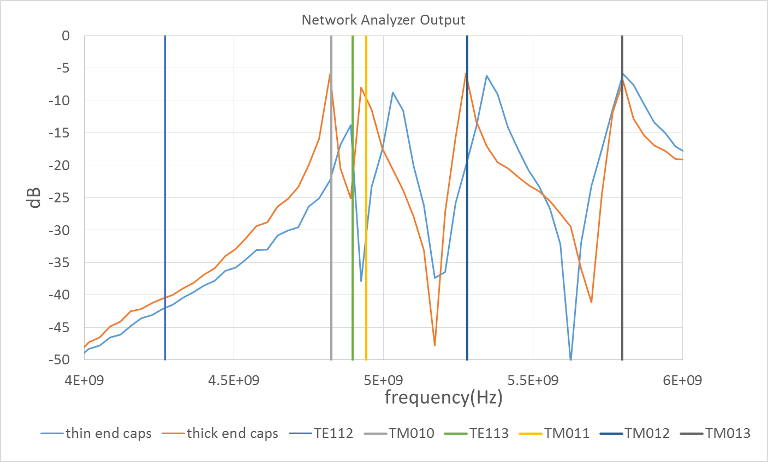
VNA
One can adjust the diameter and length parameters to move the vertical lines
A match could be made to the "thick cap" but not the "thin cap"
Plating issues caused us to abandon this desing

Slide 8
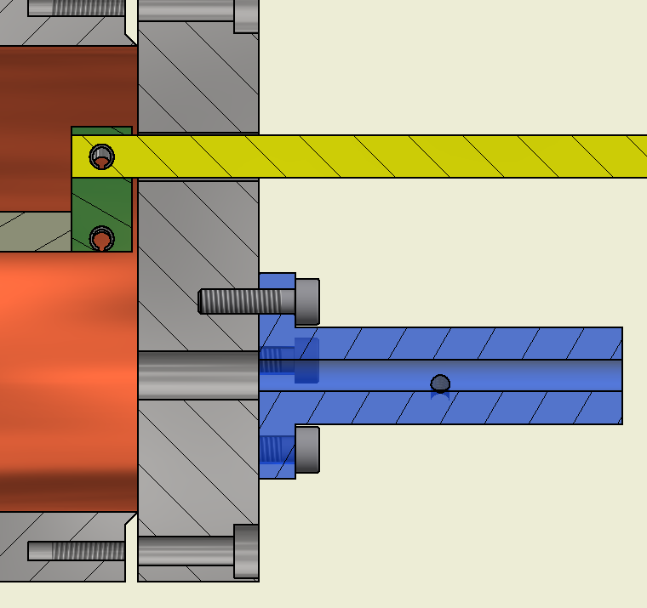
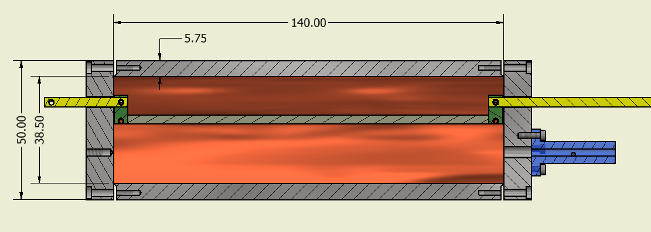
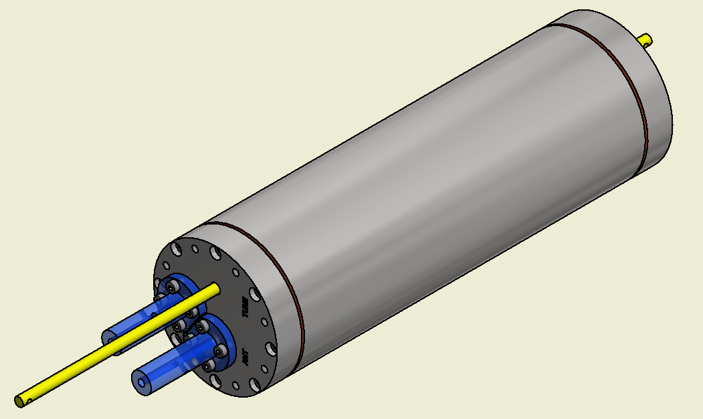
One Piece Cavity
The calculated and measured modes are a match when the D and L values are put into the spreadsheet.

Slide 9
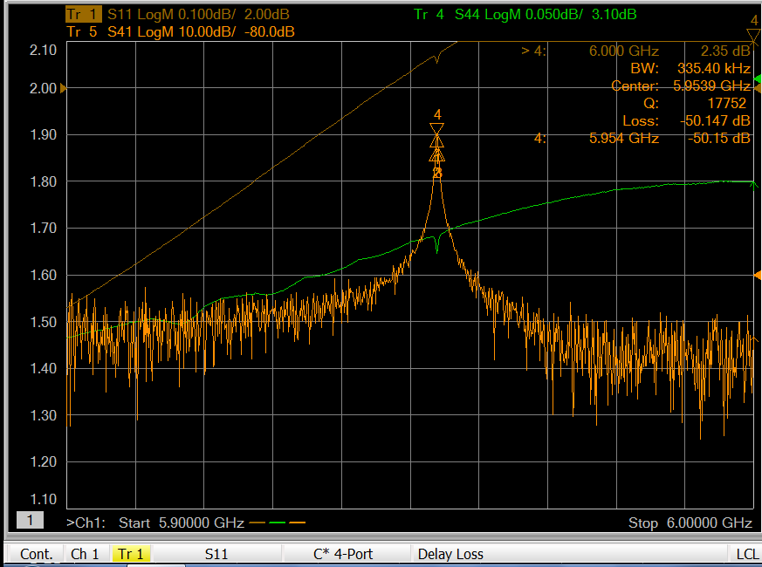
VNA Output of Empty 6mm Wall Cavity
38.6mm ID give TM010 frequency of 5.94GHz which matches measurement
Stimulating and Data antenna very weakly coupled
Direct measurement of Q from transmission peak gives 18000
All Q measurements have been 18-20 000 consistent with calculations

Slide 10
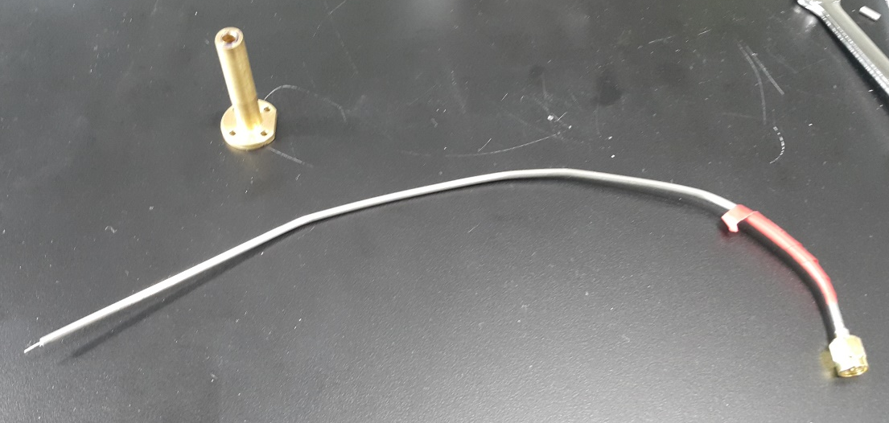
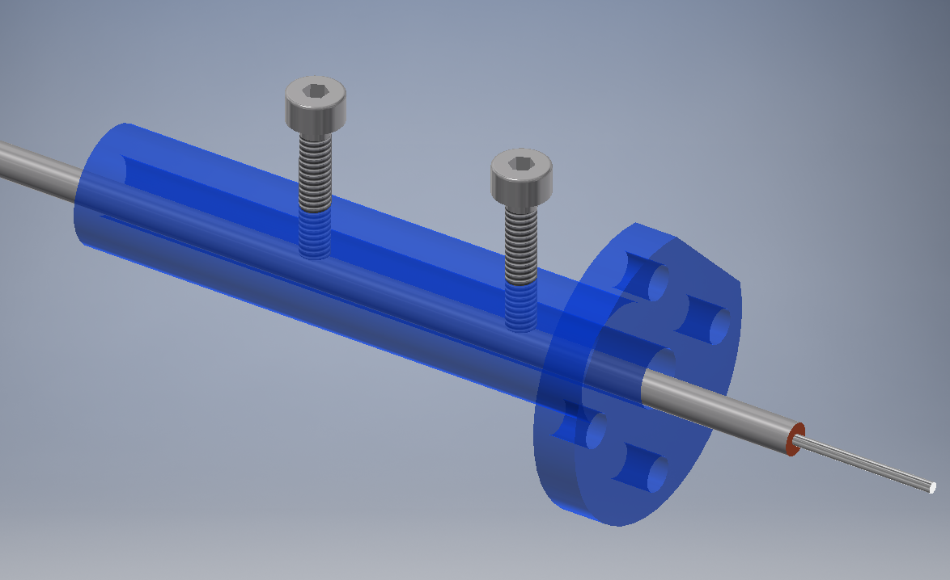
Antennas (1)
ULT-05 2.2mm OD low thermal conductivity
Exposed center about 5mm
Not very reliable

Slide 11
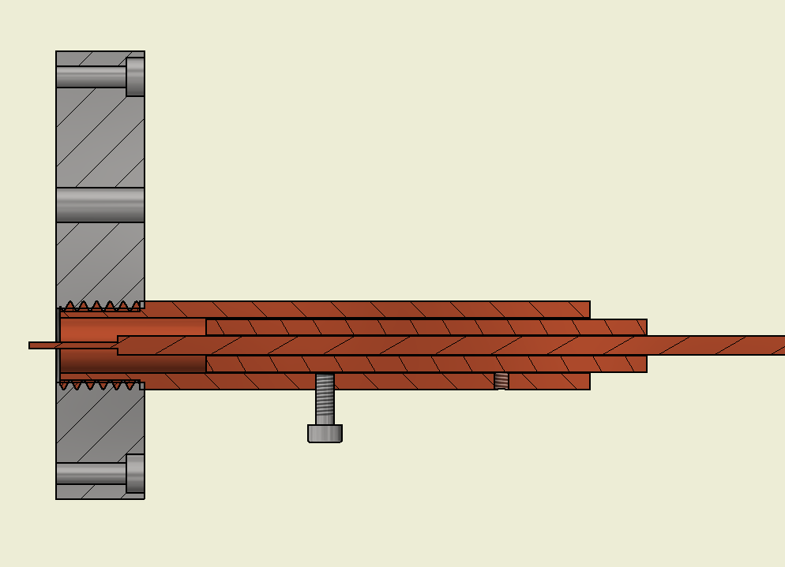
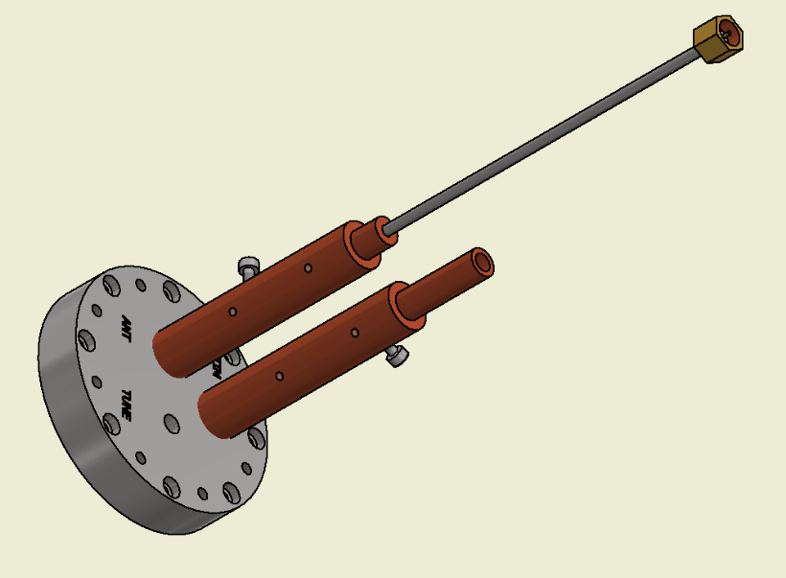
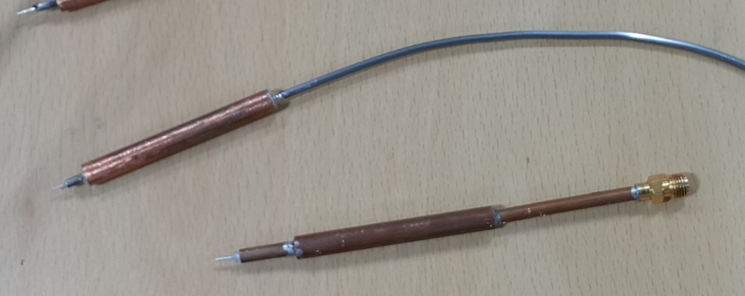
Antennas (2)
Standard ID
ID Customized to Cable
Grounding's the thing!
Much easier to achieve critical coupling
Standard OD

Slide 12
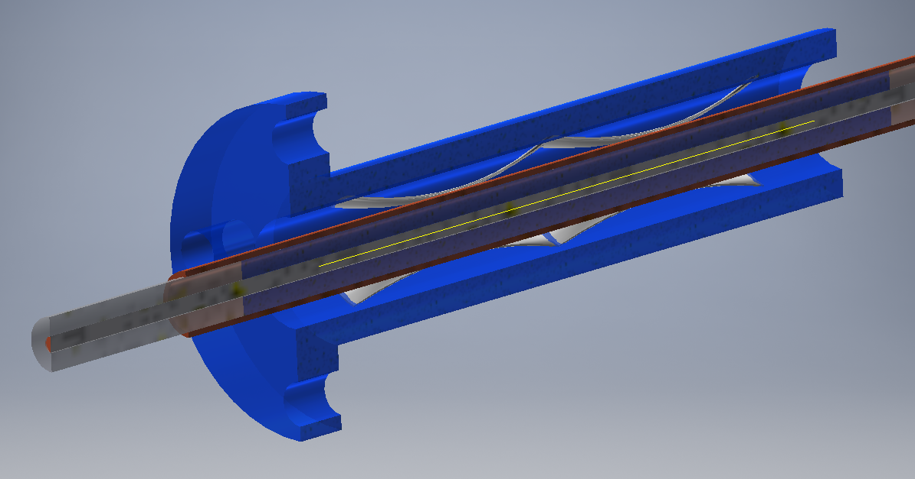
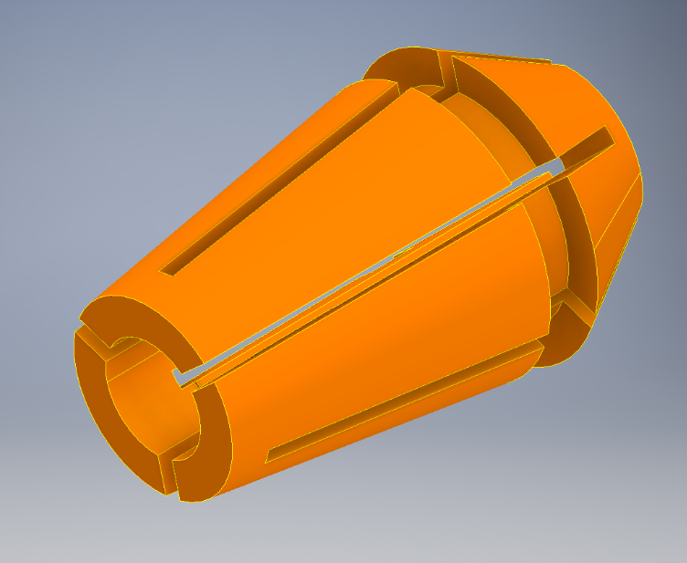
Antennas (3)
Must accommodate coupling motion

Slide 13
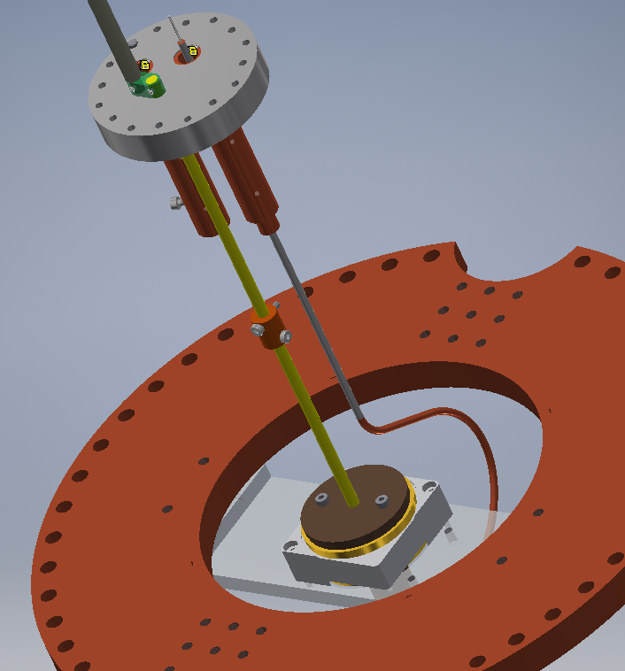
Tuning and Piezos
aTToCube Rotational Piezo Actuator
  2N-cm torque
  resistive encoder
  μ° claimed position resolution
Actuator rod passes through simple hole in cap
Homemade U-Joint, zero backlash coupler magnetic
Direct drive, gear down for greater resolution?
How critical is nano radian resolution?

Slide 14
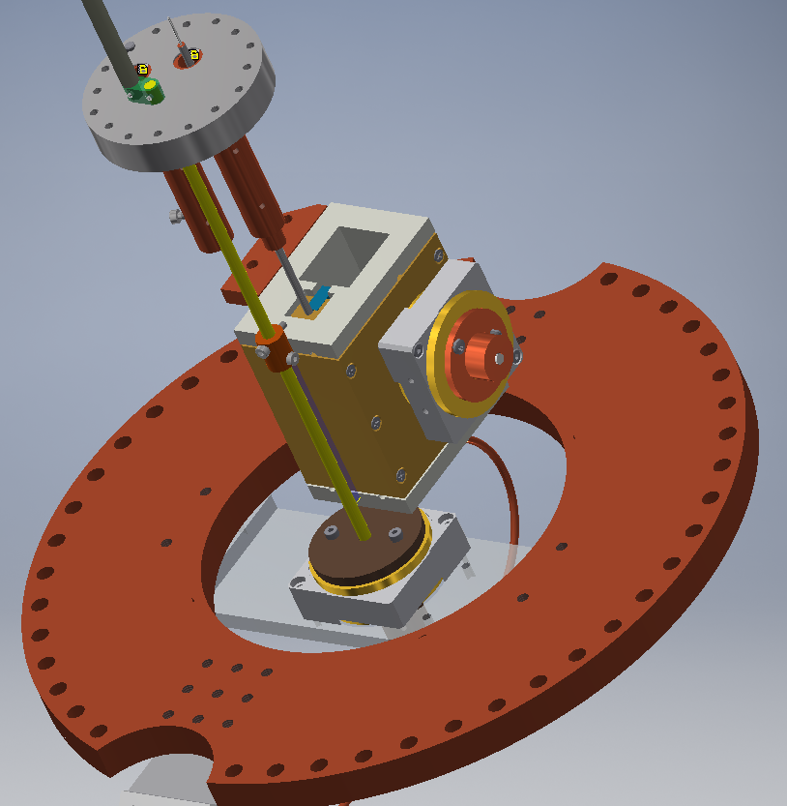
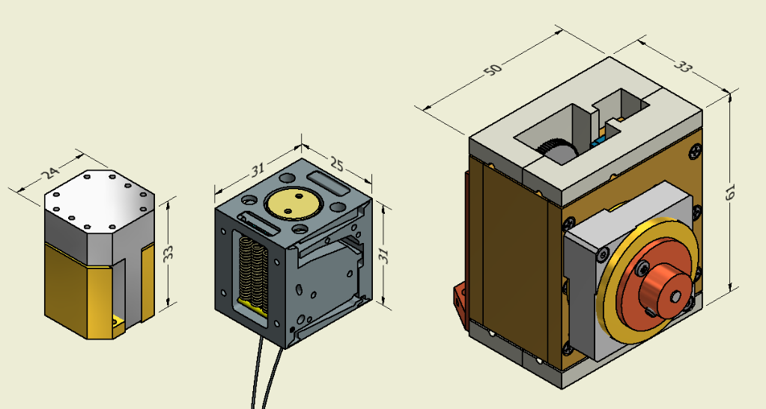
Coupling and Piezos
Finding an actuator that can function at mK and 2-300G was difficult
aTToCube Linear only 1N net force
Rotator 2Ncm so designed gear box 4x multiplier with rack and pinion
Second rotator piezo hasn't arrived plus fit and finish of gearbox pieces not too good
Also Linear actuator hasn't arrived

Slide 15
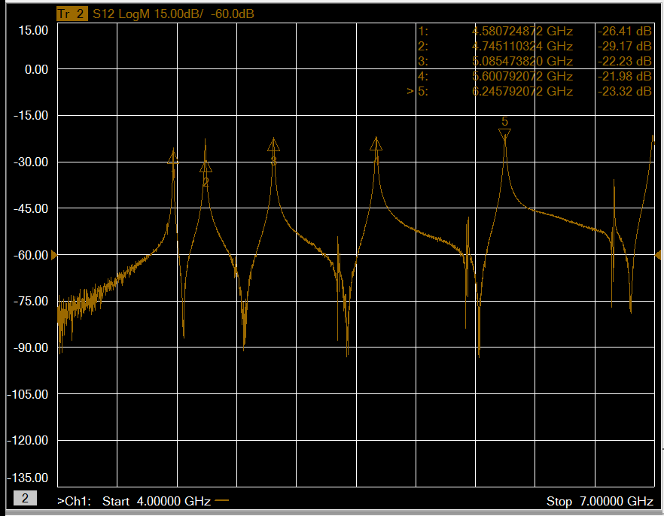
Dielectric Rod
Tuning range was 4.6-5.6 GHz, from center of cavity to the wall.
Notice the artifacts, they tend not to move but when a resonance overlaps the coupling changes as well as the Q.
The artifacts change when the tuning rod is moved up and down which is consistent with Doyu’s analysis

Slide 16
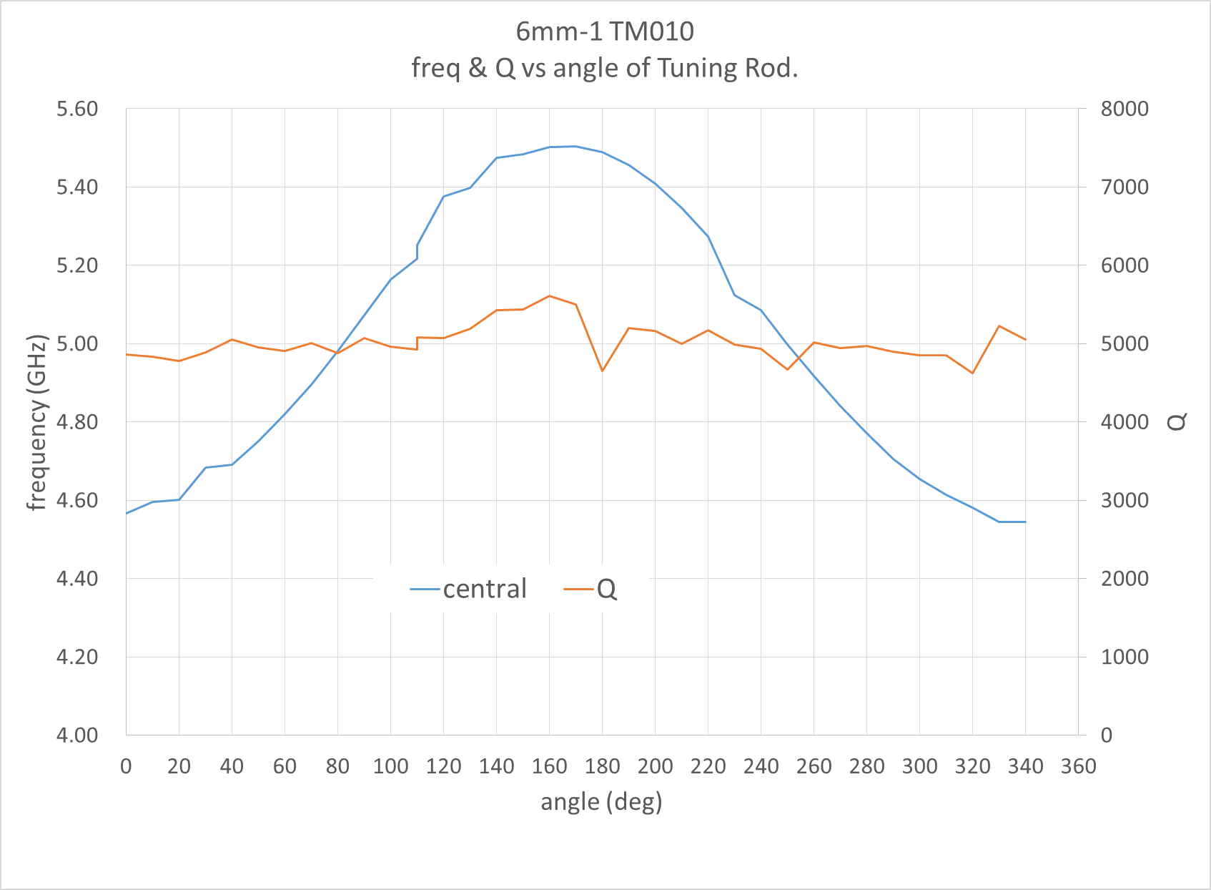
Dielectric Rod Angle Scan
Alumina tuning rod 5mm in diameter
Q goes down by factor 4
Loss tangent of Alumina

Slide 17
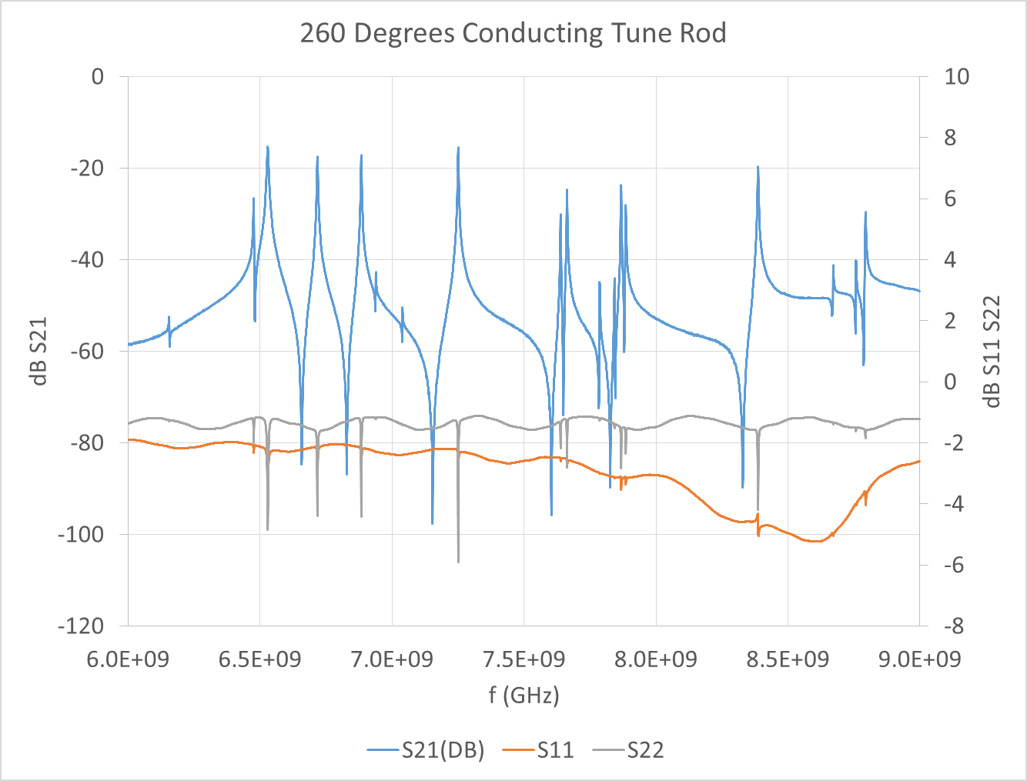
Conducting Tuning Rod
Tuning range was 8.5-6.0 GHz, from center of cavity to the wall.
Copper tuning rod 5mm diameter
Many artifacts
Tuning rod 2mm short, moving vertically generated MANY artifacts

Slide 18
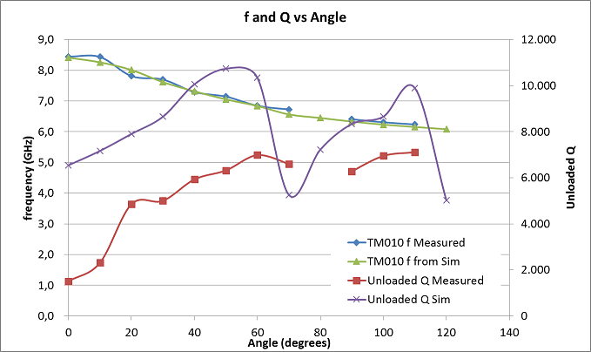
Conducting Rod Angle Scan
We haven't investigated the difference between simulation and measurement of Q values.

Slide 19

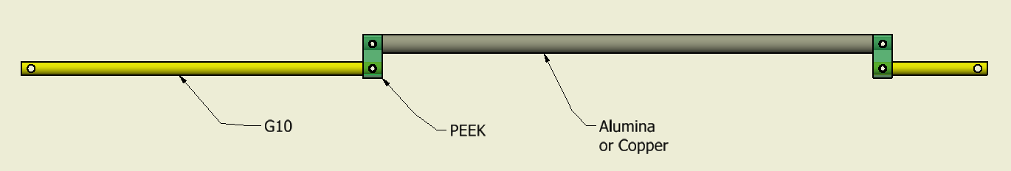
Experiences/Lessons
Tightening screws symmetrically not trivial
Grounding is critical
Loss Tangents of tuning rod assemblies
More attention to tolerances of copper surfaces

Slide 20
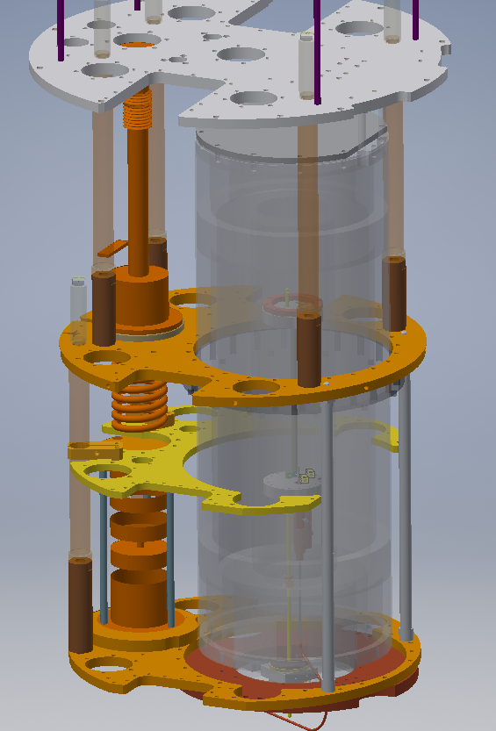
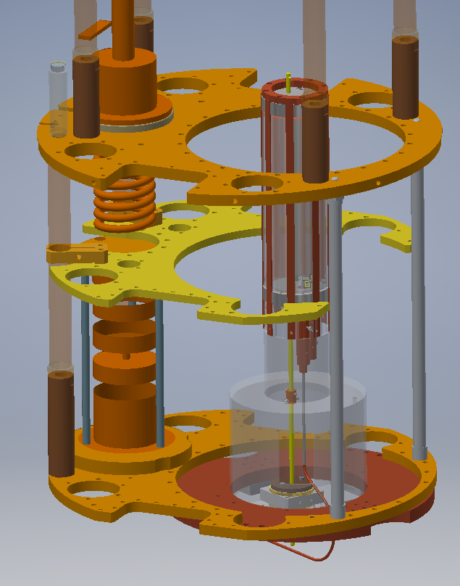
Installation in Refrigerator
Put a cavity into a cold magnet and look at it with a network analyzer
Modest goals but there's always something to learn
  no cables for piezo encoder!
Achieved 500mK
  cavity touching magnet
  ULT-05 Cable not matching specs
Piezo didn't create serious heat, encoder?
Re installed cavity without cables and careful shimming, achieved 70mK
New cavity has been annealed

Slide 21
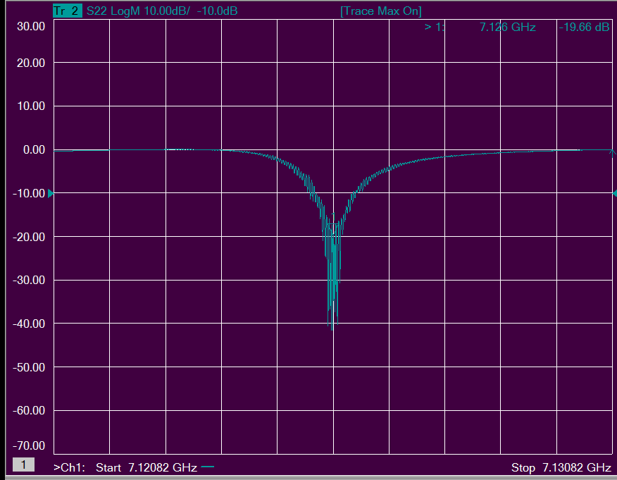
Cavity in Fridge, Metal Tuning Rod
Calibration and Reflection issues

Slide 22
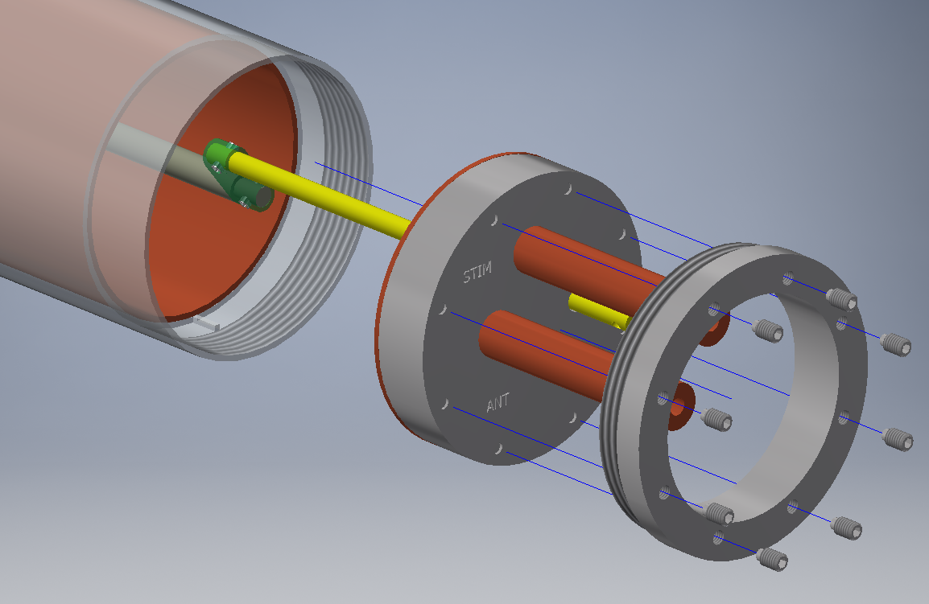
Lower Frequency in the Small Package
6mm wall is "wasteful" need better solution
Move knife edge inside
48.6mm ID gives TM010 frequency of 4.62GHz
SEOUL-TERACOM, INC.
Gun-Sik Park

Slide 23
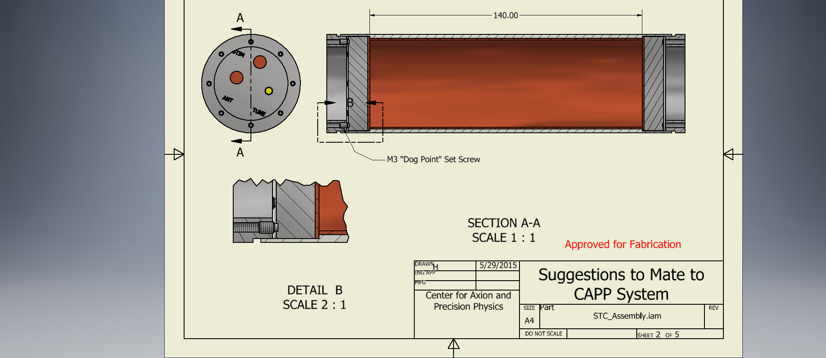
Press Fit
High purity copper sheet is formed into a tube and then put onto a mandrel that expands, press fitting the copper into the SS tube, it is bonded by a welding process.
SEOUL-TERACOM, INC.
Gun-Sik Park

Slide 24
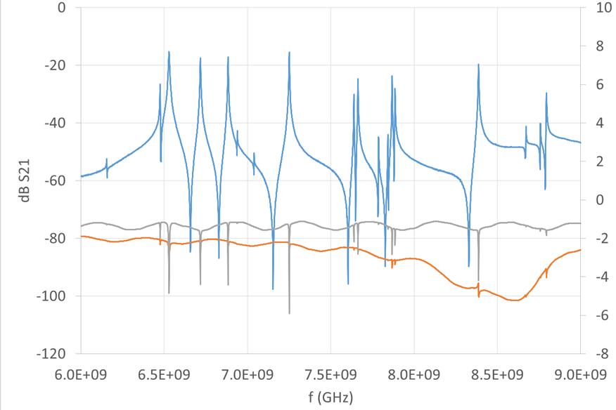
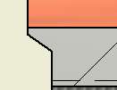
Moving On
Working very hard with Byeong-Rok to improve our simulation
  CST
  Tuning rods
  Antennas
Better calibrations, better handle on the cabling characterization
Higher purity copper
Tuning assembly optimization
Thinking about altering knife edges
More attention to Tolerancing
Add FEE
Coupling actuator
Super Conducting films

Slide 25
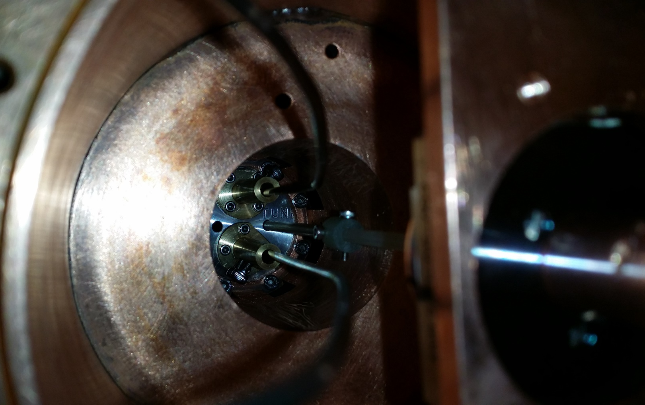

Slide 26
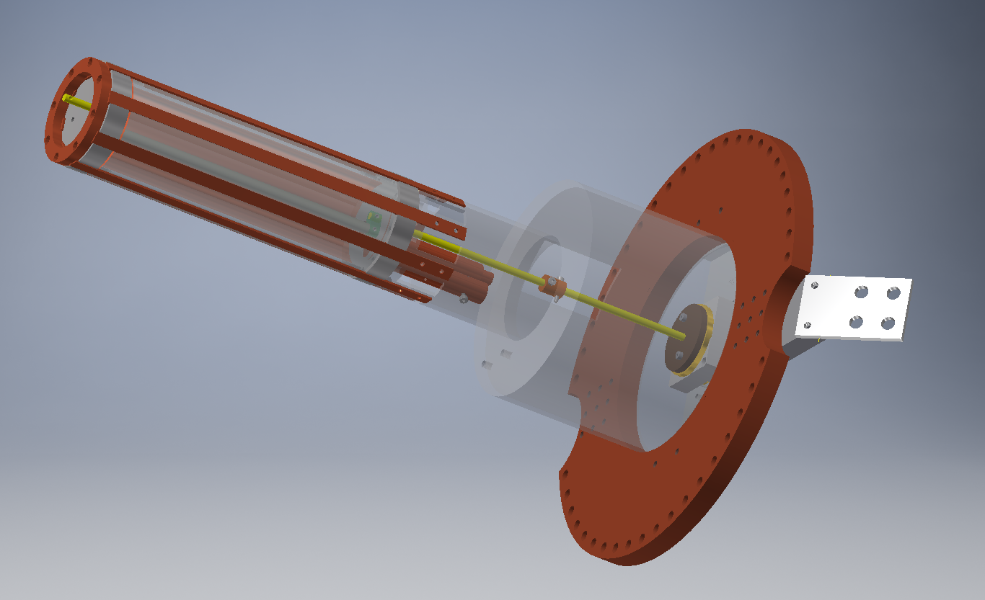

Slide 27
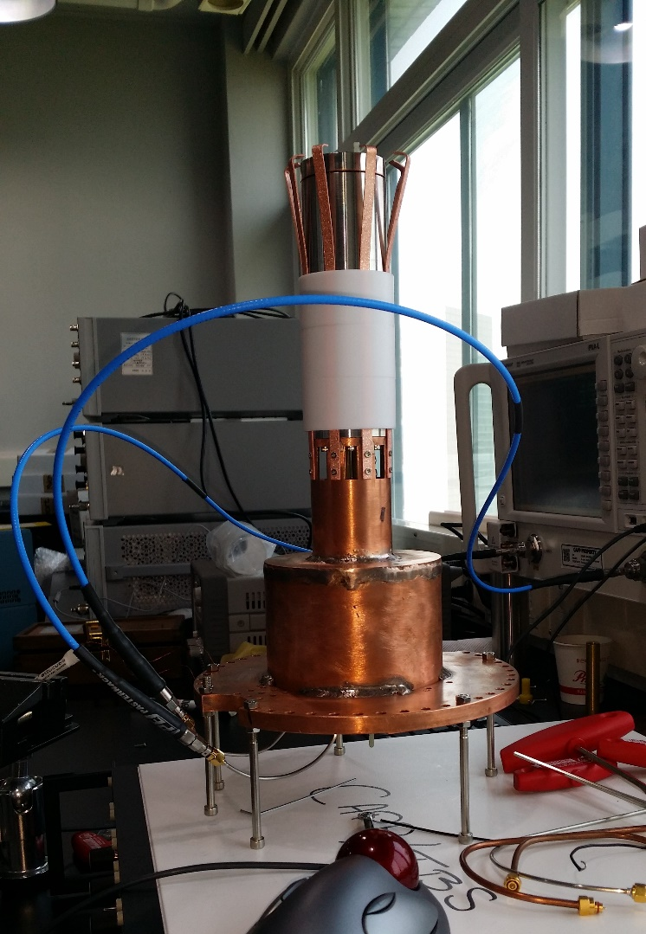

Slide 28
