Slide 1
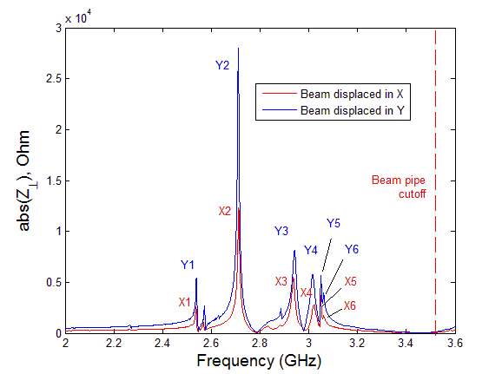
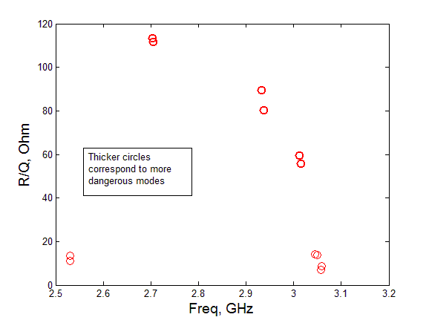
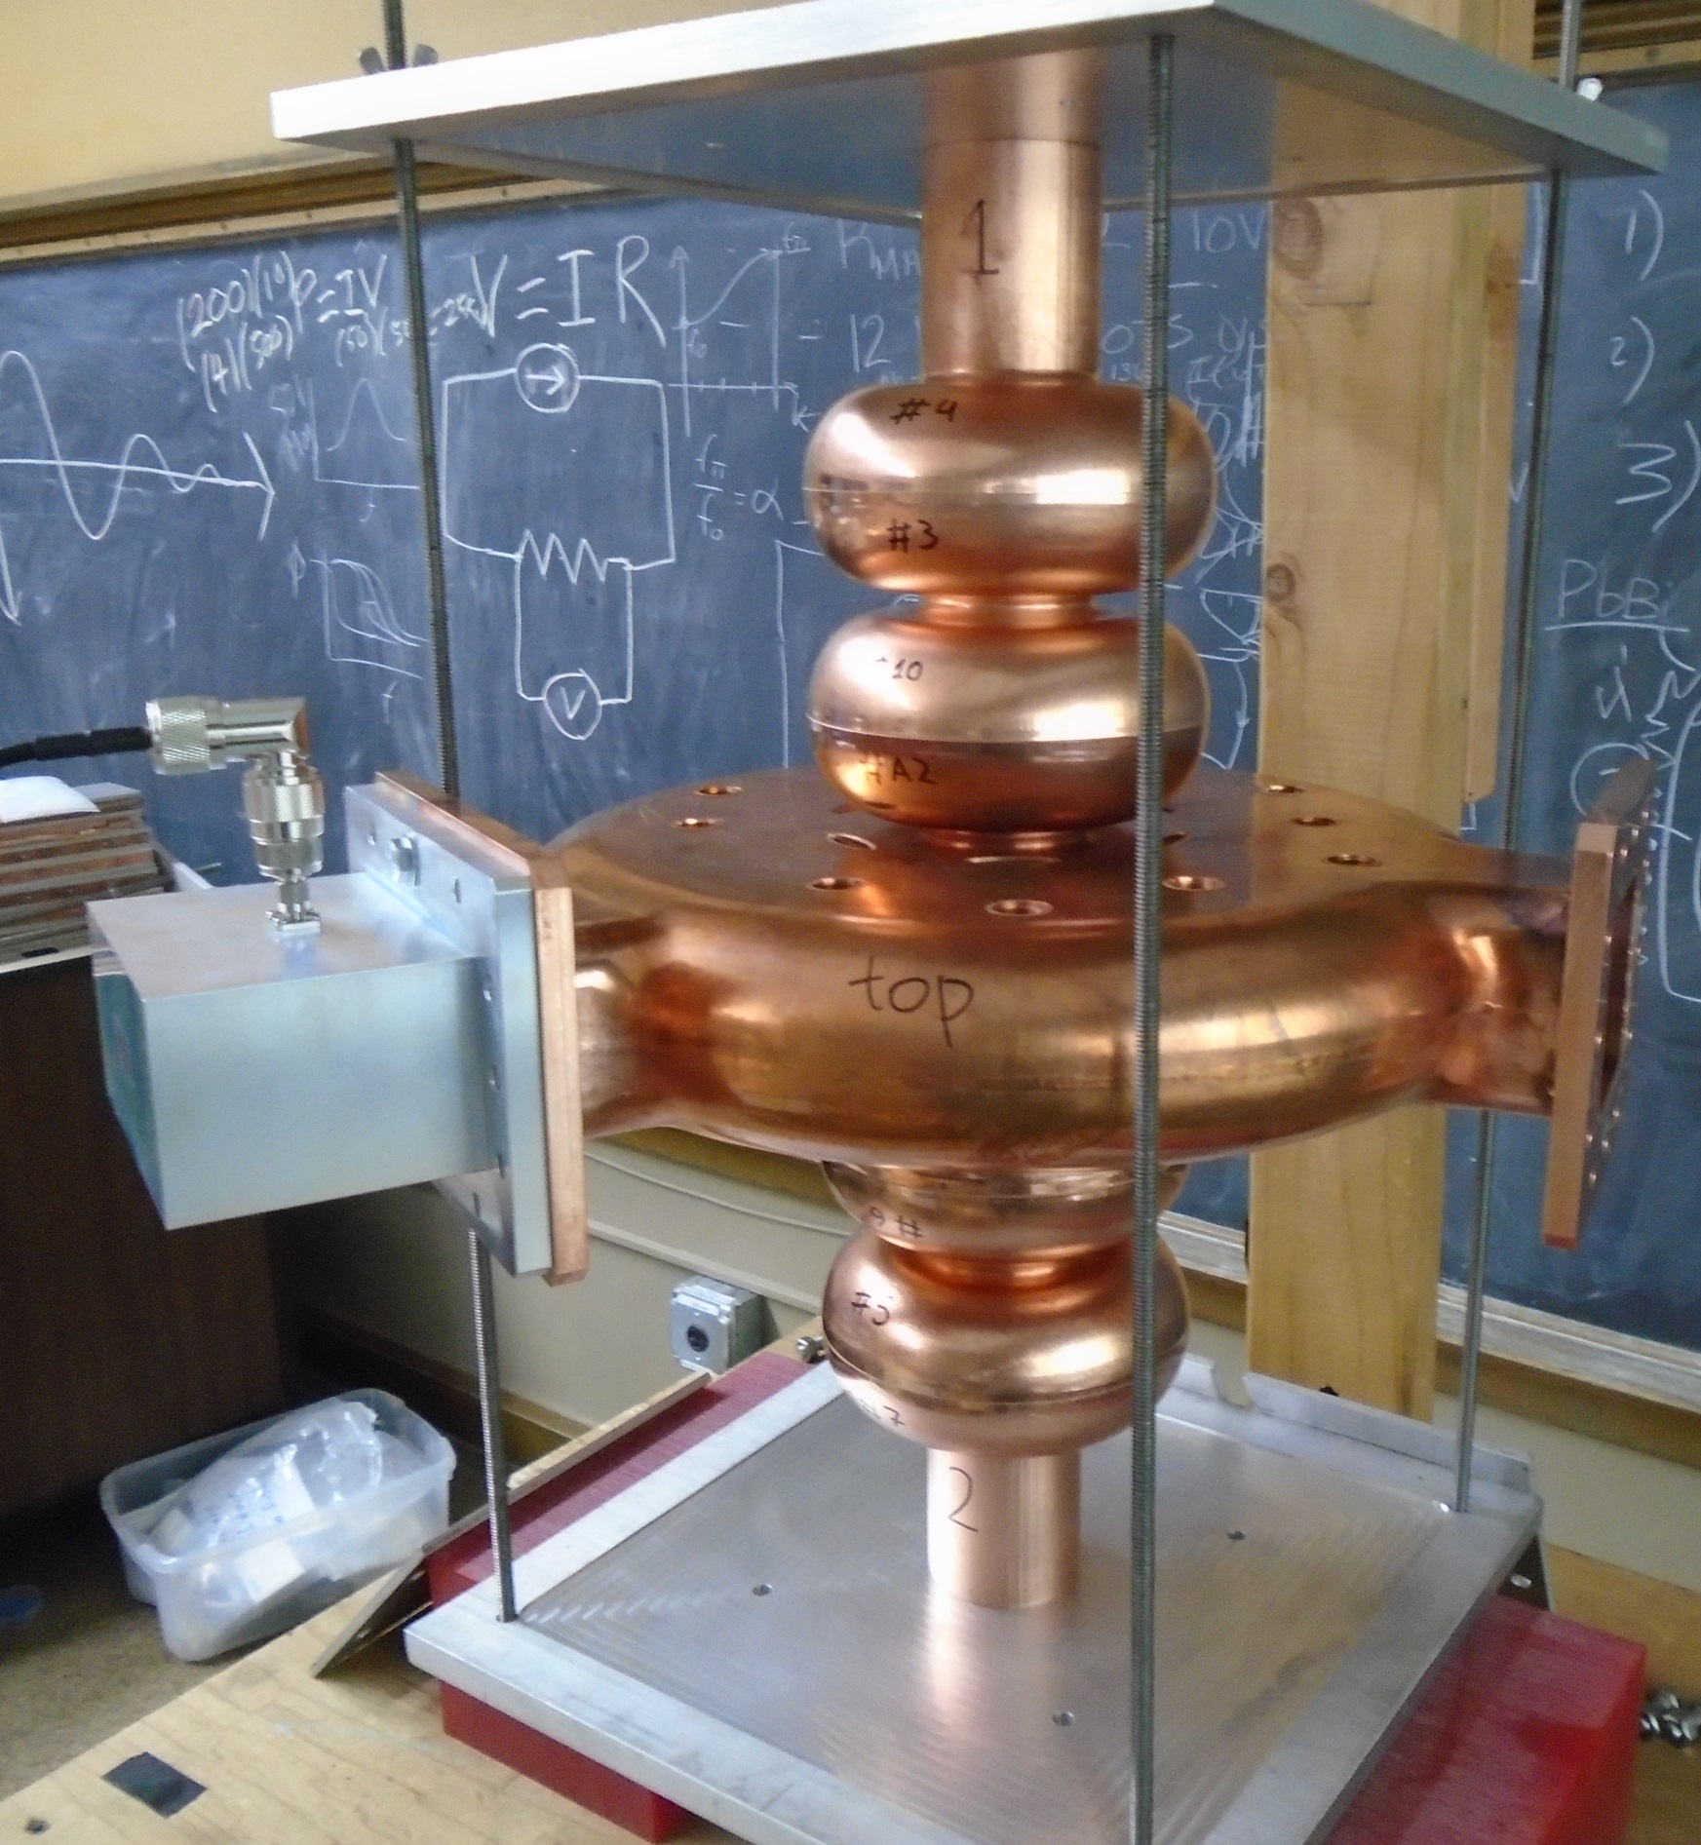
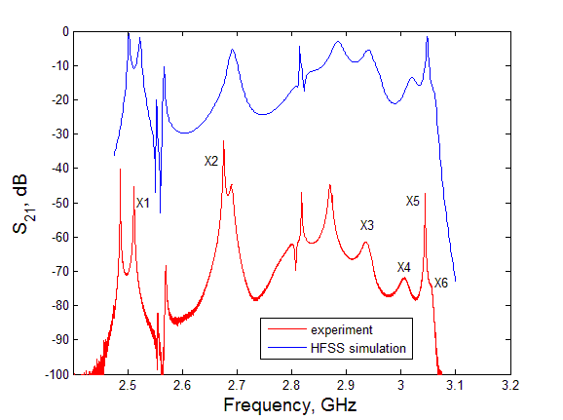
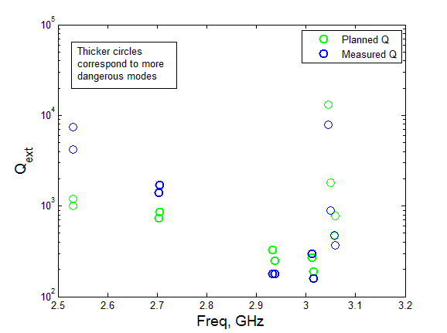
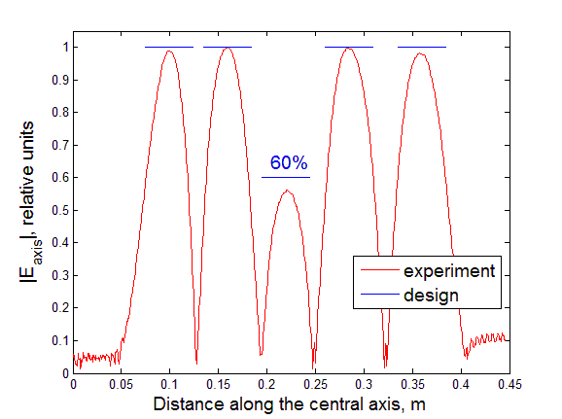
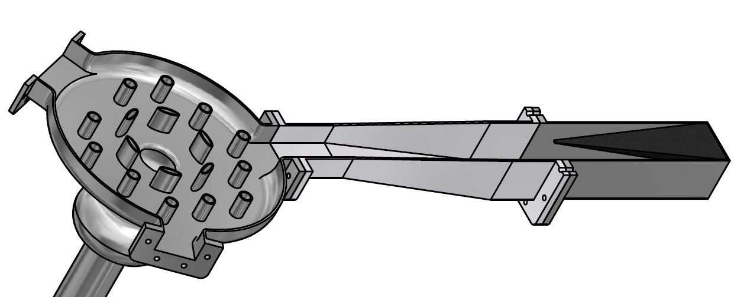
Five-cell superconducting RF module with a PBG coupler cell: design and cold testing of the copper prototype
Sergey A. Arsenyev¹ , D. Shchegolkov², E. Simakov², C. Boulware³, T. Grimm³, A. Rogacki³
¹Massachusetts Institute of Technology, Cambridge, MA 02139; ²Los Alamos National Laboratory, Los Alamos, NM 87545, USA; ³Niowave Inc., 1012 North Walnut Street, Lansing, MI 48906, USA
Abstract
Motivation
Higher Order Modes
HOM | Field in PBG cell | Freq, GHz | Area under impedance peak, ${10}^{9}Ω/s$ | $R/Q_{0}$, Ohm
X1 | TE | 2.531 | 16.4 | 11.1
X2 | TM | 2.704 | 144.4 | 113.4
X3 | TE | 2.932 | 111.7 | 89.6
X4 | TM | 3.015 | 74.3 | 55.9
X5 | TE | 3.045 | 24.2 | 14.1
X6 | TM | 3.057 | 29.9 | 6.9
Y1 | TE | 2.531 | 18.1 | 13.5
Y2 | TM | 2.705 | 144.4 | 111.8
Y3 | TE | 2.937 | 113.3 | 80.2
Y4 | TM | 3.012 | 75.1 | 59.5
Y5 | TE | 3.049 | 24.2 | 13.8
Y6 | TM | 3.059 | 29.9 | 8.8
We report experimental data obtained using a copper prototype of a superconducting radio-frequency (SRF) accelerator module. The five-cell module has an incorporated photonic band gap (PBG) cell with couplers. The purpose of the PBG cell is to achieve better higher order mode (HOM) damping which is vital for preserving the quality of high current electron beams. Better HOM damping raises the current threshold for beam instabilities in novel SRF accelerators. The PBG design also increases the real-estate gradient of the linac because both HOM damping and the fundamental power coupling can be done through the PBG cell instead of on the beam pipe via complicated end assemblies.
First, we will discuss the design and accelerating properties of the structure. The five-cell module was optimized to provide good HOM damping while maintaining the same accelerating properties as conventional elliptical-cell modules. We will then discuss the process of tuning the structure to obtain the desired accelerating gradient profile. Finally, we will list measured quality factors for the accelerating mode and the most dangerous HOMs.
General motivation for the 5-cell superconducting PBG module is described in the poster “High gradient testing of the five-cell superconducting RF module with a PBG coupler cell”.
The copper prototype serves to demonstrate the novel tuning required for the multi-cell structure with the PBG coupling cell, applied later to the niobium cavity.
Also, HOM damping can also be analyzed in the copper cavity by measuring external Q factors for the most dangerous HOMs. At room temperature, the Qext can be calculated more accurately in the copper prototype because the conductivity of copper is about 10 times higher than that of niobium at room temperature. Mode overlapping, which is an issue for measurements in the niobium cavity at room temperature, is less of a problem. Ohmic Q factors for the copper prototype are in the order of $1.5×{10}^{4}$which is much higher than Qext estimated to be a few thousands for the dangerous HOMs, therefore a superconducting experiment to measure HOM damping is not necessary.
Accelerating Mode
Transverse impedance calculated by CST Particle Studio. 12 most dangerous modes correspond to the biggest peaks in impedance.
We focused on HOMs with frequencies below the beam pipe cutoff (3.525 GHz for TE11 waveguide mode) that are longitudinally confined in the cavity and can only decay due to external damping or Ohmic losses. CST Particle Studio simulations were performed with electron beam offset from the central axis by quarter beam pipe radius in X direction and in Y direction. PML boundaries were defined on all waveguide couplers. Transverse wake impedance $Z_{⊥}$ was calculated for both cases (Fig. above). Based on integrated areas under each peak, 12 most dangerous HOMs were chosen.
The 5-cell design consists of 4 elliptically shaped (low-loss) cells and one PBG cell for HOM suppression. Low field at the periphery of the PBG cell lets the waveguide couplers be connected directly to the outside wall, which is beneficial to HOM damping and increases real estate gradient by saving space on the beam pipes. The PBG cell also acts as an accelerating cell with accelerating gradient at 60% of that in elliptical cells. The penalty in accelerating gradient incurred to implement the coupling through the PBG cell is minimal, as shown by the accelerator parameters listed below.
In the setup we used for the copper prototype (Fig. on the left), each cell consisted of two half cells, clamped together at the equator. Each half cell (except the PBG) was machined with extra 0.1” of material at the equator and then trimmed to get the necessary gradient profile. Tuning was done in multiple steps starting with the cells closest to the center and finishing with the end cells. Each step involved a bead pull measurement with results plugged into the circuit model of the cavity to estimate how much the half cells should be trimmed on the next step. The procedure continued until the desired gradient profile was achieved within 5% accuracy.
Simulations
Experiment
Copper prototype of the 5-cell accelerating module. Every half cell is machined separately and then clamped together.
Cavity dimensions and accelerating properties
Length of the module | 14.05 in (35.69 cm)
Diameter of the PBG cell | 12.32 in (31.3 cm)
Frequency | 2.1 GHz
R/Q (total shunt impedance) | 515 Ohm
G (geometrical factor ) | 265 Ohm
E_{peak}/E_{acc} | 2.65
B_{peak}/E_{acc} | $$4.48$$ $$mT/(MV/m)$$
Comparison of S21 profile to simulations allows us to identify what peaks the most dangerous modes correspond to
Design with only elliptical cells
525 Ohm
276 Ohm
2.5
$$4.27$$ $$mT/(MV/m)$$
Magnetic probes with a loop at the end were inserted in the beam pipe along the central axis to excite the HOMs. The probes were rotated in order to excite both polarizations of the HOMs.
External quality factors were calculated from measured loaded quality factors QL and Ohmic quality factors $Q_{0}$. To measure $Q_{0}$, the waveguides were blanked off with metal plates. To measure $Q_{L}$, RF loads were connected to the fundamental power coupler and the HOM waveguides to absorb HOM power extracted by the waveguides.
Measured external Q factors agree reasonably with Q factors predicted by simulations. Most of the considered HOMs are damped to $Q_{ext}<{10}^{3}$. Differences between originally planned and measured Q are explained by HFSS simulations with the actual geometry after tuning. It was found that some HOMs are very sensitive to small geometry changes introduced by the way the cavity was tuned.
Cavity
Taper
RF Load
Gradient profile of the tuned cavity obtained from bead-pull measurements.
Custom HOM waveguides are tapered up to the standard WR510 waveguide followed by a load
Work is supported by the U.S. Department of Energy (DOE) Office of Science Early Career Research Program
E-mail: arsenyev@mit.edu

