Slide 1
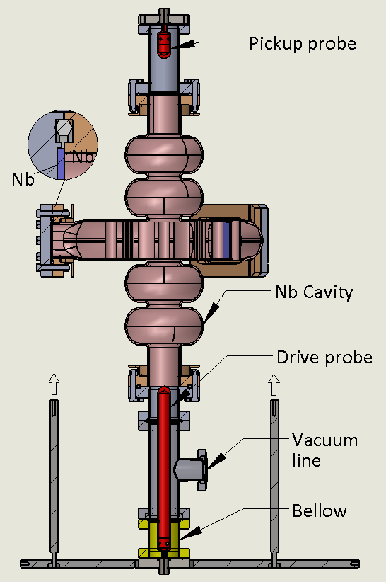
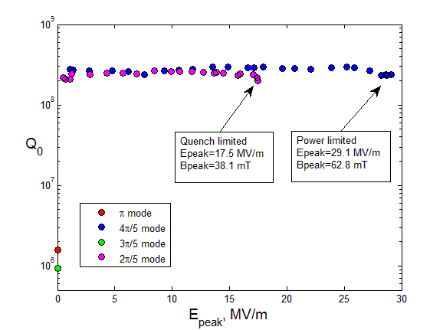
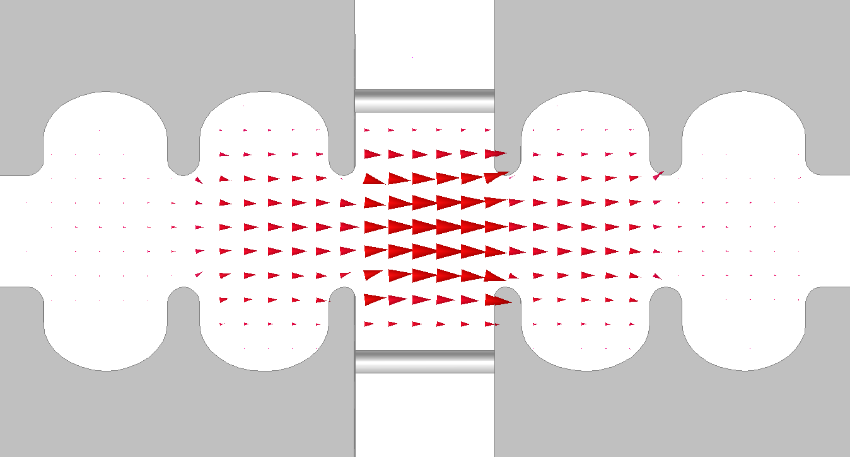
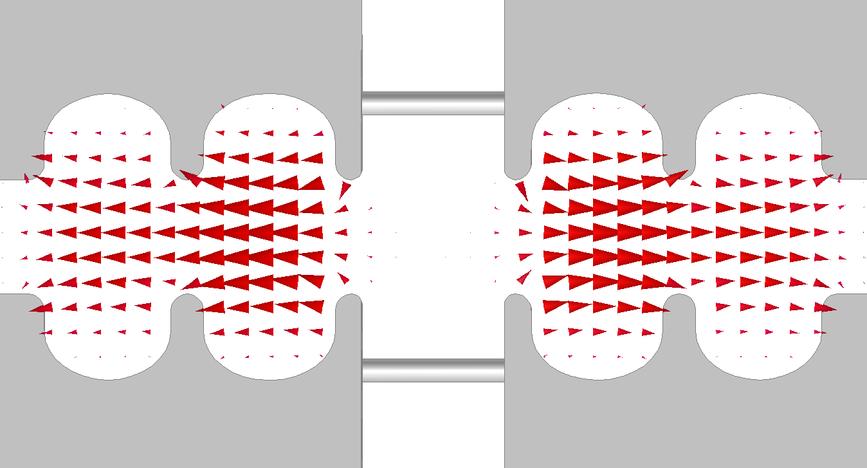
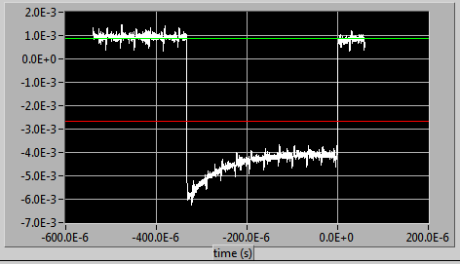
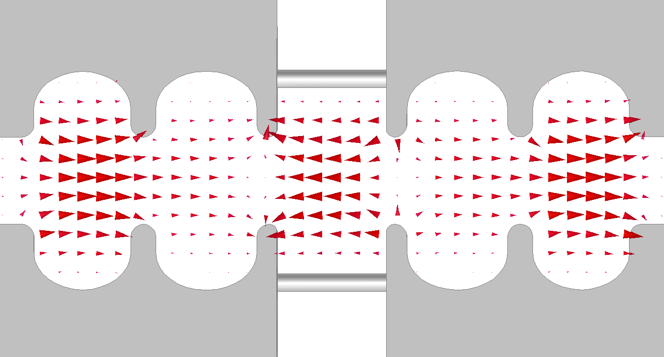
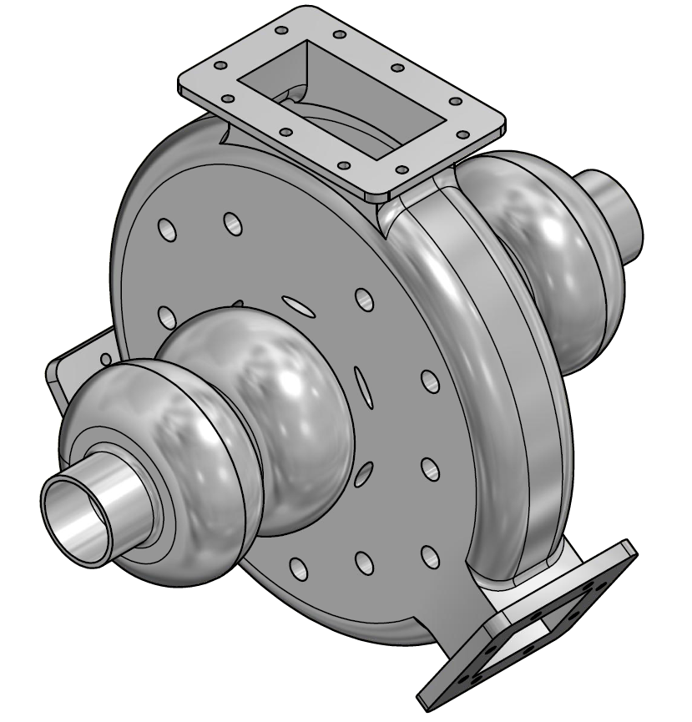
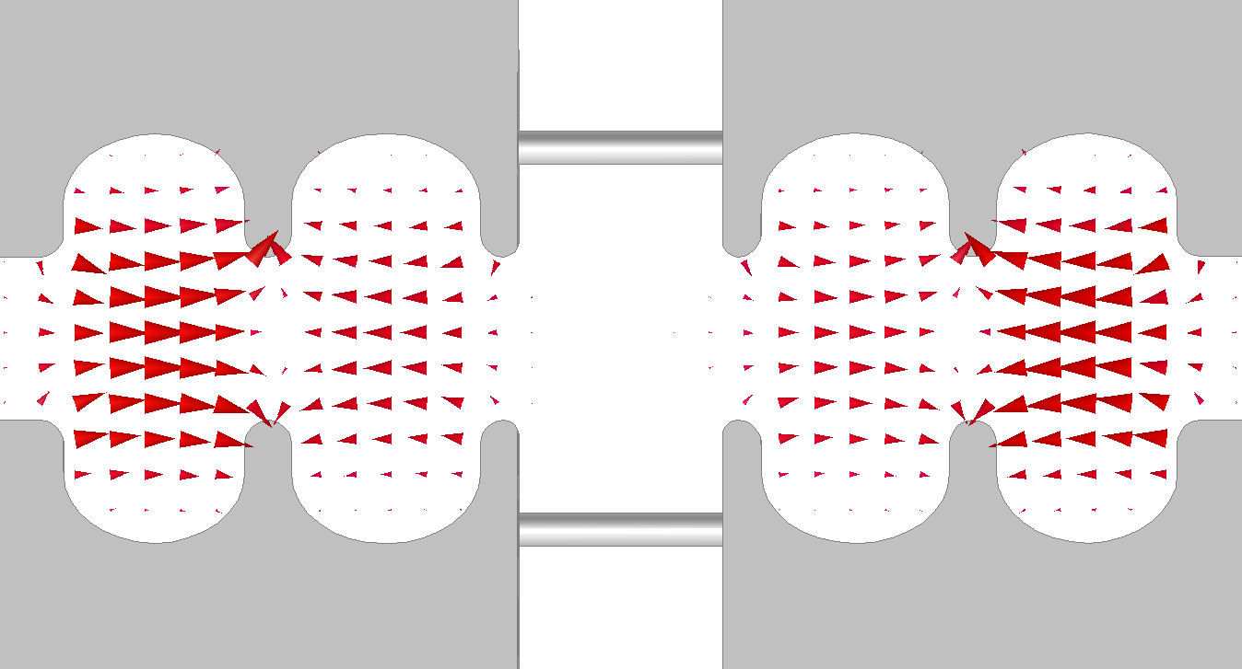
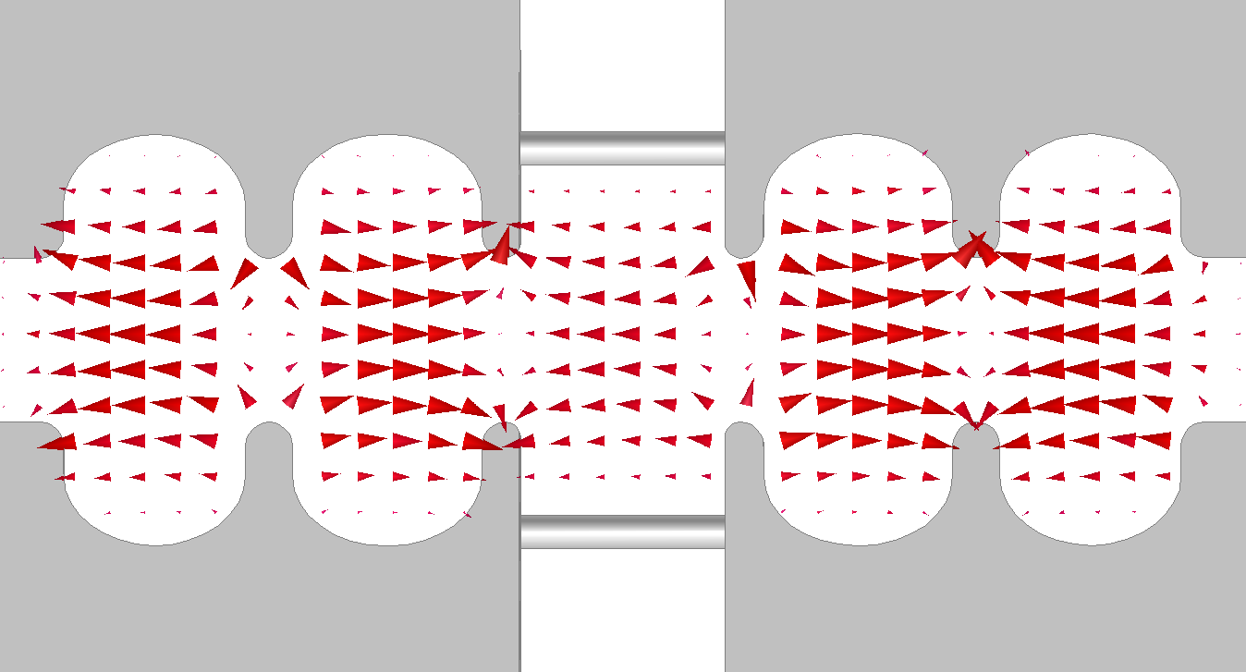
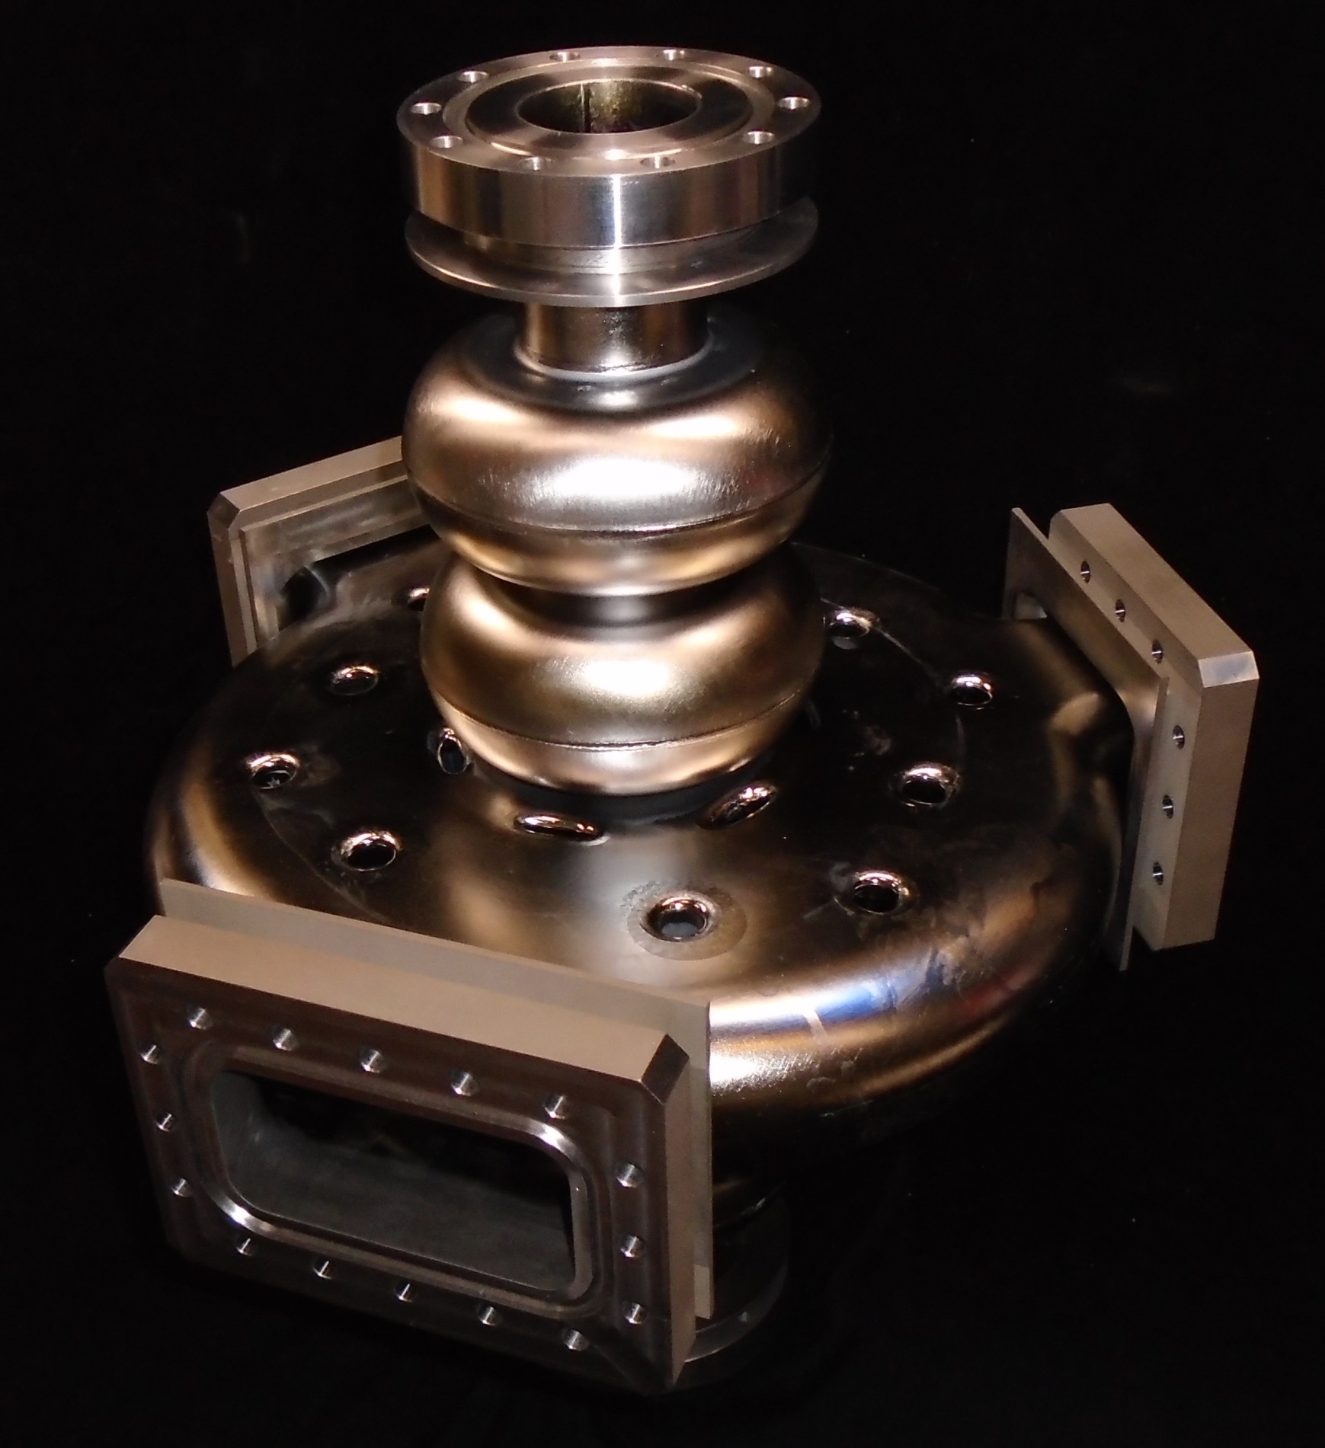
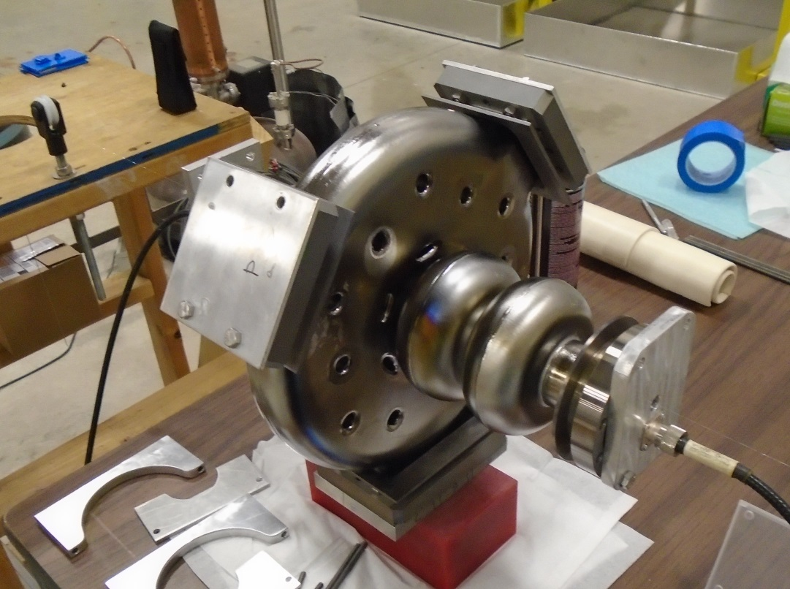
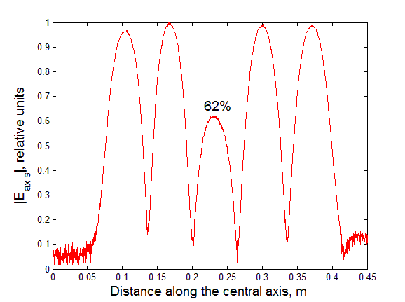
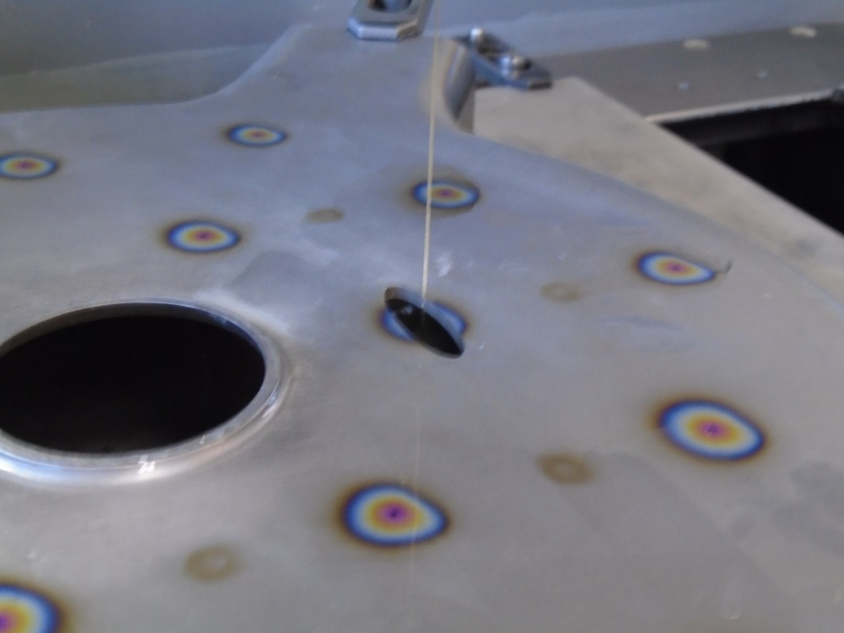
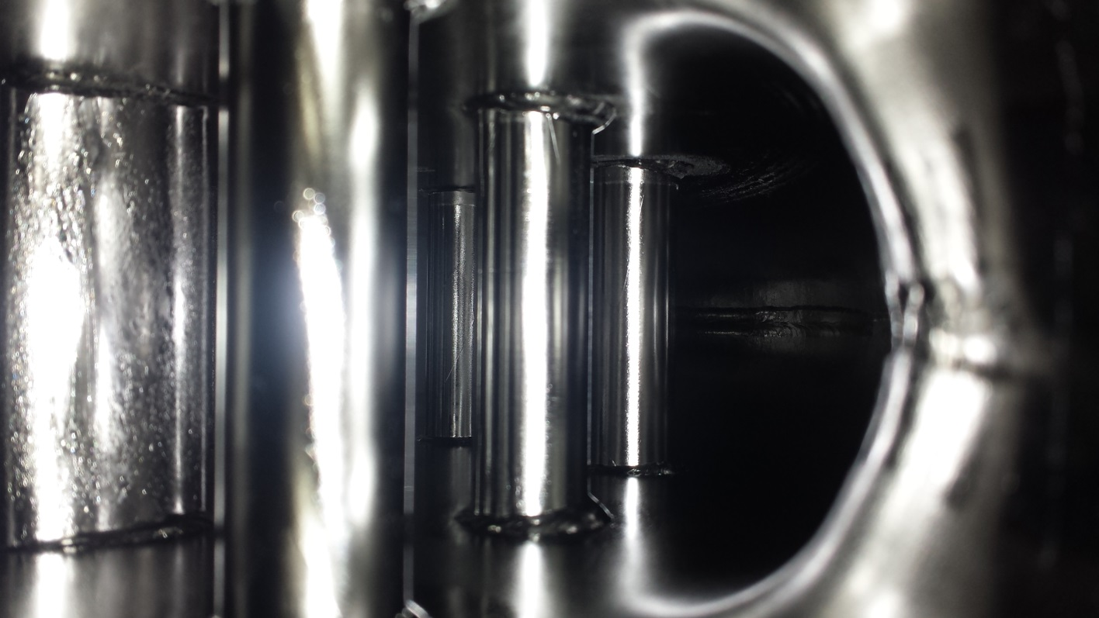
High gradient testing of the five-cell superconducting RF module with a PBG coupler cell
Sergey A. Arsenyev¹ , W. Haynes², D. Shchegolkov², E. Simakov², T. Tajima², C. Boulware³, T. Grimm³, A. Rogacki³
¹Massachusetts Institute of Technology, Cambridge, MA 02139; ²Los Alamos National Laboratory, Los Alamos, NM 87545, USA; ³Niowave Inc., 1012 North Walnut Street, Lansing, MI 48906, USA
Abstract
Motivation
High gradient testing
We report results of high-gradient testing of the first 5-cell superconducting radio frequency (SRF) module with a photonic band gap cell (PBG).
Higher order mode (HOM) damping is vital for preserving the quality of high-current electron beams in novel SRF accelerators. Because HOMs are not confined by the PBG array, they can be effectively damped in order to raise the current threshold for beam instabilities. The PBG design increases the real-estate gradient of the linac because both HOM damping and the fundamental power coupling can be done through the PBG cell instead of via the beam pipe at the ends of the cavity. A superconducting multi-cell cavity with a PBG damping cell is therefore an attractive option for high-current linacs.
The first-ever SRF multi-cell cavity incorporating a PBG cell was designed a LANL and built at Niowave Inc. The cavity was tuned to a desired gradient profile and underwent surface treatment at Niowave. A vertical test (VTS) was then performed at LANL, demonstrating an abnormally low cavity quality factor in the accelerating mode of 1:6 106.Future tests are proposed to determine the source of the losses and resolve the problem.
SRF linacs can provide large electron beam currents necessary for various applications (such as FELs).
The new generation of superconducting (SRF) linear accelerators must be able to produce high-current high quality electron beams.
For good quality of the beam, higher order modes (HOMs) excited by the beam should be suppressed.
Photonic band gap (PBG) structure confines the fundamental (operating) TM₀₁ mode but allows the HOMs to leak out.
An experiment demonstrating acceleration in a room-temperature PBG structure was successfully conducted at MIT in 2005.
Gradients as high as 18 MV/m and Q-values of $4×{10}^{9}$ in a superconducting PBG cell were experimentally demonstrated at LANL in 2013.
Using PBG resonators with incorporated HOM couplers in a cryomodule increases the real-estate gradient because there is no extra space required in the beam-pipe to place HOM couplers.
$$\frac{π}{5}$$
$$\frac{2π}{5}$$
$$\frac{3π}{5}$$
Fabrication & Tuning
Reflected power (pulse)
FM coupler (WR430)
The cavity body was fabricated by Niowave, Inc. from fine grain RRR$≥$300 niobium sheets using aluminum dies and then electron beam welded together. Two halves of the PBG cell were made separately from the rods. Holes were made in the walls of the PBG cell to fit the rods which were electron beam welded later. All 5 cells were welded together in a few steps with tuning between them in order to minimize the effect of Nb shrinkage on field flatness.
Tuning was done by trimming halves of each elliptical cell at the equator. Gradient profile after the final weld was within 5% of the design and no additional tuning was required. Nevertheless, the elliptical cells were squeezed a little in longitudinal direction to even-out the profile.
After welding, the cavity was chemically treated using 1:1:2 buffered chemical polish (BCP) solution of HF, HNO3, and H3PO4 to etch 150 $μm$ of the inner niobium surface. The cavity was then high pressure rinsed at Niowave Inc.
The FPC and the two HOM waveguide couplers were covered with Nb RRR $≥$300 plates to provide an RF seal. The plates were clamped between the cavity flanges and stainless steel covers. Aluminum hexagonal gaskets (diamond) was placed between the waveguide flanges and the stainless steel covers to provide a vacuum seal.
$$\frac{4π}{5}$$
Missing rod
Cavity quality factor for different modes as a function of peak surface electric field at 4K. The drive probe was adjusted to provide near critical coupling to the modes $\frac{2π}{5}$ and $\frac{4π}{5}$, or max achievable coupling for modes $π$ and $\frac{3π}{5}$.
Cross section of the 5-cell module with the pickup assembly and the drive assembly
$$π$$
Once the cavity was assembled and put in liquid Helium, a network analyzer was used to find all but one spatial variations of the monopole mode: $π$, $\frac{4π}{5}$, $\frac{3π}{5}$, $\frac{2π}{5}$modes. The accelerating mode was undercoupled but close enough to matched coupling that we could phase lock on it and measure $Q_{0}$from pulse decay time: $Q_{0 π}$= $1.6×{10}^{6}$. Using the same technique, $Q_{0}$ for the $\frac{3π}{5}$ mode was found to be even lower: $Q_{0 3π/5}$= $9.3×{10}^{5}$. Even after going to lower temperature 2K, the S11 profile of the accelerating mode did not change. This indicates that the mode has a very low $Q_{0}$ dominated by non-superconducting losses. Surprisingly, the other two modes showed much higher Q factors, although still lower than expected:$Q_{0 2π/5}$= $2.2×{10}^{8}$, $Q_{0 4π/5}$= $2.7×{10}^{8}$. For each of the two modes, we were able to adjust the drive probe to be near critically coupled ($β≈1$) . We were able to feed up to 135W of power into the cavity and measured $Q_{0}$ vs $E_{peak}$.
Maximum achievable field in the $\frac{2π}{5}$ mode was limited by quench-like behavior with rapid change from near zero to 100% reflected power and back. The quench was not processed after a few minutes of feeding power. For the $\frac{4π}{5}$ mode, several similar quenches were processed and we eventually reached the limit of maximum available RF power.
It was noticed that both higher-Q modes have near zero fields in the PBG cell, while both lower-Q modes have significant fields in the PBG cell. This indicates that the PBG cell is the source of the non-superconducting losses that determine Q factors of the $π$ and the $\frac{3π}{5}$ modes. It may be caused by either insufficient surface treatment that left foreign metal on the inner surface, or losses in the FPC and the HOM couplers. Losses in the waveguides could potentially be explained by poor RF seal that is formed by Nb plates clamped to the waveguide flanges. In contrast, experiments with strongly coupled FPC involved indium gaskets to provide both RF and vacuum seals.
Electron beam trajectory
Electric field of various monopole modes (HFSS)
HOM coupler
Mode | $$Q_{0}$$ | Max achieved $E_{peak}$ | Max achieved $B_{peak}$
$$π$$ | $$1.6×{10}^{6}$$ | NA | NA
$$\frac{4π}{5}$$ | $$2.7×{10}^{8}$$ | 29.1 MV/m | 62.8 mT
$$\frac{3π}{5}$$ | $$9.3×{10}^{5}$$ | NA | NA
$$\frac{2π}{5}$$ | $$2.2×{10}^{8}$$ | 17.5 MV/m | 38.1 mT
Bead pulling setup
Gradient profile of the tuned cavity obtained from bead pulling measurements. The field in the center cell is intentionally lowered to ensure equal $B_{peak}$ in every cell
Future plans
Find the cause of the low quality factors by repeating the experiment with different waveguide covers and more surface etching.
Once the problem is fixed, measure maximum achievable gradient in the accelerating mode.
Incorporate the cavity in a cryomodule
2.1 GHz 5-cell module with a PBG center cell, made from Niobium
Making holes for the PBG rods
Inside of the PBG cell
Work is supported by the U.S. Department of Energy (DOE) Office of Science Early Career Research Program
E-mail: arsenyev@mit.edu

