Slide 1
Slow Wave Cavity Concept
Workshop on Microwave Cavity Design for Axion Searches
Aug 26th, 2015
Gianpaolo Carosi

Slide 2
So far we’ve used simple cylinders
Antennas
Tuning Rod
Transmittance between Antennas
Cavity
1.5 GHz
Frequency
* LLNL sponsored HMC Clinic Final Presentation – 2010

Slide 3
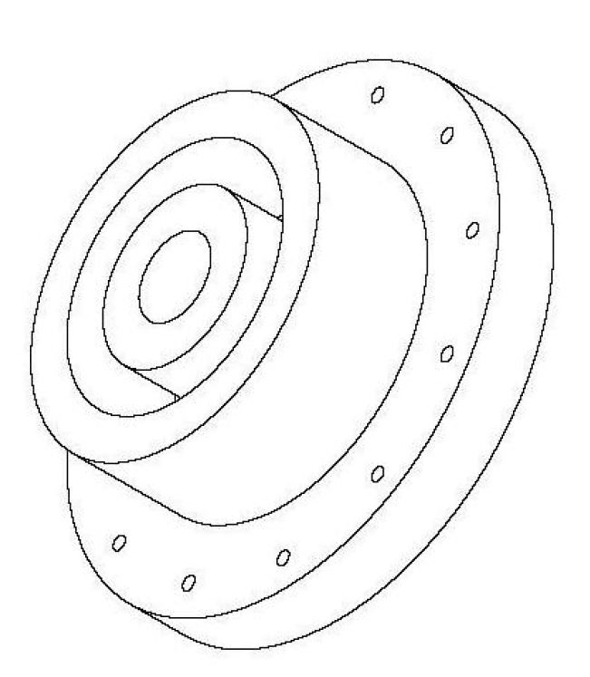
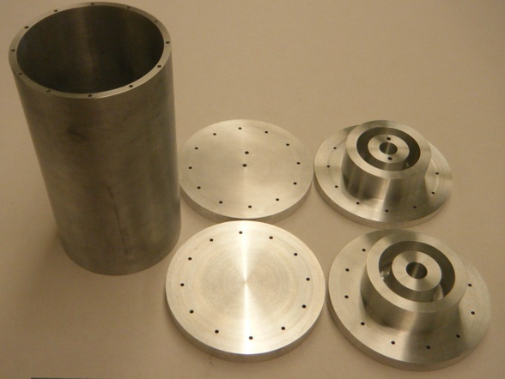
Instead of Flat Endcaps make Reactive Endcaps
*This is work done at UW from Hunter Swan (2012)

Slide 4
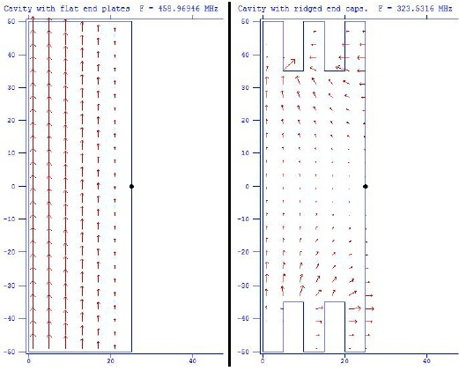
Superfish Simulations
Slow-wave cavity
(2nd half of 2019)

Slide 5
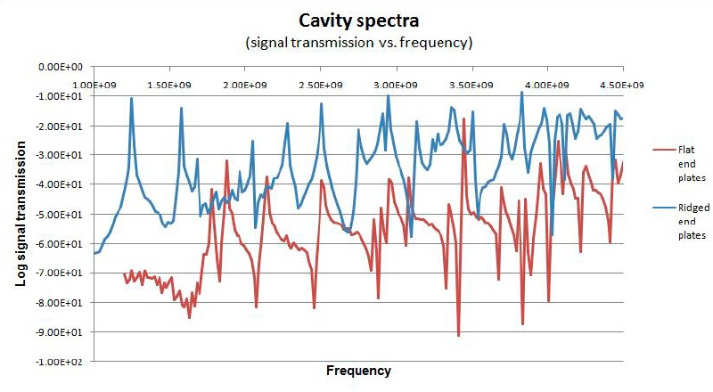
Reactive Endcaps
Slow-wave cavity
(2nd half of 2019)

Slide 6
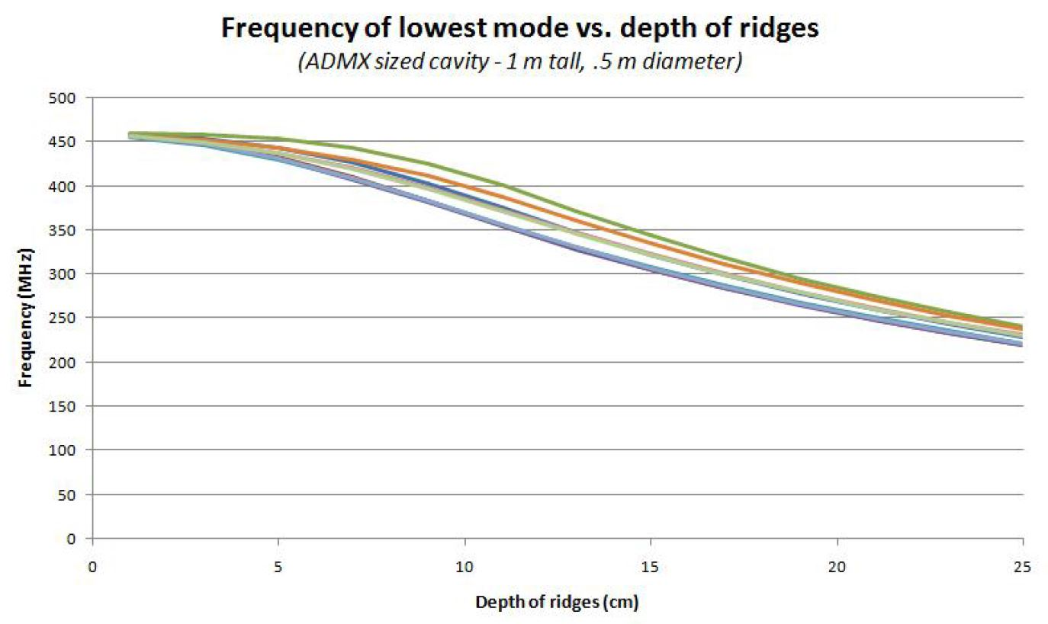
Reactive Endcaps – freq function of ridge depth
Slow-wave cavity
(2nd half of 2019)

Slide 7
Nothing for free
Take a hit in the form factor
  Empty cavity C ~ 0.69
  With ridges C ~0.4 – 0.1
Take a hit in the Q
  No ridges the Q= 18k
  With ridges the Q ~ 4K
Slow-wave cavity
(2nd half of 2019)

Slide 8
ADMX Gen 2 Science Prospects: ( < 0.5 GHz)
Slow-wave cavity
(2nd half of 2019)

