Slide 1
AXION DARK MATTER ROUNTABLE | AUGUST 24, 2015
Electronic Coupling & Tuning
G.Carosi
Heising-Simons Foundation

Slide 2
Currently we adjust the coupling to the cavity and tune the cavity with stepper motors
AXION DARK MATTER ROUNTABLE | AUGUST 24, 2015
The antennas (coupling probes) are 50Ω transmission lines
The cavity has a complicated, frequency dependent impedance
We impedance match cavity-to-probe by physically changing the length of the probe inserted into the cavity
Known problems include heat generation, mechanical precision & mechanical reliability
Heising-Simons Foundation

Slide 3
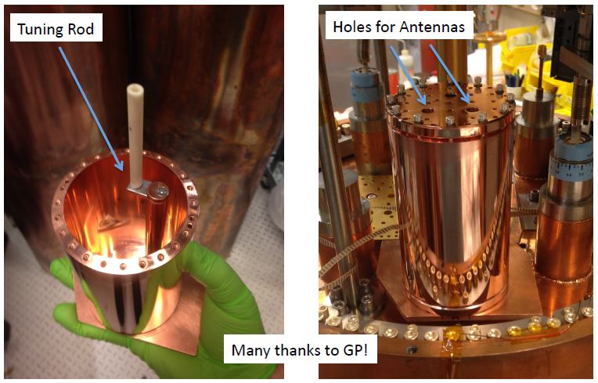
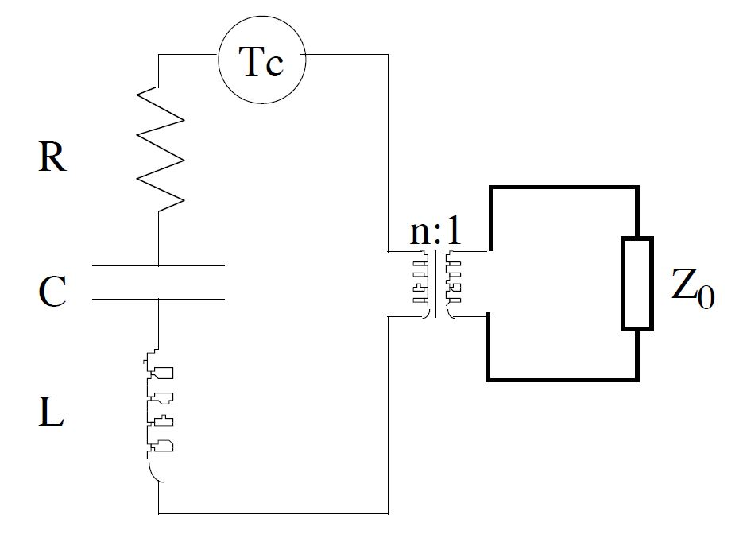
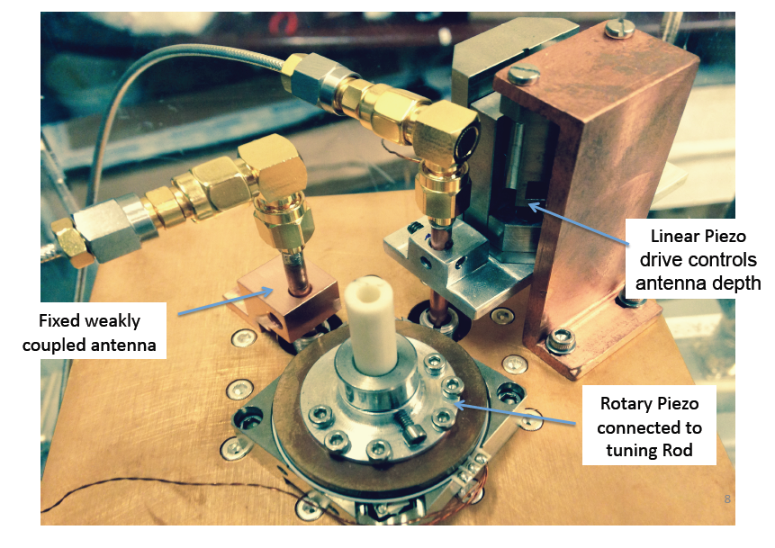
Model Cavity as Equivalent Circuit
Antenna coupling
represented as n turn transformer
sidecar
Ed Daw Thesis*

Slide 4
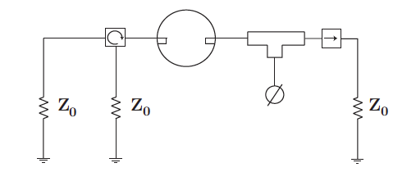
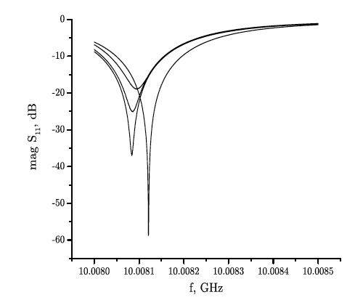
Electronic Tuning & Coupling
AXION DARK MATTER ROUNTABLE | AUGUST 24, 2015
Employ adjustable reactance to microwave cavity circuit
Phase shifters and/or varactor diodes to:
A: Adjust critical coupling electronically
B: Adjust resonant frequency electronically
Potential to solve known problems and
allow for arrays of cavities.
Need to determine if this can be done in a way that doesn’t add appreciable noise.
UW, LLNL and NRAO have begun R&D
*
* B. Riddle and C. Nelson, Impedance Control for
Critically Coupled Cavities, IEEE Trans, 2005
Heising-Simons Foundation

Slide 5
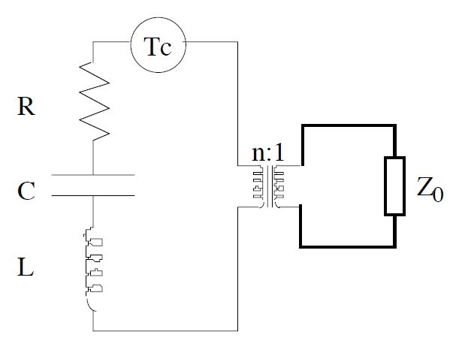
AXION DARK MATTER ROUNTABLE | AUGUST 24, 2015
Model the Cavity as an equivalent circuit
The microwave cavity is a driven harmonic oscillator with the axion-field as the driving source. This can be modeled as an LC-resonant circuit.
Antenna model as a variable coupling to an external load
Network Analyzer
out
in
Switch
Circulators
Phase shifter
Antennas
Microwave Cavity
* Ed Daw, Thesis
Heising-Simons Foundation

Slide 6
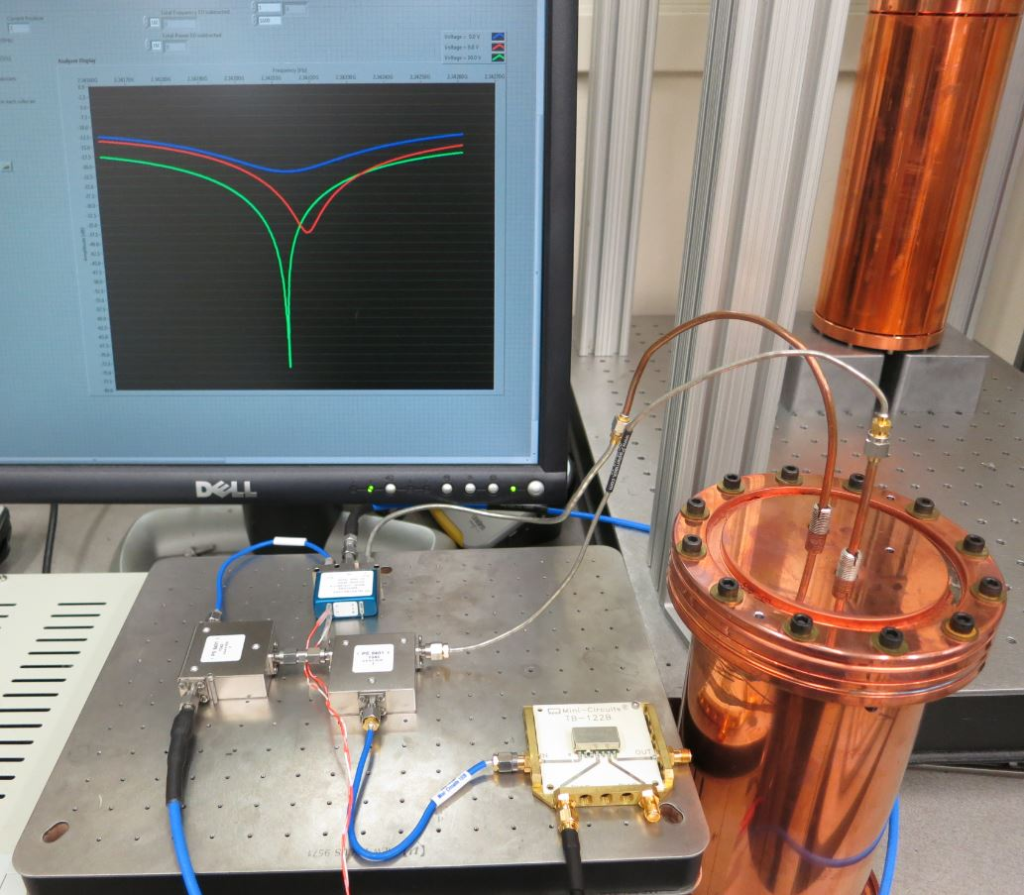
AXION DARK MATTER ROUNTABLE | AUGUST 24, 2015
Proof of principle demonstrated at LLNL
Heising-Simons Foundation

Slide 7
AXION DARK MATTER ROUNTABLE | AUGUST 24, 2015
Key to use of the technique will be characterization and minimization of added noise
Specify where noise would be added and estimate of how much (phase-shifter component).
Student project this fall to measure the signal to noise increase with and without electronic coupling.
Student will work closely in concert with NRAO on modeling.
NRAO will be lead electronic tuning design this fall.
Heising-Simons Foundation

