Slide 1
Reentrant Cavity for Low Mass Axion Search
Akash Dixit
Microwave Cavity Design for Axion Searches (LLNL)
August 2015

Slide 2
Outline
Inductive coupling to field generated by axions in external B
Reentrant cavity geometry
Cavity simulation (COMSOL)
Resonant Frequency
Field distribution
Prototype Cavity
Tuning

Slide 3
Inductive Coupling
$$∇×B_{a}=−{gB}_{0}\dot{a}=j_{a} \\ B_{a}=−\frac{1}{2}j_{a}r\hat{φ}$$
Use inductor to capture the flux generated by $B_{a}$
P. Sikivie, N. Sullivan, D.B. Tanner (Florida U.). Oct 31, 2013. 5 pp. Phys.Rev.Lett. 112 (2014) 13, 131301
Notes:
The electric field term in the Maxwell equation can be neglected since the 1/m_a is larger than the extent of the external B field

Slide 4
Cavity Geometry
$$73.5mm$$
$$240mm$$
$$25mm$$
$$1mm$$
Notes:
Cylindrical cavity with this feature size corresponds to 1.5 GHz
Reentrant design: L remains constant, but increase C to lower resonant frequency

Slide 5
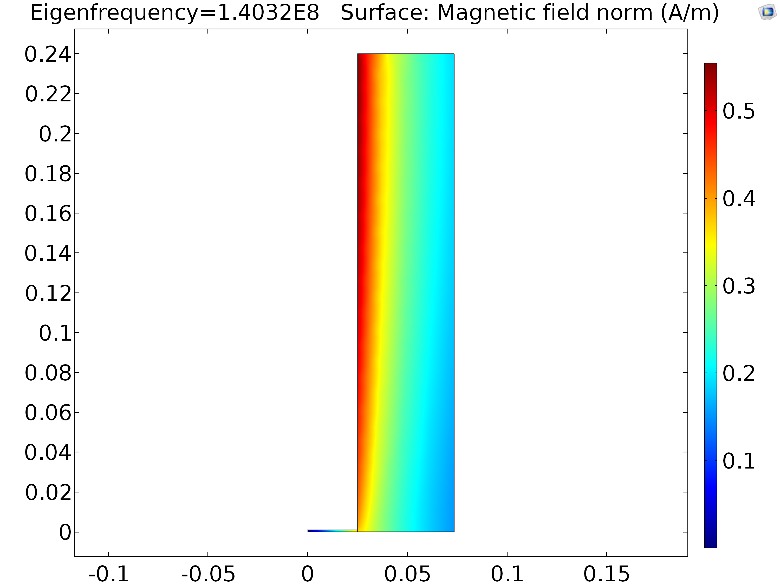
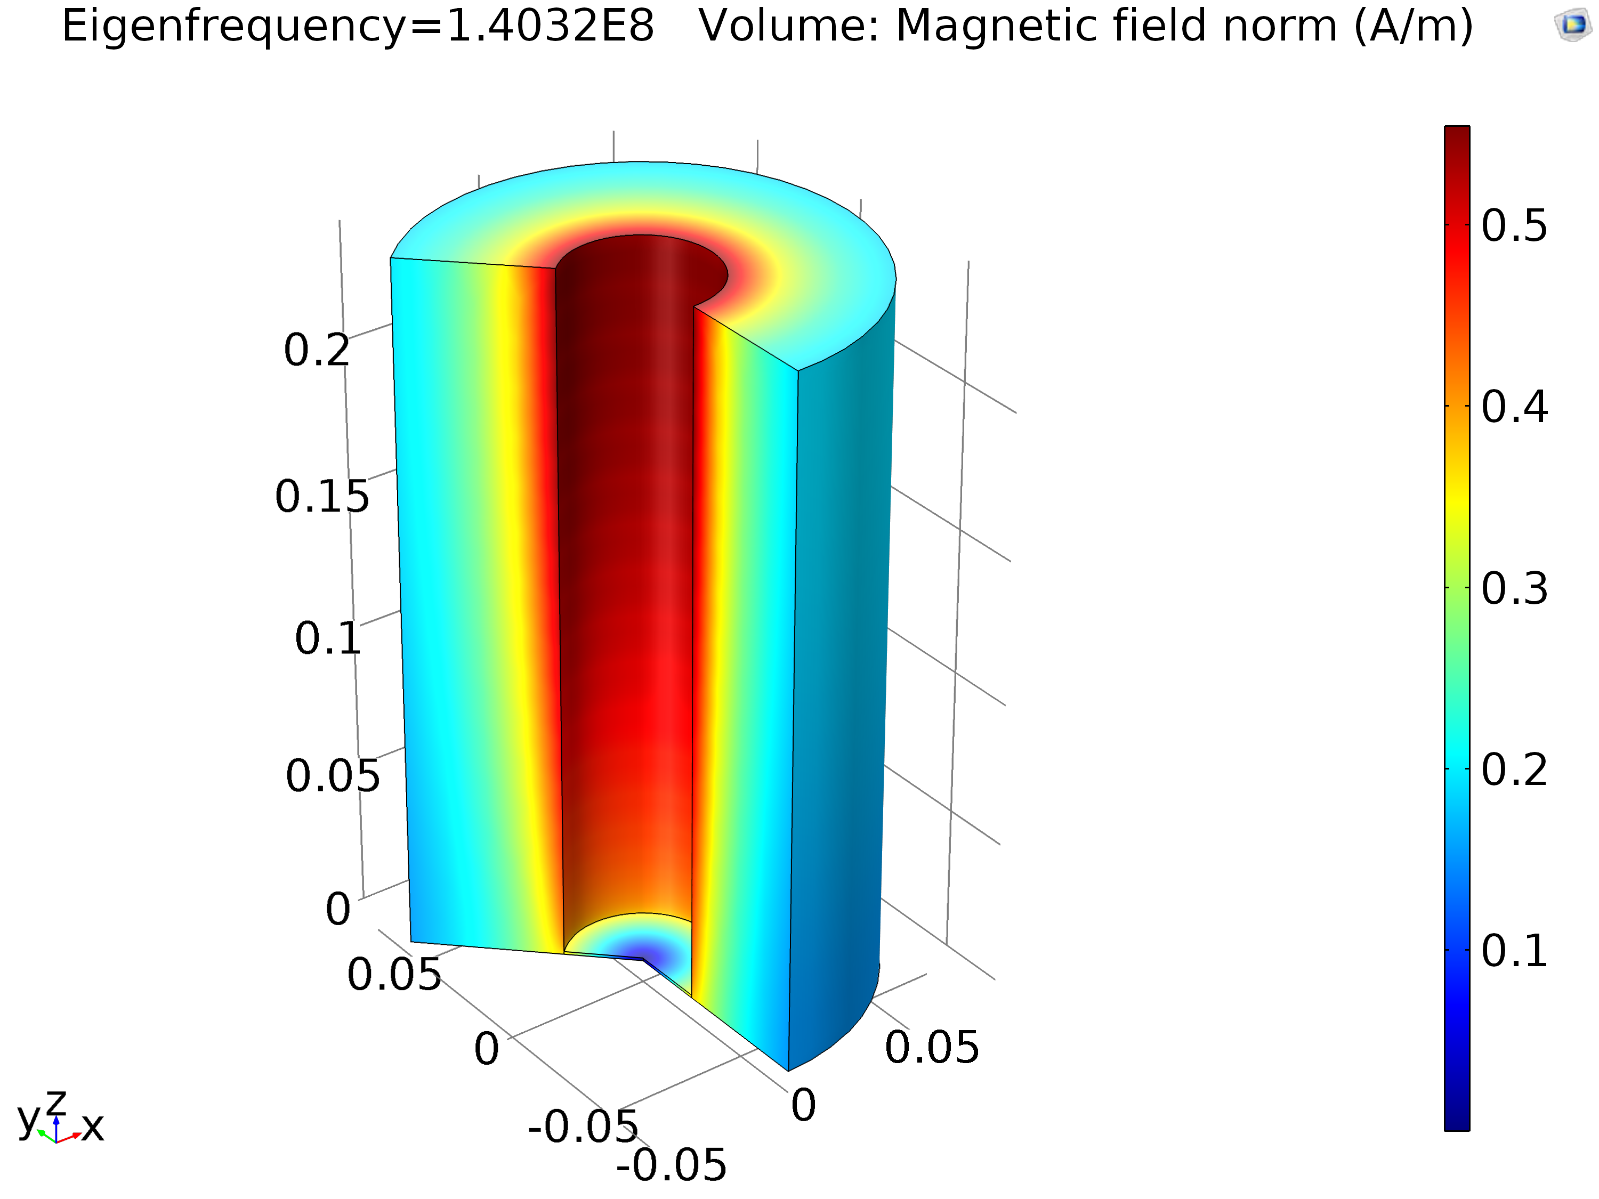
Magnetic Field Distribution
Notes:
Fermilab teslatron 4 dimension give 140MHz resonance

Slide 6
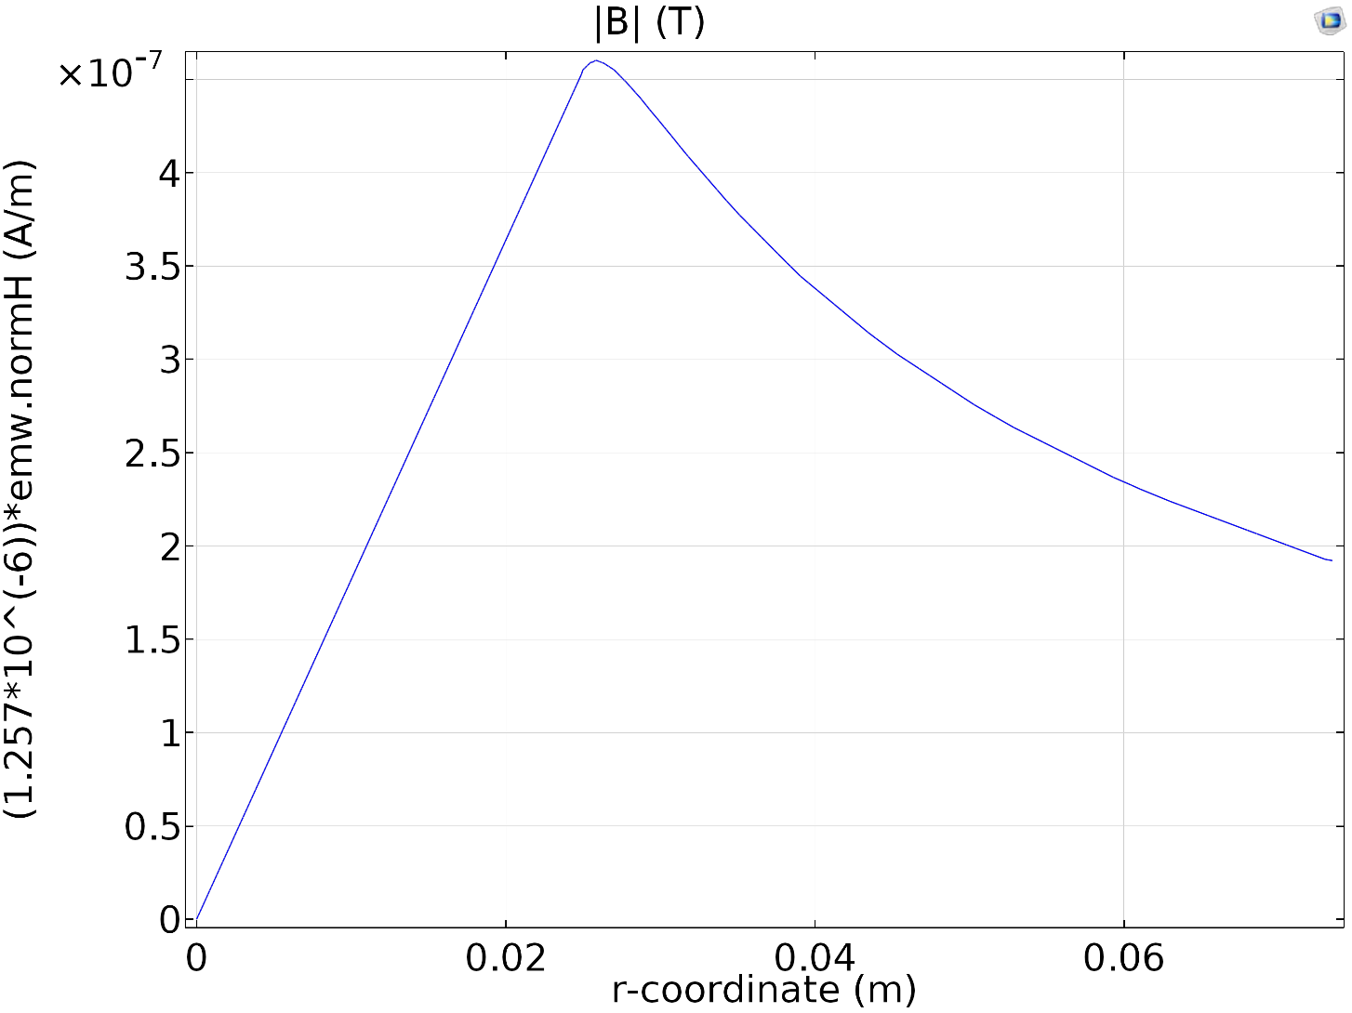
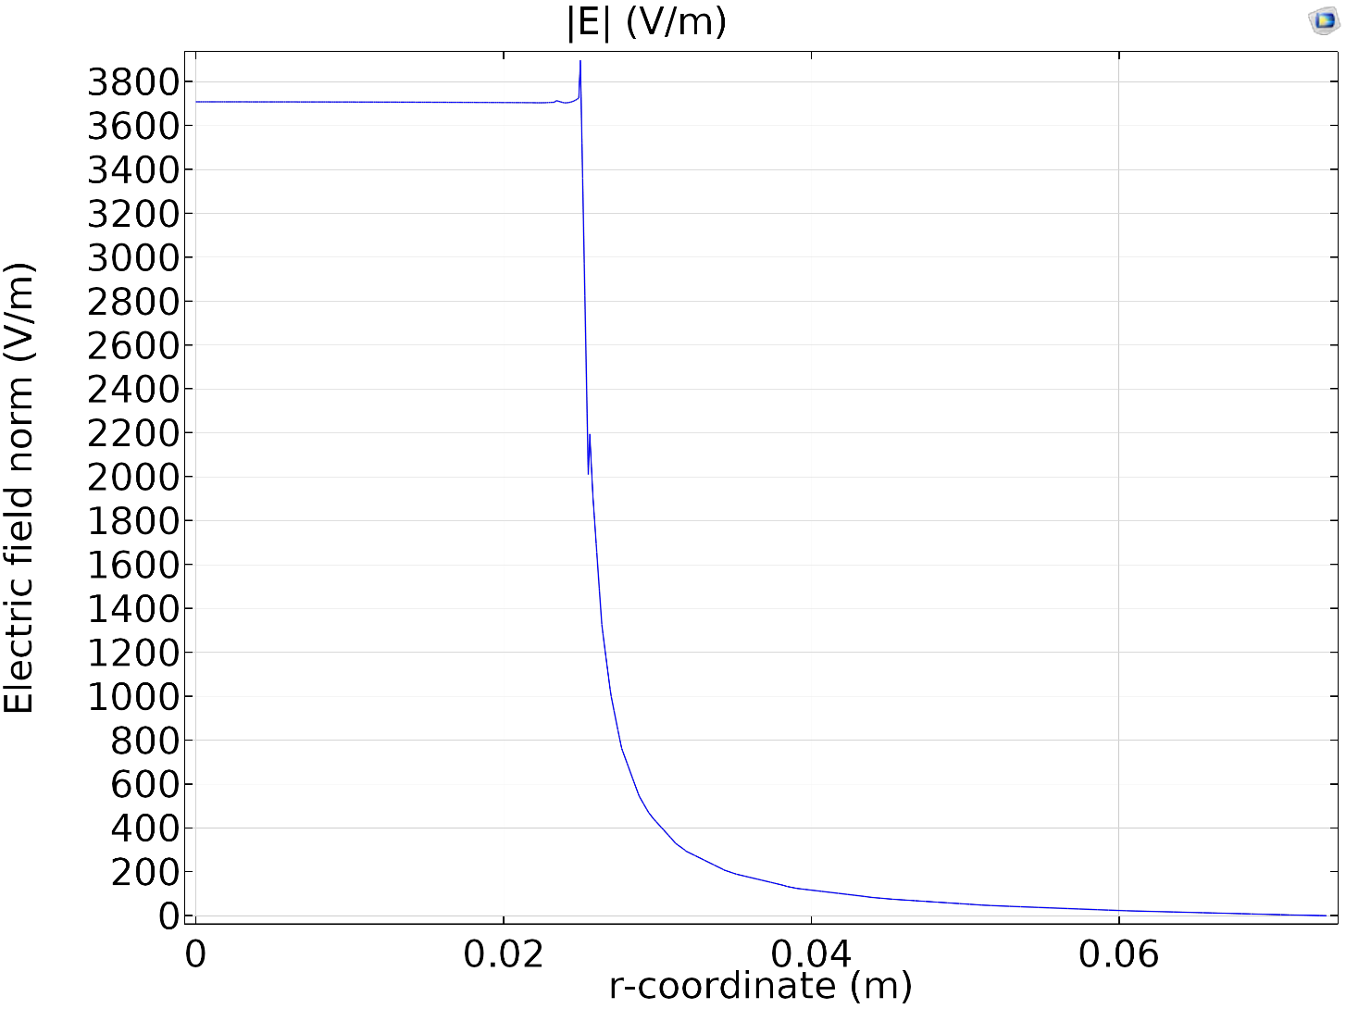
Field Magnitude
$$z=0.5mm$$
Notes:
Electric field is concentrated to parallel plate region, falls of rapidly outside.
Inductive and capacitive parts integrated but are spatially separated

Slide 7
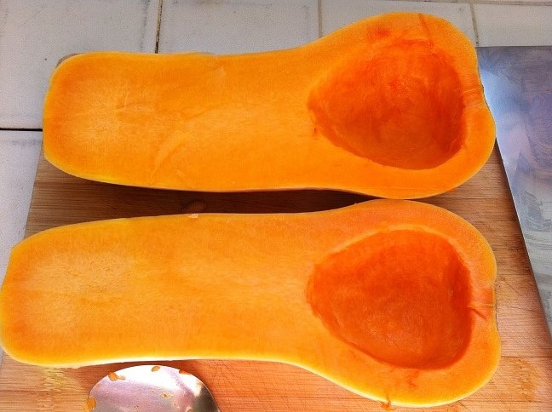
Squashed Cavity Prototype

Slide 8
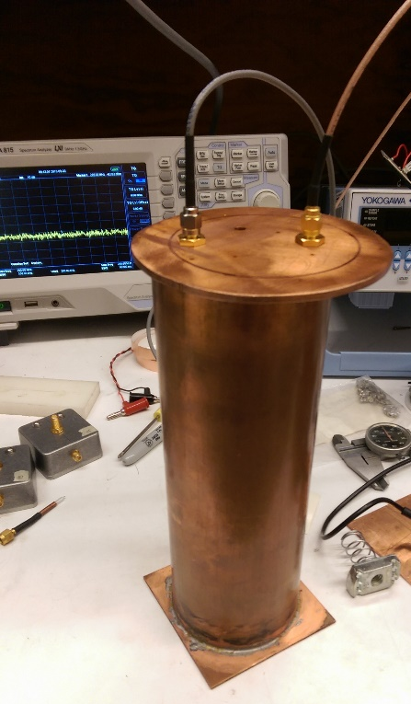
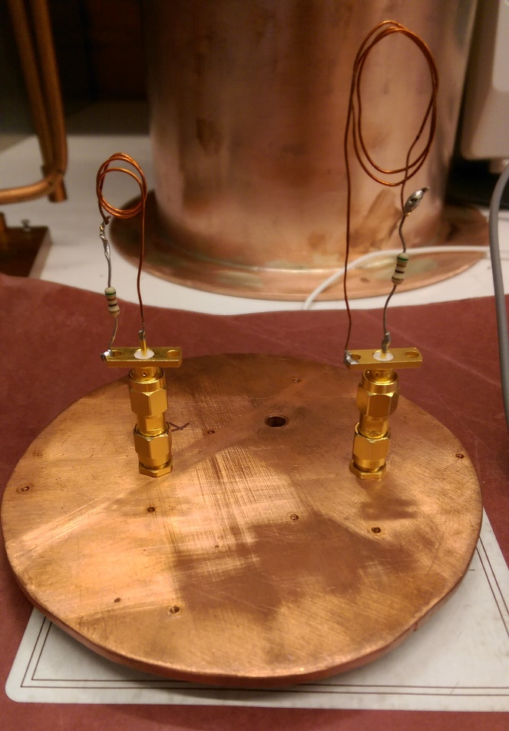
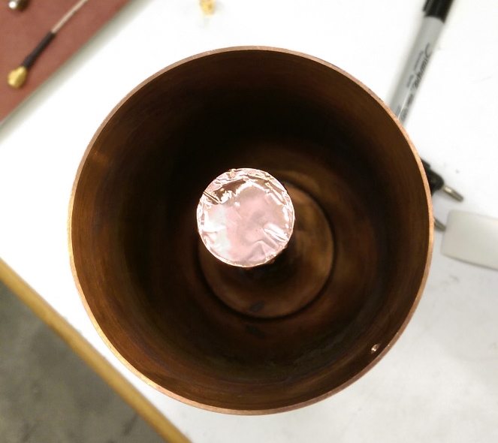
Prototype
(Left) Reentrant Cavity open.
(Center) Cap with transmitter and receiver
(Right) Assembled cavity with spectrum analyzer
Notes:
R ~ 40mm
r_i ~ 15mm

Slide 9
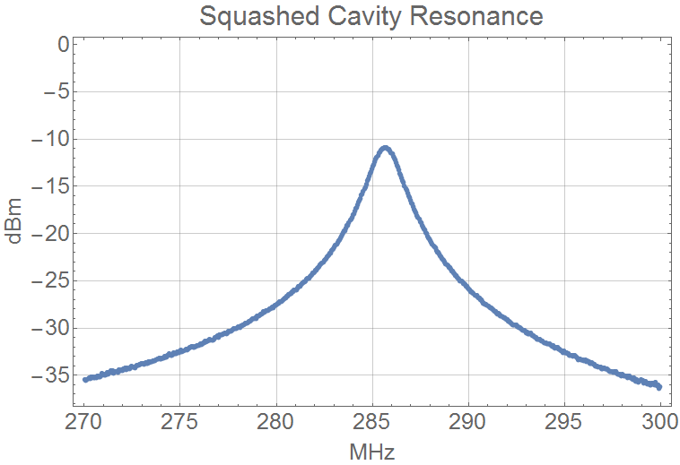

Slide 10
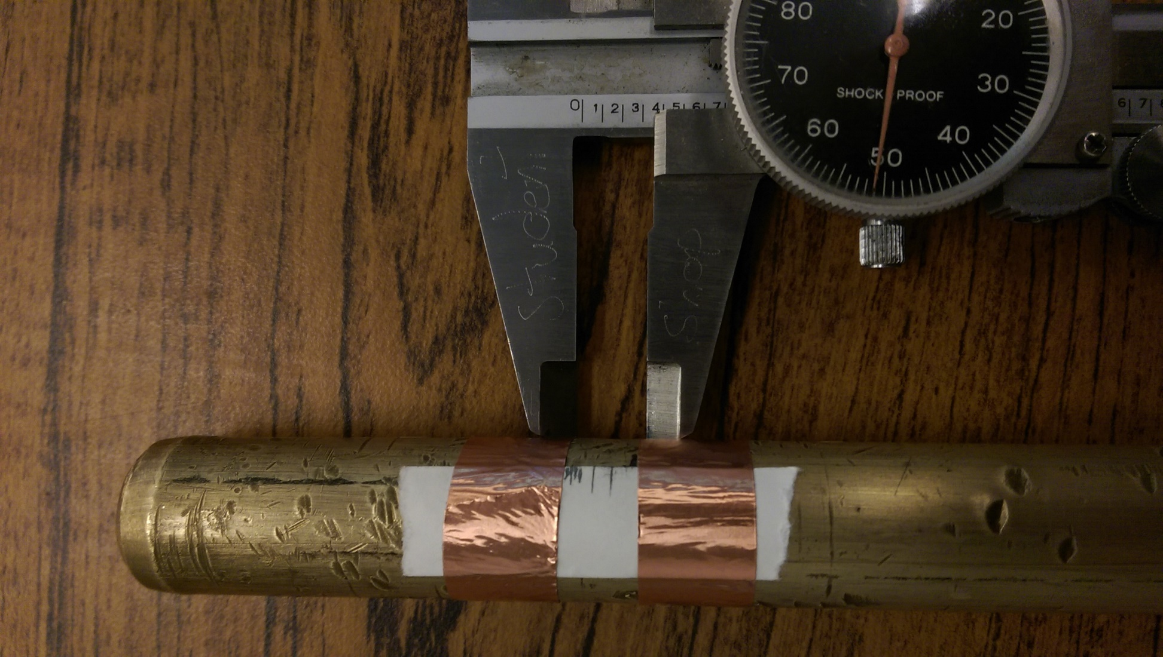
Cavity Tuning
Brass tuning rod inserted into cavity
Notes:
Use a rod to vary the gap between reentrant region and bottom of cavity

Slide 11
Cavity Tuning
Q≳200

Slide 12
Resonant Frequency vs Gap
Simulation
Data
$$C\sim \frac{A}{d} \\ ω=\frac{1}{\sqrt{LC}}\sim \sqrt{d}$$

Slide 13
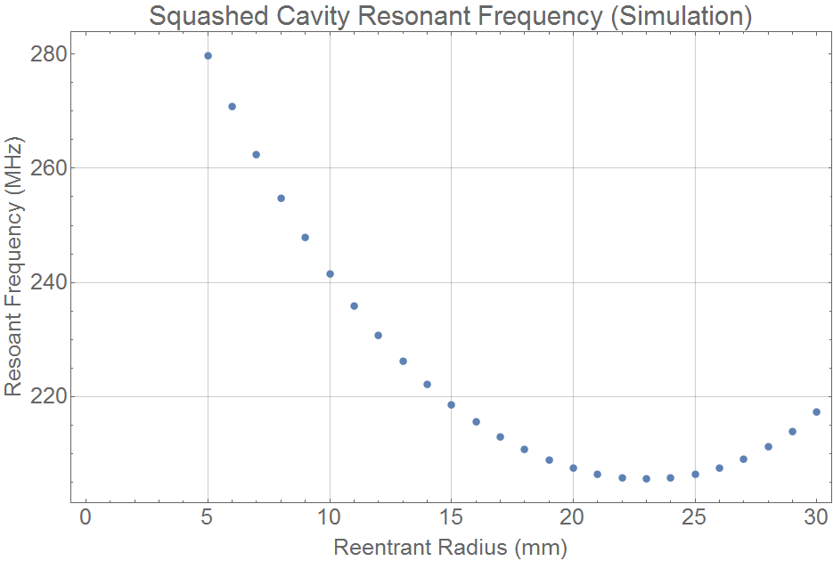
Conclusions/Future
Exotic axion current produces magnetic field
Flux detected using reentrant cavity
Cavity tuning
Vary gap by piezoeletrics
Inner plunger
$$d=1mm$$

