Slide 1
Superconducting Microresonators and Detectors
Jonas Zmuidzinas
Caltech

Slide 2
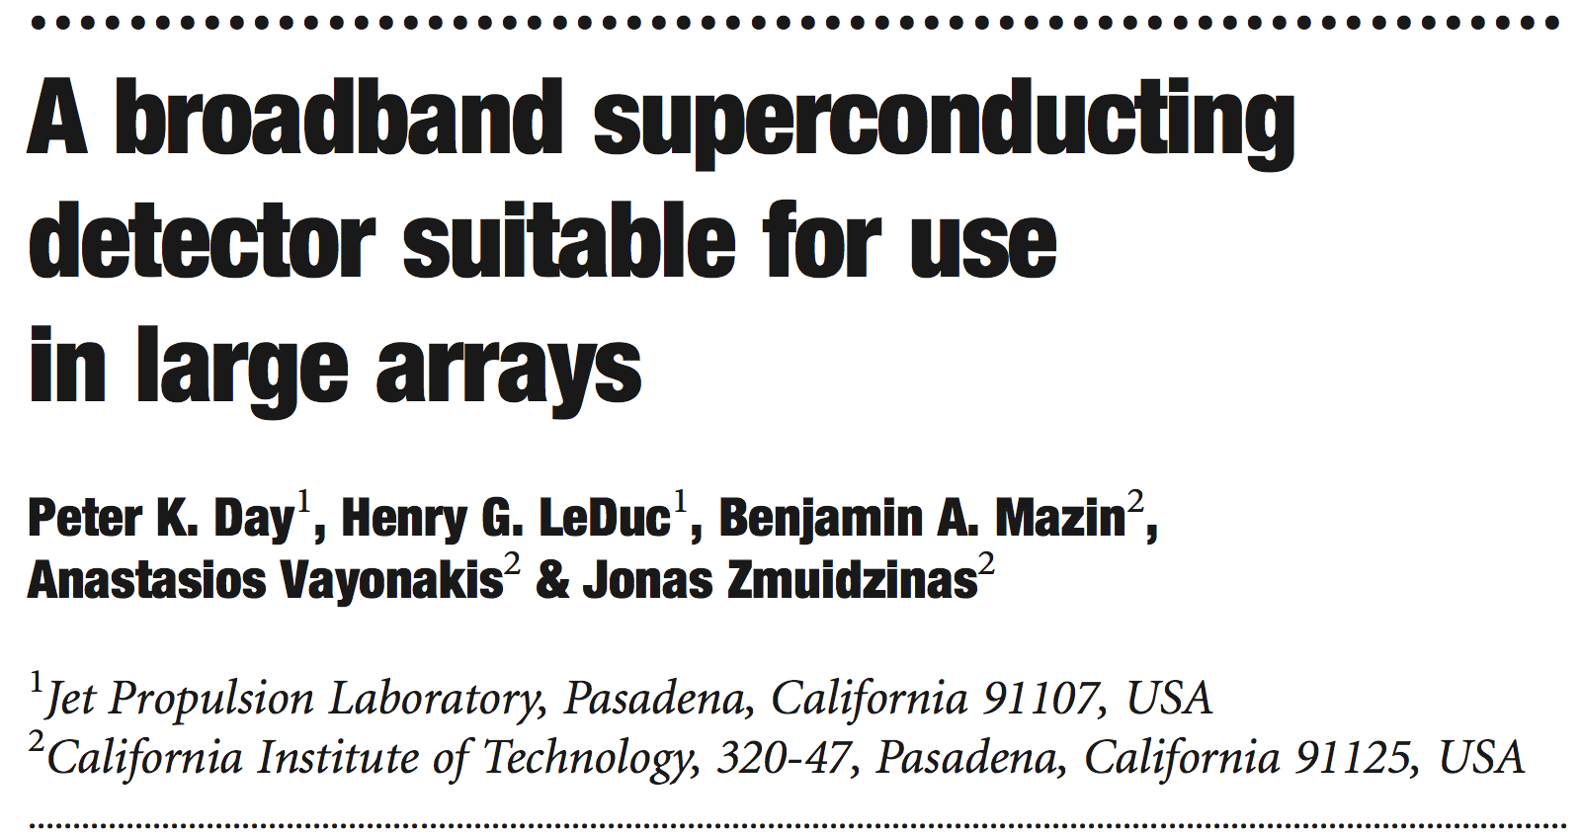
2001: CPW Microresonators
Mazin et al 2001, Proc. LTD Workshop, AIP

Slide 3
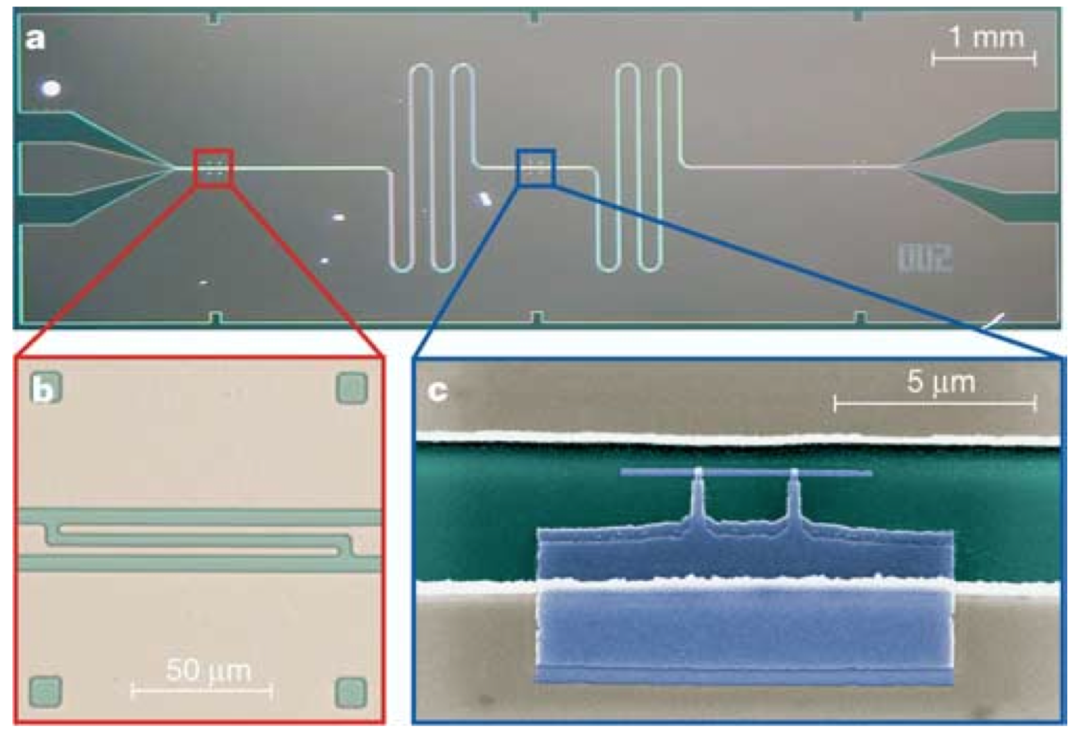
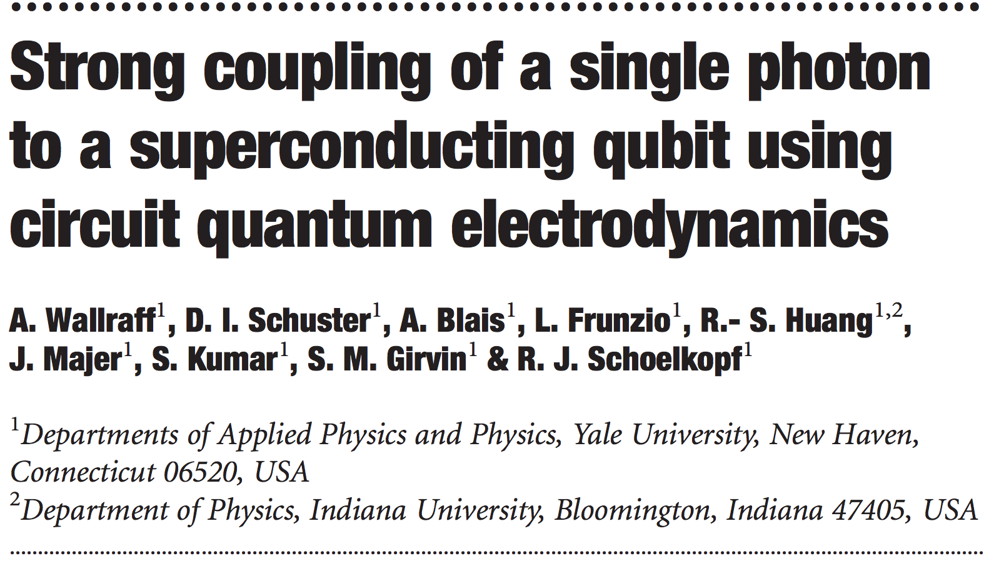
2004: CPW Microresonators and Qubits

Slide 4
Resonator geometries
Readout
line
Coplanar
Waveguide
(CPW)
Transmission-
Line resonator
Lumped-element
resonator

Slide 5
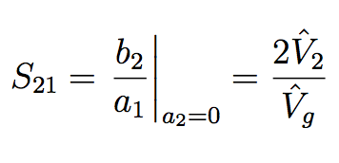
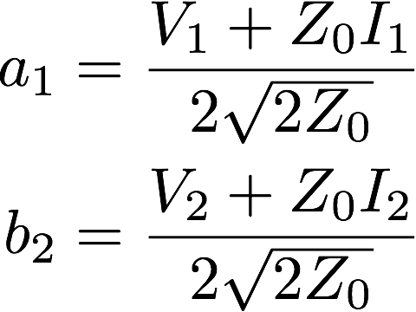


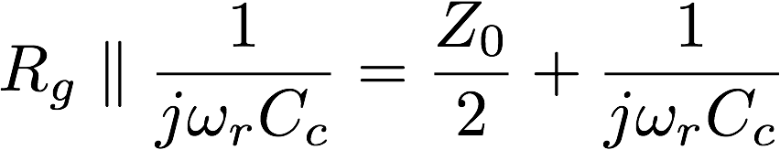
Equivalent Circuits

Slide 6
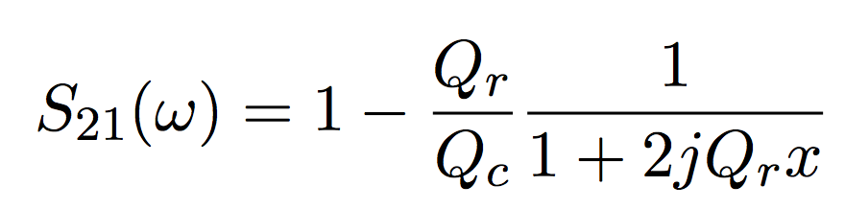

Single-channel analog readout
Readout point
Resonator frequency, Q monitored at ~100 kHz sampling rate

Slide 7
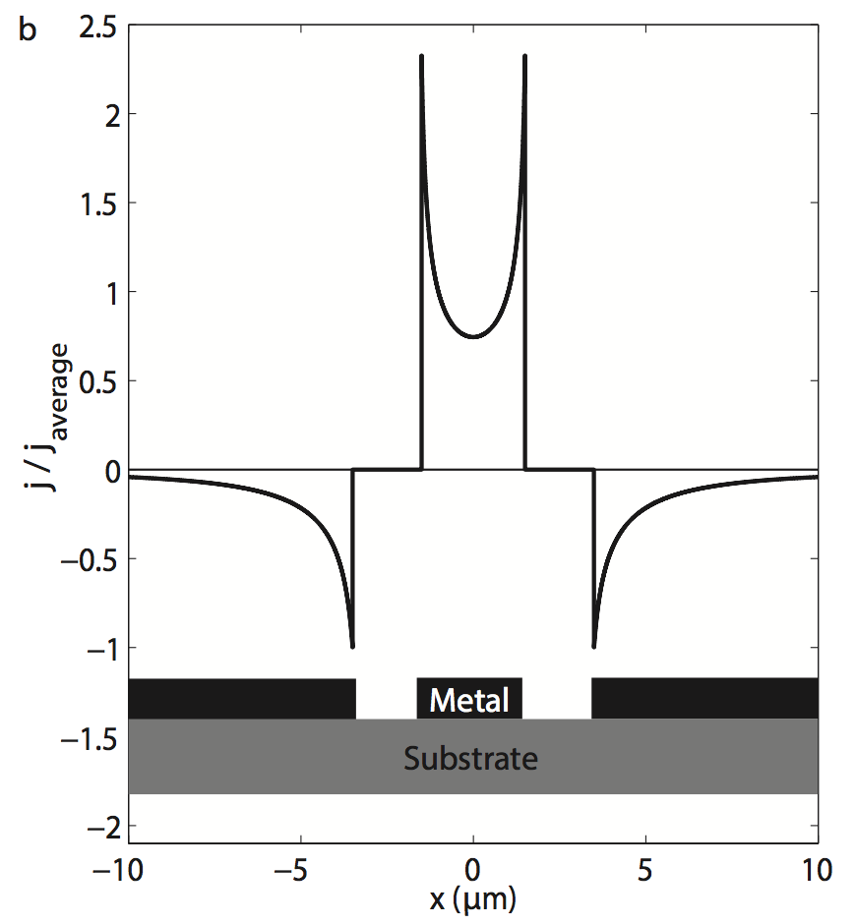
Current distribution in CPW

Slide 8
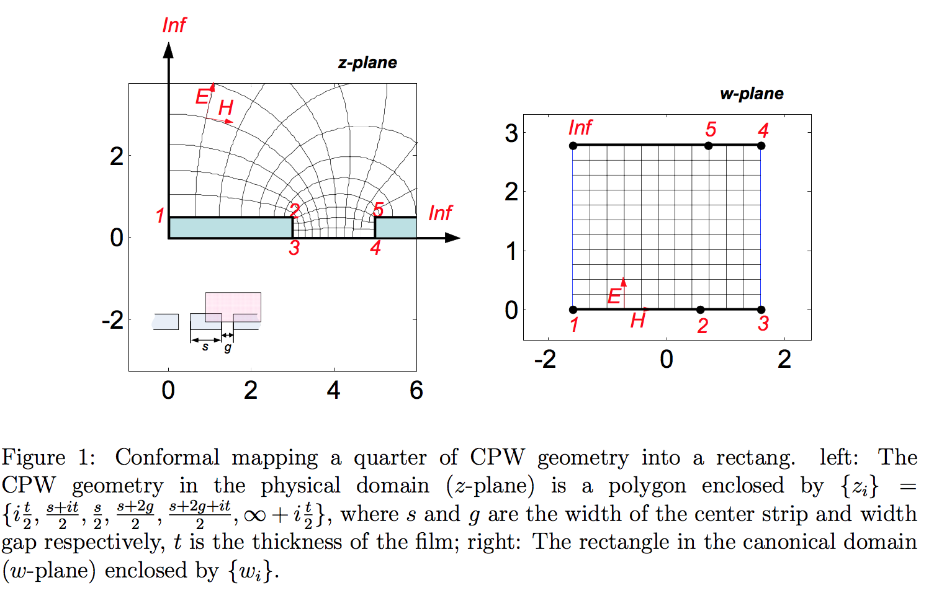
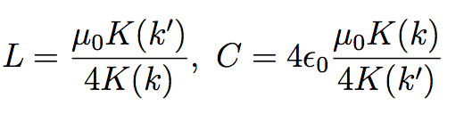
Conformal mapping
Matlab package: Schwarz-Christoffel toolbox
See J. Gao PhD thesis, Caltech, 2008

Slide 9
Electrical Conductivity
Current density
scattering
time
Newton’s
2nd law
Ohm’s law – definition of σ
Conductivity
Superconductor:

Slide 10
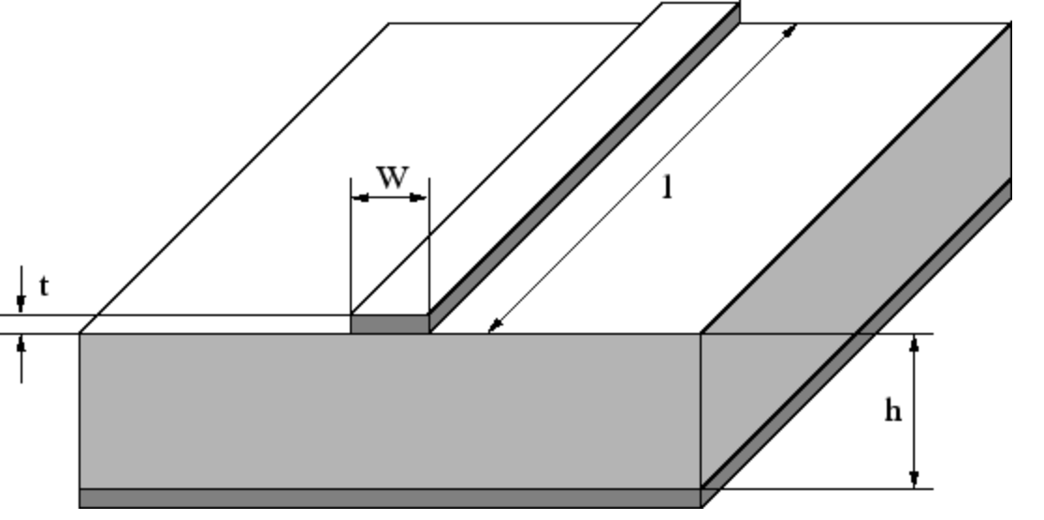
Two-fluid model
``superconducting electrons’’:
``normal electrons’’:
Superconducting + normal:

Slide 11
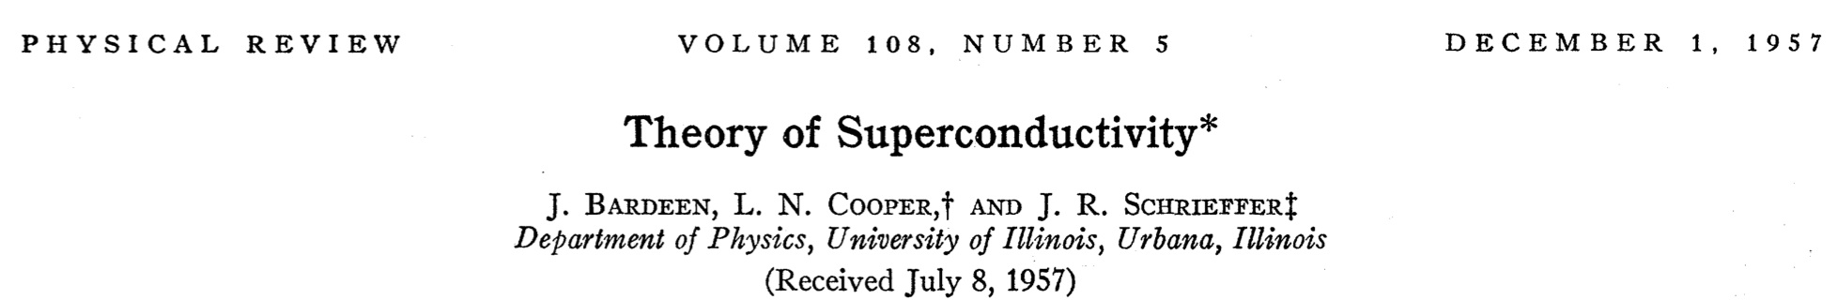
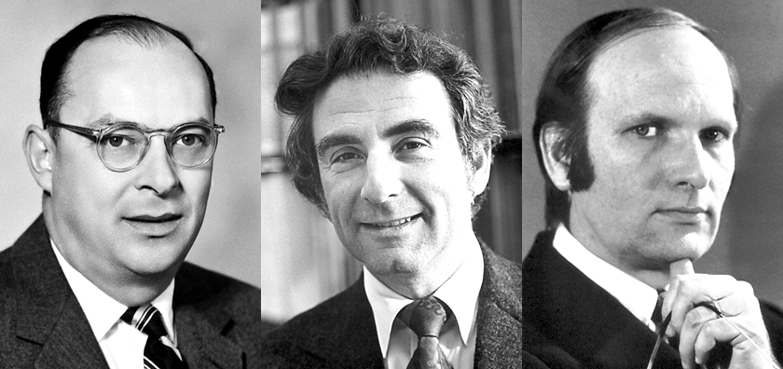
``BCS theory’’
1972 Nobel prize
e⁻
e⁻
``superconducting electrons’’ =
electron pairs

Slide 12

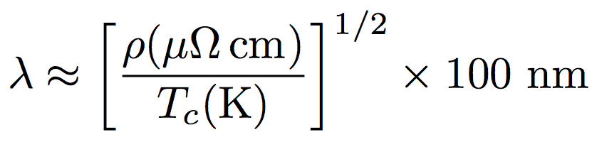
Surface impedance vs frequency
(Mattis-Bardeen calculation)
kinetic inductance
gap frequency:
onset of pair breaking
inductor
resistor
R_{s} determined by n_{qp}(T, P_{o})

Slide 13
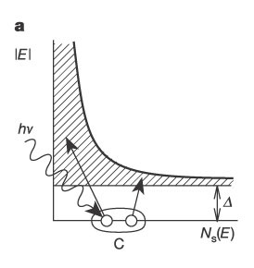
Pair breaking by photons
Pair breaking occurs when:
Pair breaking does not occur at microwave frequencies
Pair breaking does occur at infrared/visible frequencies

Slide 14
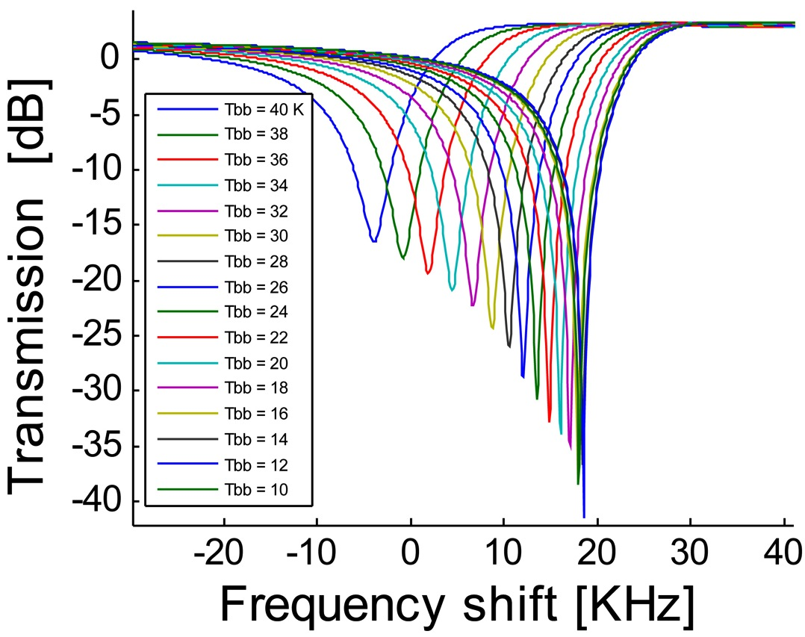
Kinetic Inductance Detectors
Cardiff ``LEKID’’ pixel
TiN film (gold) on Si substrate (green)
in
out
Variable-temperature blackbody
1 mm
Inductor (L) + capacitor (C) = RF resonator
TiN inductor is also the optical absorber
High resistivity: ρ_{TiN} ~ 500 ρ_{Al} (at 10 K)
High absorption efficiency
TiN absorber used in Herschel/PACS bolometers
Resonator frequency shifts down as submm radiation is applied
MKID = Microwave Kinetic Inductance Detector

Slide 15
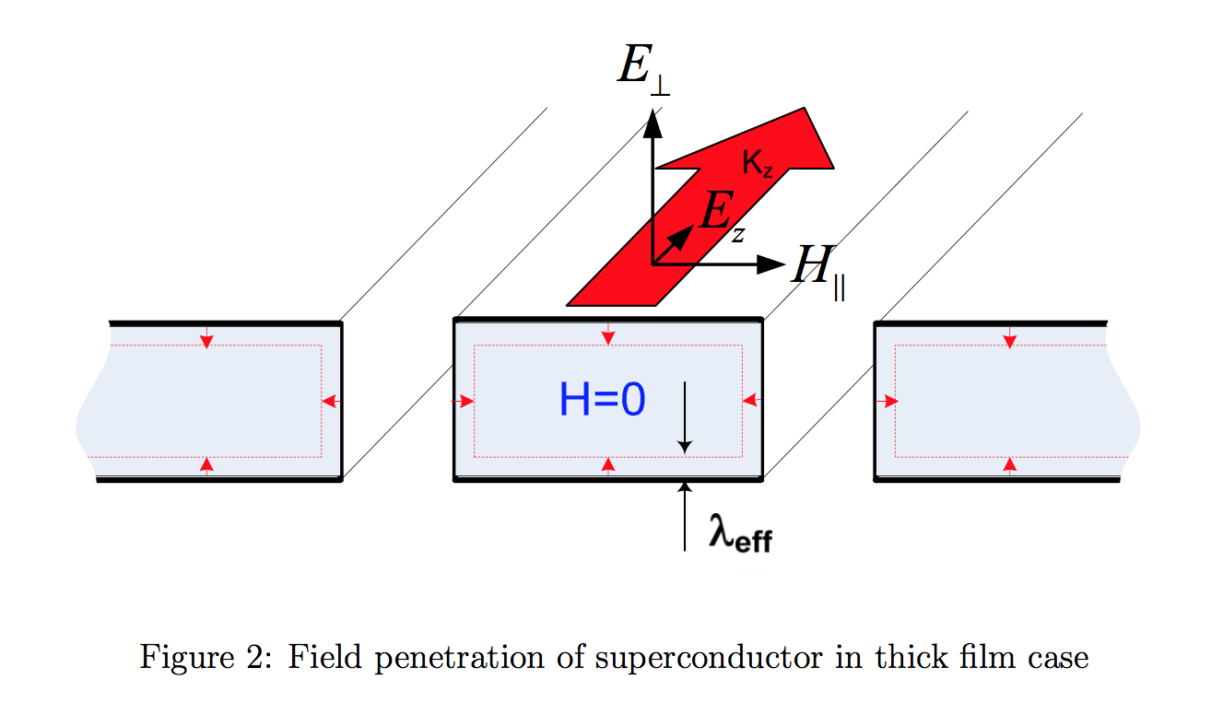
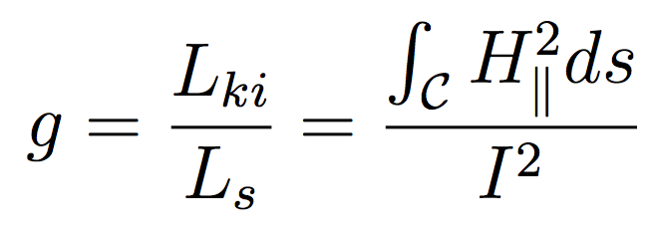

Kinetic inductance per unit length
Cases where t > λ_{eff}
Need current distribution
Use EM simulation, e.g. Sonnet
KI per unit length

Slide 16

Surface quality factor

Slide 17
CPW vs. microstrip lines
microstrip
CPW
Crystalline dielectric (e.g., silicon substrate)
or deposited amorphous dielectric (e.g., SiO2)
Kinetic inductance fraction: α ~ 2 λ / h

Slide 18
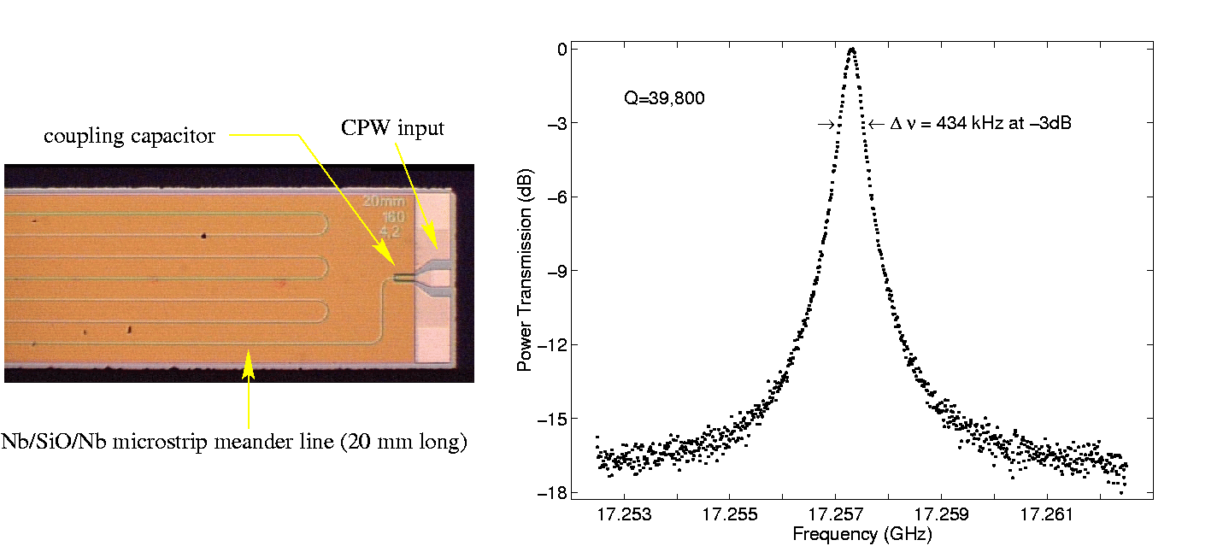
Early 2000: first resonator tests
A. Vayonakis

Slide 19
2001: CPW Microresonators
Mazin et al 2001, Proc. LTD Workshop, AIP

Slide 20
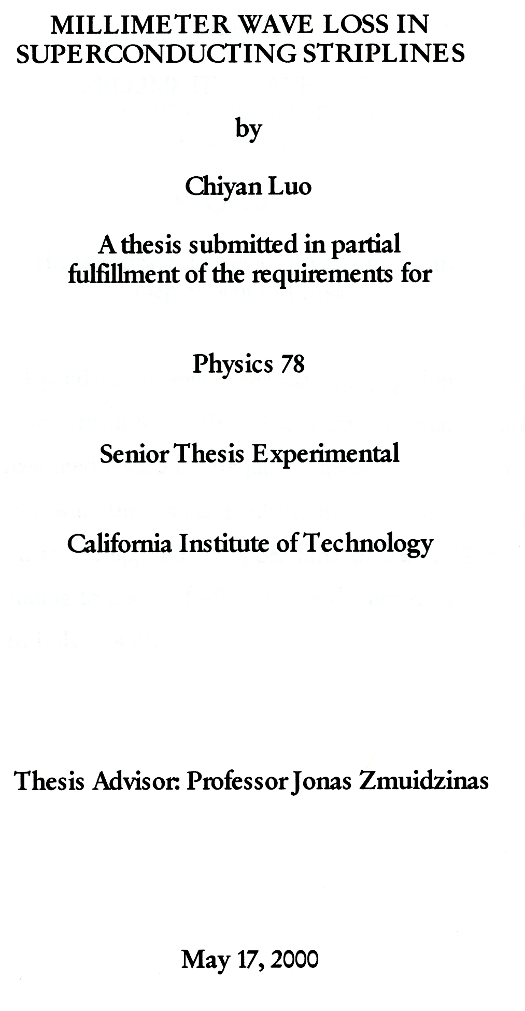
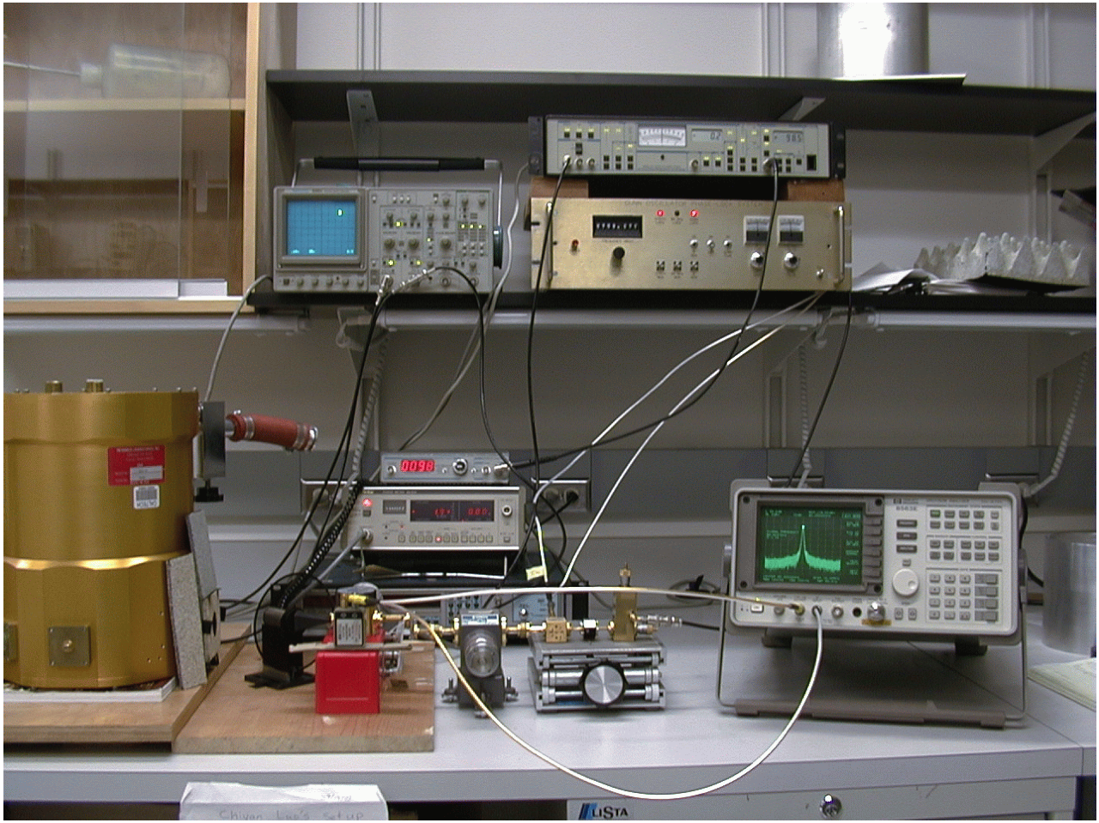
1999: mm-wave loss in superconducting microstrip
(11.4 mm long)
Credit: A. Vayonakis
Loss: 0.5% per wavelength

Slide 21
2010: BICEP2 Focal Plane
Focal plane: 2 x 2 mosaic of tiles
1 tile: 8 x 8 array of dual-polarization pixels
Each 8 x 8 mm² pixel contains :
  Dual-pol phased-array slot antenna
  Bandpass filter + TES bolometer (2 ea)

Slide 22
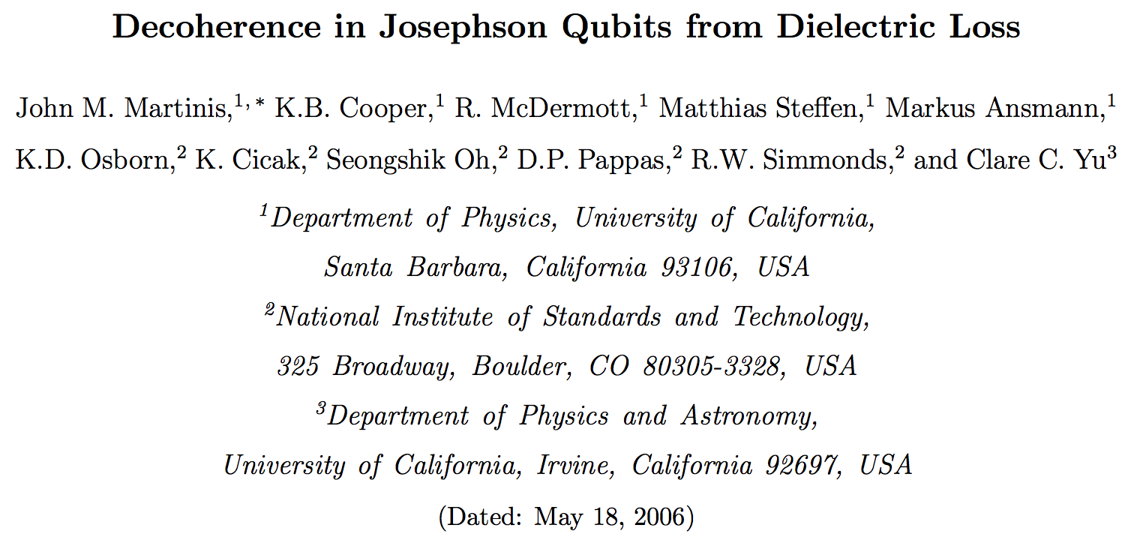
2005: Loss due to TLS in amorphous dielectrics

Slide 23
2008: TLS surface layer for CPW resonators
Gao et al. 2008

Slide 24
Resonator noise
Day et al 2003; Gao et al 2007, 2008; Zmuidzinas 2012

Slide 25
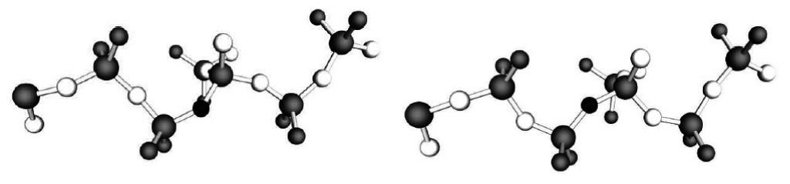
2008: Capacitor (TLS) Noise
Gao et al 2007;
Noroozian et al 2010
Gao et al 2007
Kumar et al 2008

Slide 26
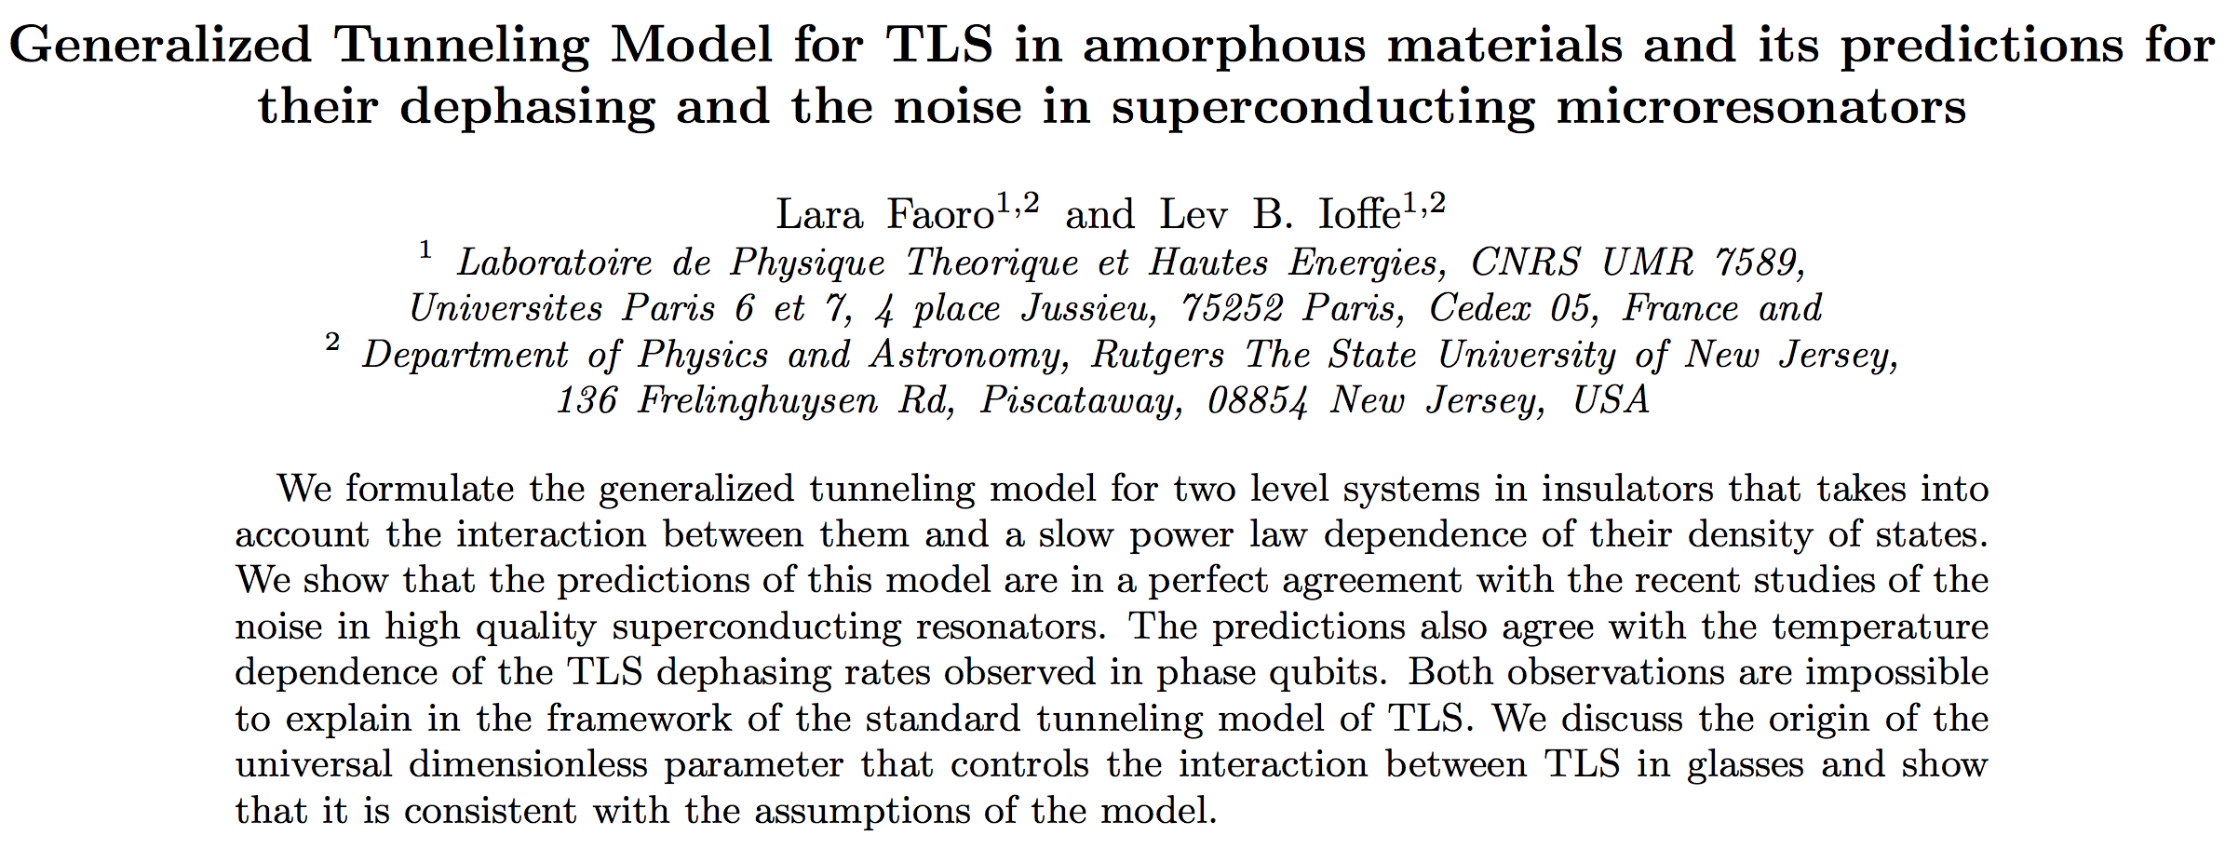
2014: Resonator noise & dephasing

Slide 27
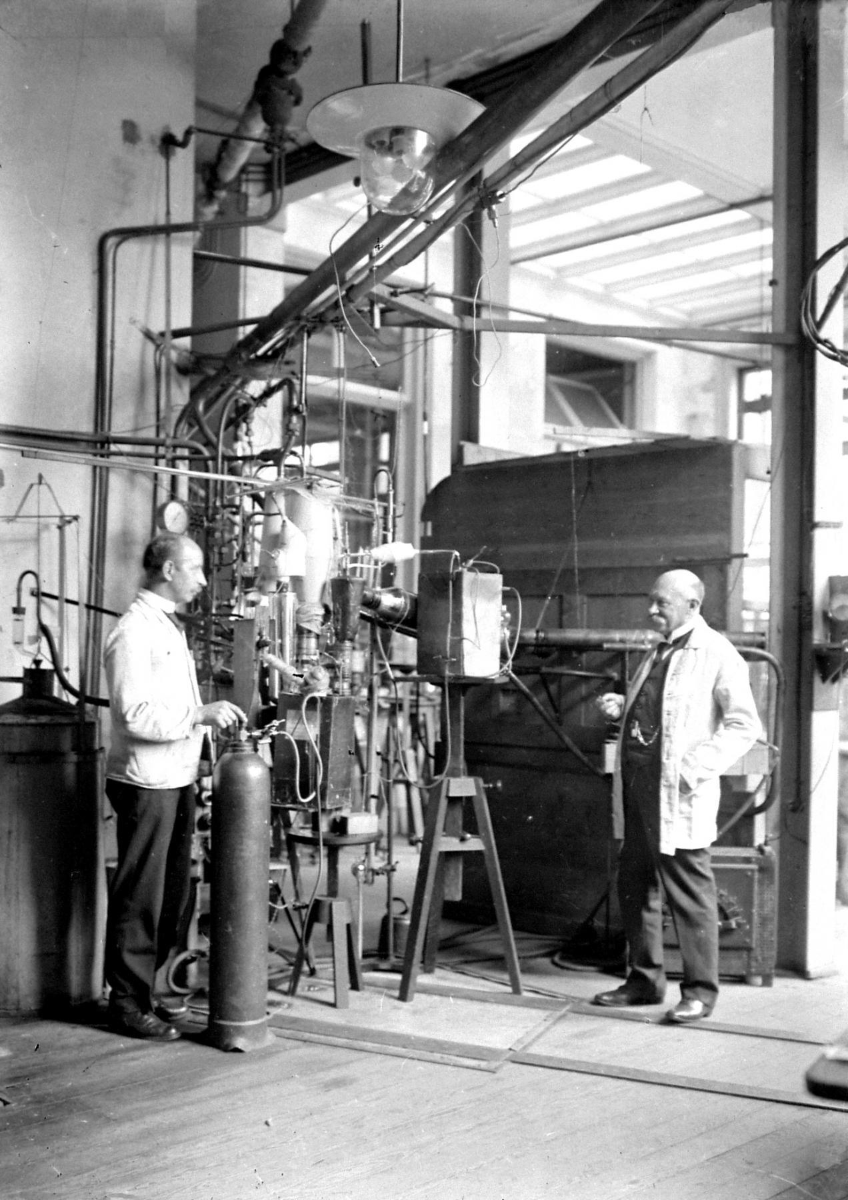
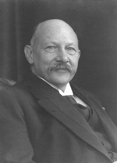
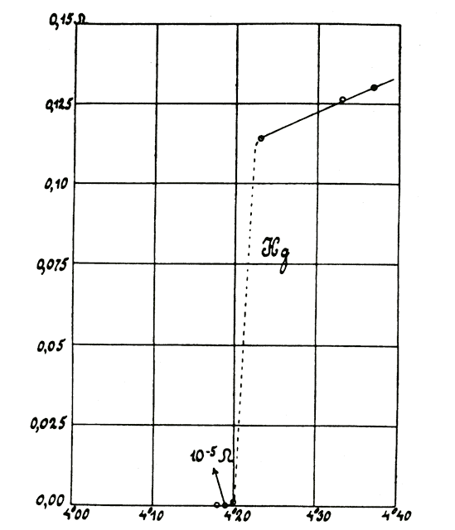
1911: Discovery of superconductivity
Heike Kamerlingh Onnes
University of Leiden
1908: liquid helium
1911: superconductivity
1913: Nobel prize
(1963)
Electrical resistance (Ω)
Temperature (K)

Slide 28
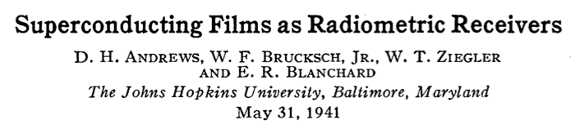
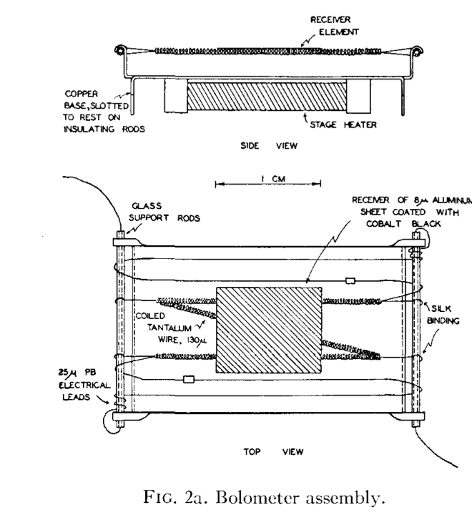
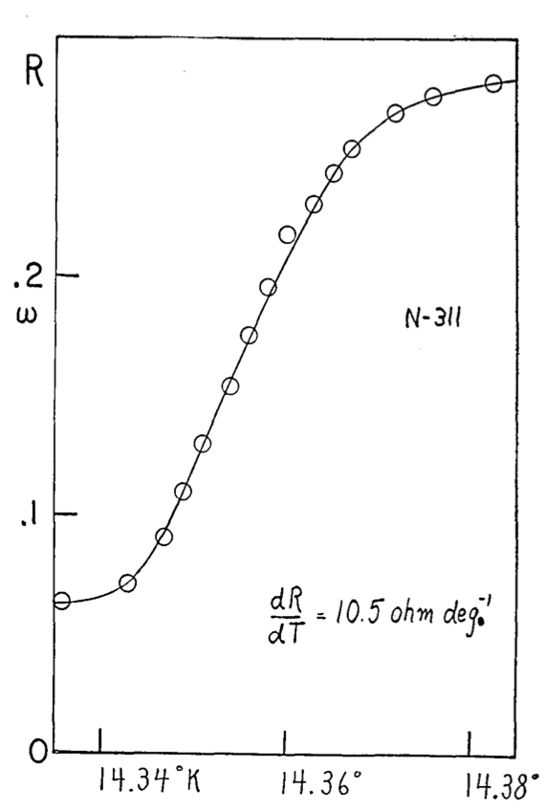
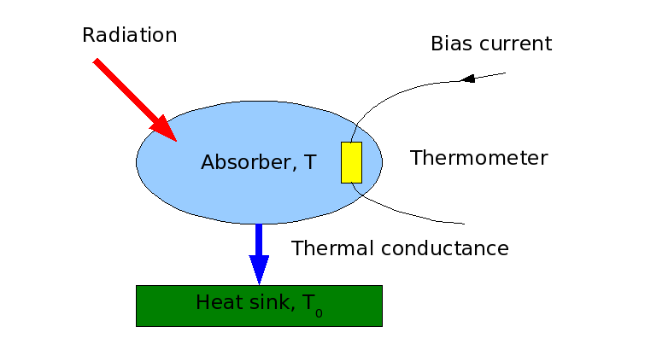
Andrews et al 1946

Slide 29
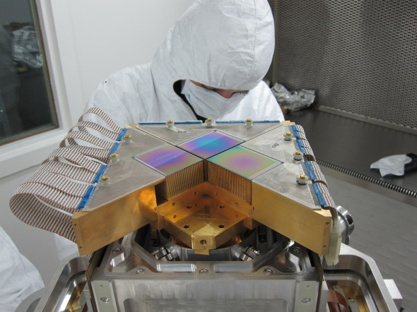
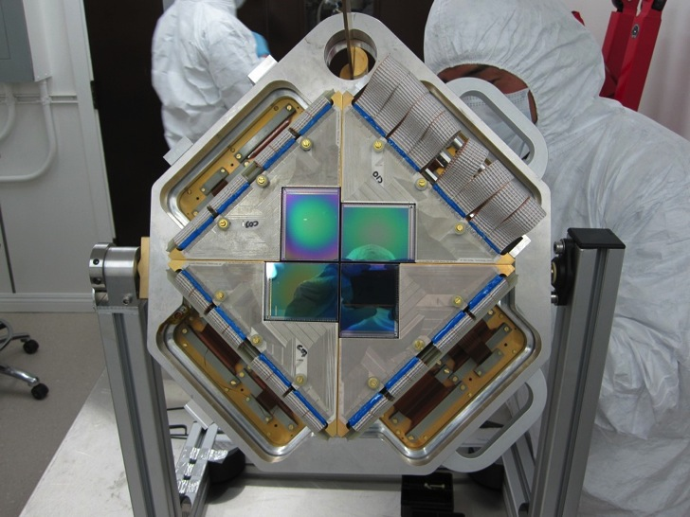
SCUBA 2 with 10,000 pixels
42x30 = 1280 pixels per tile
Voltage-biased TES: Irwin 1995
SQUID TDM mux: Chervenak et al 1999

Slide 30
1999: In search of a better detector
Individually, TES and SQUIDs are elegant, but…
TES bolometers are complex
SQUID multiplexers are very complex
  Superconducting ICs with ~12 lithography layers
TES x SQUID mux = very x (complex)²
  Expensive
TES & SQUID not integrated
  Each TES needs superconducting connection to SQUID mux
  Labor-intensive, or complex (e.g. bump bonding)
Is there an easier way ??

Slide 31
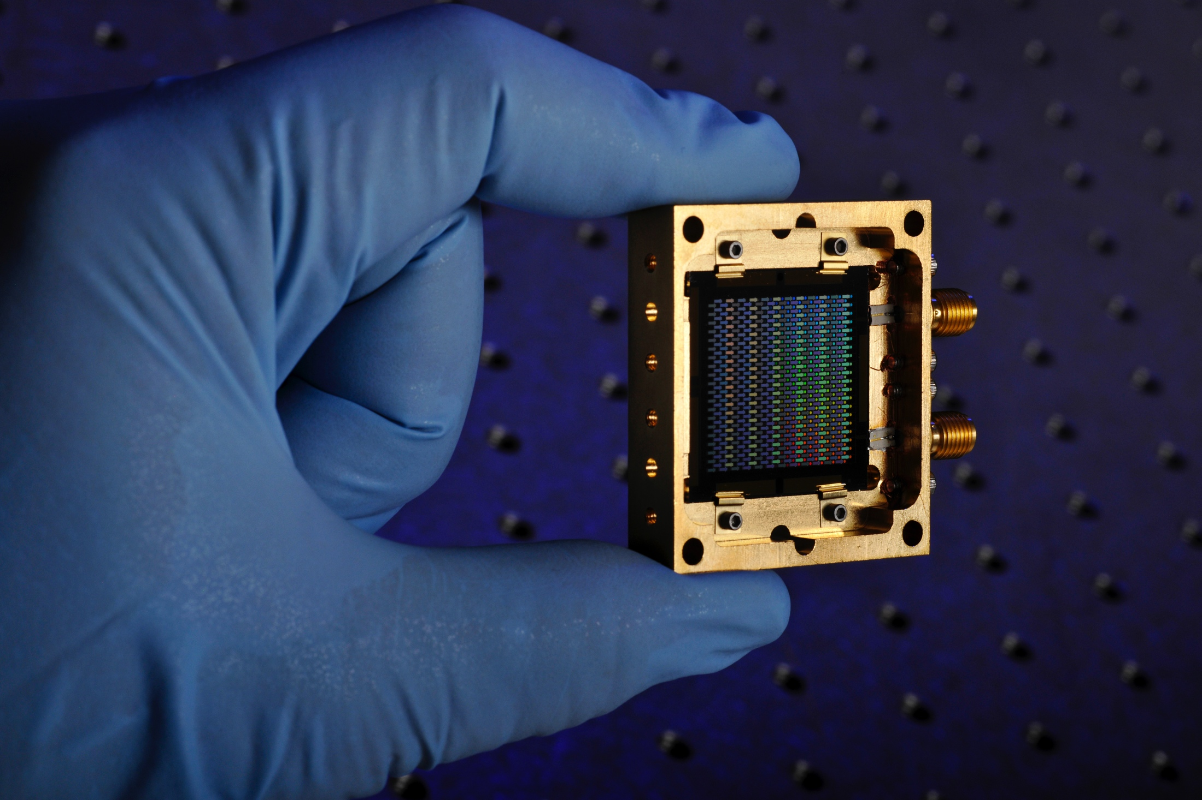
1999 – 2013: MKID
(Microwave Kinetic Inductance Detector)

Slide 32
Pair-breaking and recombination
Submm photons (hν > 2Δ) break superconducting Cooper electron pairs into individual electrons or ``quasiparticles’’
  Photon energy is not converted to heat immediately as in a bolometer
  Quasiparticles rapidly relax to gap edge via phonon emission
Quasiparticles subsequently recombine on timescale τ_{qp} ~ 10-100 μs by emitting a 2Δ phonon into the substrate
  τ_{qp} plays role of bolometer thermal time constant
Kinetic inductance depends on Cooper pair density
AC resistance depends on quasiparticle density
Barends et al 2010

Slide 33
Frequency multiplexing

Slide 34
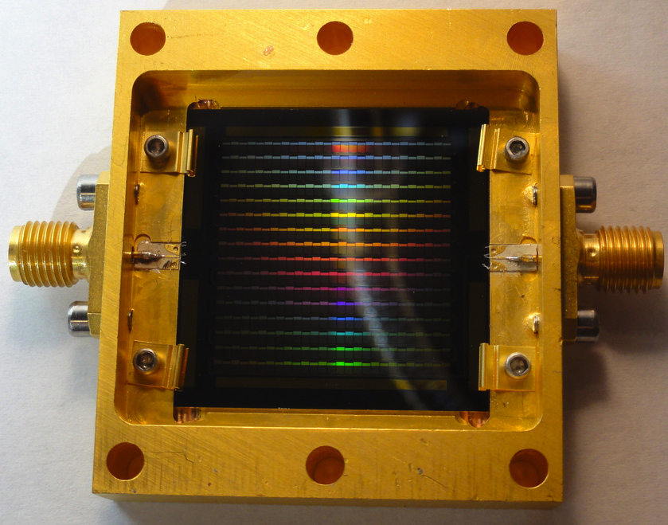
Frequency multiplexing
(18 x 24 = 432 pixels)
RF In
RF Out
(to cryo amp)
Fabrication - Rick Leduc at JPL

Slide 35
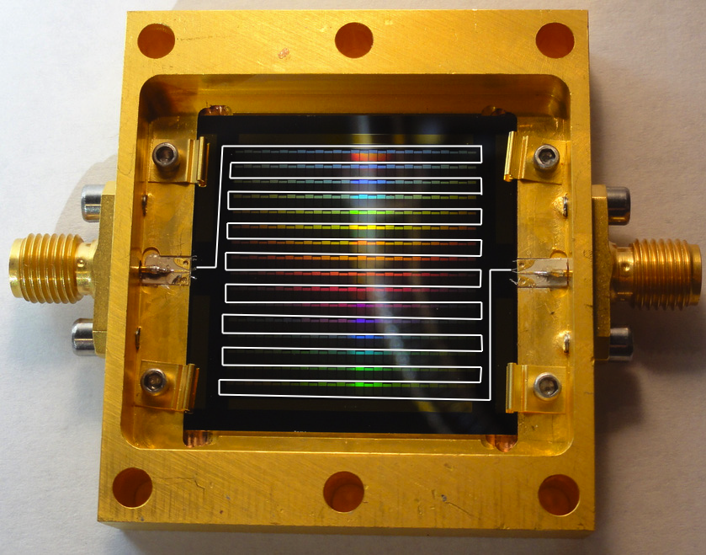
Frequency multiplexing
(18 x 24 = 432 pixels)
RF In
RF Out
(to cryo amp)
Fabrication - Rick Leduc at JPL

Slide 36
Frequency sweep
Low readout frequency (200 MHz) enabled by use of TiN (large ρ_{n} → large L_{k})
Resonator frequencies span 185-250 MHz (65 MHz bandwidth or 0.43 octaves)
415/432 resonators deeper than 6 dB (96% yield)
160 kHz average spacing

Slide 37
Resonator Q sets mux density
pixels/octave
High Q_{r} → low collision probability
  Do not rely on precise placement of resonator frequencies (σ_{f})
  Collision probability independent of σ_{f} for high mux density
Need Q_{r} ~ 10⁵ to multiplex 500-1000 pixels/octave
Previous slide: 432 pixels / 0.43 octave = 994 pixels/octave @ 96% yield

Slide 38
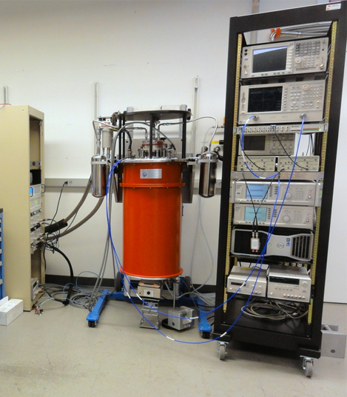
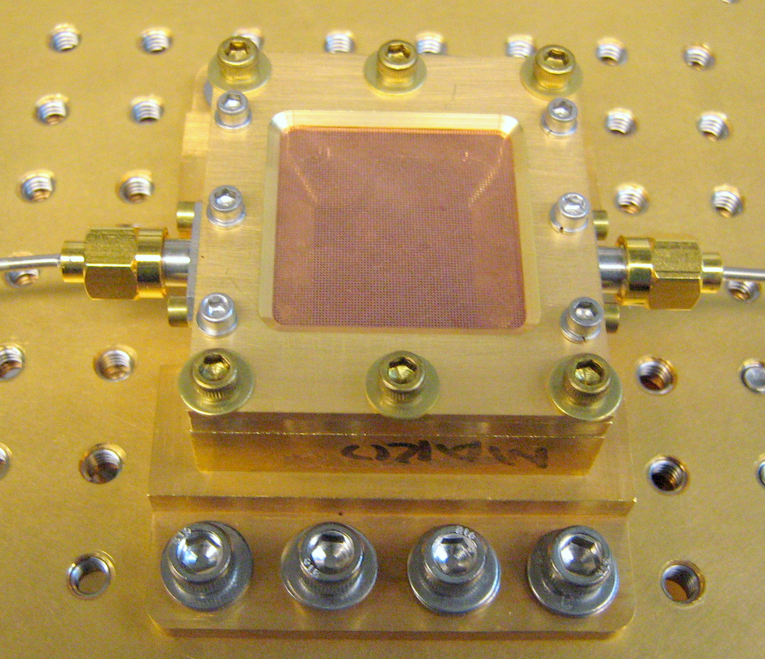
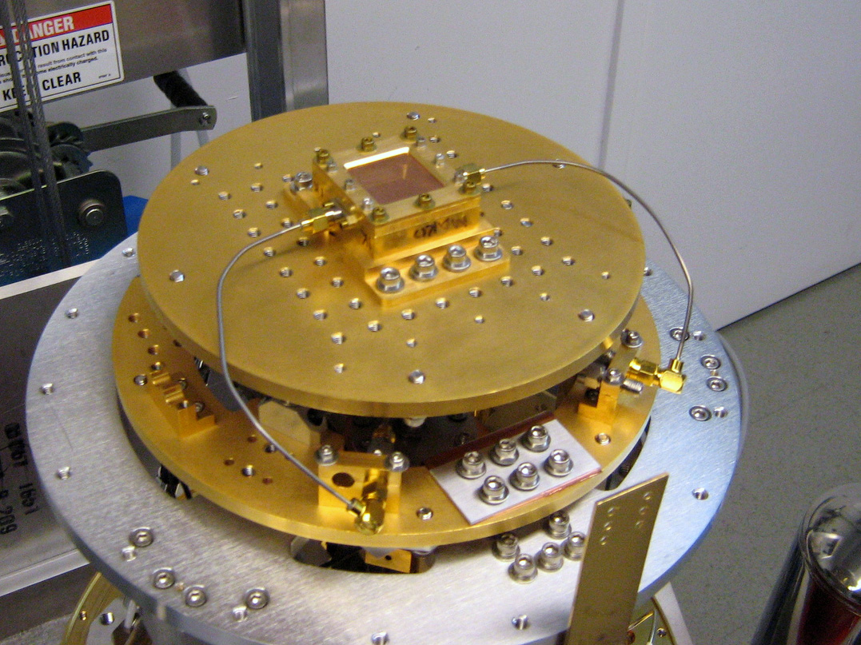
MAKO: a prototype camera
(Swenson et al, SPIE Proc., 2012)

Slide 39
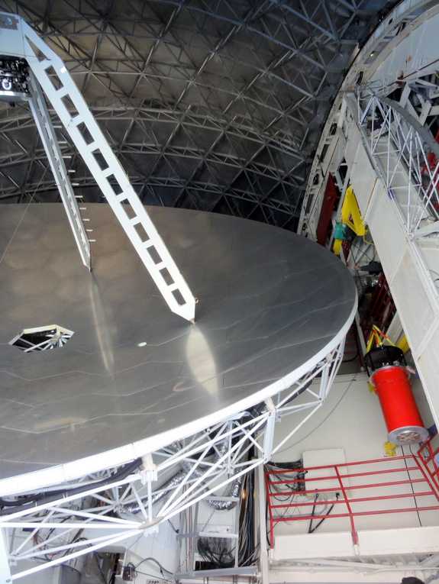
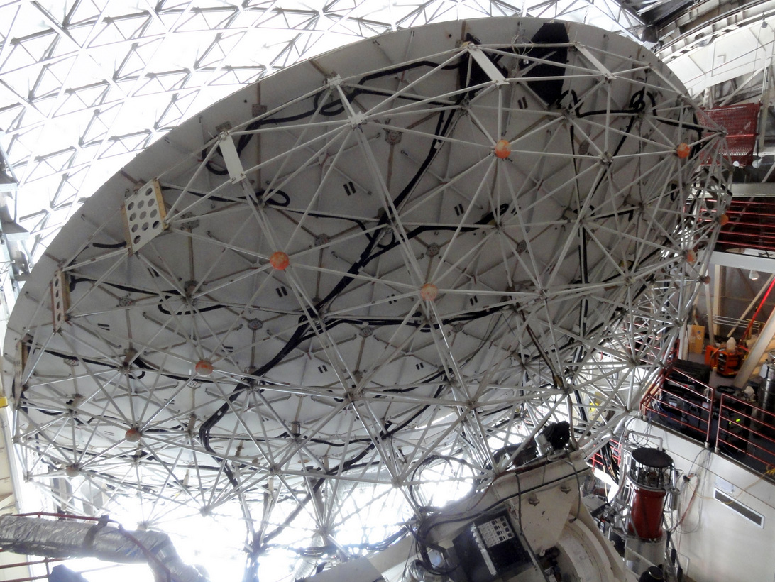
MAKO goes to the CSO
CSO: a 10.4m Leighton dish on Mauna Kea, HI

Slide 40
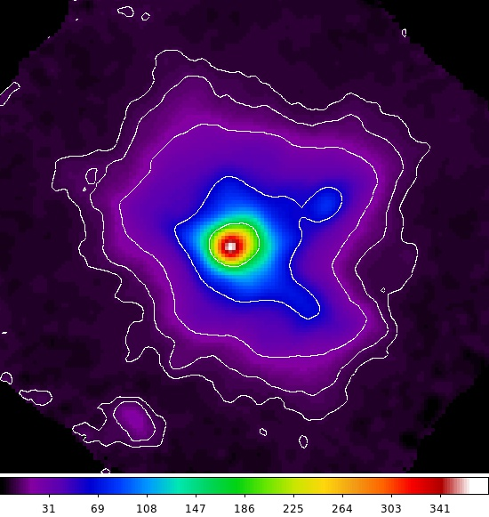
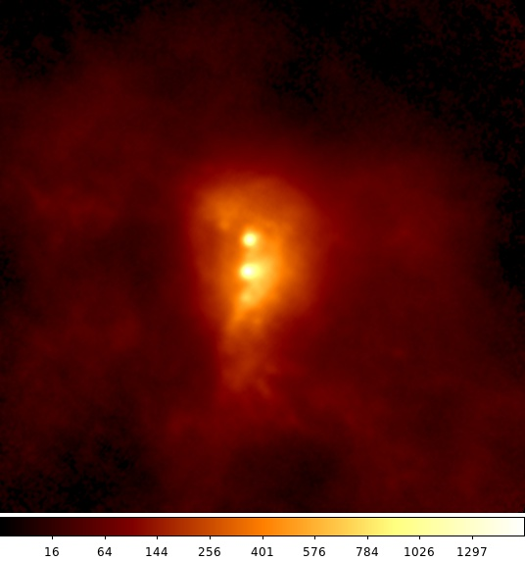
MAKO goes to the CSO
G34.3
SgB2

Slide 41
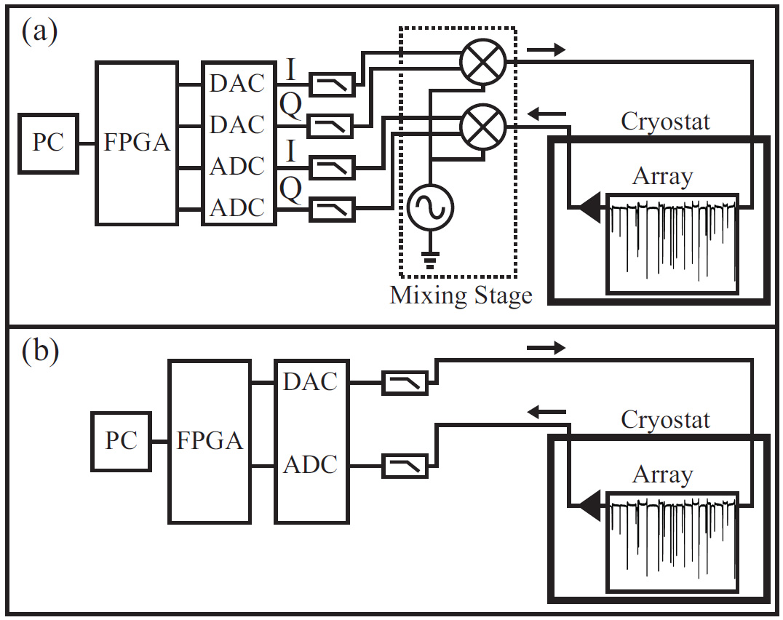
Multichannel Digital Readout
FPGA implements digital channelizer for readout tone separation
Microwave (GHz) readout requires up/down frequency conversion
RF readout (< 500 MHz) allows ``direct drive’’ with ADC/DAC
  Reduces readout bandwidth, complexity, and cost
  Converters are typically 12-bit, 500 MSPS (ADC < $200 ea)
  Use frequency readout since
Microwave readout
RF readout
L. Swenson, LTD-15 2013

Slide 42
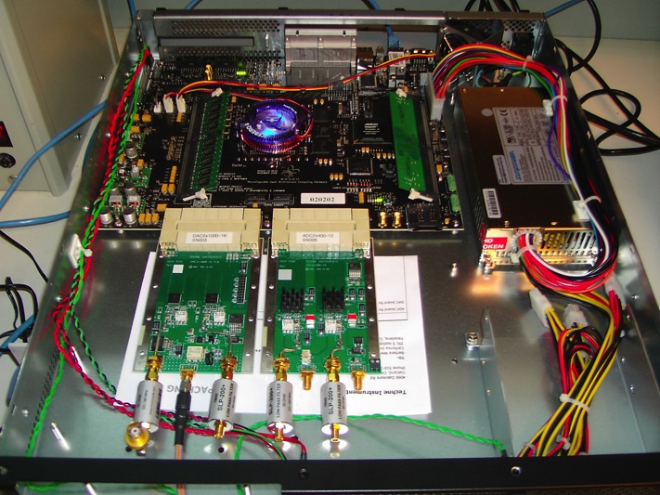
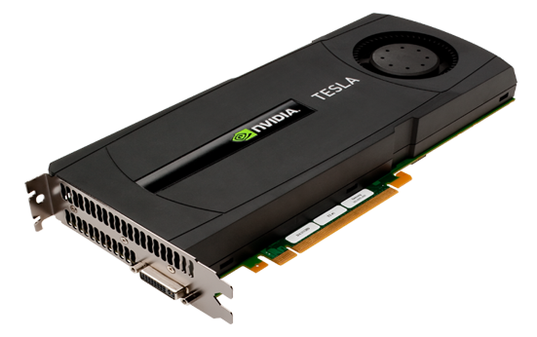
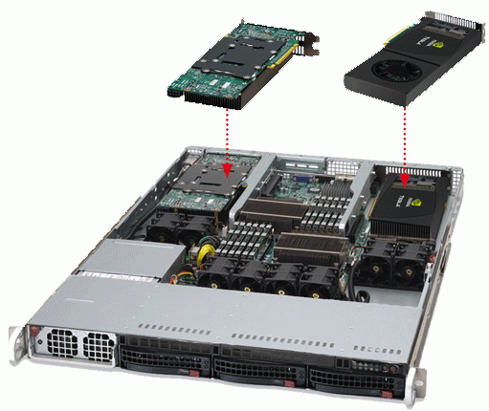
Readout Electronics
Use fast DAC to generate multifrequency readout signal, send to cryostat
Digitize returning signal (200-500 MSPS)
Perform FFT in real time (FPGA/GPU)
Select FFT channels corresponding to readout carriers
Stream to disk
1U server + GPU + PCIe ADC/DAC
ROACH 2 + custom ADC, DAC

Slide 43
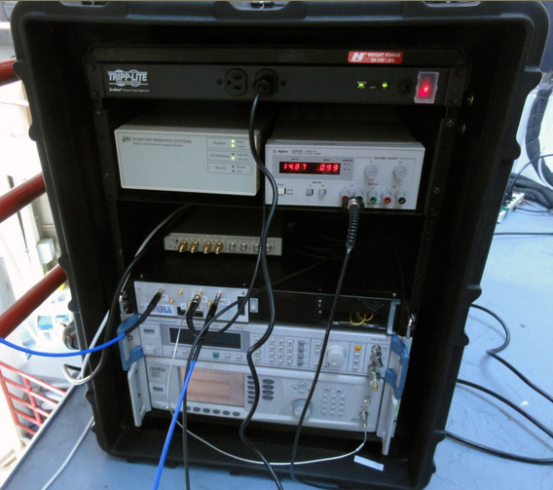
Readout Electronics
10 MHz rubidium standard & 1 PPS Signal (from GPS antenna)
Amp Bias
ROACH
Roach Clock (500 MSPS)
10 MHz standard, Clock, and Amp bias can be shared by multiple ROACH readouts
1 ROACH can handle 2 readout lines, up to 4000 detectors
MAKO/ROACH firmware developed by Ryan Monroe, CIT/JPL

Slide 44
KID/MKID projects
INSTITUTIONS | PROJECT | DESCRIPTION
MPIfR Bonn, SRON, TU Delft | A-MKID | 20 kpixel submm camera for APEX (R. Gusten)
IRAM, Neel Institute, Cardiff | NIKA2 | 5 kpixel mm camera for IRAM 30m (A. Monfardini)
UCSB, JPL | ARCONS | 2 kpixel optical camera for Palomar (B. Mazin)
Penn, NIST | BLAST upgrade | 1000 pixel, dual-pol focal plane for balloon-borne far-IR polarimetry. PI: M. Devlin
Cardiff, SRON, TU Delft, Neel Institute Grenoble, Centro de Astrobiologia (Spain), AimValley, QMC Instruments | spaceKIDS http://www.spacekids.eu/ | EU FP7 project. Development of MKID arrays for space applications. PI: Matt Griffin
Argonne National Lab | http://www.aps.anl.gov | Detectors for use with ALS synchrotron
Fermilab | http://www.fnal.gov | 100 kpixel optical MKID camera for Dark Energy
NAOJ, U. Tokyo, U. Tsukuba, U. Saitama | http://atc.mtk.nao.ac.jp | CMB polarimetry: GroundBIRD, LITEBIRD
Columbia U. | SKIP http://arxiv.org/abs/1308.0235 | Balloon-borne CMB polarimetry. PI: A. Miller
Penn, JPL | ICarIS | Balloon-borne far-IR spectroscopy. PI: J. Aguirre

Slide 45
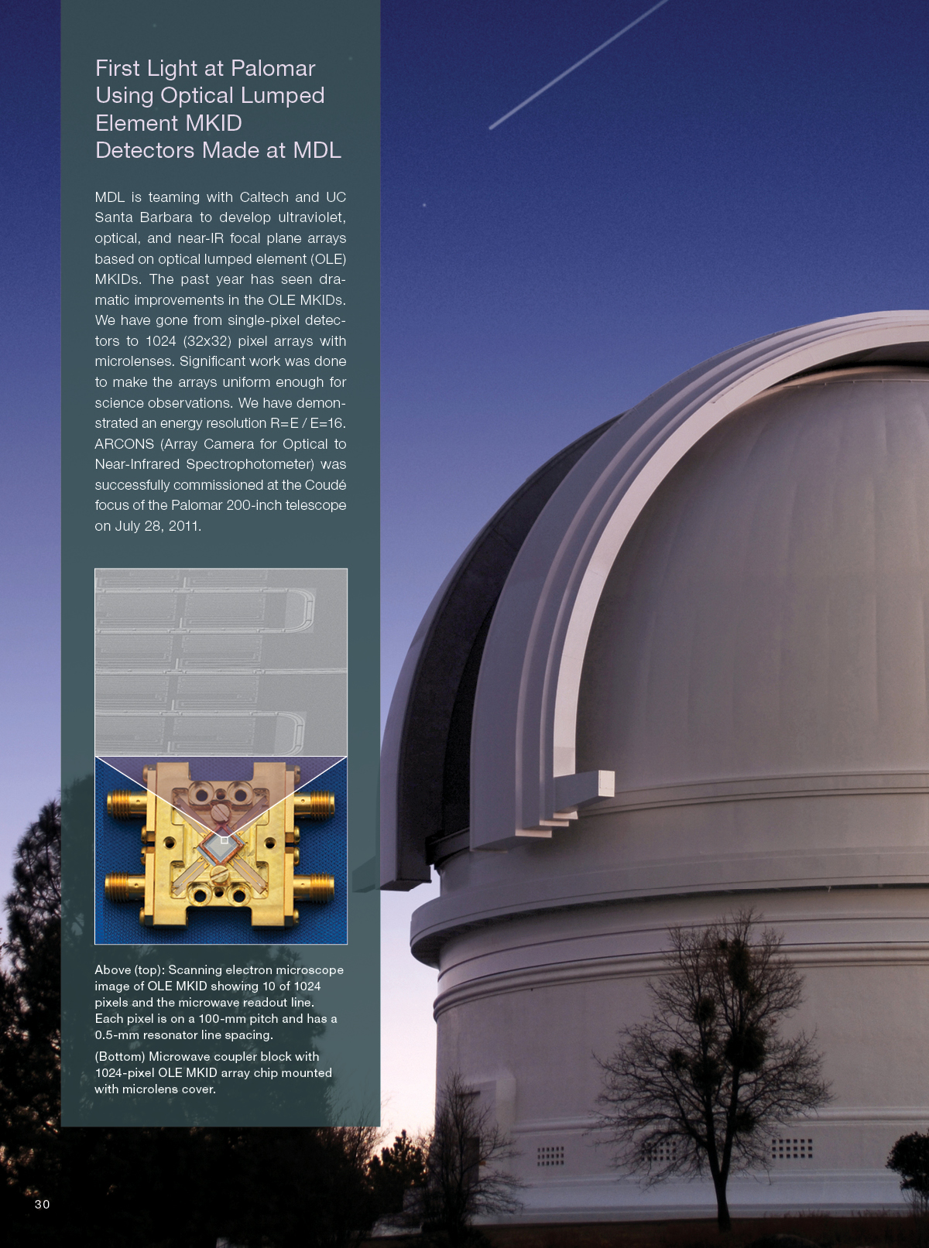
TiN MKIDs for energy-resolved single photon imaging
B. Mazin
UCSB

Slide 46

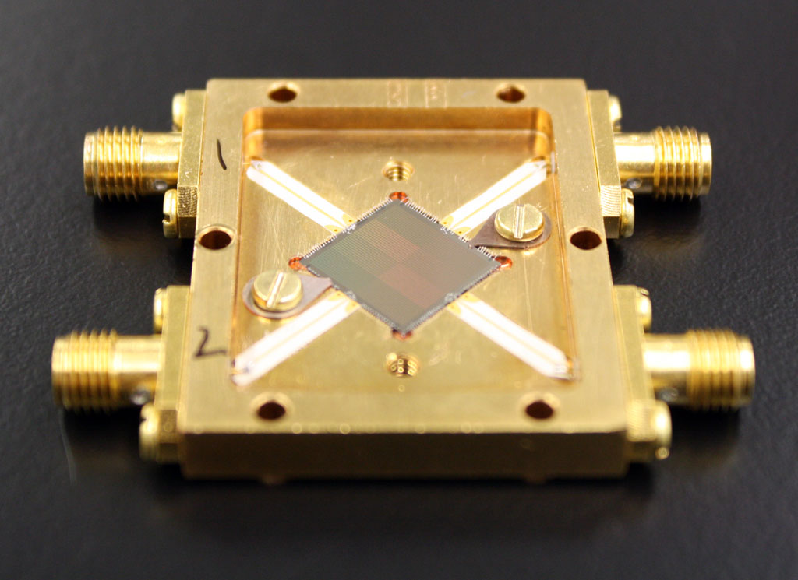
ARCONS MKIDs
2024 (44x46) pixel array
222 micron pixel pitch
2 feedlines
2 MHz resonator spacing
~92% resonator yield
~70% “good” pixel yield
  Frequency collisions dominate yield!
  More uniform TiN (multilayer, ALD, new materials) should significantly improve yield
110 mK operating temp.
Mazin et al. 2012, Optics Express, 20, 2

Slide 47

10 kpix DARKNESS Array
This is the highest pixel count LTD array ever made.
Funded to build 3 10-20 kpix instruments
DARKNESS for Palomar (NSF): 2016A
MEC for Subaru (Japan): 2016B
PICTURE-C Balloon (NASA): 2019

Slide 48

Flex cables
NbTi flex cables using G3PO connectors for high density, low head load cables. Blind-mate with LNF 4-8 GHz HEMTs.
Copper G3PO flex cables for 300 K to 4K

Slide 49


Resonator Design
We use a square microlens array to improve effective fill factor to ~92%

Slide 50

Layout Details
Multiple feedlines require good ground planes
  Don’t use high KI materials for ground planes or feedlines!
  You must have crossovers!
Getting heat of the chip is a big concern
  Use gold bond pads and gold wire bonds
Long, narrow feedlines are a yield problem
  Carefully design and debug the fab process
Notes:
Note: Present a non-proprietary technical presentation on the technology selected to be of interest by the audience (Heliophysics and Astrophysics). Keep in mind your total presentation should be no more than 20 minutes allowing an additional 10 minutes for Q&A.
Suggested talking points:
Understanding of alignment with NASA mission(s)
Commercialization or government infusion plans/goals
Compare your technology to others in the marketplace or currently under development
Business alliances/partnerships and/or synergy with NASA, Industry, academia, and other government agencies.

Slide 51




THz Superconducting Imaging Array (TeSIA) Developed for DATE5 Telescope
TeSIA:
wavelength: 350um
detector: 32x32 MKIDs/TES
NEP: 1e-16W/Hz^{0.5}
DATE5: 5m THz telescope
wavelength: 350/200um
instruments:
SIS/HEB receivers & TeSIA

Slide 52





Bi-layer LEKIDs for < 100 GHz
NIKA2 is ready for installation
NEP ≈ 10⁻¹⁷ W/Hz^{0.5}
Arrays and
beams-map
A. Catalano et al., arXiv:1504.00281, A&A, in press
NIKA selected science result: first polarised light
I, Q, U maps of the Crab Nebula at 150 GHz

Slide 53
Credit: J. Baselmans, SRON

Slide 54
4 x 880 = 3520 pixels @ 350 GHz
4 x 5400 = 21600 pixels @ 850 GHz
Total = 25120 pixels
Credit: J. Baselmans, SRON

Slide 55
Credit: J. Baselmans, SRON

Slide 56
Hubmayr et al. 2014

Slide 57



Horn-coupled KIDs for CMB polarization
McKarrick et al., Rev. Sci. Instrum. 2014, submitted
seven modules = 2317 single-polarization detectors
Prototype 150 GHz Module
Credit: B. Johnson, Columbia U.

Slide 58



LITEBIRD: a Proposed CMB Satellite
2780 MKIDs
55 – 330 GHz

Slide 59
Credit: J. Baselmans, SRON

Slide 60


Photon Noise
NIST detectors
Hubmayr, et al.
SRON
A-MKID detectors

Slide 61


Photon bunching
Superspec, Hailey-Dunsheath, et al.
150 GHz, Columbia, Flanigan, et al.

Slide 62

Quasiparticle Production Efficiency
Absorption efficiency vs frequency
Conversion efficiency of photon energy to quasiparticles
SRON/Cambridge
SRON/Cambridge, deVisser, et al.

Slide 63

Microwave generation of quasiparticles
P. De Visser
PhD thesis
TU Delft
2014

Slide 64


Nonequilibrium superconductivity:
Calculations:
S. Withington & D. Goldie
U. Cambridge

Slide 65


Nonlinear Kinetic Inductance of TiN and NbTiN
P. K. Day et al 2011

Slide 66

TiN/NbTiN “fiber” paramp
(Eom et al., Nature Physics, 2012)

Slide 67






Credits
Pete Barry
Matt Bradford
Goutam Chattopadhyay
Saptarshi Chaudhuri
Peter Day
Ran Duan
Darren Dowell
Byeong Ho Eom
Jiansong Gao
Sunil Golwala
Matt Hollister
Warren Holmes
Attila Kovacs
Rick Leduc
James Lamb
Nuria Llombart
Phil Mausokopf
Ben Mazin
Chris McKenney
David Moore
Ryan Monroe
Tony Mroczkowski
Omid Noroozian
Hien Nguyen
Steve Padin
Keith Schwab
Erik Shirokoff
Loren Swenson
Rebecca Wernis
Emma Wollman
David Woody

Slide 68
Bibliography
Zmuidzinas J. “Superconducting Microresonators: Physics and Applications”, Annu. Rev. Condensed Matter Phys. 2012 3:169-214 (2012)
Barends R., et al. “Quasiparticle Relaxation in Optically Excited High-Q Superconducting Resonators”, Phys. Rev. Lett. 100:257002 (2008)
Doyle S, et al. “Lumped element Kinetic Inductance Detectors”, J. Low Temp. Phys. 151 530-36 (2008)
Noroozian O, et al., “Crosstalk Reduction for Superconducting Microwave Resonator Arrays”, IEEE Trans. Microwave Theory Tech. 60 1235-1243 (2012)
Swenson L., et al. “Operation of a titanium nitride superconducting microresonator detector in the nonlinear regime”, J. Appl Phys. 113 104501 (2013)
McKenney C, et al. “Design considerations for a background limited 350 micron pixel array using lumped element superconducting microresonators”, Proc. SPIE 8452 84520S (2012)
Swenson L, et al. “MAKO: A pathfinder instrument for on-sky demonstration of low cost 350 micron imaging arrays”, Proc. SPIE 8452 (2012)
Swenson L, et al. “The Status of MAKO”, Proceedings of LTD-15 (2013)
McKenney C, et al. “Lumped element kinetic inductance detectors: Pixel design for large scale far infrared arrays”, Proceedings of LTD-15 (2013)

Slide 69


More details…

