Slide 1
D.B. Tanner

Slide 2
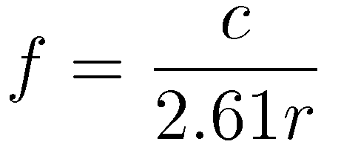
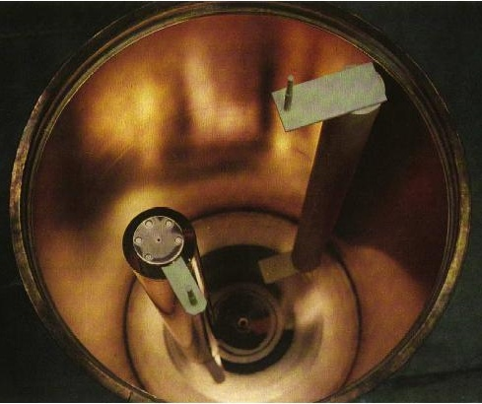
Basic cavity is a right circular cylinder
Or:
For ADMX,
r = 21 cm
f = 550 MHz
L = 100 cm

Slide 3
“Sweet spot” is ~ 4-5 GHz
f (GHz)
0.5
1
2
5
10
20
10⁻¹²
10⁻¹³
g_{aγγ} [GeV⁻¹]
KVSZ
10⁻¹⁴
ADMX
(Higher TM)
DFSZ
ADMX
(complete)
10⁻¹⁵
ADMX
(Phase II)
Ω_{a} ~ 0.23
10⁻¹⁶
1
10
100
m_{a} (μeV)

Slide 4
Signal strength
Power from the cavity is
Where C is form factor, ρ_{a} is the halo density, m_{a} the axion mass, and
Q_{L} ~ 70000(GHz/f )^{2/3} (ASE); Q_{a} ~10⁶ are quality factors
g_{γ} ~ 0.97 (KSVZ); g_{γ} ~ 0.36 (DFSZ) are coupling strengths
We use DFSZ; look for ~10⁻²² Watts power

Slide 5
Baseline is a right circular cylinder
Or:
For Sweet Spot,
r = 2.6 cm
f = 4.5 GHz
L = 5.6 cm

Slide 6
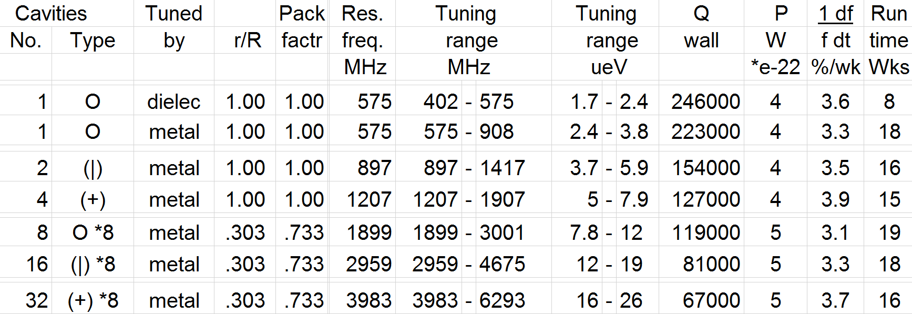
In ADMX magnet, need up to 32 cavities
Cover about 1 decade in axion mass

Slide 7
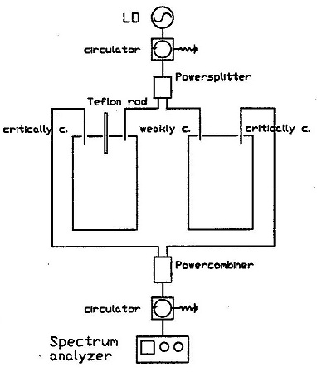
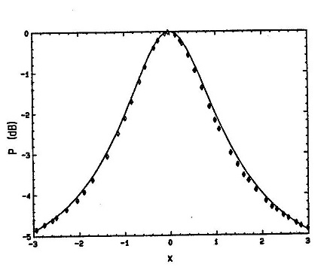
Cavities must be added in phase

Slide 8
Requires them to have identical resonances
Tune (dead reckoning), measure, adjust…
Use a servomechanism

Slide 9
Requires them to have identical resonances
Tune (dead reckoning), measure, adjust…
Use a servomechanism
Need a method to bring all resonances to a common frequency
Method: Pound, Drever, Hall (PDH) reflection locking
Used by LIGO, VIRGO and other gravity experiments

Slide 10
PDH references
Electronic Frequency Stabilization of Microwave Oscillators
R.V. Pound, Rev. Sci. Instrum. 17, 490 (1946).
Laser phase and frequency stabilization using an optical resonator
R.W.P. Drever, J.L. Hall, F.V. Kowalski, J. Hough, G.M. Ford, A.J. Munley, and H. Ward, Appl. Phys. B31, 97-105 (1983).
An introduction to Pound–Drever–Hall laser frequency stabilization
Eric D. Black, Am. J. Phys. 69, 79 (2001).
Understanding Pound-Drever-Hall locking using voltage controlled radio-frequency oscillators: An undergraduate experiment
C.E. Liekhus-Schmaltz and J.D.D. Martin, Am. J. Phys. 80, 232 (2012).

Slide 11
Pound Drever-Hall (PDH) reflection locking
Cavity reflects (promptly) waves that are not on resonance
Reflection dip at resonance, along with phase change

Slide 12
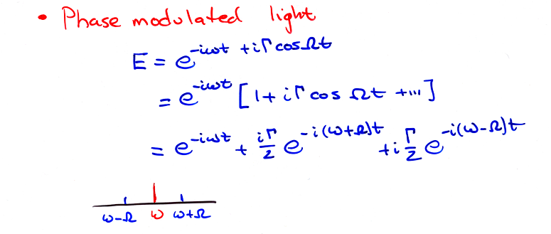
Phase-modulated light

Slide 13
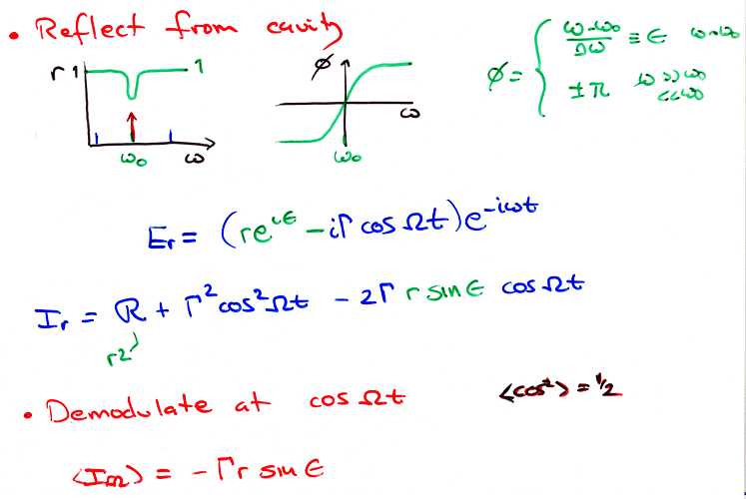
As cavity tunes, phase of reflected carrier shifts

Slide 14
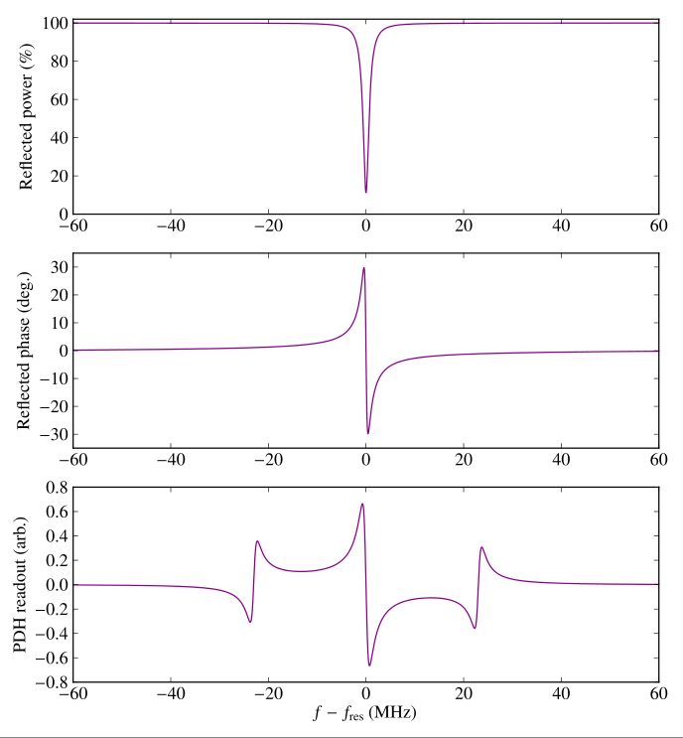
Simulated PDH signal

Slide 15
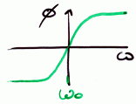
Each cavity can be driven to resonance at the carrier
5 GHz oscillator
φ
N-way splitter
20 MHz
oscillator
Amplifiers
Directional couplers
Mixer
Cavities
Tuning rod actuators

Slide 16
THE END

