Slide 1
Technical Design of the Resonant Extraction for the Mu2e experiment
Vladimir Nagaslaev
Technical Design Peer Review
August 25-27, 2015

Slide 2
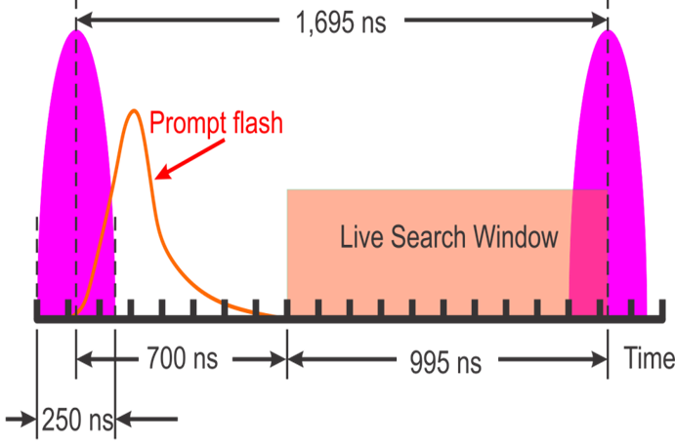
Introduction: Motivation
Mu2e Experiment:
  Pulsed beam
  Detector dead time - 700ns
  Detector Live time - 995ns
Slow extraction is important to deliver this time structure

Slide 3
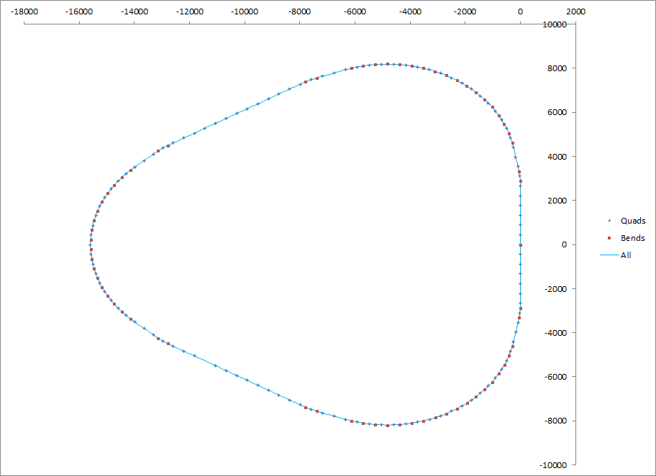
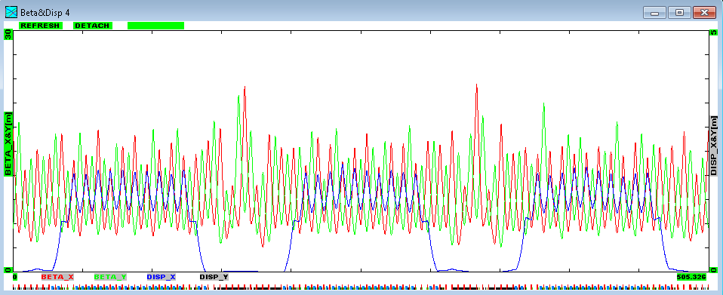
Introduction: Debuncher Ring
Circumference | 505m
#FODO cells | 57
Max Beta | 15m
Operating point | 9.763 / 9.769
Max Intensity | 3e8 p
Acceptance (unnorm.) | 36 πμ
Injection
Extraction to Accumulator
Regular FODO, 60°per cell
Zero Dispersion in SS
Betas optimized for aperture
Rapid 6D stochastic cooling
RF bunch rotation/debunching
Transfer to Accumulator
Debuncher lattice functions

Slide 4
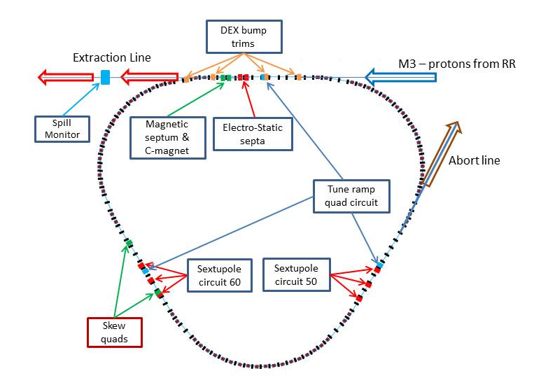
Implementation of RE in the DR
3rd Integer resonance
Qx/Qy=9.650/9.735
New injection point
Extraction in SS30
ESS
2 families of Sext.
A family of tune Quads
Magnetic septa
Dynamic orbit control
Abort line
RFKO system
Spill monitoring
Spill regulation
SS20-30
RFKO kicker
SS10-60
SS40-50

Slide 5
Requirements
Mu2e Proton Beam Requirements (doc-1105)
Parameter | Design | Limit
Length of slow spill period | 54 ms | >20 ms
Average intensity per pulse on target | 31 Mp | <50 Mp
Maximum variation of pulse intensity on target | ±50% | ±50%
Additional Requirements
Extraction efficiency | 98%
Unextracted left over | <5%

Slide 6
Beam scenario in the Delivery Ring (DR)
Parameter | Value | Units
MI Cycle time | 1.333 | sec
Number of spills per MI cycle | 8
Number of protons per micro-pulse | 3.1×10⁷ | protons
Maximum DR Beam Intensity | 1.0×10¹² | protons
Instantaneous spill rate | 18.5×10¹² | protons/sec
Average spill rate | 6.0×10¹² | protons/sec
Duty Factor (Total Spill Time ÷ MI Cycle Length) | 32 | %
Duration of each spill | 54 | msec
Spill On Time per MI cycle | 497 | msec
Spill Off Time per MI cycle | 836 | msec
Time Gap between spills | 5 | msec

Slide 7
Technical and operational risks
Technical Risks (extraction specific)
  High losses
    Large effective thickness of ESS planes
    Insufficient kick in the ESS
    Inadequate ESS alignment
    Inadequate orbit control
  High spill variations
    Regulation is not fast enough
    Regulation is not deep enough
    Insufficient RFKO power
  Insufficient aperture
  Magnet strengths are not sufficient
  Magnet ramping capabilities are insufficient
  Insufficient machine diagnostics
  Substantial fraction of the beam not extracted
  Beam instabilities
Operational risks
  Radiation and machine protection

Slide 8
Path to satisfy the requirements and address risks
Develop the model/design
  Determine the optimal parameter space
  Determine necessary hardware and specifications
  Identify key elements of the design that are necessary to satisfy requirements
  Satisfy machine stability conditions
Verify design: simulations/prototyping/beam-tests
Prepare the Ring (aperture, diagnostics, lattice)
Ensure fabrication/installation satisfy the specs
Address risks:
  Evaluate and reserve back up options when appropriate
  Include in the design or pre-mitigate when necessary

Slide 9
Physics model of the Resonant Extraction
Physics model of the Resonant Extraction
Theoretical model
Simplified parametric model
Tracking simulations
  Orbit
  Synergia
  MARS
Beam studies
Machine operation issues
  Stability
  Optics design

Slide 10
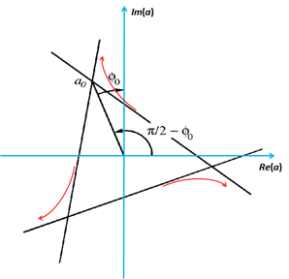
Theoretical model of Resonant Extraction
L.Michelotti: “Preliminaries toward studying resonant extraction from the Debuncher”, 2010
Hamiltonian:
with:
and
Separatix conditions:
For optimal orientation φ₀=-π/6:

Slide 11
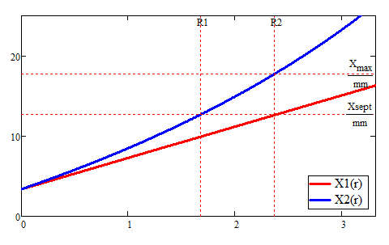
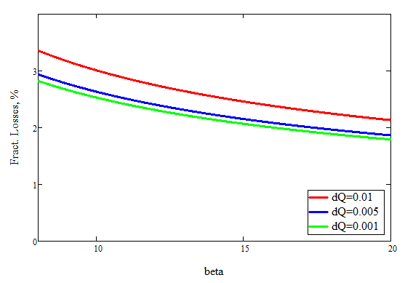
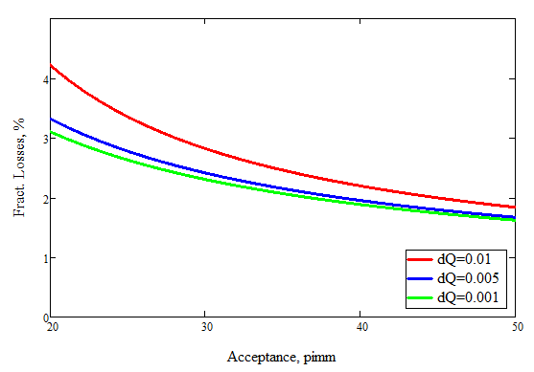
Parametric model of the RE, application
Semi-analytical extension of the model:
V.Nagaslaev, L.Michelotti: “Parameter Space Optimization For The Third Integer Resonant Extraction.”, 2012
Current x-position X₁ and x-position after 3 turns, X₂ as functions of parameter r.
Geometrical losses vs beta-function at ESS
Geometrical losses vs machine acceptance

Slide 12
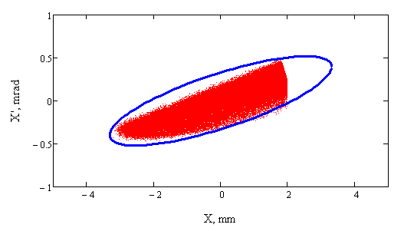
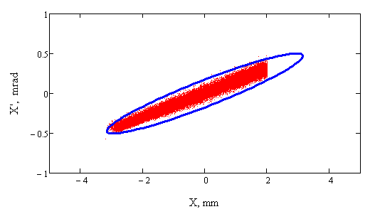
Synergia tracking simulations
We adopted Synergia package for the tracking simulations:
  RF fields; RFKO fields
  DEX bump with ramping
  Tune ramping; full spill tracking
  Aperture definition
  Substantial speed up
Main results include:
  Full spill simulations
  Ramping curves
  Extracted beam samples at ESS
  DEX bump optimization
  RFKO heating rates
Extracted beam footprint, DEX bump off
  Performance benchmarked with earlier ORBIT results
  No known physics observed to impact performance.
Extracted beam footprint, DEX bump on

Slide 13
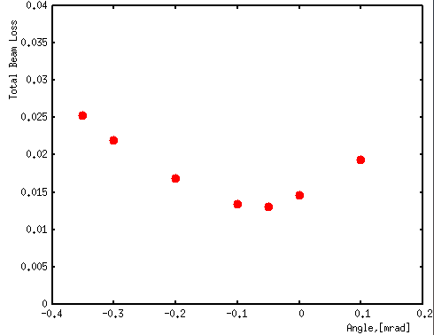
Tracking simulations with MARS
Tracking extracted beam with MARS code:
  Tracking particles in media and DC fields
  Radiation levels, Residual activation, Energy deposition, etc
  Essential for beam loss calculations and geometry optimization
Plot:
Total beam losses
Narrow angle spread beam
Losses vs beam misalignment

Slide 14
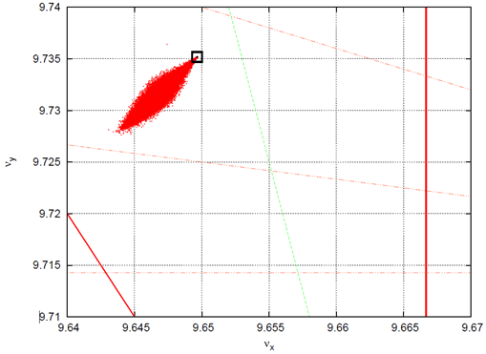
Machine operation issues: Space Charge (SC)
Laslett tune shift:
→ 0.01
With dispersive effects Q_{SC} → 0.007
Not an issue if approaching the resonance from below

Slide 15
Machine operation issues: Instabilities
DR intensity increases ~10⁵
Instabilities?
  TMCI
  Weak head-tail
  Electron cloud
  Microwave
  IBS
[ A.Burov , BeamStability_Mu2e.pdf ]
Considered in much more challenging version of Mu2e with 24kW beam power. Not nearly an issue for the 8kW

Slide 16
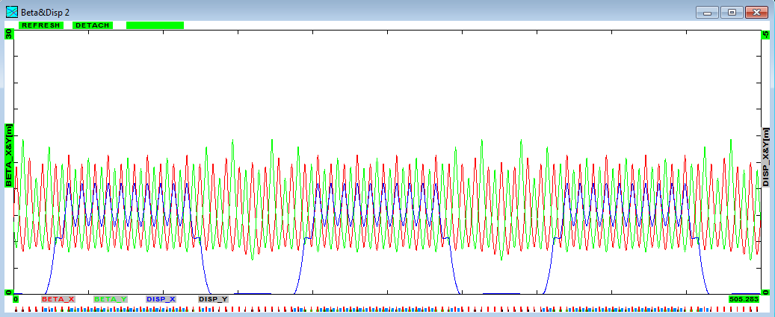
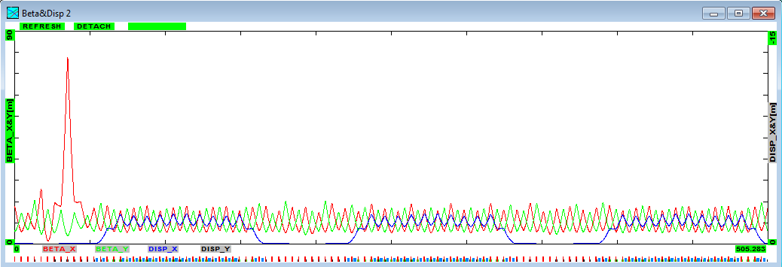
Machine operation issues: Optics redesign
Optics redesign
  Smoothing optics
  Increasing β_{X} at ESS1
Existing optics
Difficulties with implementing a large beta-bump
Currently we consider only smoothed optics design with possibly a modest beta-bump, not a part of the project baseline.
“Smoothed” optics
Beta-bump optics

Slide 17
Magnet specifications and definition
Magnets and Power Supplies
Tune ramping quads
Sextupole magnets
Dynamic (DEX) bump dipoles

Slide 18
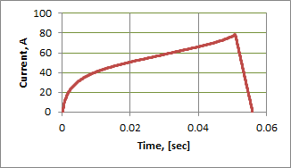
Magnets: Tune ramping quads
Locations:
0-harmonic circuit: 3 quads in the middle of each SS. Not the only possible choice.
Strengths:
Ramps:
The tune ramp curve was calculated from the linear spill tune curve defined in Synergia.
Magnet and PS Specs:
Field distortions <1%
Stability <0.5%
Ripple <0.05%

Slide 19
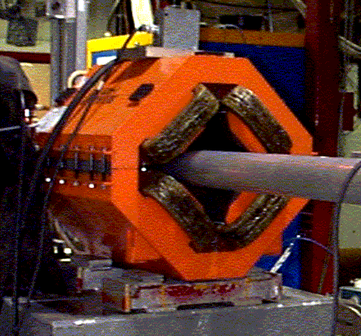
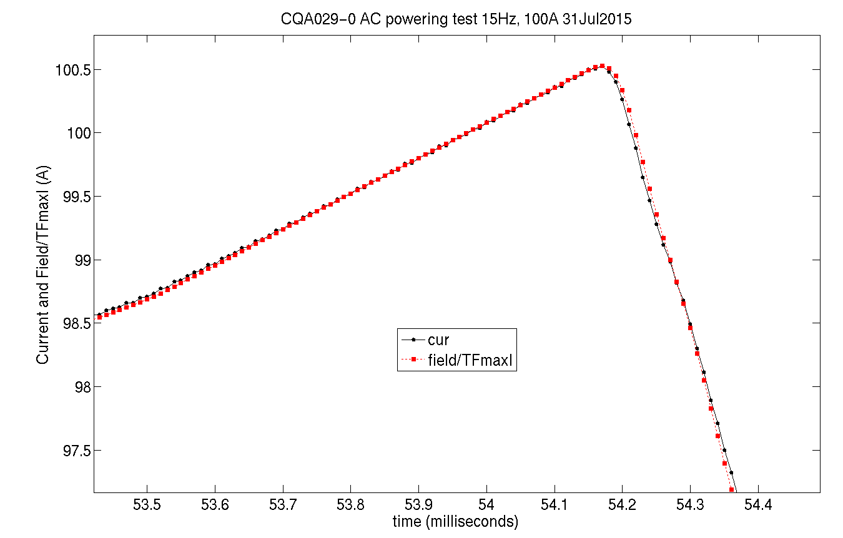
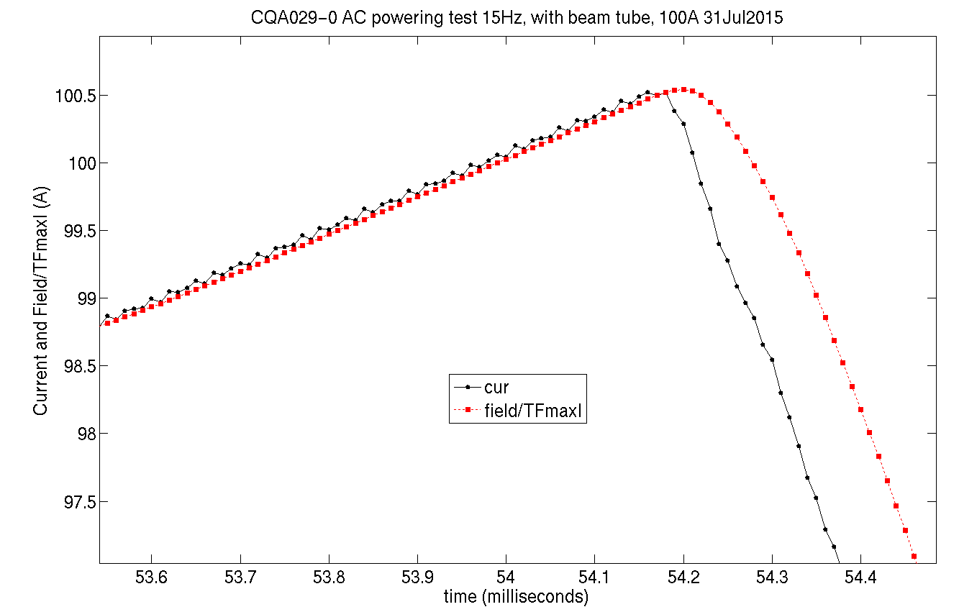
Magnets: Tune ramping quads
Choice of magnet types:
CQA type, available in storage. Air cooled.
Power supplies:
PS design is an extension of the existing
Booster PS design. Low risk.
Magnet tests performed:
Magnet performs very well on the ramp.
Field delay of ~0.1ms detected with SS beam pipe

Slide 20
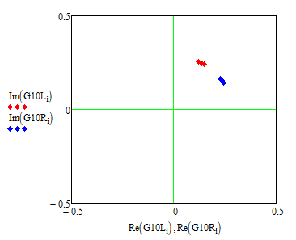
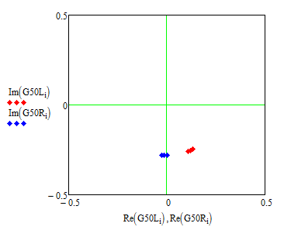
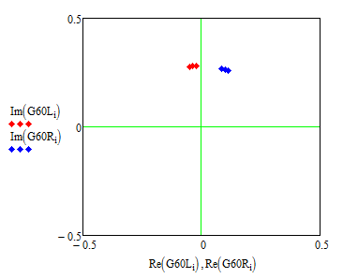
Magnets: Sextupoles
Strengths
B”L=80 T/m
Would like to have 2 orthogonal families of magnets
FODO cell PA 60° is ideal for adding up
Choice of locations available in SS50 and SS10-60
Noticeable difference Left-Right
Best choice: 10R+50L
SS 50: Left and Right
SS 10: Left and Right
SS 60: Left and Right

Slide 21
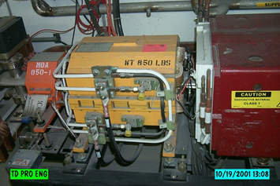
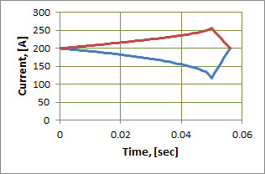
Magnets: Sextupoles
Ramps: There is practically no cost difference between DC and AC options. It may be useful to reserve ramping capability, e.g. to adjust separatrix orientation instead of orbit control
Magnet choice: Existing design of ISA magnets is suitable, but no spares – will have to build them.
Water cooling is required.
Power supplies: PS design is an extension of the existing Booster PS design. Low risk.
Magnet and PS Specs:
Field distortions < 1%
Stability < 0.5%
Ripple < 1%

Slide 22
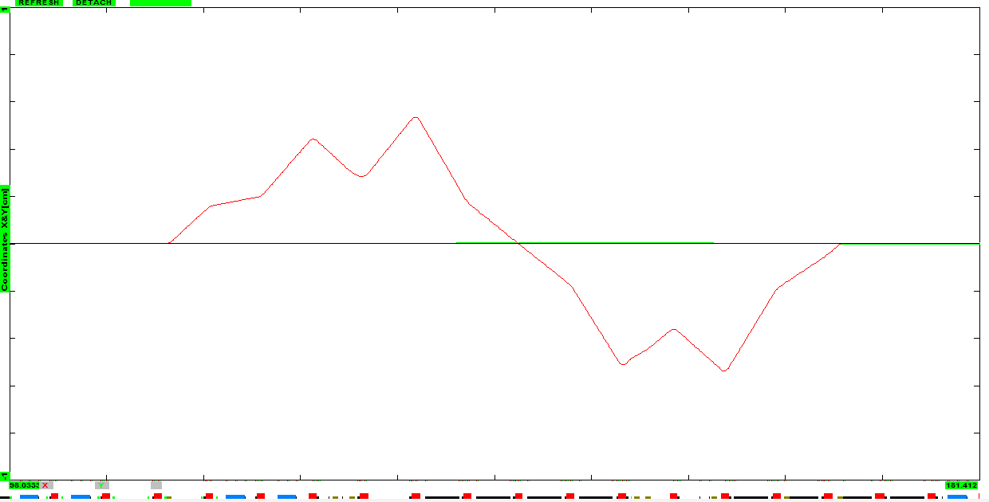
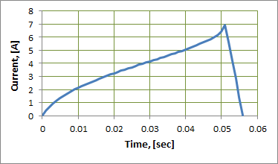
Magnets: DEX bump
Locations: Very tight space in SS30 limits the choice of trim locations. Substantial orbit shifts, in particular, at Q205 is a concern.
Kick:
Strengths: BL_{Max}=0.014Tm
Ramps: Calculated to keep the orbit angle at ESS1 constant.
0.4mR
1cm
2Q7
2Q5
3Q0
3Q3
3Q5
H210
H206
H301
H305
2Q10

Slide 23
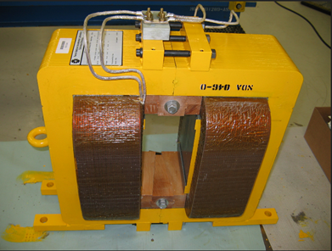
Magnets: DEX bump
Magnet choice: Debuncher style NDB. Air cooling is sufficient.
Power supplies: Only 7A , but needs lots of voltage to drive the fast ramp. Splitting 2 coils in parallel, augmenting the PS with the 350V regulation.
Magnet testing: FEA analysis show that magnet should perform well in the AC mode. However in the case of distorted lamination issues may appear, therefore testing was recommended. Tests are in progress now.
Magnet and PS Specs:
Field distortions < 1%
Stability < 1%
Ripple < 1%

Slide 24
Transverse RF Knock-Out (RFKO)
Transverse RF Knock-Out (RFKO)
Overview
Theory and simulations
Measurements

Slide 25
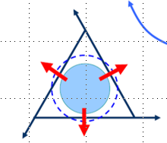
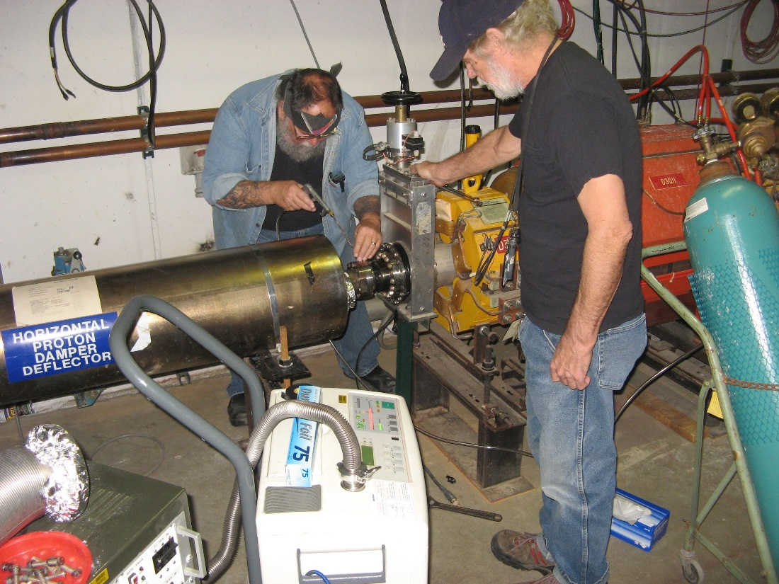
RF Knock-Out – Overview
Transverse RFKO- fast betatron beam heating
We will use transverse RFKO for the regulation of fast spill rate ripples.
Simulations show that 1uR kick at max power is sufficient for fast spill regulation. (!?)
Calculations of the emittance growth rate (EGR) are consistent with simulations and beam measurements.
The kicker waveform has to be FM-modulated with the BW covering the beam tune spread.
Spill regulation is made through regulating the RFKO power.
We will use the old Tevatron damper kicker. It’s already installed and tested with beam.

Slide 26
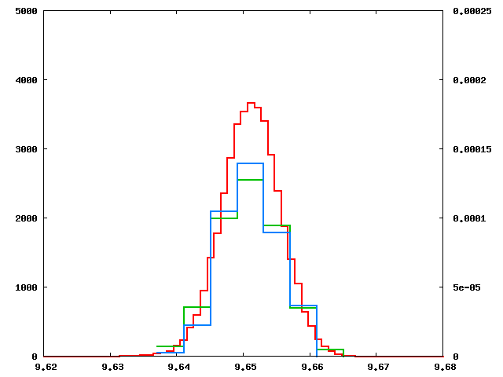
RF Knock-Out – Theory and simulations
V.Nagaslaev et al., FERMILAB-CONF-11-475-A
Two types of modulation were studied in tracking simulations: linear chirp and random “colored” noise. Performance is very similar.
Emittance growth rate (EGR) is the most essential characteristic of the RFKO heating.
Beam tune spread and EGR in narrow ΔQ bins
Tune distribution and emittance growth rates in narrow BW:
proportional to occupancy
close performance

Slide 27
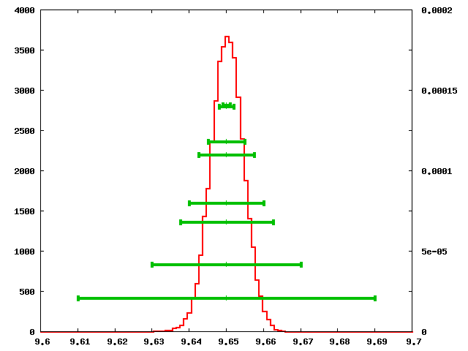
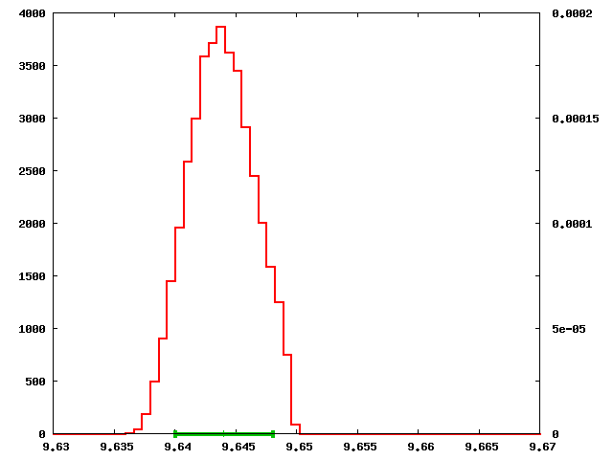
RF Knock-Out – Theory and simulations
Beam tune spread and EGR in wide ΔQ bins
Tune distribution and emittance growth rates with wide BW:
~1/width
What if the tune width is dominated by the Space Charge?
Tune width due to the SC alone does not provide any mixing, so EGR=0

Slide 28
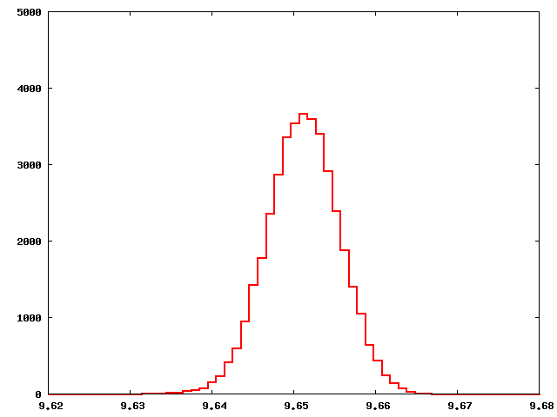
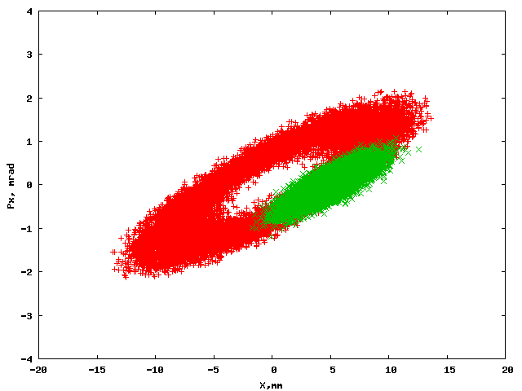
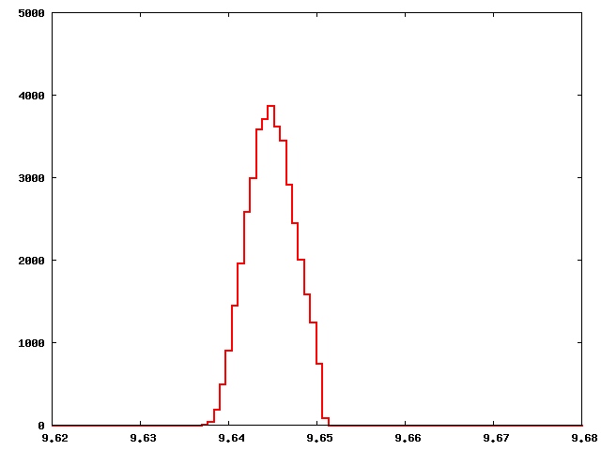
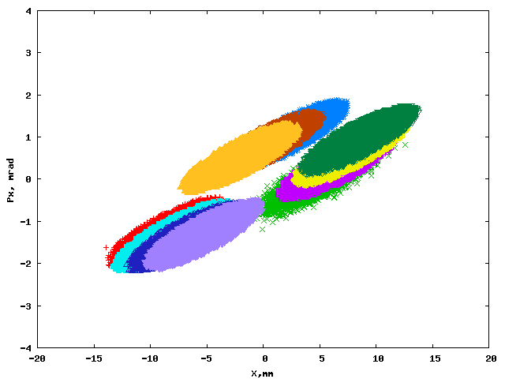
RF Knock-Out – Theory and simulations
Cx=2; SC is off Phase space after 1000 turns
Cx=0; SC is on Phase space after EACH of 1000 turns

Slide 29
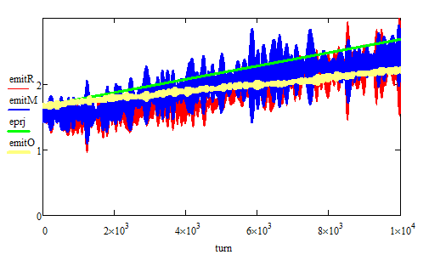
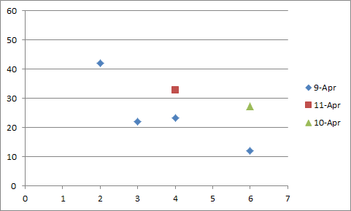
RF Knock-Out – Comparing with measurements
60π mm-mr/sec
EGR(Orbit)=33π mm-mr/sec
@ 25W+25W
EGR measurement in the Debuncher ring:
Difficult measurements
Final results consistent with calculations
Orbit
EGR, π μ/sec
FM width, kHz

Slide 30
RFKO Summary
RFKO emittance growth is inversely proportional to the beam tune spread
RFKO needs non-zero chromaticity and chromatic tune spread
Chromatic tune spread should be large enough to ensure fast mixing
Calculated emittance growth rates are consistent with simulations and beam measurements

Slide 31
Spill Control
Spill Control
Simulations
Regulation logic
Spill Monitoring

Slide 32
Spill Control system
Required: spill uniformity at the level of ±50%
On average spill is controlled by the tune ramping quad circuit
We plan to regulate fast spill variations with the RFKO kicker
RFKO is fast and proved to be very effective in slow extraction for medical applications
We are cautiously optimistic about use of.
Early simulations of the RFKO regulation with ORBIT:
  No regulation when spill rate is high
  Large variations
  High statistical noise

Slide 33
Spill Control system
RFKO regulation simulations with Synergia:
  Regulation responds to 10% increase in the reference spill rate
  Large variations
  High statistical noise
Proportional regulation seems to do the job, but it produces large oscillations due to the beam response latency and overregulation

Slide 34
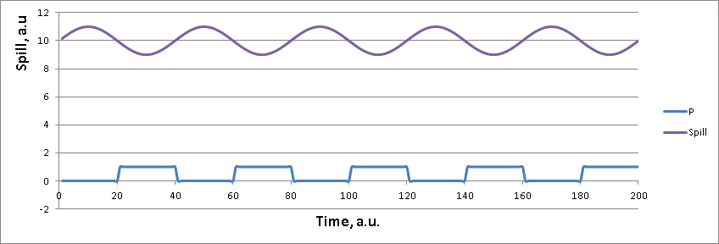
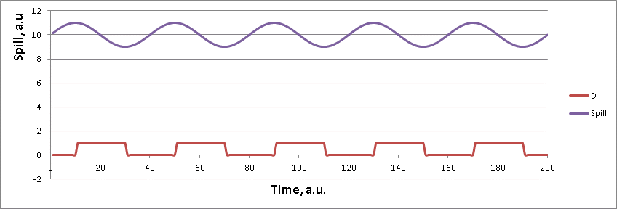
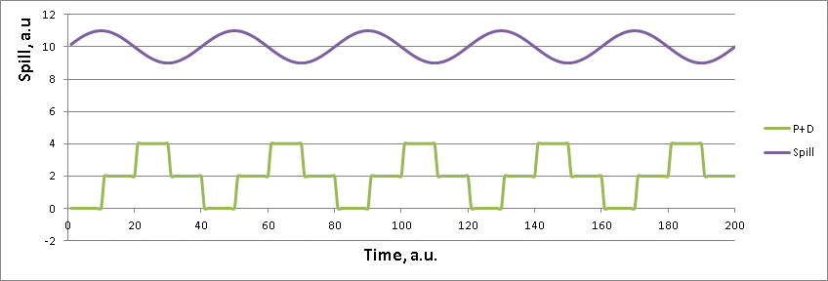
Spill Control system: overregulation
Oscillations in the spill rate appear as a result of beam response latency and overregulation with proportional loop P
This can be alleviated by using the derivative regulation loop D
Or a combination of P and D
Derivative loop has a “prediction” power
and therefore has a potential to smoothen
oscillations. Problem of tracking simulations is that D signal is intrinsically very noisy. Same problem may occur if the SM sensitivity is limited.

Slide 35
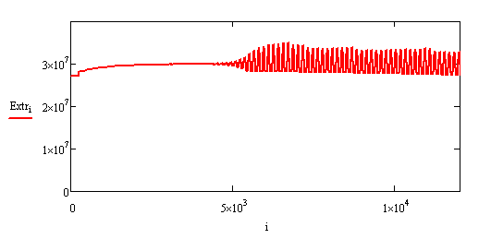
Spill Control system: noise-free simulations
For practical purposes of the electronics FB simulations we developed a simplified NOISE-FREE semi-analytical model of RE:
Beam distribution is assumed to have a Gaussian shape limited by the separatrix size A(t):
On each step recalculate:
  New ε_{X}
  New A(t)
  New part of beam outside of the separatrix
  New extracted beam
  Spill Monitor response
  Spill error signal
  Regulation gain
  RFKO power
The model is now employed for the hardware optimizations

Slide 36
Spill Control system: regulation topology
Spill Mon
Learning function filter
(feedforward)
Done in uP
And FPGA
Ideal Spill
AM Signal
+
+
e
PID filter
(feedback)
External Generator
FM Signal
-
+
Spill Mon
Tune Quads
Very flexible and adaptive system
Based on past experience with MI SE

Slide 37
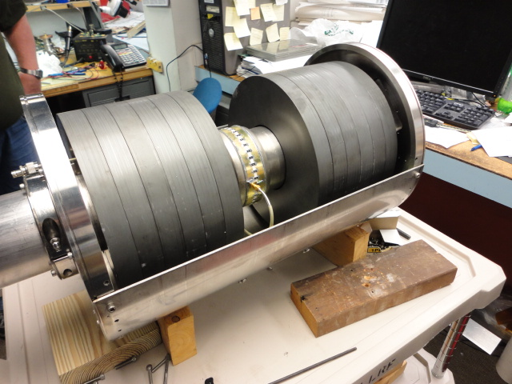
Spill Monitoring
Dedicated WCM device for SM
  Enhanced sensitivity
  Beam tested
  Ready for use
Will use DR DCCT for additional I-loop input
Will need additional instrument for the D-loop input. Plan to use the Extinction Monitor output.

Slide 38
Electrostatic Septum Design
Electrostatic Septum Design
Design considerations
Beam losses budget
Prototyping
Full scale prototype

Slide 39
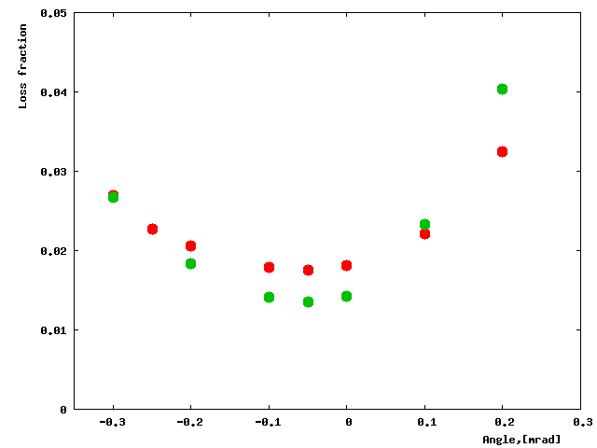
ESS design considerations: foils
Foils or wires?
Total losses vs beam angle.
MARS:
  100u dia wires; 50u foils
  Conservative case
  Narrow angle spread beam
  No significant advantage
Would the foils stay flat?
Would a wire be destroyed by a single spark?
Red- 100μ wires; Green- 50μ foils
The choice does not appear to be obvious, but at this point we prefer foils as a more mechanically stable option

Slide 40
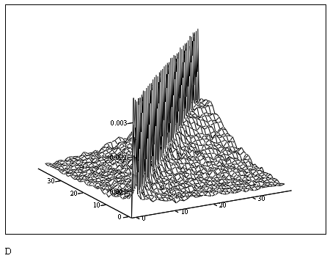
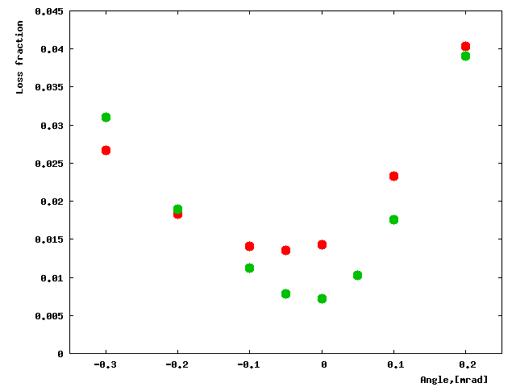
ESS design considerations: pre-scattering
Do we need a diffuser?
Optimal geometry for the diffuser
Losses predominantly occur for those particles that pass through the septum plane at low angle
These particles can be deflected to a small angle by the diffuser plane in front of the septum plane
Works best with low density materials (e.g. Carbon)
Mo foil plane can also be effective with foil spacing of 20mm
Total losses vs beam angle.
We reserve 0.5m of frame length in front of the foil plane of ESS1 for the diffuser.
50u foils, 2.6mm spacing:
Green– with diffuser; Red – without diffuser

Slide 41
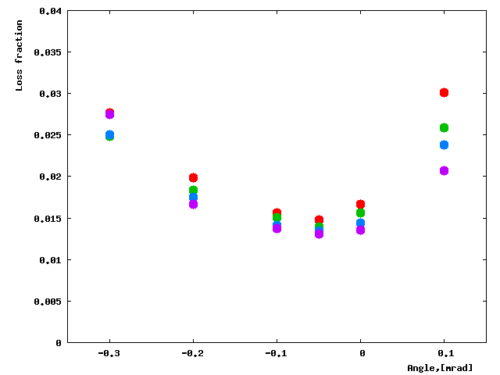
ESS design considerations: septa lengths
What’s the optimum ESS length ratio?
MARS:
Total losses vs beam angle.
  Losses are most significant in ESS1
  Losses grow with ESS1 length due to the beam angle spread
  Performance can be improved by making L1 < L2
ESS1/ESS2 length ratio:
Purple-0.5m/2.5m; Blue-0.7m/2.3m; Green-1m/2m; Red-1.5m/1.5m
Practical choice: L1=1.25m (+0.5m diffuser)
and L2=1.75m leads to equal total vessel lengths. This makes design of two septa fully interchangeable.

Slide 42
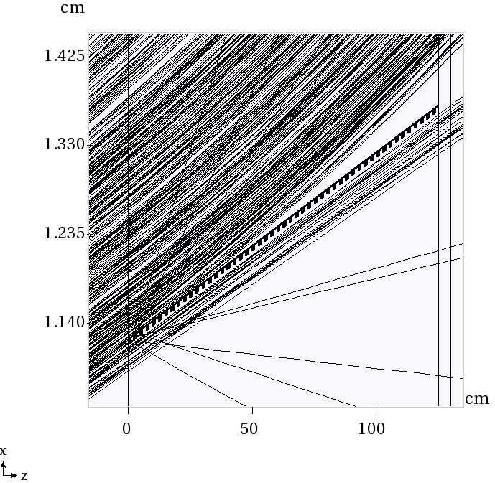
ESS alignment and flatness
Optimal ESS alignment angle
Losses sensitive to misalignment or wide angle spread
Flatness is most important in first part of ESS1
Small positive bend acceptable in the end of ESS1
Design should allow flipping the frames
It might be beneficial to introduce a small positive bend in the end of ESS1
Motion control better than 50u

Slide 43
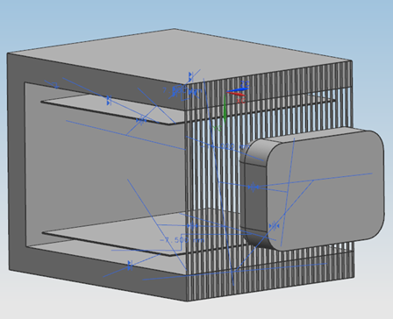
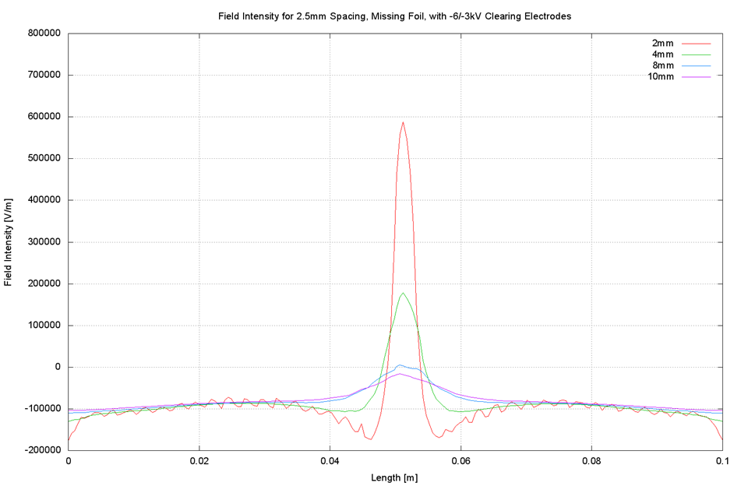
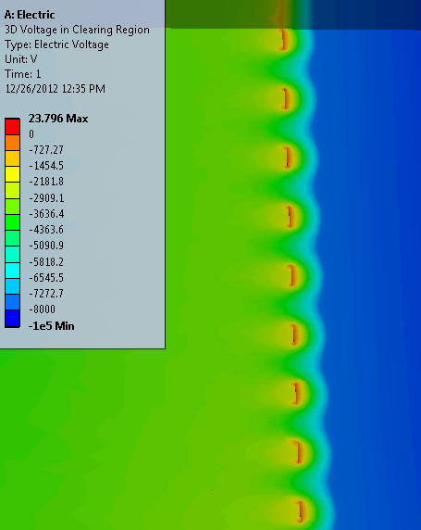
ESS design considerations: ions
How to minimize effect of ions?
It is believed that if ions created in residual gas are pulled into the strong field gap, they assist spark generation. Field penetration from the ESS gap into the area of high density proton beam should be avoided even if there is a broken foil.
Clearing electrodes required (up to 10kV)
Allowed spacing = 2.6 mm center-center

Slide 44
ESS Design studies overview
Need to do the engineering studies:
Foil strength, yield
Attaching foils: crimping, brazing
Foil stretching, removal, assembly
Foil flatness
High voltage studies

Slide 45

ESS prototyping
“Prototype-I”
Foil attachment
Stretching
Test flatness
Completed

Slide 46

ESS prototyping
Stretching prototype
Foil attachment
Foil assembly techniques
Test flatness
In progress
See presentation of M.Alvarez

Slide 47



ESS prototyping
HV Prototype
Vacuum facility- NWA

Slide 48


ESS prototyping
HV Prototype
Foil breaking limit
Cathode material, handling
Feedthrough
Foil materials
Conditioning techniques
Period of extremely hard conditions
Lots of interesting observations
In progress
See presentation of M.Alvarez
R=3.5u
R=26u

Slide 49


ESS prototyping
Large scale prototype
Working towards the full scale prototype
Test design solutions in real scale
Satisfy ESS specifications
Preproduction prototype
May reuse parts in production
See presentation of D.Tinsley’s

Slide 50
Conclusions

Slide 51
Conclusions
The physics model of slow extraction has been developed to determine the key system parameters and hardware specs
We have a plan of building the new hardware and a plan to ensure the performance parameters will be met.
Material and design studies for the ESS with the foil plane are in progress and we proceed with the full scale preproduction prototype.
Technical and operational risks are being addressed and in most cases mitigated.

Slide 52
Supplemental slides

Slide 53

Extraction channel
ESS1
ESS2
LAM
C-Mag
Q203
Q204
Q205
Delivery Ring
Extraction channel
Extraction line

Slide 54

Extracting from multiple separatices

Slide 55

Approaching resonance with SC

Slide 56
Special Topics
Special Topics
Instrumentation
Technical risks
Radiation protection
Machine protection

Slide 57
Instrumentation: BPMs
Debuncher BPMs can only see 53MHz and will be upgraded to Echotech standard with 2.5MHz electronics.
  Repurpose Tevatron BPM crates
  Repurpose Recycler BPM electronics
Tunnel hardware will be repurposed.
BPMs will have sub-millimeter resolution.
  Closed orbit and TBT available.
Delivery Ring BPM system is off-project on the Delivery Ring AIP.
Courtesy B.Drendel

Slide 58

Instrumentation: DCCT
Delivery Ring DCCT hardware repurposed.
Analog conditioning and VME electronics modified for Mu2e operation.
The system has an accuracy of one part in 10⁵ over the range of 1 x 10¹⁰ to 2 x 10¹² particles with a noise floor of 2 x 10⁹.
The Accumulator unit will become a working spare.
Courtesy B.Drendel

Slide 59



Instrumentation: Schottky
Repurpose Tevatron 21.4MHz Schottky which has an acceptable aperture.
Down convert from 36th/37th harmonics to 1st harmonic (0 to 590 KHz)
Use 24-bit ADC to sample signal
  2 to 4 MHz sampling
  100 db dynamic range
Use digital signal processing to produce tunes
  Tunes to ±0.001 at 590 Hz
  Tunes to ± 0.0001 with averaging over many spills
Courtesy B.Drendel

Slide 60

Instrumentation: BLMs
The M4 Line Beam Loss Monitor (BLM) system has been designed to measure a 0.2% localized loss with microsecond integration.
This will allow seeing losses develop inside of an individual slow spill.
30 BLMs will be placed at key locations along the 245m beam line.
This system design is identical to the existing Main Injector, P1, P2, M1 and M3 line BLM systems.
There is not a sufficient pool of spare hardware and electronics so new parts will need to be purchased and constructed to build the system.
Courtesy B.Drendel

Slide 61
Technical risks
Technical Risks (extraction specific)
  High losses
    Large effective thickness of ESS planes
    Insufficient kick in the ESS
    Inadequate ESS alignment
    Inadequate orbit control
  High spill variations
    Regulation is not fast enough
    Regulation is not deep enough
    Insufficient RFKO power
  Insufficient aperture
  Magnet strengths are not sufficient
  Magnet ramping capabilities are insufficient
  Insufficient machine diagnostics
  Substantial fraction of the beam not extracted
  Beam instabilities

Slide 62



Radiation protection
Extraction channel- Elevation view
In-tunnel shielding
Beam enclosure has been designed for 13W 8GeV operations
Mu2e: 8kW 8GeV beam
In-tunnel shielding above extraction channel
Concrete shielding in the isle
Additional shielding if needed
Beam

Slide 63

Radiation protection
Protection of people downstream (not in RE scope)
M4 line enclosure protected by shielding wall during installation
Mu2e PS hall protected by shielding wall during commissioning and g-2 operation
G-2 protected by shielding wall during Mu2e operation
Shield wall

Slide 64
Machine protection
Accident case scenarios
DR abort system is not capable to abort beam during the spill, we can only abort in the end of the spill and inhibit next one.
Worst case scenario: loss or extraction of the whole spill intensity in a single pulse
Beam permit system can inhibit the next spill:
  On BLM trip
  On Spill Monitor threshold
  On Detector diagnostics
  On regulation system abort signal
Single bunch is not destructive for:
  Septum foils
  Production target
  Detector systems

Slide 65
Beam loss – local and global budget

Slide 66




Beam loss – local and global budget
Phase space of circulating beam
Phase space of extracted beam
Total losses in the ring
Total losses in DS Beam line
Losses downstream
Local losses defined as missing beam DS of C-mag
DS losses calculated as beam scattered outside of the 20 π-mm-mrad area
Total losses = Local + DS losses (nearly twice local)
“Anything scattered is lost” ?
Tolerance on effective thickness of the foil plane <50u

Slide 67

Beam loss – local and global budget
Synergia tracking:
87% lost in first turn
99.7% lost in first 3 turns
40% lost before the first arc
16% in the first arc
33% in the known narrow elements
Localized losses in the ring
Tracking assumes idealized apertures, this breakdown just gives a general idea.

Slide 68


Beam losses and related extinction issues
Scattered beam tracking
Scattered beam integration
All scattered particles are expected to be lost very quickly, so they should not contribute to out of time beam contamination.

