Slide 1
Mu2e Project Overview
Steve Werkema – Mu2e Accelerator Systems L2 Manager
Mu2e Resonant Extraction Design Review
25 August 2015

Slide 2
Outline
The Mu2e Experiment
The Muon Campus
The Mu2e Project Accelerator Systems
Construction Progress
Schedule Overview

Slide 3



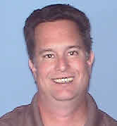
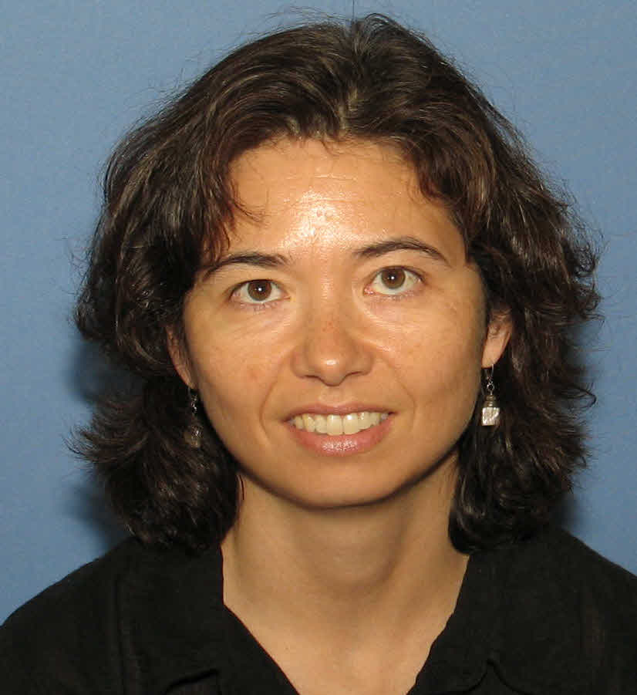
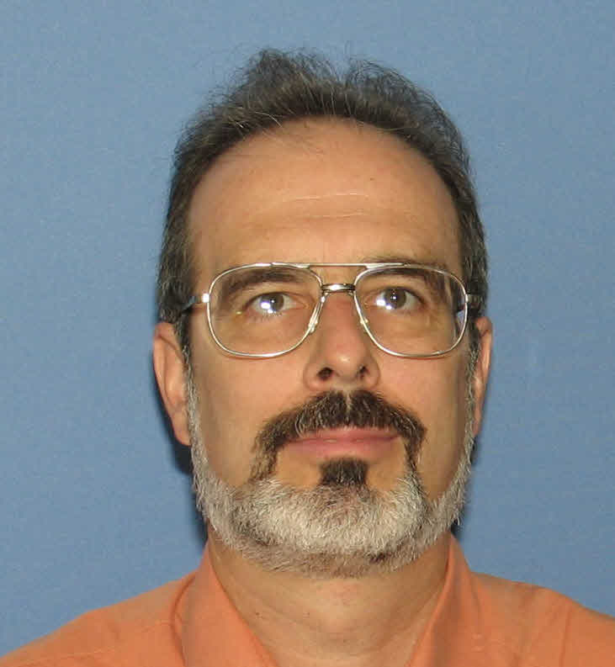
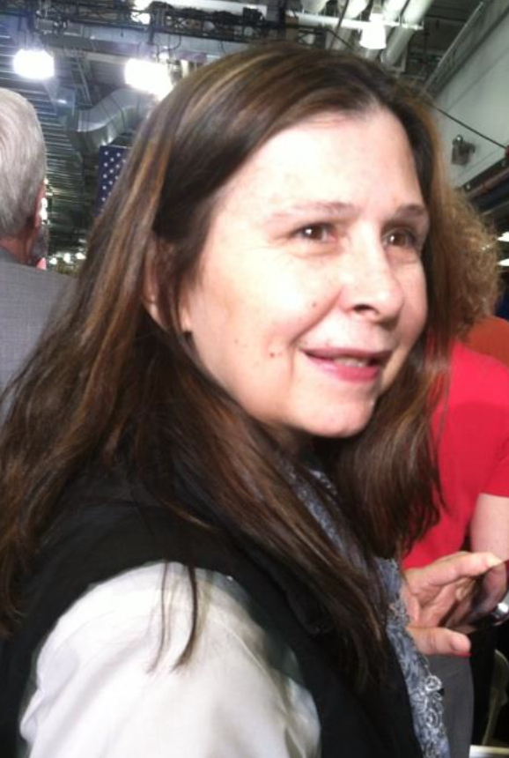

Mu2e Project Office People You May See at this Review
Ron Ray
Mu2e Project Manager
Kurt Krempetz
Mu2e Project Mech. Engineer
Gary Drake
Project Elec. Engineer
Mike Andrews
Mu2e ES&H Manager
Julie Whitmore
Mu2e Deputy Project Manager
George Ginther
Mu2e Mechanical Integration Team Coordinator
Karen Byrum
Electrical Integration Team Leader
Dee Hahn
Mu2e ES&H Coordinator

Slide 4
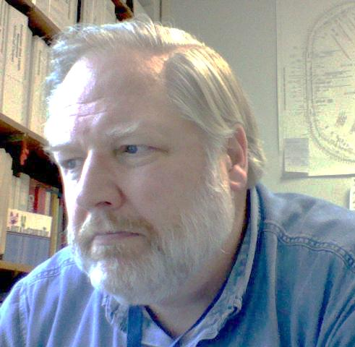
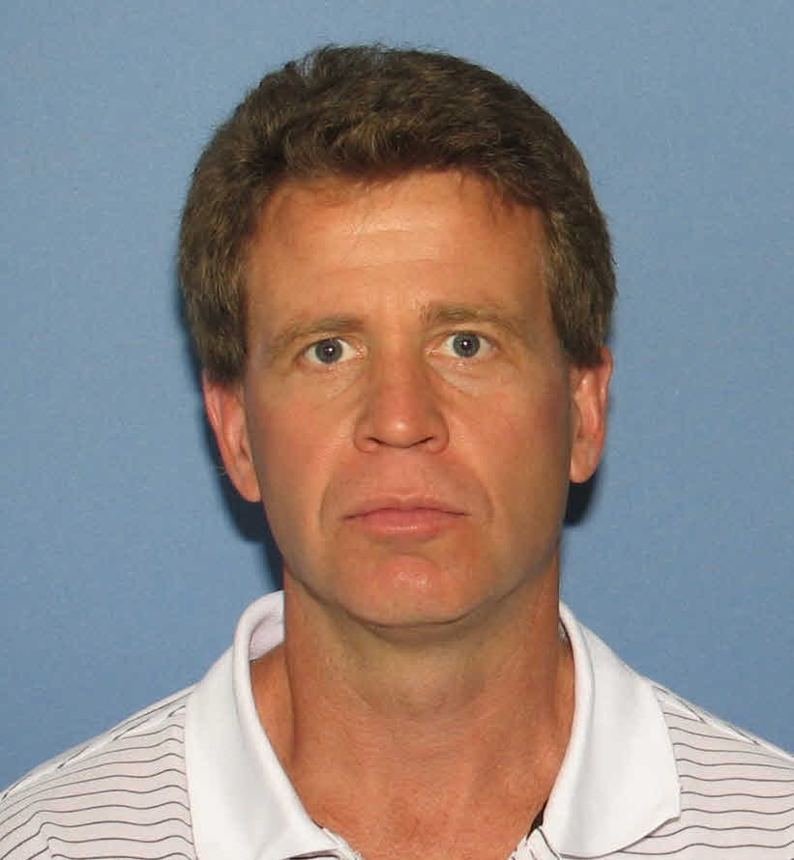





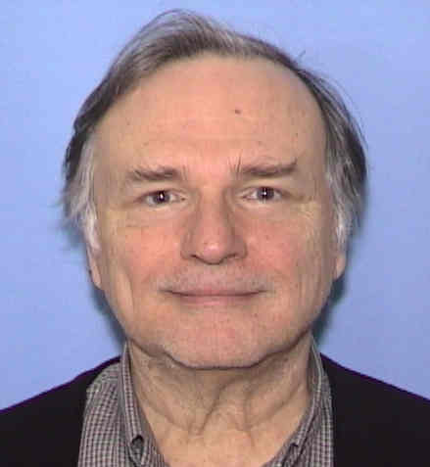
Various Accelerator/Resonant Extraction People
Steve Werkema
Mu2e Accelerator Level 2 Manager
Jerry Annala
AD / Muon Department Head
Dave Tinsley
Mechanical Engineer (ESS)
Peter Prieto
Electronics Engineer
(Spill Regulation)
Vladimir Nagaslaev
Mu2e Accelerator Deputy Level 2 Manager
Resonant Extraction L3
Denton Morris
AD / MI Department
NWA Test Facility
Matt Alvarez
Mechanical Engineer (ESS)
Leo Michelotti
Resonant Extraction Theory

Slide 5
The Mu2e Experiment

Slide 6
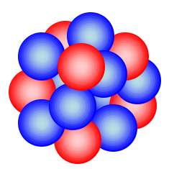


Charged Lepton Flavor Violation
The Mu2e experiment will attempt to detect Charged Lepton Flavor Violation (CLFV)
CLFV is a process involving charged leptons (e, μ, τ) that violates the conservation of the number of leptons of each flavor
Al
e⁻
μ ⁻
μ ⁻ N → e⁻ N
L_{μ}: 1 0
L_{e}: 0 1
Both L_{μ} and L_{e} are not conserved in this process
Ordinary muon decay is not CLFV
L_{μ}: 1 0 0 1
L_{e}: 0 1 -1 0
If this is observed, it is evidence physics beyond the Standard Model
Notes:
Mu2e is looking for a neutrinoless final state.

Slide 7
What Mu2e Measures
The Mu2e experiment will measure the ratio of the number muon captures in aluminum that produce a conversion electron to the number of those that are captured in the ordinary way. This ratio is designated “R_{μe}”
Rate of CLFV μ → e conversion
μ capture rate
The goal of Mu2e is to measure R_{μe} with a single event sensitivity of 2.87×10⁻¹⁷

Slide 8
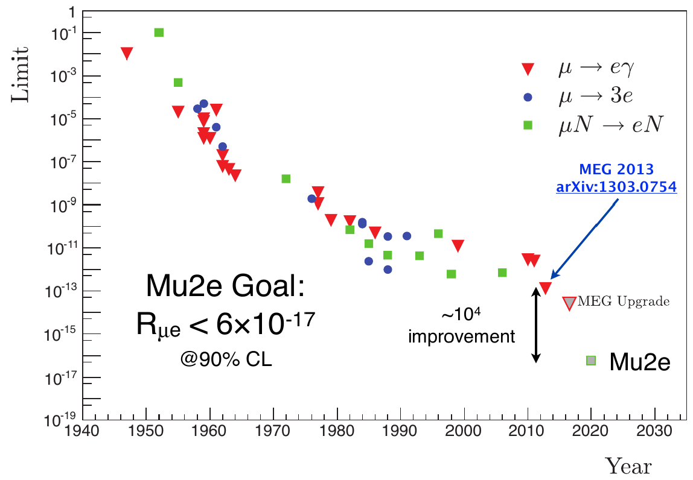
Results of Previous CLFV Searches
COMET Phase I

Slide 9
Mu2e Apparatus
The Mu2e apparatus consists of three superconducting solenoids joined together to make a continuous whole
Production Solenoid
Contains proton target
Magnetic mirror – reflects secondaries back toward transport solenoid
Transport Solenoid
Collimation
Momentum and charge selection
Transport to stopping target
Detector Solenoid
Contains stopping target
Tracker (straws)
Calorimeter (BaF₂ crystals)
Proton Beam
Calorimeter
105 MeV e ⁻
Tracker
2.5 T
1 T
4.5 T
1 T
2 T
~ 0.0019 stopped μ⁻/POT
10¹⁰ Hz of stopped muons
Al Stopping Target
Notes:
Particle trajectories drawn by Ron Ray.

Slide 10
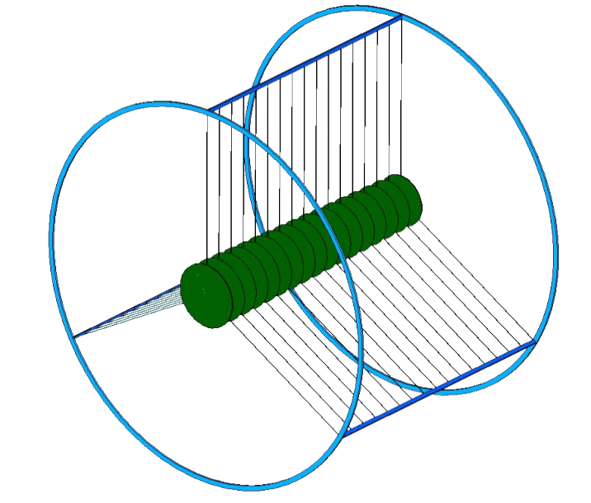
Stopping Muons
Aluminum
Nucleus
μ ⁻
Captured μ ⁻
M_{μ} = 105 MeV/c²
Mu2e muon stopping target
17 Al 200 μm foil disks
Disk radii decrease from 83 mm to 65 mm in downstream direction
A muon that is stopped in the Mu2e target is captured into an atomic orbital state of an aluminum nucleus
The muon quickly (≲ psec) transitions* to the 1S state where its wave-function overlaps the nucleus
* A target monitor counts nuclear transition photons
Notes:
The muon stopping target is designed to simultaneously optimize the muon stopping rate will minimizing the amount of material through which a conversion electron must pass.

Slide 11
The Muon Campus

Slide 12
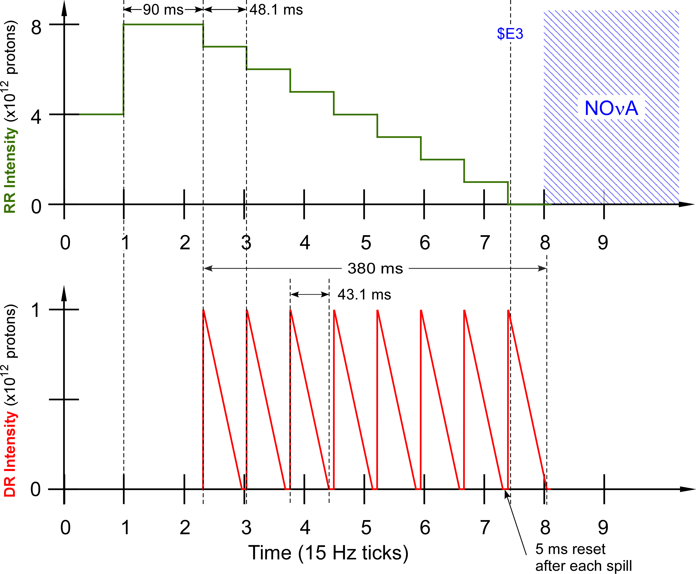
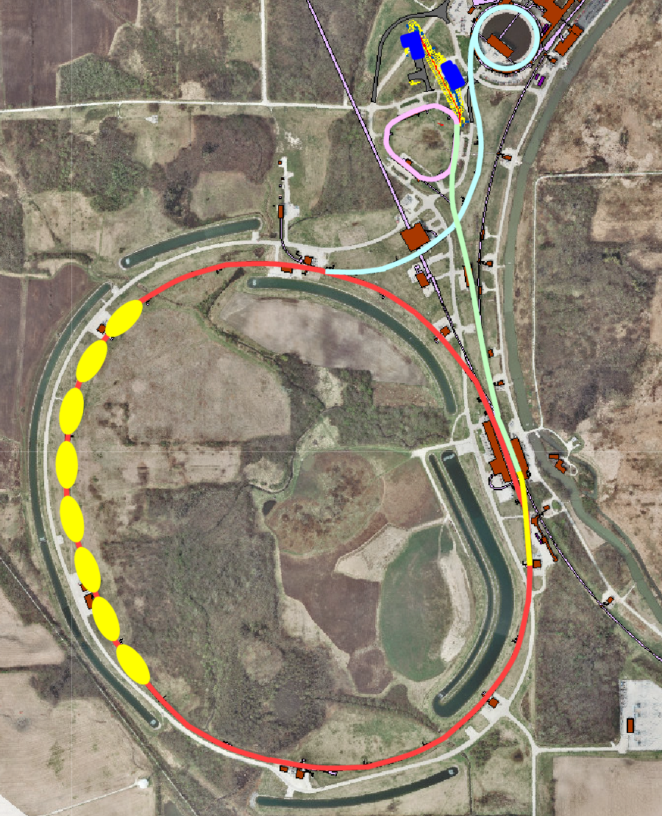
Acquisition of Beam for Mu2e
Muon Campus
Muon Campus Beamlines
Recycler Ring
Accelerator timeline for Mu2e proton beam delivery
Spill duration: 43.1 msec
Interval between spills 48.1 msec
Duty Factor: 27.1%
(Total Spill Time/Length of Cycle)
Peak Delivery Ring proton intensity: 1.0 ×10¹²
Notes:
The muons for the Mu2e experiment come from the interaction of a primary proton beam with a tungsten target in the Mu2e experimental hall. The protons that meet the requirements of the experiment are derived thusly:
Two Booster proton batches (4 Tp/batch) of 8 GeV KE are transported to the Recycler Ring via the MI-8 Line. Booster batches are injected into the Recycler at a rate of 15 Hz. Thus, the basic unit of time in the Accelerator Timeline is one 15 Hz cycle = 67 msec ≡1 tick
- The protons are rebunched in the Recycler with a 2.5 MHz RF system into 8 narrow 1 Tp bunches that occupy 2/7th of the Recycler circumference.
- These bunches are extracted, one-at-a-time, from the Recycler and transported to the Delivery Ring.
- The single bunch circulating in the Delivery Ring is resonantly extracted over approximately 54 msec to the Mu2e proton target forming a train of bunches spaced in time by 1.695 micro-sec (Delivery Ring T_{rev}).
- These proton bunches are transported to the proton target via the M4 Beamline.
- During transport from the Delivery Ring to the target the beam pulse passes through an extinction section containing a fast ac dipole magnet that removes the unwanted beam between pulses.
- This process is repeated twice for every 1.333 sec MI ramp cycle in the part of the cycle during which NOvA beam is being accelerated in the Main Injector.

Slide 13
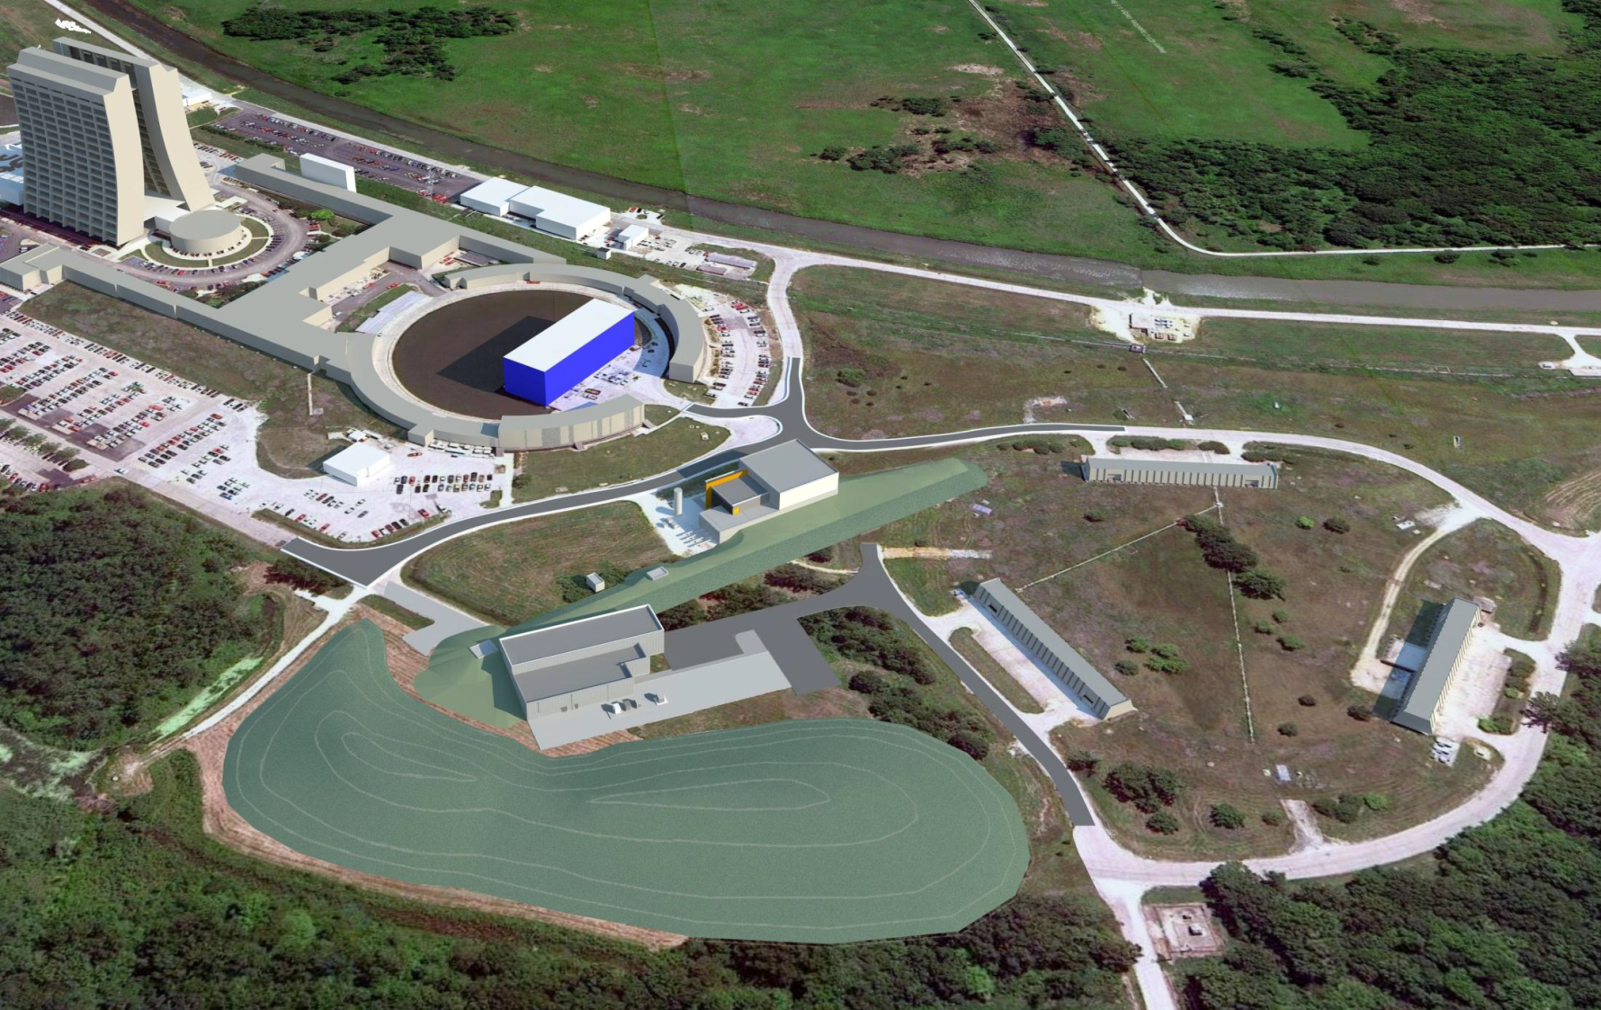
The Muon Campus
+ ^{a new Recycler RF system}
+ ^{Recycler to P1 transfer}
+ ^{Beamline upgrades}
+ ^{Cryo support}
g-2 (MC-1)
M4 Beamline
Picked over remnants of the Antiproton Source 😐
Mu2e
The Muon Campus Program consists of a total of 9 projects
Notes:
Note: the Mu2e and g-2 experiments will not be able to run at the same time.

Slide 14
DOE Projects, AIPs, GPPs
Building the Muon Campus requires the following projects:
DOE Projects
  Muon g-2
  Mu2e
AIPs (Accelerator Improvement Projects)
  Recycler RF
  Beam Transport
  MC Cryo Plant
  Delivery Ring
GPPs (General Plant Projects)
  MC-1 Building
  Beamline Enclosure
  MC Infrastructure Upgrade
Notes:
DOE Projects = Projects for which DOE Order 413.3b applies

Slide 15
Muon Campus Upgrades Required for the Mu2e Experiment but not on the Mu2e Project
Accelerator Upgrade | Project
MI-8 beamline to Recycler Ring Injection | NOvA Project
Recycler Ring 2.5 MHz RF system | Recycler RF AIP
Delivery Ring 2.4 MHz RF Cavities and HL Amps & Cooling | Recycler RF AIP
Single bunch extraction from Recycler Ring | Beam Transport AIP
Beamline aperture upgrades | Beam Transport AIP
AP1, AP2, AP3 to M1, M2, M3 conversion & upgrade | Beam Transport AIP
Beam transport instrumentation & infrastructure | Beam Transport AIP
Beam transport controls | Delivery Ring AIP
Delivery Ring Injection | Delivery Ring AIP
Delivery Ring Abort | Delivery Ring AIP
Delivery Ring infrastructure | Delivery Ring AIP
Delivery Ring Controls and Instrumentation | Delivery Ring AIP
D30 straight section reconfiguration | g-2 Project
Delivery Ring Extraction (except ESS) | g-2 Project
Extraction line (M4) to M5 split | g-2 Project
M4 beamline enclosure | MC Beamline Enclosure GPP

Slide 16
The Mu2e Project Accelerator Systems

Slide 17
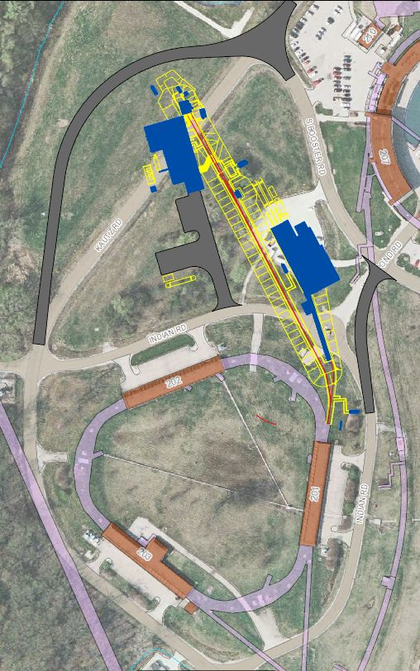
Mu2e Accelerator Systems Scope Overview
×
475.02.08.03 Extinction Monitor
475.02.09 Target Station
Mu2e
Bldg
475.02.07 External (M4) Beamline
MC-1
Bldg
475.02.08.02 Extinction
475.02.03 Instrumentation & Controls
475.02.04 Radiation Safety
Everywhere
Delivery Ring
475.02.05 Resonant Extraction
475.02.06 Delivery Ring RF
Notes:
Note: Kautz Road will not be routed around the Mu2e building – hence the big red X.

Slide 18
Mu2e Proton Beam Requirements
Parameter | Design Value | Requirement | Unit
Total protons on target | 3.6×10²⁰ | 3.6×10²⁰ | protons
Time between beam pulses | 1695 | > 864 | nsec
Maximum variation in pulse separation | < 1 | 10 | nsec
Spill duration | 54 | > 20 | msec
Beamline Transmission Window | 230 | 250 | nsec
Transmission Window Jitter (rms) | 5 | <10 | nsec
Out-of-time extinction factor | 10⁻¹⁰ | ≤ 10⁻¹⁰
Average proton intensity per pulse | 3.1×10⁷ | < 5.0×10⁷ | protons/ pulse
Maximum Pulse to Pulse intensity variation | 50 | 50 | %
Target rms spot size | 1 | 0.5 – 1.5 | mm
Target rms beam divergence | 0.5 | < 4.0 | mrad
3-4 year run
Time Structure
Intensity
Beam
Size
Notes:
The time structure requirements are generally for the reduction of prompt backgrounds in the Mu2e detector.
The intensity requirements optimize Mu2e detector performance.
The beam size requirements optimize muon yield and preclude excessive energy density in the proton target.

Slide 19
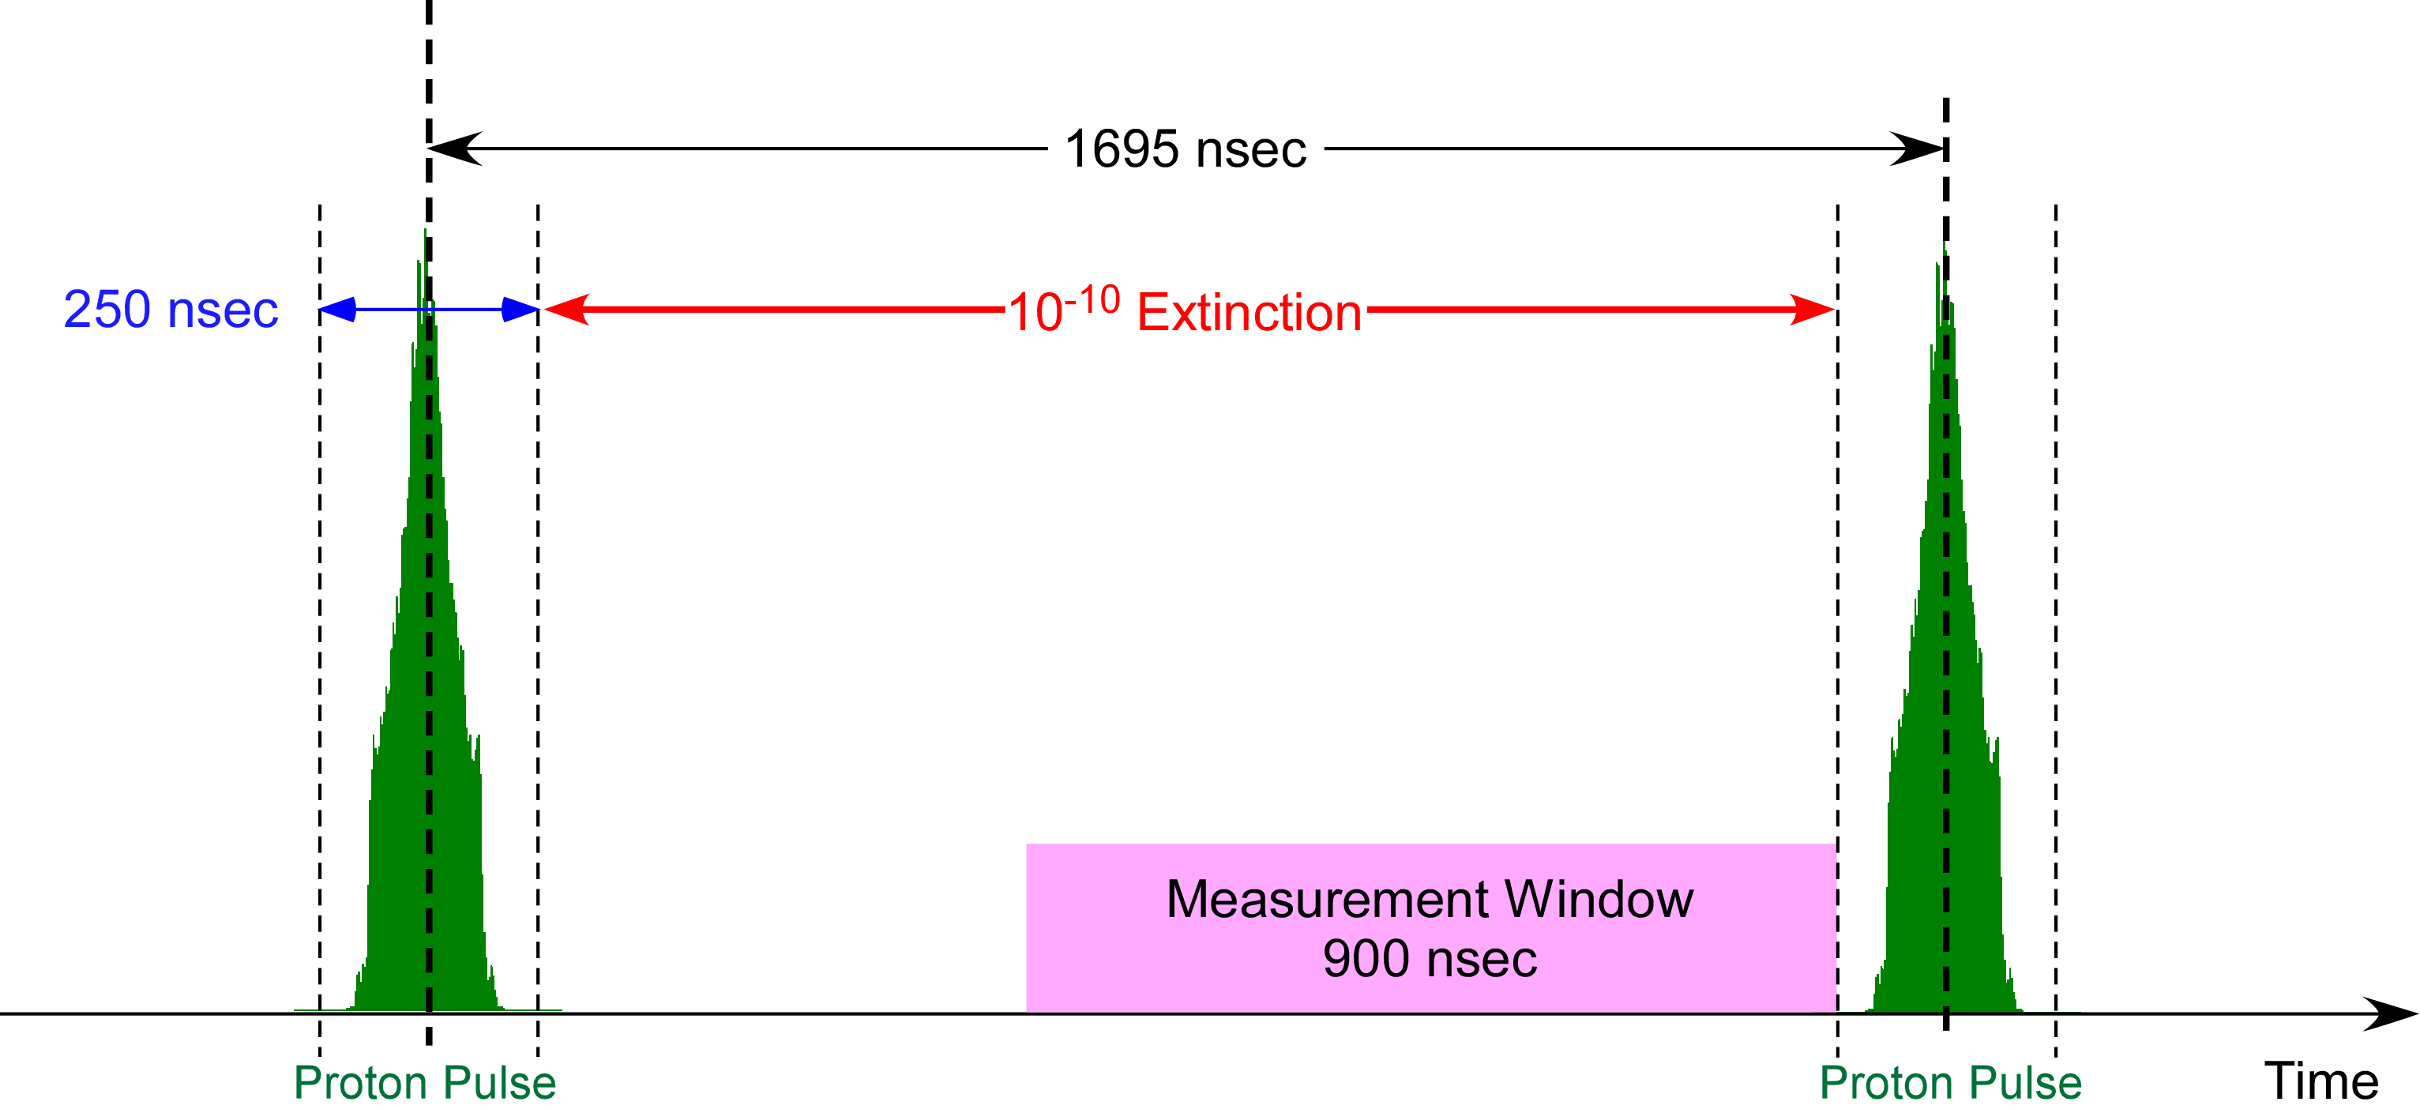
Proton Beam & Extinction Requirements
Two successive proton pulses on the Mu2e target (out of ~30,000 per spill)
(Requirement: <50 Mp/pulse)
Notes:
Holdoff time is the time required for primary proton induced background particles to decay or be lost by interaction with muon beamline materials. Holdoff time is determined by physics and may not be what is shown here.
Therefore, the measurement window is decreased as the proton pulse width is increased. The measurement window ends at the leading edge of the next proton pulse.

Slide 20
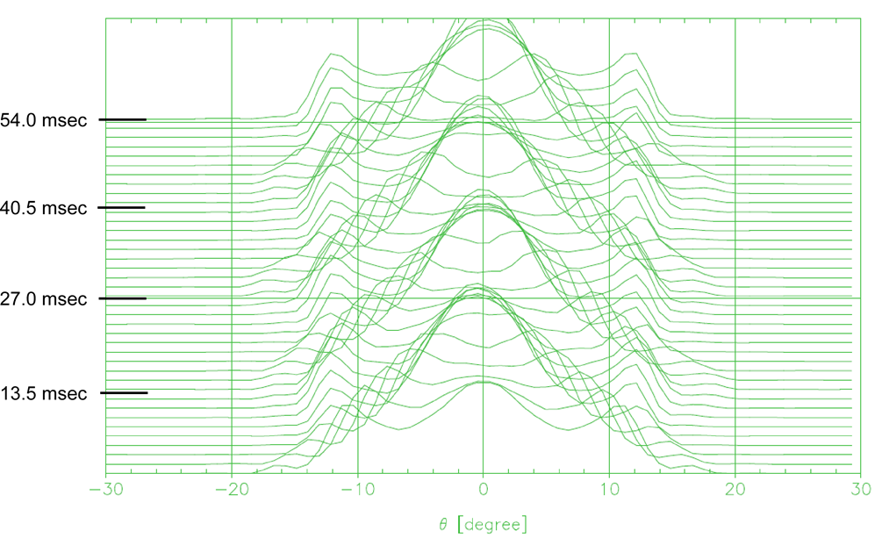
Delivery Ring Bunch Shape Variation in Time
The re-bunched beam from the Recycler is poorly matched to the 2.4 MHz RF bucket in the Delivery Ring. Thus, the beam tumbles in the bucket. The bunch shape changes at twice the synchrotron frequency (T_{synch} = 25.6 msec).
-94 ns
-47ns
47ns
94 ns
Waterfall display of the variation of the proton bunch time profile as the bunch rotates in the 2.4 MHz RF bucket. A trace is plotted every 1.35 msec over the course of the spill. The vertical axis is time relative to the start of the spill. The horizontal axis is Delivery Ring phase (1° = 4.708 nsec).

Slide 21
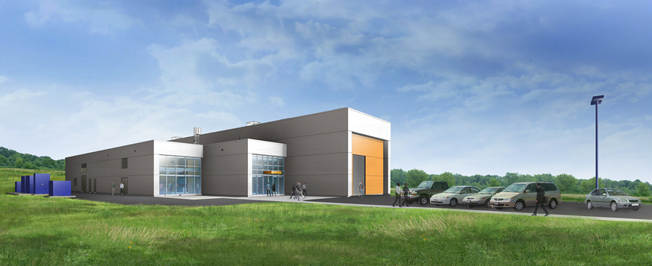
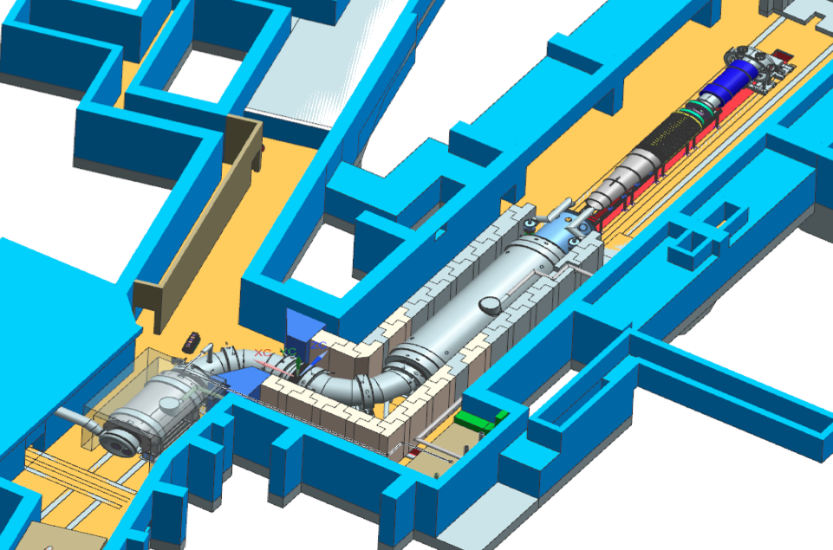
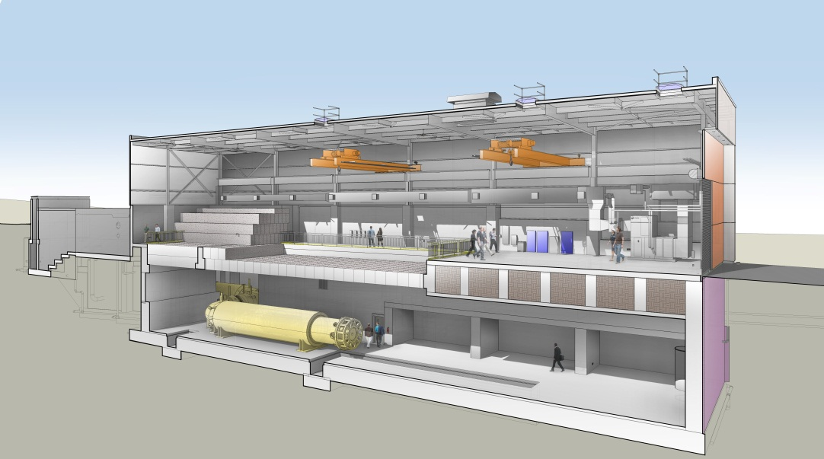
The Mu2e Building
Proton Target
lives here
M4 Beamline

Slide 22
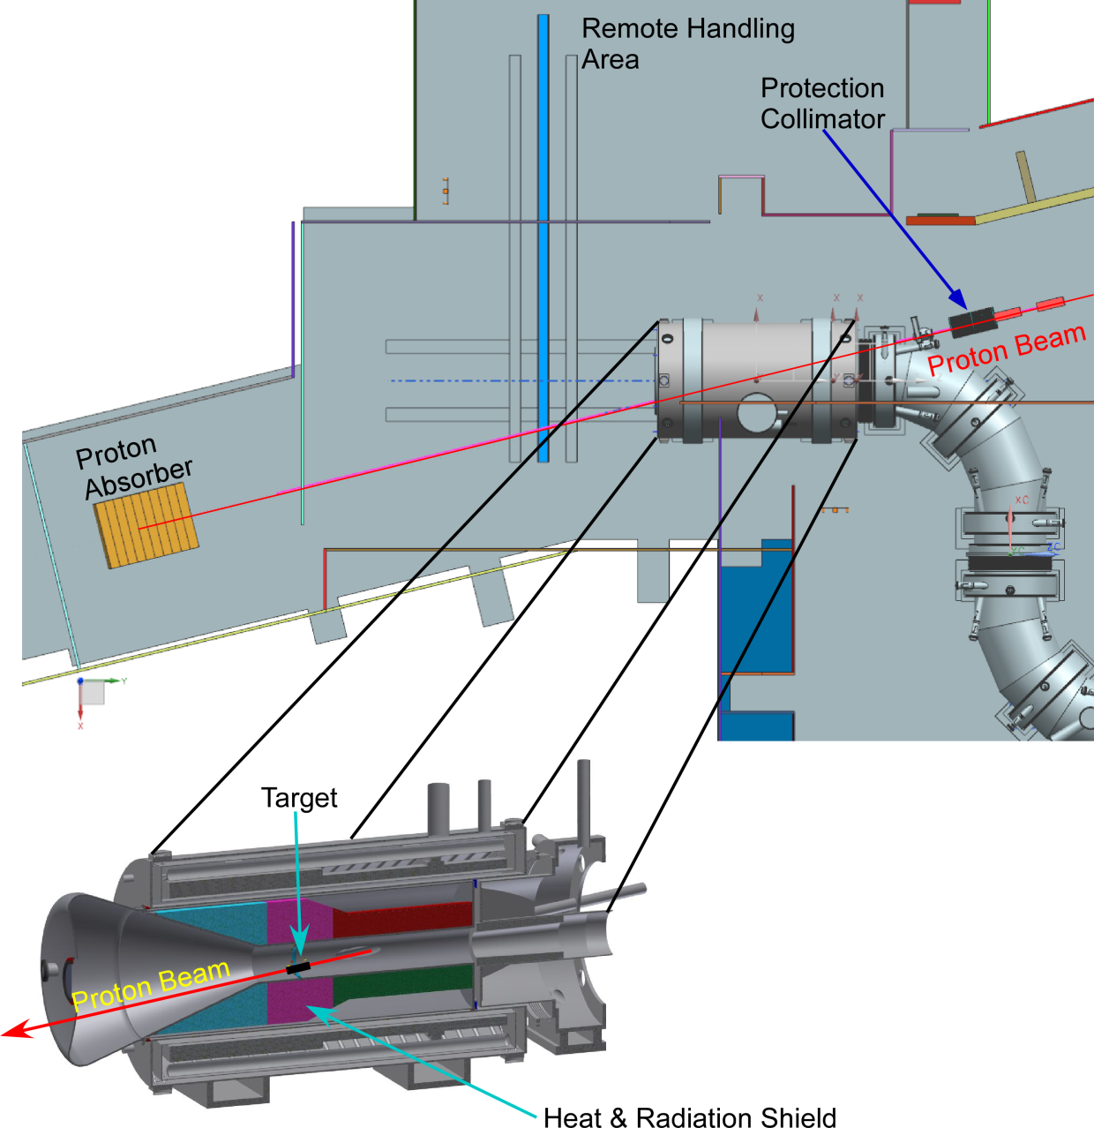
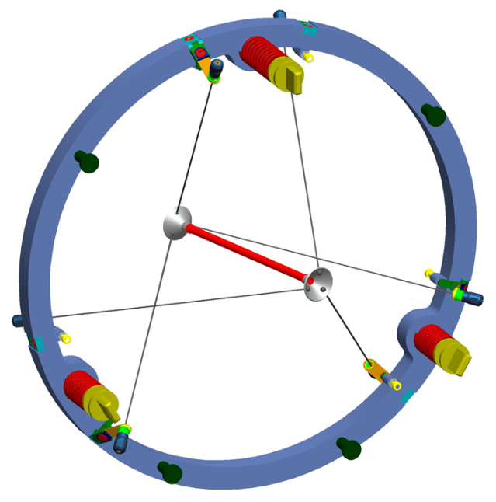
Mu2e Proton Target Station
Target – located inside the Production Solenoid (PS)
Heat & Radiation Shield (HRS)
Proton Absorber
Protection Collimator
PS

Slide 23
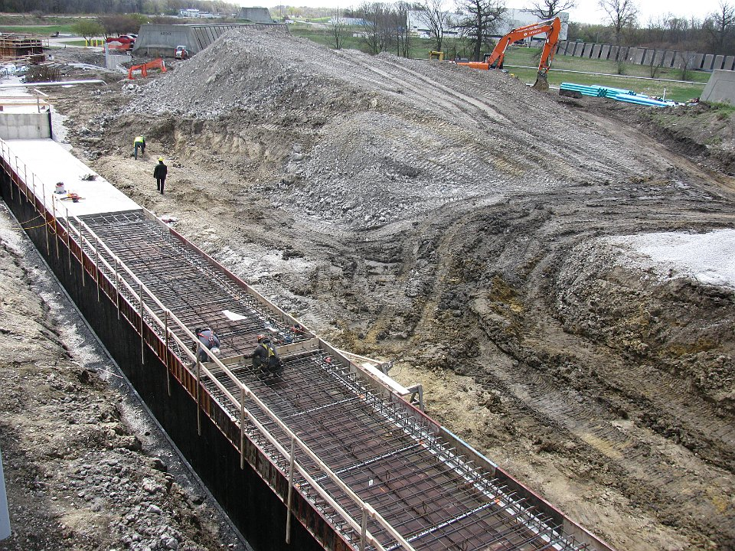
M4 Enclosure Construction

Slide 24
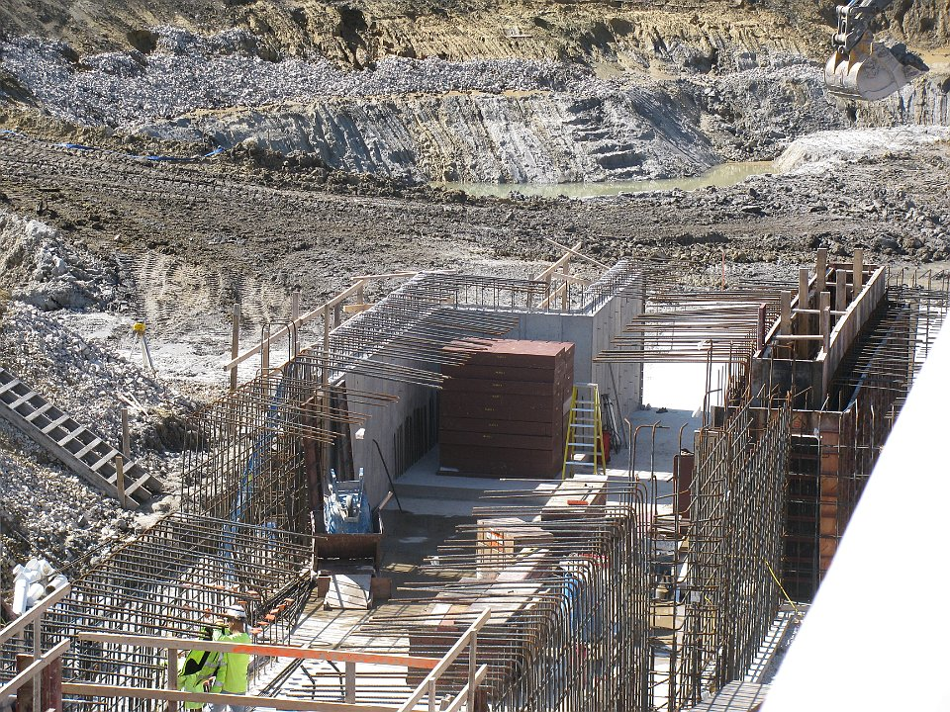
M4 Beamline Enclosure construction – Diagnostic Absorber

Slide 25
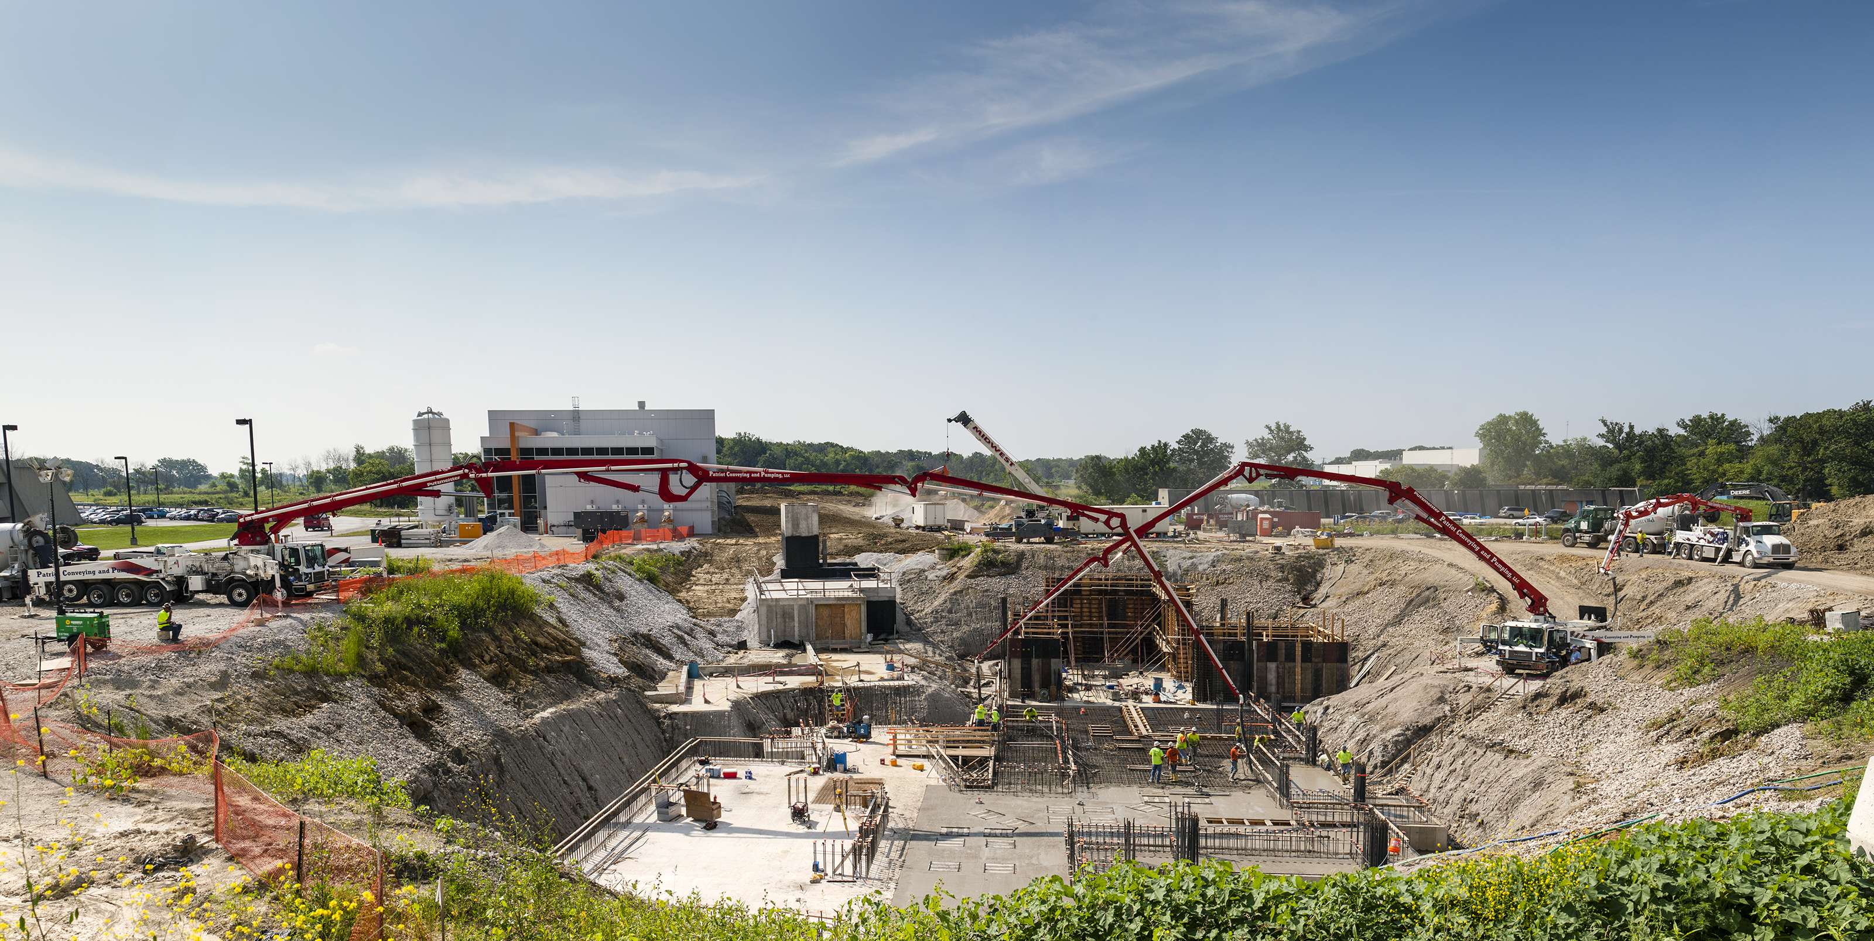
Pouring Mu2e building floor slab
Looking east toward g-2 Building

Slide 26
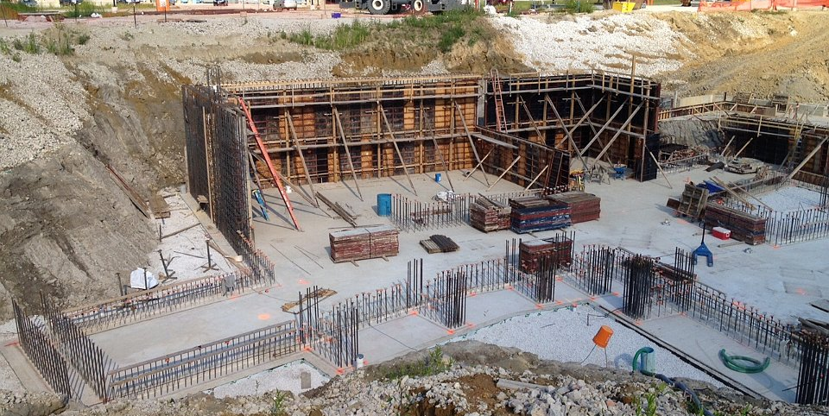
Framing the walls in the proton target station area of the Mu2e building

Slide 27
Schedule

Slide 28
Schedule
PS Arrives @ Mu2e Bldg
CD-2/3b
CD-3c
Mu2e Complete
M4 Enclosure
BO
Beam to Diagnostic Absorber
Resonant Extraction Design
Fabrication & Installation of Res. Extr. Magnets, Power Supplies, & Electronics
Fabricate ESS
Install ESS
Commission Res. Extr.
External (M4) Beamline Design
Extinction & M4DA Section Installation
Hbend Section Installation
Final Focus Section Installation
Target Station Design
Target Fabrication
Target Remote Handling Fabrication & Installation
HRS Procurement & Fabrication
HRS Installation
Extinction Design
AC Dipole, Pwr Supply & Collimator Procurement, Fabrication & Install
Extinction Monitor Procurement, Assembly & Install
Instrumentation & Controls Design
Instrumentation & Controls Implementation
Radiation Safety Design
Radiation Safety Procurements, Fabrication & Installation
Delivery Ring RF Design
Delivery Ring RF Procurements, Fabrication & Installation
Beam Operations:
g-2 Beam Operations
M4 Commissioning with single turn Beam
Q3 | Q4 | Q1 | Q2 | Q3 | Q4 | Q1 | Q2 | Q3 | Q4 | Q1 | Q2 | Q3 | Q4 | Q1 | Q2 | Q3 | Q4 | Q1 | Q2 | Q3 | Q4 | Q1 | Q2 | Q3 | Q4 | Q1 | Q2 | Q3 | Q4 | Q1 | Q2 | Q3 | Q4
FY14 FY15 FY16 FY17 FY18 FY19 FY20 FY21
Notes:
Notes:
No Muon Campus beam between Spring 2014 and Winter 2017
The ESS replaces a Delivery Ring extraction kicker module. Therefore, ESS installation precludes further single turn extracted beam to the M4 beamline.
HRS installation takes 10 days (box on schedule is over-sized)
Target installation is off-project and estimated to occur in Dec. 2021.
Beam commissioning is off-project

Slide 29
Muon Campus Program Cost
Project | Total Project Cost ($M) | Accelerator Costs ($M)
Muon g-2 Project | 46.4 | 22.2
Mu2e Project | 271.0 | 50.2
Recycler RF AIP | 9.7 | 9.7
Beam Transport AIP | 6.2 | 6.2
Delivery Ring AIP | 9.3 | 9.3
Cryo AIP | 9.7 | 9.7
MC-1 Building GPP | 9.0
Beam Enclosure GPP | 9.7
MC Infrastructure GPP | 1.0 | 1.0
Total | 372.0 | 108.3
All costs are base cost + estimate uncertainty (contingency)

