Slide 1
Mu2E Extraction Regulation using RFKO
Peter Prieto
Michelle Ibrahim

Slide 2
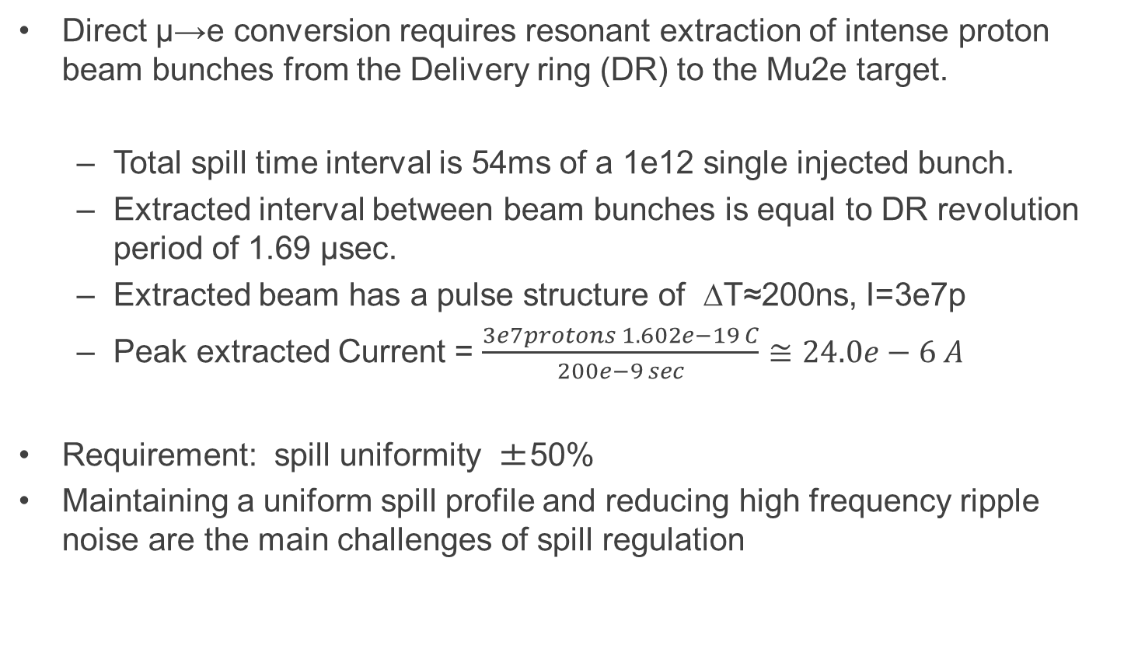
INTRODUCTION
Direct µ→e conversion requires resonant extraction of intense proton beam bunches from the Delivery ring (DR) to the Mu2e target.
  Total spill time interval is 54ms of a 1e12 single injected bunch.
  Extracted interval between beam bunches is equal to DR revolution period of 1.69 µsec.
  Extracted beam has a pulse structure of ΔT≈200ns, I=3e7p
  Peak extracted Current = $\frac{3e7protons 1.602e−19 C}{200e−9 sec}$ $≅24.0e−6 A$
Requirement: spill uniformity ±50%
Maintaining a uniform spill profile and reducing high frequency ripple noise are the main challenges of spill regulation

Slide 3
Spill Regulation
Main element of Spill Regulation is RF Knock Out (RFKO) which regulates the particle extraction rate.
RFKO is implemented through heating the stable beam transversely at frequencies swept around the tune frequency spread.
We reserve the possibility of including QXR (quadrupole extraction regulator) to control ripple intruded by power supplies and other possible sources of spill variations.

Slide 4
Power Supply Ripple
Most likely source of spill rate ripple is the quads magnet field ripple. Extraction is sensitive to ripple at very low level, which is difficult to measure other than at extraction itself.
Magnet ripples may be phase locked to the power line, which could simplify regulation but we should assume random phases are possible as well.

Slide 5
RFKO Regulation
2 regulation loops, a feedback loop and a cycle-to-cycle feedforward learning loop combined together forming extraction regulation.
The spill intensity minus the reference intensity are used by the feedback parameters P (proportional element), I (integral element), D (derivative element) which all added together produce amplitude corrections to the chirp signal which is the reference to the power amplifier driving the stripline kicker.
Integrator windup needs to be taken into account in the loop

Slide 6
Intensity Regulated Spill using Wall Current Monitor (WCM)
Extracted beam (spill) is measured using a WCM with bandwidth between 50 KHz and 10 MHz. The signal is amplified, digitized, and filtered before it is used by the real-time feedback loop as well as the cycle-to-cycle learning regulation loop.

Slide 7
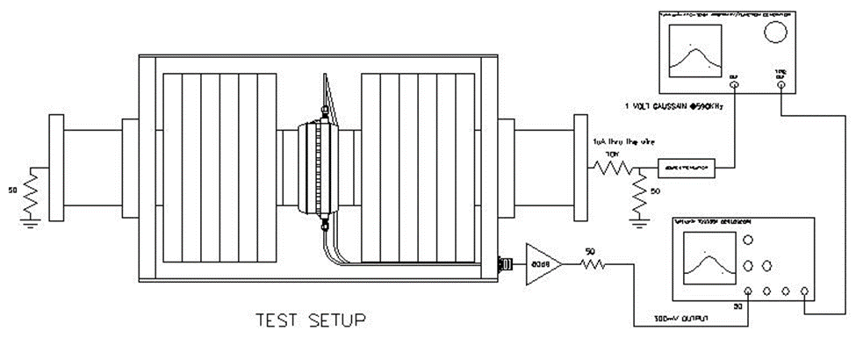
WCM Impedance Measurement Test Stand
Wire measurement of the WCM. The impedance of the WCM is 54 Ohms. It was designed to be 100 Ohms at 2MHZ.

Slide 8
Wire Measurements of Spill from WCM
Simulated 3e7 protons/bunch using wire through the WCM. It is expected that averaging of the spill signal due to noise will be required limiting the bandwidth of the feedback regulation loop.

Slide 9
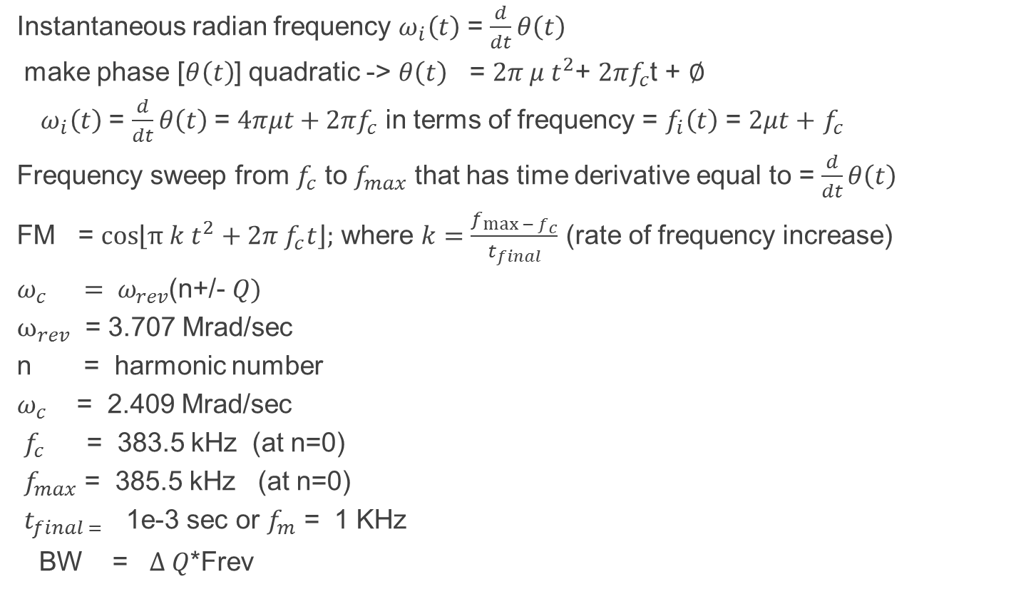
RFKO Frequency Sweep
Instantaneous radian frequency $ω_{i}\left(t\right)$ = $\frac{d}{dt}θ\left(t\right)$
make phase [$θ\left(t\right)$] quadratic -> $θ\left(t\right)$ = $2π μ t^{2}$+ $2πf_{c}$t + $∅$
${ ω}_{i}\left(t\right)$ = $\frac{d}{dt}θ\left(t\right)$ = $4πμt+2πf_{c}$ in terms of frequency = $f_{i}\left(t\right)$ = $2μt+$ $f_{c}$
Frequency sweep from $f_{c}$ to $f_{max}$ that has time derivative equal to = $\frac{d}{dt}θ\left(t\right)$
FM = $\cos\left\lfloor π k t^{2}+2π f_{c}t\right\rfloor ;$ where $k=\frac{f_{\max{− f_{c}}}}{t_{final}}$ (rate of frequency increase)
$ω_{c} = ω_{rev}$(n+/- $Q)$
$ω_{rev}$ = 3.707 Mrad/sec
n = harmonic number
$ω_{c}$ = 2.409 Mrad/sec
$f_{c }$ = 383.5 kHz (at n=0)
$f_{max}$ = 385.5 kHz (at n=0)
$t_{final =}$ 1e-3 sec or $f_{m}$ = 1 KHz
BW = $∆ Q$*Frev

Slide 10
AM Modulation of FM RFKO
AM Modulation of Chirp signal.

Slide 11
Real time Processing
Processor update rate is line locked, can be 5760 Hz.
5760Hz interrupt rate means processor has 173.611us to calculate loop error, apply gain, integrate (PI loop elements) and scale output to stripline kicker.
Processor can update 311 new values during a 54 msec spill.
In learning regulation, between each spill the processor has more time to perform complex signal processing.

Slide 12
Feedback Loop Bandwidth
In a feedback-feedforward scheme, the feedback loop has a lower bandwidth than the feedforward.
WCM limits the bandwidth of the feedback loop at 10MHz.
The step response of the power amplifier (> 1 us)
The computational time of the processor (5KHz)
The bandwidth of the stripline kicker 10-50MHz
The time constant of extraction ≤ 500 turns (1 ms -> 1 KHz)
Therefore the dominant pole in the feedback loop is imposed by the extraction time constant.

Slide 13
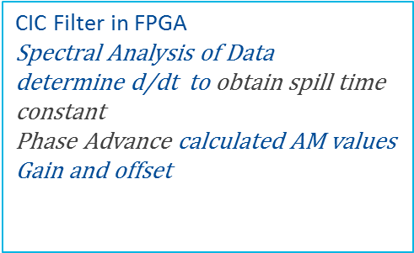
Feed-Forward and Feedback Loops
The feedforward loop is non-causal since the correction can be applied with an arbitrary phase.
Spill Mon
CIC Filter in FPGA
Spectral Analysis of Data
determine d/dt to obtain spill time constant
Phase Advance calculated AM values
Gain and offset
Done in uP
And FPGA
Ideal Spill
AM Signal
To Power Amp
+
+
e
External FM Signal Generator
TeK
Proportional Integral, Derivative ? Controller
-
+
Spill Beam

Slide 14
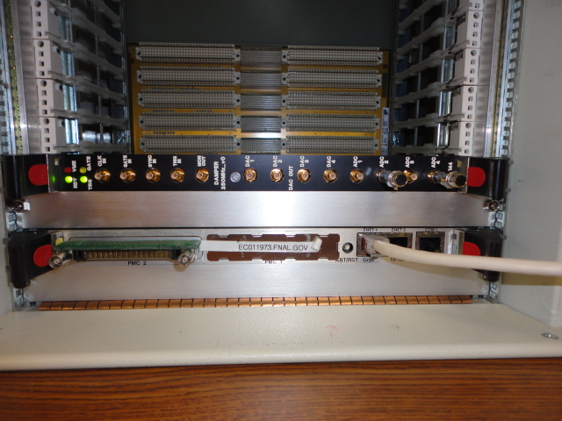
HARDWARE ELEMENTS
MVME 5500 micro Processor responsible for computing both regulation loops in a VME64X crate together with 4 channel ADC/DAC needed to digitize ISpill from WCM and DDCT
DAC signals will be the AM drive to FM source which in turn will drive the Power Amplifier

Slide 15
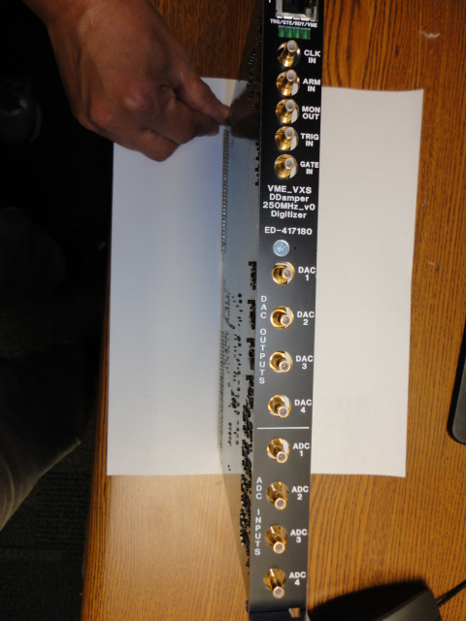
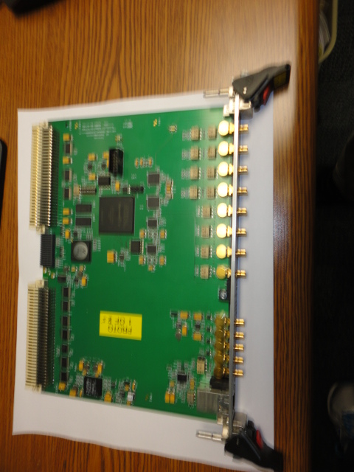
Front Panel of 4 Channel ADC/DAC
VME64X Board
VME64X Cyclone V FPGA Digitizer Board

Slide 16
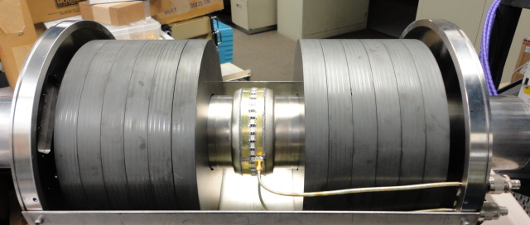
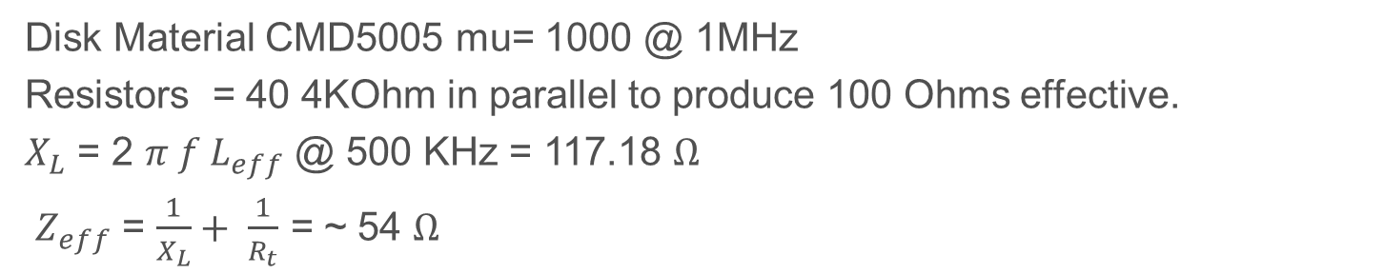
Wall Current Monitor (WCM)
Disk Material CMD5005 mu= 1000 @ 1MHz
Resistors = 40 4KOhm in parallel to produce 100 Ohms effective.
$X_{L}$ = 2 $π f L_{eff}$ @ 500 KHz = 117.18 $Ω$
$Z_{eff}$ = $\frac{1}{X_{L}}+ \frac{1}{R_{t}}$ = ~ 54 $Ω$

Slide 17
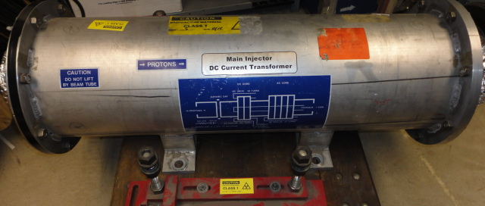
DCCT
DCCT used in Main Injector, same type as one that will be installed in Delivery Ring used to measure circulating beam intensity an alternate component of the feedback loop.

Slide 18
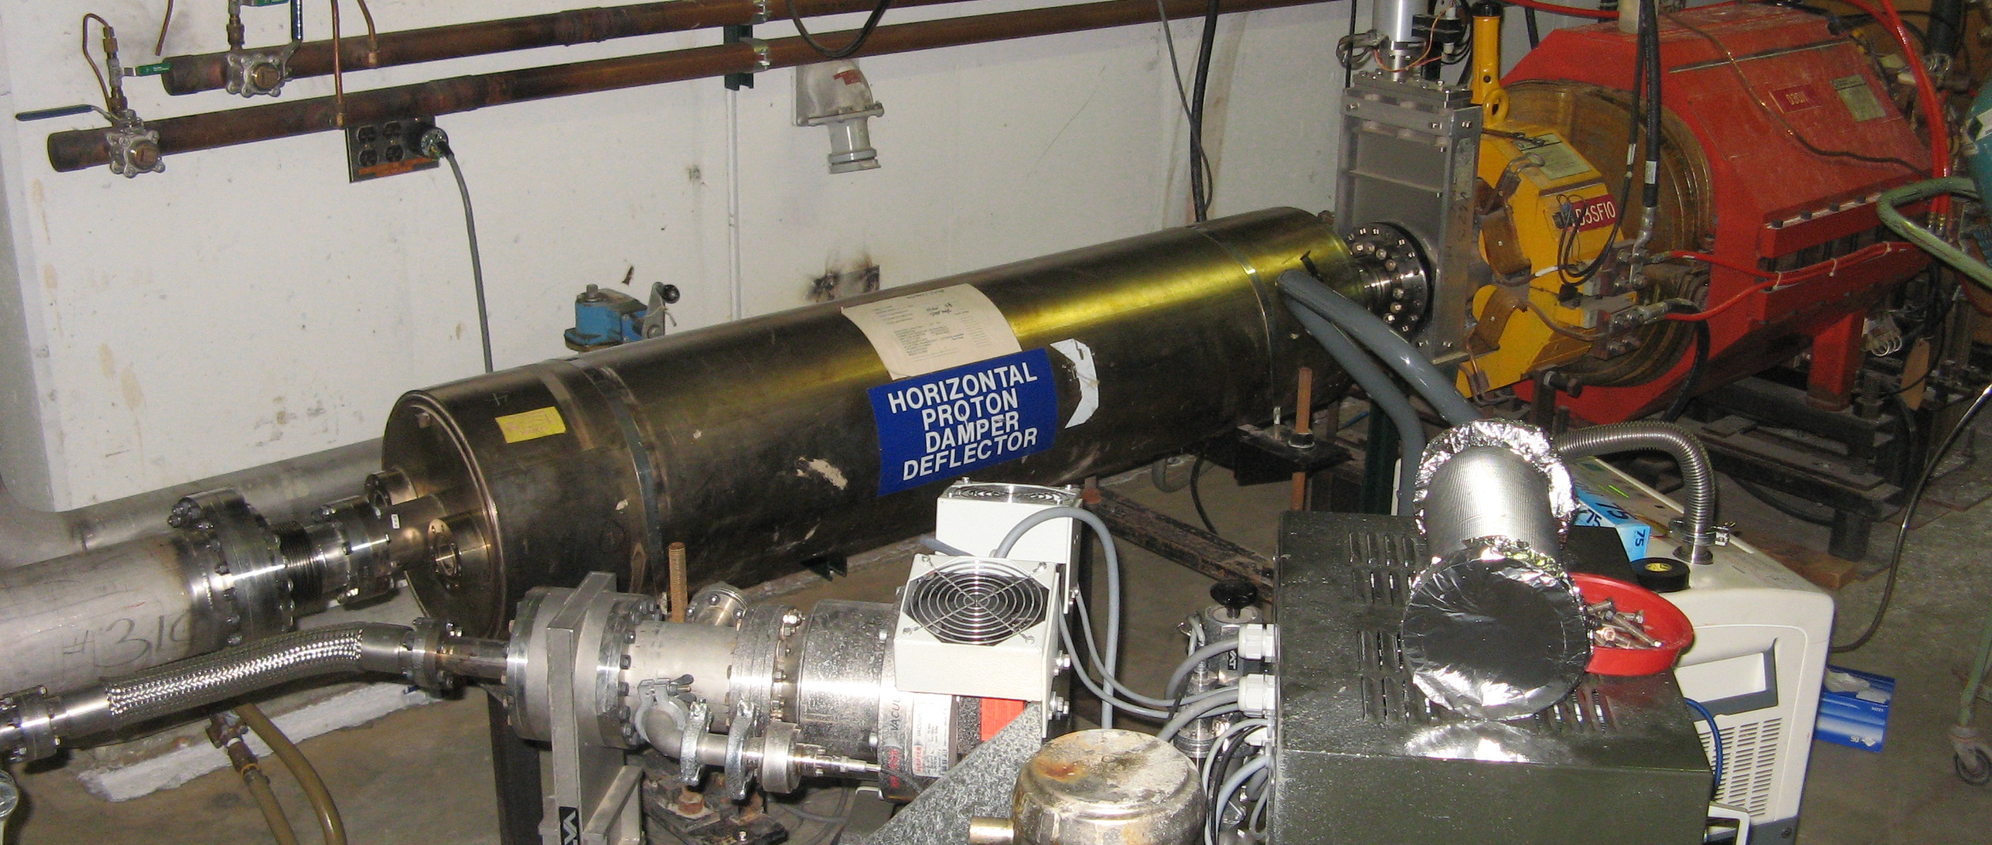
Stripline Kicker installed in DR
Stripline kicker installed in DR during RFKO studies.

Slide 19
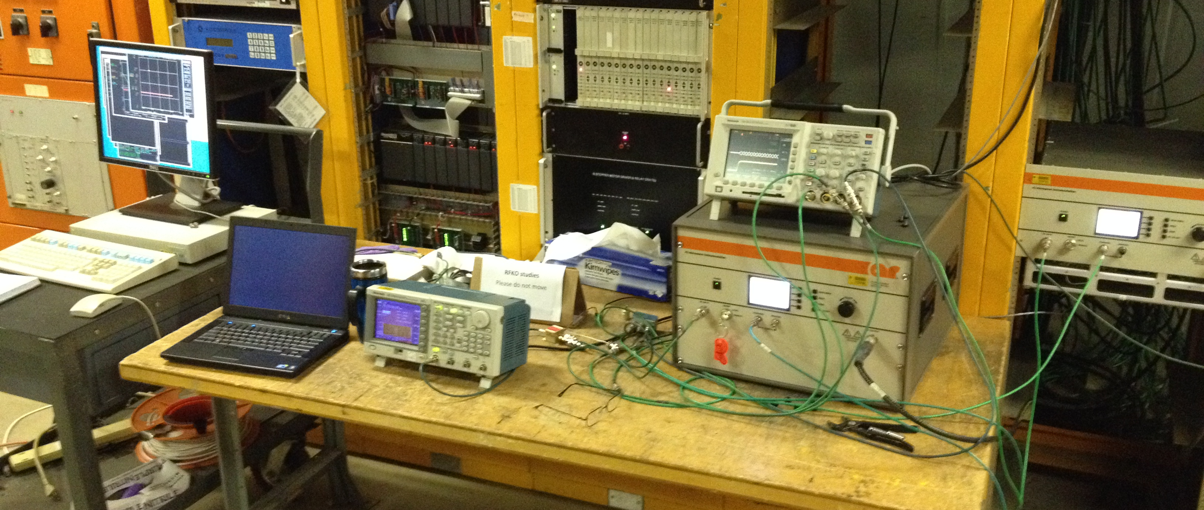
RFKO Test Setup in DR
1 KW power amplifier used to drive stripline kicker during RFKO studies.

Slide 20
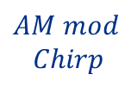

Real Time Regulation Loop simulated in MATLAB
Loop Step size = 1.69 us
Ideal Reference
$$AM mod$$
$$Chirp$$
+
$$α_{1}$$
Calculate beam εmittance
Calculate #particles outside of separatrix
Extraction delay through septum
P I
X
K
-
Beam Extracted
Chirp
CIC
Filter
ADC
+90 dB
WCM
Z = 54 Ω
Extracted Particles

Slide 21
Matlab Simulation of Spill Regulation
The simulation models “radio frequency knockout” (RFKO) to control the beam emittance growth.
  The regulation loop error signal modulates the amplitude an FM signal driving the stripline.
  The resulting RF horizontal kick causes the beam to heat transversely, allowing particles to transition though the separatrix and “spill out” into the unstable region.
Each iteration of the simulation loop is 1 revolution.
The error signal can either be based on the DCCT model or the spill monitor model.

Slide 22
Regulation Block Diagram Description
PI blocks represent proportional and integral controllers.
  The error signal is the difference between the input and reference signals.
  The output of the controller determines the magnitude [α_{n}] of an chirp waveform [y_{n}(t)].

Slide 23
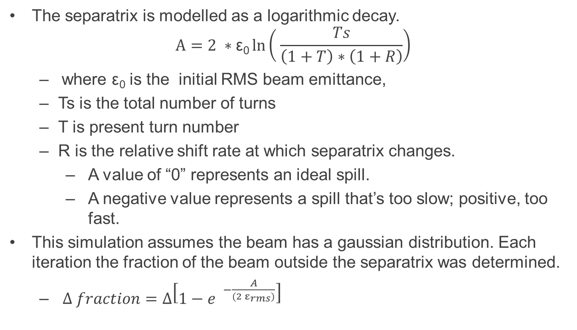
Separatrix Block Diagram Description
The separatrix is modelled as a logarithmic decay.
$$A=2 ∗\text{ε}\text{0}\ln\left( \frac{Ts}{\left(1+T\right)∗\left(1+R\right)}\right)$$
  where ε₀ is the initial RMS beam emittance,
  Ts is the total number of turns
  T is present turn number
  R is the relative shift rate at which separatrix changes.
      A value of “0” represents an ideal spill.
      A negative value represents a spill that’s too slow; positive, too fast.
This simulation assumes the beam has a gaussian distribution. Each iteration the fraction of the beam outside the separatrix was determined.
  $∆ fraction=∆\left[1−{e }^{−\frac{A}{(2 ε_{rms})}}\right]$

Slide 24
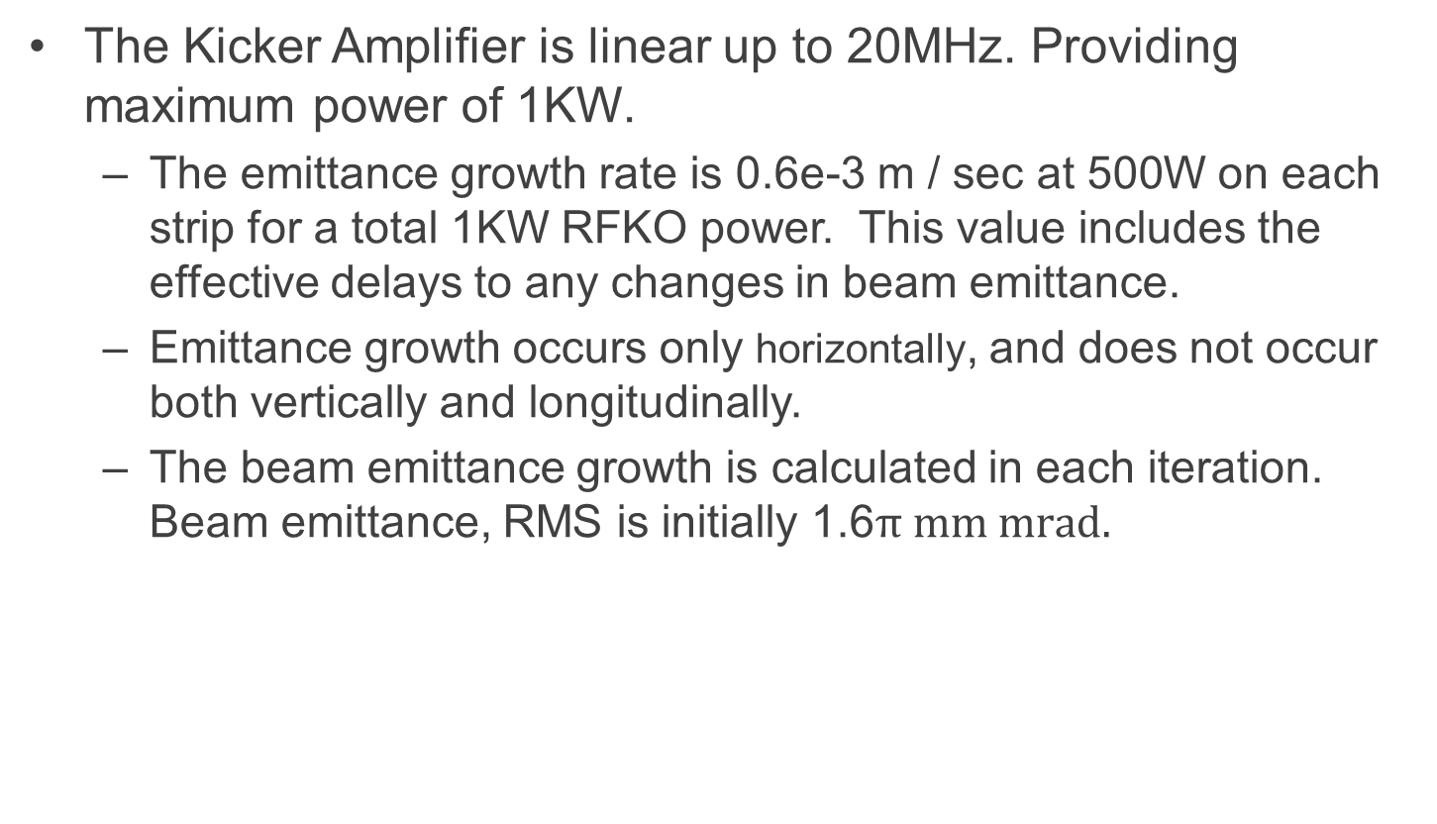
Simulation Block Diagram Description
The Kicker Amplifier is linear up to 20MHz. Providing maximum power of 1KW.
  The emittance growth rate is 0.6e-3 m / sec at 500W on each strip for a total 1KW RFKO power. This value includes the effective delays to any changes in beam emittance.
  Emittance growth occurs only horizontally, and does not occur both vertically and longitudinally.
  The beam emittance growth is calculated in each iteration. Beam emittance, RMS is initially 1.6$π \text{mm} \text{mrad}\text{.}$

Slide 25
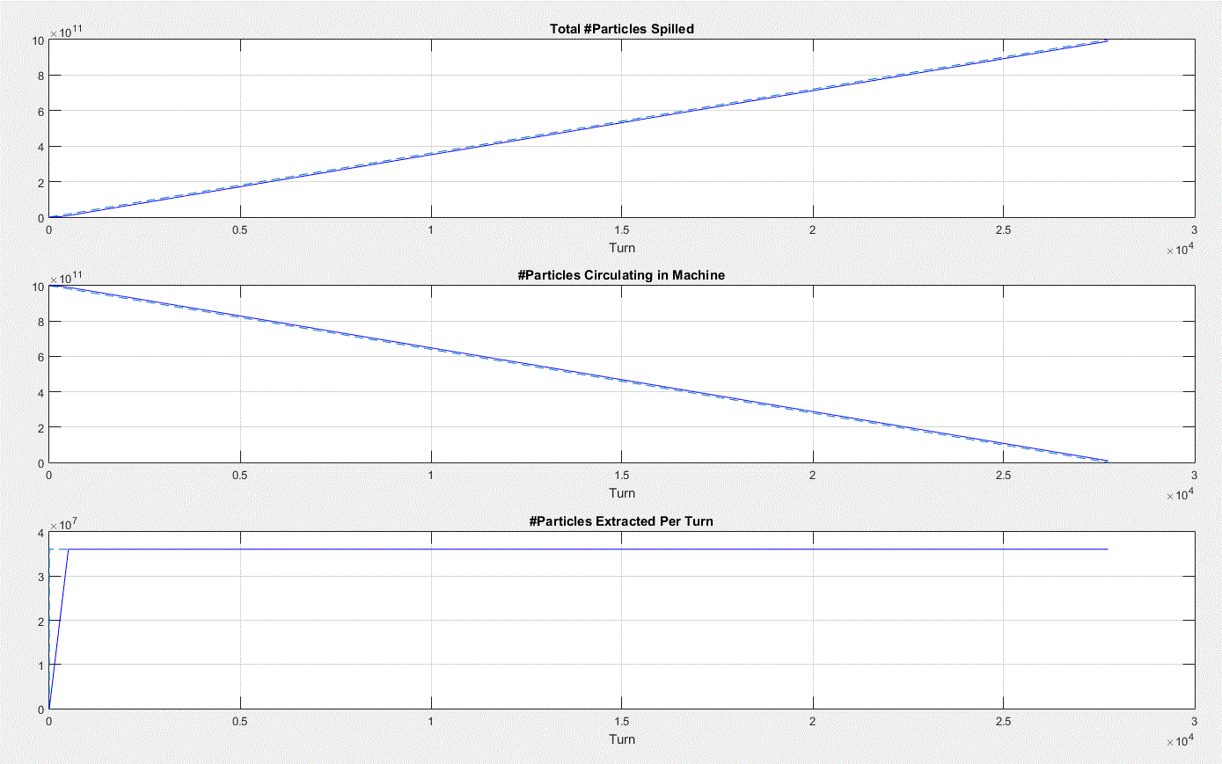
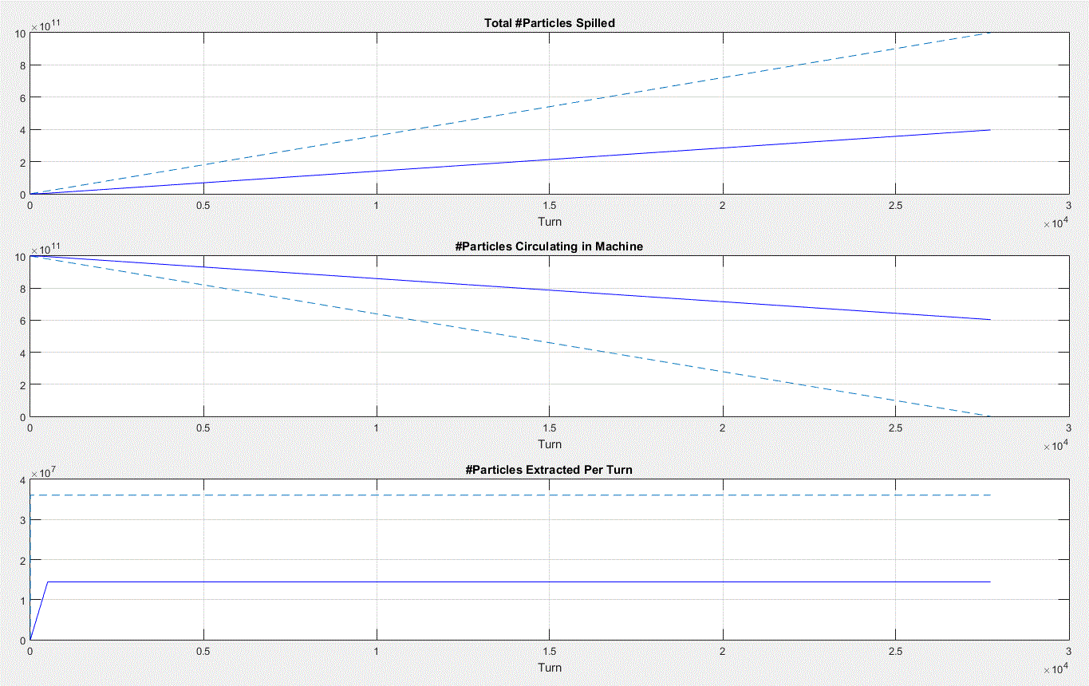
With No RFKO, beam emittance is constant. #Particles extracted is only determined by rate of the change in separatrix size.
When ShiftRate =“0” , the spill is ideal.
ShiftRate is set to -0.6. Separatrix size reduces 60% slower than ideal case. Less particles are extracted.

Slide 26
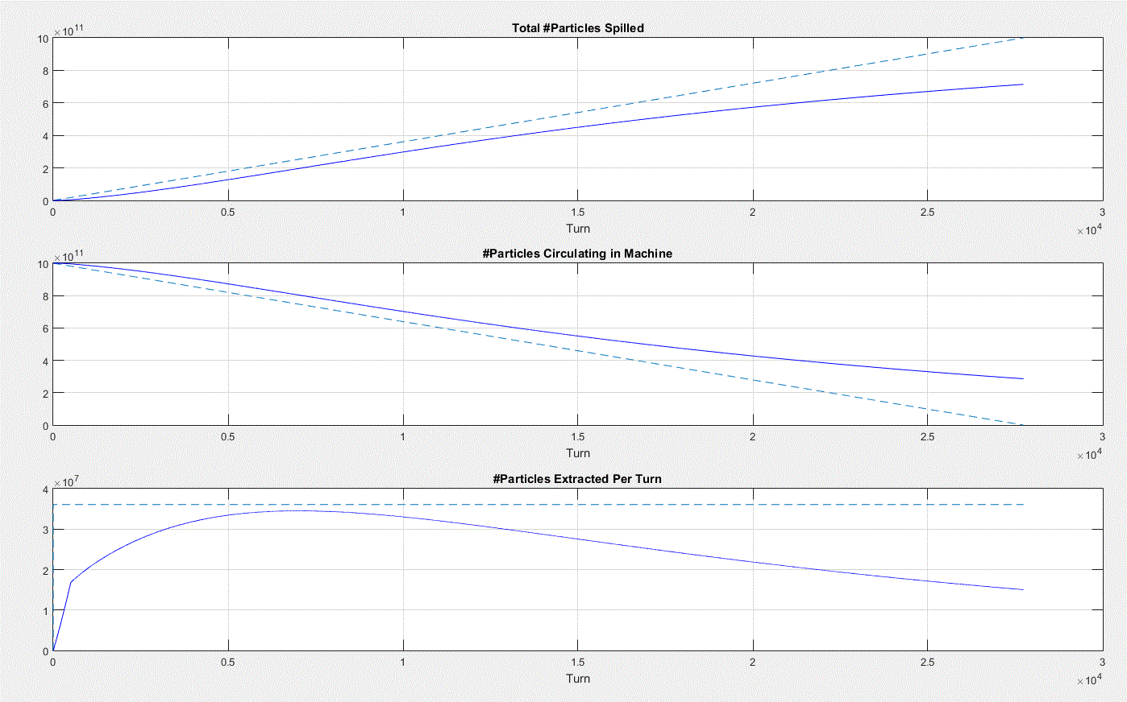
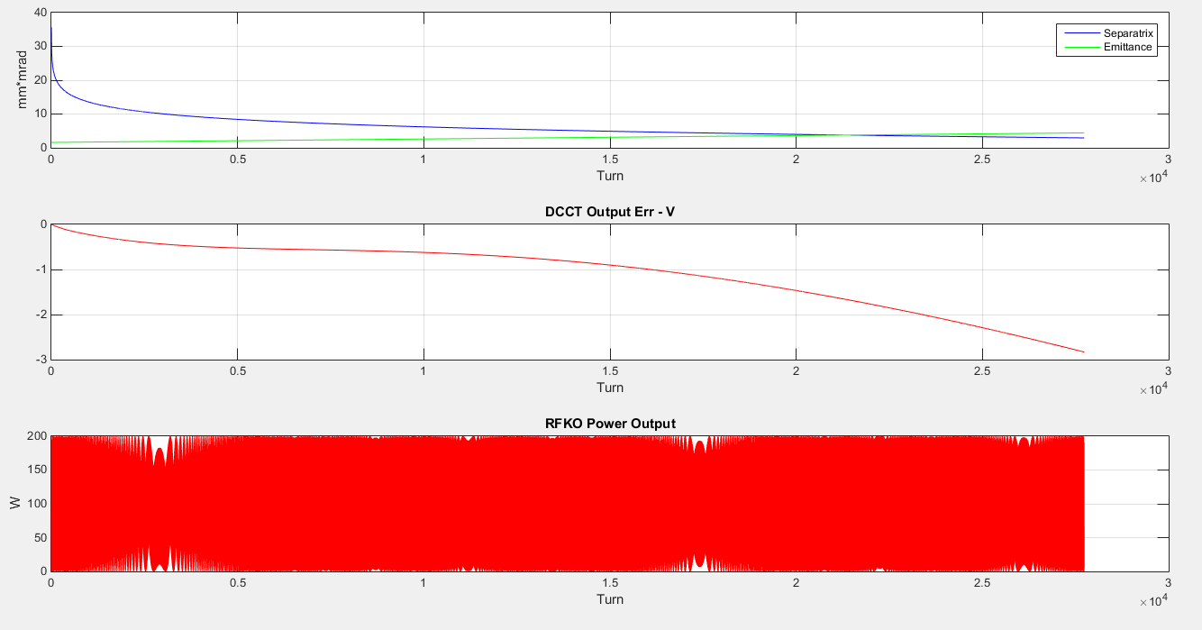
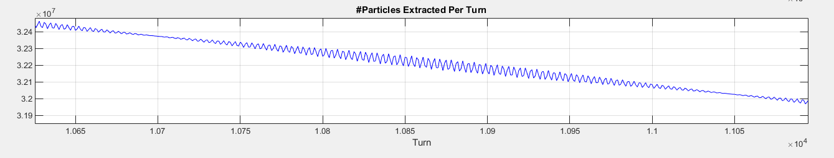
ShiftRate=-0.6 → Separatrix’s size shrinks slower
Constant, unregulated RFKO causes some beam emittance growth and drives more extraction than case with no RFKO.

Slide 27
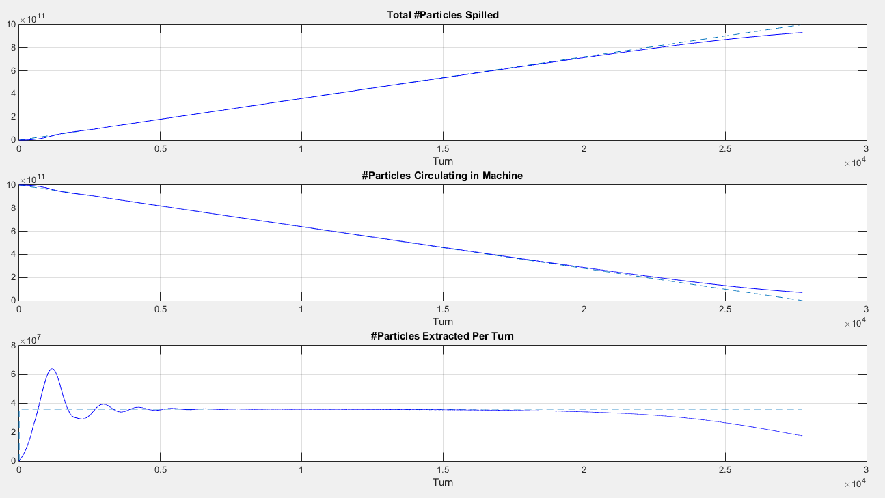
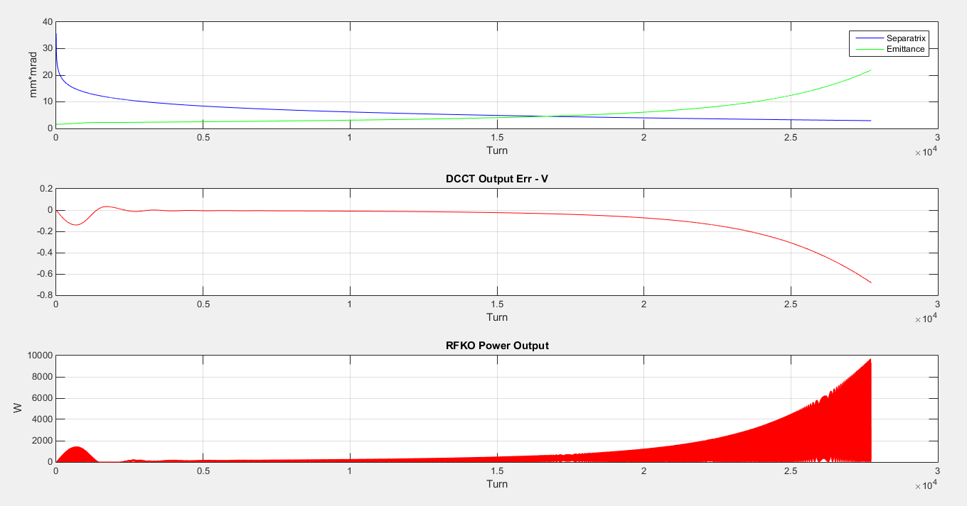
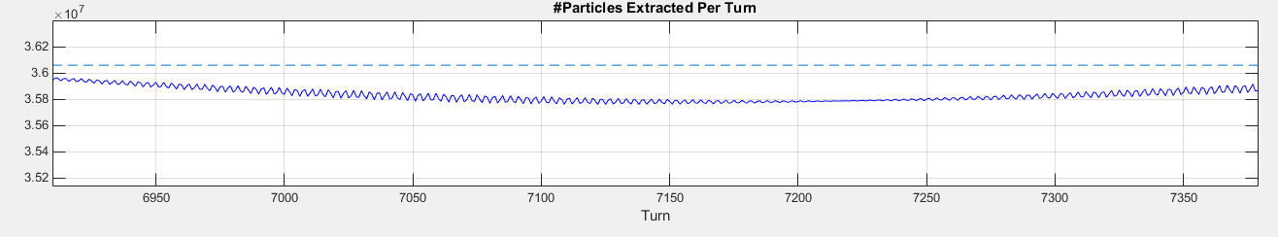
ShiftRate=-0.6; Regulation using PI controller and DCCT
RFKO not clamped to maximum and allowed to grow as needed during spill (27733 turns).

Slide 28
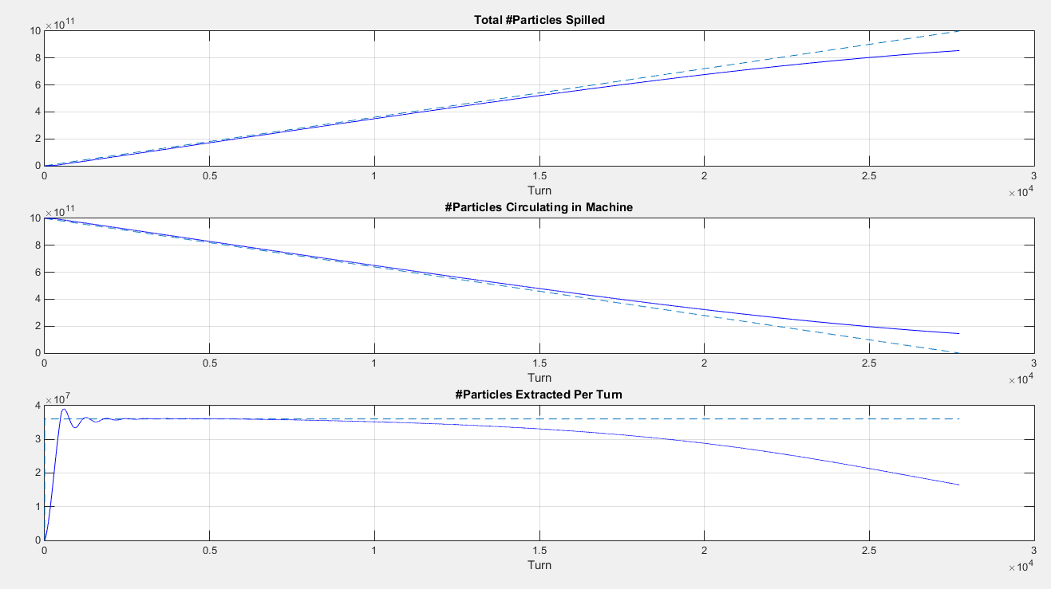
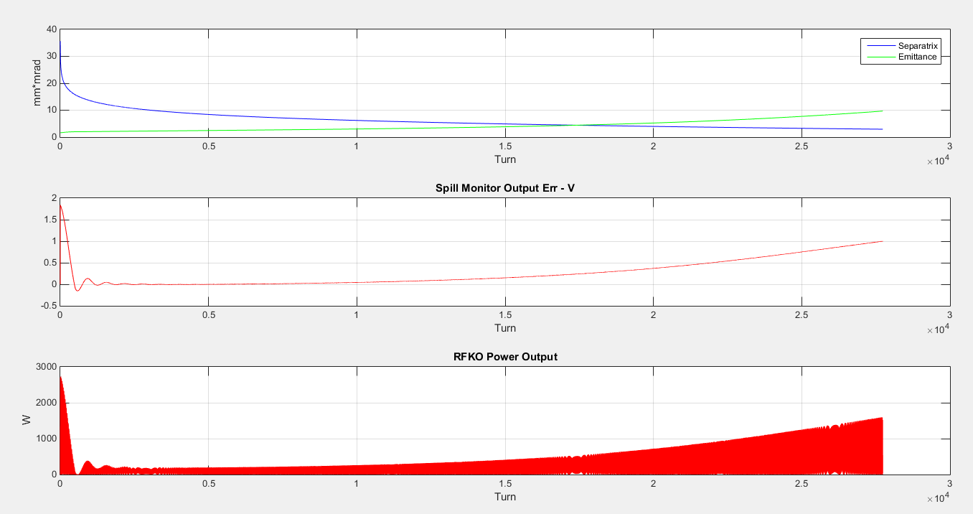
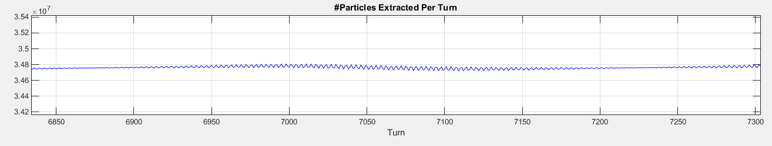
ShiftRate=-0.6; Regulation using P controller and WCM
RFKO not clamped to maximum and allowed to grow as needed during spill (27733 turns).

Slide 29
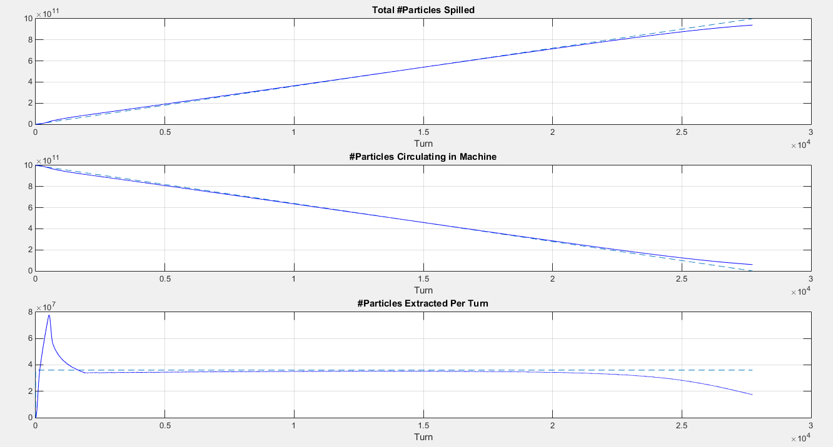
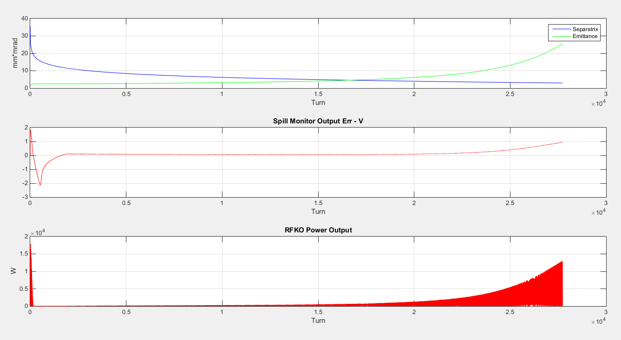
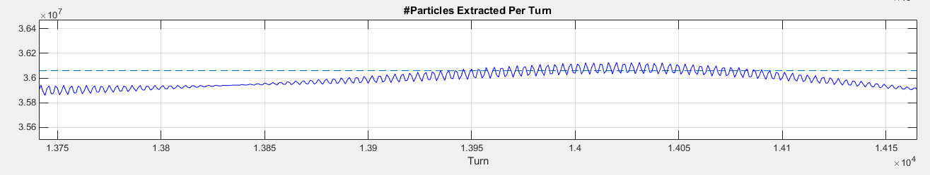
ShiftRate=-0.6; Regulation using PI controller and WCM
RFKO not clamped to maximum and allowed to grow as needed during spill (27733 turns).

Slide 30
Conclusions
We have substantial experience at Fermilab using the hardware architecture proposed. We have used it in other real-time applications so we are piggybacking on existing designs, production and operating systems.
Feel confident the hardware architecture is capable of performing RFKO regulation.
Modelling with MATLAB is ongoing to develop a better feel for regulation response to non-linear dynamics (as modelled).
We are within the time-frame not to be in the critical path.
May need to add other regulation elements The hardware is made flexible to allow this.

