Slide 1
Design Concepts of the Mu2e Electrostatic Septa - Motion Control
David Tinsley
Mu2e Resonant Extraction Technical Review
August 25, 2015

Slide 2
Extraction Channel Layout (Plan View)
Circulating beam
Beam direction
Extracted beam

Slide 3
Motion control under the ends of the septa vacuum vessel
Plan Section View
ESS2
ESS1
Q203
Downstream
Elevation view
Upstream
Vacuum bellows before
and after both septa.
Q203
ESS2
ESS1
Motion Control
Beam Direction
Motion Control

Slide 4
Shielding around Septa
D-30 Straight Layout
Steel Shielding
Above Septa
And Quads
Q204
ESS2
Q203
ESS1
Q202
Beam Direction
Downstream
Upstream

Slide 5
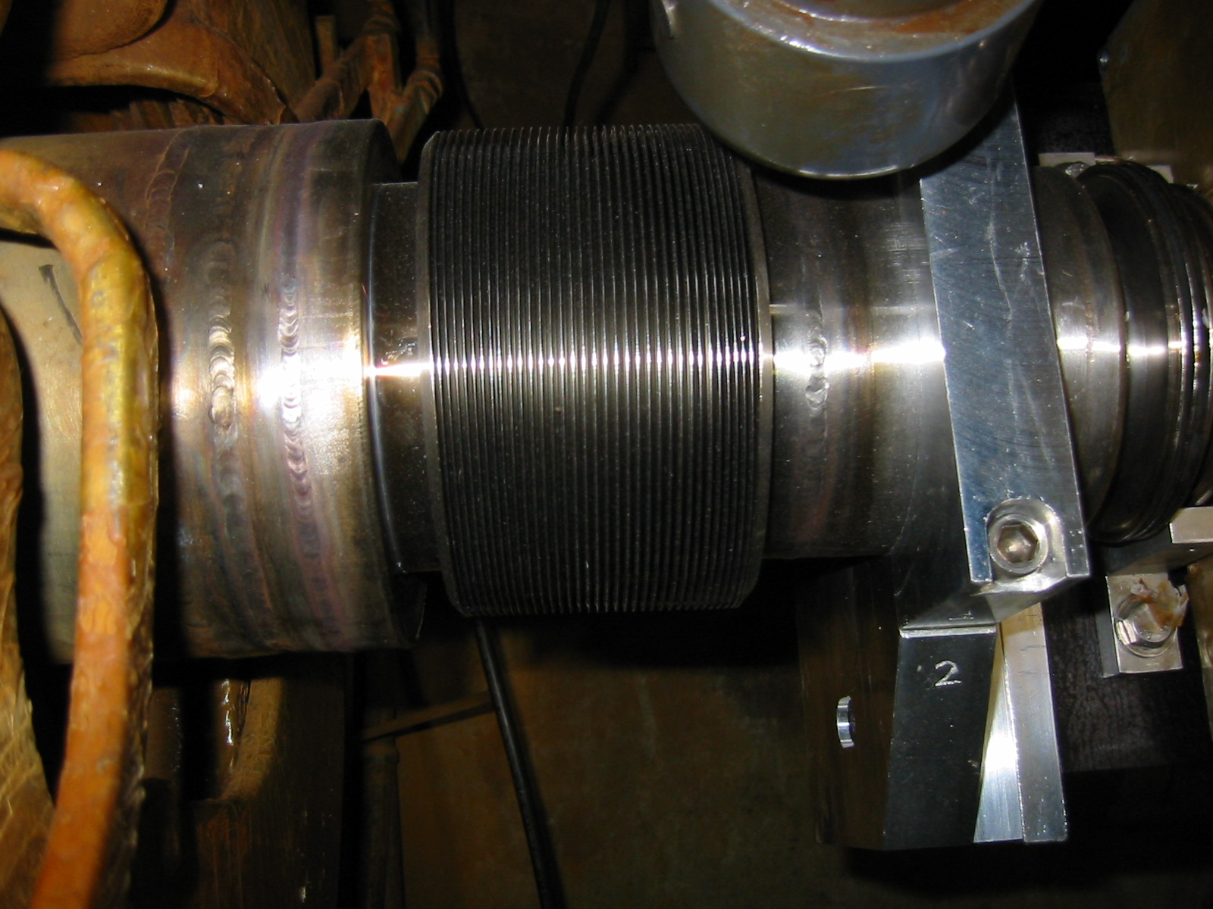
Bellows Specifications
Pbar Debuncher motorized quads used MC-413126 (cuff OD of 5.5").
The limit switches for the stands were set at +/- 0.5" and at other locations, the motion was +/- 0.75" so they would work in this application.

Slide 6
Bellows Drawing

Slide 7
Tevatron Electrostatic Extraction Septum Motion Control
Extraction Septa
LVDT
Pad
Bellows
LVDT
Limit Switches
Micro Slide
Stepper Motor, 200 steps per revolution

Slide 8
Tevatron Electrostatic Extraction Septa Bellows

Slide 9
Micro Slide and Stepper Motor and LVDT
Micro slide has a micrometer pitch thread, 40 threads per inch, which is .025 inch per revolution.
Micro slide have minimal backlash of better than .001 inch.
The stepper motor has 200 steps per revolution. Therefore the movement is .000125 inch per step.
There are limit switches which prevents over travel of slide.
LVDT ’s (Linear Variable Differential Transformer) are radiation hard.
LVDT has the type of precision that can be achieved is about or better than 1/10% of the full throw.

