Slide 1
Timing Plots in Milliblock MCC3 Samples
Mark Convery (SLAC)
22 July 15

Slide 2
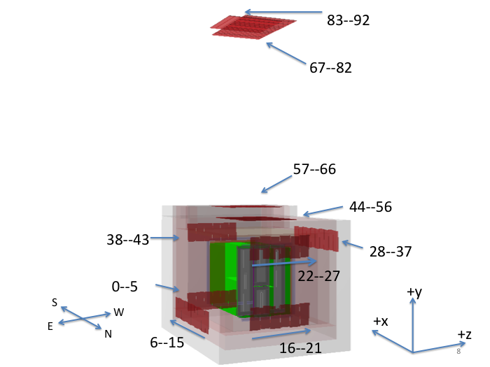
Looking at Timing Between TPC Hits/MC Truth/External Counters
Counters now included in MC datastream (thanks Michelle and Matt Thiesse)
MCC3 produced 1000 events milliblock CRY events (thanks Tingjun)
Look for coincidences between counters and TPC hits
Could be useful online monitoring plot based only on hit info

Slide 3
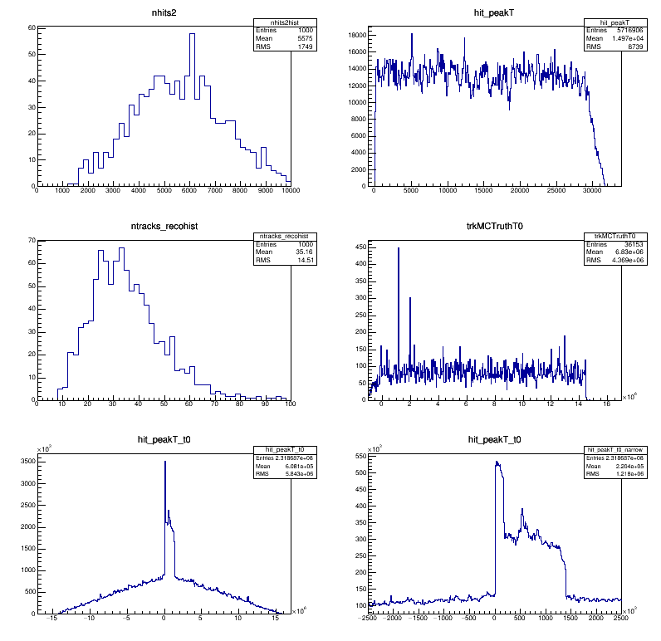
Compare TPC Hit times to trkMCTruthT0
Warm up using trkMCTruthT0
Easy to do using mergeana trees from MCC3
Some problems due to duplicate tracks
Subtract trckMCTruthT0 from hit time
Nice “prompt” peak
Short-drift volume spike
Long-drift volume wide

Slide 4
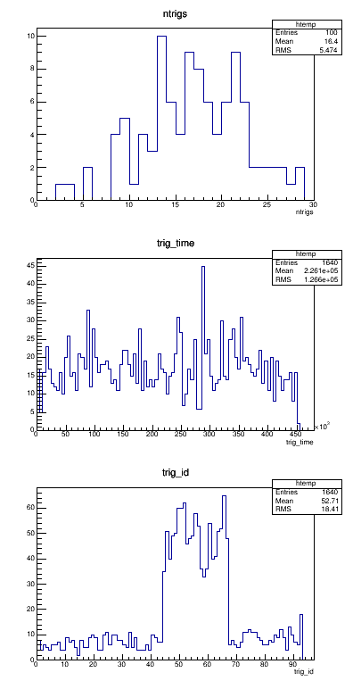
Getting Counters into anatree
Requires a few changes to AnaTree
Change Tree variable (trig_time) dynamic array
Add trig_id
In anatreemodule.fcl
TrigModuleLabel = simcounter
Prodcosmics_lbne35t.fcl also needs simcounter added
Will get changes in for next MCC
For now, rerun ana part of MCC (only 100 events
Rate in cryo-top counters = 60/1600 mS = 40 Hz
Rate in roof-top counters looks low
Need to extend CRY box?

Slide 5
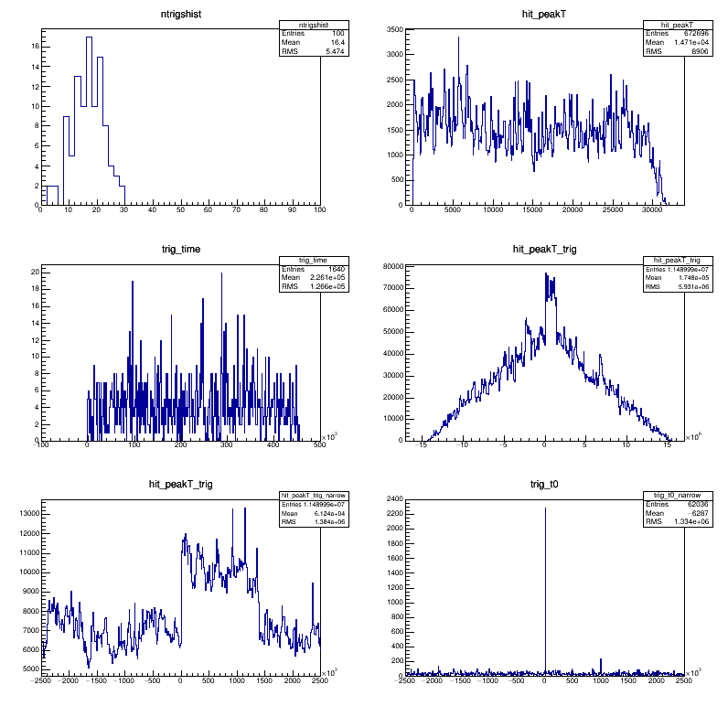
Compare External Counters to TPC Hits
Requires a few changes to AnaTree
Change Tree variable (trig_time) dynamic array
Add trig_id
In anatreemodule.fcl
TrigModuleLabel = simcounter
Prodcosmics_lbne35t.fcl also needs simcounter added
Will get changes in for next MCC
For now, rerun ana part of MCC (only 100 events)

Slide 6
Next Steps
Fix duplicate MCtrk and counter problems
Commit anatree changes
Re-run more MCC3 ana
With large CRY sample and counters simulated can now measure counter coincidence rate in fully simulated data
Will try to get this done this week
Try to understand roof counter rates
Look at doing this with DAQ data

