Slide 1
Collar Pack #2 Disassembly Incident
Summary
Helene Felice
Heng Pan, Dan Cheng, Xiaorong Wang, Soren Prestemon, Maxim Martchevsky,
Ahmet Pekedis, Matt Reynolds, Daryl Horler, Jason Duponte, Tom Lipton, Jordan Taylor

Slide 2
On 07/07/2015
During the collar pack #2 disassembly an incident happened:
The upper coils shifted and collapsed
Preliminary assessment immediately after incident
No one was injured
No assembly tooling were damaged
All collar stacks are intact.

Slide 3
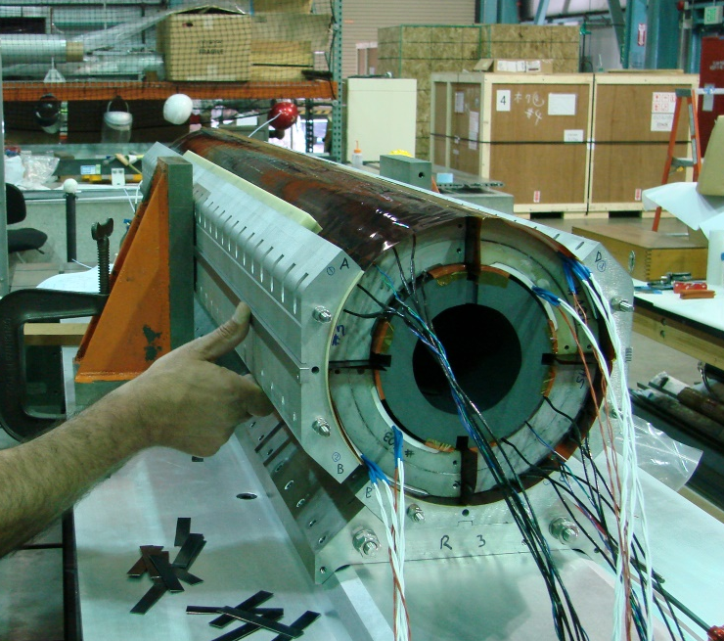
Context of the incident
Normal setup
During the incident
The center coil support spud was not in place;
The technicians were removing the side collar pack, the steel angle block was released
1- Disassemble the top collar stack
2 -Disassemble the collar stack #2
Steel Angle block
Coil support spud
Return End
Return End
Assembly Table
Assembly Table

Slide 4
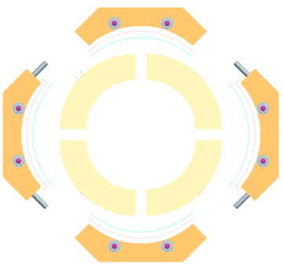
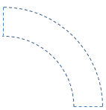
Incident sequence
Return end view
Coil 104 fell onto the assembly table,
Coil 3 fell into coil 5
Red circles indicate the edge of the coil impacting other coil or assembly table.
03
03
104
104
104
03
03
104
103
103
05
05
103
05
103
05
103
104
104
Ready to disassemble
Collars removed
Coils fell off
Return end view

Slide 5
Preliminary Assessment summary details in Heng’s talk
Coil 104
OL splice: epoxy delamination
Damaged wiring of the SG bridges (temp comp), SG are intact
Indents on the coil OD
Bump on the mid-plane
All electrical tests ok
Coil 3
Some local scratches (red circle area)
All electrical tests ok
03
103
05
104
Coil 103
No visual damage
All electrical tests ok
Coil 5
Sectioned wiring from bridges to connector
Kapton GPI damage observed with epoxy damage underneath where coil 104 SG impacted coil 5
All electrical tests ok

Slide 6
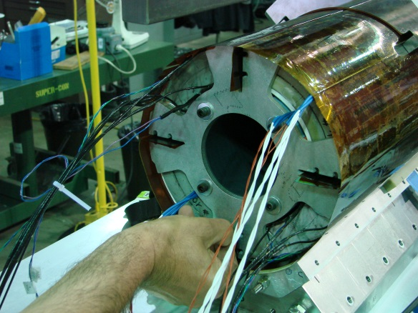
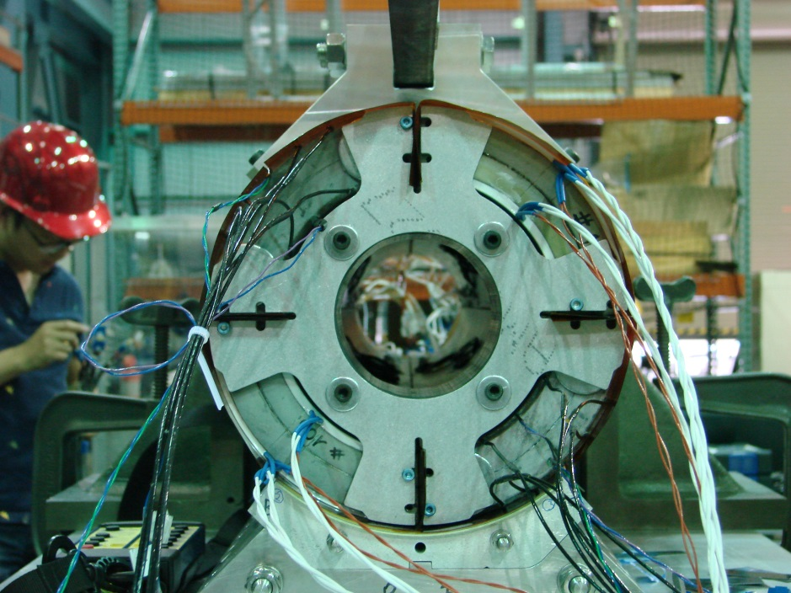
Corrective action already implemented
Modification of the spud
To capture the 4 coils
Modification of the procedure to account for missing disassembly steps
Cause analysis process started at LBNL
Will possibly lead to additional corrective actions
See Patricia Thomas’slides

