Slide 1
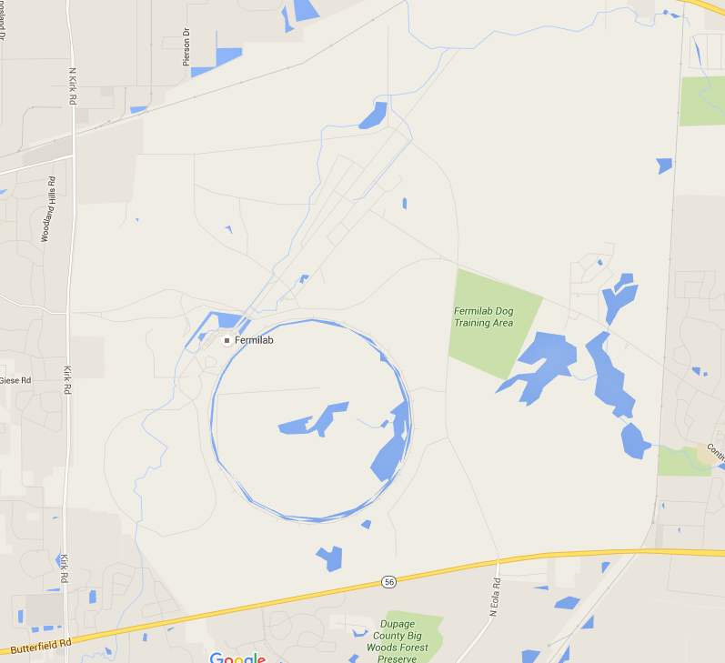
Laser Safety Implementation at Fermilab’s FAST Facility
Chip Edstrom
Laser Safety Officer Workshop
09-27-2016

Slide 2
The Fermilab Accelerator Science & Technology Facility FAST – By The Numbers
Parameter | Value
Calmar Seed Laser Output | 500 mW, 1053 nm @ 81.25 MHz
NGA IR Output | 50 uJ/pulse, 1054 nm
UV Transport | 5 μJ/pulse 253 nm
Bunch charge | < 10 fC – 3.2 nC per pulse
Bunch train | 0.5 – 9 MHz (Nom: 3 MHz) for up to 1 ms
Bunch train frequency | 1 – 5 Hz
Electron Bunch Length | 0.94 ps – 50 ps (Nominal: 4 ps)
Low Energy Transport Range | 20 MeV – 50 MeV

Slide 4
Why FAST?
UV Drive Laser Based Photoinjector
Short (ps-scale) pulse length for short time resolution measurements
50 MeV Low Energy Section from two 9-Cell SRF Cavities
Crystal channeling @ 45 MeV → High-intensity X-ray source
Future
300 MeV High Energy Section from an 8-Cavity Cryomodule
Offers flexible energy range for injection to IOTA @ 150 MeV
Inverse Compton Scattering @ 300 MeV → High-brilliance γ-ray source
IOTA
More beam means more statistics beyond PIP-II!

Slide 6
The FAST Drive Laser

Slide 7
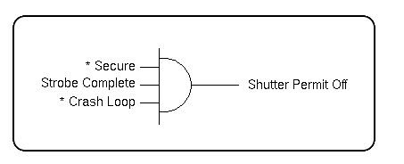
Safety System - Interlocks
How we stop the beam…
THE FAST LASER LAB
3 Primary Modes
Safety system inhibits through shutters/amps
Designed fail-safe
Regular Testing

Slide 8
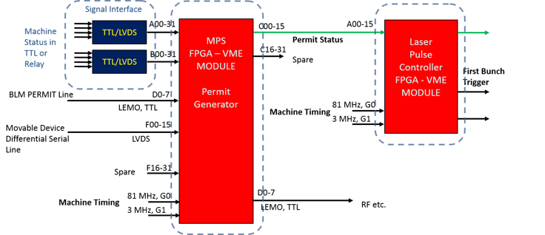
Machine Protection System (MPS)
How we start the beam…
Overview
Permit Generator & Laser Pulse Controller

Slide 9
Laser Lab Administrative Controls
Stanard Operating Proceedures
Laser Lab
Drive Laser
Alignment
527 nm
Viewports

Slide 11
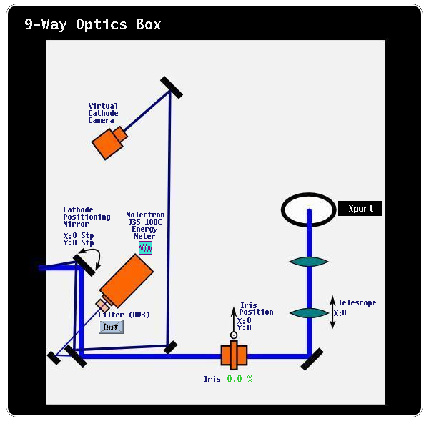
Beamline Laser Safety - Gun
In the cave
UV/IR Xport
COB
Viewports
MPI
OTR Transport

Slide 12
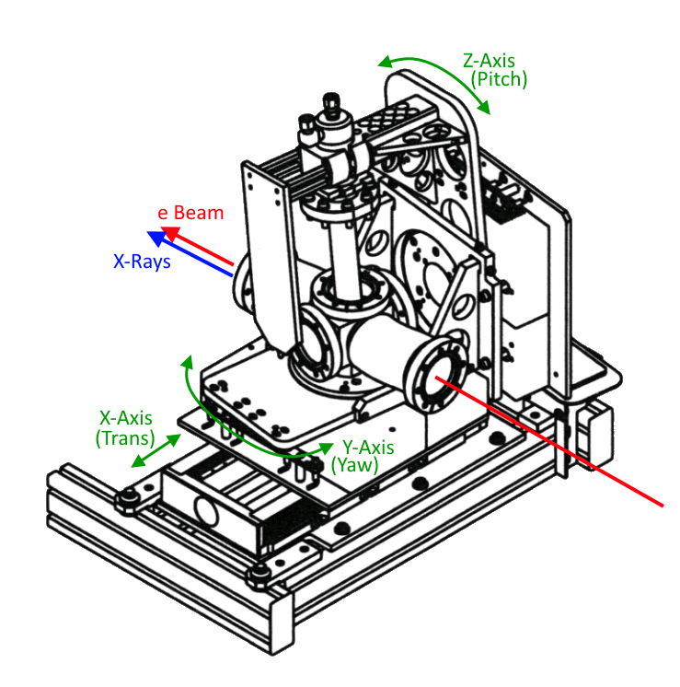
Beamline Laser Safety - Goniometer
Considerations:
Viewports
Laser Position Monitors

Slide 13
Beamline Laser & X-Ray Safety – Crystal Channeling
Considerations:
Viewports
X-Rays (Bremsstrahlung)

Slide 14
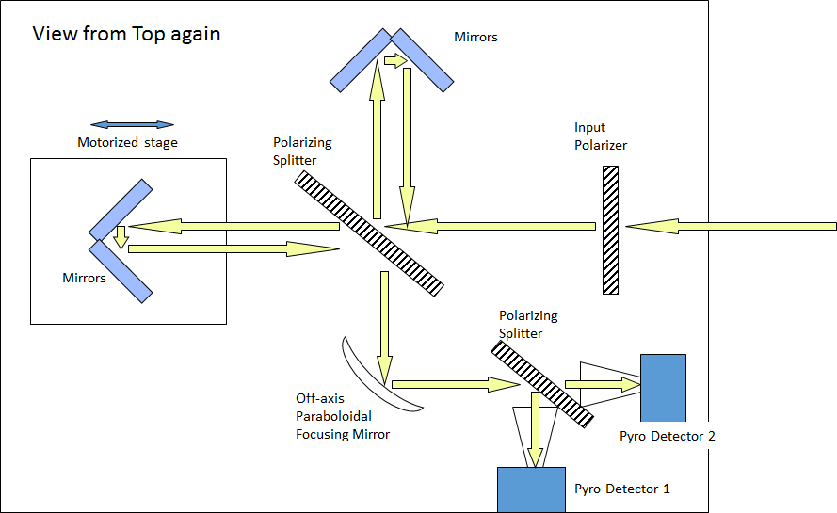
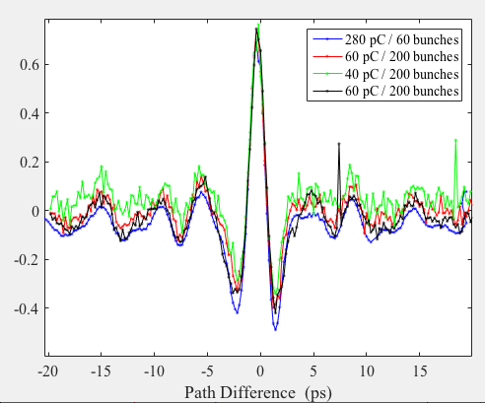
Streak Camera & The Martin-Puplett Interferometer
Used for electron bunch length measurement.
Fully enclosed
THz radiation comes from
the OTR foil at x121

Slide 15
In Summary – Visit us @ FAST.fnal.gov
50 MeV operations concluded Summer 2016
Building-out 300 MeV Line (Beam 2017)
HINS Work in Progress (2.5 MeV P Beam at MDB 2017)
IOTA Construction / Fabrication / Procurement in progress (e Beam 2018)
Protons from HINS to follow after move from MDB
Shielding Assessment is being finalized
High energy enclosure being built
Interlocks and MPS are growing
To accommodate High Energy Beamline / IOTA

