Slide 1
Horizontal Test Stand – 2 (HTS-2) Project Overview
Joe Ozelis
July 15, 2015

Slide 2
Outline
Introduction
Project Timeline/Schedule
Project Scope
Cost to Complete
FY16 Proposed Budget and Scope
Project Plan/Documentation

Slide 3
Introduction
HTS-2 is a facility for performing testing of 650MHz elliptical cavities for the PIP-II project
Dressed cavities outfitted with helium vessel, magnetic shielding, tuner, HOM, and high power couplers
Both β’s to be accommodated
Two cavities contained in a single cryostat
Cavities are tested in HTS-2 to ensure that as an integrated system they meet performance specifications before inclusion into a cryomodule
All/most cavities to be HTS tested before inclusion in prototype CM
Some subset tested during production
HTS-2 will be located in MDB, current site of HTS-1 and STC, which perform similar functions for 1.3GHz elliptical cavities and 325MHz spoke cavities, respectively.

Slide 4
Timeline/Schedule
HTS-2 as a facility is needed for evaluation of dressed prototype cavities and cavities for prototype CM.
Verification of e.g., high-Q₀ retention will be critical, along with verification of ancillary systems/integrated performance.
Funding constraints lead to stretch-out of PIP-II schedule and need-by date for an operational HTS-2 at FNAL
This delay means it is now feasible for the HTS-2 to be integrated with cryo, RF, controls etc. initially at RRCAT, and commissioned there.
HTS-2 Cryostat fabrication complete | 31 Dec 2016
Integration of FNAL HTS-2 cryostat complete | 31 July 2017
Arrival at FNAL | 30 Sep 2017
Commissioned at FNAL | 30 March 2018

Slide 5
Project Scope
HTS-2 is a facility
HTS-2 cryostat (includes cryogenic feedcan)
High Power RF systems (amplifiers, distribution, controls, passive components)
Low Level RF systems (amplitude/phase controls, readback, resonance controls)
Cryogenic distribution (GHe, LHe, LN2, GN2, valves, controls, 2K pumping, instrumentation)
Safety systems & Interlocks (PPS and MPS, infrastructure, ODH)
Controls (RF & DAQ, cryo)
Infrastructure (LCW, HVAC, AC power/lighting, access gates)

Slide 6
Project Scope – DAE Deliverables
HTS-2 is a facility
HTS-2 cryostat (includes cryogenic feedcan)
High Power RF systems (amplifiers, distribution, controls, passive components)
Low Level RF systems (amplitude/phase controls, readback, resonance controls)
Cryogenic distribution (GHe, LHe, LN2, GN2, valves, controls, 2K pumping, instrumentation)
Safety systems & Interlocks (PPS and MPS, infrastructure, ODH)
Controls (RF & DAQ, cryo)
Infrastructure (LCW, HVAC, AC power/lighting, access gates)

Slide 7
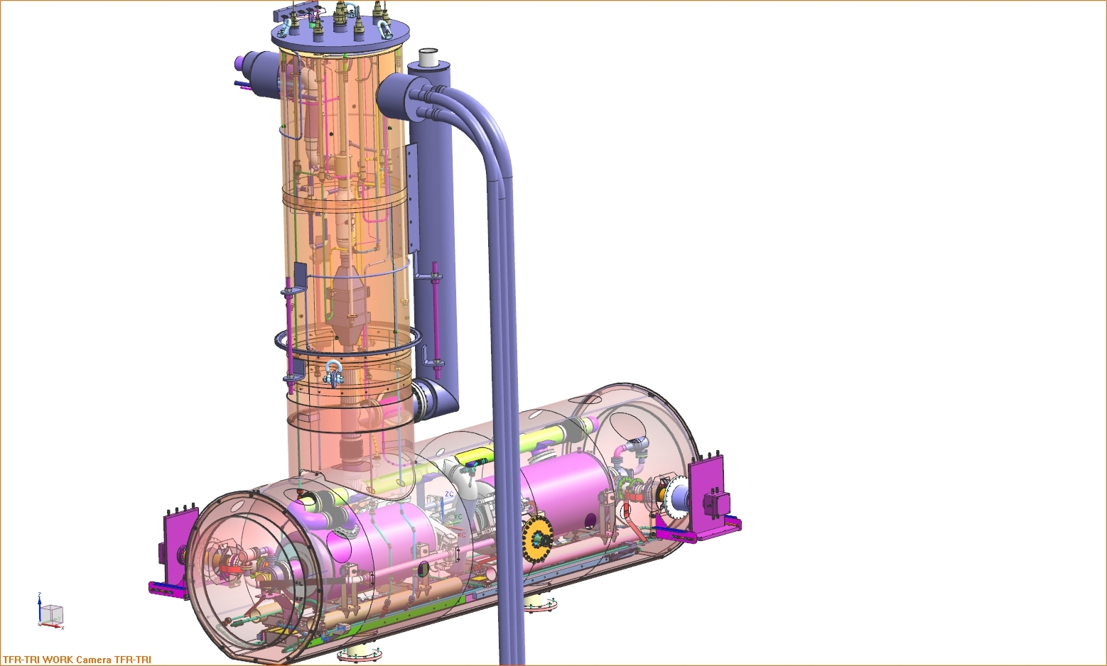
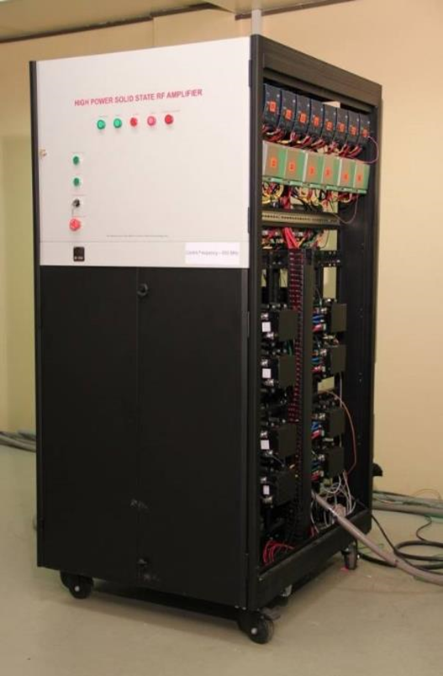
Project Scope : DAE Deliverables Q2/3-CY2017
Q3-CY17
Two 40 kWatt Units
(RRCAT)
RRCAT
FNAL
FNAL
RRCAT
FNAL:
Cryogenic for HTS at FNAL July 16/17
DAE:
Two 40kW RF Dec 16
LLRF/RF Protection Oct 16
Control System Jan 17
Integration with cryostat at RRCAT July 17
Integrate HTS-2 delivered at Fermilab Aug 17
FNAL:
Test of 1st Dressed Cavity at FNAL Sept 17
IIFC RF Protection
(BARC/FNAL)
IIFC LLRF
(BARC/FNAL)
IIFC Controls (BARC/FNAL)
Integration (DAE/FNAL)

Slide 8
HTS-2 : Cost to Complete, FY16, FY 17 Budgets
FY16
4.3 FTE’s (CryEng, MechEng, RFEng, CtrlEng, MTs, ETs)
Design, fabrication, installation of cryo distribution systems
Installation of RF and controls systems as supplied by RRCAT
Enclosure/infrastructure design, assembly, layout (racks, trays, AC power, HVAC, LCW, gates, cryostat supports, shldg)
M&S : 735k$
Does not include cost of HTS-2 cryostat or RF amplifiers (supplied by RRCAT)
Includes Shielding blocks, racks, cable trays & cabling, HPRF components,, 2K pump skid, safety system infrastructure (gates, chipmunks, interlock HW), cavity & coupler vacuum systems (cavity/coupler/ins vac), HVAC (ODH fans)

Slide 9
HTS-2 : Cost to Complete, FY16, FY 17 Budgets
FY17
2.7 FTE’s (CryEng, MechEng, RFEng, CtrlEng, MTs, ETs)
Complete installation and commissioning of cryo distribution systems
Completion of installation of control systems (RF, cryo, diagnostics, interlocks)
Safety documentation/reviews/ORC
M&S : 180k$
Remaining infrastructure purchases, cryostat support stands, cabling, commissiong prep

Slide 10
FY16 Proposed Budget and Scope
One year delay scenario
FY16 – minor preparation work for facility, complete designs
Compete facility design
Procure & install racks/cable trays
Spec & install LCW
Mech installation of cryo distribution and some controls/instr.
Complete LLRF design
1.3FTE/105k$ M&S

Slide 11
Project Plan
Multi-institute collaboration (as opposed to in-house) puts a premium on the development of well-defined and comprehensive requirements and specifications for each of the sub-systems.
Think of it as writing a spec (SOW) for a vendor to provide the sub-system
FNAL acts as a “general contractor” or system integrator
FNAL is also one of the “vendors”
We need to generate a Project Plan/Document that describes
Scope
Requirements
Responsibilities
Interfaces
Deliverables

Slide 12
Project Plan – Content of Each Section
Introduction/Overview
Cryostat and Feedcan (Klebaner)
High Power RF Systems (Pasquinelli)
RF Interlocks (Prieto)
Low Level RF Systems (Chase)
Cryogenic Controls/Monitoring (Klebaner/Patrick)
Interlocks (MPS & PPS) (AD/ES&H (Anderson))
Controls (Patrick)
Needed for Project, but not relevant to DAE/IIFC:
Infrastructure
Cryogenic Distribution System

Slide 13
Project Plan – Outline of Sections
Scope
What does the system do – functionality?
Requirements specification
How does the system achieve the functionality?
Responsibilities
Who (Institutionally) will do what?
Interfaces
What other systems/subsystems does this system work with, and how/where/when?
Deliverables
What gets shipped to FNAL?

Slide 14
Project Plan – Path Forward
Identify leaders for each system/sub-system/section
Begin writing drafts
Meet as small group regularly to review progress and especially address interface issues/definitions
Review/revise drafts
Prepare more detailed budget and resource estimates based on draft Project Plan
Prepare Integrated Project Schedule encompassing all sub-system task and resources, with correct logic. Timeline to match actual budget and DAE deliverables
Goal for Project Plan Draft by mid-September 2015
To be subsequently reviewed/approved by IIFC

