Slide 1
Development of Optical Metrology Data Analysis Engine
Ben Sheff

Slide 2
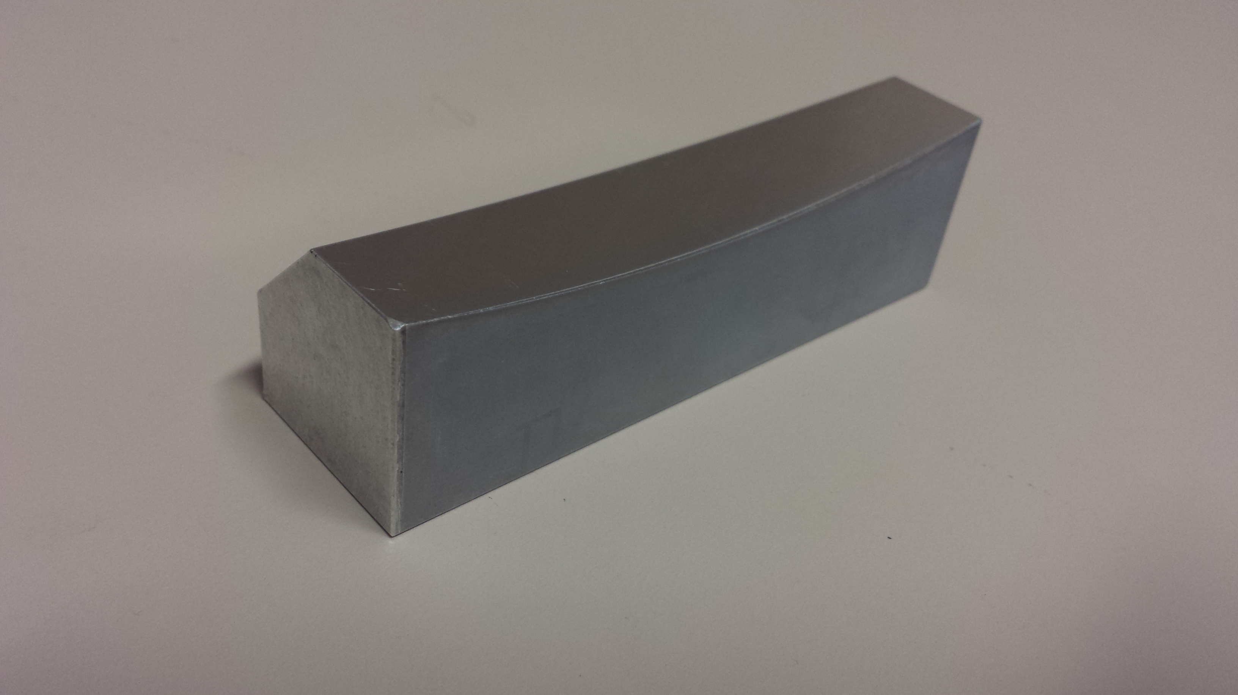
X-ray Optics
As beamlines get better, need better mirrors
Residual slope error below 50 nrad
Long trace profiler (LTP) is a high precision metrology tool
Measures slope of mirror at each point to within 50 nrad
Extremely accurate for small range of angles, but has problems farther out
New analysis tools needed to handle this

Slide 3
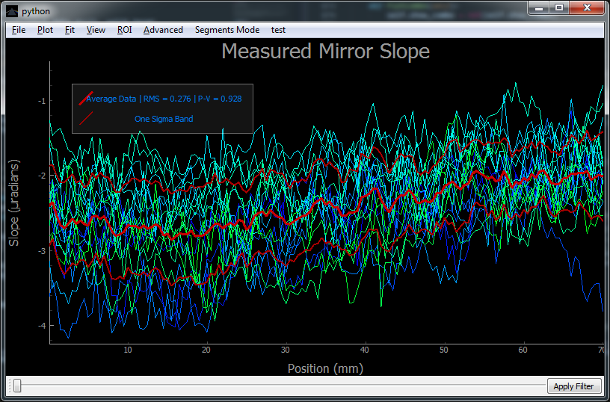
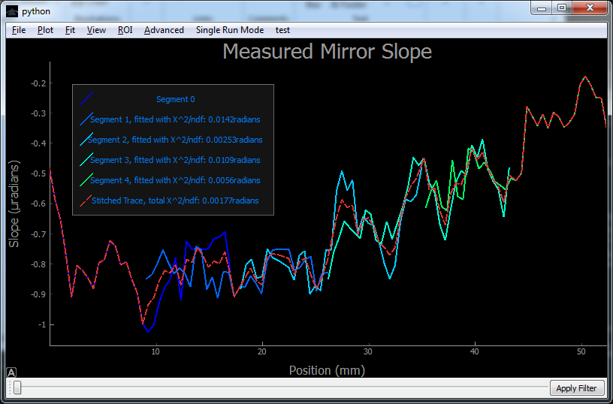
Analysis Software
Developed Optical Metrology ENgine (OMEN) in Python
Handles standard analysis
Easy, dynamic filtering
Fitting options, with live-updated residue plot
Region-of-interest selection
Tools to deal with high angles
Stitching together overlapped, adjacent scans of mirror segments
Soon will include option to add calibration run

Slide 4
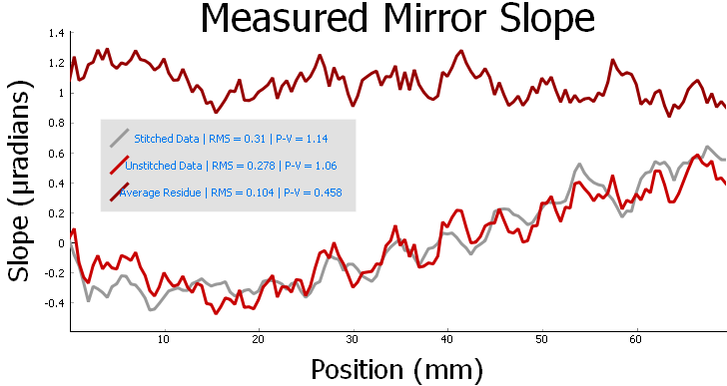
Goals
Complete a calibration curve for the LTP
Make working calibration look-up table
Analyze systematic errors
Integrate into OMEN
Improve stitching code
Standard deviation of difference between stitched and unstitched is about equal to standard deviation of either

