Slide 1
External quality factor: What is going on inside a half-wave resonator?
Nathan Prins
Supervisor: Dr. Zachary Conway
Physics Division
Argonne National Laboratory
July 24th, 2015

Slide 2
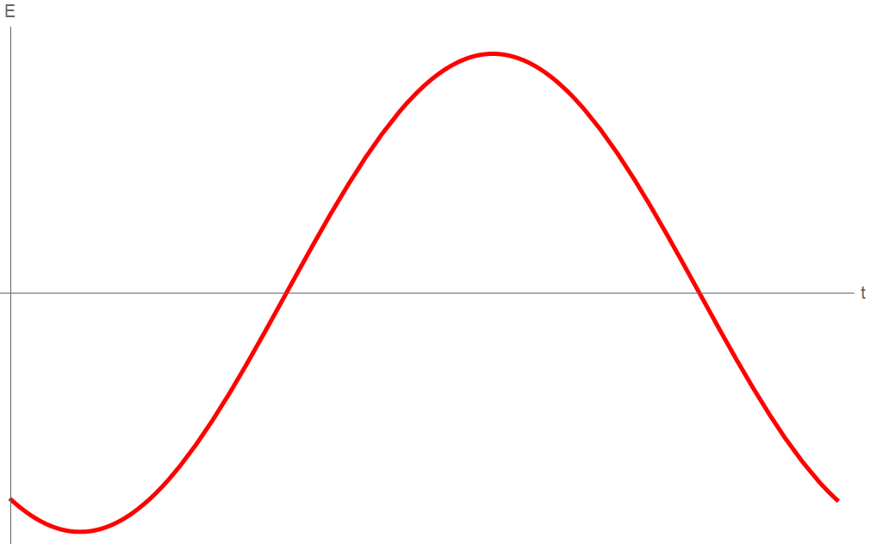




Why?
Accelerating cavities use resonant electromagnetic (EM) fields to accelerate and focus particle bunches
  we use half-wave resonators
Need to monitor EM field
  Amplitude: amount of acceleration of the bunch
  Phase: amount of acceleration and longitudinal focusing of the bunch
Focusing with phase
Particle $a$ arrives first
  most initial energy
  receives smaller acceleration
Particle $b$ represents ideal particle
  enters cavity at synchronous phase
Particle $c$ arrives last
  least initial energy
  receives greatest acceleration
$$c$$
$$b$$
$$a$$

Slide 3
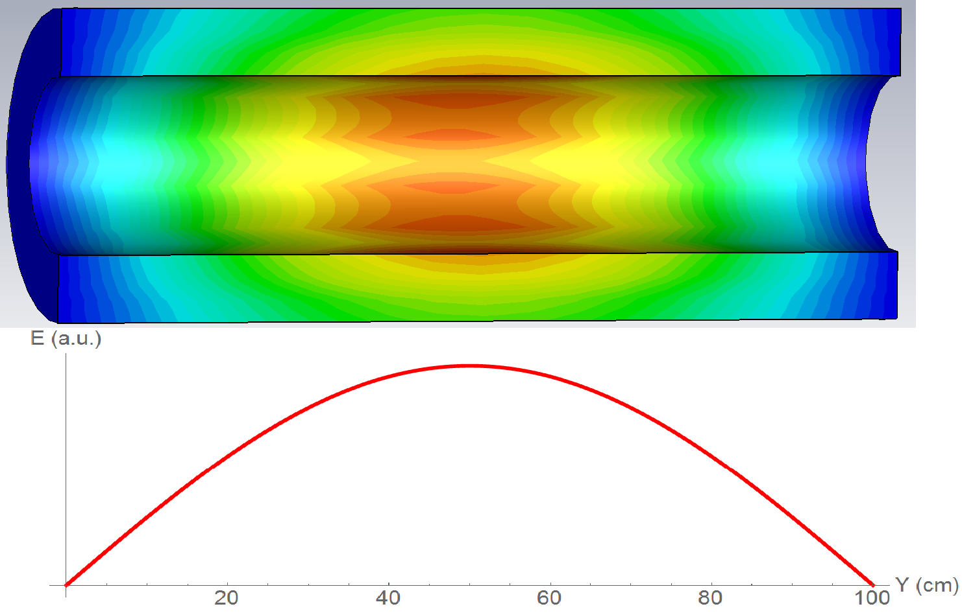
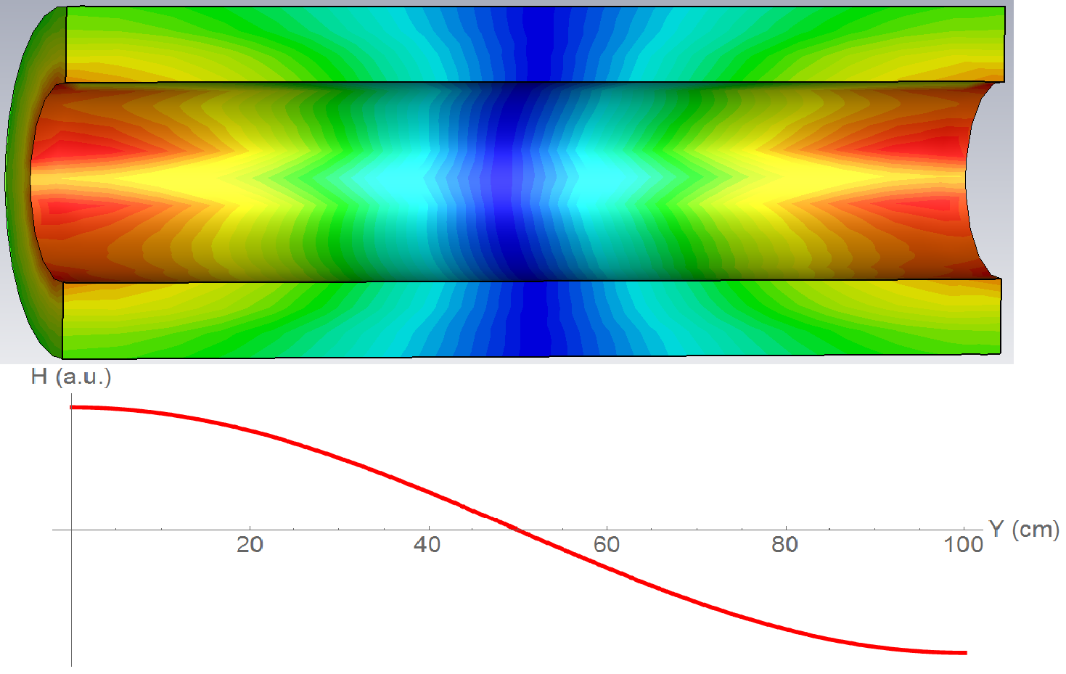
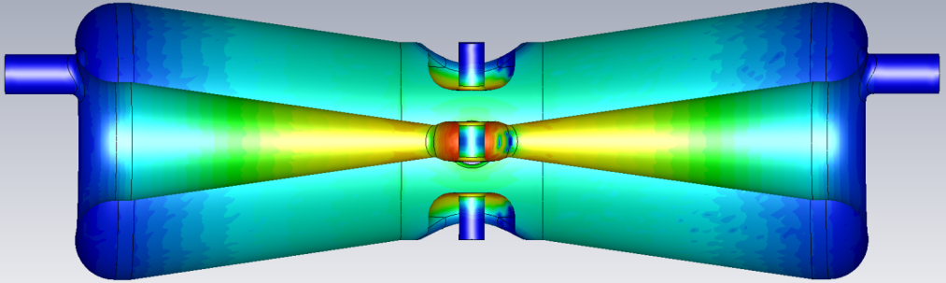
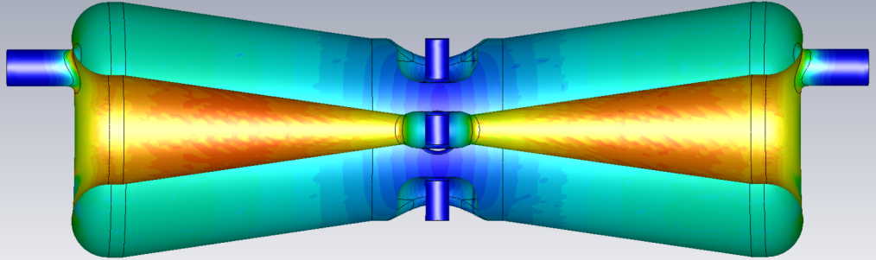


What is a half-wave resonator (HWR)?
A HWR resonates transverse electric
and magnetic (TEM) modes
  must be a coaxial line
  fundamental mode is a half-wavelength
  beam axis is where E-field is maximum
  for maximum acceleration
Our HWR is used to accelerate $H^{−}$ ions
  $f_{0}=162.5$ MHz; $β=0.112$
  superconducting niobium
E-field
Above: The volume electric (top) and magnetic (bottom) fields shown as a contour plot for an ideal coaxial line. The plots under each figure show the general half-wave shape of the respective field amplitudes.
Left: The volume electric (top) and magnetic (bottom) fields shown as a contour plot for our HWR.
*for contour plots, blue corresponds to low magnitudes, red corresponds to high magnitudes.
$18$cm
B-field

Slide 4
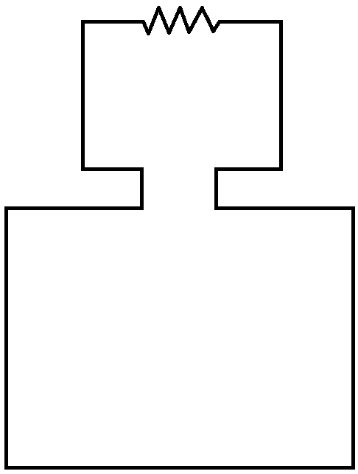
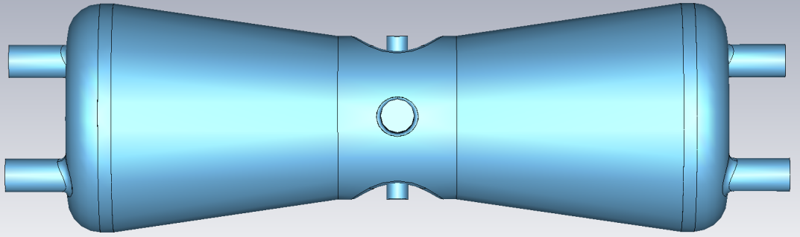







External quality factor for half-wave resonators
We need to couple power out of the cavity.
  from Faraday’s law: use changing magnetic field
  $$ℇ=−\frac{dΦ}{dt}=−\frac{d}{dt}\iint{B∙da}$$
  calculate power from induced voltage
A convenient parameter is the external quality factor:
$$Q_{ext}=\frac{ω_{rf} U}{P_{out}}$$
  External quality $Q_{ext}$: losses out of couplers
  Loaded quality $Q_{L}$: total losses
$$R=50Ω$$
$$H$$
$$B\left(t\right)=B_{0}e^{iωt}$$
$$W$$
Above: The circuit drawn is an ideal square loop used for hand calculations.
Left: We put a coupling loop in one of the ports on the top of the cavity. The zoomed-in figure is a cross-section view of the port showing the loop geometry.
$$H$$
$$W$$
$9.155$cm

