Slide 1
Optimization of the DPSS Nd:YLF Amplifier Chain for the 263 nm Drive Laser at the FAST Facility
Julie M. Gillis
Department of Physics
Department of Chemistry and Biochemistry
Duquesne University
Supervisors: James K. Santucci and Jinhao Ruan
FNAL Accelerator Division
Summer Internships in Science and Technology (SIST) Program
Fermi National Accelerator Laboratory
August 4, 2015

Slide 2
Outline
Research at FAST
Making an Electron Beam
Drive Laser System
Improving the Amplifier Chain
Downstream Effects
Final Remarks

Slide 3
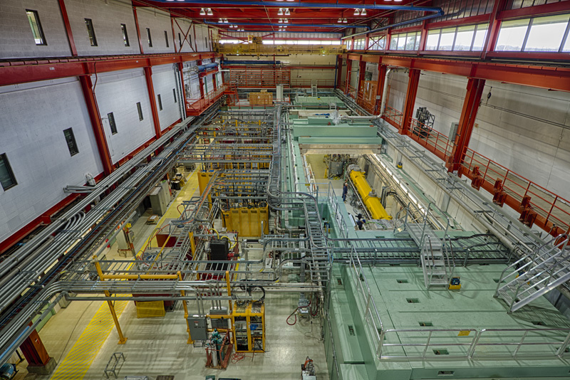
Research at FAST

Slide 4
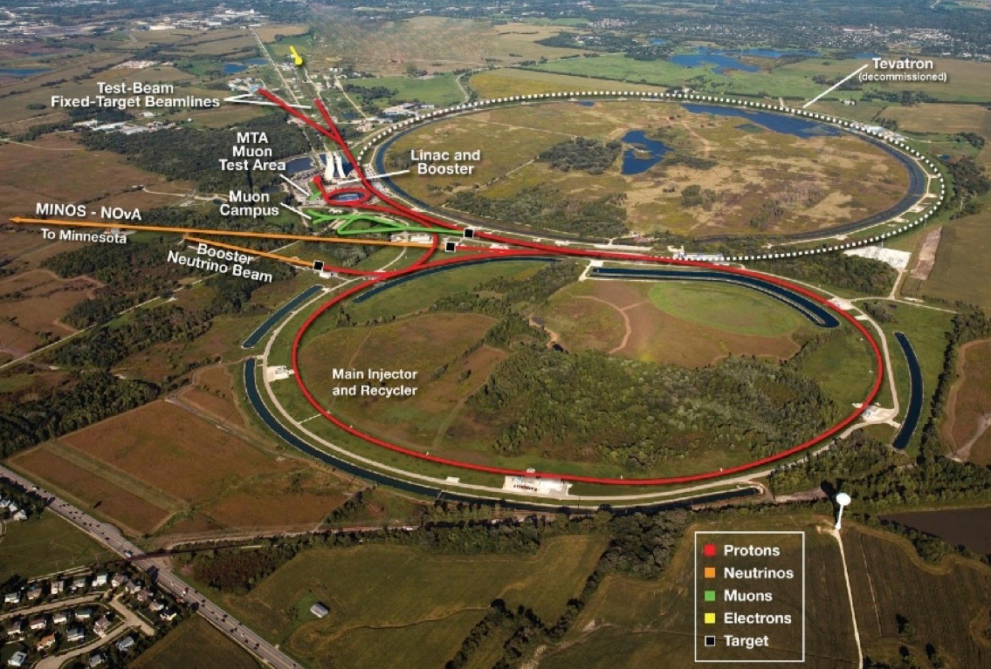
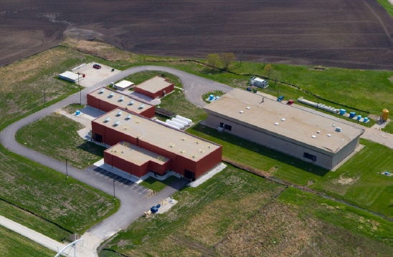
The FAST Facility
Fermilab Accelerator Science and Technology
Testbed for advanced accelerator research and development (AARD)
FAST Facility

Slide 5
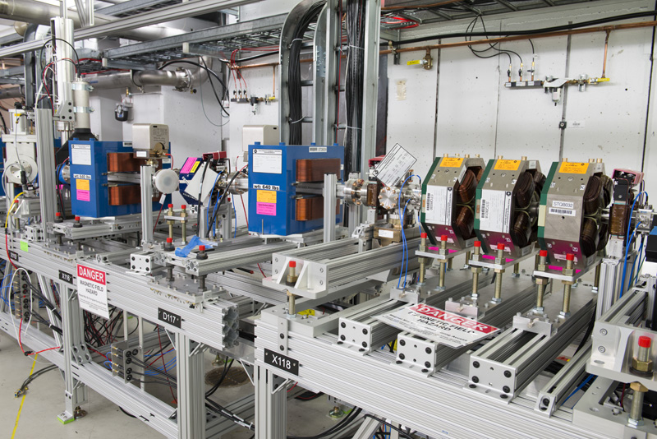
50 MeV Electron Linac
Superconducting radiofrequency (SRF) linear accelerator coupled to a photoinjector
2 capture cavities
Dipoles, quadrupoles, transverse profile monitors

Slide 6
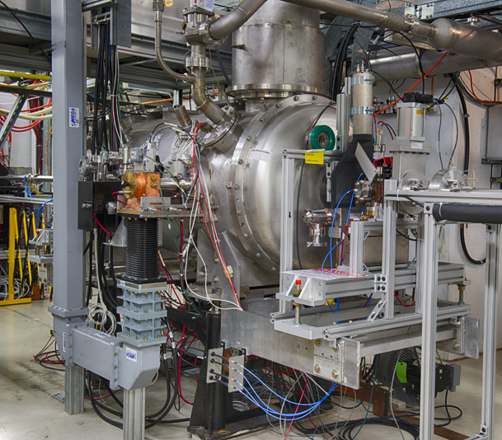
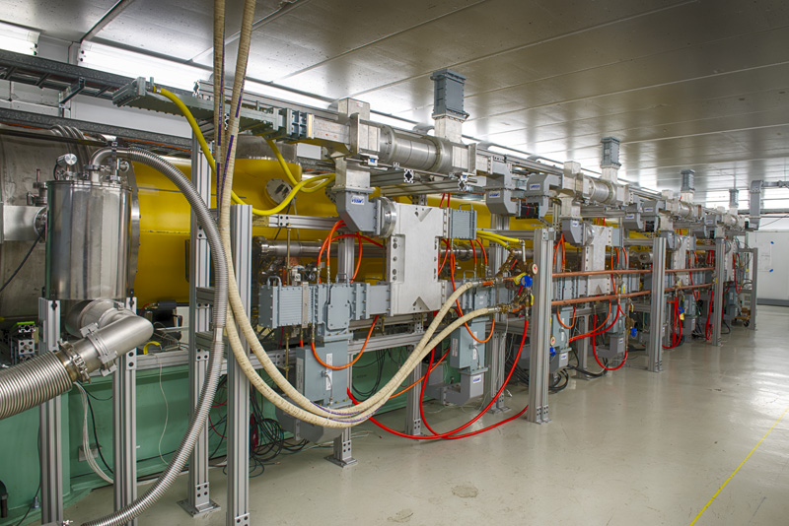
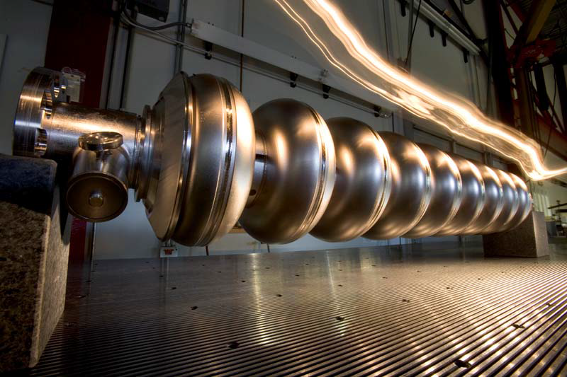
SRF Technology
Nine-cell niobium accelerating cavities with a resonant frequency of 1.3 GHz
TTF/ILC-type cryomodule for 300 MeV electron beam

Slide 7
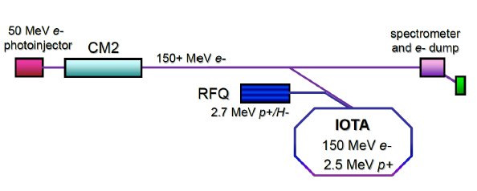
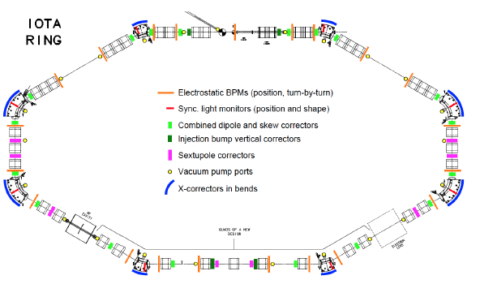
IOTA Ring
Integrable Optics Test Accelerator
39 meter circumference
Nonlinear lattice for addressing intensity limitations

Slide 8
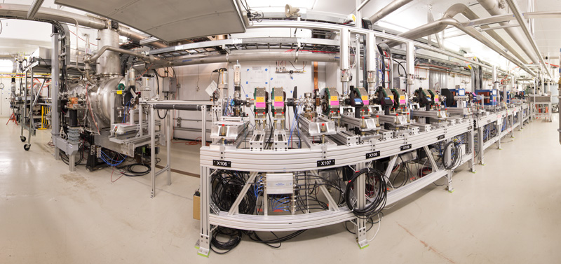
Making an Electron Beam

Slide 9
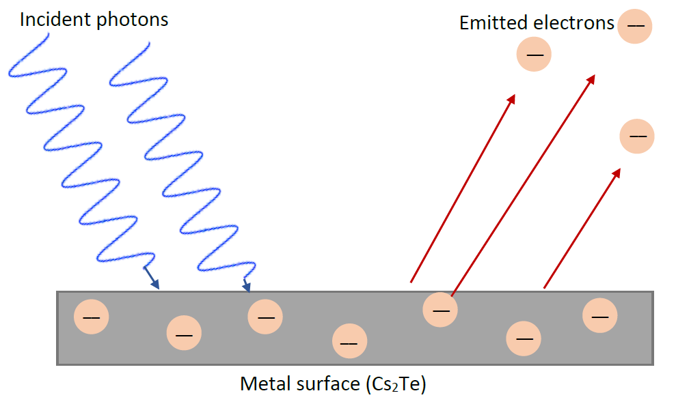
Photoelectric Effect
Wave-particle duality of light
Metallic surface bombarded with photons release electrons
$$K_{max}=h\left(f−f_{0}\right)$$
$$K_{max}=E−ϕ$$
$$E=hυ=\frac{hc}{λ}$$

Slide 10
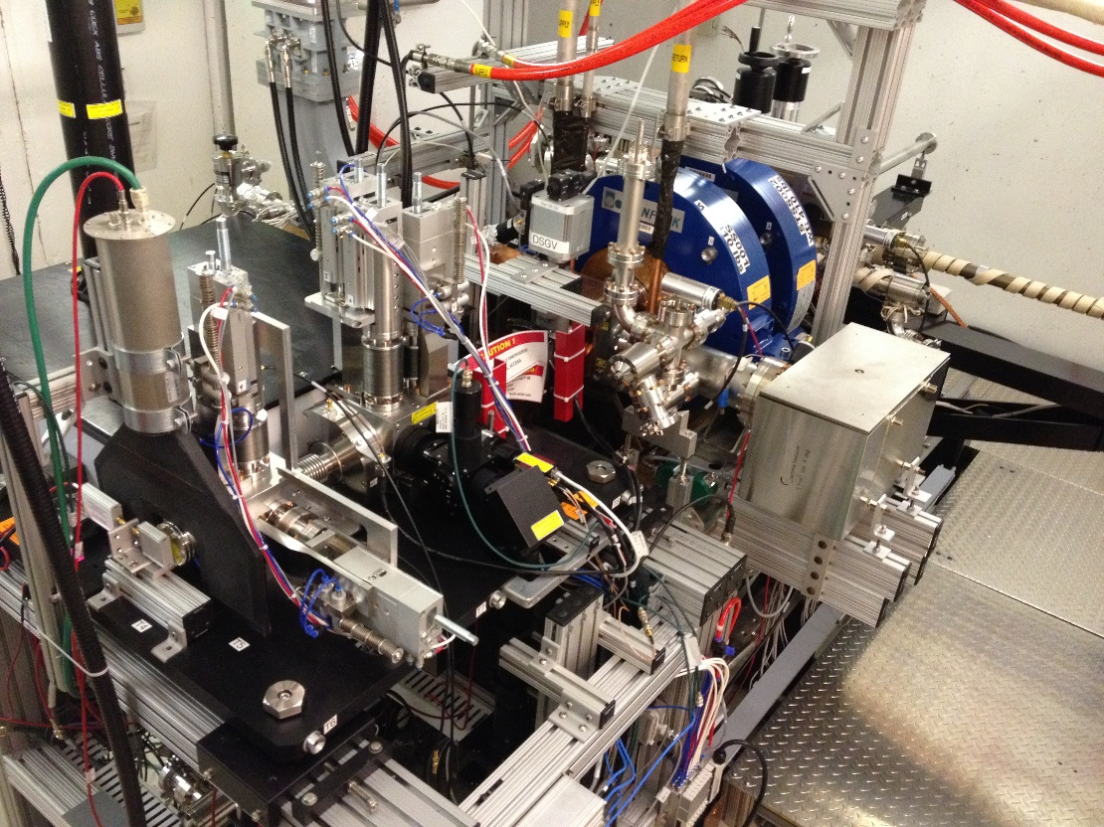
RF Electron Gun
1-1/2 cell PITZ at DESY Zeuthen design
Cs₂Te photocathode
p-type semiconductor
Band gap = 3.2 eV
High quantum efficiency
10%-1%
Incident light must be UV
How do we get there?

Slide 11
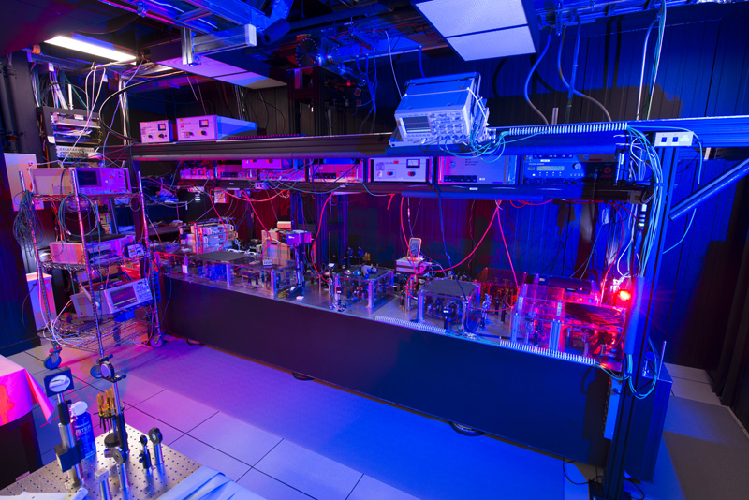
Drive Laser System

Slide 12
Phase-Locked Drive Laser
YLF seed laser
3 picosecond, 1053 nm (IR) pulses
Amplifier chain (3 pre-amps, 3 single-pass amps, 1 commercial amp)
Fourth harmonic wavelength generation
Frequency-doubling crystals (1053 nm → 526.5 nm → 263.25 nm)
Transported to electron gun

Slide 13
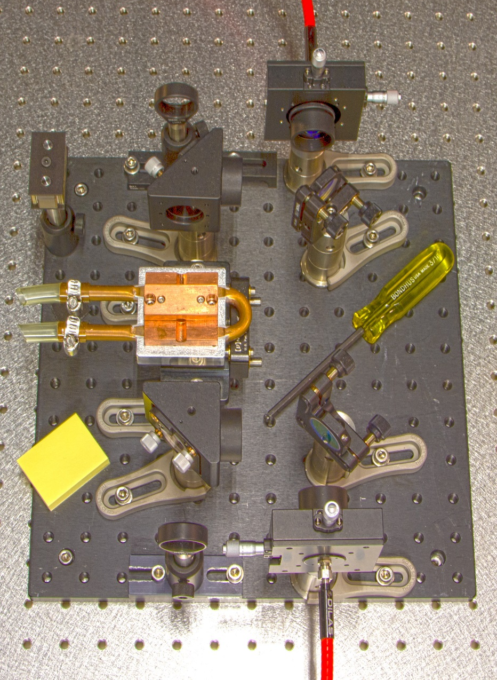
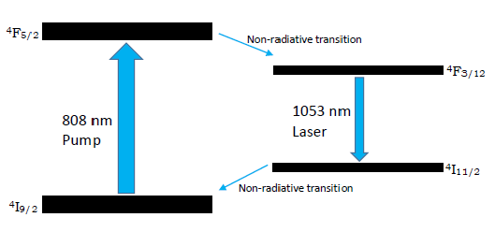
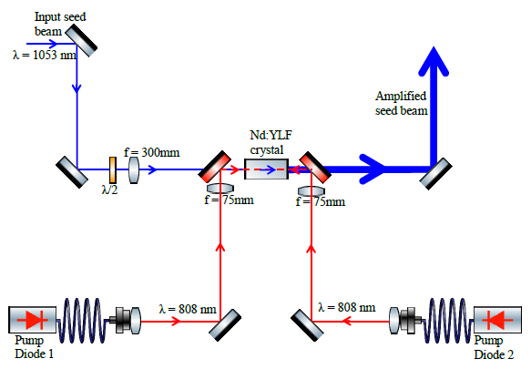
DPSS Amplifiers
Diode-pumped solid state amplifiers
End-pumped by 808 nm diodes
Gain medium = Nd:YLF crystal

Slide 14
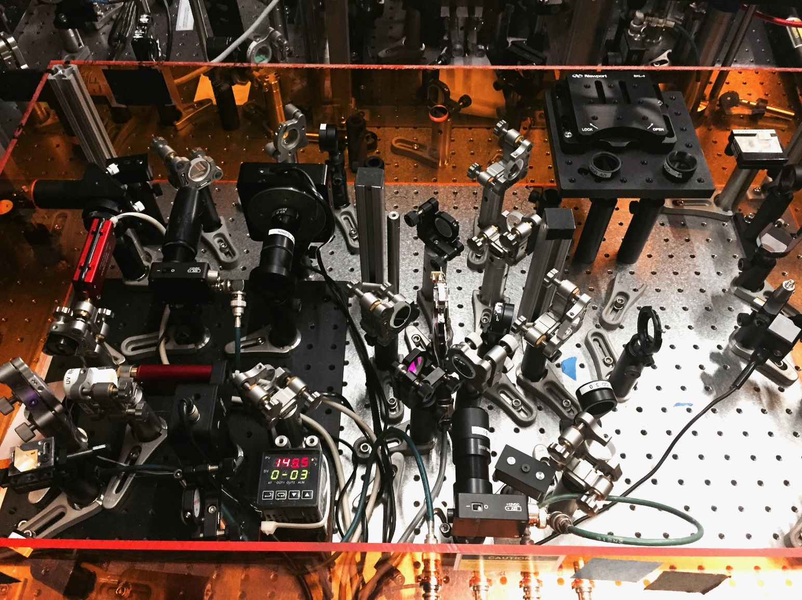
Improving the Amplifier Chain

Slide 15
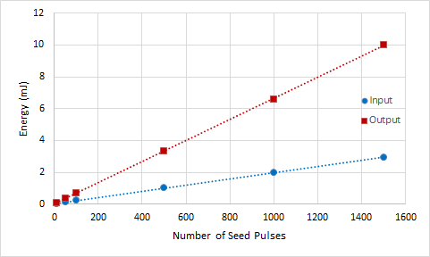
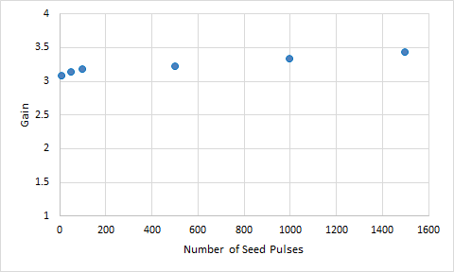
Preliminary Measurements – SPA3
SPA3 Gain: 3.23
6.97 μJ per pulse

Slide 16
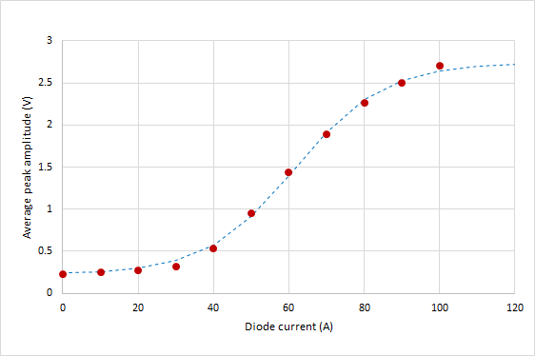
Preliminary Measurements – SPAT
50 seed pulses per bunch
Pick-off of seed after SPA1 to Sandbox Table

Slide 17
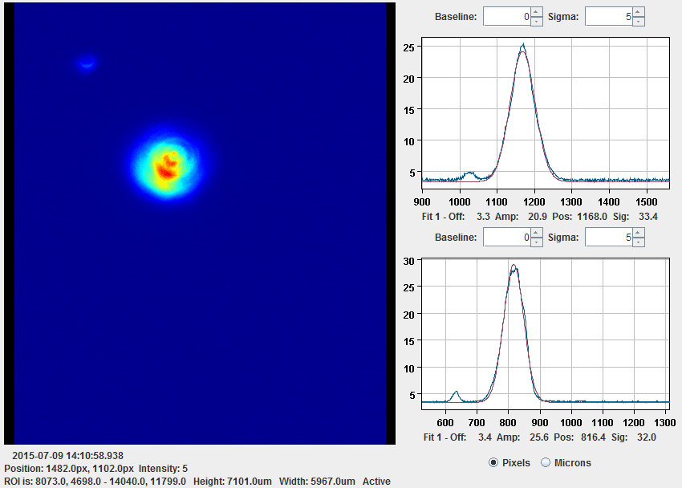
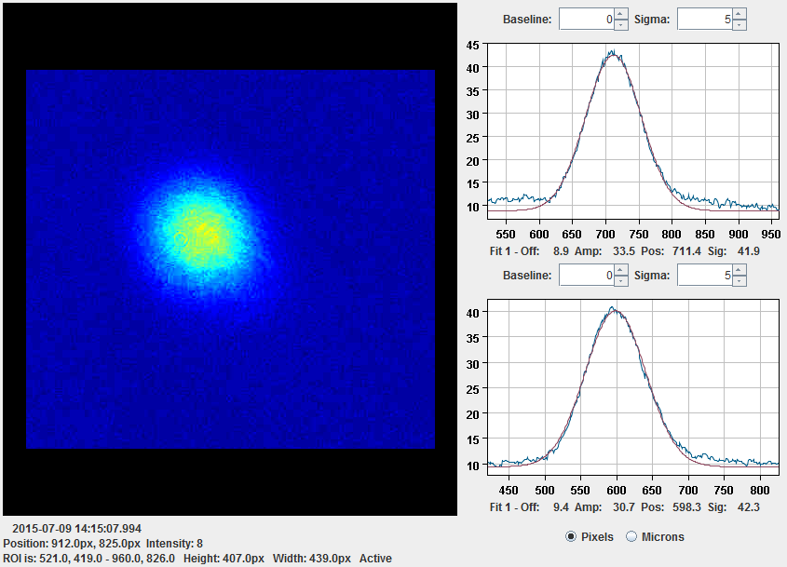
Beam Spot Analysis
CCD camera for imaging beam profiles
1 pixel = 3.45 μm
Gaussian profiles
Measured at crystal distance
SPAT
X sigma: 33.4 pixels
115.2 μm
SPA3
Y sigma: 32.0 pixels
110.4 μm
X sigma: 41.9 pixels
144.6 μm
Y sigma: 42.0 pixels
145.9 μm

Slide 18
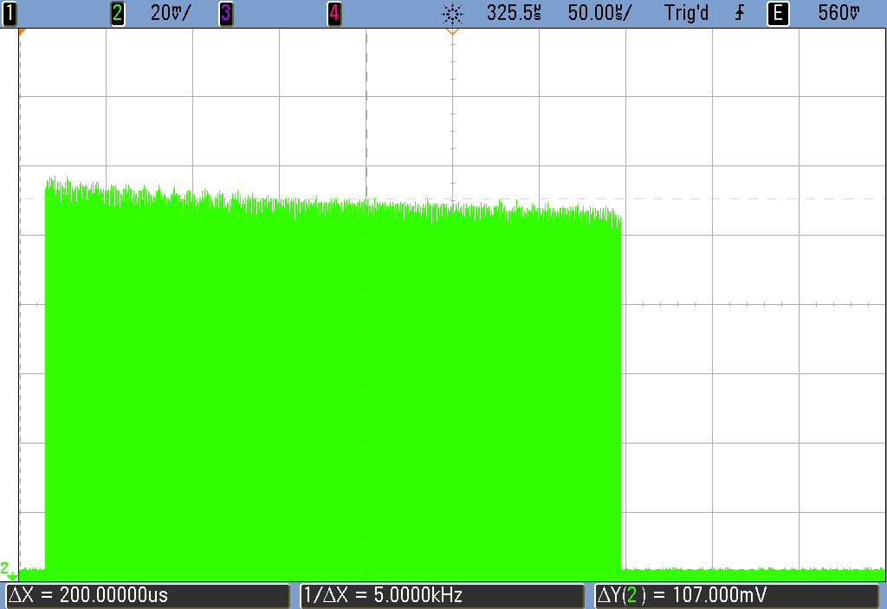
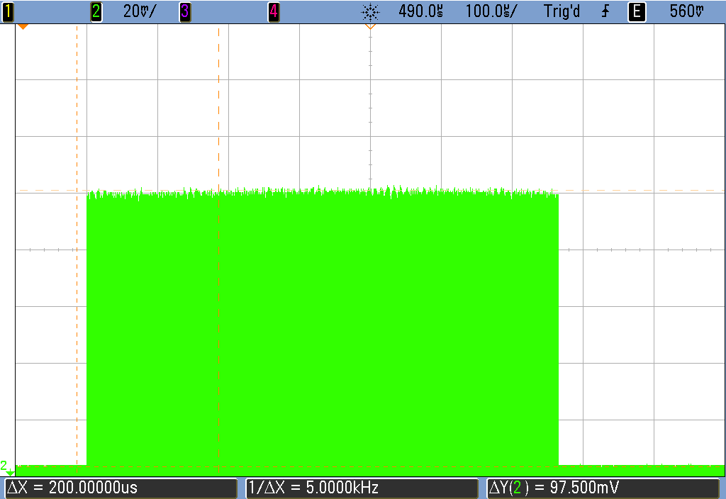
Timing Adjustments
Flat pulse trains for more pulses
Adjust timing of pump diode trigger delays and pulse widths
Delay: 1.097 ms
Width: 1.856 ms
Delay: 1.718 ms
Width: 1.280 ms

Slide 19
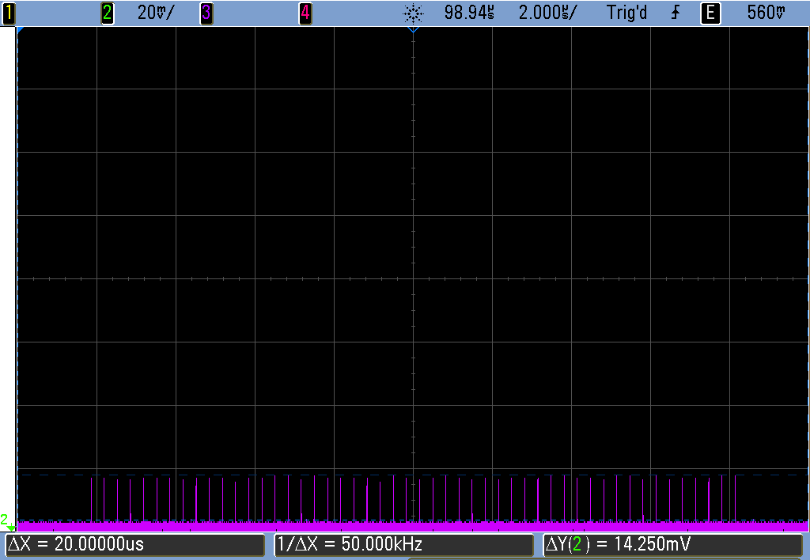
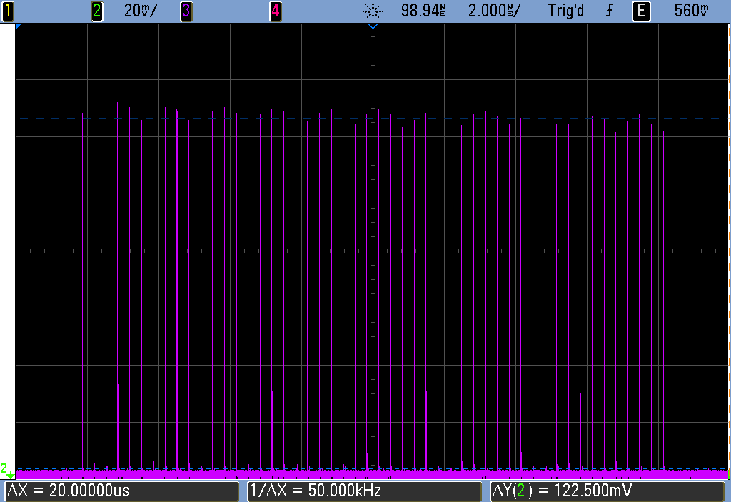
Maximizing SPAT
On sandbox table with 50 seed pulses per train
Photodiode measurements:
Gain: 8.60
Energy meter measurements:
0 A → 10.2 μJ
90 A → 107.9 μJ
Gain: 10.58

Slide 20
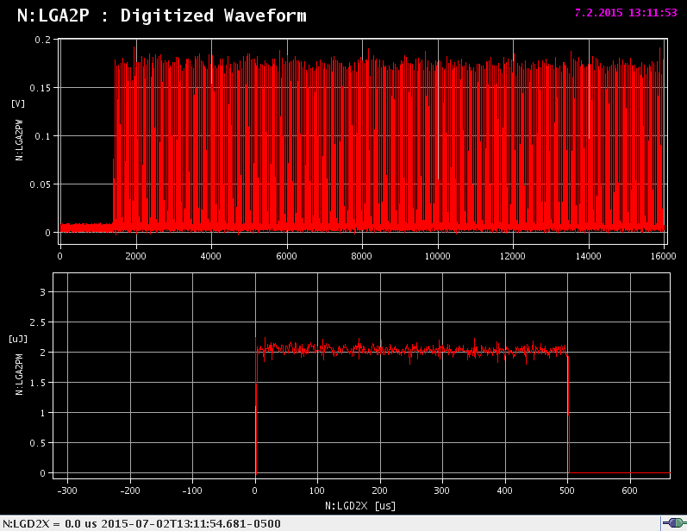
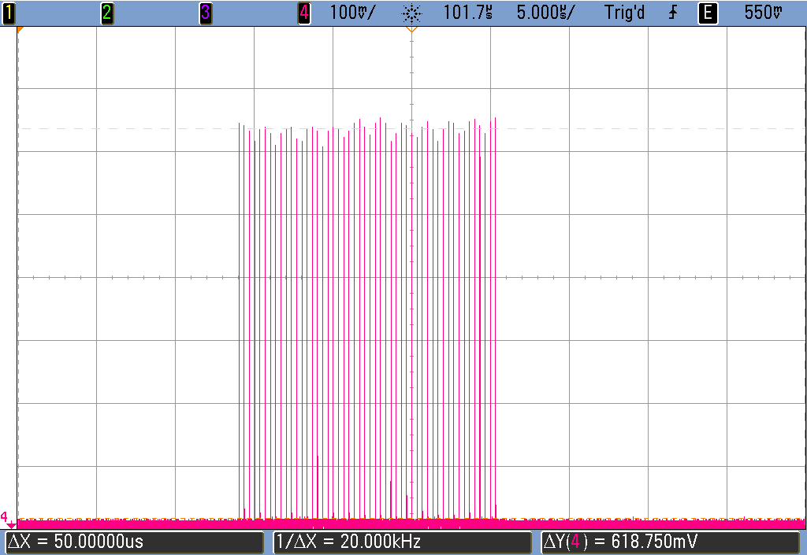
Replacing SPA3
Align through all existing downstream optics
Northrop Grumman Amplifier (NGA)
Frequency-doubling crystals and diagnostics
New diode calibration
Maintain flat pulse trains

Slide 21
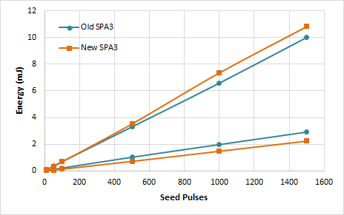
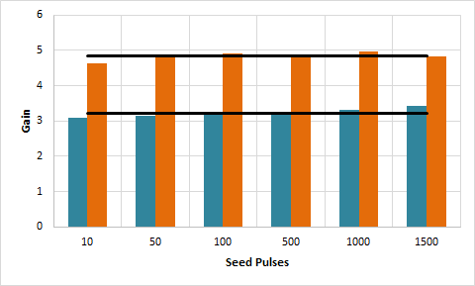
Results Comparison
Gain = 4.83
4.83
3.23
Are these improvements actually significant?

Slide 22
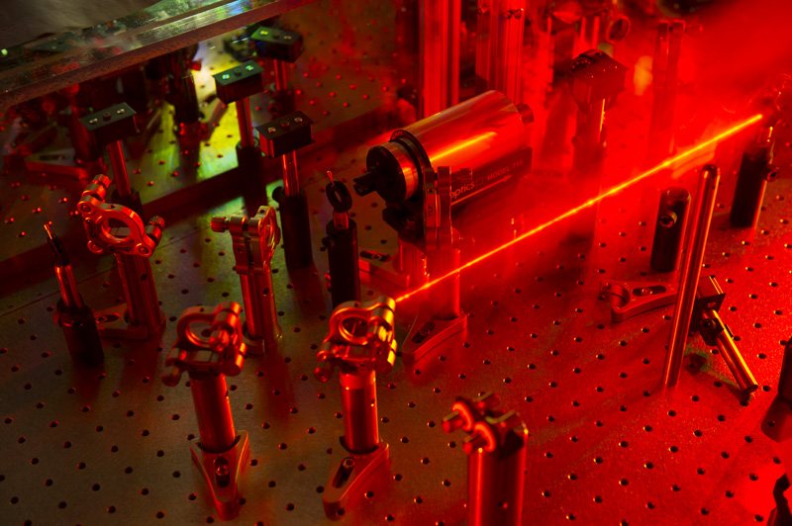
Downstream Effects

Slide 23
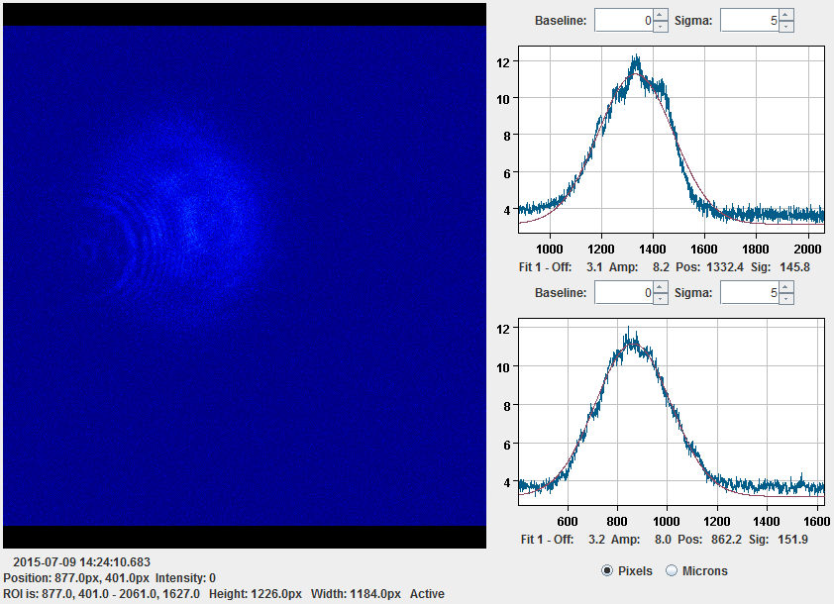
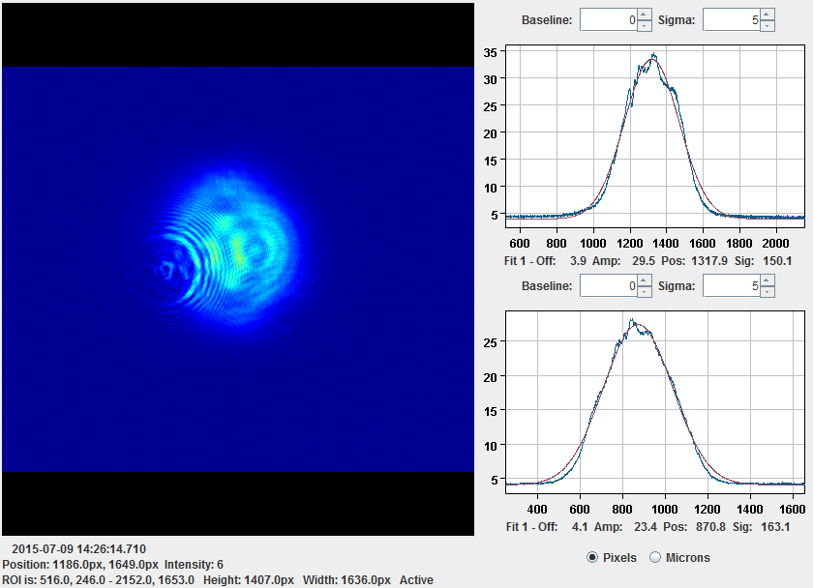
Effects on NGA
500 seed pulses
2.85 mJ to 32.4 mJ
64.8 μJ per pulse
Gain: 8.5 → 11.37

Slide 24
Effects on UV Pulse Energy
BBO crystals only have ~50% efficiency for transmitting converted light
4.8 μJ per pulse → 10.2 μJ per pulse
15.7% total efficiency

Slide 25
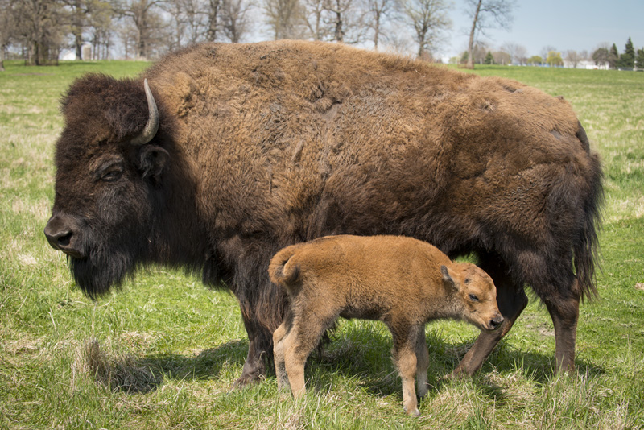
Final Remarks

Slide 26
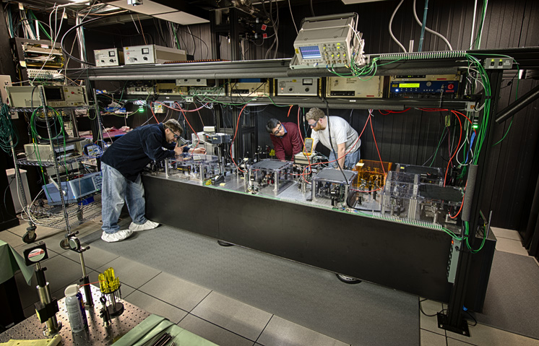
Future Work
Tune up the rest of the amplifier chain
Replace SPA2 (gain = 1.4) with an improved SPA3
Increase UV pulse energy
Goal: ~50 μJ per pulse

Slide 27
Many thanks
Jamie Santucci, Jinhao Ruan, and Chip Edstrom
Laser and Injectors Groups at FAST
FAST/IOTA Group
SIST Committee
Fellow interns of Summer 2015
Fermi National Accelerator Laboratory
Operated by Fermi Research Alliance, LLC under Contract No. De-AC02-07CH11359 with the United States Department of Energy.

Slide 28
References
K. Carlson, et al., Fermi National Accelerator Laboratory. Design of the Advanced Superconducting Test Accelerator. Beams-doc-4212, 2012.
P.H. Garbincius, et al. Fermi National Accelerator Laboratory. Proposal for an Accelerator R&D User Facility at Fermilab’s Advanced Superconducting Test Accelerator. Fermilab-TM-2568, 2013
J. Ruan. ASTA Injector Laser Lab Standard Operating Procedure, 2015

Slide 29
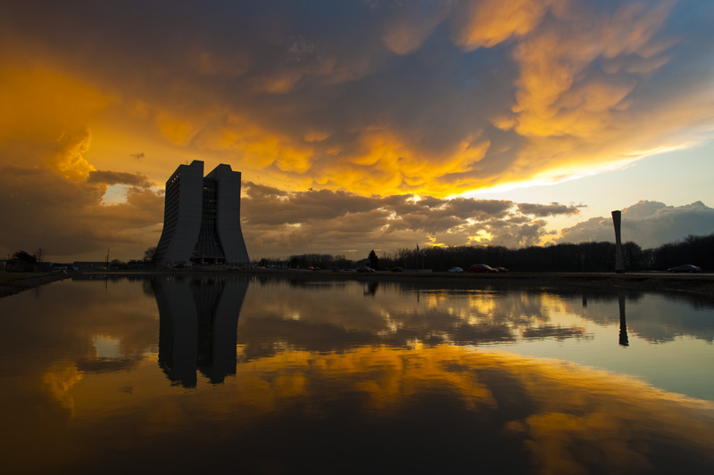
Questions?

