Slide 1
Optimization of the Fixed Target Beamline for the Neutron Therapy Facility
By Kelly Vazquez, FNAL SIST Intern
MentorS: Dr. Thomas Kroc & Dr. Carol Johnstone

Slide 2
Overview
Introduction:
Objective
Background
The NTF Beamline
Accelerator Programs
OptiM
MAD8
Finding the Bend Center
Results
Conclusions & Future Work

Slide 3
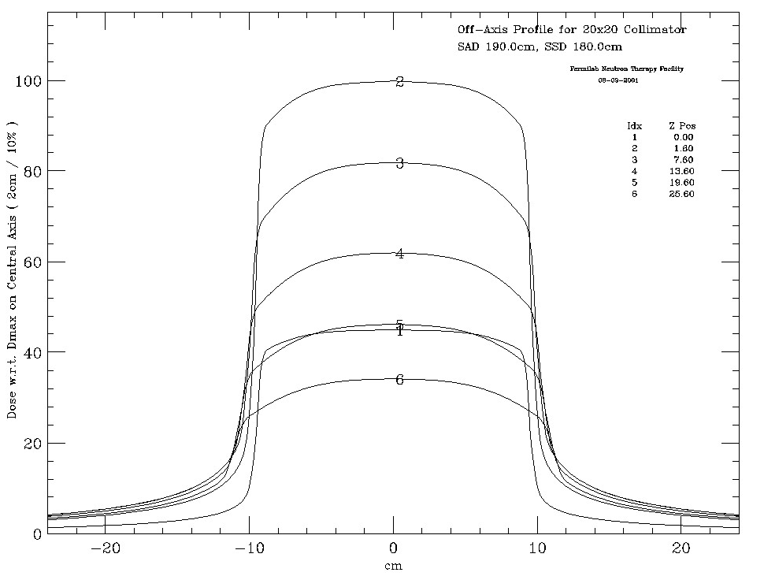
Introduction: Purpose
Existing fully operational, fixed-target beamline
Served as the source of neutrons for irradiation in the Neutron Therapy Facility (NTF) that ceased its treatment of cancer patients in 2011
Due to data previously collected and analyzed we proposed that the beam may be entering off-axis
The purpose of our project was:
Reduce the Quadrupole magnet currents in the beamline
Verify misalignment in the existing fixed-target beamline
If misaligned, optimize the beamline such that it enters the NTF line on-axis

Slide 4
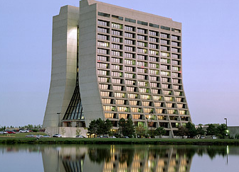
Introduction: Background
Leader in the area of particle physics, Fermi National Accelerator Laboratory uses a series of accelerators to create powerful beams of particles
Fermi’s linear particle accelerator (Linac) creates the proton beams needed for various experiments
750keV H- ion source in the Linac’s pre-accelerator
Approximately 500 feet long
Accelerates the proton beam up to 400 million electron volts(MeV)
Linear accelerators have significant applications to medicine
Dr. Robert Stone began experimenting with neutron therapy for cancer patients in 1938.
In the 1970s, Dr. Robert Wilson of Fermilab created the Neutron Therapy Facility(NTF)
September 7, 1976 NTF treated their first patient.

Slide 5
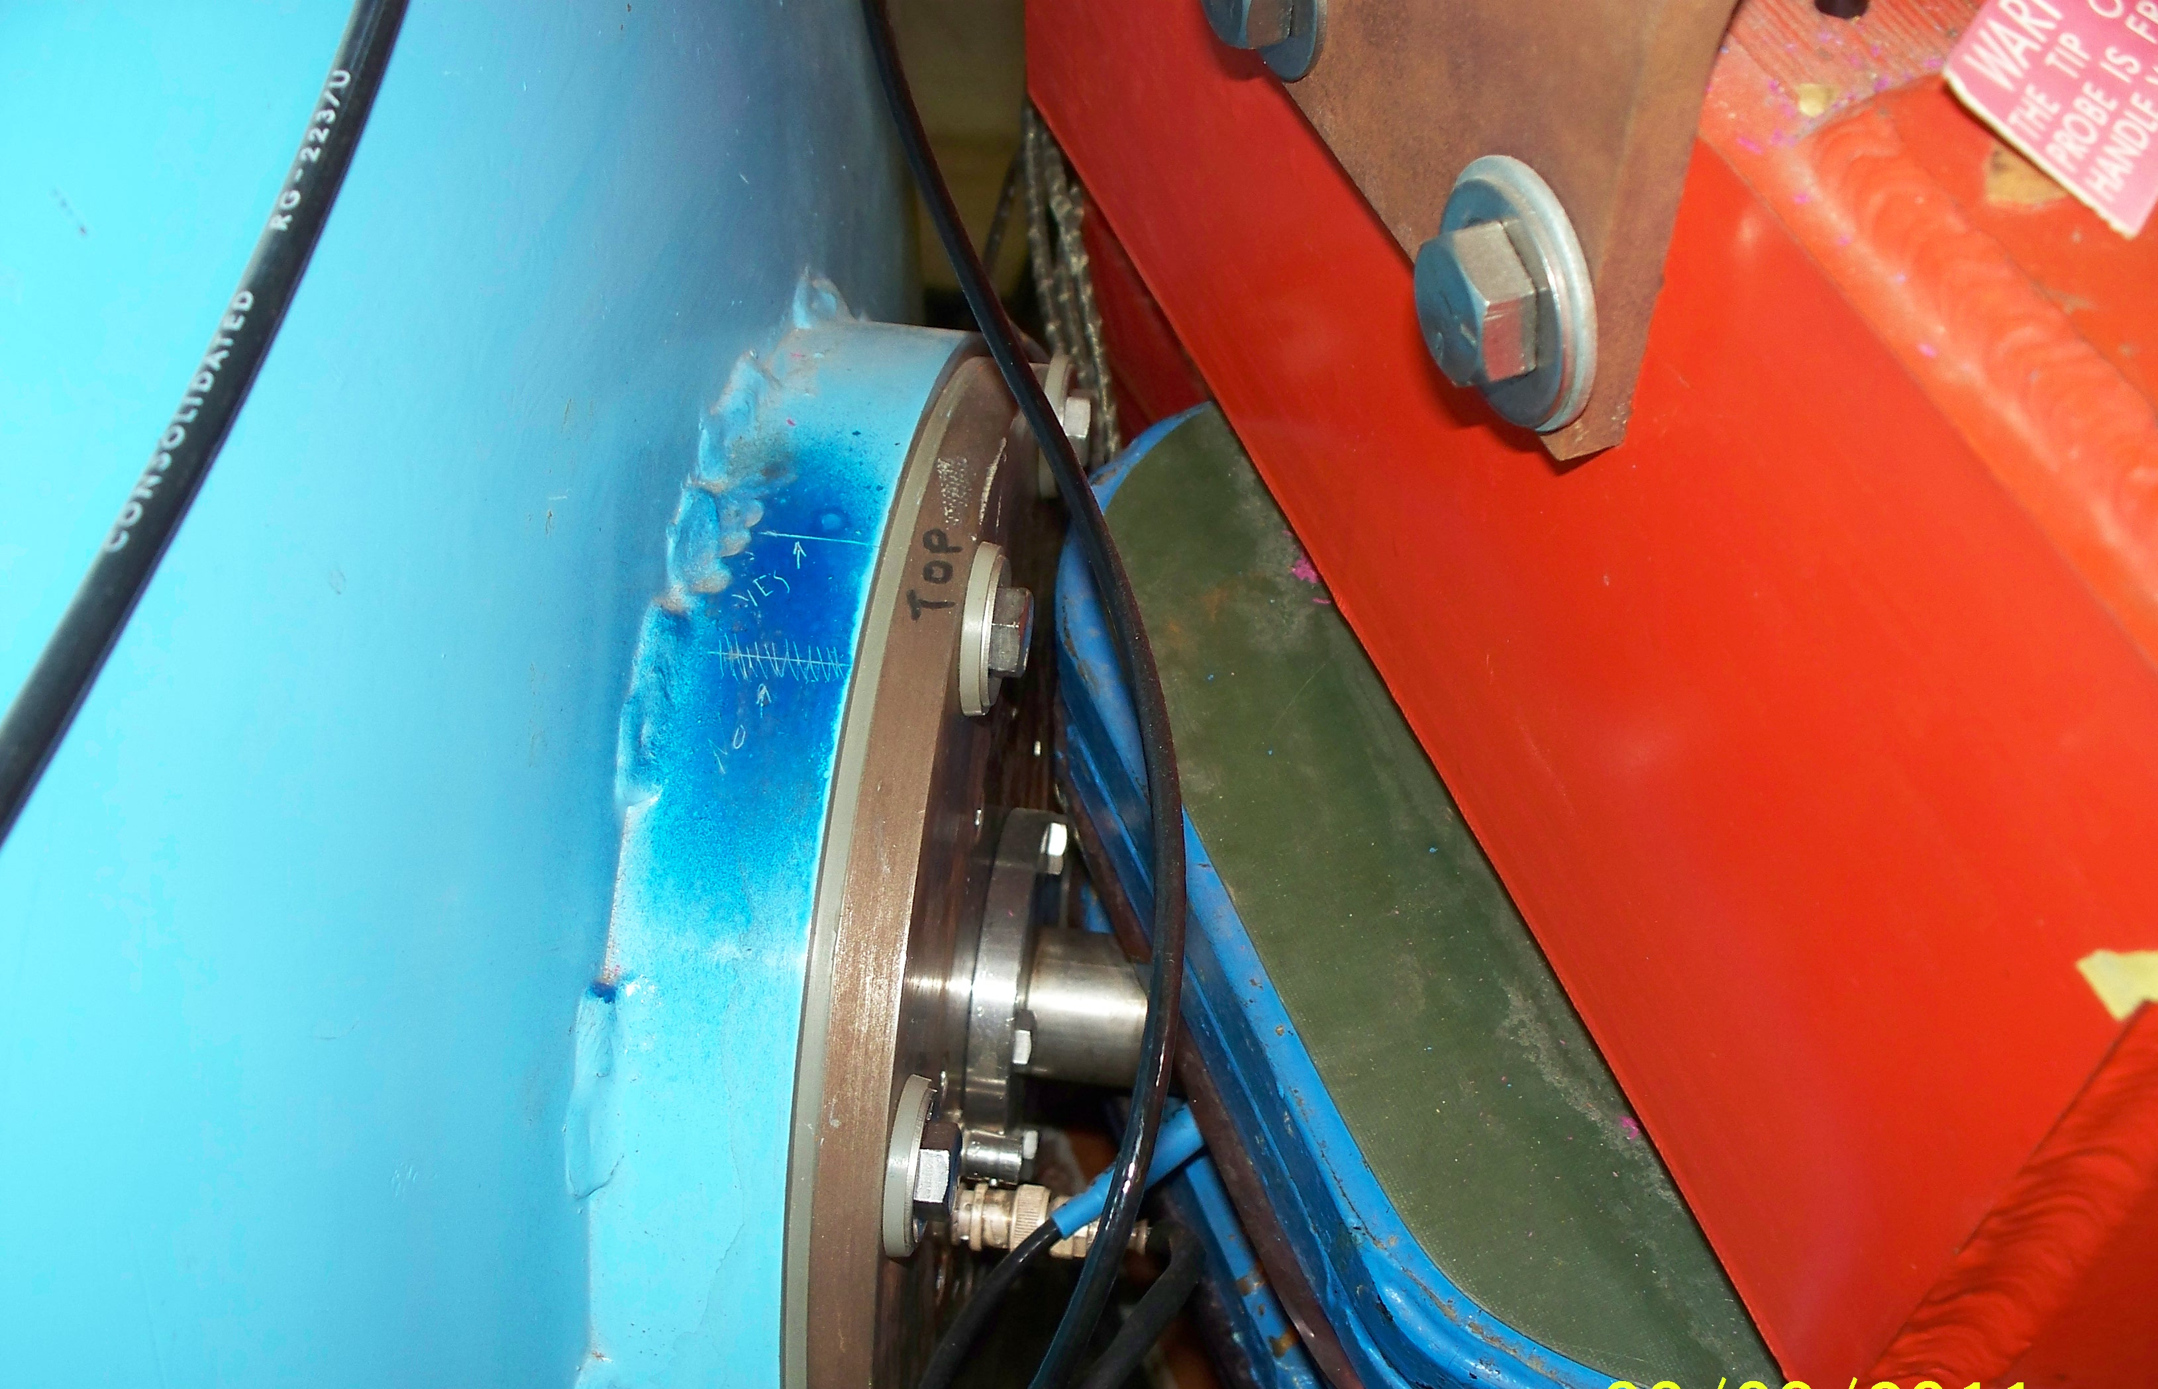
The Entrance to the NTF Beamline

Slide 6
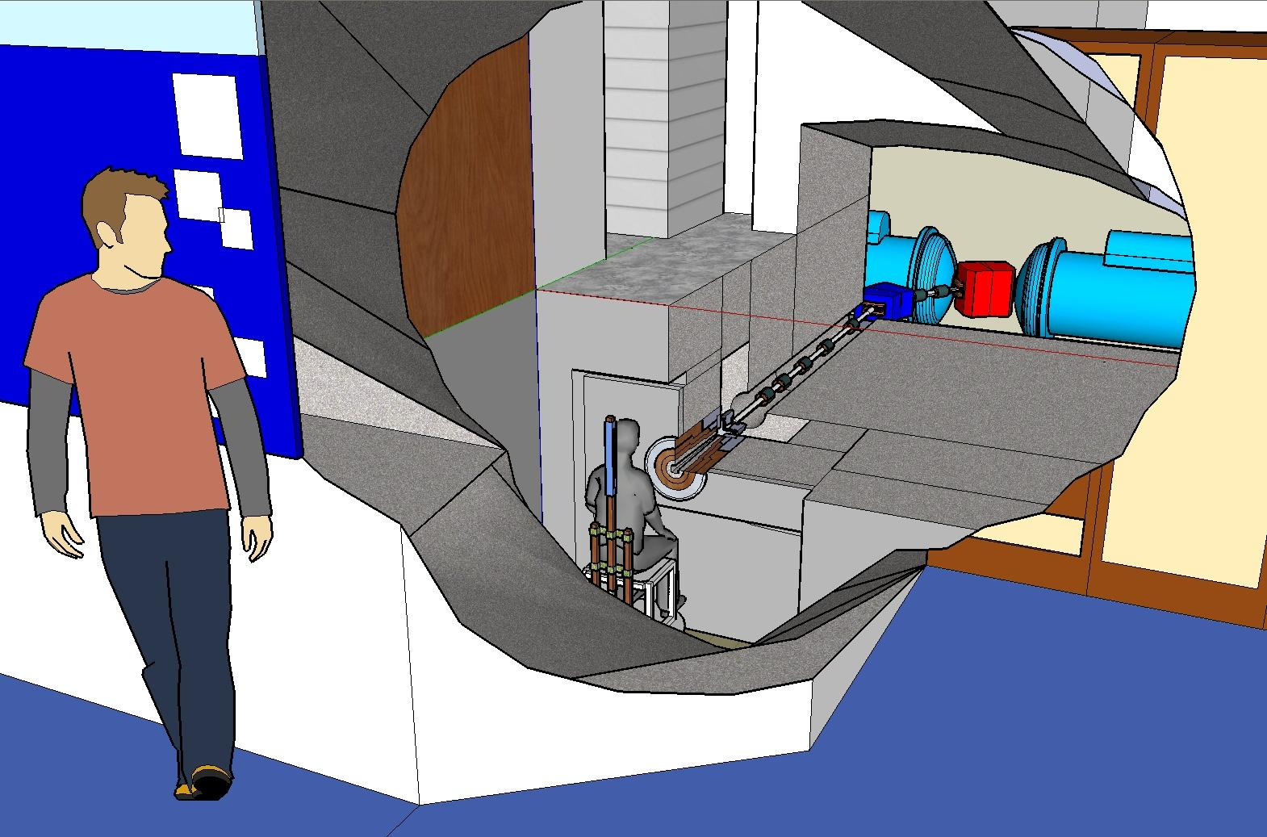
The NTF Beamline
58° rectangular dipole bending magnet marks the entrance of the beamline
2 quadrupole magnets placed in an optically focus-defocus pattern
To complete 90°, the beam reaches another rectangular bending dipole magnet of 32°
Sequence of 5 additional focusing quadrupoles completes the beamline

Slide 7
Accelerator Programming Background
Elements of the Beamline
Dipoles
“Bending Magnets”
A dipole magnet has 2 poles. This magnet is used to realize bends in the design trajectory of the particle beam.
Quadrupoles
“Focusing Magnets”
A quadrupole magnet has 4 poles. This magnet is horizontally defocusing. A quadrupole which defocuses in one plane focuses in the other.
Optical Lens Analogy
Need for FODO
Concave/Convex

Slide 8
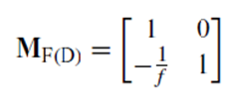
Accelerator Programming Background
Applications of Linear Algebra
Matrices for focusing and defocusing quadrupoles
Apply Thin Lens Approximation
TWISS Parameters
Useful in measuring beam emittance
β_{x,y} components
α_{x,y} components

Slide 9
OptiMX
Developed and maintained by Fermi physicists
Aimed at assisting with the linear optics design of particle accelerators
Allows the user to compute dispersion and beam sizes
Linear optics calculations done based on a 6 dimensional transfer matrix
Able to output and plot betatron functions (Twiss Parameters)

Slide 10
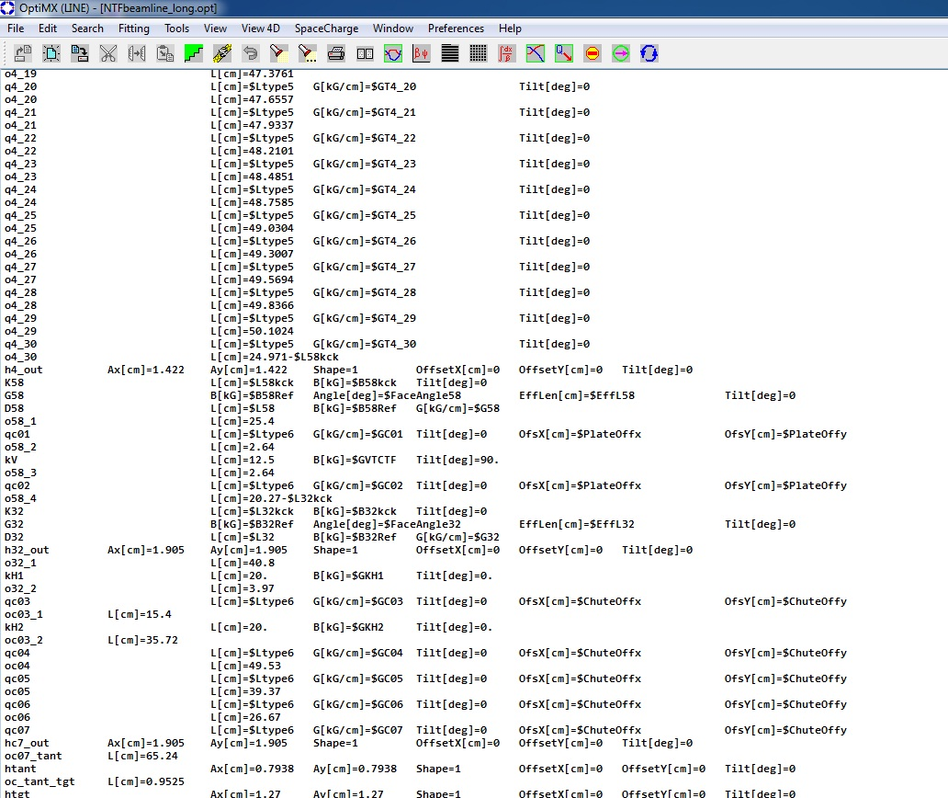
OptiMX: Input Files
Input initial values for momentum & energy of 66 Mev Proton
Verified that the existing OptiMX files matched the survey lengths for each of the elements along the beamline
$$E=m_{0}c^{2}+K$$
$$E^{2}= p^{2}c^{2}+m_{0}c^{2}$$
$$p=\sqrt{\frac{(E^{2}−m_{0}c^{2}) }{c^{2}}}$$

Slide 11
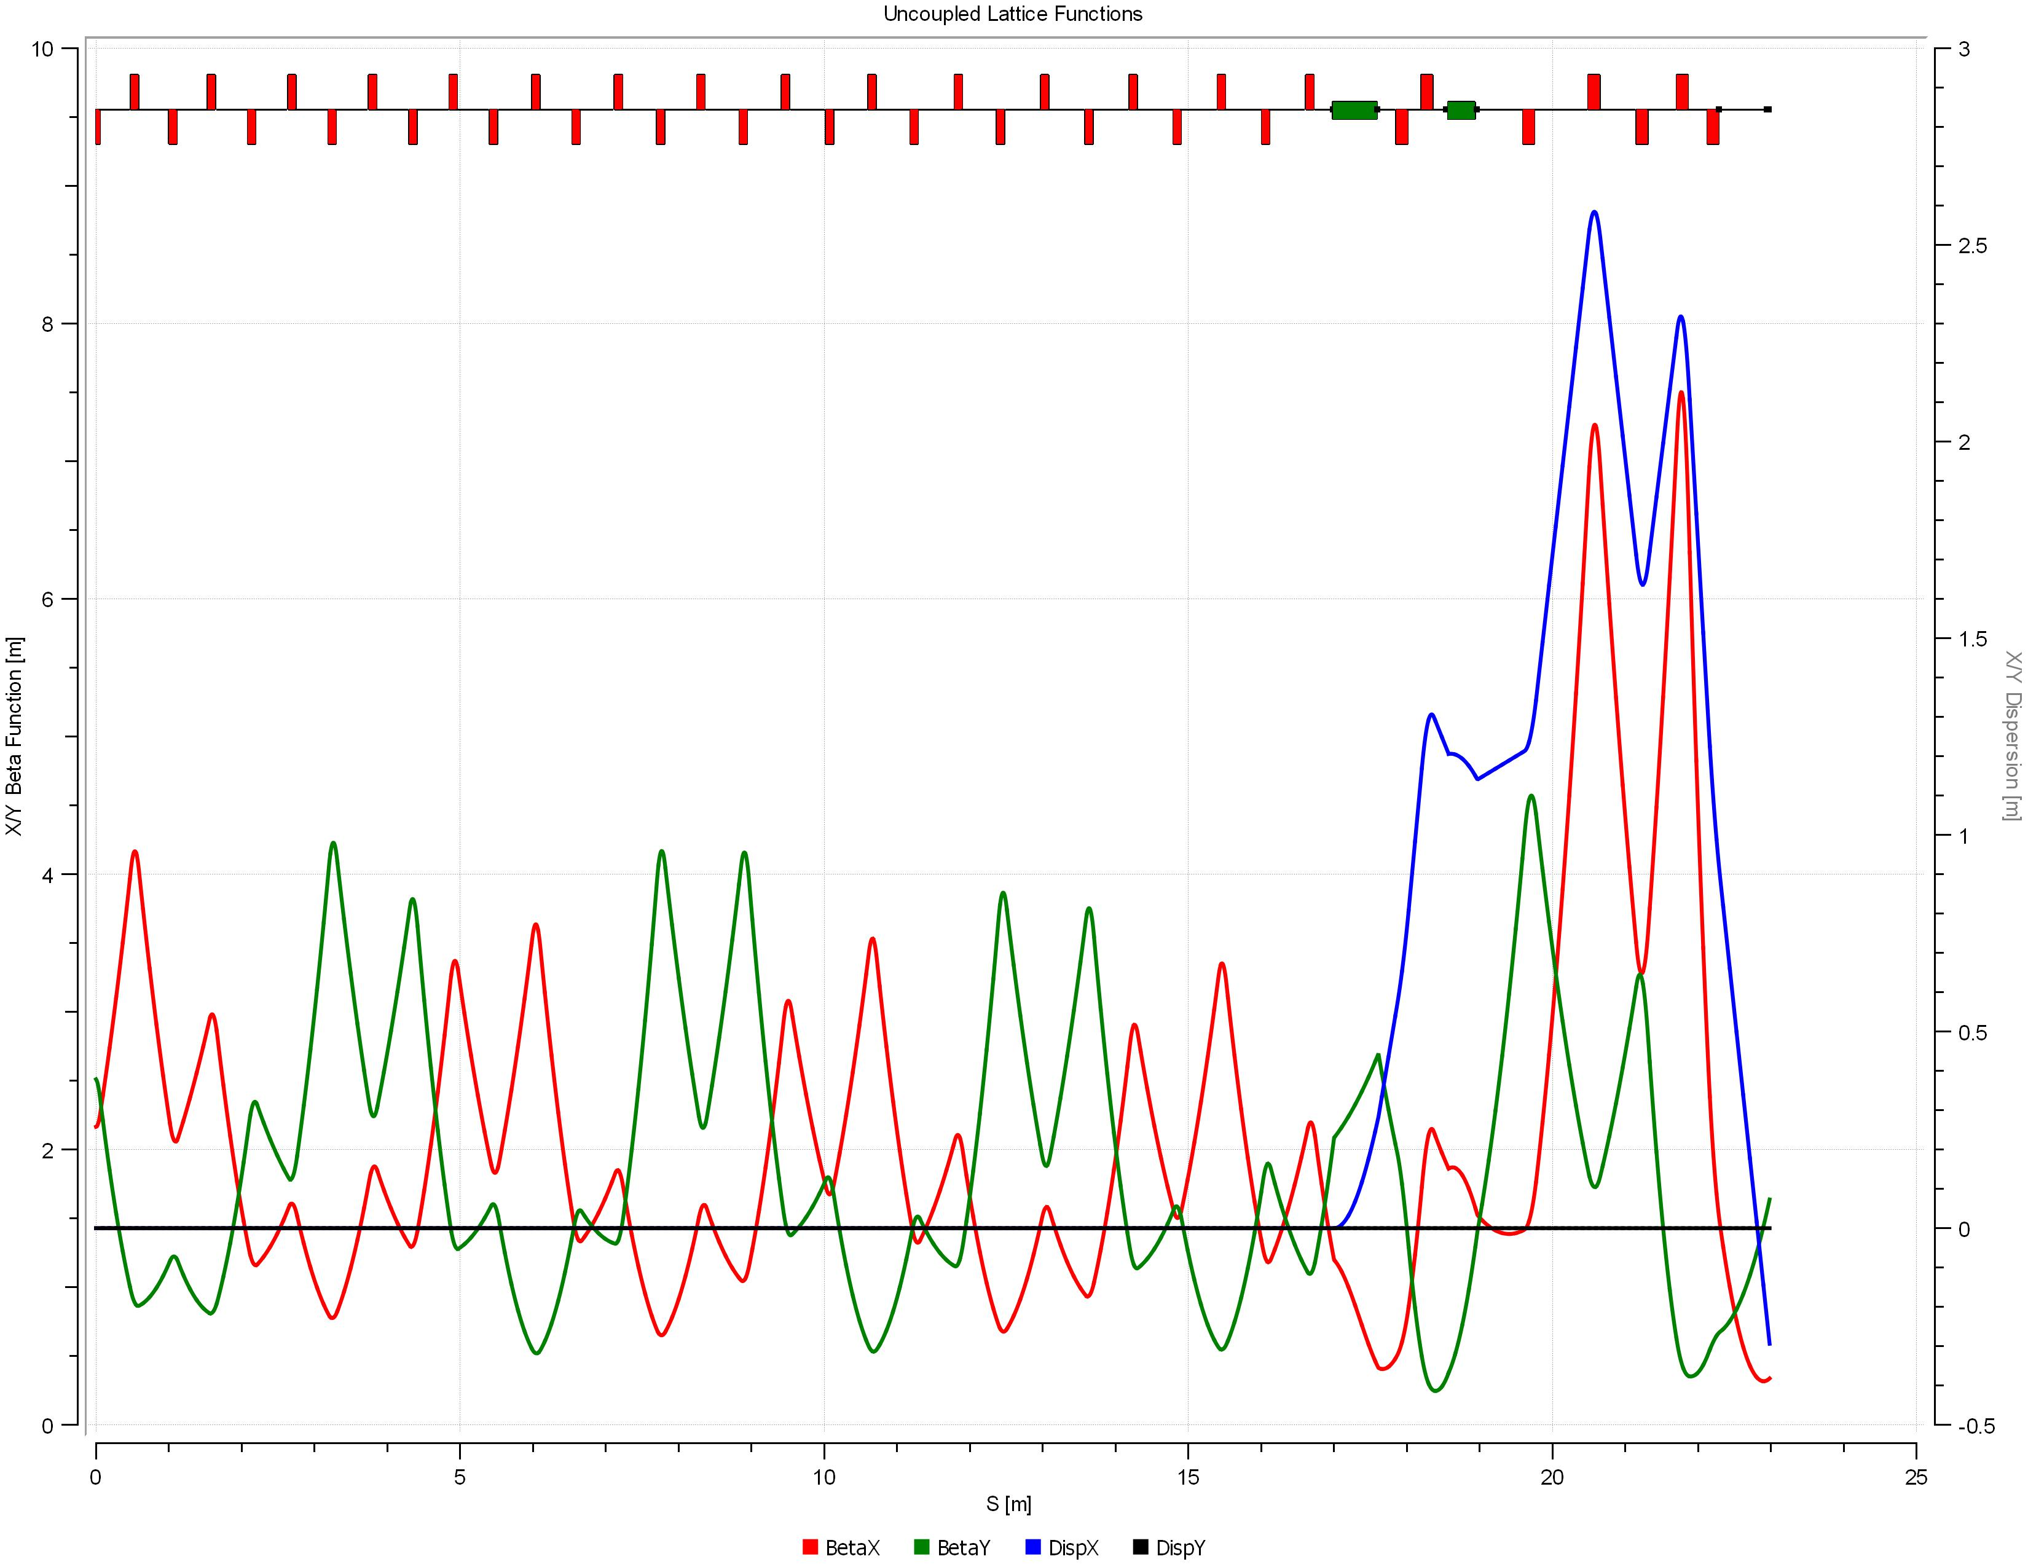
OptiMX: Twiss Parameters

Slide 12
MAD8
Methodical Accelerator Design, v. 8.0
Performs many functions that OptiM simply cannot
MAD-X currently maintained and operated by CERN
Forefront of particle accelerator design and simulation
One of the standard scripting languages for accelerators

Slide 13
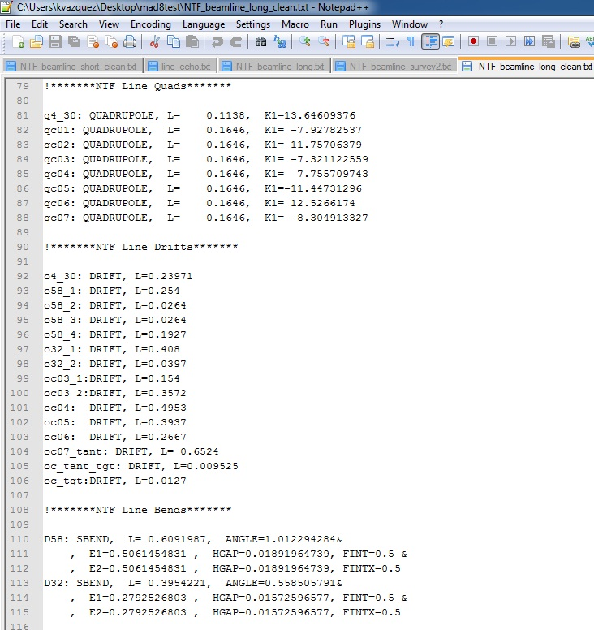
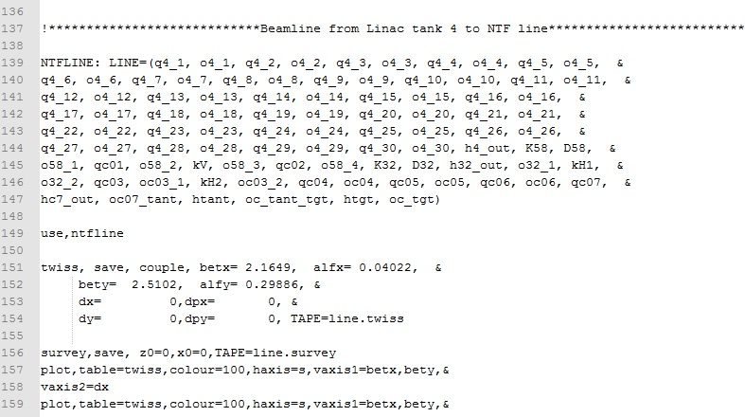
MAD8: Input Files

Slide 14
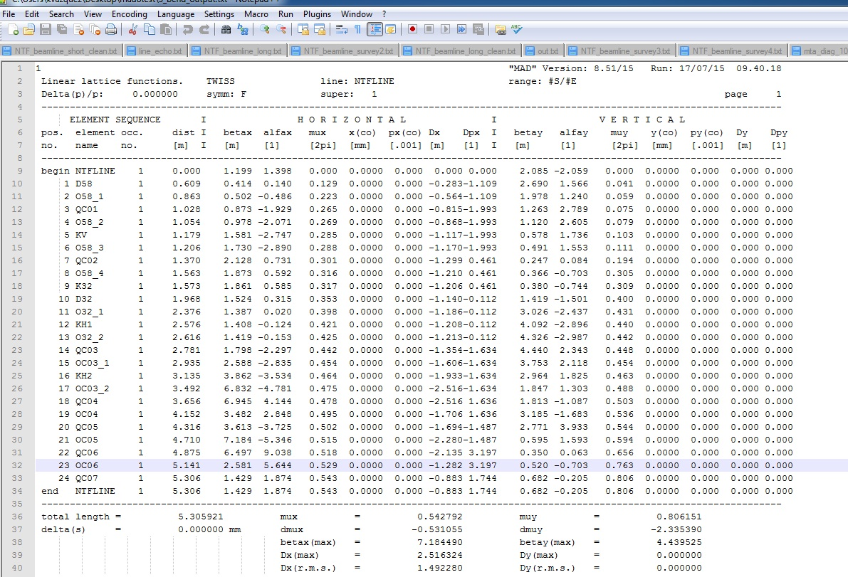
MAD8: Output Files
Verified that all of the TWISS parameters matched those calculated in OptiM
Generated plots of the βx,y functions
Using the SURVEY command, we were able to output a geometrical survey of the elements

Slide 15
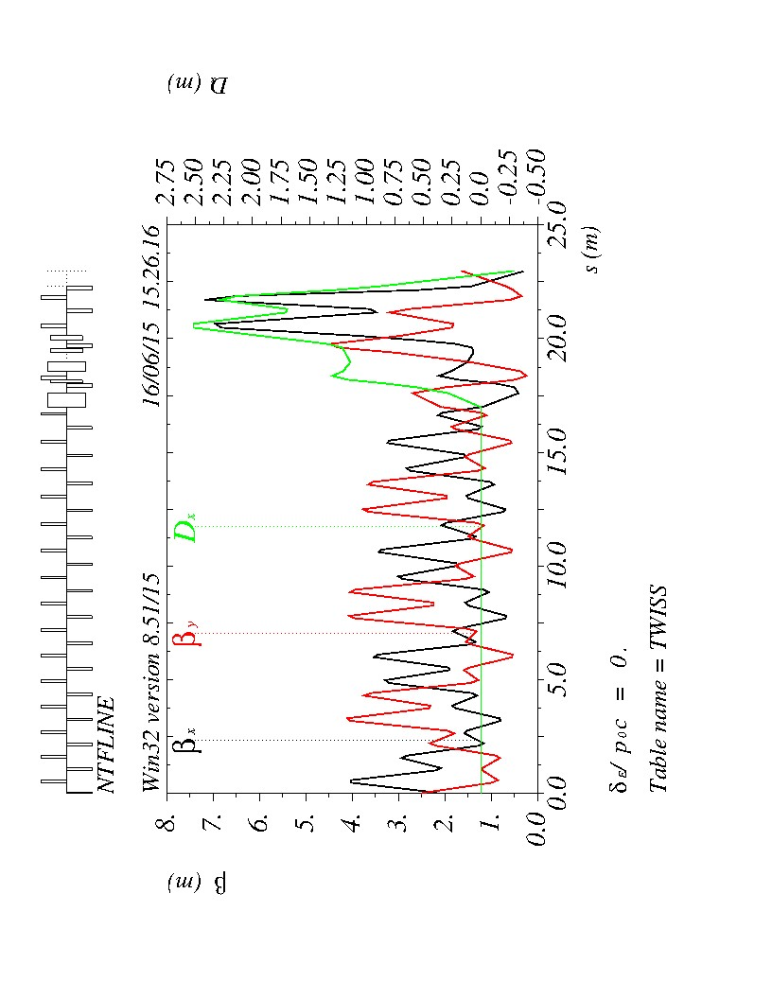
MAD8: TWISS Parameters

Slide 16
Matching
OptiMX
MAD8

Slide 17
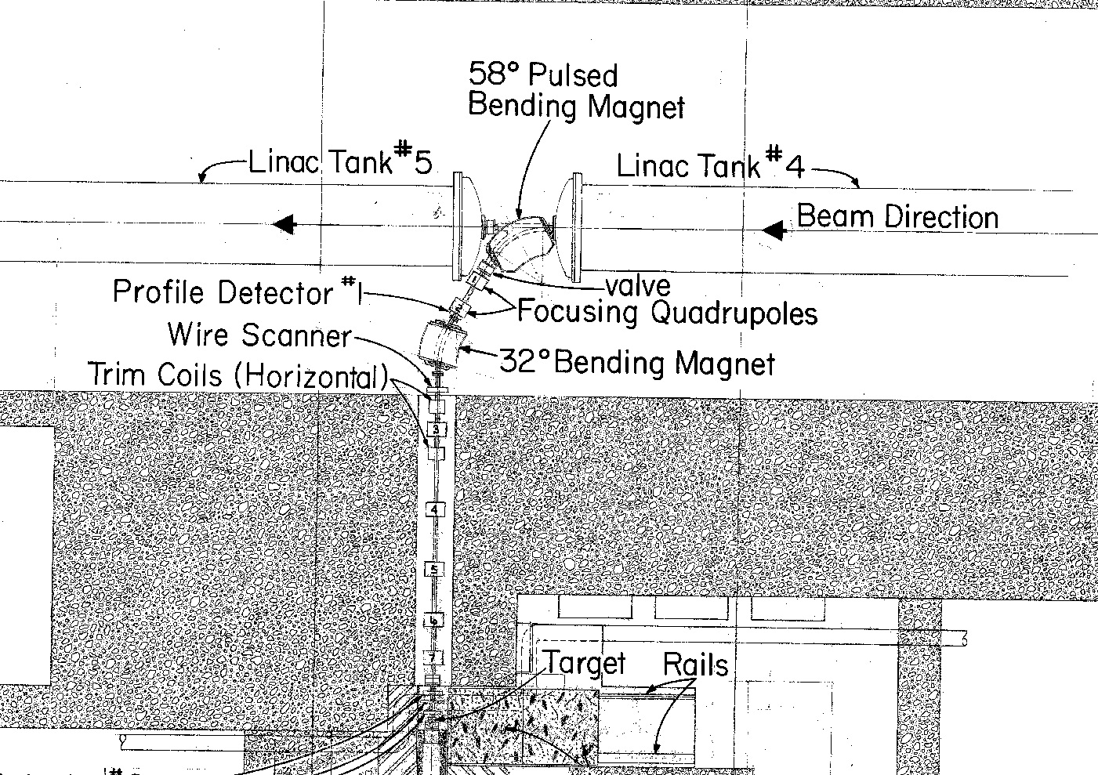
Finding the Bend Center of the Magnets
Survey alignment data was used to develop equations that fit the coordinates
If correctly aligned on-axis the beam should strike through the bend center of each of the bending dipole magnets
Survey command in MAD gave the θ_{Bearing}
Using these equations the physical intersection points of the lines were calculated
The equation for the perpendicular bisector of each of the dipoles was found
Coordinates of the intersection point of the line bisecting the dipole and the line through the physical elements was determined

Slide 18
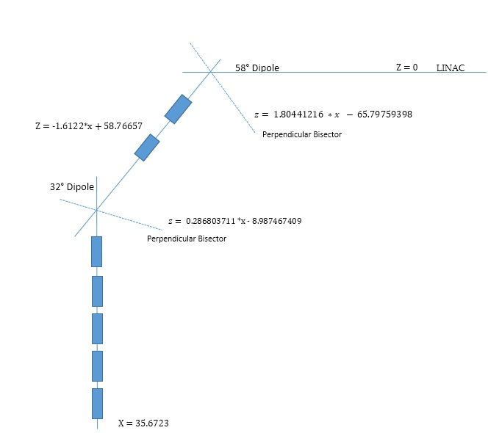
Schematic Layout

Slide 19
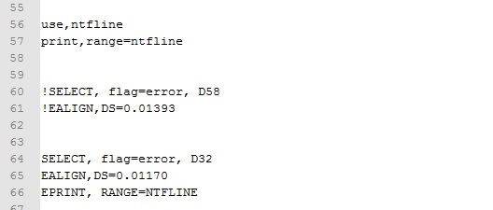
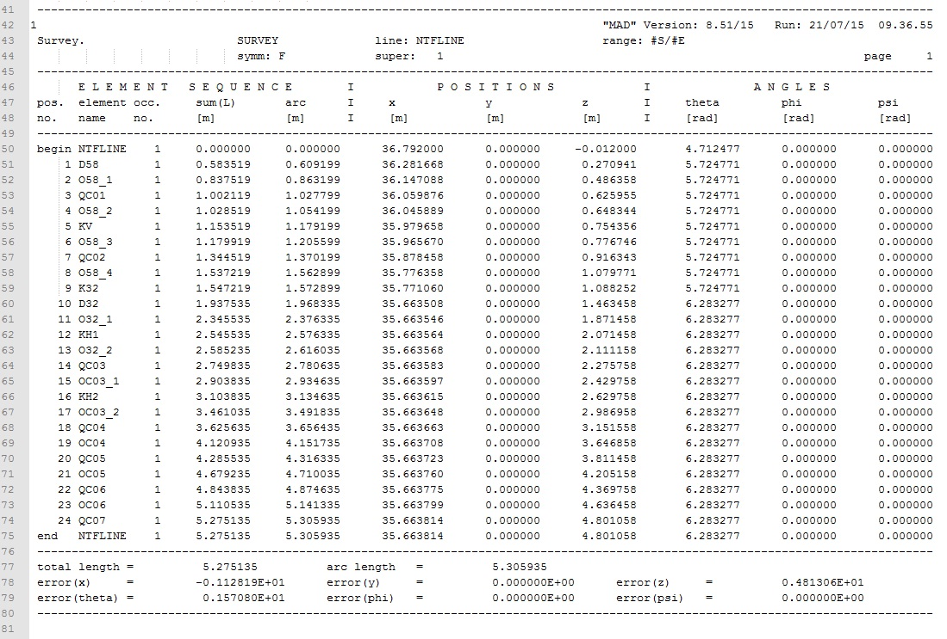
MAD8: Survey and Error Analysis
SURVEY command
Outputs a geometrical survey of the elements that allowed us to compare physical lengths to effective
ERROR command
Assigns calculated misalignments to specific elements

Slide 20
Results
Successful conversion from OptiM to MAD8
Compared output to that of the alignment survey
Calculated intersection points and found misalignment error
 | Distance(cm)**
Misalignment in 32° | 1.17022
Misalignment in 58° | 1.39255
Total Misalignment | 1.34487
**Denotes misalignment upstream

Slide 21
Conclusions & Future Work

Slide 22
Conclusions & Future Work
Restatement of Purpose:
Reduce the Quadrupole magnet currents in the beamline
Verify misalignment in the existing fixed-target beamline
If misaligned, optimize the beamline such that it enters the NTF line on-axis
Bringing it all together
We must verify the MAD error alignment output of 0.0134487 meters upstream
Use the values collected at the target showing the off-axis beam distribution and work back upstream
y = -97.701x + 988.69
$$x= (y−988.69)/−97.701$$

Slide 23
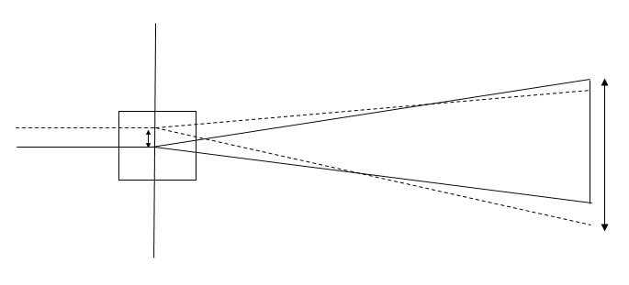
Conclusions & Future Work
Using the x-coordinates calculated we can find the relationship between change in current and horizontal motion
We can find the corresponding distance upstream using geometrical ratios
This distance allows us to compare to the MAD misalignment
$$\frac{x−coordinate}{190cm}= \frac{y}{109cm}$$

Slide 24
References
[1] Hans Grote and F. Christoph Iselin. The MAD Program User’s Reference Manual. Geneva, Switzerland, 2013.
[2] Valeri Lebedev and J.F. Ostiguy .The OptiMX User Guide. Fermilab. 2014.
[3] Fermilab. Accelerator Report No. 4-5. 2004.
[4] All pictures of the Neutron Therapy Facility used with permission of Fermilab.

Slide 25
Acknowledgements
I would like to say a special thank you to my advisors:
Dr. Thomas Kroc and Dr. Carol Johnstone
for their continual support throughout the duration of this project.
I would also like to thank Adam Watts, Dr. Elliott McCrory, Sandra Charles, Mayling L Wong-Squires, and the SIST committee for this opportunity.

Slide 26
Questions?

