Slide 1
Geant4: Web Application & Validation
Rasheed Auguste
Supervisor: Hans Wenzel
SIST Final Presentation
August 4, 2015

Slide 2
Outline
Geant4 Web Application: http://g4validation.fnal.gov:8080/G4WebAppNG/
User editing interface
Experimental Data Browser improvements
Database schema extension
Geant4 Simulation:
Pion-matter Cross section (Xs) tests
Simulation and experimental data comparison

Slide 3
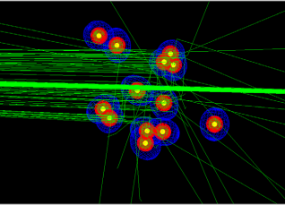
What is Geant4?
Open-source toolkit for all particle interactions in matter
Contains physics models for these interactions
Energy scale from eV (chemistry) to TeV (high energy physics)
Important for high energy physics, nuclear and accelerator physics, and studies in medical and space science.
Constantly checked against experimental data and improved
A small group of randomized cells in Geant4 being irradiated by kilovoltage x-rays in the current work at the University of Adelaide in South Australia.
M Douglass et al.
Notes:
The Geant4 collaboration regularly performs validation and regression tests
Identify and analyze physics processes of interest
i.e. K/p/pi/n cross sections
Validation of detector response with physics list best modeling the detector response
A small group of randomized cells in Geant4 being irradiated by kilovoltage x-rays done at the University of Adelaide in South Australia
Geant4-DNA application where incoming radiation effects on DNA are studied
Guidance on physics models and Geant4 version to use
Add experimental data to Geant4 database

Slide 4
Geant4 Validation Repository Framework
Data access object software design pattern with an abstract interface to the database
User interface
Stores both in form of images with meta data or raw data points.
Experimental data
Geant4 Simulation Results
Notes:
PostegreSQL database stores both simulated and experimental data in form of images with meta data or raw data points.
meta data describes the test and lists the references from where the experimental data for comparison was obtained from, as well as other parameters that describe the test (e.g. beam particle, target material, etc.).
Web Application allows the user to interactively select and overlay data from the database in the form of plots, data tables, or histograms.
viewing results from development releases, upload of new tests and/or modification of selected tests.
API Library is the code and medium by which the two communicate, it isolates the user from editing/accessing the database directly

Slide 5
Notes:
Experimental Data Browser allows to select different experimental data sets and shows the selected data overlaid in one plot.
data can be selected by target material, reaction, type of beam, beam energy, secondaries and the quantity plotted.
Test Result Browser allows to select various Geant4 simulations and overlays the results to available experimental data.
In addition the user can choose the Geant4 version as well as the physics model or physics list used to obtain the simulation result.

Slide 6
Notes:
Selected Dicello et al. from experimental data browser
Proton total reaction cross sections in the 10-20MeV range for C and Ca
Default plot of experimental results
New feature added this summer

Slide 7
Web Application Development
Java development using open-source PrimeFaces library
Webpage HTML user interface
Requested features from my work:
Protect against malformed user inputs
Staged delete
Default display

Slide 8
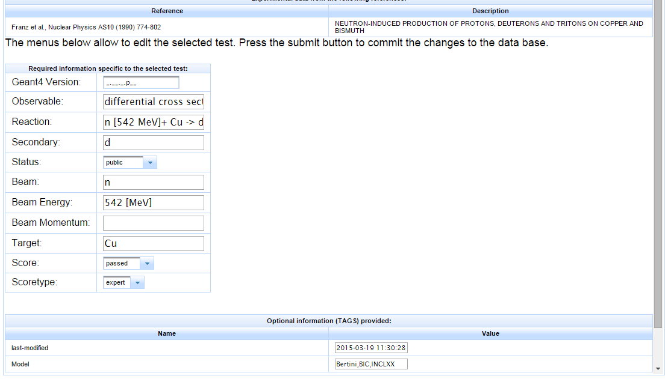
Edit Test – Masked/Dictionary Entries
Notes:
Added masked entry fields for Geant4Version
Dictionary valued drop-down menus for status, score, and scoretype

Slide 10
Geant4 Simulation Development
Simulations run will be put into Geant4 database
Using Python and ROOT scripts to automate data generation
User will see data in web application test result browser
Geant4 simulations compared to experimental data
Looked at pion interactions in matter
Useful for experiments like LARiAT for detector response and measurement results validation

Slide 11
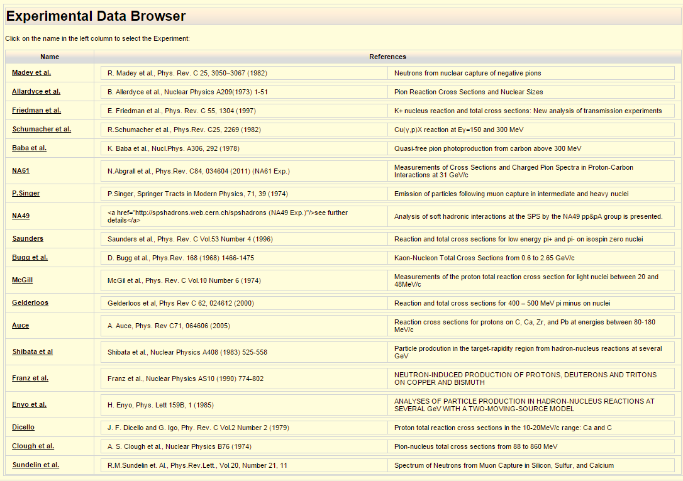
Added Data – Experimental Data Browser
Notes:
Big change, added more data into database
Experimental Data Browser shown has new tests highlighted with red accent
Data has been pion/kaon cross section data for different elements
Pertinent to neutrino experiments
Working with SQL database to enter exp. Data and then display with web application

Slide 12
Geant4 Event Simulation
Particles from nuclear reaction
(N_{in})
Incident particles (N_{inc})
Elastically
scattered particles (N_{el})
Target of Atomic number(A), thickness (s), and density (d)
Notes:
Particle goes from point a to point b in a specific material - target
Identify particle and process by which step occurs
Stepped particle process is counted

Slide 13
Key:
Pb
Au
Sn
Ag
Cu
Fe
Ca
S
Al
C
All simulations done with G4 Version 10.01.p02
Notes:
Look at delta resonance behavior
Cross sections scale up with atomic number
Pi plus lower than pi minus, less likely to penetrate and be ejected by positively charged nucleus because of coulomb force

Slide 14
Key:
Pb
Au
Sn
Ag
Cu
Fe
All simulations done with G4 Version 10.01.p02
Ca
S
Al
C
All simulations done with G4 Version 10.01.p02
Notes:
Look at delta resonance behavior
Cross sections scale up with atomic number
Pi plus lower than pi minus, less likely to penetrate and be ejected by positively charged nucleus because of coulomb force

Slide 15
Geant4 Simulation (lines) agree nicely with experimental data (dots)
All simulations done with G4 Version 10.01.p02
Notes:
Geisha (LHEP) and Simulated data on top of each other
Total
Inelastic
Elastic

Slide 16
Geant4 total cross section simulation vs. data (Ashery)
Liquid Argon
C1*(atomic mass)^C2 total cross section fit results Geant4 C2 = 0.67 +/- .01 Experimental data C2 = 0.70+/- .008
Close to expected C2 = 0.66
Geant4 at 300 MeV
Ashery at 315 MeV
40
Notes:
Ashery data vs. Geant 4 simulation
Experimental data taken at 315 MeV
Geant 4 taken at 300 MeV
Near Delta Resonance peaks
Both should scale with atomic mass ^ 1/3

Slide 17
Conclusion
PostgreSQL database development
Programming with Java and HTML and modern web application framework
Simulation automation with Python and Root
Cross-section experimental procedure
Experimental physics versus simulation

Slide 18
Acknowledgements
Hans Wenzel for project supervision and advice
Geant4 PDS group at Fermilab for welcoming atmosphere
Geant4 Collaboration for feedback
The SIST committee for the opportunity to intern at Fermilab

Slide 19
BACKUP SLIDES
Geant4 Dicello et al. Display table
Database schema implementation
Total cross section plot

Slide 20
Experimental Data Browser – Dicello et al.
Notes:
Table of plotted data from default display
Dicello et al. still, looking at Carbon and Calcium at low energy

Slide 21
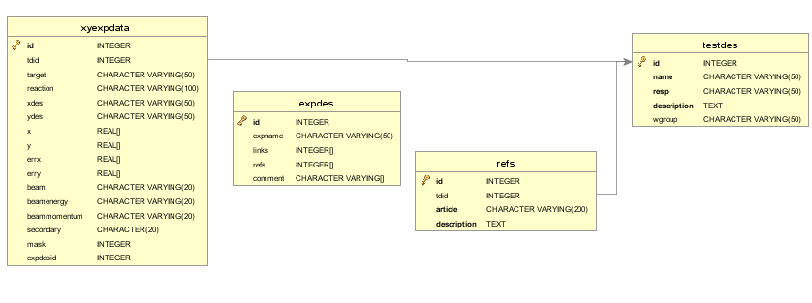
Default Display – Extension of Database Schema
Replace xyexpdata elements (i.e. nameofexperiment) with reference to unique experiment description table (expdes)
Experimental data relates to simulated data (testdes) so that they both can be overlaid
Notes:
Xyexpdata elements hold test data
Note key variables like target, reaction, x,y, etc.
Change will move information held in nameofexperiement and reference fields to unique experiment descriptions
Note unique experiment descriptions table and corresponding relation to test description
Extends database schema in this way to keep experiment information with cleaner references

Slide 22
Key:
Pb
Au
Sn
Ag
Cu
Fe
Ca
S
Al
C
All simulations done with G4 Version 10.01.p02
Notes:
Look at delta resonance behavior
Cross sections scale up with atomic number
Pi plus lower than pi minus, less likely to penetrate and be ejected by positively charged nucleus because of coulomb force

