Slide 1
Developing Partnerships with Industry
Miguelangel Marchán
Under the supervision of Cherri Schmidt
Directorate/ Office of Partnerships and Technology Transfer

Slide 2
Overview of Project
Developing/Managing Partnerships
TechConnect Innovation Summit
Performing Agreement
Basic Research on Accelerators
Notes:
So while my project last year involved working with patents this summer my project will revolve around developing and managing partnerships with industry and other institutions. My project is split into two parts. One half deals with creating connections by attending a technology showcase and expo and the other half deals with actually performing an agreement between Fermilab and industry.

Slide 3
Office of Partnerships and Technology Transfer (OPTT)
Responsible for:
Handling Intellectual Property
License technology
Developing agreements with industry, universities, and other institutions outside of the Department of Energy (DOE)
Notes:
This summer I worked with the Office of Partnerships and Technology Transfer (OPTT). As a part of the Department of Energy’s mission, OPTT is dedicated to performing Technology Transfer activities. Tech Transfer is the process by which tech or knowledge developed in one place or for one purpose is applied and used in another place for the same or different purpose. This process can involve licensing patented technology that Fermilab has developed. For example, this is a picture of a Fermilab patented technology, SEUSS, (Single Event Upset Suppression System) that we are currently looking to license. Tech Transfer can involve performing agreements with industry universities, and other institutions outside of DOE.

Slide 4
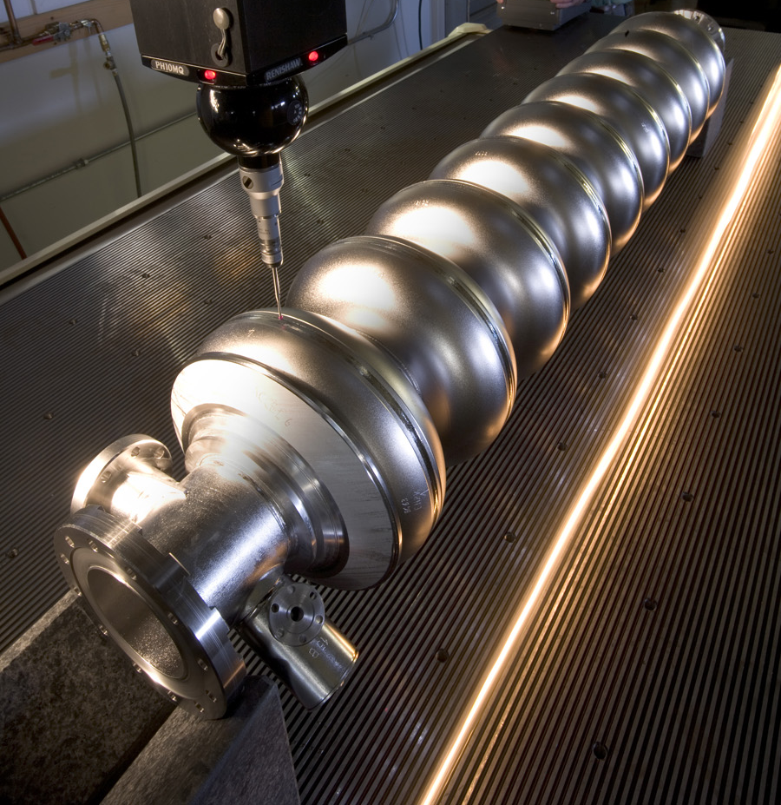
Performing Agreements
Various kinds of agreements:
Strategic Partnership Project (SPP)
User Agreements
Cooperative Research and Development
Agreement (CRADA)
CRADA with MuPlus Inc.
“Pressurized Gas Beam Monitor for Extremely High Intensities”
Design and simulation of a prototype RF resonator
Notes:
DOE Facilities have several mechanisms at their disposal that facilitate technology transfer efforts between labs and outside partners. There are User Agreements, Strategic Partnership Projects, and Cooperative Research and Development Agreements (or CRADA for short). A CRADA is used for collaborative research between DOE labs and public/private entities for the mutual benefit of both parties. The CRADA that I worked on was between Fermilab and MuPlus Inc, an accelerator physics firm here in Batavia. The project titled “Pressurized Gas Beam Monitor for Extremely High Intensities” proposes to design and simulate a prototype RF resonator. Here’s a picture of a kind of Radio Frequency cavity used in various physics projects such as this one.

Slide 5
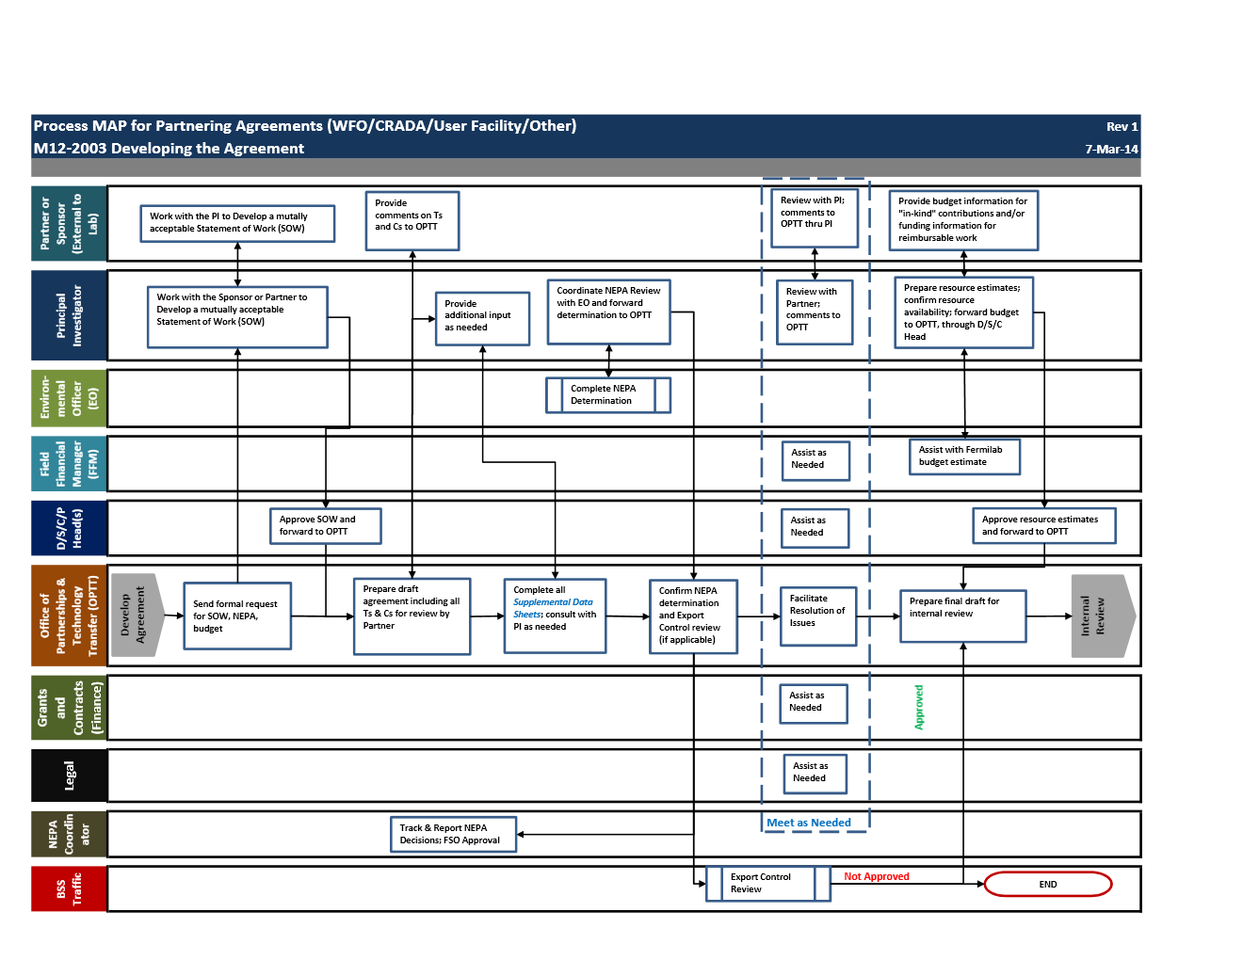
Performing Agreements
External Partner
Principal Investigator
Environmental Officer
Legal
Field Financial Manager
Division Head
OPTT
We have a partner, now what?
Notes:
So we have a partner, and we know what kind of agreement we want. now what? Performing an agreement requires the work of several people: OPTT, External Partner, Field Financial Manager (works on budget), Legal department, and Principal investigator (PI).

Slide 6
Performing Agreements – CRADA
3 Main components to every agreement
Statement of Work
Scope, Approach, Schedule, Deliverables
Terms and Conditions
Supplemental Information that must be submitted to DOE
PI
Me
Notes:
But here is a flow chart of what I worked on specifically. I followed the process map shown on the last slide as well as procedures that have been made to complete CRADAs. To perform this agreement I needed the assistance of various individuals but mostly from the Principal Investigator, or the person responsible for working with MuPlus. The PI works with the partner to complete various tasks. Every agreement has 3 key components:
A Statement of Work that clearly defines the scope, approach, schedule, deliverables
And terms and conditions that articulate the rights and obligations of each party to the agreement.
And supplemental information that must be submitted to DOE
The JWS and SOW define the proposed budget for the project and include information on how the project benefits the parties and DOE.
Every proposed project at the laboratory requires a review and determination under the National Environmental Protection Act (NEPA) to ensure that the proposed work will not create an adverse environmental impact at the laboratory. I worked with the PI to complete this review.
After all of the appropriate documents have been completed I then use the OPTT checklist to make sure that everything has been completed. I then prepared all of the documents for internal review. This is to assure quality before sending the agreement to DOE.

Slide 7
Performing Agreements – CRADA
Make sure there is no conflict of interests by individuals assigned to the project
National Environmental Policy Act (NEPA) determination
Export Control Determination
Will equipment, information, technology, or data exported or provided to a foreign national in the U.S?
PI
Me
Notes:
But here is a flow chart of what I worked on specifically. I followed the process map shown on the last slide as well as procedures that have been made to complete CRADAs. To perform this agreement I needed the assistance of various individuals but mostly from the Principal Investigator, or the person responsible for working with MuPlus. The PI works with the partner to complete various tasks. Every agreement has 3 key components:
A Statement of Work that clearly defines the scope, approach, schedule, deliverables
And terms and conditions that articulate the rights and obligations of each party to the agreement.
And supplemental information that must be submitted to DOE
The JWS and SOW define the proposed budget for the project and include information on how the project benefits the parties and DOE.
Every proposed project at the laboratory requires a review and determination under the National Environmental Protection Act (NEPA) to ensure that the proposed work will not create an adverse environmental impact at the laboratory. I worked with the PI to complete this review.
After all of the appropriate documents have been completed I then use the OPTT checklist to make sure that everything has been completed. I then prepared all of the documents for internal review. This is to assure quality before sending the agreement to DOE.

Slide 8
Performing Agreements – CRADA
Checklist
Prepare all the documents for Internal Review
Agreement is sent to DOE for approval
PI
Me
Notes:
But here is a flow chart of what I worked on specifically. I followed the process map shown on the last slide as well as procedures that have been made to complete CRADAs. To perform this agreement I needed the assistance of various individuals but mostly from the Principal Investigator, or the person responsible for working with MuPlus. The PI works with the partner to complete various tasks. Every agreement has 3 key components:
A Statement of Work that clearly defines the scope, approach, schedule, deliverables
And terms and conditions that articulate the rights and obligations of each party to the agreement.
And supplemental information that must be submitted to DOE
The JWS and SOW define the proposed budget for the project and include information on how the project benefits the parties and DOE.
Every proposed project at the laboratory requires a review and determination under the National Environmental Protection Act (NEPA) to ensure that the proposed work will not create an adverse environmental impact at the laboratory. I worked with the PI to complete this review.
After all of the appropriate documents have been completed I then use the OPTT checklist to make sure that everything has been completed. I then prepared all of the documents for internal review. This is to assure quality before sending the agreement to DOE.

Slide 9
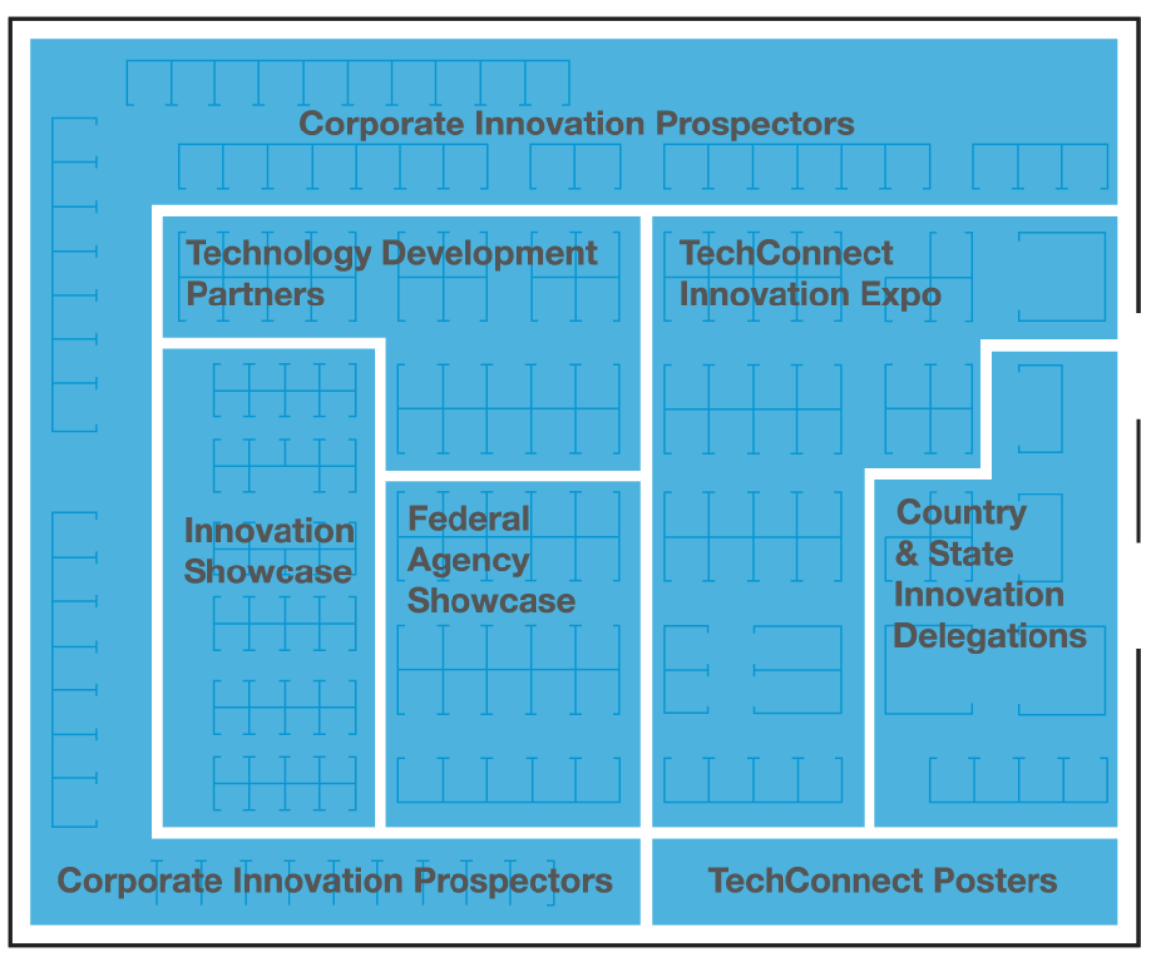
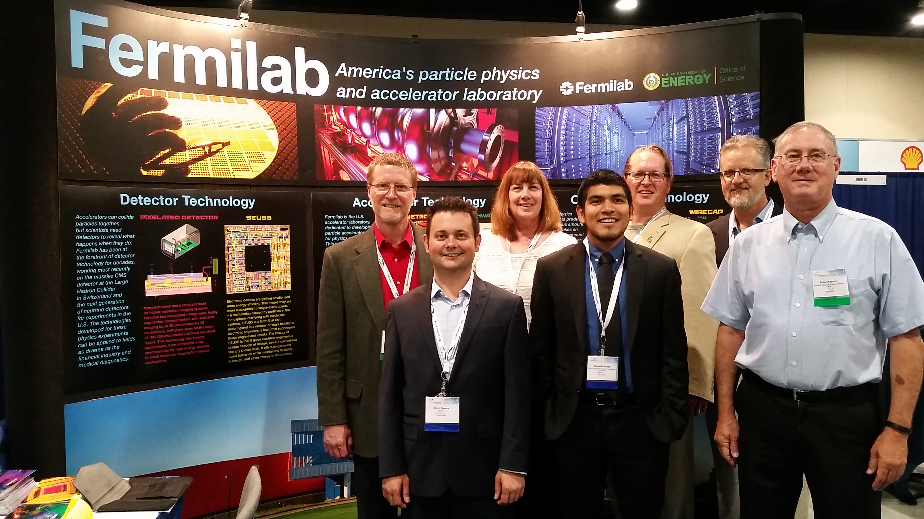
TechConnect Innovation Summit
Participants came together to showcase their available technologies and in search of partnerships
Showcased 6 Fermilab patent-pending technologies
Attended workshops on emerging technologies
More than 40 connections made with institutions and companies
Fermilab Booth
Notes:
Washington DC.
Innovation Showcase & Expo where participants from industry and various institutions came together in search of partnerships and comercializable tech
Fermilab had a booth where we showcased the tech

Slide 10
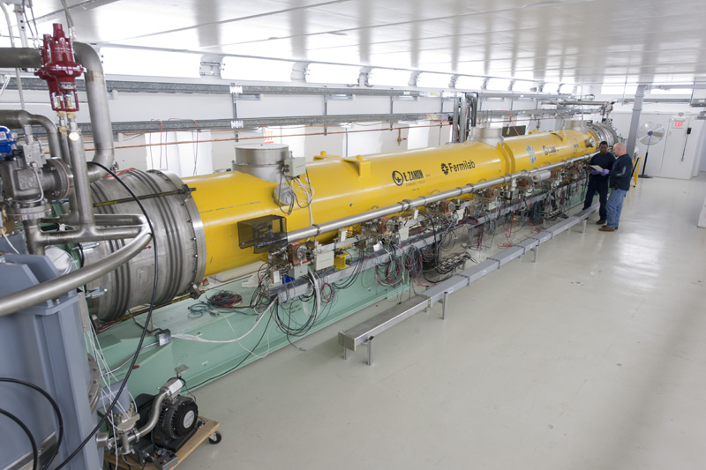
TechConnect Innovation Summit – Electron Beam Accelerators
Hot lead from a well-known running shoe manufacturer
What can Fermilab offer?
My job was to do a short study on the use of electron beam accelerators in industry

Slide 11
TechConnect Innovation Summit – Electron Beam Accelerators
Approximately 1700 high-current, industrial electron-beam accelerators being used by industry
Markets for industrial electron beams total $50 billion per year
The use of these accelerators can be more environmentally friendly and reduce power consumption

Slide 12
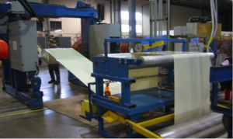
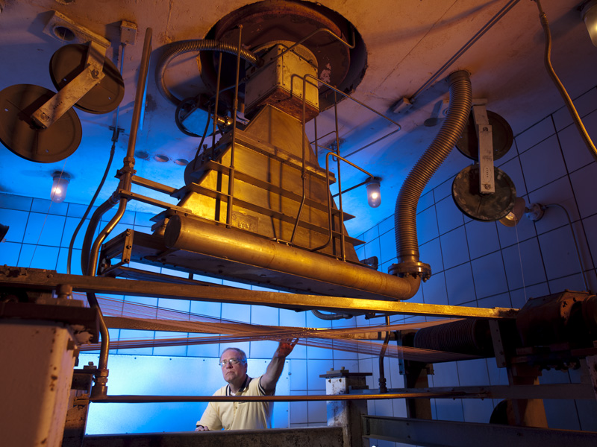
TechConnect Innovation Summit – Electron Beam Accelerators
In industry, EB accelerators are categorized by their energy range
Different applications require different beam energies
 | Low Energy | Medium Energy | High Energy
Energy Range | 70 keV – 300 keV | 300 keV – 5 MeV | 5 MeV – 10 MeV
Notes:
Processing tubing and cable,,, wire and cable insulation

Slide 13
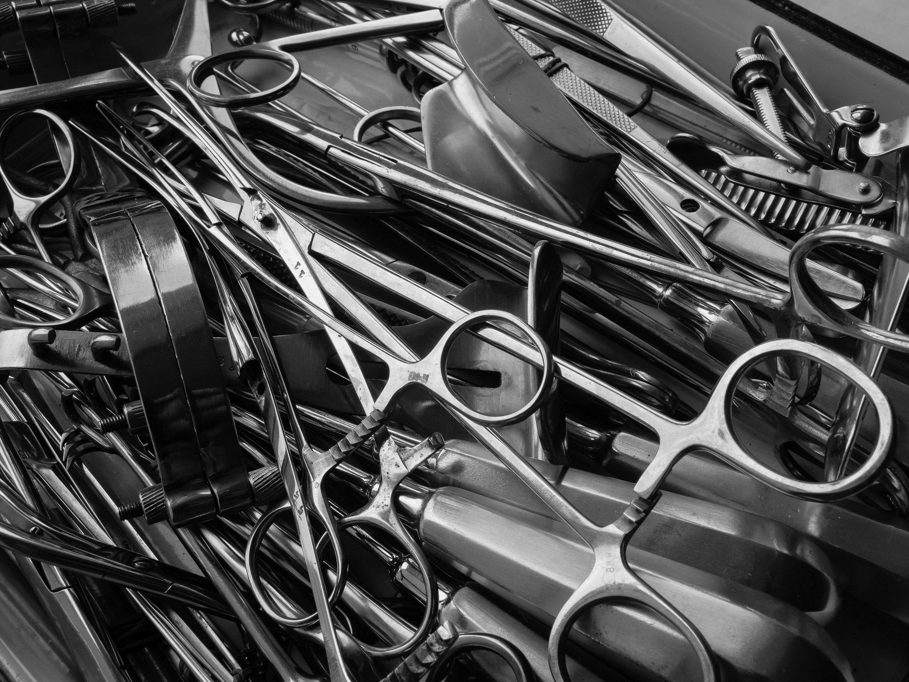
TechConnect Innovation Summit – Electron Beam Accelerators
Market Segment | Electron Energy | Maximum penetration
Surface Curing | 80-300 keV | 0.4 mm
Shrink Film | 300-800 keV | 1.6 mm
Wire and Cable | 0.4-3 MeV | 11 mm
Sterilization | 3-10 MeV | 40 mm

Slide 14
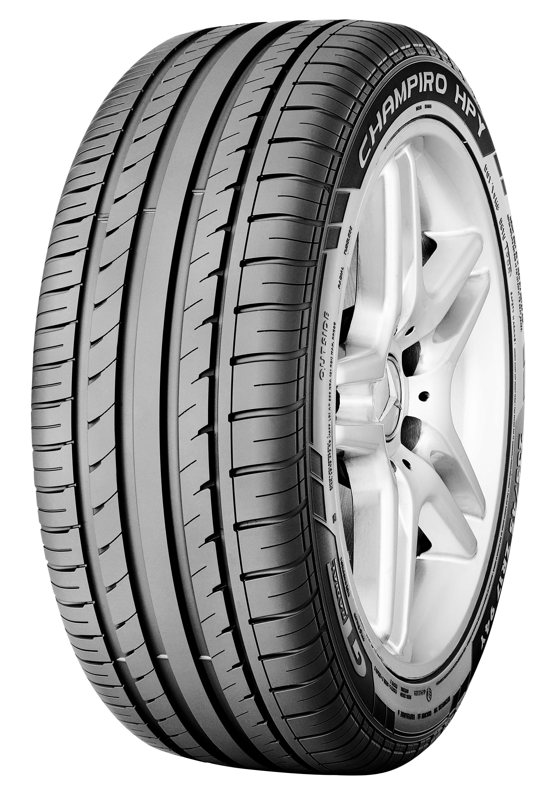
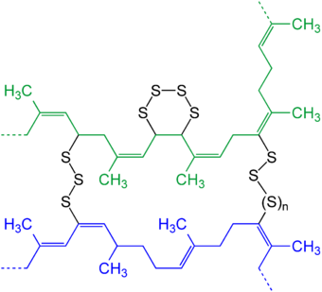
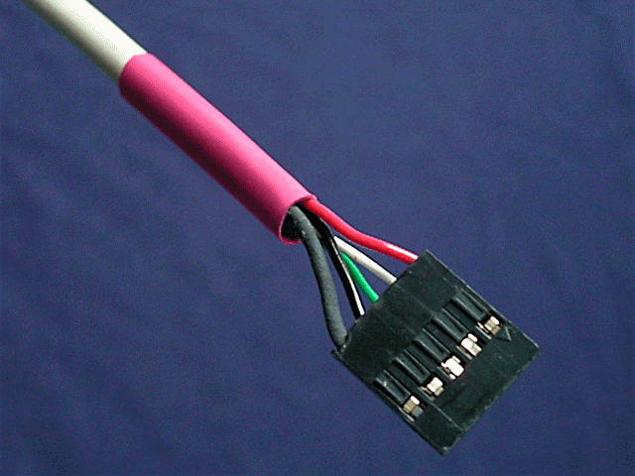
TechConnect Innovation Summit – Cross-Linking Polymers
Cross-Link - bond that links one polymer chain to another. They can be covalent bonds or ionic bonds
Advantages
Can be done at room temperature
No use of catalysts or cross-linking agents
Reduced energy usage
Notes:
Most relatable to the shoe manufacturer

Slide 15
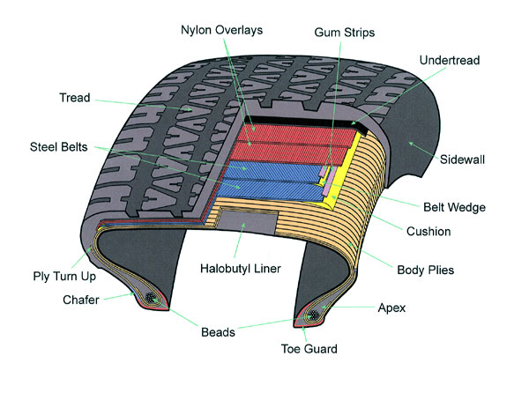
TechConnect Innovation Summit – Radial Tires
Michelin developed their first radial tire in 1946
The technology spread to Europe and Asia in the 1950s and 1960s
Radial design is the standard for all automotive tires
Notes:
Most relatable to the shoe manufacturer

Slide 16
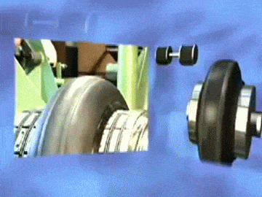
TechConnect Innovation Summit – Vulcanization of Rubber
Vulcanization of rubber
Cross-linking of rubber
Advantages
Less energy consumption than using heat
Helps tire keep its shape
maintains the tacky surface condition needed to allow the different layers to stick together

Slide 17
Conclusion
Performed a CRADA agreement with industry
Prepared for and attended the TechConnect Innovation Summit with Fermilab Staff
Performed short study on electron beam accelerators

Slide 18
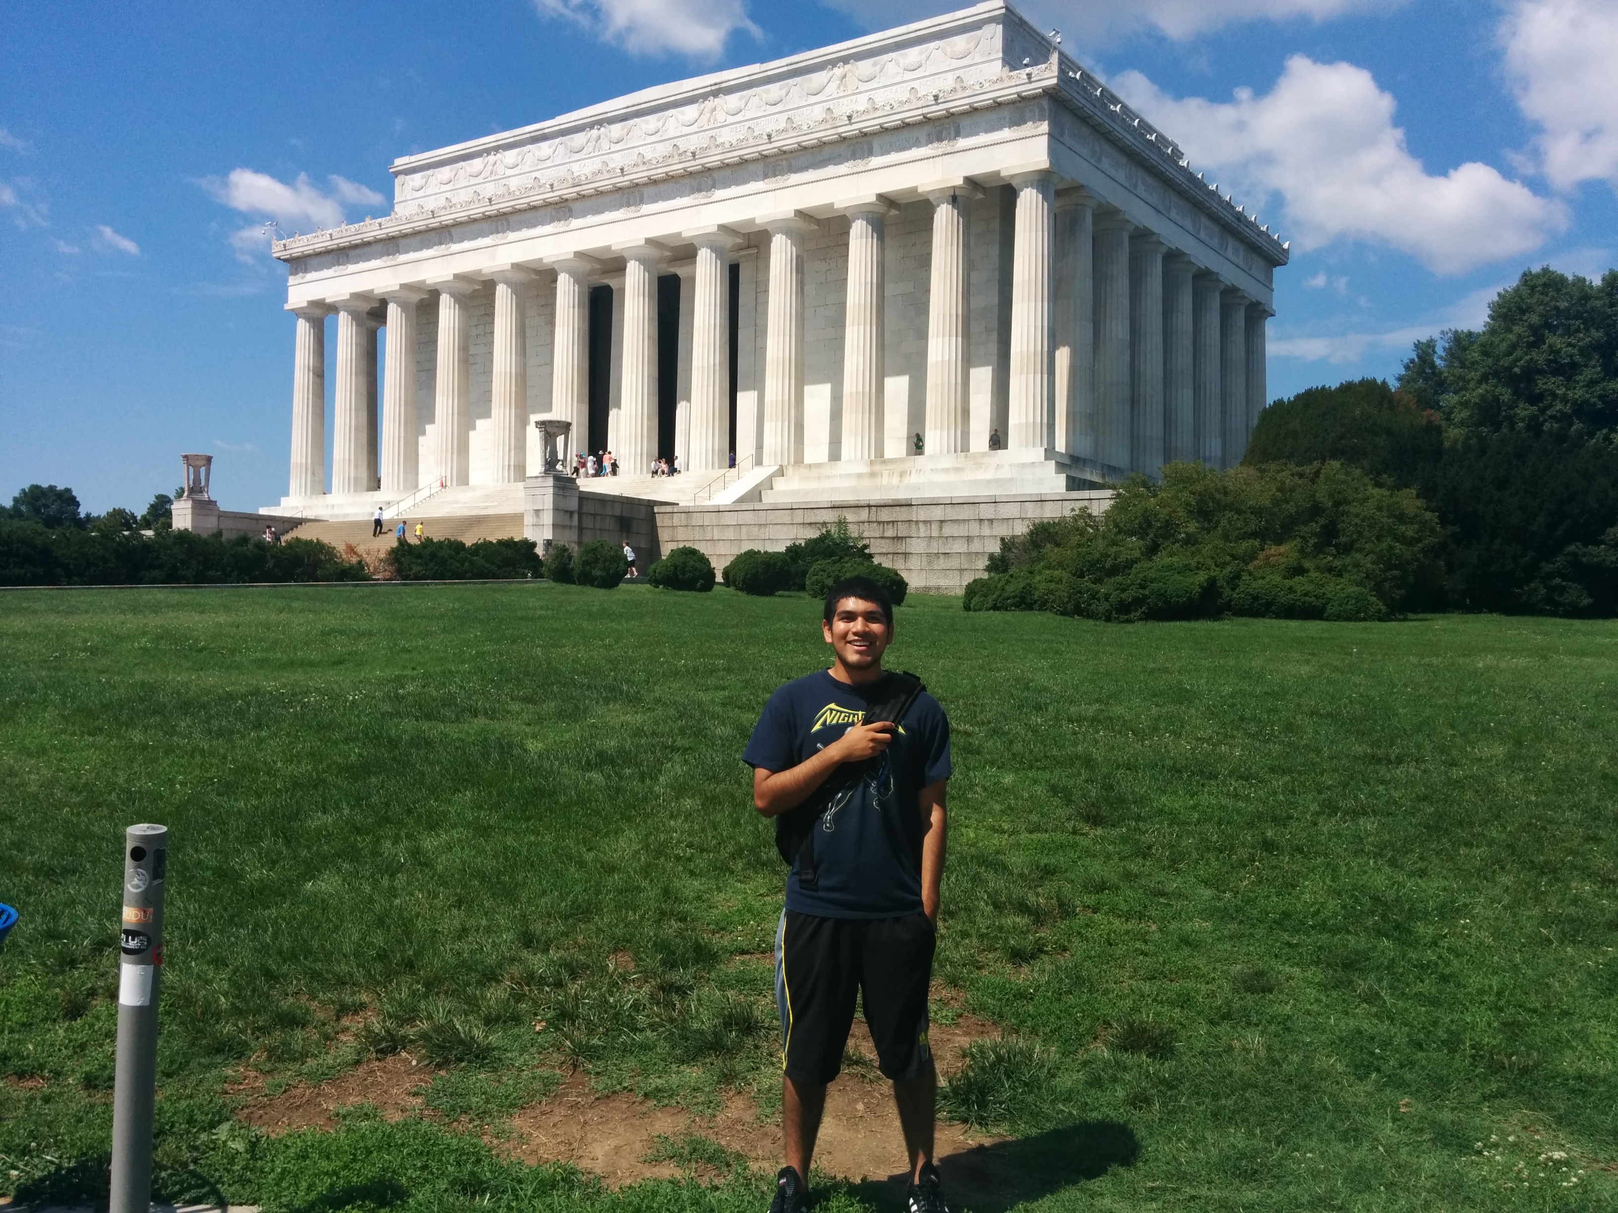
Acknowledgements
SIST Committee
Cherri Schmidt
Aaron Sauers
David Peterson

Slide 19
Questions?

