Slide 1
Stability Analysis of an Adaptive Notch Filter for RF Noise Suppression
Trevor Vannoy
APS Accelerator Systems Division
Mentor: Tim Berenc

Slide 2
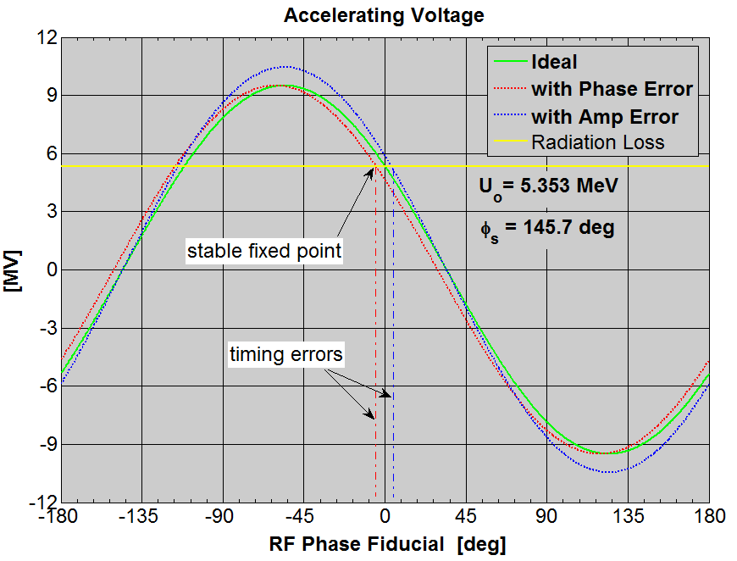
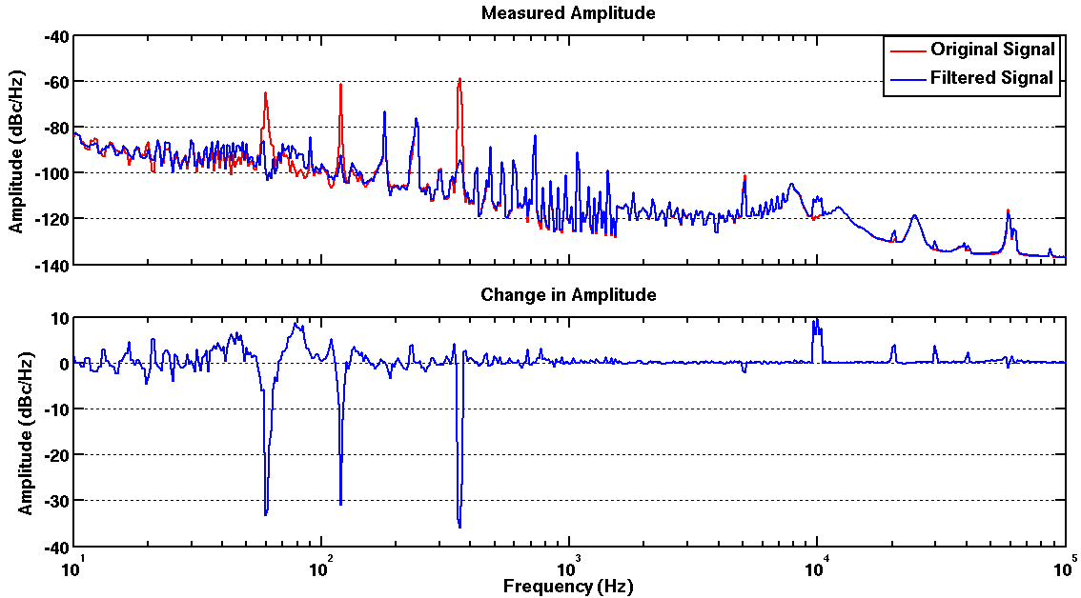
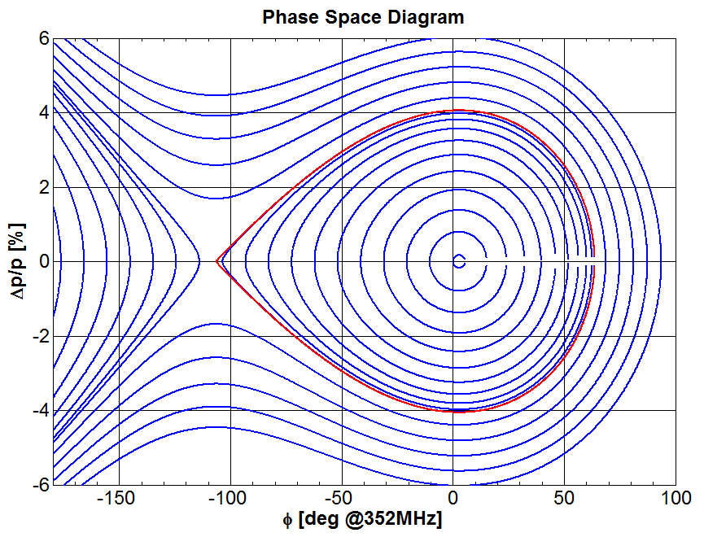
Background
360 Hz
120 Hz
60 Hz
Reduced by ~30 dB

Slide 3
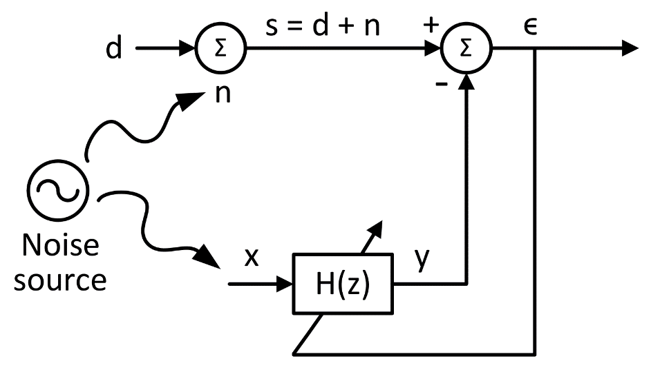
Adaptive Noise Canceller

Slide 4
Adaptive Noise Canceller

Slide 5
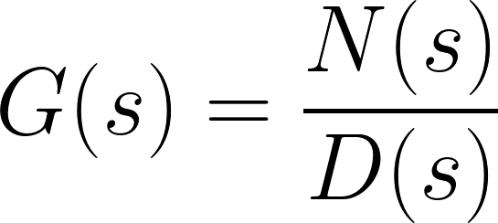
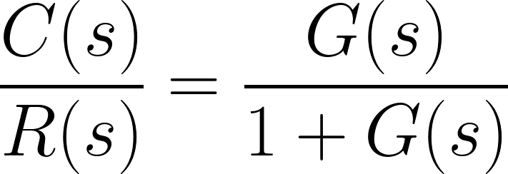
Closed Loop Transfer Function
Open-Loop transfer function
Closed-Loop transfer function
Stability of the closed-loop system is determined from its poles
Its poles are the zeros of 1 + G(s)

Slide 6
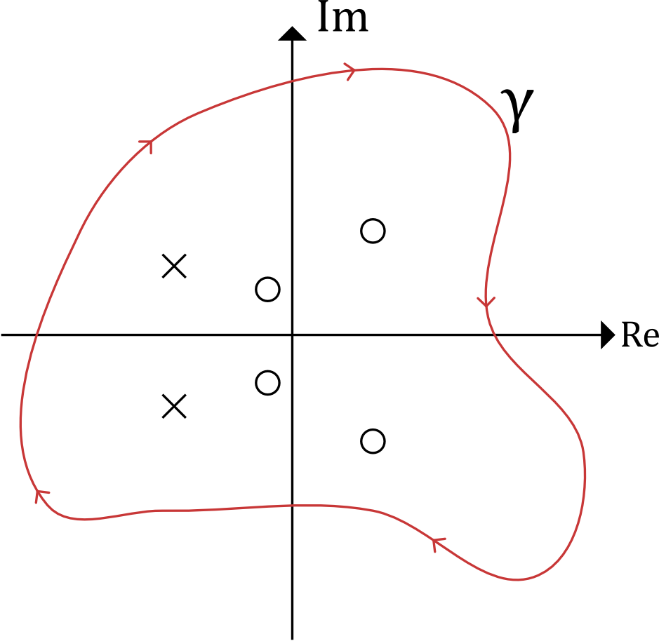
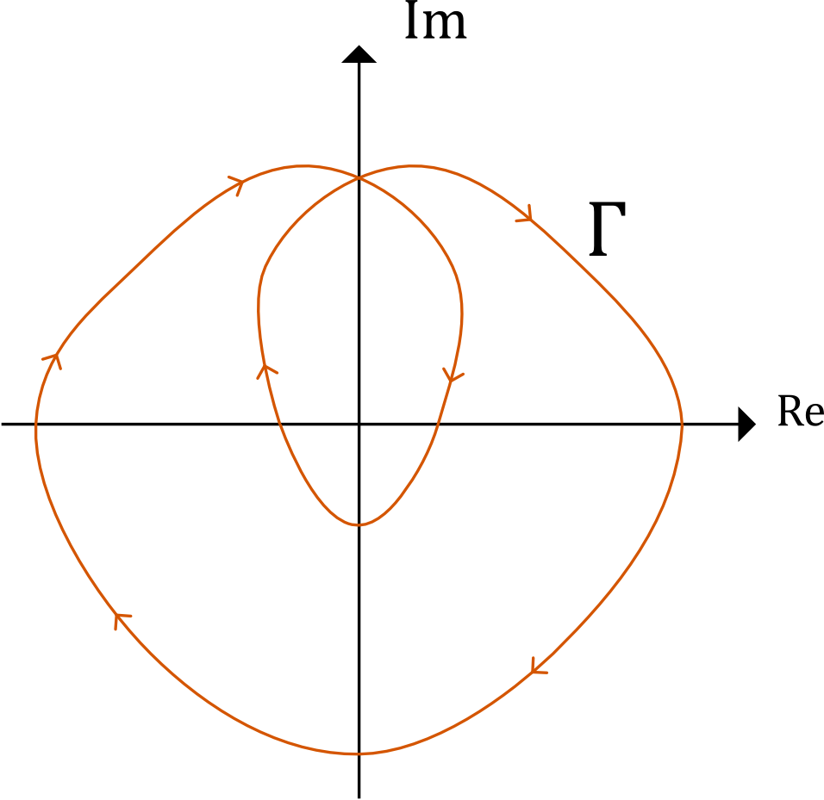
Argument Principle

Slide 7
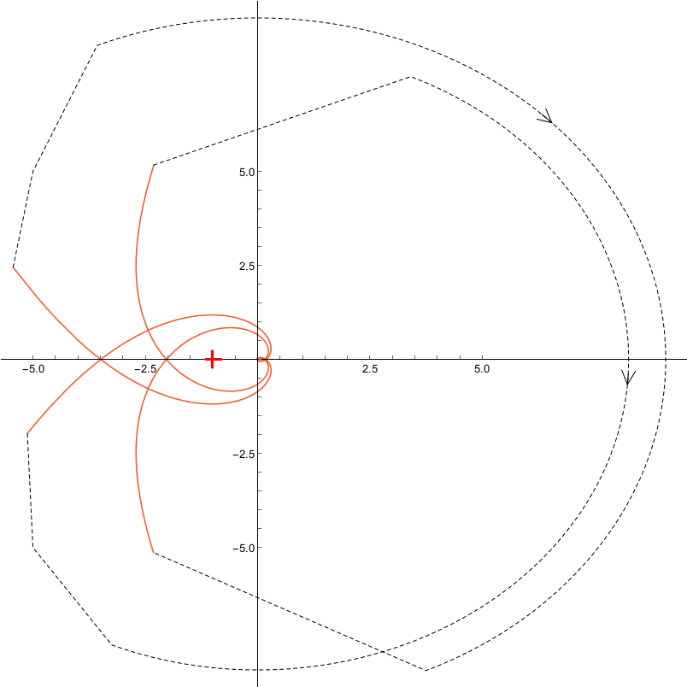
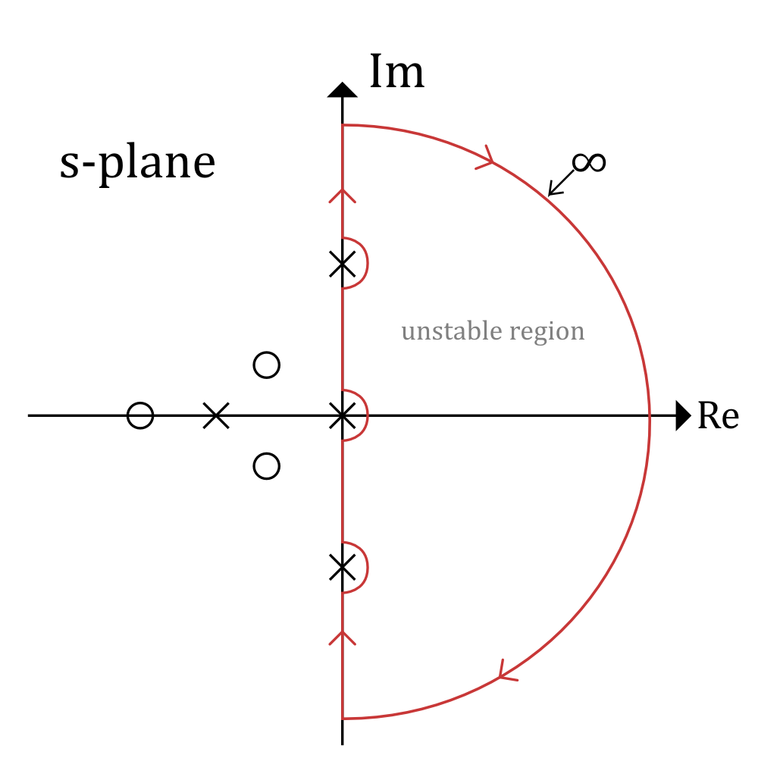
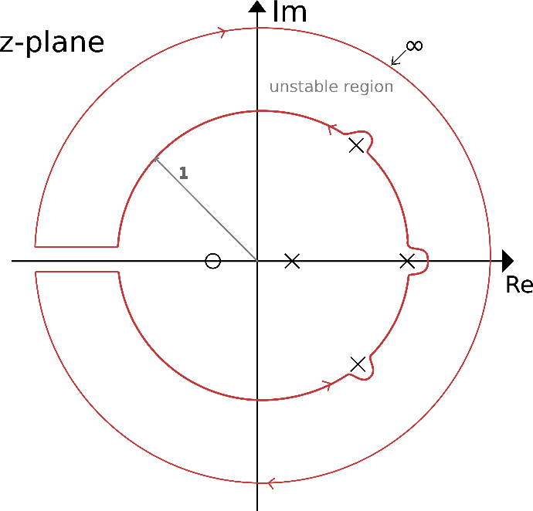
Nyquist Example
ϒ
Γ
Can handle poles on the contour by integrating around them

Slide 8
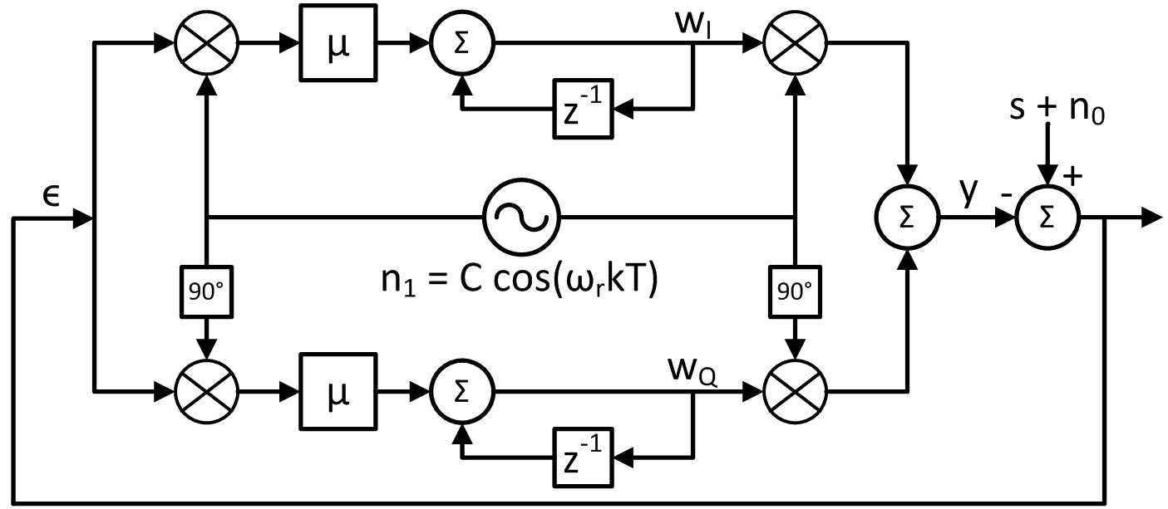
Adaptive Notch Filter
G(z)

Slide 9
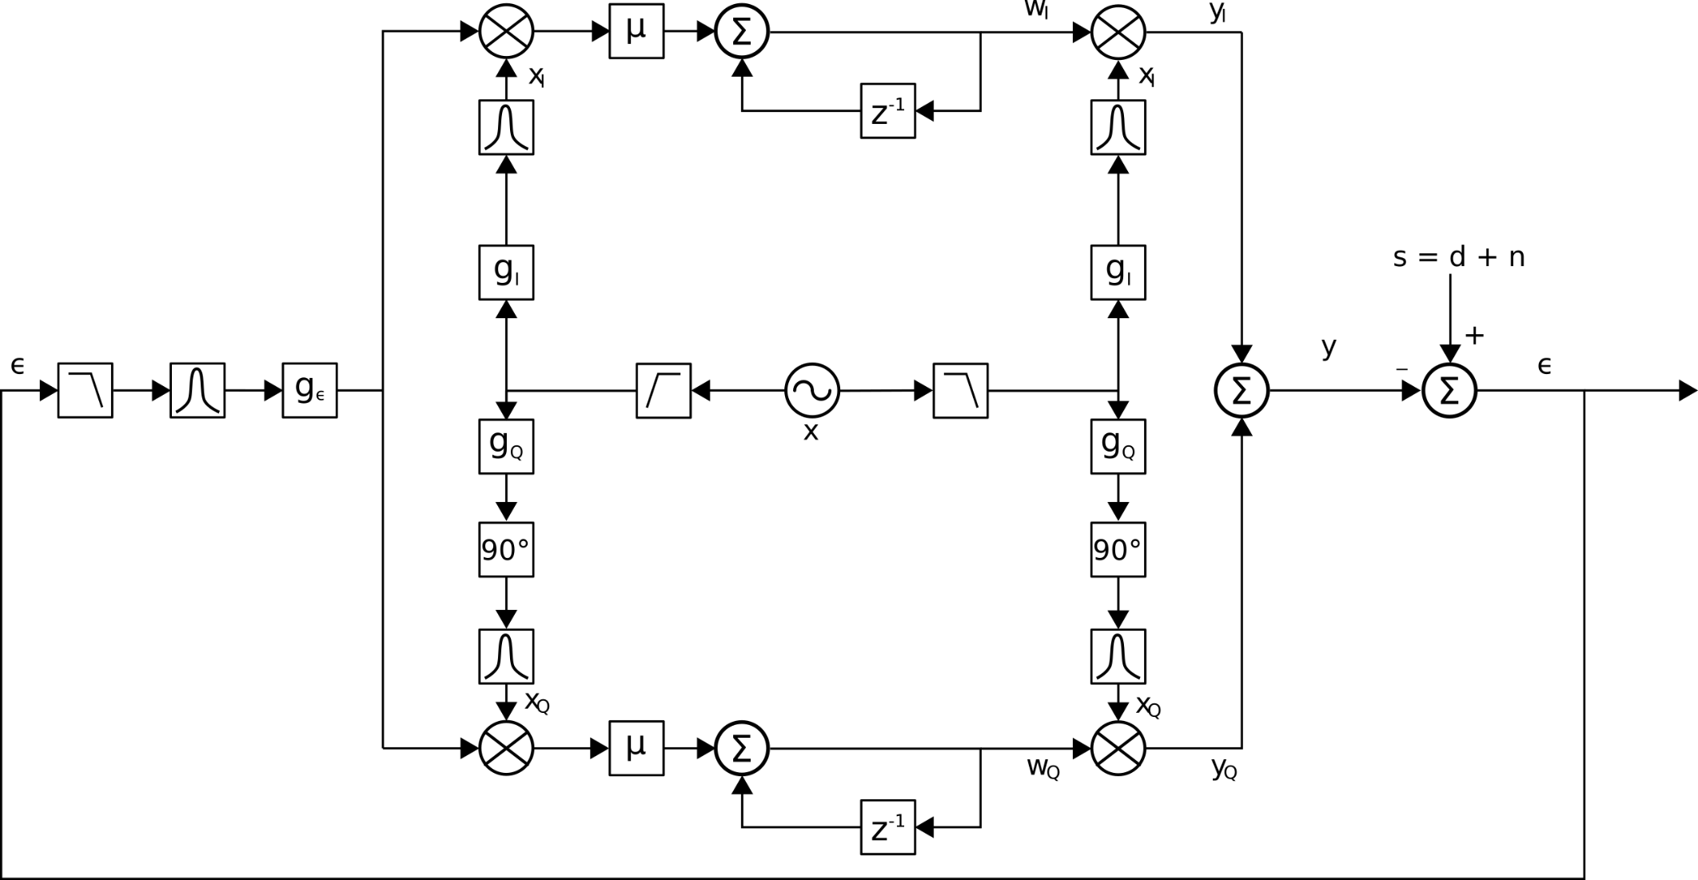
Adaptive Notch Filter Actual Implementation
Gains
LPF
BPF
G(z)

Slide 10
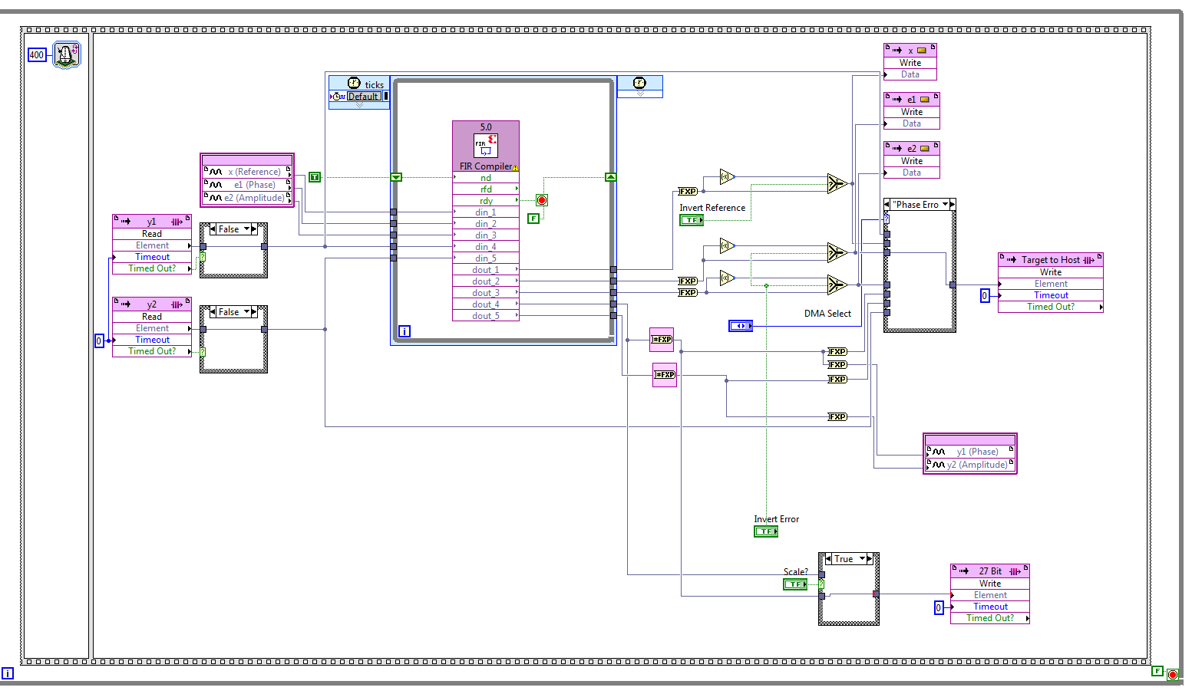
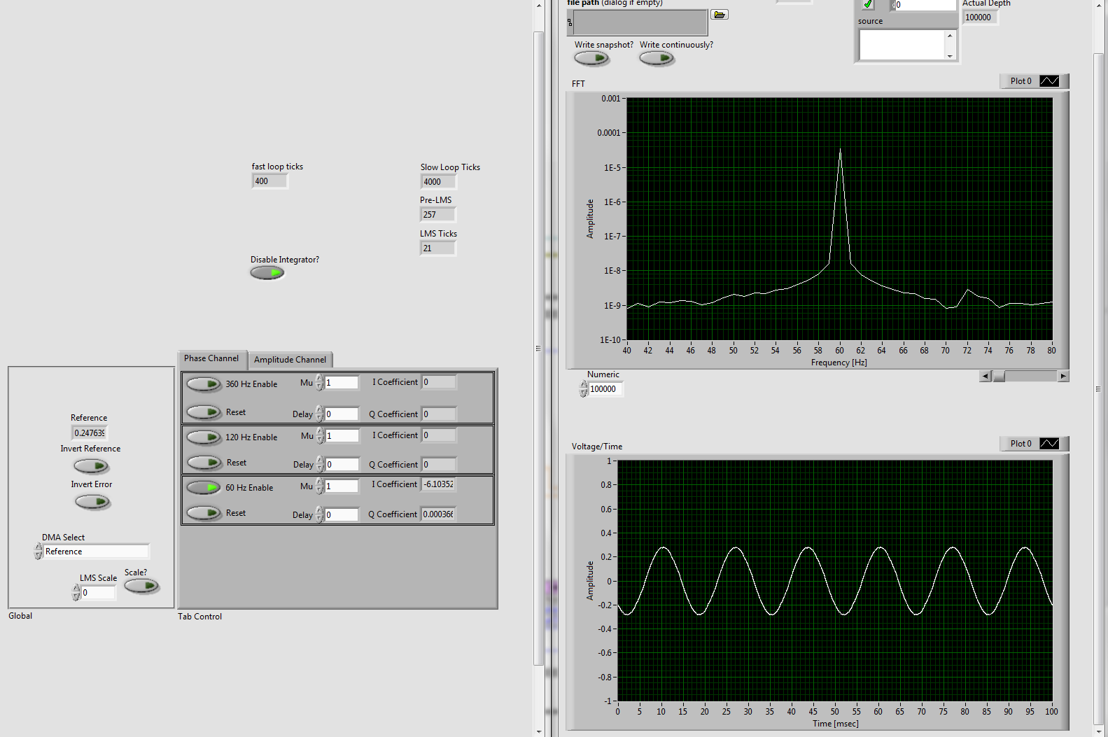
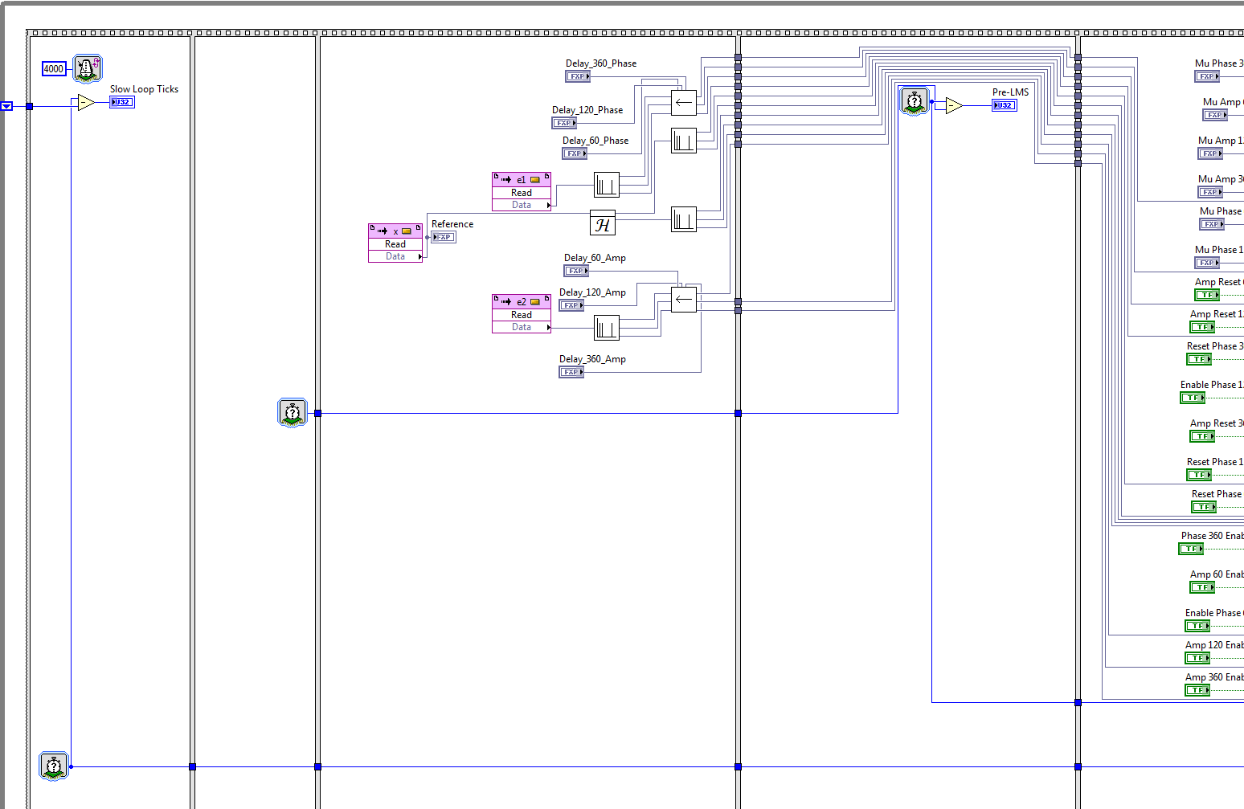
Labview Code

Slide 11
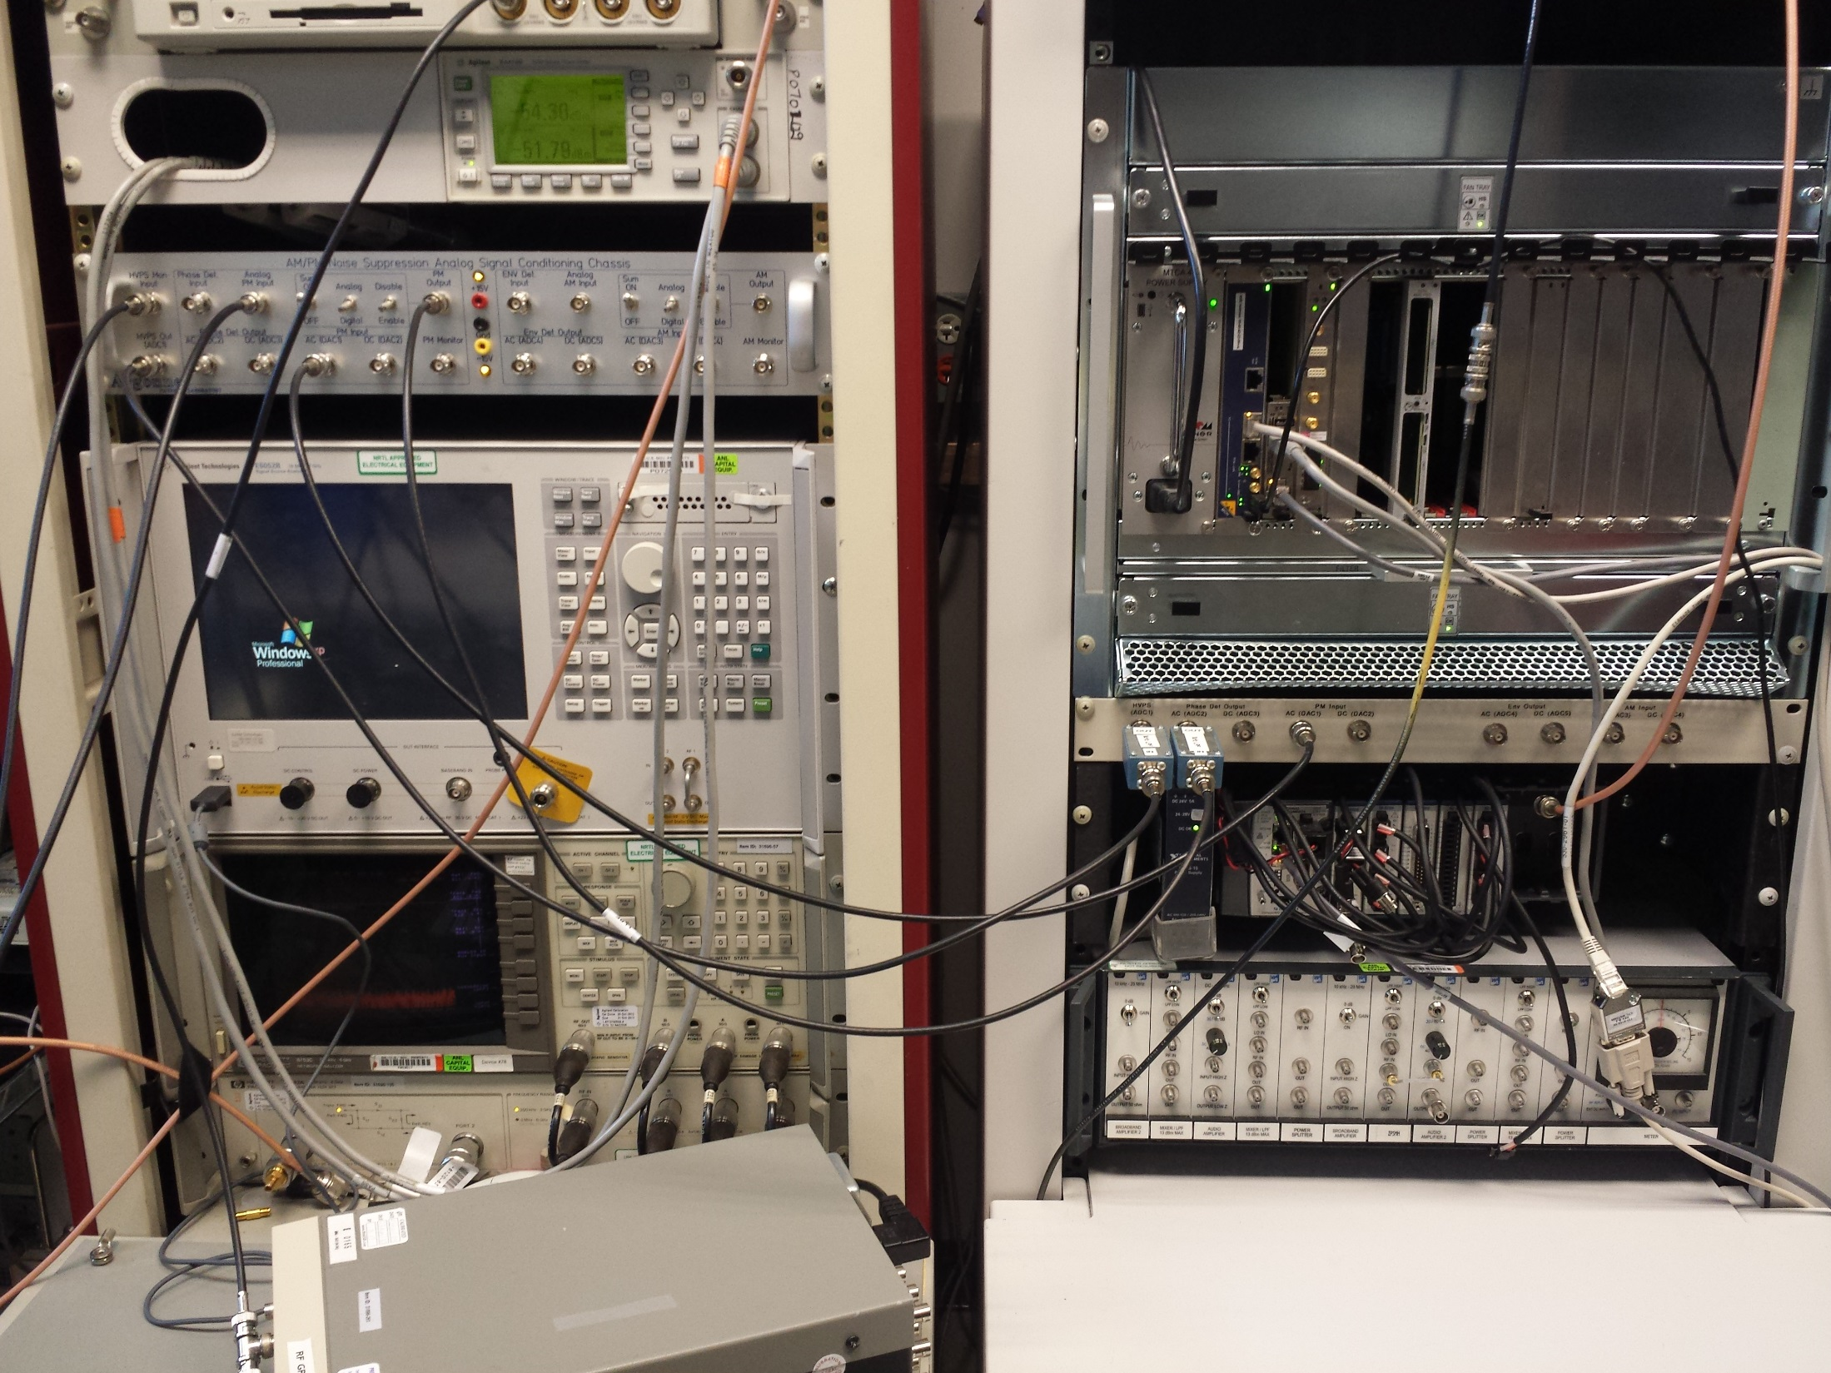
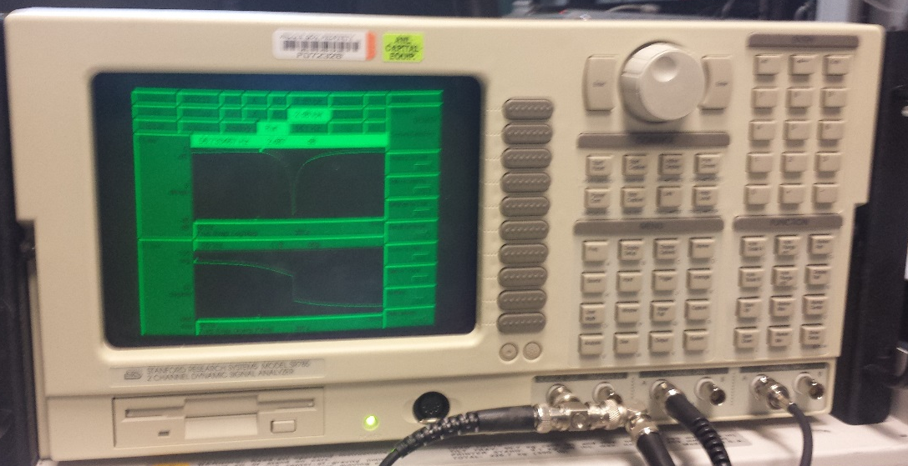
Lab Setup

Slide 12
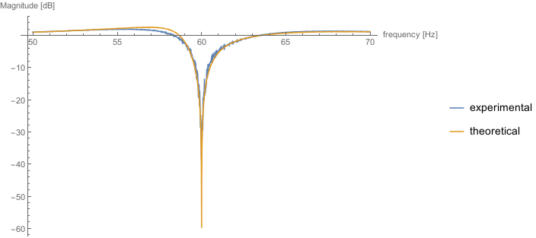
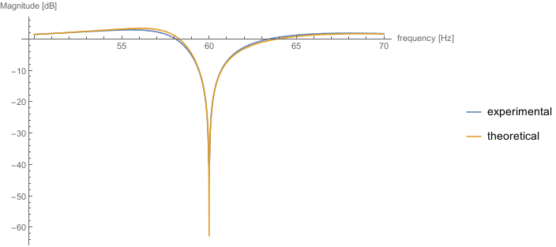
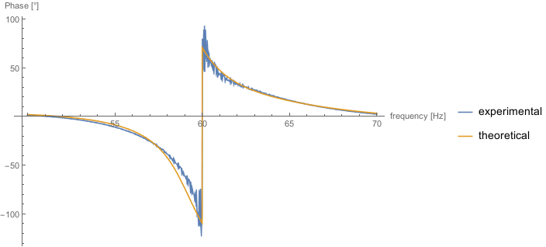
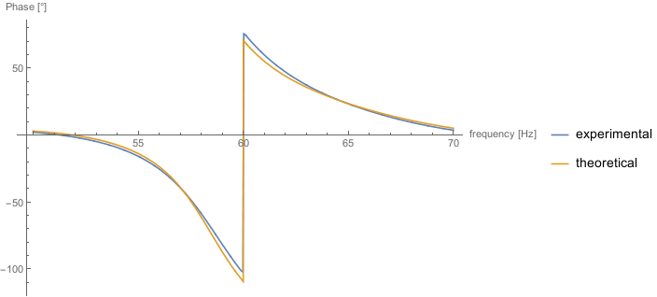
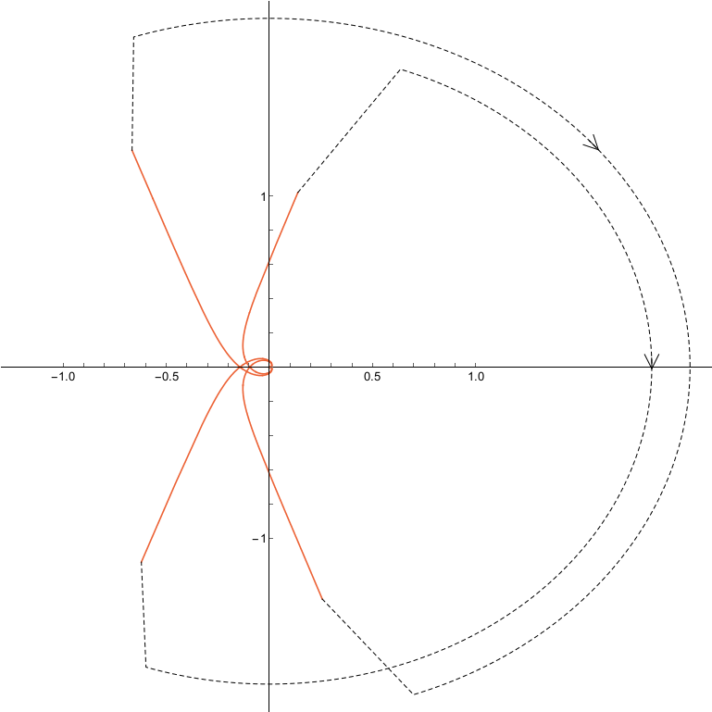
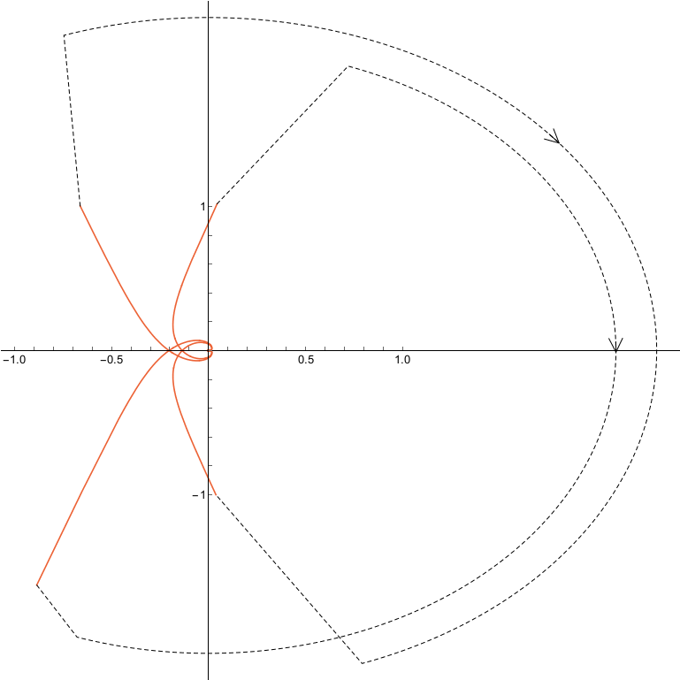
Results
Non-ideal Hilbert filter
Improved Hilbert filter
magnitude
phase
Nyquist

Slide 13
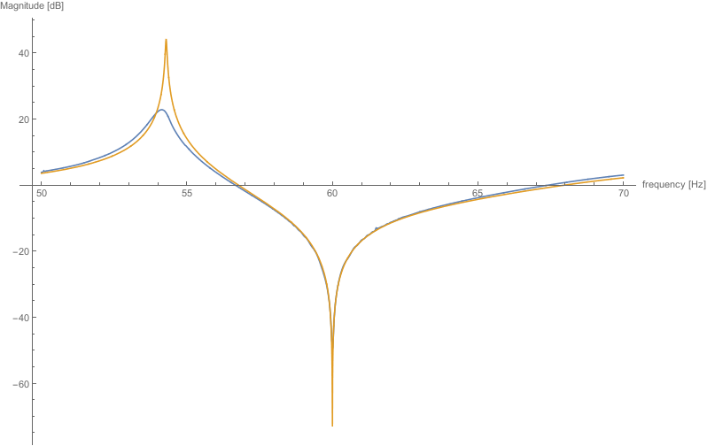
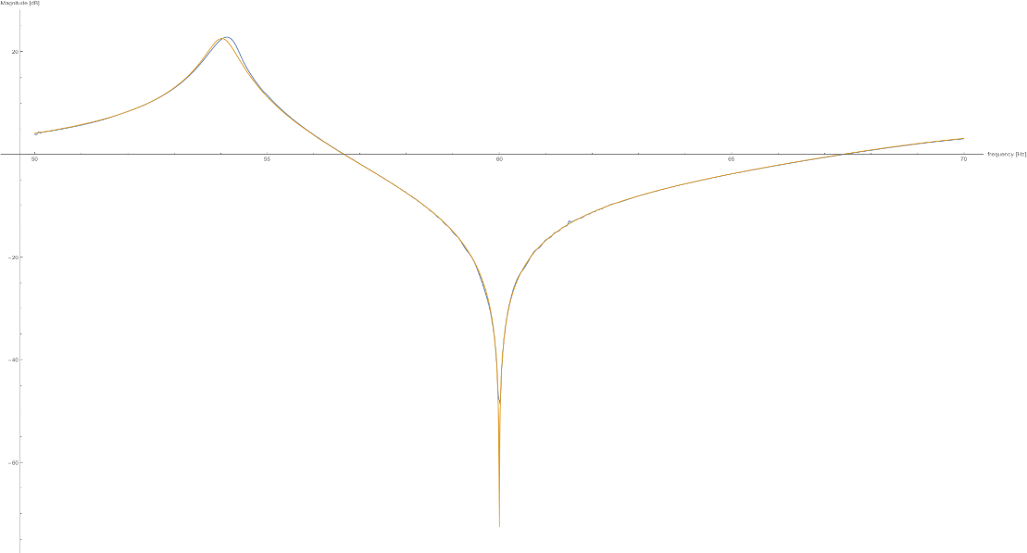
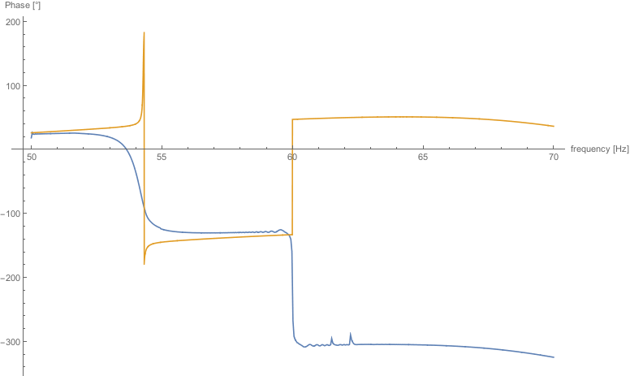
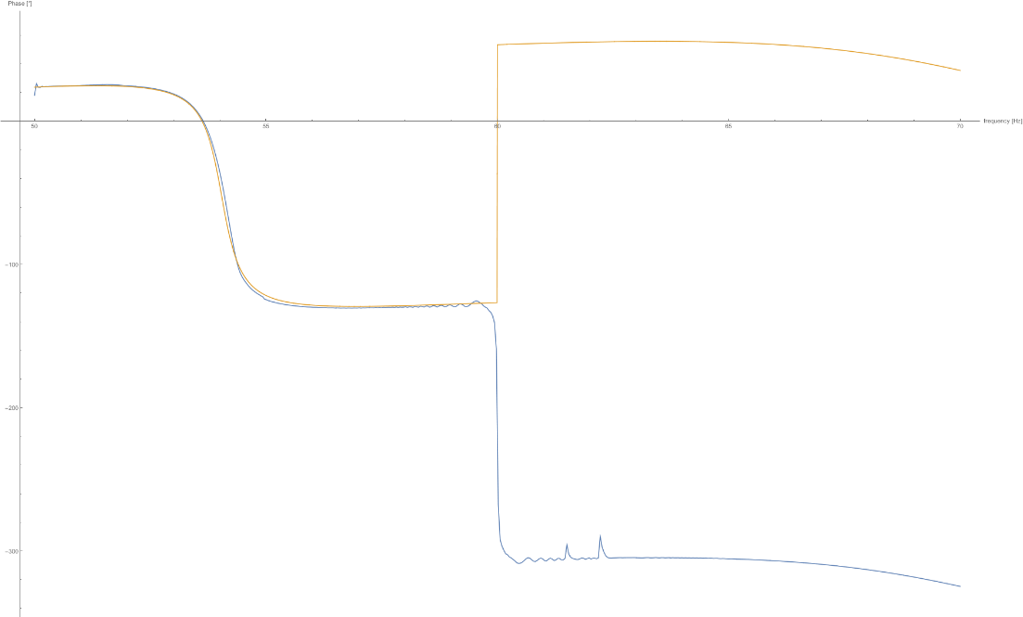
Results
Higher gain
Adding 3 samples of group delay
to theoretical model
magnitude
phase
Nyquist

Slide 14
Future Work
Determine where additional group delay is coming from
Determine where -1.2 dB gain difference is coming from
Improve Hilbert filter for other frequency channels
Add multiplier to fix scaling
Redesign Hilbert filter
Model 120 Hz and 360 Hz channels
Change parameters in Mathematica code
Include existing RF feedback loops in analysis

