Slide 1
Electron Beam Phase-space Tomography at FAST Injector
Tianyi Ge
Charles Thangaraj

Slide 2
Tomography is a tool to reconstruct the phase space of a particle beam
?
?
Longitudinal phase space
Transverse phase space
✓
✓
Changing the phase of a RF cavity
Changing the strength of a quadrupole
Projections

Slide 3
Techniques to reconstruct the phase space
Algebraic reconstruction technique
Simultaneous algebraic reconstruction technique
Filtered back projection

Slide 4
ELEGANT simulation setup
Varying quad strength
S
C
REEN
Q
U
A
D
?
Beam
P
L
O
T
✓

Slide 5
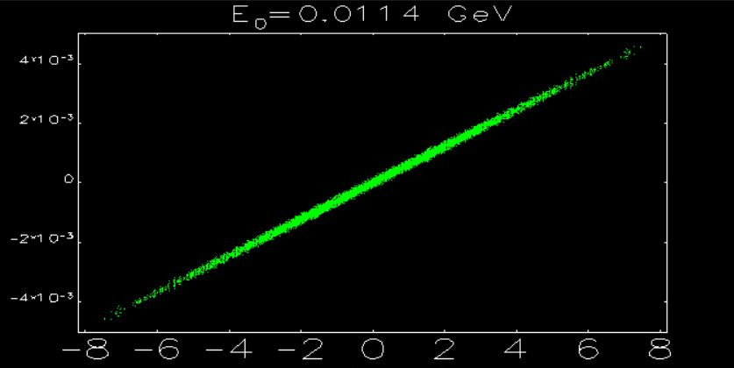
ELEGANT simulation plot of incoming phase space
X’
X (mm)

Slide 6
Effects of a quadrupole on electron beam*
The phase space of an electron beam undergoes the following mapping, as defined by the transportation matrix.
Shear
Expansion
Rotation
Therefore, expansion constants and rotational angles can be expressed by and from ELEGANT.
*

Slide 7
Matrix elements R11 and R12 from ELEGANT determine scaling constants and rotational angles.
The expansion and rotation matrices are determined by R11 and R12.

Slide 8
Steps of reconstructing phase space
We first restore the rotation-only phase space with and
We apply the ART algorithm on and subsequently reconstruct the phase space

Slide 9
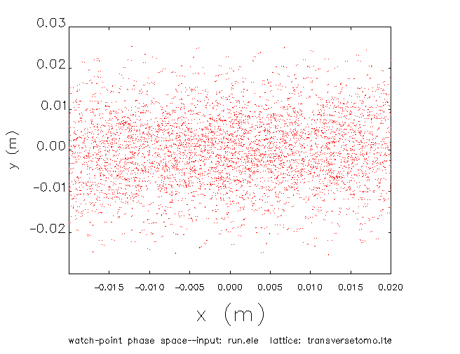
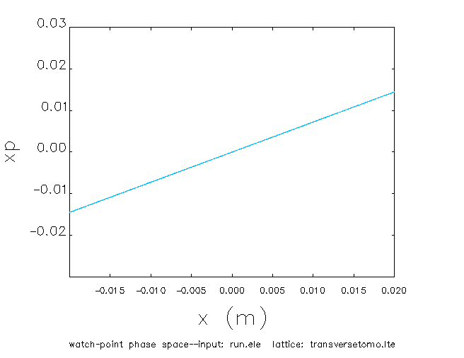
Simulation of a quadrupole on phase space
y(m)
X’
X (m)
X (m)

Slide 10
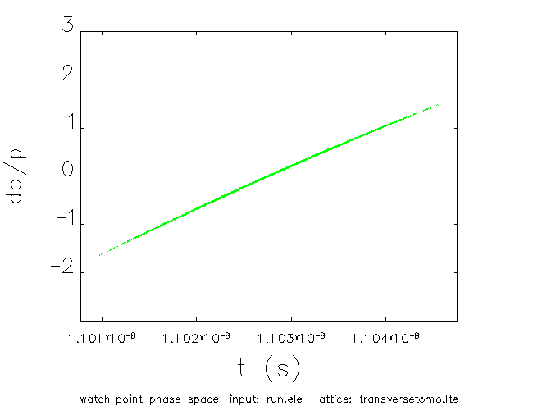
Changing the phase of a cavity is equivalent to rotating the phase space.
dp/p (%)
t (s)

Slide 11
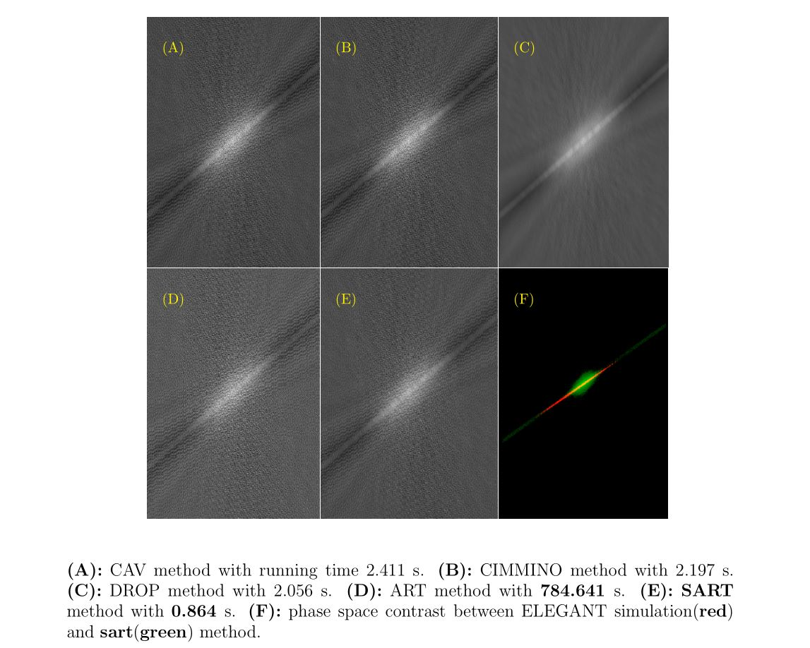
Reconstructed phase space of one quad
5mm

Slide 12
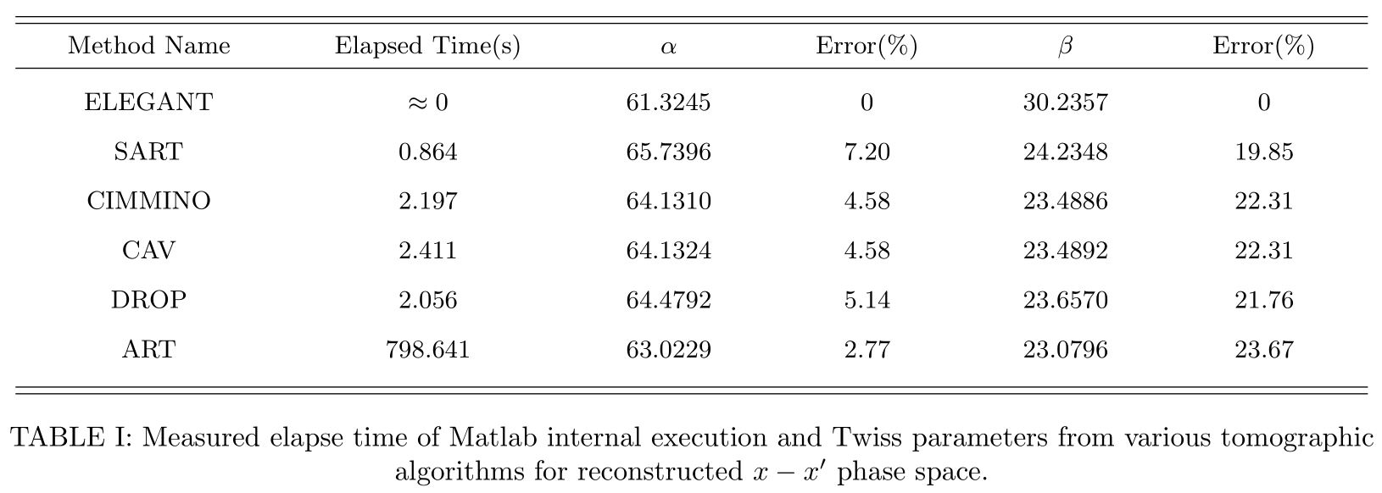
Comparison of elapsed time and Twiss parameters for reconstructed phase space

Slide 13
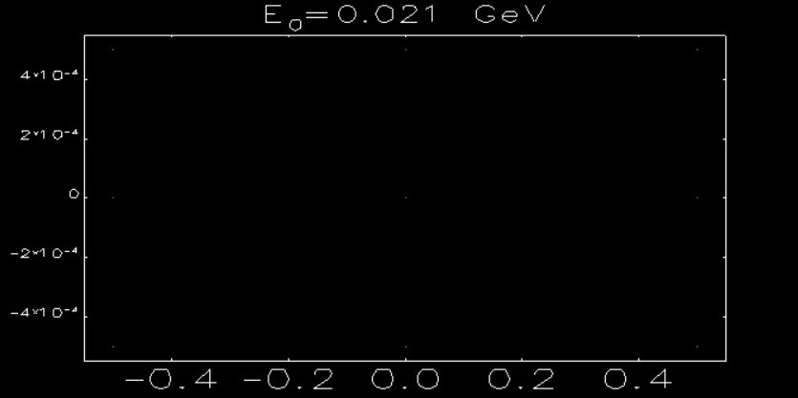
ELEGANT simulation of 3 x 3 pixel phase space (same for )
X’
X (mm)

Slide 14
Video demo of 3D phase space reconstruction

Slide 15
Reconstructed 3 x 3 pixel phase space
5mm

Slide 16
Reconstructed 3 x 3 pixel phase
5mm

Slide 17
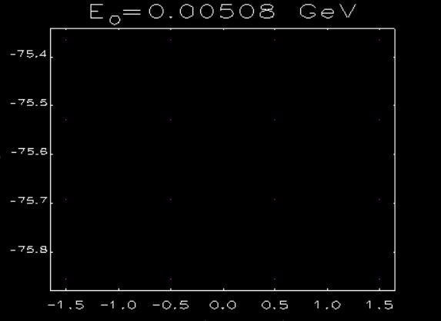
ELEGANT simulation of 4 x 4 pixel phase space
z (mm)

Slide 18
Reconstructed 4 x 4 pixel phase space
5mm

Slide 19
Limitations, Advantages and Features
Limitations
Will need 180 degree coverage. Might need more quadrupoles for certain setups.
Minimum number of angles to get a less noisy background is unclear. Open to study.
Background issues
Advantages
Can be implemented in the FAST injector.
Quick technique < 1 minute for the reconstruction itself.
Implemented in all 3 phase spaces.
Features
MATLAB code available at repository. Extensively commented.
Video demo for the entire workflow.
Couple of features to be added in the final week
THANKS….. to the Lee Teng Intern Program,
Eric Prebys for this opportunity.
Thanks to Sasha Valishev
for providing the time to complete this work

