Slide 1
Development of Optical Metrology ENgine (OMEN)
Ben Sheff

Slide 2
Introduction
APS is a 7 GeV, storage-ring-based hard x-ray synchrotron radiation source at Argonne National Laboratory
Funded by DOE Office of Science, Basic Energy Sciences
Produces collimated, intense beams of hard x-ray radiation
Useful for a variety of applications
Requires advanced optics to manipulate
Image courtesy of https://www1.aps.anl.gov/About/Welcome

Slide 3
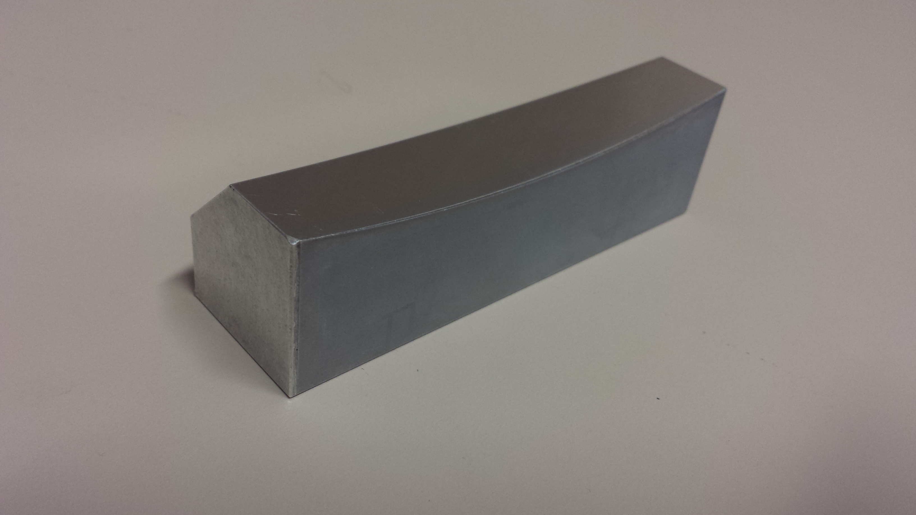
X-ray Mirrors
As beamlines get better, need better mirrors
Residual slope error as low as 50 nrad
Autocollimator-based Long trace profiler (AC-LTP) is a high precision metrology tool^{1,2}
Measures slope of mirror at each point to within 50 nrad
Extremely accurate for small range of angles, but has problems farther out
New analysis tools needed to handle this

Slide 4
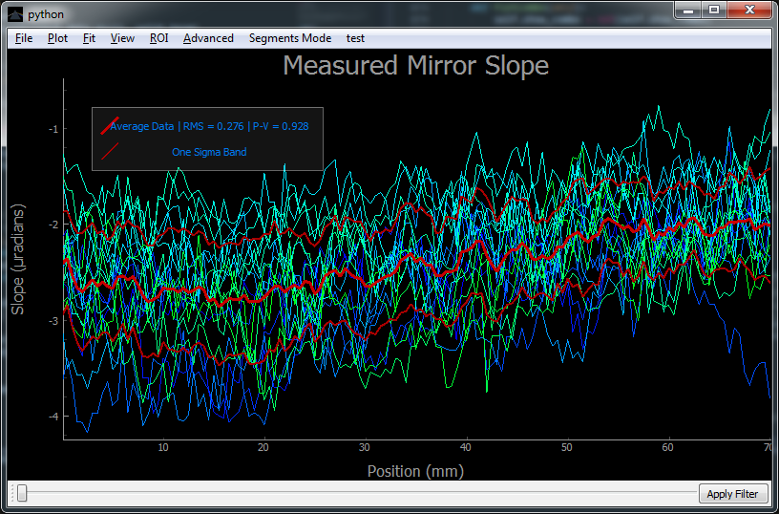
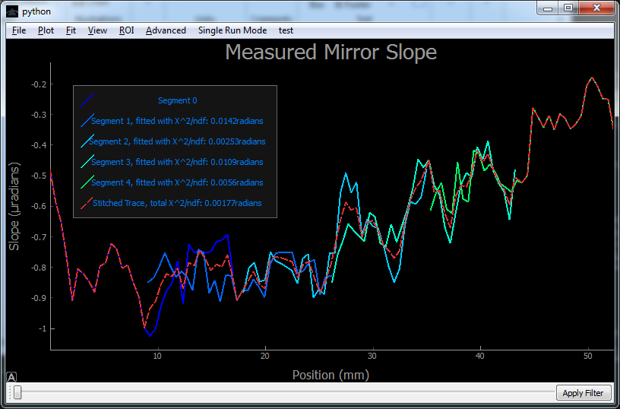
Analysis Software
Developed Optical Metrology ENgine (OMEN) in Python
Handles standard analysis
Easy, dynamic filtering
Fitting options, with live-updated residue plot
Region-of-interest selection
Tools to deal with high angles
Stitching together overlapped, adjacent scans of mirror segments
Adding calibration run

Slide 5
Object Oriented Design
OMEN class handles GUI and manages companion classes
Three companion classes
Raven handles data collection and most processing
Lightning handles stitching and mirror profile comparison
Medium handles input/output standard formats
Easy to modify, and to re-use parts for other purposes
OMEN
Raven
Lightning
Medium1
Image courtesy of Sid Meier’s Civilization V
Image courtesy of Blazon.com/heraldry/
Image courtesy of Lyoha123, uploaded to Wikimedia commons

Slide 6
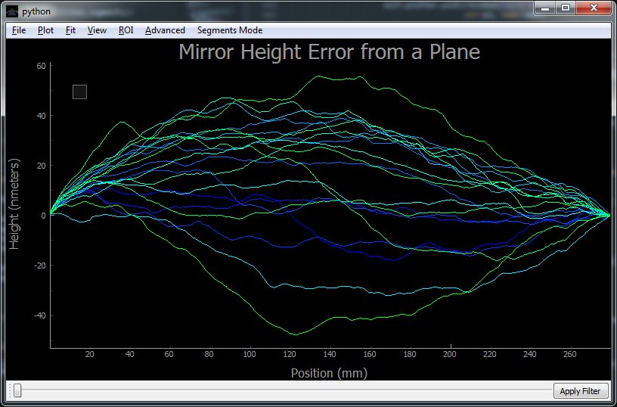
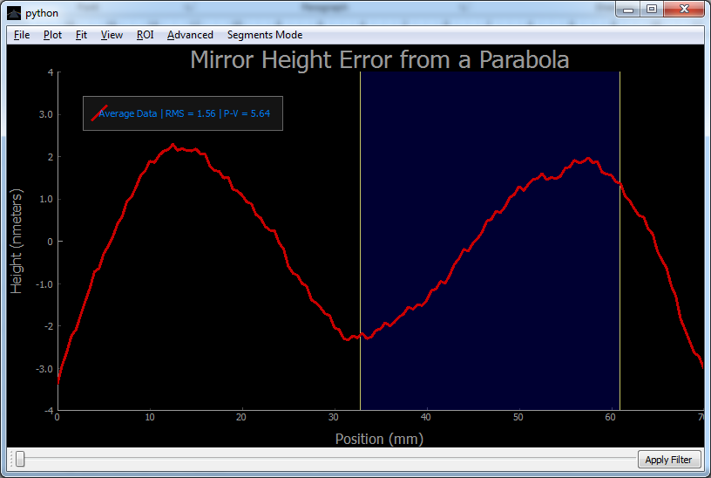
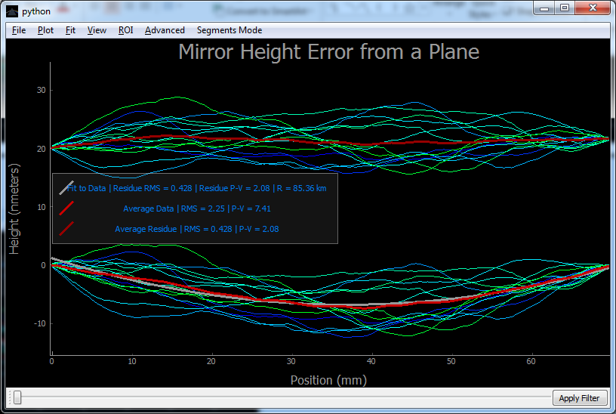
OMEN in Action

Slide 7
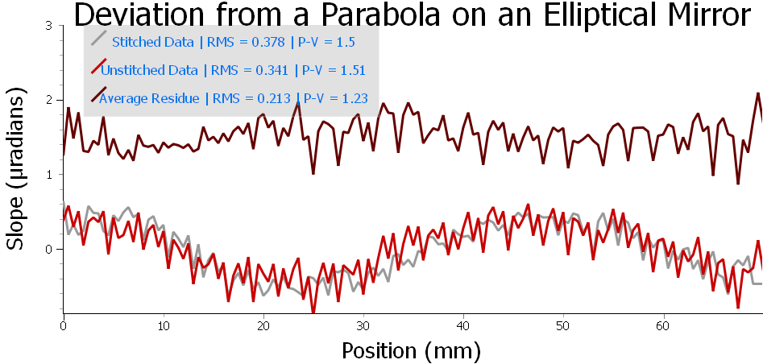
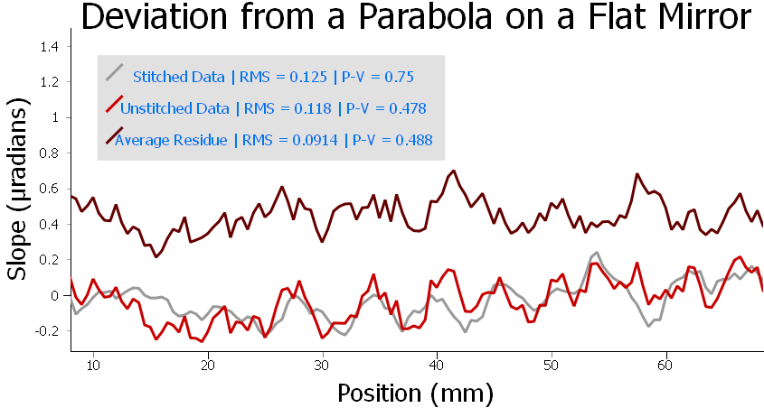
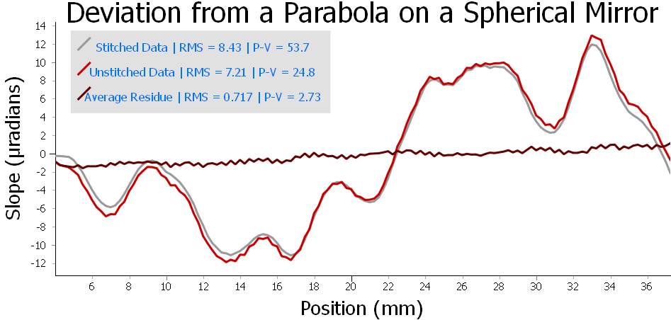
Dealing with Highly Curved Mirrors
Preliminary Work: Take overlapping partial scans and stitch together
Each scan over a small region over which the mirror is roughly linear
Tilt mirror so the scan center is horizontal
Use Lightning to stitch together partial scans
Compare the result with full scan

Slide 8
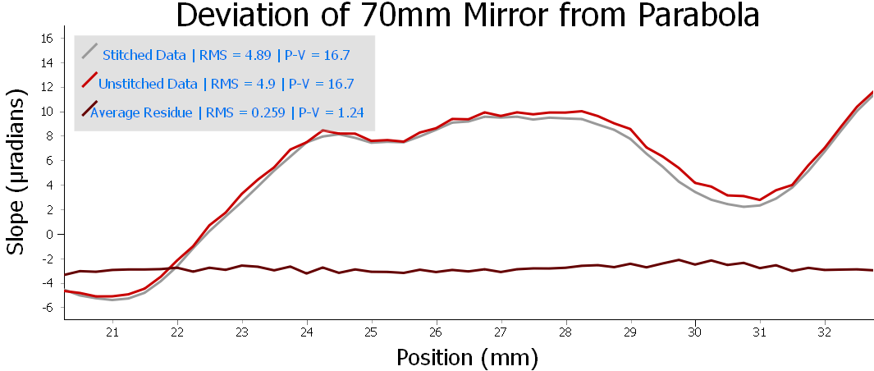
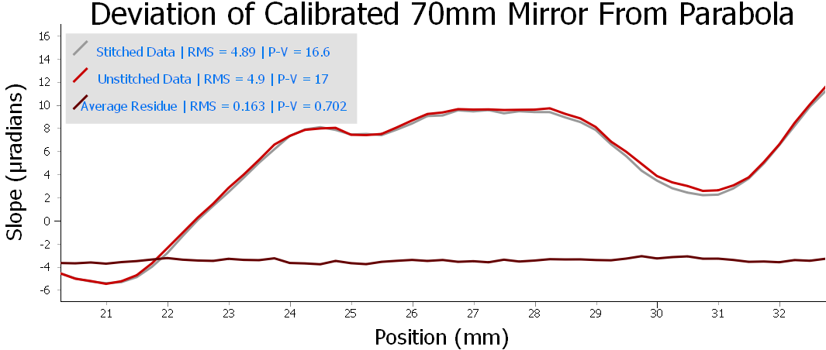
Calibration
Significant deviation between stitched and non-stitched
Seems to correlate with angle measured
New high precision small angle generator against which to calibrate³
Accurate on the order of 10 nrad
Tested small calibration run
Inverted and interpolated data to make a look-up table
Further investigation warranted, with more accurate measurements

Slide 9
Conclusions and Future Direction
Code is robust, and will be useful for future analysis
Easy to use
Rapid analysis
Stitching code allows for new measurement capability
Further investigation will be conducted into calibration in the future
More accurate measurements needed
Some known systematic errors introduced by analysis have yet to be corrected
eg., All interpolation is simple linear as of yet
http://img2.goodfon.su/original/2048x1360/7/39/doroga-vdal-povorot-izgib.jpg

Slide 10
Acknowledgements
Lee Teng Undergraduate Fellowship for their generous sponsorship and for granting me the opportunity to take part in this research.
My mentor, Dr. Assoufid for welcoming me into his group, and being willing to meet me almost every day to discuss my project.
Jun Qian and Joe Sullivan for their work building, programming, and operating the equipment, and for helping me understand what the data was and how to work with it.
The Optics Group in the X-ray Science Division of the Advanced Photon Source at Argonne National Laboratory, and Argonne National Laboratory itself for hosting me for the summer.

Slide 11
References
¹ Lahsen Assoud et al., Nucl. Instrum. Methods A 710, 31-36 (2013).
² J. Qian, J. Sullivan, M. Erdmann, A. Khounsary, L. Assoud, Nucl. Instrum. Methods A 710, 48-51 (2013).
³ D. Shu, J. Qian, W. Liu, S. Kearney, J. Anton, J. Sullivan, and L. Assoud, Proc. SPIE 9206, Advances in Metrology for X-Ray and EUV Optics V, 920601 (October 7, 2014); doi: 10.1117/12.2084726Proc. of SPIE Vol. 9206

Slide 12
Questions

