Slide 1
Optimization of FAST Electron Gun Beam Parameters Using ASTRA
Lucas Kang
Lee Teng Presentations
August 6, 2015

Slide 2
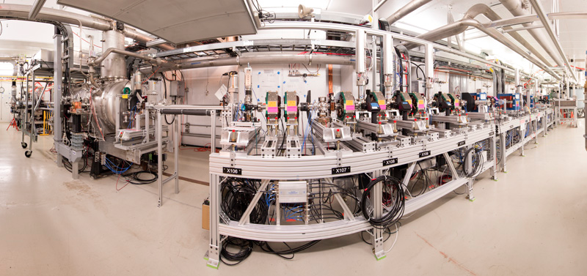
FAST
The Fermilab Accelerator Science and Technology Facility (FAST) includes a superconducting RF linear electron accelerator which will provide venues for advanced accelerator R&D (AARD) and future experiments like IOTA.
Figure 1: Cyro Module and beam line, FAST Cave Configuration at NML. Photocathode electron gun and toroid monitor to the left, beam travels to the right.

Slide 3
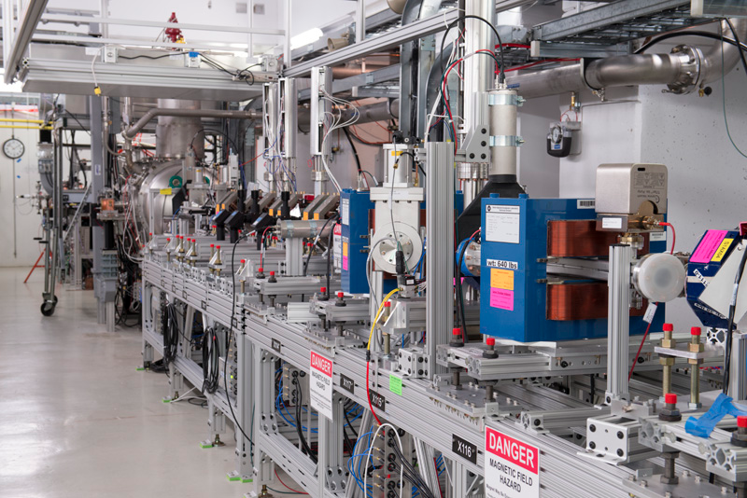
Photoinjector Gun
RF photocathode electron gun (Cs₂Te)
Developed at DESY Zeuthen (PITZ)
Normal-conducting 1½ cell 1.3 GHz gun
Driven by 5 MW klystron
Solenoids to focus beam
Routinely operated at peak
gradients of 40-45 MV/m
producing an output beam
energy of ~5 MeV
Utilizes a feedback system to
regulate temperature to better
than ±0.02 °C for beam and
phase stability
Figure 2: Photoinjector gun, Cyro Module, and beam line.

Slide 4
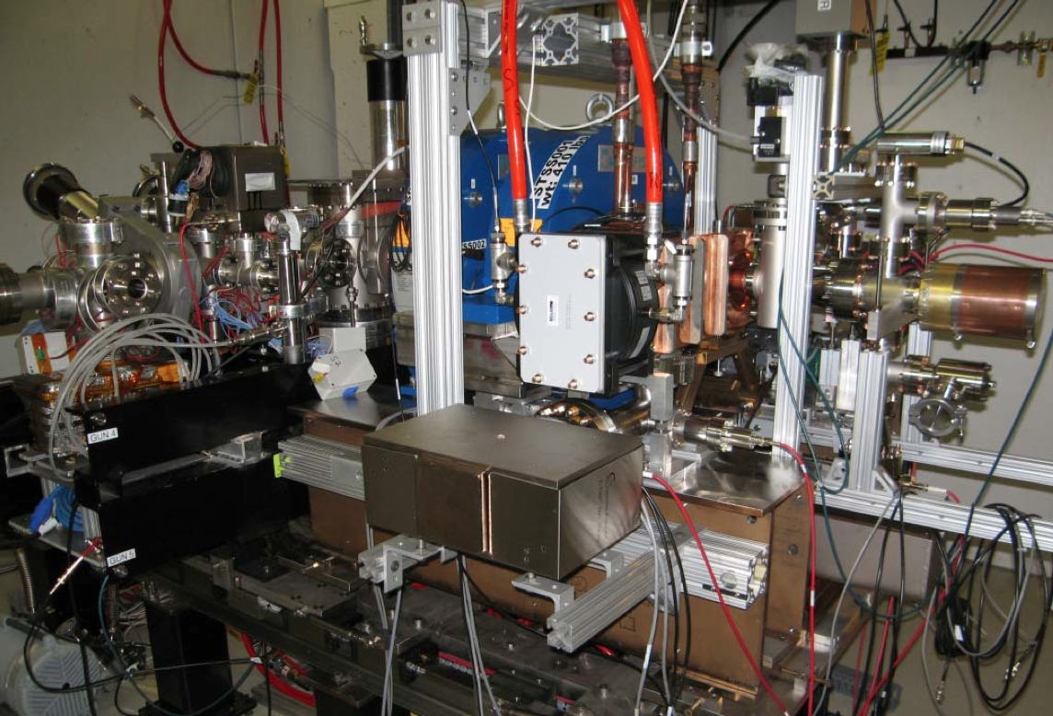
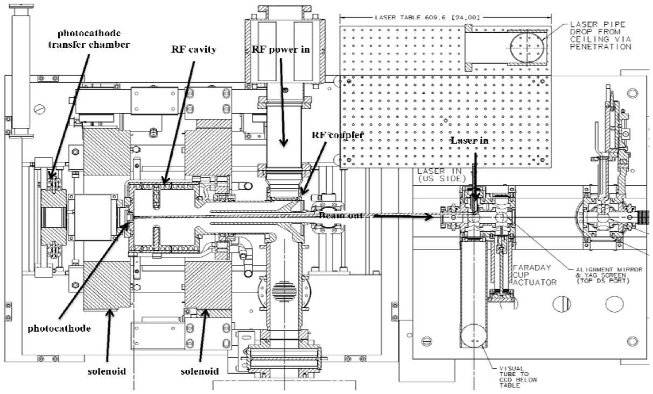
Photocathode Laser
Photocathode is a 10 mm diameter polished molybdenum disk
Coated with Cs₂Te
7 mm diameter photosensitive area
263 nm wavelength laser light directed onto the photocathode
Light reflected off of 45º off-axis mirror downstream of the RF coupler
Injection phase
Relative phase of pulses with respect to the RF
Figure 3: (a) Electron gun installation in the FAST enclosure in August, 2012.
(b) Cross section of gun, solenoids, transfer chamber, downstream instrumentation. Toroid monitor placed before the Faraday Cup to measure beam intensity/charge.

Slide 5
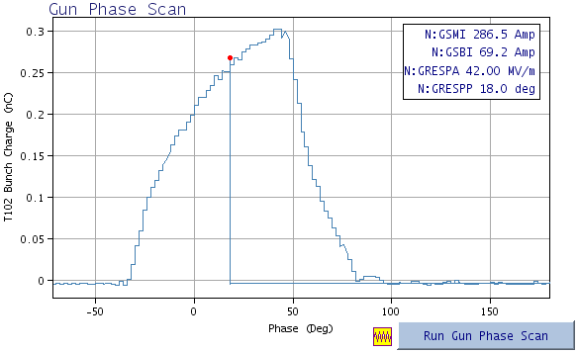
Phase Scan
In order to optimize gun operation, the RF phase of the gun was varied with respect to the laser across various phase scans
Accelerated charge measured as a function of launch phase (by a toroid monitor)
Figure 4: Measured phase scan from the electron gun in FAST. Data taken from a toroid monitor placed 1.186 m downstream from the gun. Plateau in charge is characterized by a significantly steeper slope than was observed at PITZ, which may be caused by a secondary emission of electrons.

Slide 6
Discrepancy
Faraday Cups and integrating current transformers (ICT) used at PITZ
Heat load and secondary emission; sufficiently short/isolated bunch
However, the phase scans from FAST do not match those from PITZ despite the identical nature of the guns (save for different beam charge)
There is no consistent explanation for this discrepancy
Figure 5: (a) Measured and simulated phase scan (beam charge vs. RF phase). (b) Detailed phase scan for RF phase range ∼100–115° [2].

Slide 7
The Problem
Charge vs. Phase readings had an unexpectedly high peak followed by an abrupt drop-off (maybe related to difference in scale between guns)
There also existed a smaller peak in charge after the bunch
Schottky-like effect manifesting itself in the Cs₂Te photocathode.
Secondary emission of electrons (next slide)
Increased slope of plateau

Slide 8
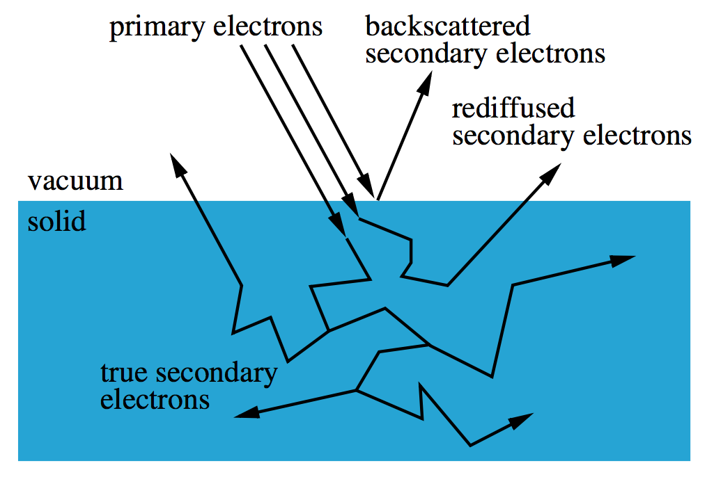
The Schottky Effect
Describes the lowering of the work function or the potential barrier of a metal by an external electric field
Leads to an increased electron emission from the metal
Which may explain the unexpected phase scan at FAST
The charge of a bunch at t₀ is determined as:
E is the combined longitudinal electric
field in the centre of the cathode
Q₀ is the charge of the macro particles
as defined in the input distribution
(rescaled to fit Q_{bunch})
Figure 6: Depiction of secondary emission

Slide 9
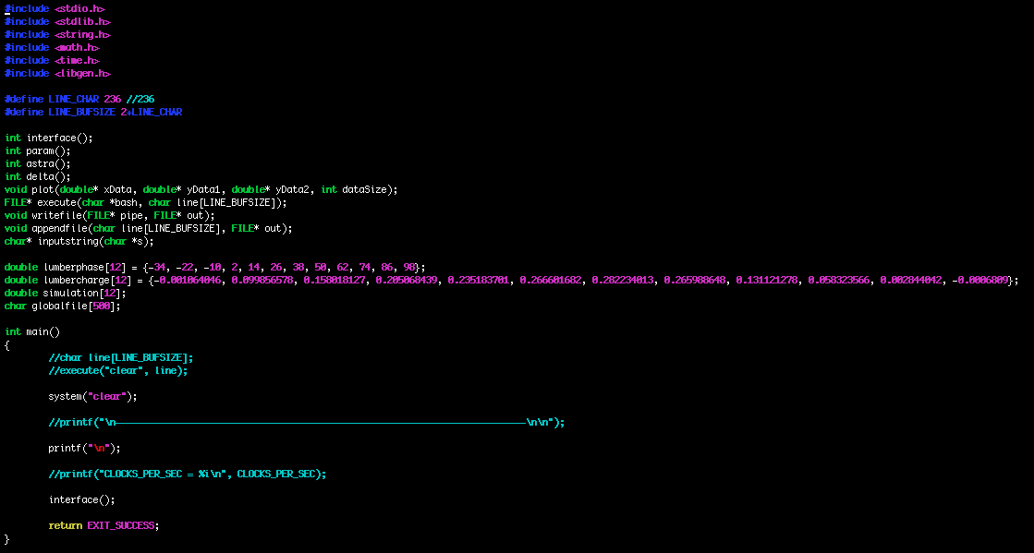
Program
ASTRA
A Space TRacking Algorithm
Written by Klaus Floettmann
Simulation of datasets through a Monte-Carlo approximation
However ASTRA lacks
certain tools/software
Parameter modification
Parameter optimization
Curve-fitting
Also, ASTRA is difficult to
automate since it is just an
executable
Figure 7: The optimization program, first written in Python, was translated to C in order to more efficiently process large amounts of raw data. Now, it acts as an environment in which bash script and analysis can be run side-by-side.

Slide 10
Optimization
Chi-square test for the variance or standard deviation
Simplified to a delta value (χ), as σ ² → 1
S is scaling factor between simulation and hardware
f(x) is phase scan function measured experimentally
f_{sim}(x, a) is simulated phase scan function

Slide 11
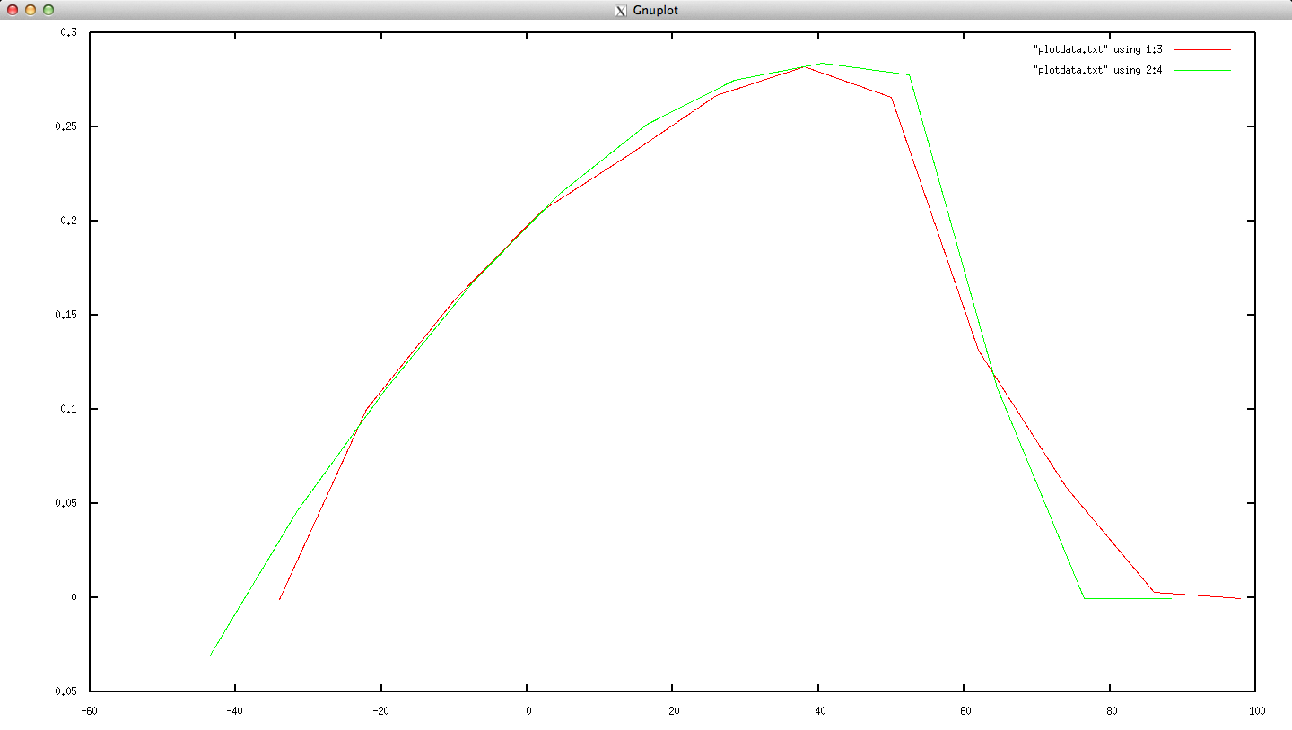
Results
H_max, H_min; SRT_Q_Schottky, Q_Schottky; SE_d0, SE_Epm, SE_fs
Correlation between charge and Schottky/secondary emission
0.30
Measured charge
Simulation charge
0.20
Bunch Charge (nC)
0.10
0.00
-40
0
40
80
Figure 8: Through the tuning of gun geometry, charge, and Schottky parameters, a relatively accurate approximation of our recorded data was achieved. This lends further evidence towards the hypothesized impact of secondary emission, and hints at a potential hardware scaling factor.

Slide 12
Future Work
The program developed, as well as the parameters it found, will continue to predict future experimental readings and diagnose issues
As FAST strives for higher intensities and more bunches, this work will set the stage for future optimization
spectrometer dipole
beam absorber
egun
toroid
CC1
CC2
chicane
20 m
Figure 9: Upstream floor plan of the FAST photoinjector. The beamline is 1.2 m above the floor, the floor is 6.1 m below grade, and the building length is 74 m [1].

Slide 13
Special thanks to Elvin and Dan.
Any questions?

