Slide 1
DUNE Three Horn Design Study
Brendon Bullard

Slide 2
Purpose
Benchmarking G4LBNE/V2 and V3
Want to study focusing performance for a three horn system based off the optimized design
Investigate the tunability of this design through the repositioning of Horn 2

Slide 3
Procedure
50m POT in V2/V3 for reference design and optimized design at 66 and 120 GeV
50m POT in V2 for three horn design at 0.5, 2.0, 4.0, and 6.0 m separation between Horn 1 and Horn 2
Visualization in HepRep (use 50 POT)

Slide 4
Reference Design Horns

Slide 5
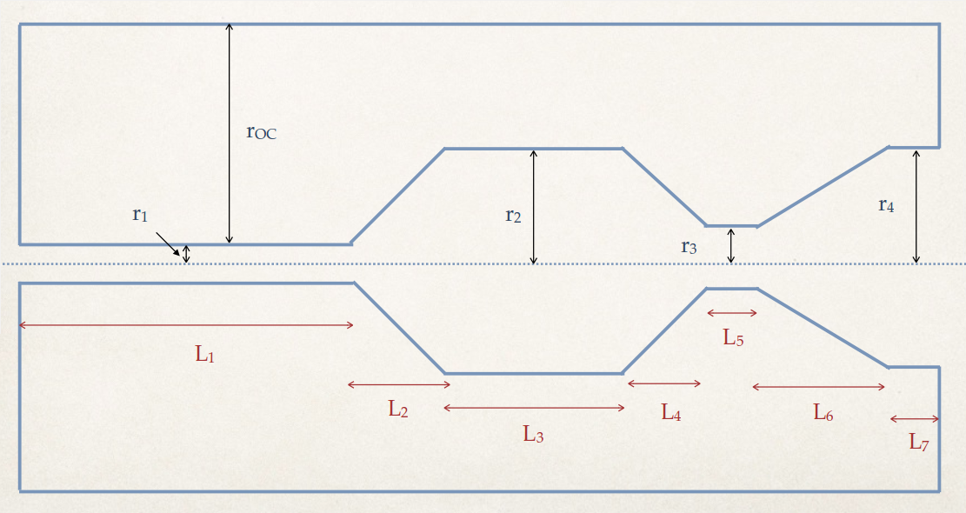
Reference and Optimized Designs

Slide 6
Reference Design: π+ (1-10 GeV)
V2
66 GeV
V3
V2
120 GeV
V3

Slide 7
Optimized Design: π+ (1-10 GeV)
V2
66 GeV
V3
V2
120 GeV
V3

Slide 8
Reference Design

Slide 9
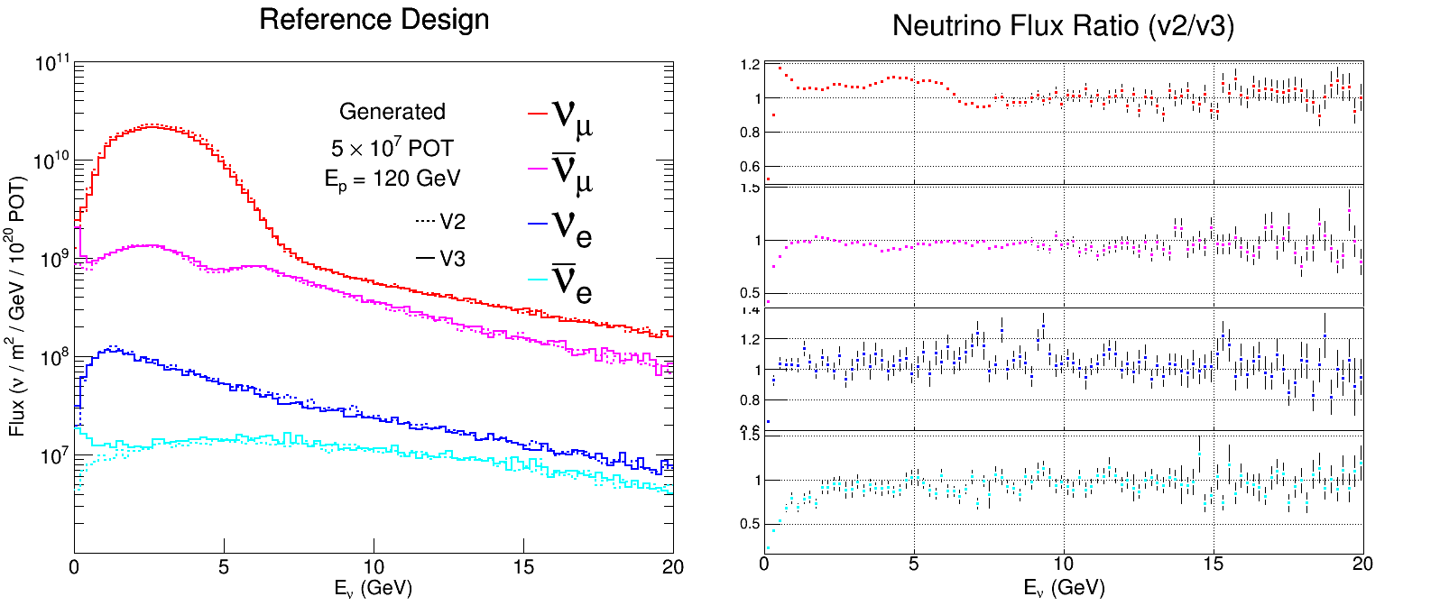
Reference Design

Slide 10
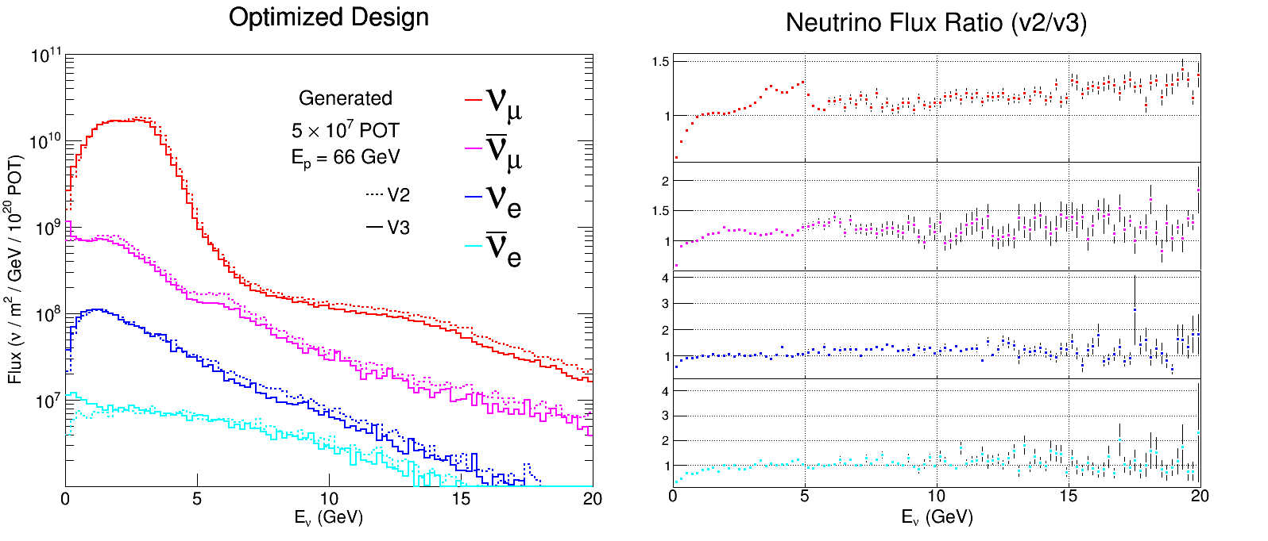
Optimized Design

Slide 11
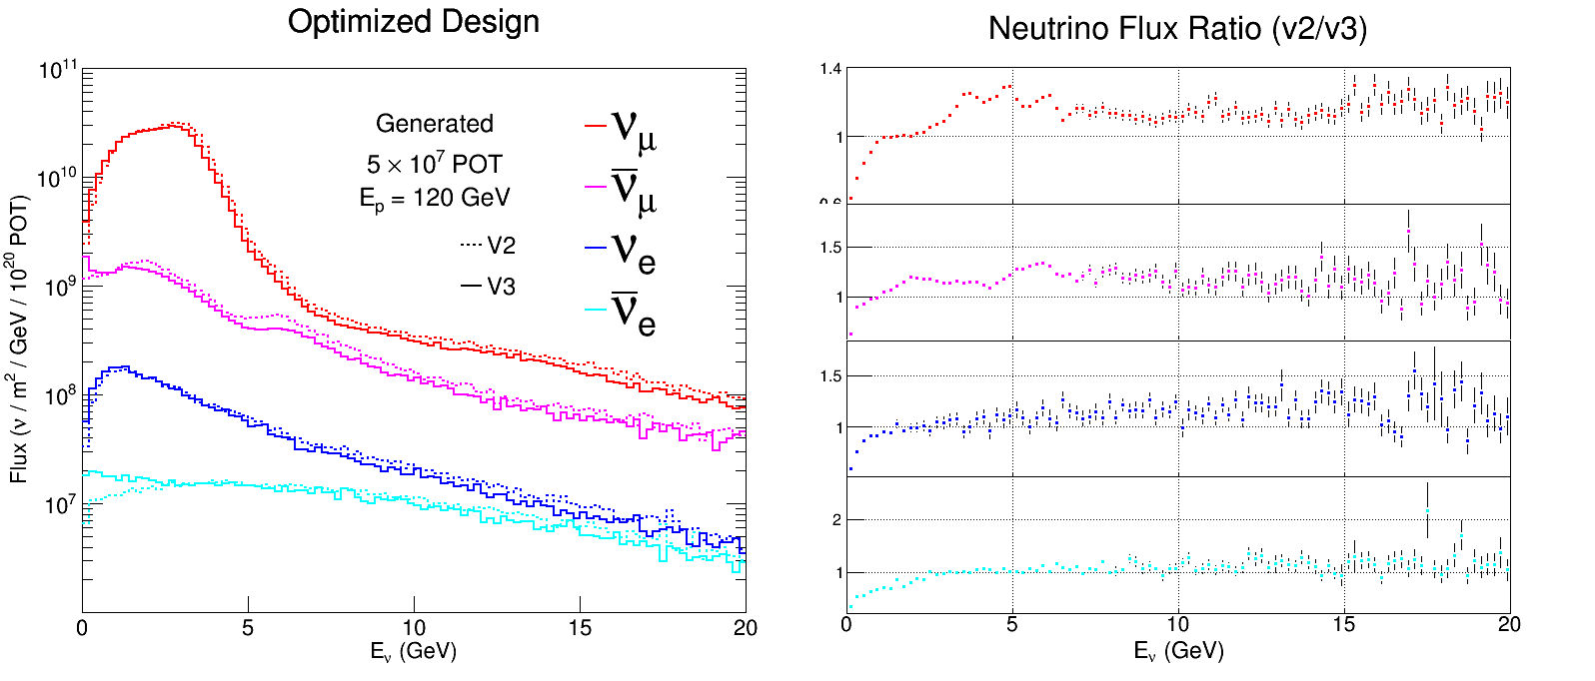
Optimized Design

Slide 12
Observations
Verify that optimized design outperforms reference
V3 has overall lower flux due to the more accurate use of beamline components
V3 low energy bins are higher because V2 has automatic low energy cuts

Slide 13
Three Horn Design
Same beam specifications as optimized design, except Horn 1 is cut between L₃ and L₄

Slide 14
Visualization of Three Horn Design
0.5m
2.0m
4.0m
6.0m

Slide 15
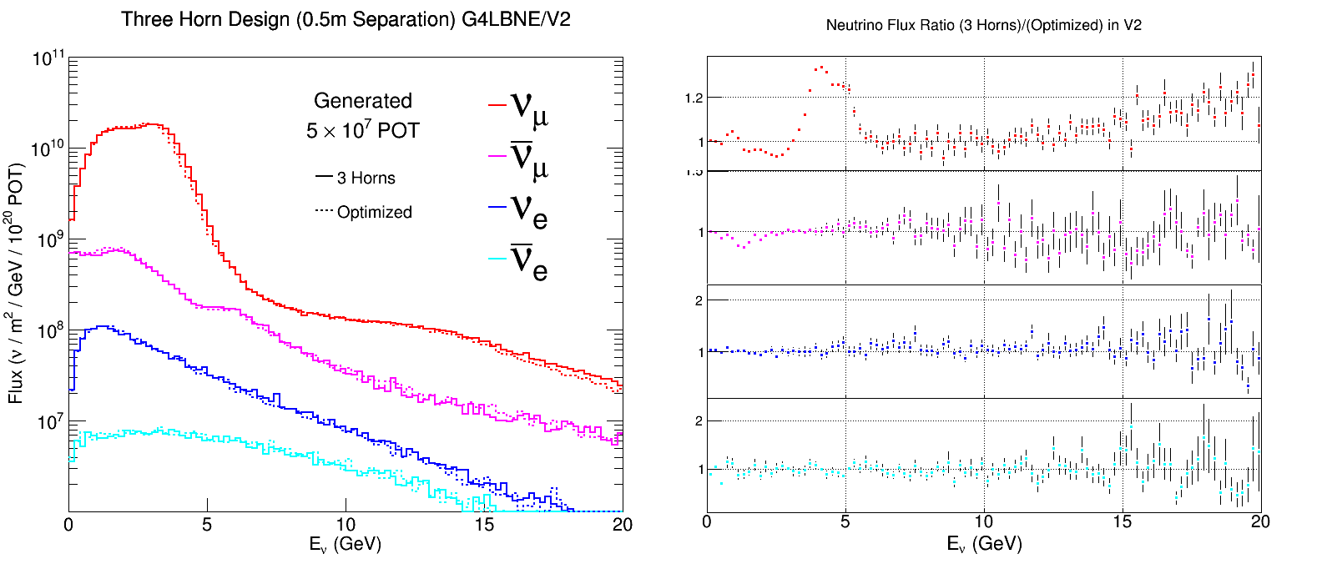
0.5 meter Separation

Slide 16
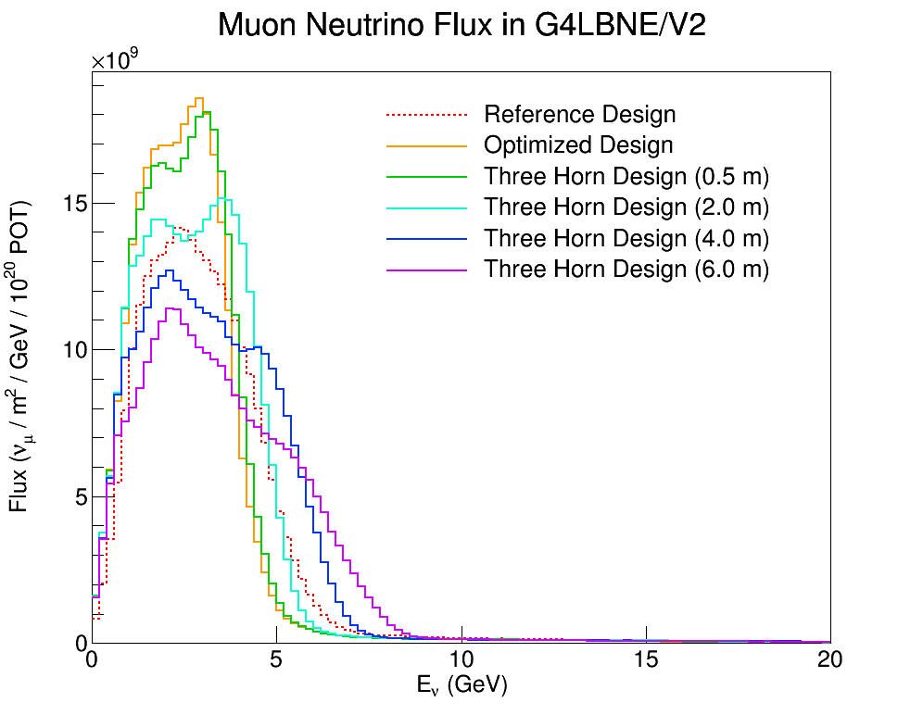
Three Horn (all separation lengths)
66 GeV

Slide 17
Conclusions
The 0.5 m separation design yields comparable neutrino flux to the optimized design - a three horn design can be found that has equal or better flux
Simply moving the location of Horn 2 doesn’t give quality tuning. Likely will be the case for other Horn 2 OC radii

Slide 18
Future Work
Study anti muon neutrino beam
Implement three horn design in G4LBNE/V3
Use a genetic algorithm to optimize the three horn geometry – Horn 2 OC radius and separation distance increase complexity by 2 degrees of freedom

Slide 19
End

