Slide 1
NEAR DETECTOR SPECTRA AND FAR NEAR RATIOS
Amit Bashyal
August 4, 2015
University of Texas at Arlington

Slide 2
Introduction
Near Detector and Near Far Correlation
DUNE Beamline with near detector position
Optimized and Reference beamline
Near and Far detector neutrino fluxes
Beam Matrix for Near and Far detector
Beam Matrix Table
Conclusion and Future works

Slide 3
Near Detector and Near Far Correlation
DUNE : numu →nue oscillation experiment
Near Detector to understand the neutrino flux and predict flux at the far detector
Far Detector to observe the oscillation effect
BUT
Systematic uncertainties which makes the prediction less accurate
SOURCES OF UNCERTAINTIES
Hadron Production, material budget, alignments of beamline parts, finite transverse size of decay pipe, target length and so on.

Slide 4
Continued
Near and Far Detector sees different neutrino flux due to their location.
Systematic uncertainties don’t cancel.
Need to know uncertainties to make the prediction of far detector flux more accurate.
Methods
Far near ratio
Beam Matrix

Slide 5
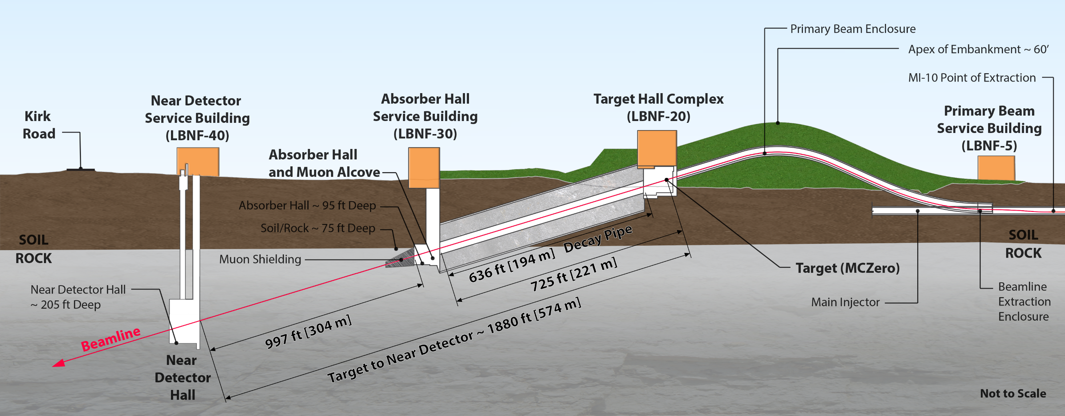
DUNE Beamline with Near Detector

Slide 6
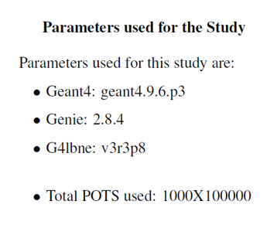
Beam Parameters
Reference Beam
Proton Beam Energy:80 GeV
Proton Beam Intensity: 1.2 MW
Beam spot size: 1.3 mm
Optimized Beam(CP_run5_9116)
Proton Beam Energy: 66 GeV
Proton Beam Intensity: 1.2 MW
Beam Spot Size: 1.65 mm

Slide 7
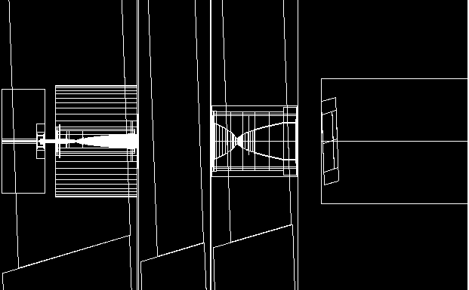
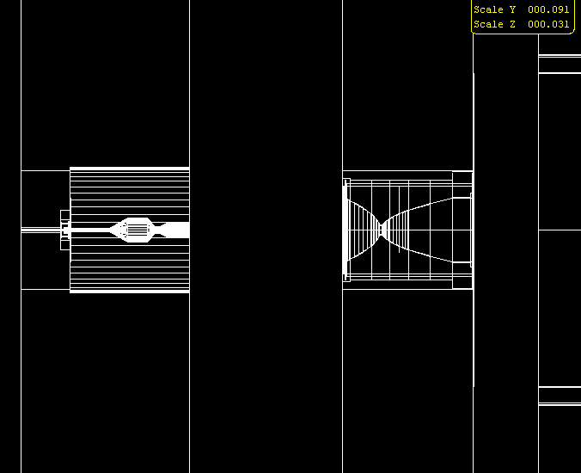
Horn 1
Horn 2
Reference Beam
Relative position of target and focusing system in optimized and reference configuration.
The target is longer and wider in optimized configuration.
Optimized Beam
Horn Current:
Reference: 230 kA.
Optimized: 298 kA.
Horn 1
Horn 2

Slide 8
Reference Beam
The fluxes are scaled for the cycle time of the accelerator for protons with different proton energy.
Optimized Beam

Slide 9
574 m → Near Detector Location
1297 km → Far Detector Location
Flux Ratio multiplied by R squared ratio (R = detector location).
2 to 6 GeV→ Focusing region. Optimized reference has smaller normalization uncertainty (better focusing).
Highlighted is the focusing region.

Slide 10
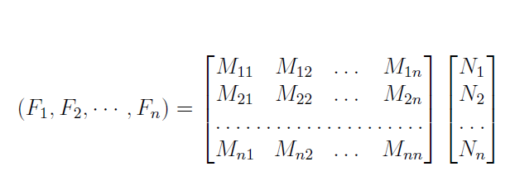
Beam Matrix Method
Near Far Correlation from Far Near Ratio Method
Here, F_{i} = Neutrino event in the far detector
R_{i} = Near Far Ratio
N_{i} = Neutrino event in the near detector
Limitation of the ratio plot → Near Far correlation only in the given neutrino energy bin
Each neutrino event at energy E_{n} implies neutrino spectrum in the far detector.
Beam Matrix method gives a more accurate near far correlation.
Near Far Correlation from Beam Matrix Method

Slide 11
Reference Beam Matrix
Optimized Beam Matrix

Slide 12
DUNE Reference Beam Matrix
The energy smearing becomes more prominent as we go to higher energy neutrino event.
Smearing for 2.5 to 3 GeV (Red), 5.5 to 6.5 GeV (Green) and 8.5 to 10.5 GeV (Blue).

Slide 13
Optimized Beam Matrix
Smearing for 2.5 to 3 GeV (Red), 5.5 to 6.5 GeV (Green) and 8.5 to 10.5 GeV (Blue).

Slide 14
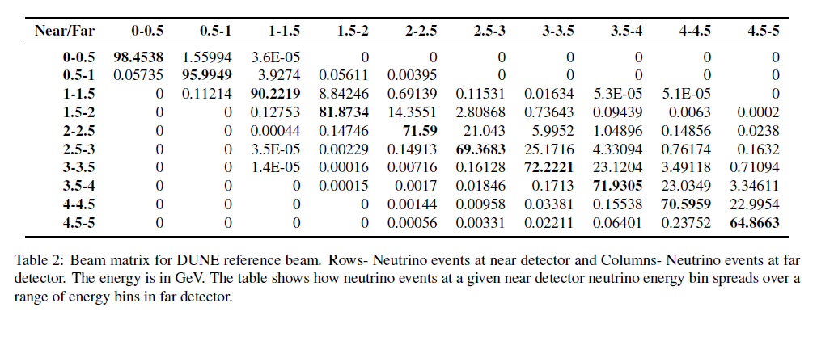
Beam Matrix Table for Reference Beam
Interpretation of Beam Matrix Table
Neutrino events at, lets say 0-0.5 GeV bin at near detector implies a neutrino spectrum at far detector such that :
98.45% of that event (X (R_{near}/R_{far})² )is in 0 to 0.5 GeV Far detector neutrino energy bin.
1.559% of that event(X (R_{near}/R_{far})² ) is in 0.5 to 1 GeV Far detector neutrino energy bin.
And so on……

Slide 15
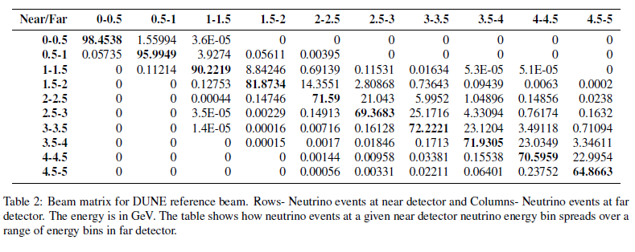
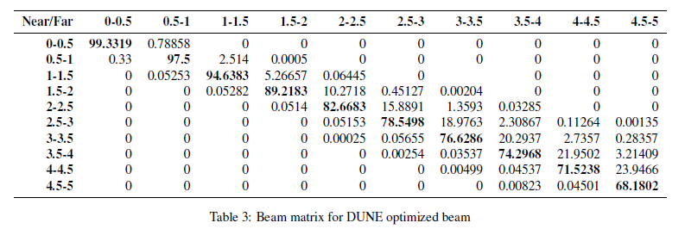
Reference Beam
Optimized Beam

Slide 16
Conclusion and Future Work
Near Far Ratio and Beam Matrix → Two method to predict the Far detector spectra from the near detector events.
Ratio shows that optimized beam configuration performs well in the focusing region.
Beam Matrix essentially shows the spread of uncertainties at far detector over a range of energy bins. The table shows Optimized beam has less spread than the nominal one.
Optimized beam shows lesser off diagonal elements (and smaller) than the reference beam. By optimizing the beam, we were able to increase the neutrino flux and decrease the spread of systematic uncertainties at the same time.
FUTURE WORKS:
Test accuracy of near/far ratio and beam matrix using different physics model.

Slide 17
BACK UP SLIDES

Slide 18
Decay angles for pions (2.5 to 3 GeV)
Decay angles for pions
(5.5 to 6.5 GeV)
Decay angles for pions (8.5 to 10.5 GeV)

Slide 19
Reference Beam
XY position of pions at the end of second focusing horns giving neutrinos of different energy range at Near Detector

Slide 20
Optimized Beam
XY position of pions at the end of second focusing horn giving neutrinos of different energy range at Near Detector

