Slide 1
QXFP Winding and Curing
Miao Yu
08/19/2015

Slide 2
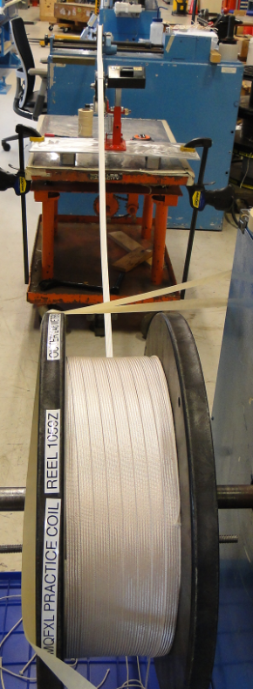
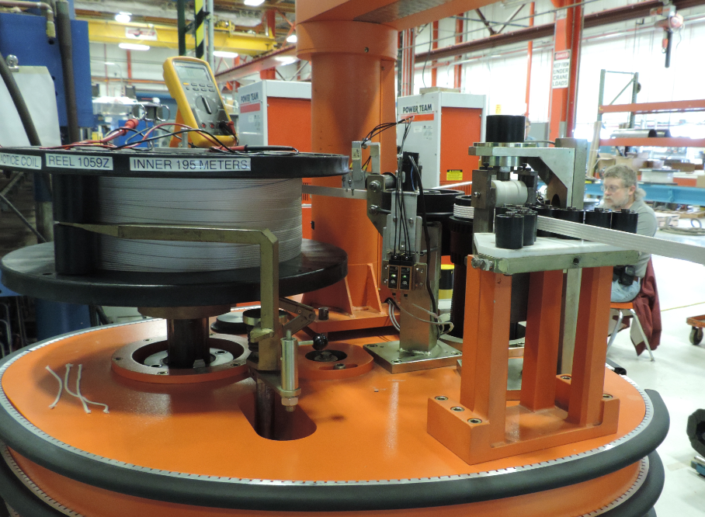
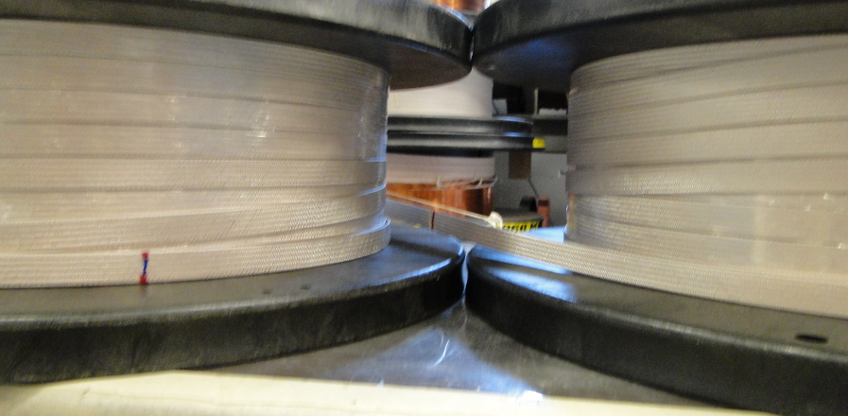
QXFP 01a
Cable
Reel # 1059 Z with total length 441.7 m
L1 requires min. 185 m and L2 requires min. 234 m (20 m extra)
Back wind in the way of reverse bending to fit both L1 and L2 spools in the Selva boom.

Slide 3
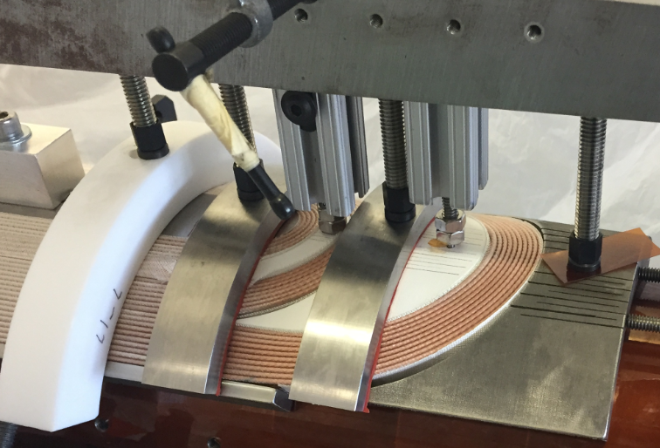
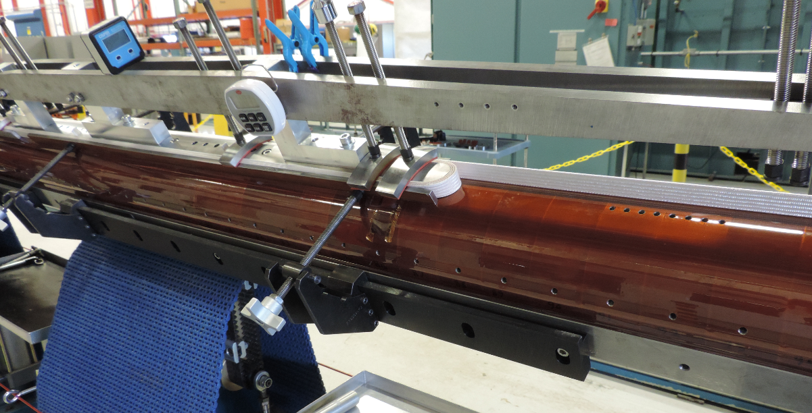
L1 Winding
With binder, but without the winding tool.
25 kg winding tension
No popped strand.
End parts fit well

Slide 4
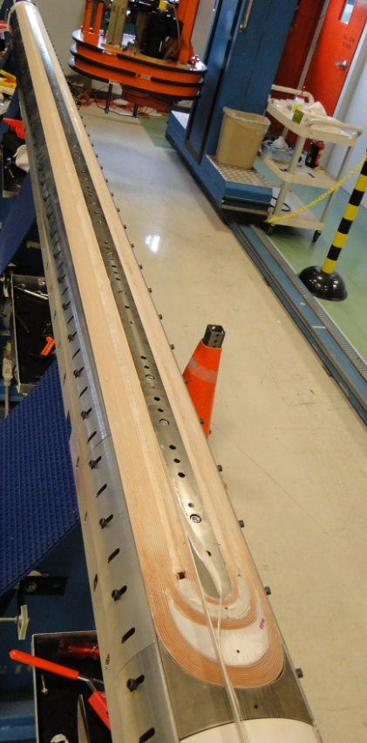
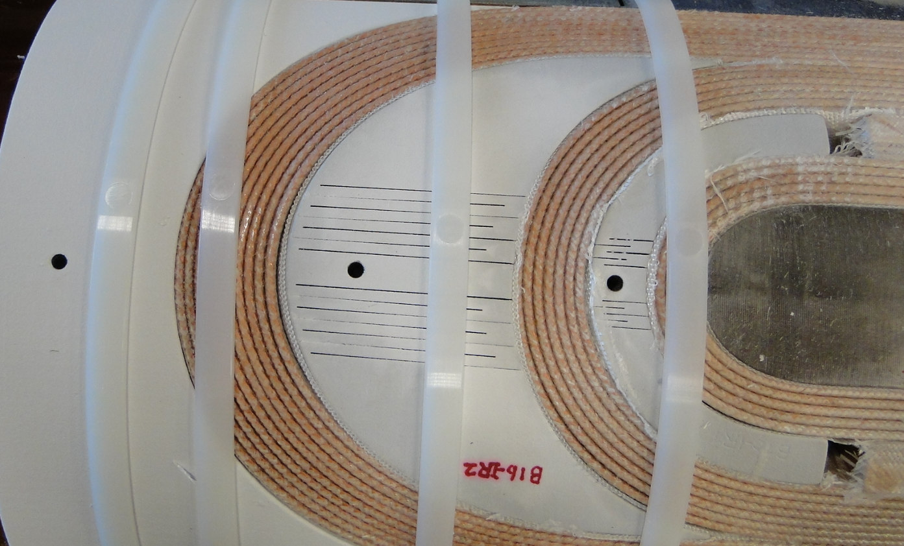
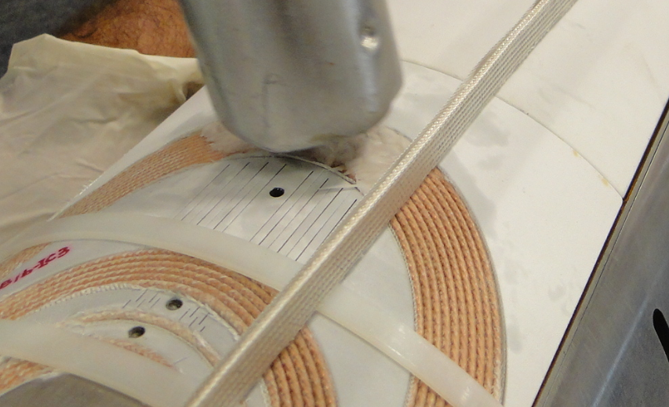
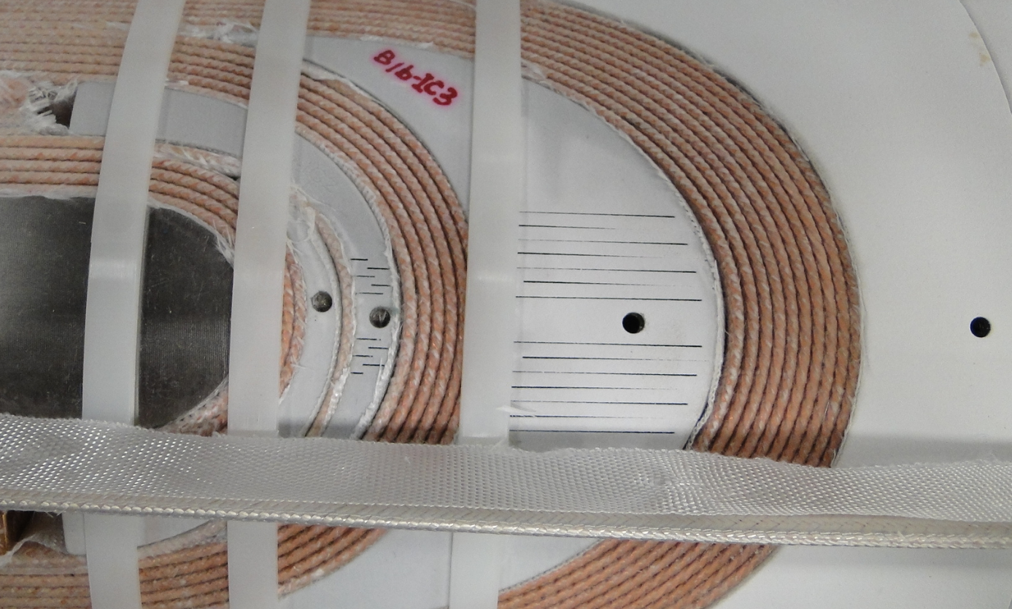
L1 Curing

Slide 5
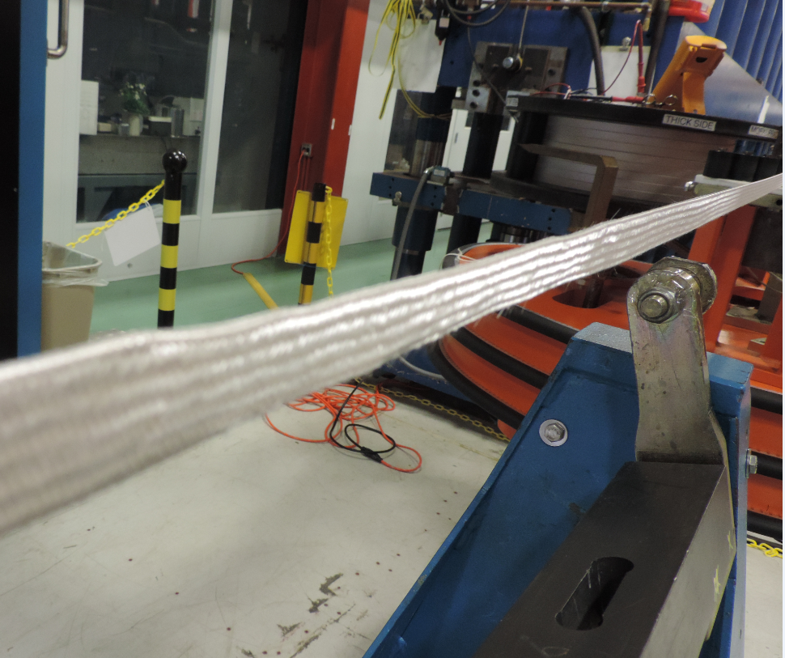
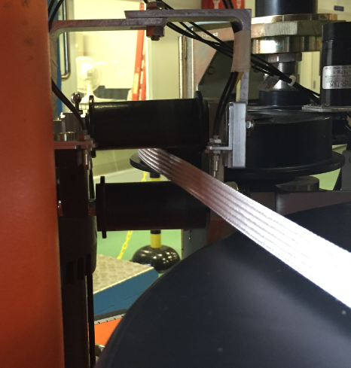
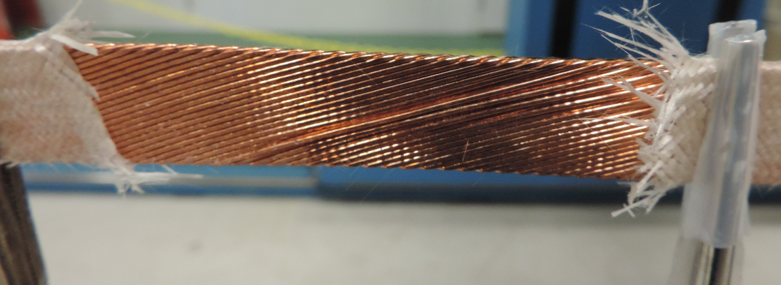
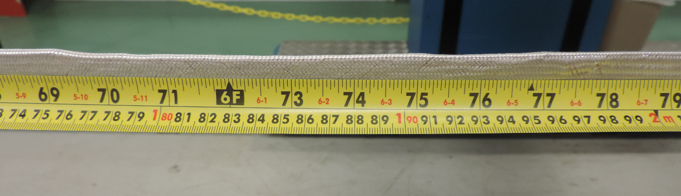
L2 Winding (popped strands)
On turn 8, 69" - 79“ from lead end NT, the cable roped.
The cable coming from the spool touching the roller (hard way bending).
Fixed the popped strands without removing insulation until the middle 4” section.
Fixed the cable location sensor.

Slide 6
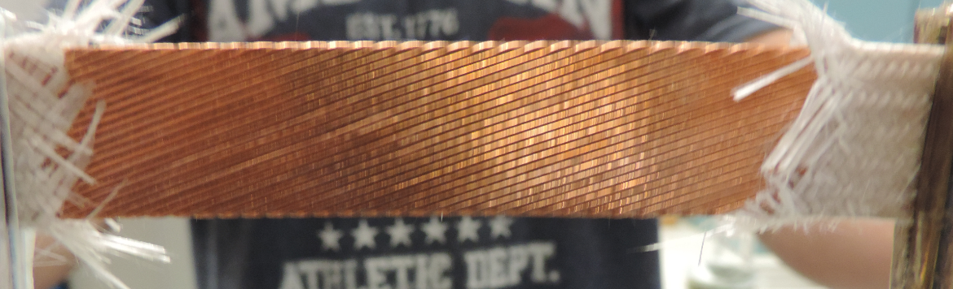
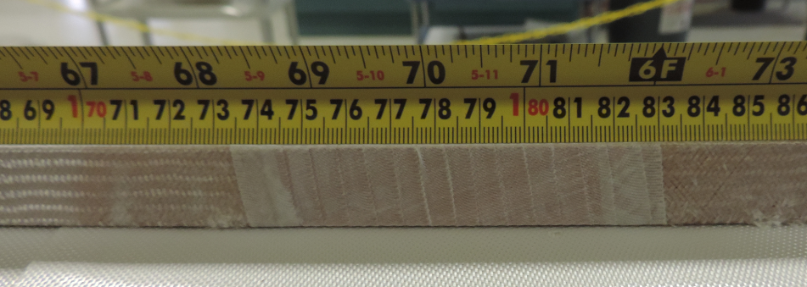
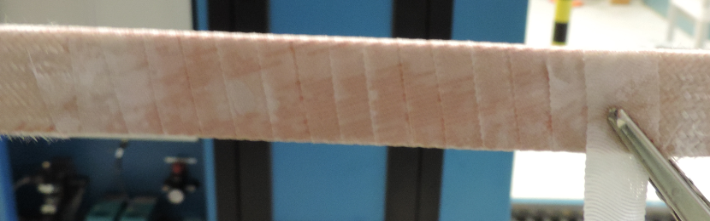
Remove insulation and fixed the popped strands
Wrapped with 3 mil E-glass, 50% overlap
Paint the binder and cured.
It is in the straight section, ~1.8 m from LE

Slide 7
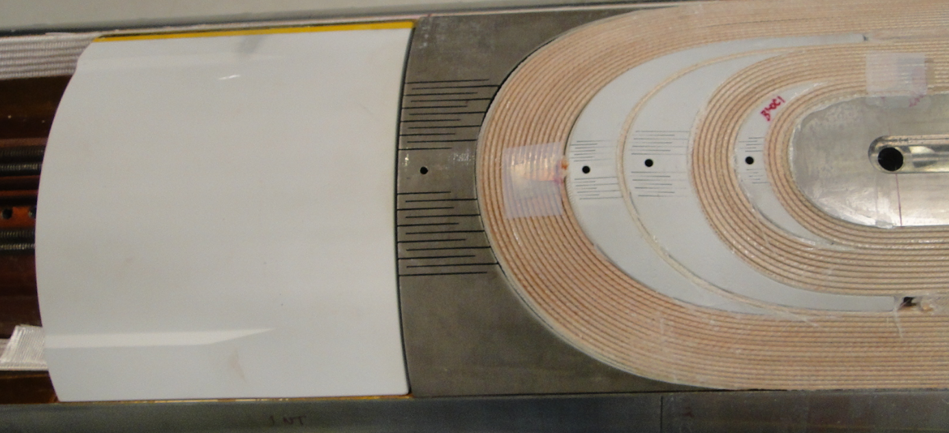
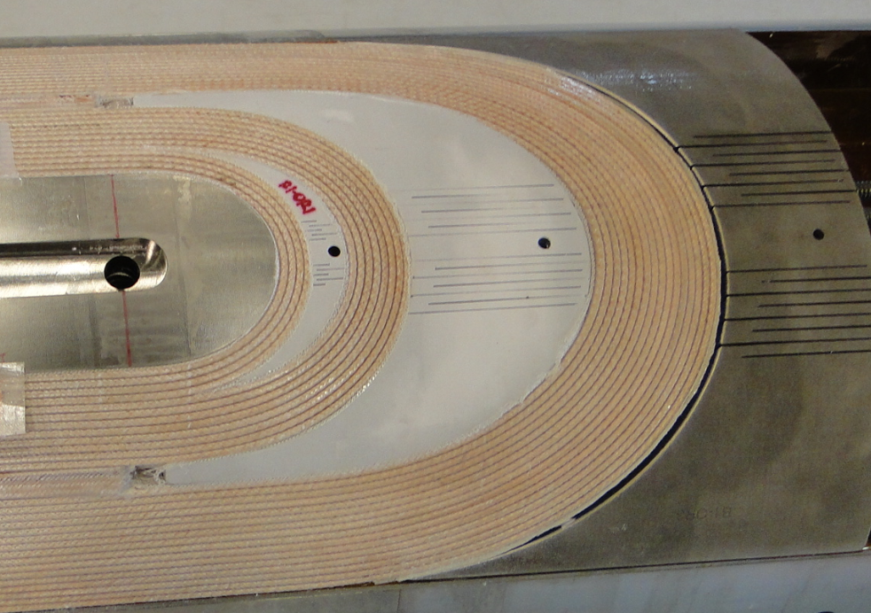
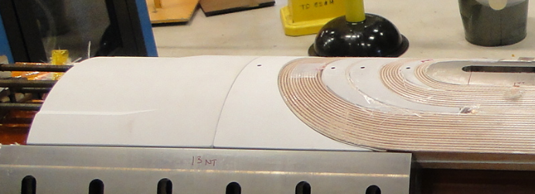
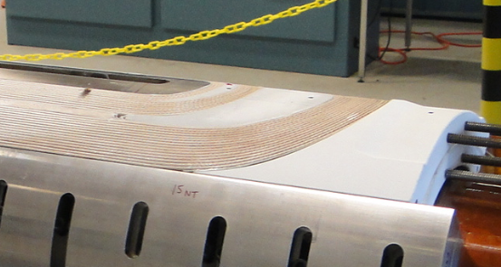
L2 Curing

Slide 8
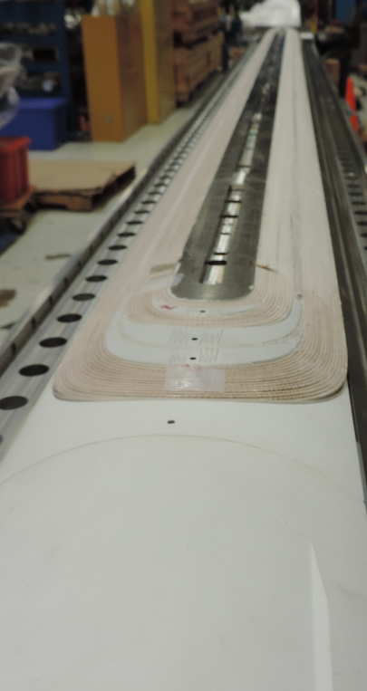
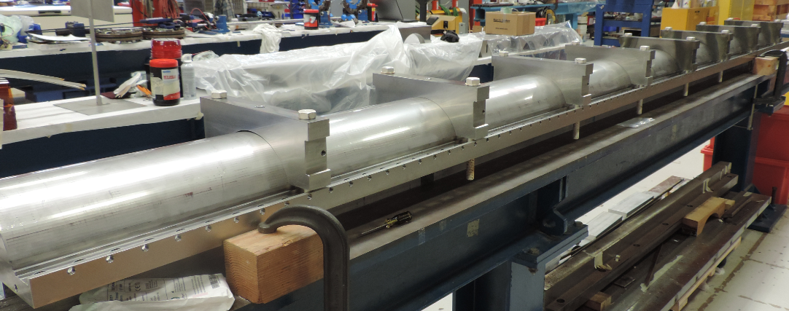
Coil in Reaction Fixture

Slide 9
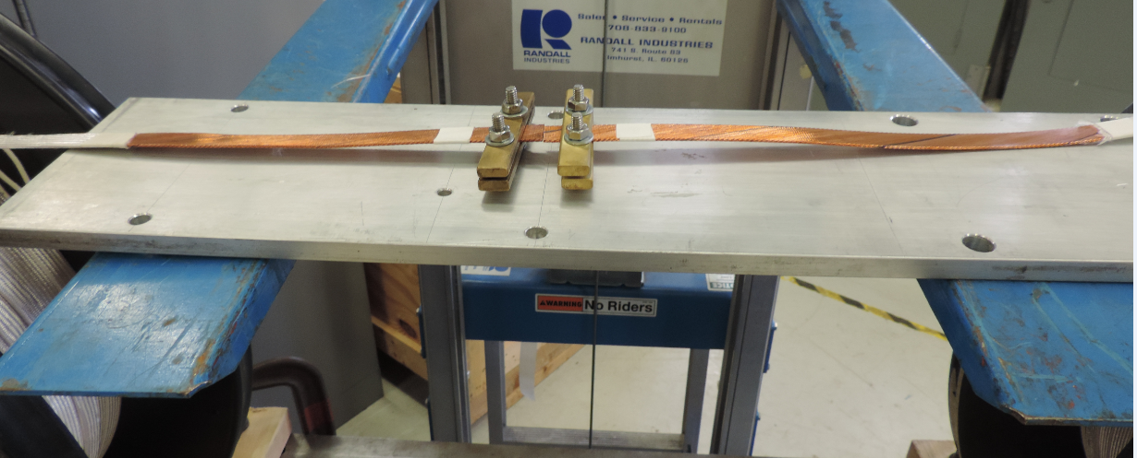
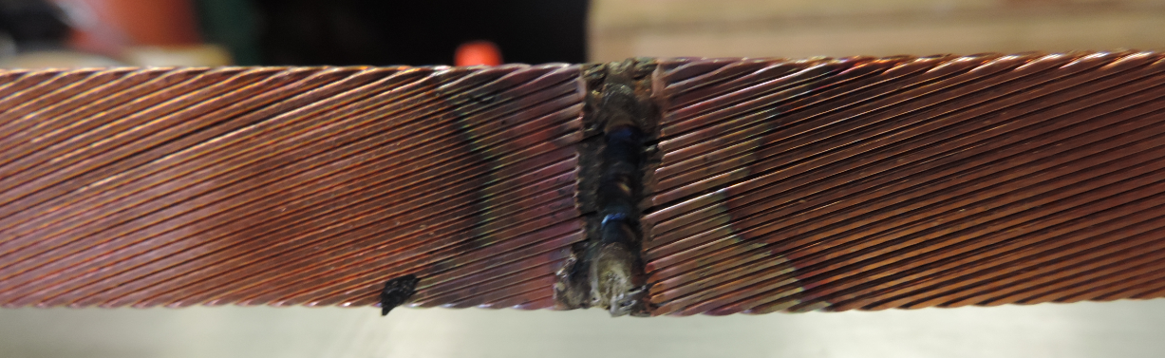
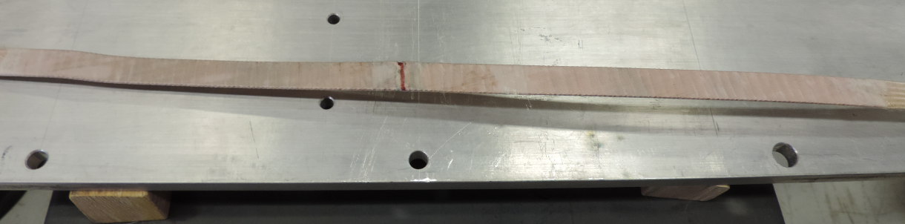
QXFP 01b – practice coil
Cable
Reel # 1056Z (158.5 m) + 1061Z (164.5 m) + 1055Z (156.9 m)
L1 193.8 m (full spool of 1056Z) and L2 286.1 m (full spool of 1055Z, 52 m drop off)
Back wind in the way of reverse bending to fit both L1 and L2 spools in the Selva boom.

Slide 10
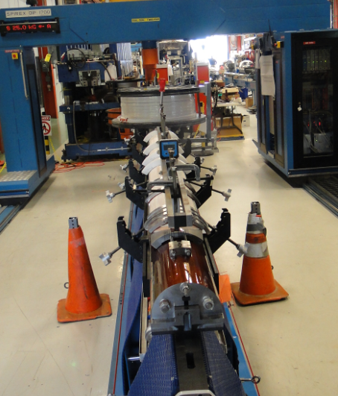
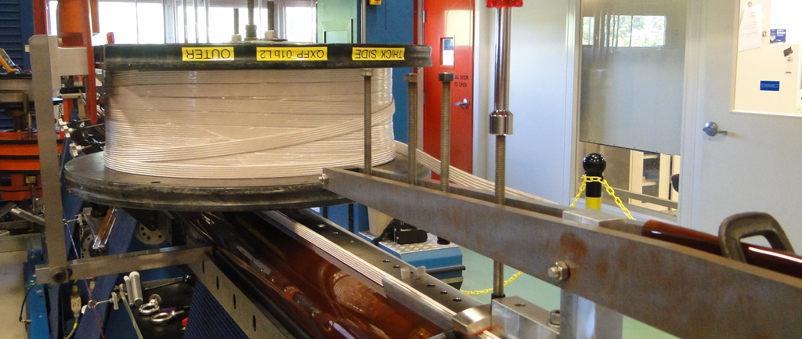
L1 Winding
No popped strands
L2 spool was mounted on top of the coil, rotating together with the winding mandrel

Slide 11
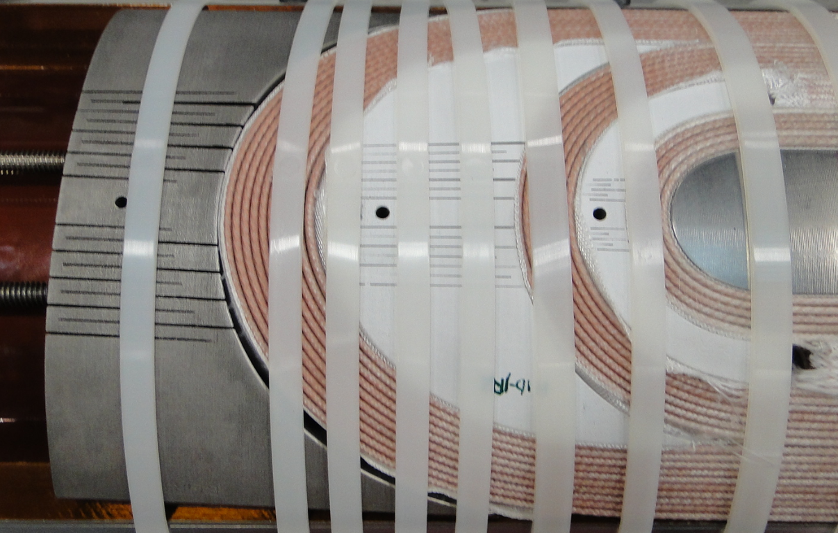
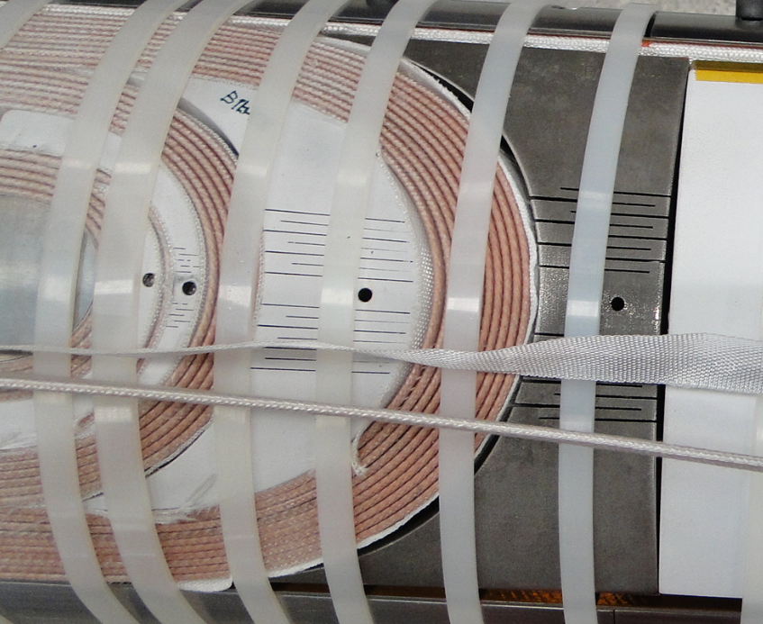
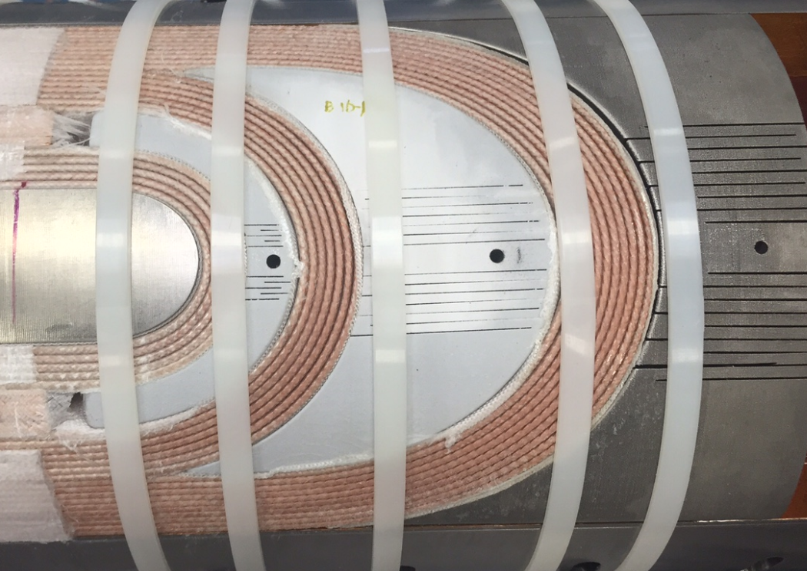
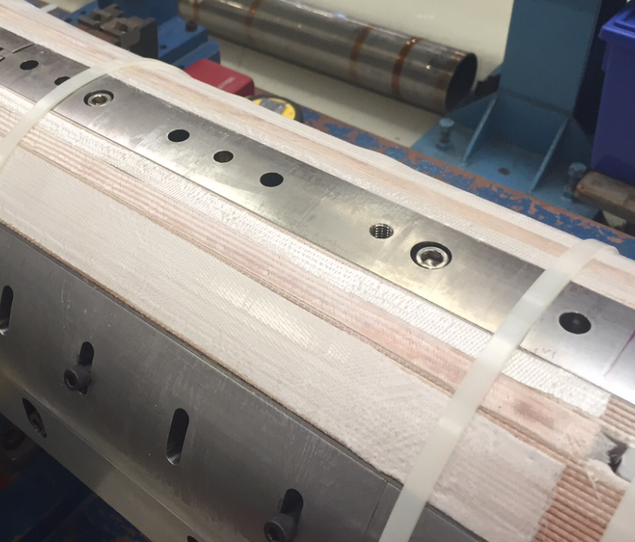
L1 Curing
Before
After

