Slide 1
Possible QXF v2 Fabrics
E.F. Holik, Steve Krave, Miao Yu, Lucas Zimmerman

Slide 2
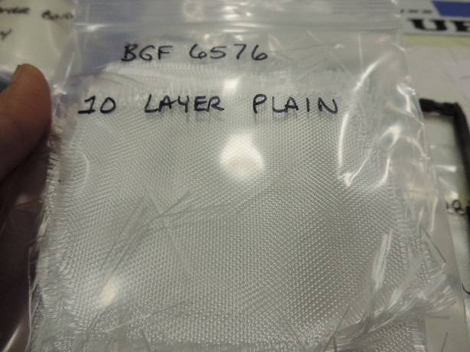
What and How
Possible OD/ID, Interlayer, Tape S-2 glass candidates were measured for thickness with and without binder.
Measurements were taken with 1 to 12 layers of material between two 7cm x 7 cm plates from 1.75 to 5 Mpa.
https://plone4.fnal.gov/P1/USLARP/MagnetRD/qxf/meetings/2015/folder.2015-03-09.2798827302/ProposedPlanForMeasuringMaterialThickness.pptx
https://plone4.fnal.gov/P1/USLARP/MagnetRD/qxf/meetings/2015/20150506structurecoilWG/20150506_LARP_MQXFS_MeasuredMaterialThicknesses.pptx

Slide 3
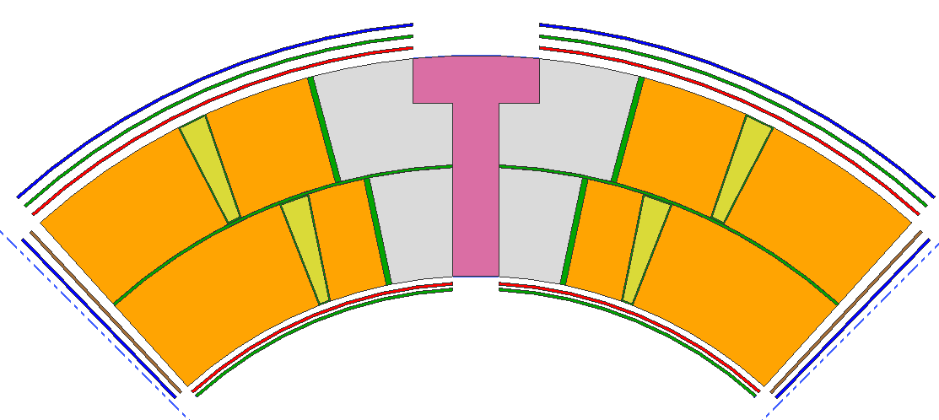
Needed S-2 Glass
310 µm
S2 glass (Impreg)
410 µm
S2 glass (Reaction)
100 µm (4 mil)
Polyimide trace
660µm
S2 glass
Midplane
100 µm (4 mil )
Polyimide trace
150 µm (6 mil)
S2 glass

Slide 4
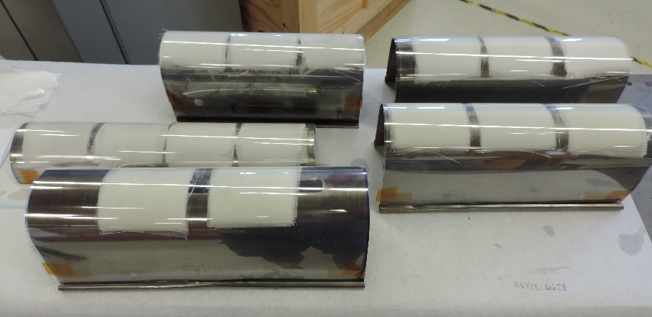
5 Fabrics Measured
Company | Style | Sizing | Nom. Thk. | Weave | oz/yd2 | g / cc | Warp | Fill | Warp CNT | Fill CNT
BGF | 6781 | 497A | 0.0095" | 8H Satin | 8.95 | 1.26 | SCG 75 1/0 | SCG 75 1/0 | 58 | 54
BGF | 6576 | tbd | 0.0116" | 8H Satin | 10.5 | 1.21 | SCG 75 1/0 | SCG 150 1/0 | 150 | 24
JPS (large order) | 26781 | tbd | 0.0090" | 8H Satin | 8.5 | 1.26 | SCG 75 1/0 | SCG 75 1/0 | 56 | 53
JPS (to be verified) | 6781 | tbd | 0.0096" | 8H Satin | 8.94 | 1.24 | SCG 75 1/0 | SCG 75 1/0 | 57 | 54
Hexcel | 4522 | F81 | 0.0051" | Plain | 3.64 | 0.95 | SCG 150 1/2 | SCG 150 1/2 | 24 | 22
Hexcel (large order) | 66281HT | tbd | 0.0070" | 4H Satin | 5.96 | 1.14 | SCG 75 1/0 | SCG 75 1/0 | 38 | 37
Satin weave is more pliable, incompressible, and dense when compared to plain weave
Plain Weave
8H Satin Weave
Notes:
BGF 6576 is an asymmetric weave. The high density warp filaments are along the long length of the spool or roll. The low density fill strands go across the roll (~1 yard). The warp filaments would go along the coil length so that the impregnated fabric would be stronger along the axial direction.

Slide 5
Measured Thickness (single layer equivalent)
Candidate / Test setup | 1.6 MPa | 5.0 MPa | 5.0 MPa | 1.6 MPa
BGF 6576 10 layer plain | 208 | 198 | 196 | 201
BGF 6576 2 layer binder | 341 | 329 | 327 | 338
JPS 26781 single layer plain | 158 | 148 | 152 | 148
JPS 26781 10 layer plain | 166 | 158 | 156 | 164
JPS 26781 triple layer binder | 296 | 269 | 269 | 285
Hexcel 66281HT 10 layer plain | 122 | 117 | 117 | 121
Hexcel 66281HT 4 layer binder | 209 | 191 | 189 | 202
Hexcel 4522 12 layer plain | 94 | 87 | 87 | 91
Hexcel 4522 single layer plain | 133 | 121 | 121 | 120
BGF 6781 12 layer plain | 182 | 170 | 170 | 177
BGF 6781 single layer plain | 186 | 170 | 170 | 184
BGF 6781 2 layer binder | 289 | 259 | 259 | 274
Microns
10 layer plain: 10 sheets of fabric without binder were measured together
Single layer plain: a single sheet of fabric without binder was measured
2 layer binder: binder was applied to 2 sheets of fabric and subsequently measured.
Triple layer binder: binder was applied to 3 sheets of fabric and subsequently measured.
4 layer binder: binder was applied to 4 sheets of fabric and subsequently measured.

Slide 6
Best Candidates
Microns
Candidate / Test setup | Thickness | Goal | Difference | Layers
BGF 6576 2 layer binder | 655 | 660 | -5 | two layers
BGF 6781 2 layer binder | 776 | 660 | 116 | three layers
JPS 26781 triple layer binder | 538 | 660 | -122 | two layers
Hexcel 66281HT 4 layer binder | 571 | 660 | -89 | three layers
BGF 6576 10 layer plain | 394 | 410 | -16 | two layers
JPS 26781 10 layer plain | 471 | 410 | 61 | three layers
Hexcel 66281HT 10 layer plain | 352 | 410 | -58 | three layers
Hexcel 4522 12 layer plain | 435 | 411 | 24 | five layers
BGF 6576 10 layer plain | 394 | 310 | 84 | two layers
JPS 26781 10 layer plain (large order) | 314 | 310 | 4 | two layers
JPS 6781 10 layer plain (estimate) | 332 | 310 | 22 | two layers
Hexcel 66281HT 10 layer plain | 352 | 310 | 42 | three layers
Hexcel 4522 12 layer plain | 261 | 310 | -49 | three layers
BGF 6781 12 layer plain | 340 | 310 | 30 | two layers
BGF 6576 10 layer plain | 197 | 150 | 47 | one layer
JPS 26781 single layer plain (large order) | 150 | 150 | 0 | one layer
JPS 6781 single layer plain (estimate) | 158 | 150 | 8 | one layer
Hexcel 66281HT 10 layer plain | 117 | 150 | -33 | one layer
Hexcel 4522 single layer plain | 121 | 150 | -29 | one layer
BGF 6781 single layer plain | 170 | 150 | 20 | one layer
Interlayer Insulation
Reaction OD
Impreg OD
Impreg ID

Slide 7
Summary
BGF 6576 with 497A (currently used) sizing seems to be the best candidate for the reaction OD and Interlayer insulation.
JPS 26781 with 933 HTS (High Temperature Silane [AGY]) sizing seems to be the best candidate for impregnation ID and OD but has a 5800 yard minimum order. Can get fewer yards with CS767 JPS sizing (untested)
JPS 6781 with CS767 JPS sizing is the next best candidate for impreg ID and OD.
125 micron tape was ordered but 175 micron tape was shipped. Corrected order is in progress.
Coil Fab Thickness @ 5 Mpa (µm) | Nom. | W&C | RXN | IMPG
ID | 150 |  |  | 150, 158
OD Reaction | 410 |  | 394 (2 layers)
OD Impregnation | 310 |  |  | 314, 332
Interlayer (w/ binder) | 660 | 655 (2 layers)
Tape (w/ binder) | 125 | N/A
Tape (w/o binder) | 125 | N/A
Many thanks to Lucas Zimmerman for data collection!

