Slide 1
MQXFS1 Observations and Feedback from the Assembly Processes
Dan Cheng
8/20/2015

Slide 2
Outline
Observations and feedback on assembly processes
Summary and Status

Slide 3
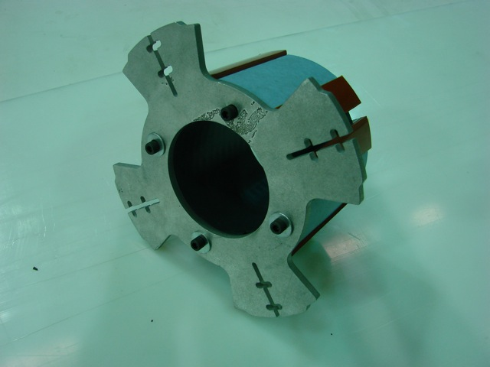
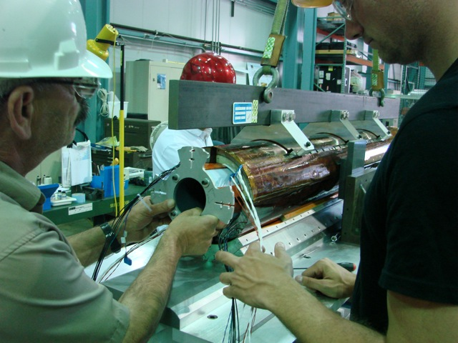
Improved Coil Support Spud
Procedures and tooling were adjusted after the disassembly incident
Redesigned coil support spud was incorporated into the use of coil pack builds #3-5
Screws positively engage with each coil to prevent relative motion

Slide 4
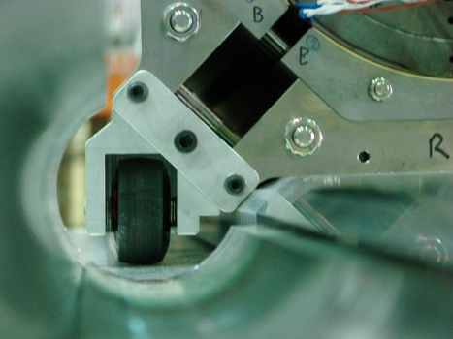
MQXFS1 Coil Pack Insertion Rails
Coil pack was inserted into the shell & yoke assembly with the insertion rails

Slide 5
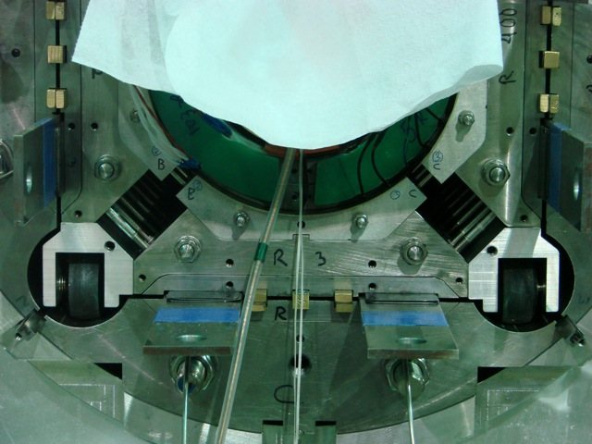
MQXFS1 Coil Pack Insertion Rails
Rails were removed when the bladders were first cycled

Slide 6
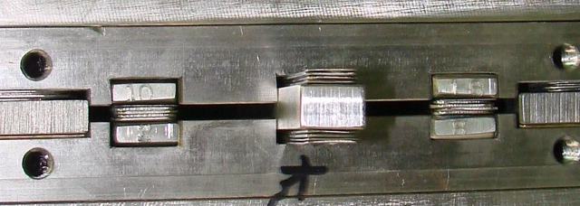
MQXFS1 Master Keys & Shims
MQXFSD Alignment and load keys required many shims in nominal dimensions
MQXFS1 keys were increased in thickness
1 mm per each load key half, and 2 mm in alignment key
This reduced the amount of shim required during bladder operations
Material was changed to bronze instead of mild steel

Slide 7
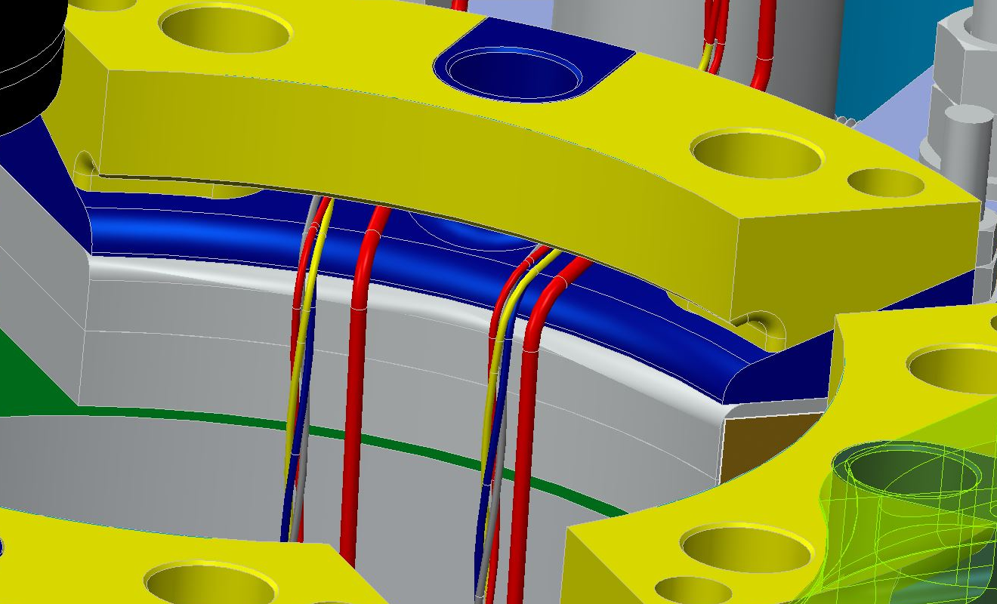
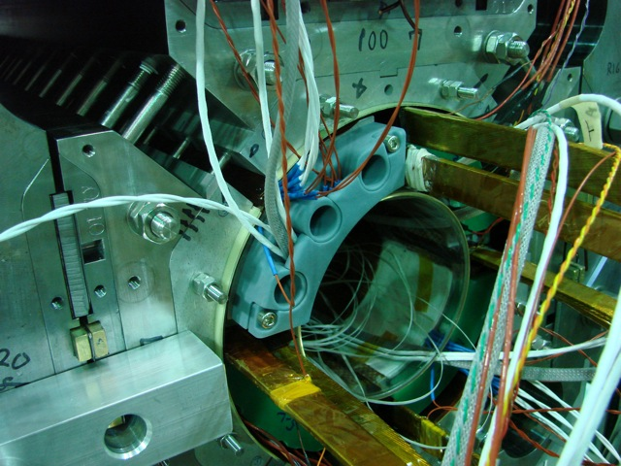
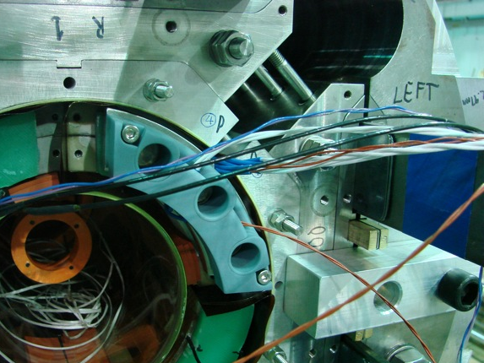
MQXFS1 Wire Routing
IL wiring is being routed under the axial end plates via SLA (Accura Bluestone) wire guides

Slide 8
Threaded holes in Collars
There are still some chips that are being generated by the screwing/unscrewing process of the aluminum collarpacks
Chips were vacuumed after bolting operations
Long magnet designs plan for Load Pad and Collar stacks to be preassembled, and only load pads would be bolted
CERN has already tested this option in the short model with promising results

Slide 9
Summary
Magnet assembly incorporated improvements
Redesigned coil support spud was used
Coil pack insertion rails were used successfully
Increased key thicknesses to reduce required shimming
Wire guides to protect and route instrumentation wires
Status
Axial loading should be completed this week
Electrical QA to follow
Pizza box fabrication has experienced some delays
Connector mounts & wiring and magnet support are in fabrication

Slide 10
Additional Slides

