Slide 1
QXF structure working group
Status on “MQXFS Assembly Test”
Preliminary results
08/20/2015
H. Felice, H. Pan,
D. Cheng, X. Wang
M. Reynolds, A. Pekedis, T. Lipton

Slide 2
Collar pack overview
Collarpack #1 with Fuji , 0.062”(incl. coil GPI) radial shim – no key shims
Collarpack #2 no Fuji, 0.060-61” (incl. coil GPI) radial shim – no key shims
  Incident during disassembly
Collarpack #3 with Fuji, 0.057”(incl. coil GPI) radial shim – no key shims
Collarpack #4 with 0.057” total radial shim + 0.017” keypole
  Keypole to collar gap ~ 0.0015” per side
  Decision to increase key shimming
Colalrpack #5 with 0.057” total radial shim + 0.018” keypole

Slide 3
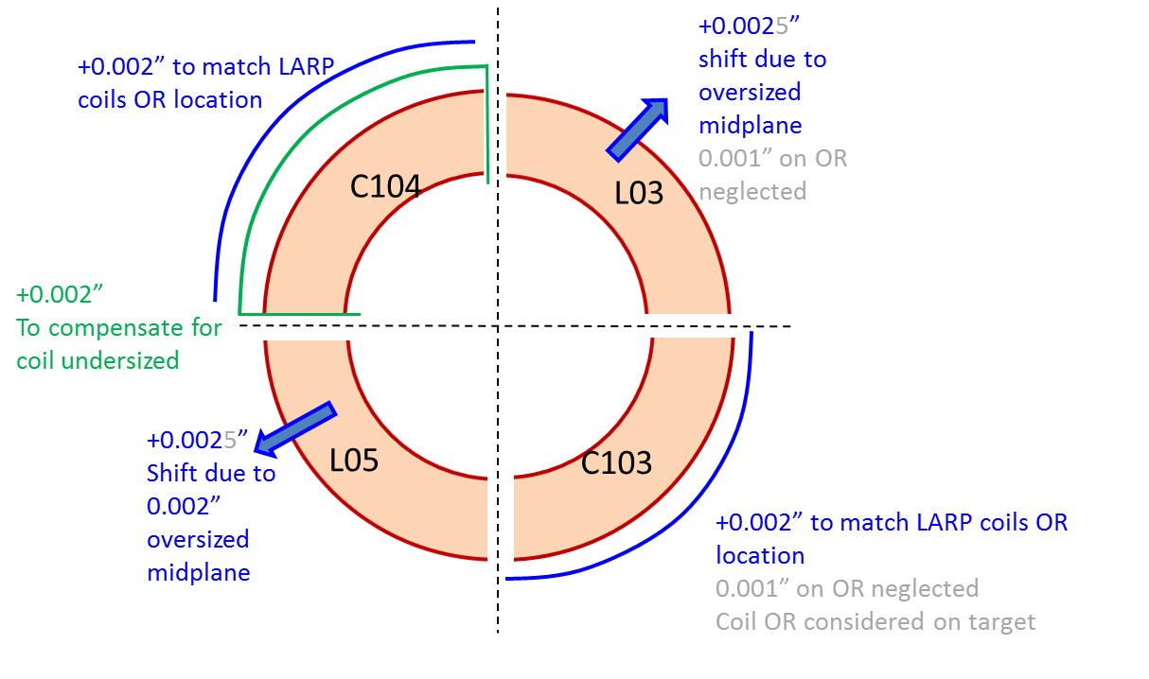
MQXFS – Assembly Test collar-pack #5 (final)
Final build for MQXFS assembly test
From coil OR to collar | L03 | C103 | L05 | C104
Kapton Ground plane insulation | 0.005” (0.125 mm)
Coil specific shim | 0 | 0.002” 0.050 mm | 0 | 0.004” 0.100 mm
Fuji paper (very low pressure) | N/A
G10 + Kapton | 5x0.009” + 0.002”+ 0.005”
Total radial shim including GPI: 0.052”+0.005”=0.057” (1.45 mm)
Coil alignment keys shimming: 0.018”per side = 0.013” on key (G10+kapton) + 0.005”from collar
Measurement showed gaps pole to collar closed

Slide 4
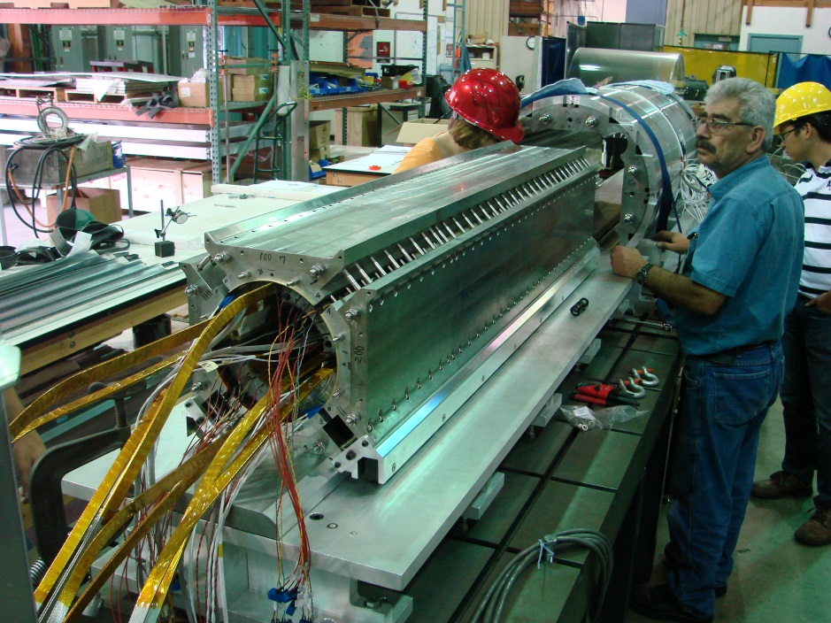
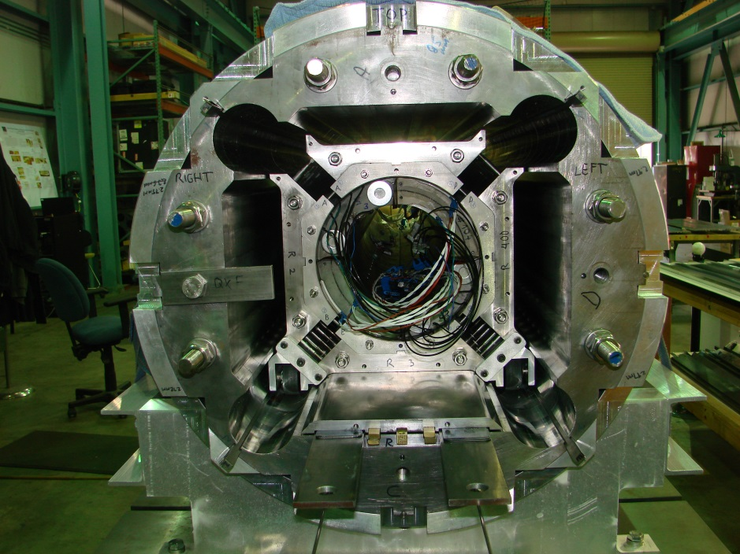
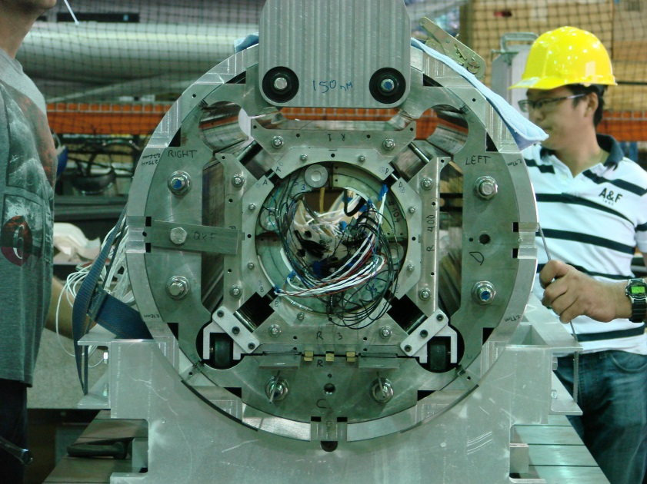
Coil pack insertion
See Dan’s slides for details

Slide 5
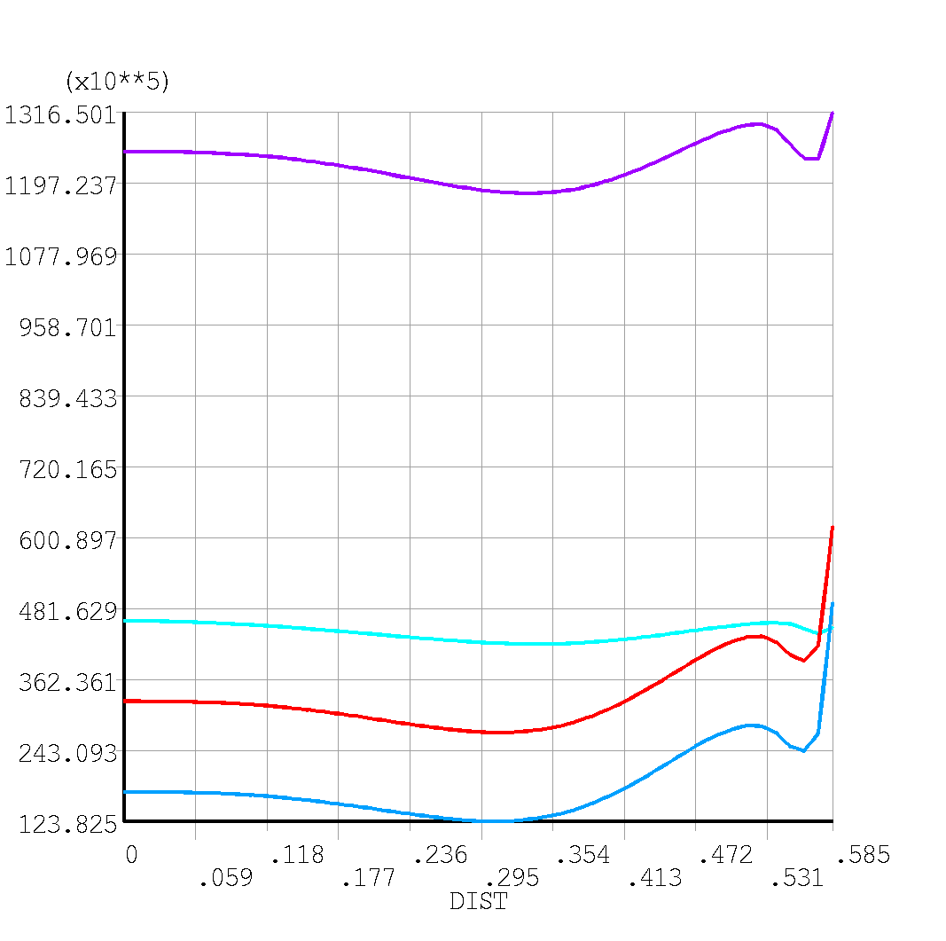
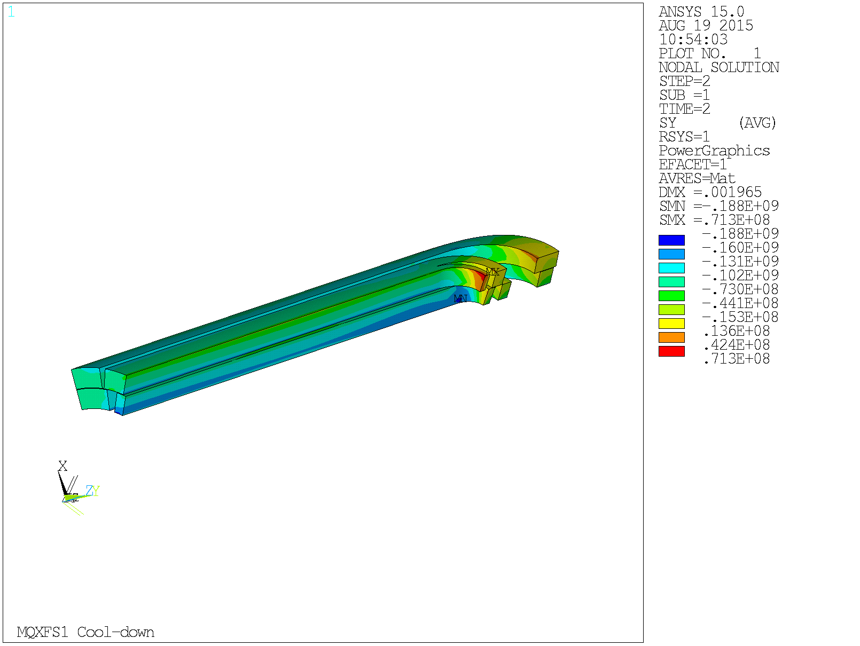
Assembly targets
3D target set up to have conservative stress distribution in the coil (~HQ02)
Interference in ANSYS: 475 μm
Contact pressure (Pa)
Azimuthal stress at cold
4.2 K
RT
130 T/m
140 T/m
Distance from center (m)

Slide 6
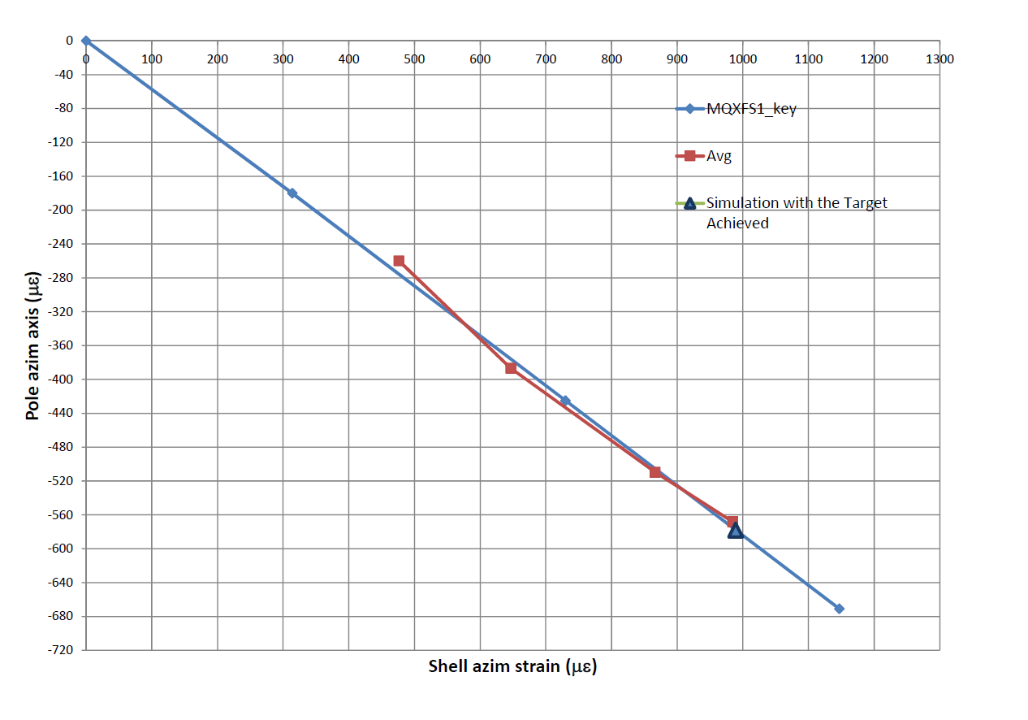
Average LARP strain gauge data
Preliminary results
Confirmation of pole to key contact

Slide 7
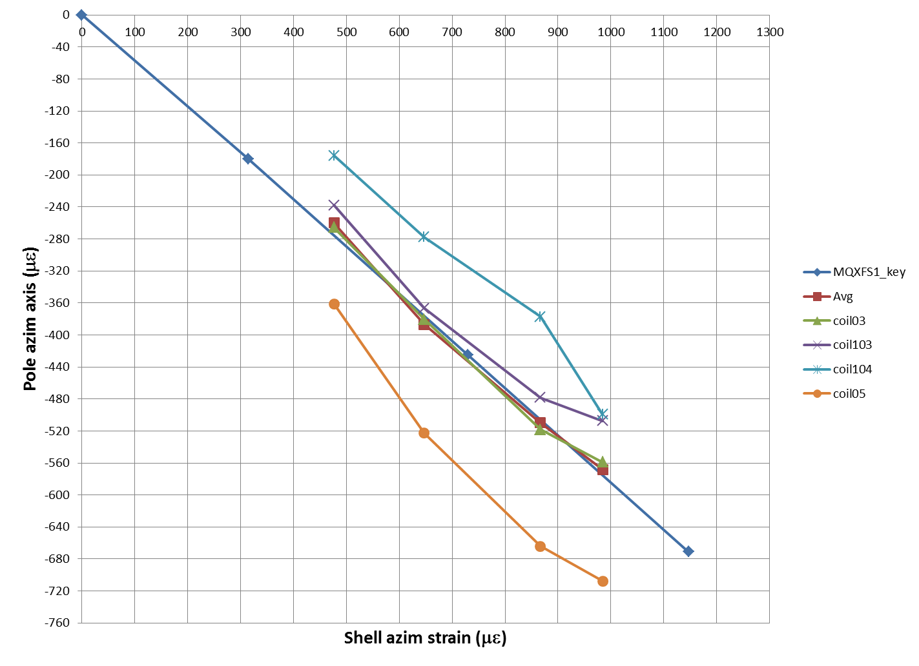
LARP strain gauge data
Preliminary results

Slide 8
Shell εθ versus time (LBNL SG data)
Load key shims:
Removal of 0.020”gap shims
50 mil
60 mil
63 mil
Gap keys tight
Some Gap keys tight
ANSYS bladder pressure
ANSYS - 474 μm
All bladders at 3500psi
24MPa
Bladder pressure by quadrant
All bladders at 1500psi
10 MPa
All bladders at 2000psi
14MPa
From 2500 psi to Max: 4200 psi (29MPa)

Slide 9
Shell εz versus time (LBNL SG data)
Ansys_pole_key, fr=0.3
Ansys_pole_key, fr=0.2

Slide 10
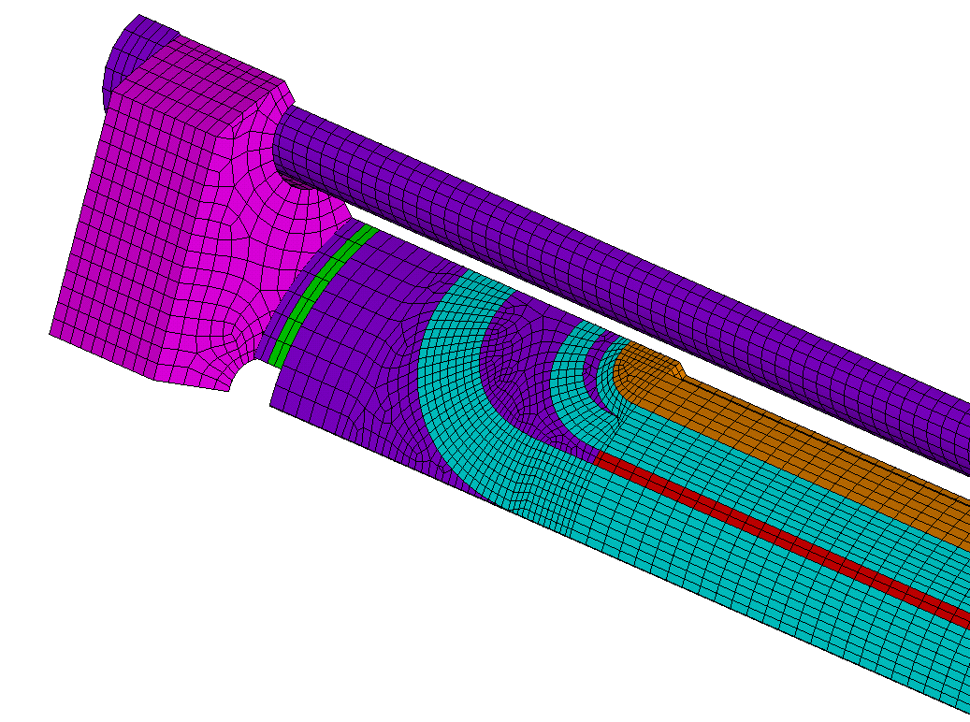
Axial preload Support
target
Gradient | F_{z} [MN]
130 T/m | 1.23
140 T/m | 1.37
Nitronic endplate
to SS pusher: sliding contact μ=0.2 with separation
Axial displacement imposed to the rod nodes at z=0 to simulate pre-tensioning of the rods
SS and G10 pushers to coil: bonded contact element
Coil components bonded
Rod Material | Rod force at RT | Rod force at 1.9 K | Rods σ_{z} at RT | Rods ε_{z} at 1.9 K | Rods σ_{z} at 1.9 K | TARGET RT
Alu 7075 | 0.2 MN | 0.58 MN | 58 MPa | 2110 με | 168 MPa | 819 με
Axial preload to be performed by the end of the week

