Slide 1
MQXFS Mechanical Interfaces And Shipping
Dan Cheng, Ray Hafalia
8/20/2015

Slide 2
Outline
Magnet Packaging envelope & interfaces
Shipping interfaces proposals

Slide 3
MQXFS Assembly

Slide 4
MQXFS Assembly Length Requirements
2158 mm
428 mm
355 mm*
~150 mm
180 mm
* Extended lead length due to CERN coils being produced with 375 mm long copper stabilizers instead of 2nd NbTi cable

Slide 5
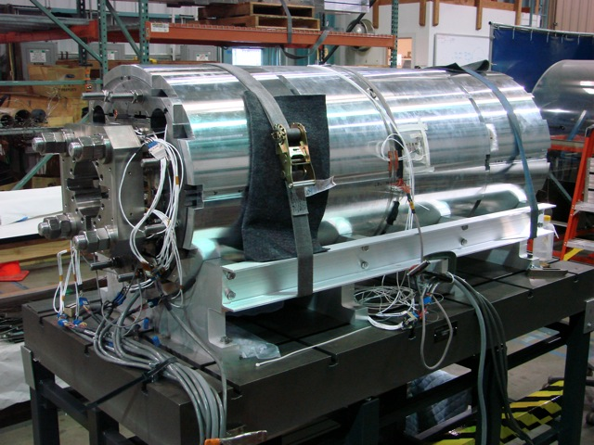
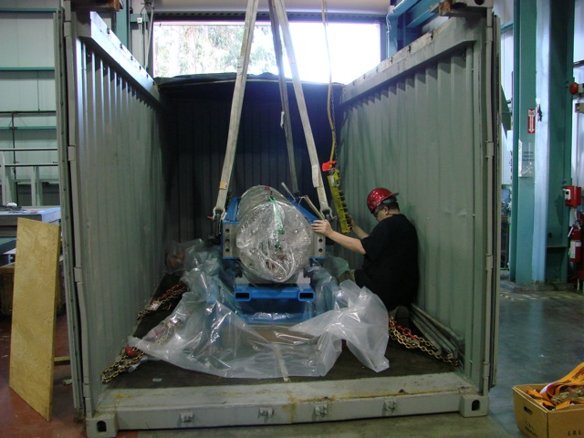
MQXFS1 Shipping
We are exploring the shipping of MQXFS1 in the LQS shipping container
Isolated load frame already exists
Adapter plates would be necessary to mount a shorter magnet

Slide 6
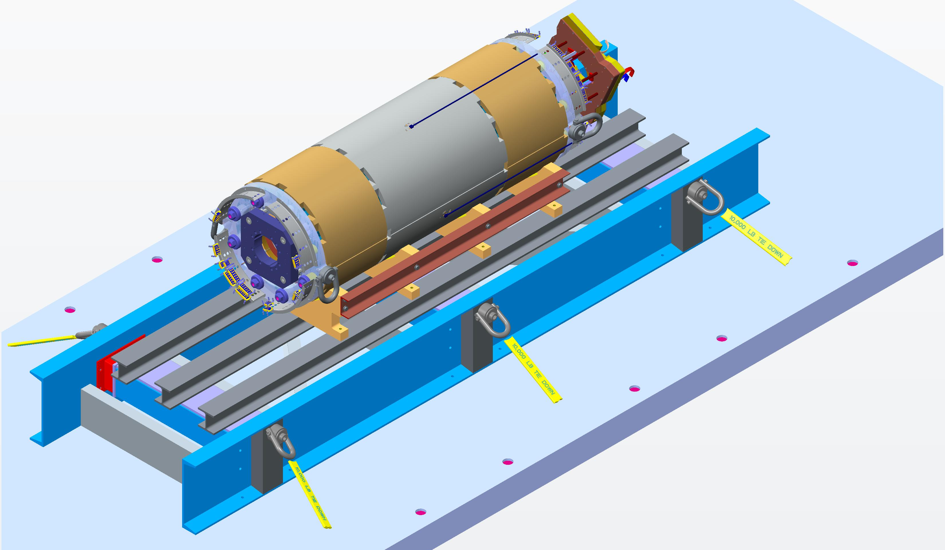
MQXFS1 Shipping & Handling
We are exploring the shipping of MQXFS1 in the LQS shipping container
Magnet and support cradles would be mounted to an adapter plate structure
Four lifting swivels (two per end) can be used to handle the magnet and/or for lifting and tilting with two hooks

Slide 7
MQXFS1 Shipping & Handling
A second option for tilting
A pedestal for pivoting the magnet could also be incorporated if two hooks are not available, and no other horizontal preparations are required once received at FNAL

Slide 8
MQXFS1 Status
Pizza box connection box is currently in fabrication
Experienced delays in production
Wiring & Connectors
Support rings & connector skirts are in fabrication
Connector and wiring bundles have been defined

Slide 9
Additional Slides

Slide 10
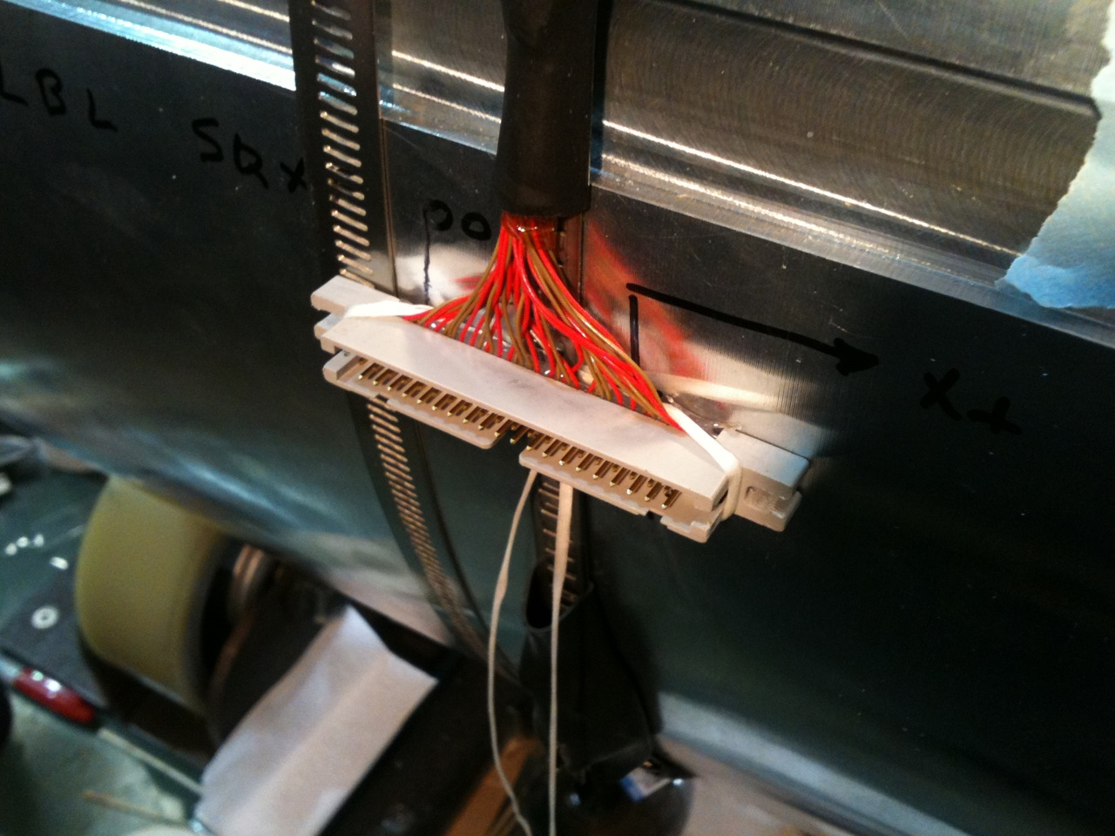
MQXFS Assembly Diameter requirements
647 mm
Guide Plate*
614 mm Dia. shell
Connector can be oriented to line up with one of the 647 mm diameter lobes
CERN-style shell SG connector on OD of shell, approximately ~15 mm proud in one location

Slide 11
*LQ Test Configuration
Tri-lobed 647 mm dia. Guide Plate was used in the LQ tests

Slide 12
MQXFS Assembly Support Interface
Typical ¾-10 tapped 4-hole pattern support interface

Slide 13
MQXFS Connection Box Design
Splices (and CLIQ leads) will be made in two layers
CLIQ leads (max. 3)
Full-size cables shown
Current leads

Slide 14
MQXFS Wire Routing
All IL wires will pass thru wire guides underneath the axial endplates

Slide 15
MQXFS Wire Routing
All wires will terminate in Hypertronics connectors on LE of magnet
Wires from RE will be routed through wire guides in 1 or 2 cooling holes

