Slide 1
LQS Shipping Analysis
& Future Plans
Carlo Santini

Slide 2

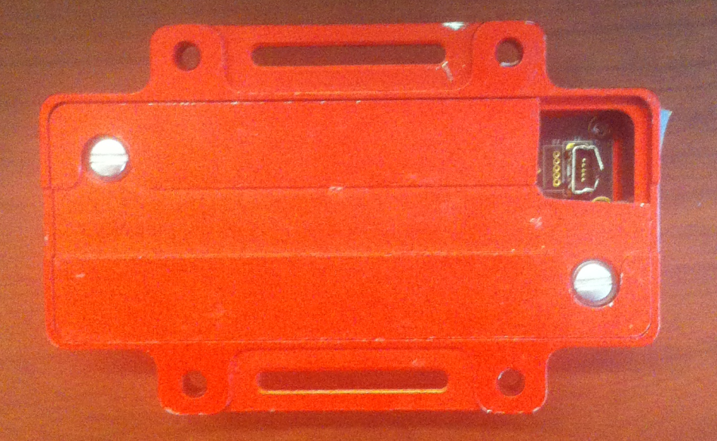
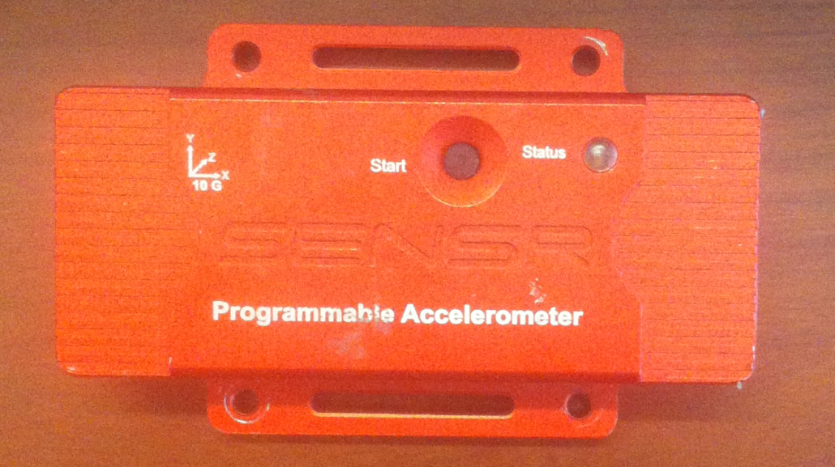
Accelerometers
Sensr GP1 Programmable Accelerometer
100 samples per second
MEASURED QUANTITIES SETTING & STORAGE
a_{x}, a_{y}, a_{z}
Every period (60 s) the accelerator records max, min and mean values (Data Records)
If a value excedes a threshold (2g), the accelerometer saves data from 0.25 seconds before to 0.5 seconds after the EVENT (Event Records)
[g]
|a|, a/|a|
T [K]
t [date]

Slide 3
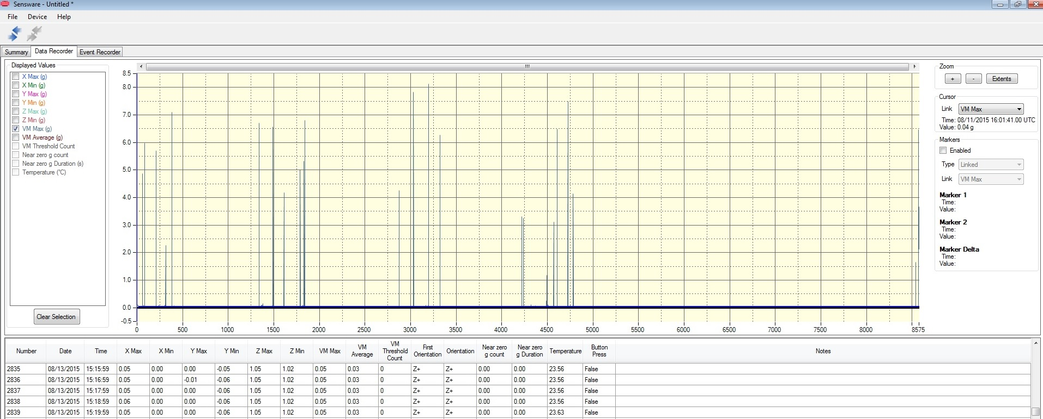
Example: Data Records
Data Records:
The max, min and mean values every period (60 s)

Slide 4
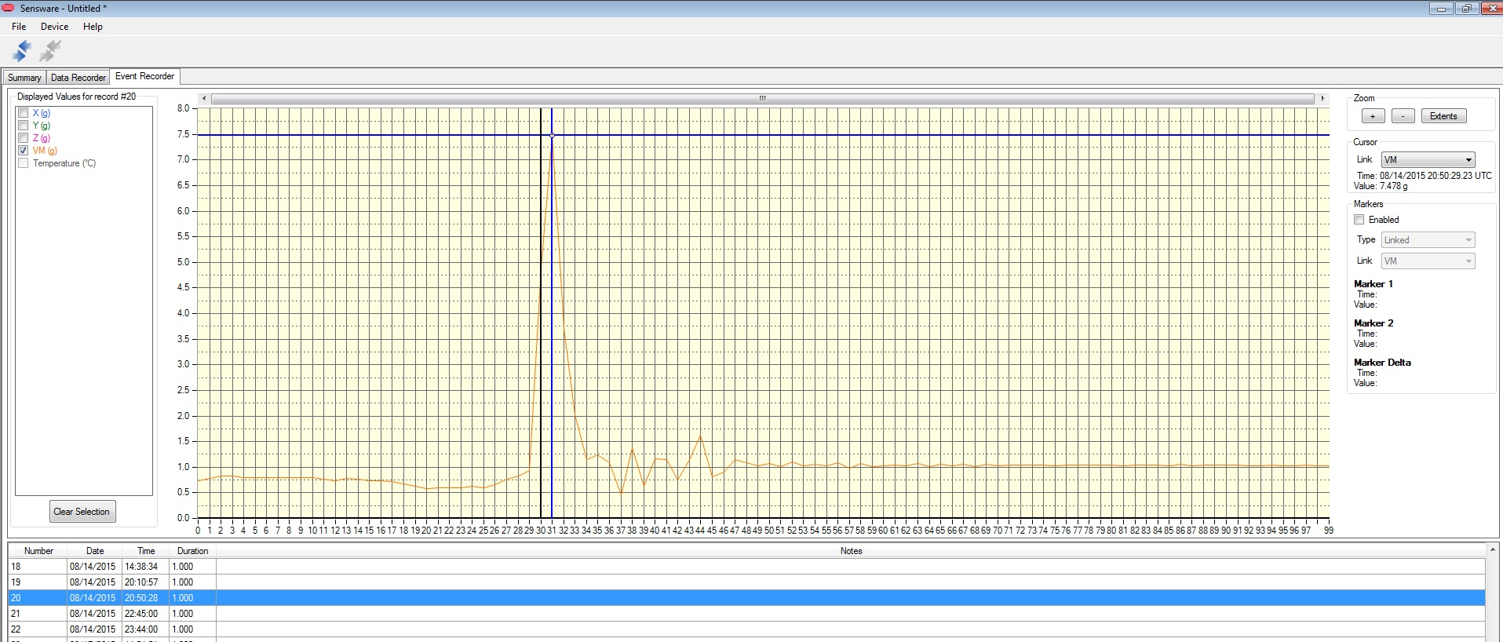
Example: Event Records
Event Records:
a_{x}, a_{y}, a_{z},|a| trends during each Event.

Slide 5
Trips Analyzed
LQS01: LBNL to FNAL, IB3 to IB1
LQS01b: LBNL to FNAL, IB3 to IB1, IB1 to IB3, FNAL to LBNL
LQS02: LBNL to FNAL
LQS03: FNAL to LBNL

Slide 6
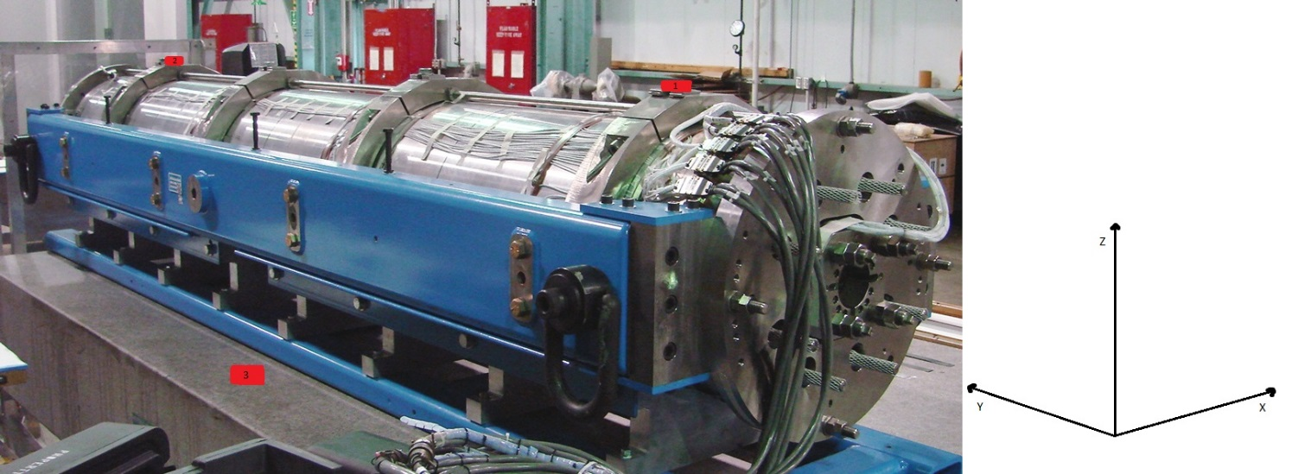

LQS01
From LBNL to FNAL
09/10/09 – 09/15/09
From IB3 to IB1
10/29/09 – 10/30/09

Slide 7
LBNL-FNAL
09/10/09 – 09/15/09
Sensor 3 (Truck)
Sensor 1 (Magnet)
Sensor 2 (Magnet)
EVENT
09/11/09 13:36:59
Δa_{x} = -1.779g
Δa_{y} = 1.447g
Δa_{z} = -4.648g
NO EVENT
9/11/09 13:36:00-13:37:00
NO EVENT
9/11/09 13:36:45-13:37:45
|Δa|= 5.183g
Max |Δa|= 0.53g
Max |Δa|= 0.90g
Very high acceleration magnitude
but
The shock absorbers worked very well

Slide 8
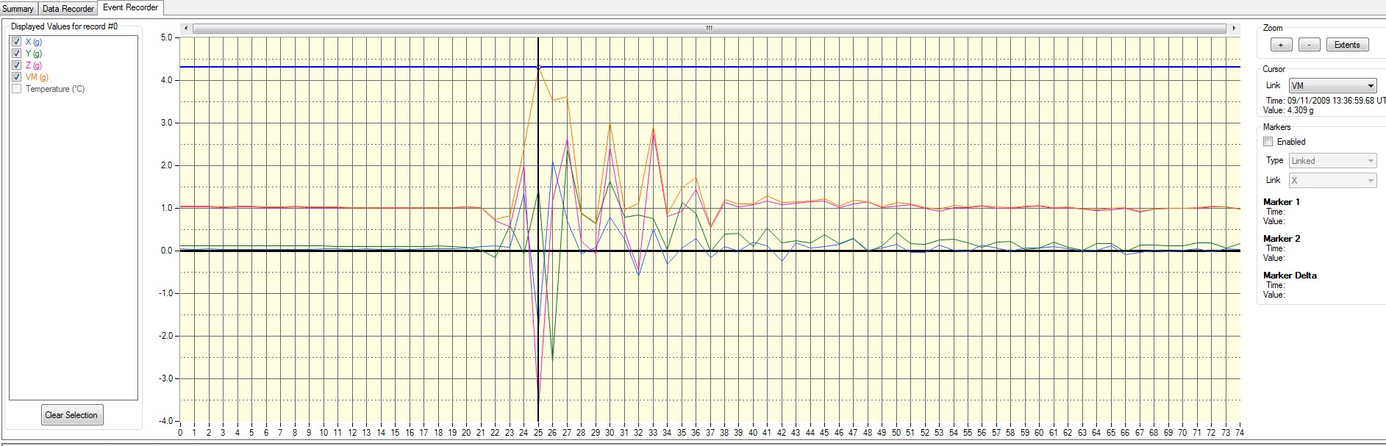
Event Record

Slide 9
IB3-IB1
10/29/09 – 10/30/09
There were only one EVENT above the threshold
Sensor 1 (Magnet)
Sensor 2 (Magnet)
EVENT
10/30/09 13:38:50
Δa_{x} = 1.177g
Δa_{y} = 0.112g
Δa_{z} = 2.193g
EVENT
10/30/09 13:38:25
Δa_{x} = 1.381g
Δa_{y} = -1.696g
Δa_{z} = 2.153g
|Δa|= 2.491g
|Δa|= 3.069g
Slightly above the threshold

Slide 10
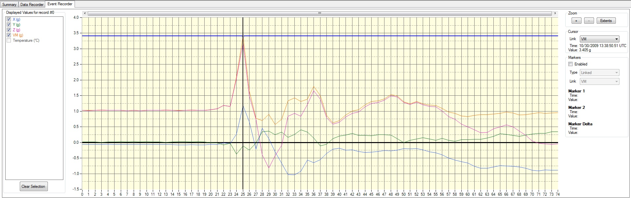
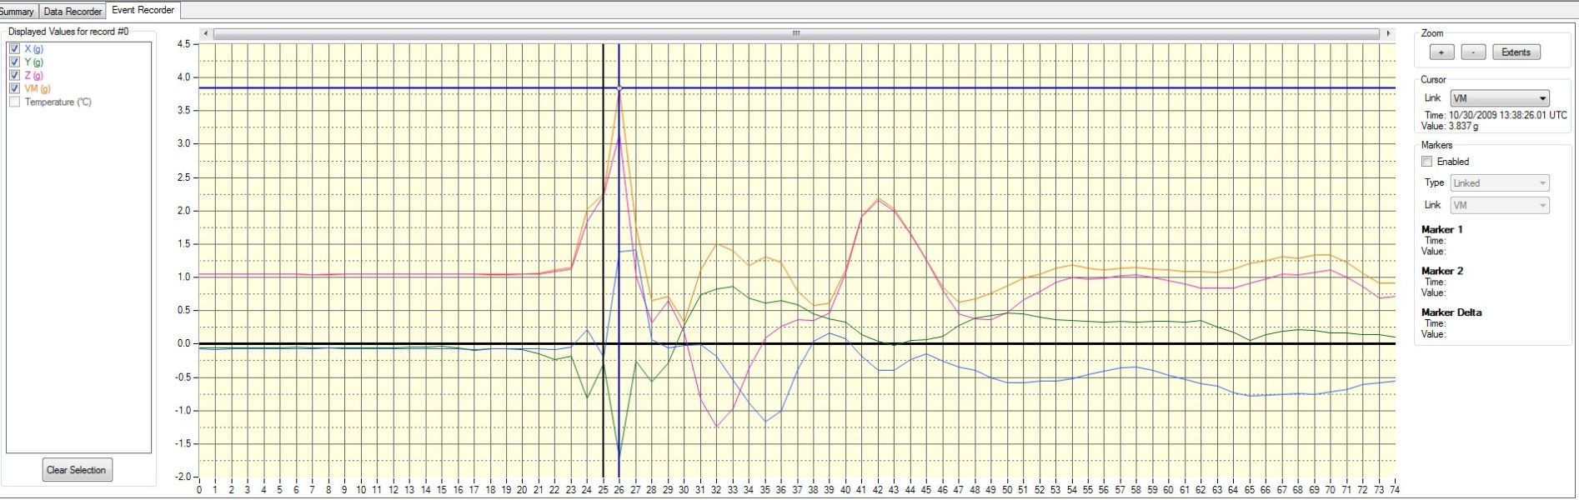
Event Record
Sensor
1
Sensor
2

Slide 11
Conclusions
Shock Absorbers worked well.
There are data from 8 different trips of 4 different magnets (LQS01, LQS01b, LQS02, LQS03).
The only significant EVENT above the threshold did not cause adverse effects.

Slide 12
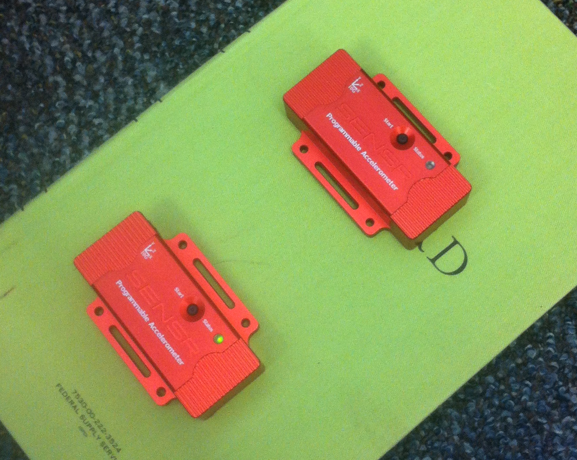
Future (Now)
Two accelerometers will be installed in the QXFS#6’s shipping crate:
one anchored to the coil support (shocks absorbed).
one anchored to the external crate.

Slide 13
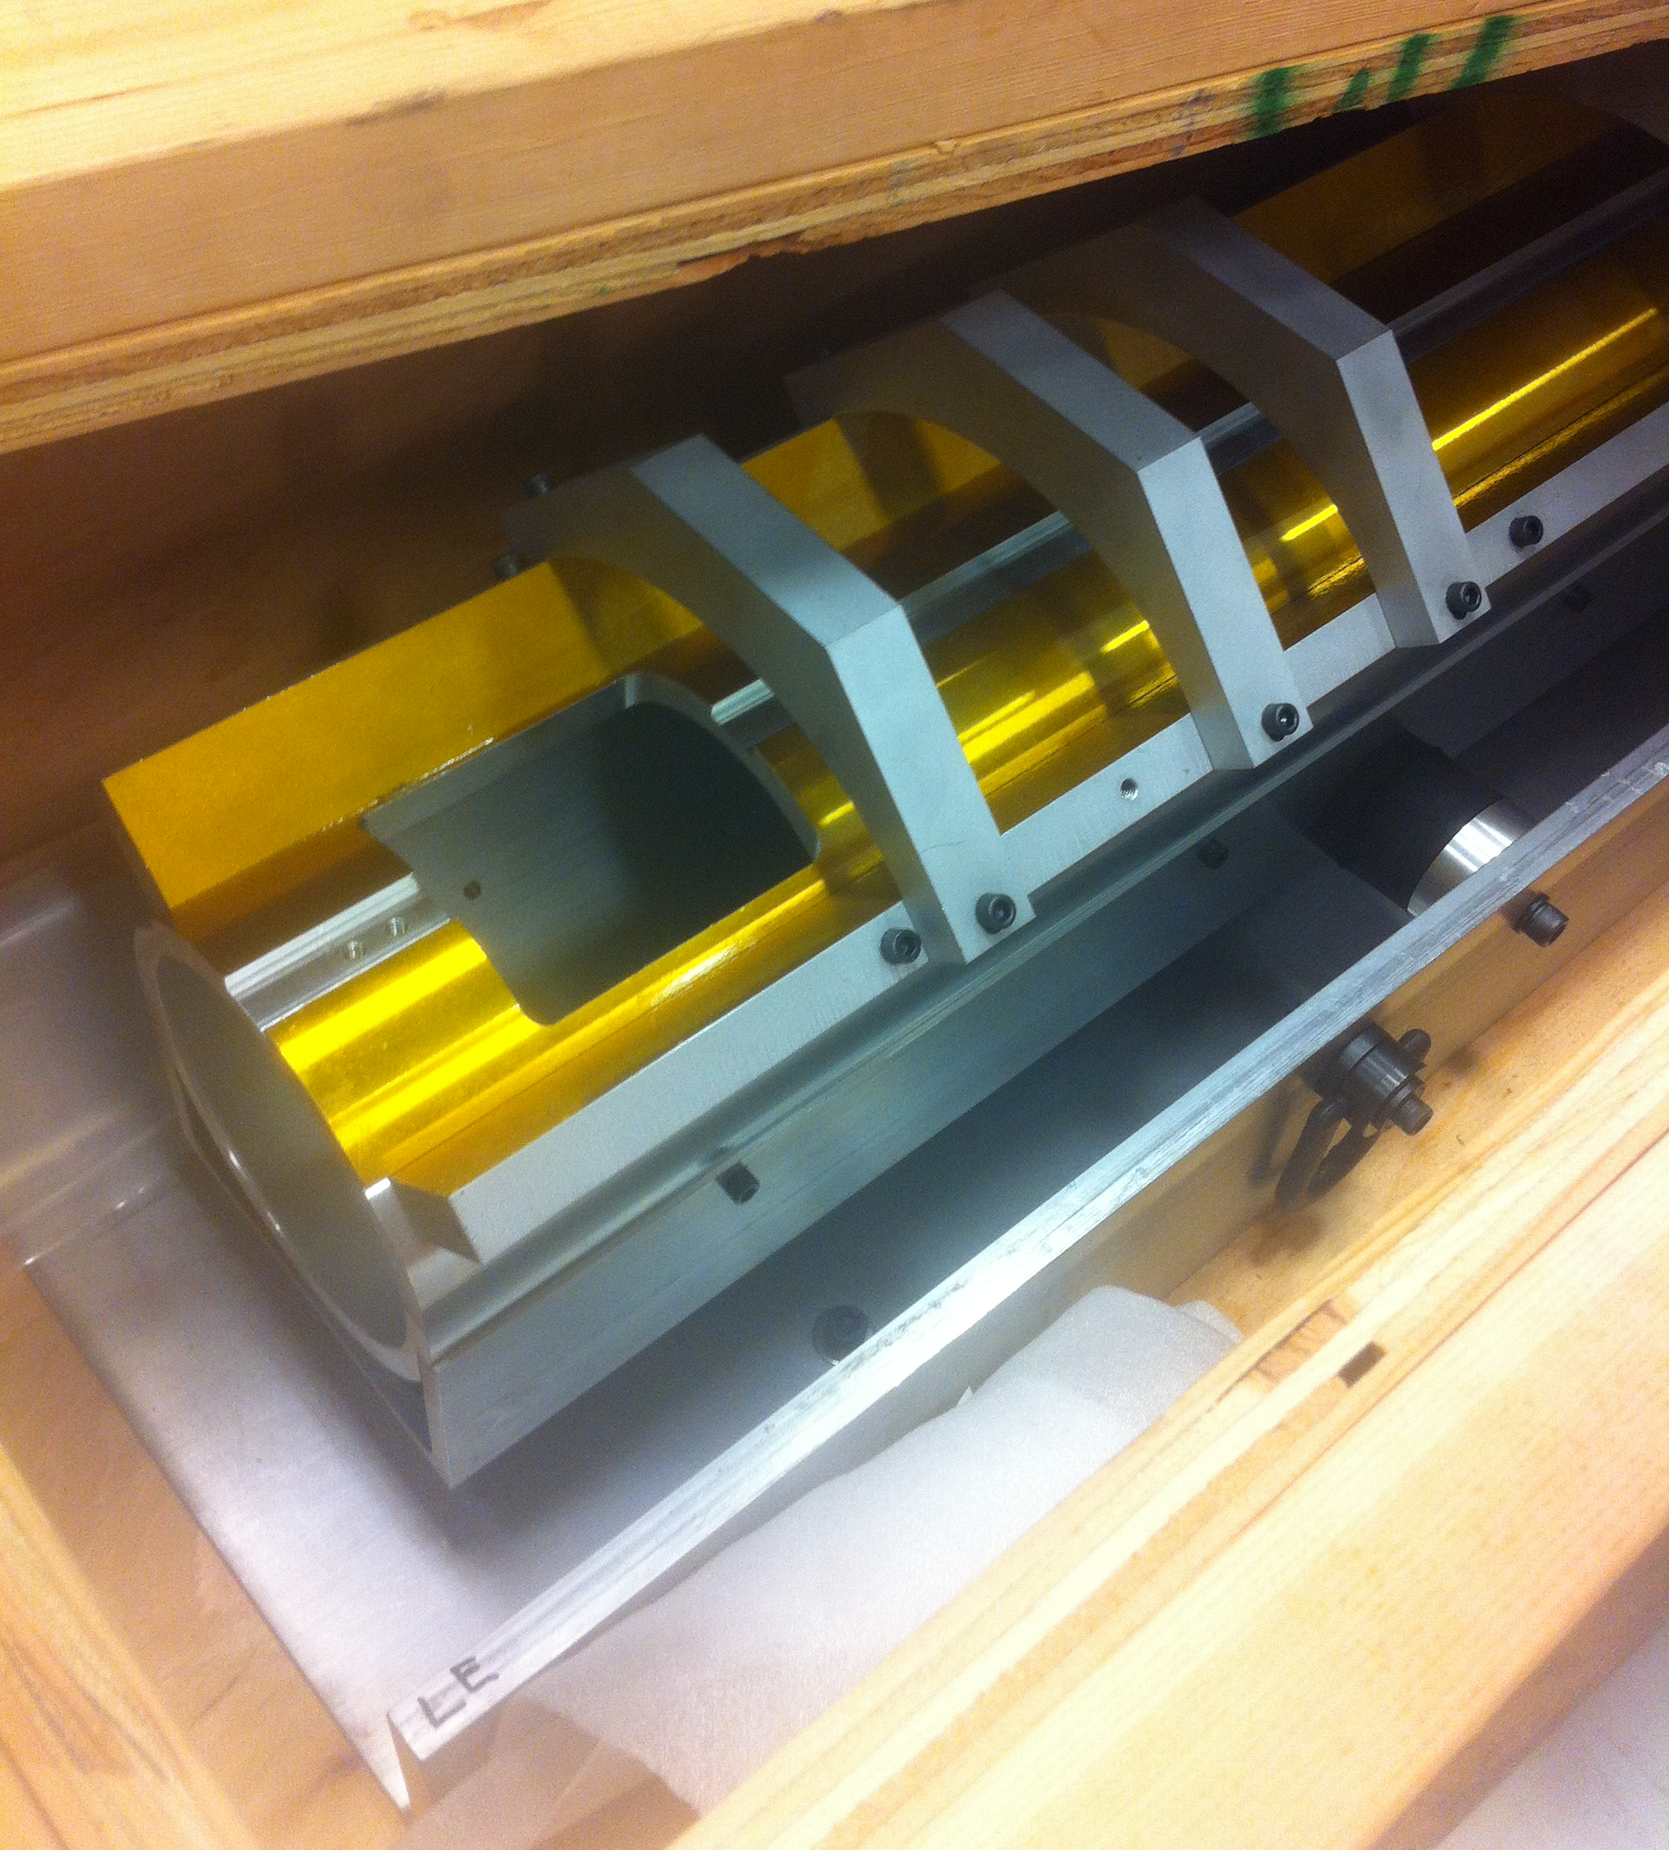
Coil Support

Slide 14
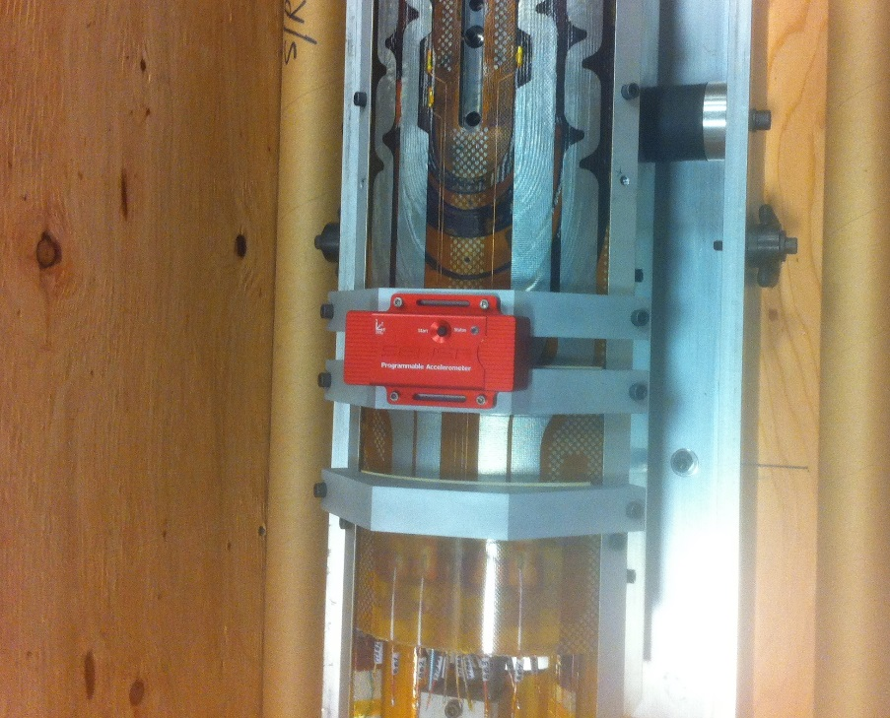
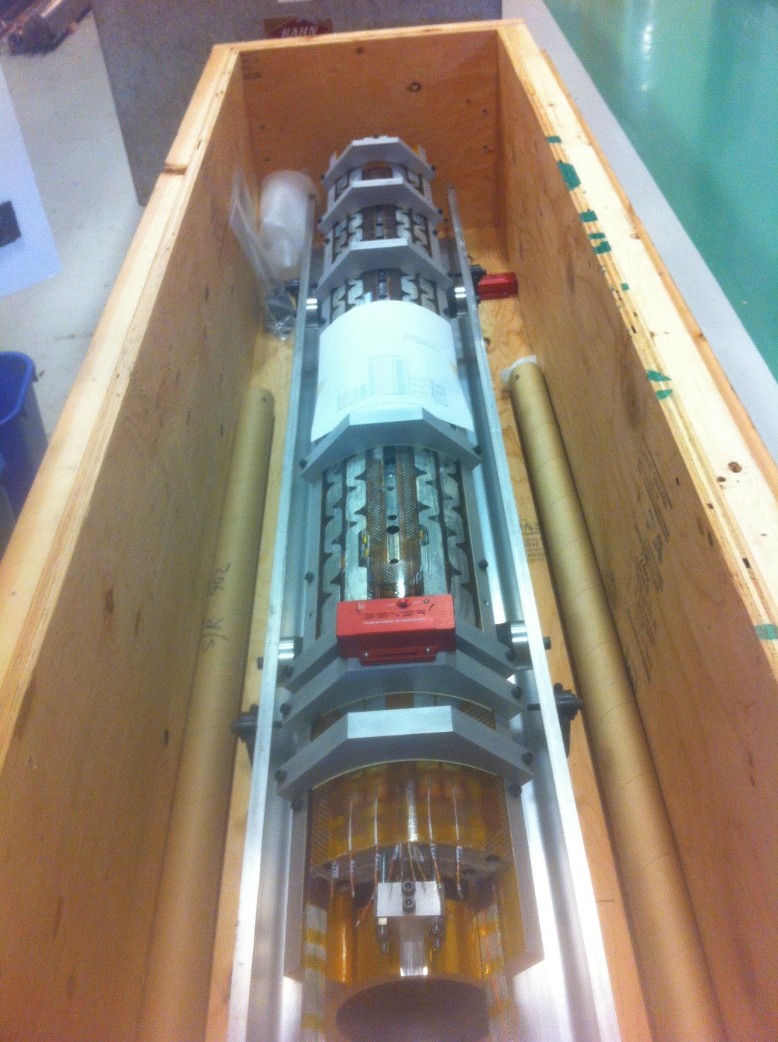
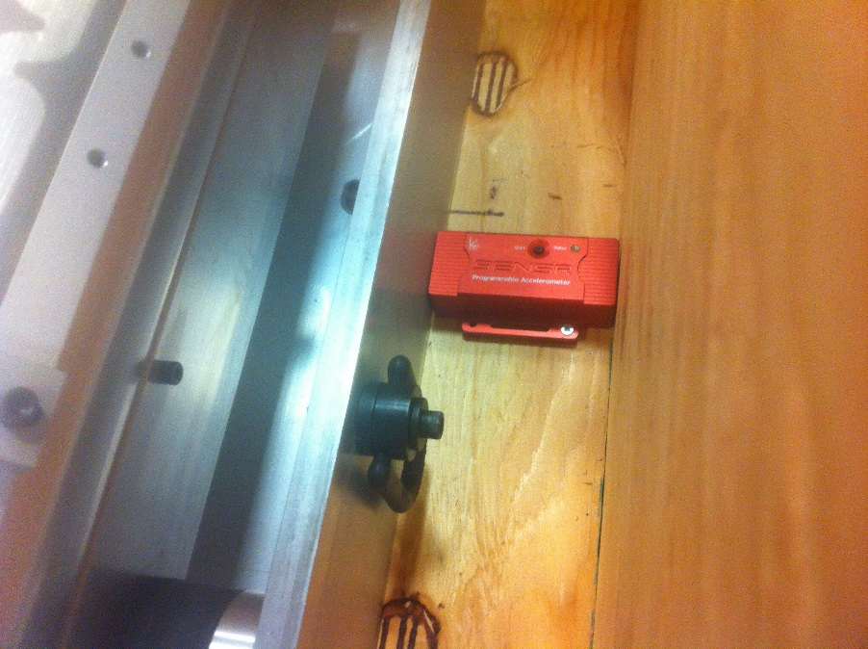
Coil Ready for Shipping

Slide 15
Trucks Shipping
QXFS#6
MQXFS#1
LTL Shipping
(Less than TruckLoad)
FTL Shipping
(Full TruckLoad)
Packages are unloaded and re-loaded multiple times during transit.
Cheap (100-200$).
Slower (5-6 days to Berkley)
Shipment stays in the same truck from point A to point B
Expensive (>1000$)
Faster (3-4 days to Berkley)

