Slide 1
Muon Department Meeting
Jerry Annala
Off Project Activities
20 August 2015

Slide 2
Announcements
Late congratulations to Vladimir for promotion to Scientist II
Guest Scientist starting soon
No Power Next Thursday in BWT Tunnel work day
Review schedule – next step should be near end of September
Target Station Dept Engineers moving to BWT
  Possible need to double up offices
  Building up to six offices downstairs
  Will need to reorganize downstairs

Slide 3
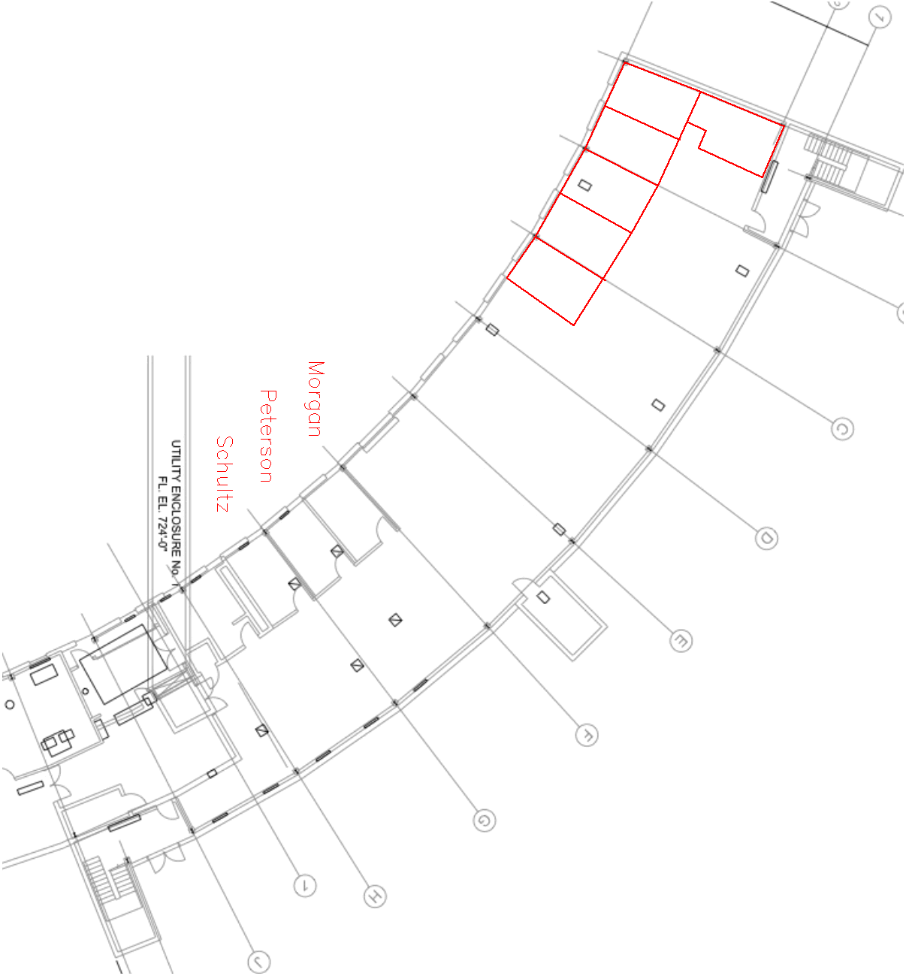
Plan to add six offices downstairs

Slide 4
Non Project Activities
Looking for what topics each of you can contribute to
Looking for the topics that I haven’t listed or thought of
Looking for volunteers to coordinate topics
Need to have all of this work organized and documented

Slide 5
Allocation of time toward operations next year
 | Fraction of time allocated to operations
Jerry Annala | 23%
Jim Budlong | 32%
Brian Drendel | 8%
TonyLeveling | 35%
Jim Morgan | 31%
Vladimir Nagaslaev | 20%
Al Sondgeroth | 80%
Dean Still | 18%
Dave VanderMeulen | 33%
Steve Werkema | 27%

Slide 6
Non Project activities
Controls
  Application software
  Database entries
  Alarm lists
  Datalogger lists
Call in lists
Reviews and approvals
  ORC
  SAAD
  Shielding Assessment

Slide 7
Non Project activities
Departmental Procedures
Commissioning Plans and Documentation
Labeling of hardware
  Magnets
  Power Supplies
  Transformers
  LOTO points
  Etc.
Interlock lists
Lockout lists
Other safety (getting chipmunks, gates, lock cores etc. back to normal configuration).

Slide 8
Non Project activities
Timer (required hardware, triggers, settings, etc.)
  Reference Drawings
  Magnet circuits
  Utility drawings
Conventions
  Polarity
  Naming/numbering
  Beam Accounting
Cable mitigation

