Slide 1
QXFP Winding and Curing
Miao Yu
08/24/2015

Slide 2
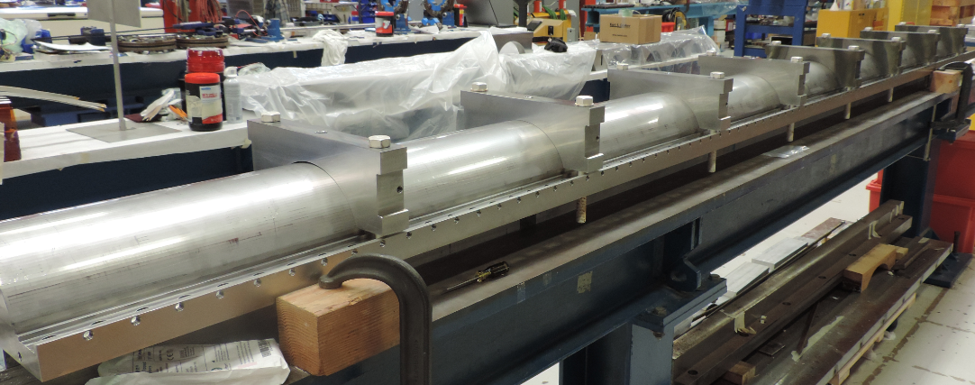
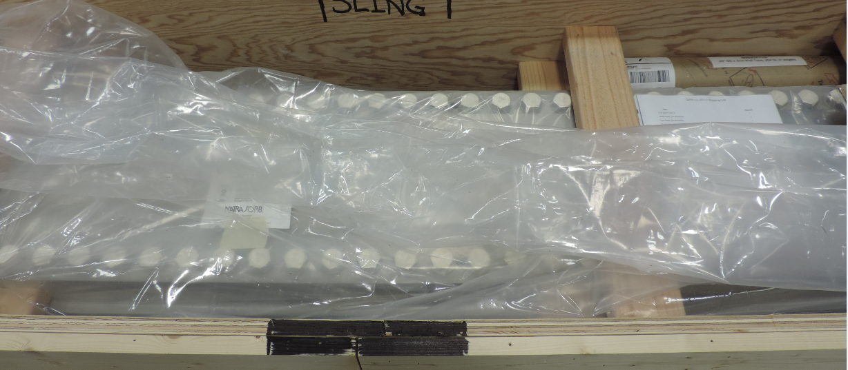
QXFP 01 Ship to BNL

Slide 3
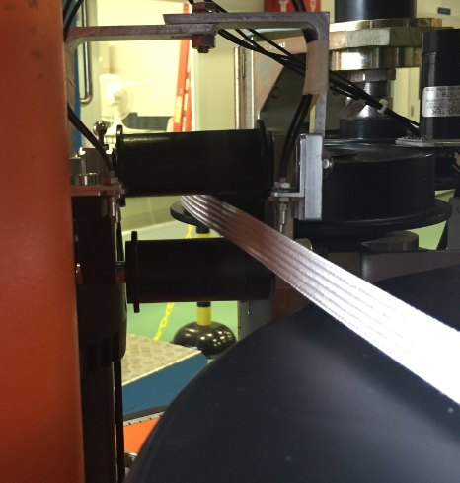
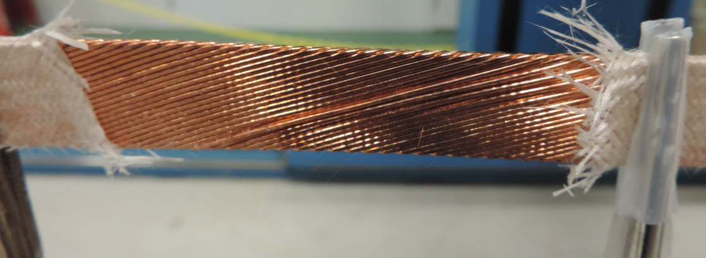
L2 popped strands
On turn 8, 69" - 79“ from lead end NT, the cable roped.
The cable coming from the spool touching the roller (hard way bending).
Fixed the popped strands without removing insulation until the middle 4” section.
Fixed the cable location sensor.

Slide 4
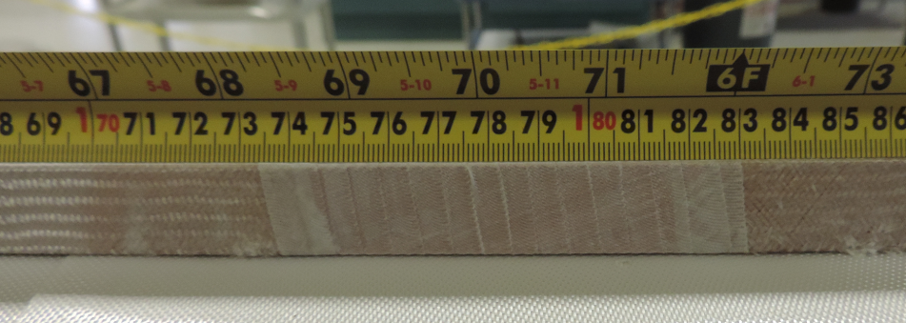
Remove insulation and fixed the popped strands
Wrapped with 3 mil E-glass, 50% overlap
Paint the binder and cured.
It is in the straight section, ~1.8 m from LE

Slide 5
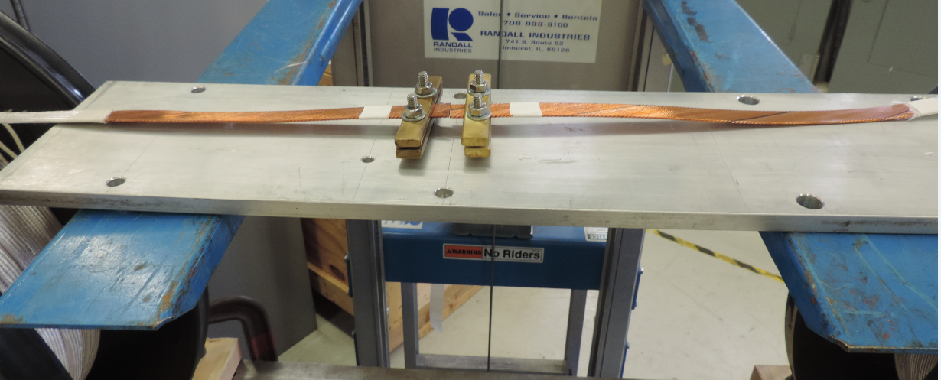
QXFP 01b – practice coil Cable
Three spools of cable welded into one full spool

Slide 6
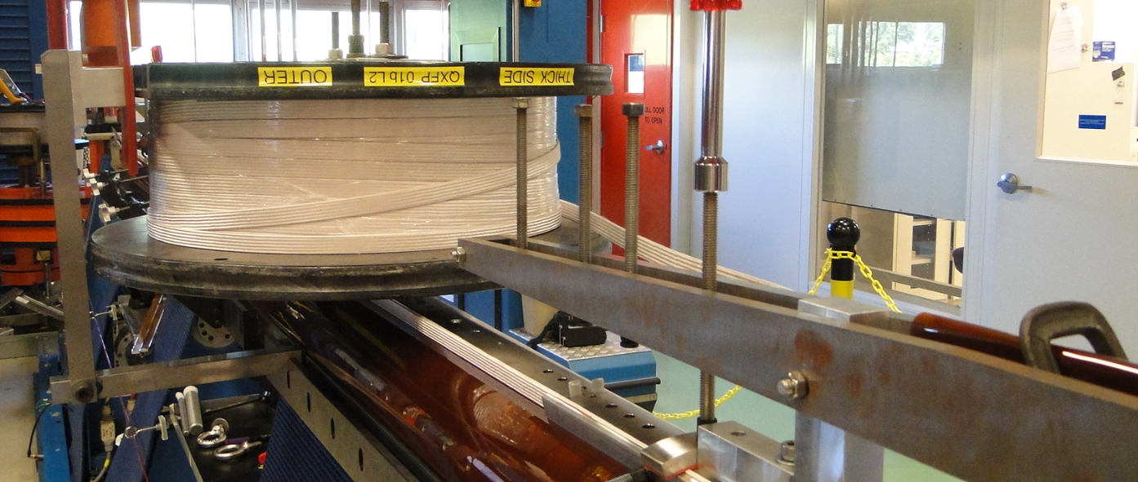
L1 Winding
No popped strands
L2 spool was mounted on top of the coil, rotating together with the winding mandrel

Slide 7
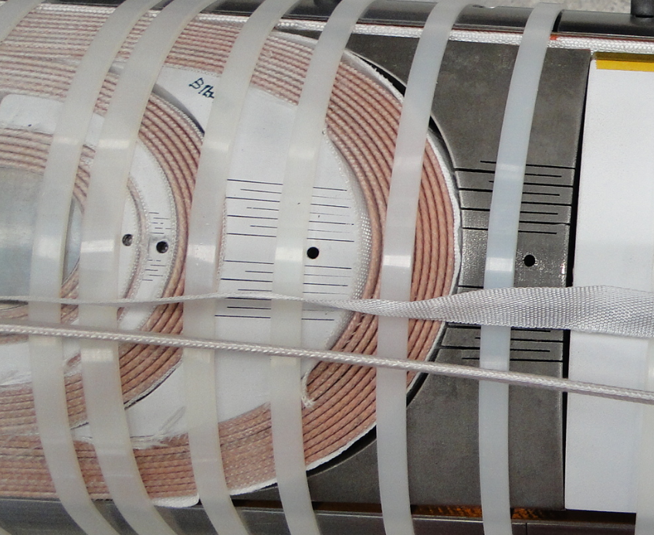
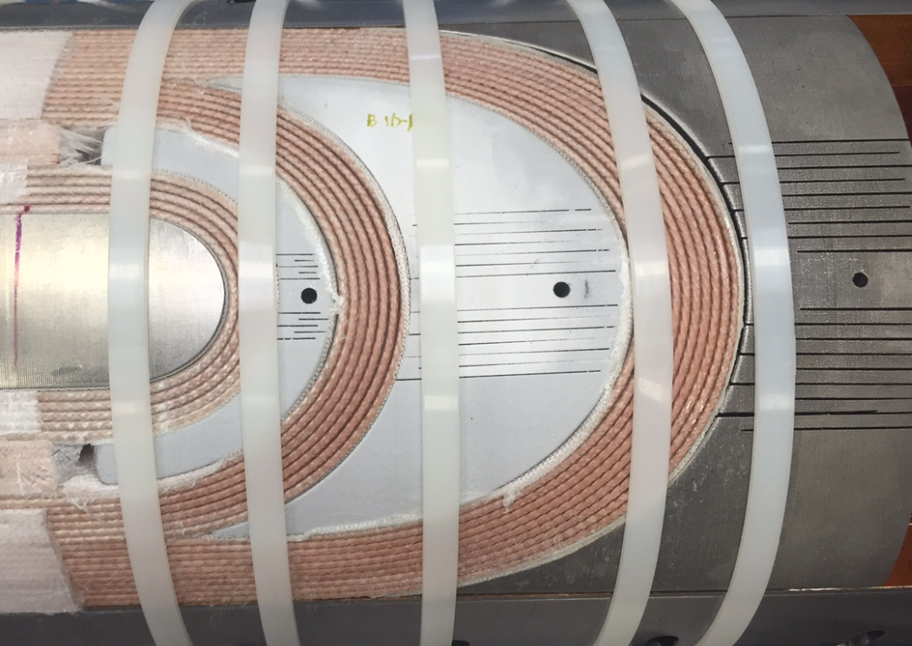
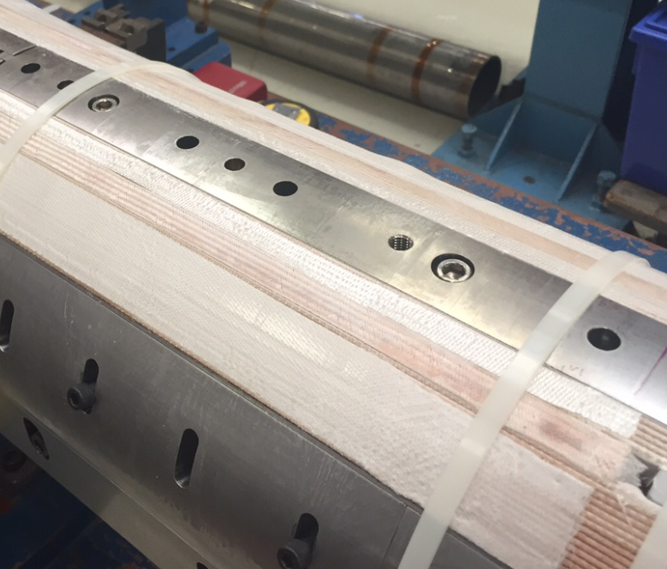
L1 Curing
Before
After

Slide 8
Schedule on QXFP
Finish QXFP 01b W&C on Sep. 08

Slide 9
Schedule on QXFS v2
QXFS 07 will start on Sep. 28

