Slide 1
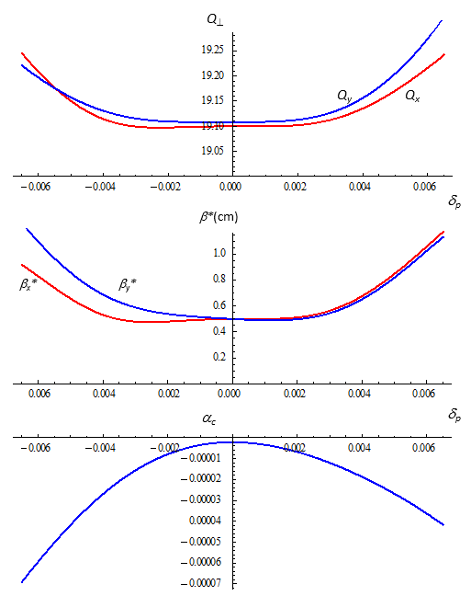
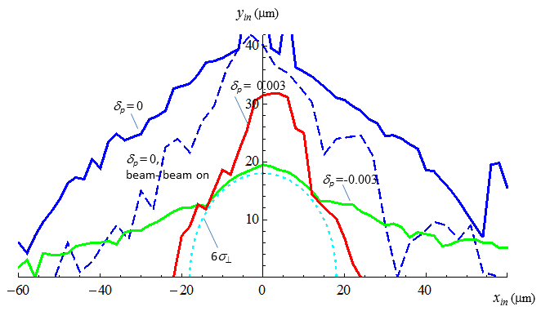
Upgrade of the 3 TeV MC Lattice Design
Tunes moved to slightly above integer to improve Dynamic Aperture (albeit it would not be particularly good for the closed orbit in the presence of misalignments)
2048 turns dynamic aperture in the plane of initial particle coordinates at IP x_{in}, y_{in} for indicated values of constant δ_{p} calculated with beam-beam interaction off (solid lines) and on (dashed line) using MADX PTC_TRACK routine and MAD8 TRACK LIE4 option respectively.
With beam-beam on β*≈3mm so that σ⊥*≈2.3μm.
Still, the OFF-momentum DA is barely sufficient – further work is desirable.
Bare lattice parameters vs. δ_{p} . Accidentally α_{c}(0)= -2.15⋅10⁻⁶ (was shooting for a higher absolute value)
Muon Collider Design – Y.Alexahin, MAP Meeting 08/28/2015 1

Slide 2
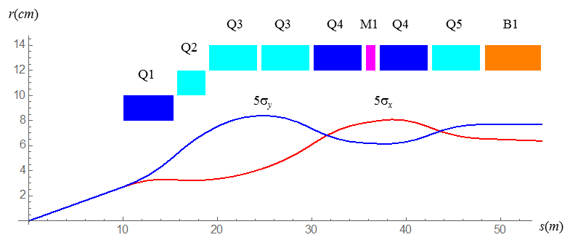
Preliminary Design of the 6 TeV MC FF Multiplet
The design goals: β*=3mm, d*=10m, B_{dipole} > 3T to sweep charged secondaries and spread ν’s
Constraints: B_{tip} < 16T in quads, magnet bore IR > 5σ⊥^{(max)}+ 3cm (guarantees good field quality in the beam region), magnet length < 6m to insert masks
β_{x}^{(max)} = 296km β_{y}^{(max)} = 319km
Parameter | Q1 | Q2 | Q3 | Q4 | Q5
ID (mm) | 160 | 200 | 240 | 240 | 240
G (T/m) | 200 | -125 | -100 | 103 | -78
B_{dipole} (T) | 0 | 3.5 | 4.0 | 3.0 | 6.0
L (m) | 5.3 | 3.0 | 5.1 | 5.1 | 5.1
Magnet apertures are ~1/2 those in the Higgs Factory while the field is only 60% higher – must be doable!
Muon Collider Design – Y.Alexahin, MAP Meeting 08/28/2015 2

