Slide 1

The MICE RF System
K Ronald, University of Strathclyde
For the MICE RF team

Slide 2
Content
The MICE experiment
  Outline of the key features of the apparatus
    Role of and requirements for the RF system
MICE RF Cavities
  Summary of key features
  Brief statement of status
RF drive system
  Review of RF drive systems- key components
  RF and modulator systems
  LLRF will be addressed by Andy Moss
Distribution network
  Review of simplified ‘over the top’ configuration
Muon-RF phase determination
  Requirements and proposed solution

Slide 3
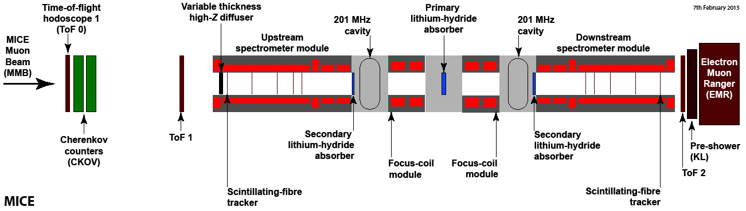
MICE Experiment
MICE will demonstrate the reduction of the emittance of a muon beam
  Transit of muons through low Z absorbers
    One primary LiH absorber and two secondary absorbers
      Secondary absorbers provide some cooling
      Primarily present to protect detectors
  Partial restoration of translational momentum by RF cavities
  Measurement of the emittance both upstream and downstream
    By scintillating fibre trackers in strong 4 T solenoid fields
    Each particle measured separately
    Particle flux is completely asynchronous

Slide 4
MICE High Power RF systems
MICE HPRF system requirements have changed
  Only two cavities, no coupling coil
  Two cavities bracketed by two thin LiH absorbers, sandwiching main absorber
  Required operational date on the beamline is Summer 2017
    Potential to pre-commission hardware: Starting Aug 2016
    Exploit proposal for the RF cavities modules delivered UK Spring 2016
  Enables demonstration of ionisation cooling with re-acceleration
  First results complete before end US fiscal year 2017

Slide 5
MICE RF system: Accelerating gradient
2MW peak output from RF drive amplifiers BUT assume
  LLRF ~10 % overhead to achieve regulation
  Estimated <10 % reduction in operating into transmission line and reactive load
  Power delivered to each cavity 1.62 MW
Cavity 1
Cavity 2
  Each cavity fed from two couplers
    Output from each amplifier split in 90º hybrids
    Line lengths balance 90º phase shifts
  Anticipated gradient in each cavity 10.3 MV/m
    Slight uplift in gradient from 7.2 MV/m in each ‘STEP V’ cavity
    Cavity Q and shunt impedance from simulation
Beamline
HPRF
HPRF
RF Amp 1
RF Amp 2
LLRF Feedback
RF Drive
RF
RF Drive
LLRF

Slide 6

MICE High Power RF cavities
RF cavities and couplers
  The cavities are large room temperature copper cavities built by LBNL
    Feature large aperture with very thin Be ‘beam’ window for Muon transit
    Mechanically tuned by mechanical elastic deformation
    Electropolised to enhance surface quality- mitigate breakdown risk
  High Q- 50,000, Shunt impedance implies 8 MV/m for 1 MW of input power
    Fill time ~200μs,
    1.62 MW of input power implies 10.3 MV/m
    This is estimate of power available from a single amplifier chain
    Only feasible to complete two amplifier chains (one per cavity) in time for operation in 2017
    Pragmatically defines the achievable gradient
  Couplers and RF windows are evolved from the MuCool cavity prototypes
    Two magnetic loop couplers are required- installed on ‘equatorial’ ports
    Revised design and coatings inhibits sparking (even in B field)
    Tested at MTA
    Production couplers will be further revised to make easier to obtain critical coupling

Slide 7

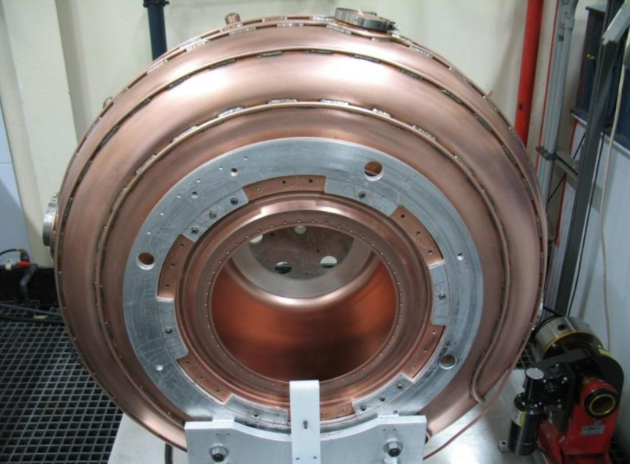
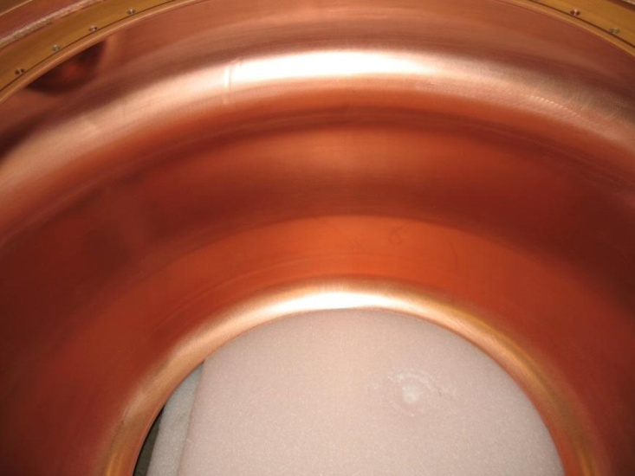
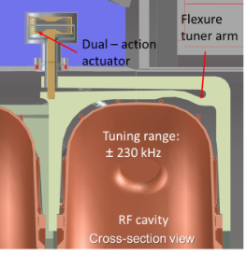
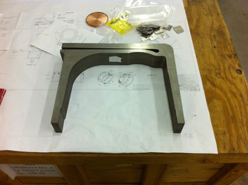
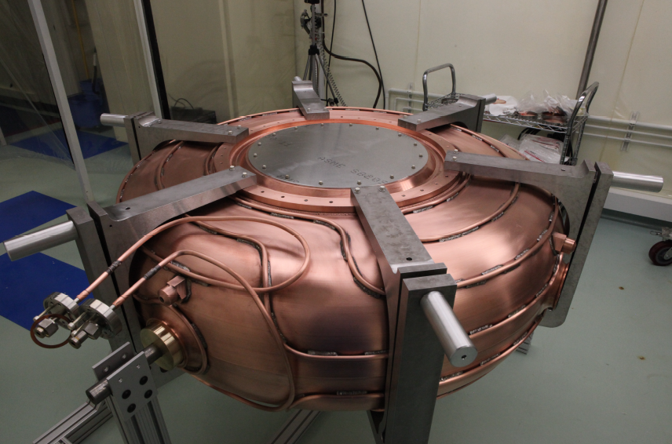
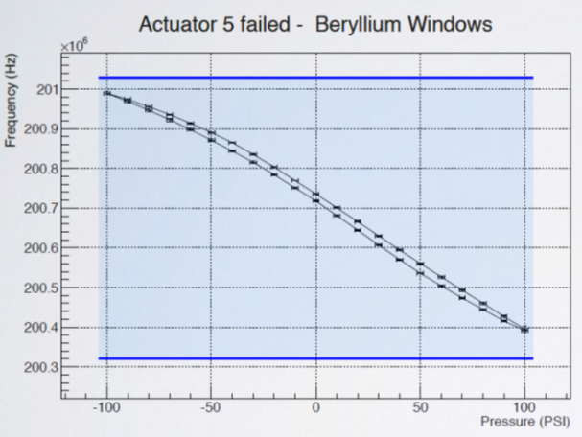
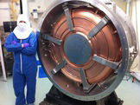
MICE High Power RF cavities
Cavities and Couplers

Slide 8
MICE High Power RF cavities
Cavities and Couplers
  Operation experience at MTA
    Showed couplers were not easy to tune- now redesigned
      Relatively minor change to the flange location
    Showed minor issues associated with tuner actuators- redesigned to remove gas drive chambers from vacuum
    Tuners shown to be able to keep cavity on frequency
    Tests to 14MV/m with and without strong magnetic fields
      No evidence of breakdown with upgraded components
      B fields are broadly comparable to those at MICE
  At relatively short pulses (MICE 1ms cf MTA 250μs)

Slide 9
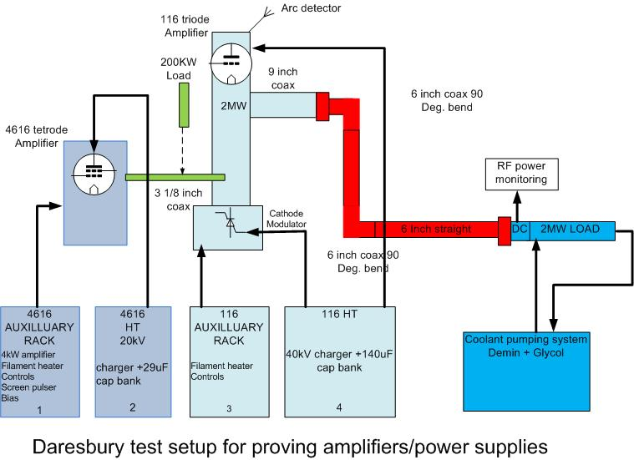
RF drive chain
Complex Chain of Amplifiers
  Source (LLRF) will drive an SSPA (~4kW)
  SSPA drives a tetrode valve pre-amplifier (250kW)
    Burle/Photonis 4616 based system
  Tetrode amplifier drives triode valve amplifier (2MW)
    Thales TH116 based system
    MICE has four ‘New’ TH116 valves
    Production of more could be ‘difficult’

Slide 10
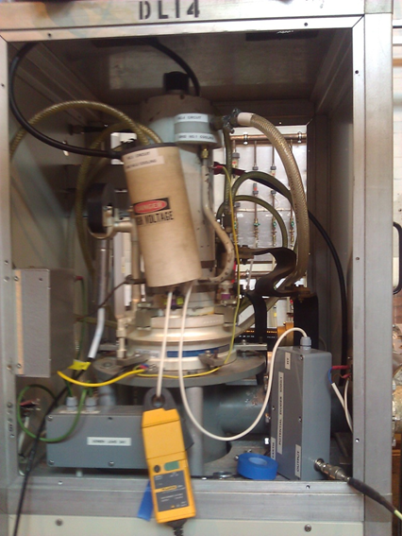
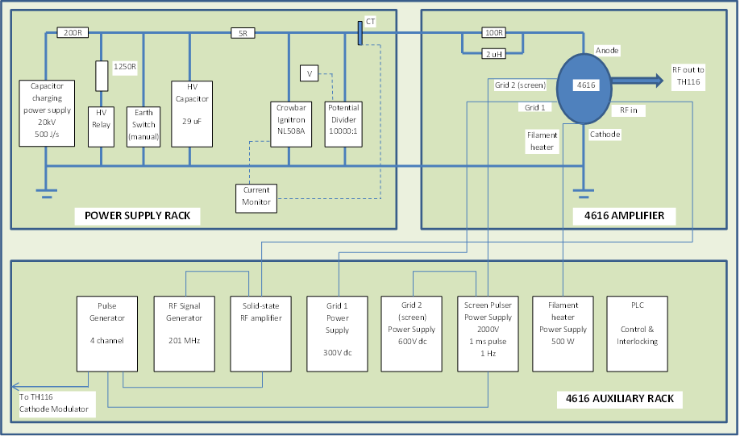
RF drive chain
Tetrode Amplifier and modulator

Slide 11
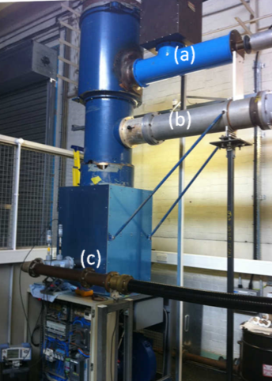
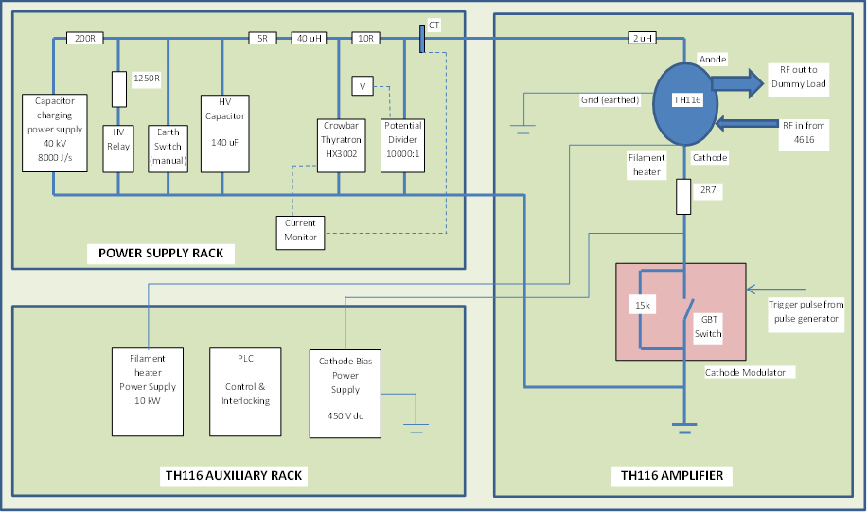
RF drive chain
Triode Amplifier and Modulator

Slide 12
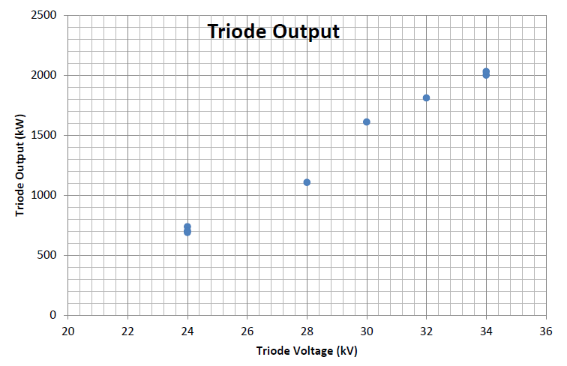
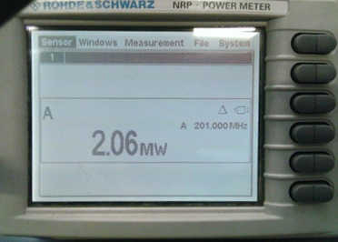
High Power Driver System
Amplifiers have achieved required performance
  ~10dB gain
  2.06MW output RF
    At required duty
  34kV bias voltage
  129A forward average current
  η=46% (electronic)
  Gain 10.8dB
  Input port return loss -12.5dB
    VSWR 1.6
Drive from Tetrode
  170kW output RF
  18kV bias voltage
  15.5A forward average current
  η=61% (electronic)
  Gain 19dB
Drive from SSPA
  2.27kW
Drive from oscillator
  3.7dBm
HT feedline,
Output 9 inch coaxial line,
Input 3 inch line

Slide 13
Installation at RAL
Status
  First amplifier set have been constructed and installed in Daresbury test facility
  First set of modulator racks completed and installed
  Achieved required peak power levels
    At required duty
  Key lessons:
    Problems with the HT crowbar on the triode circuit
    Resolved by changing the HT switch
      However triode switch peak voltage spec marginal
    Solution- crowbars for both valve amplifiers will be changed
      From Thyratron/Ignitron valves to solid state switches
    Gives higher headroom (triode) and eliminates warm up delay (tetrode)
  Racks now back at Daresbury for commissioning of triode no 2.
    Upgrades to modulators will happen during this commissioning phase

Slide 14
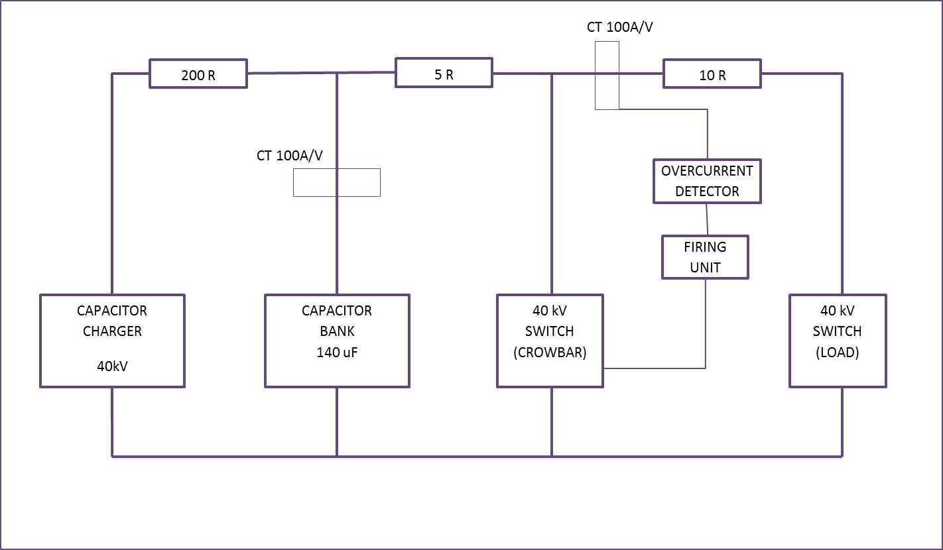
New Crowbar Tests
Tests carried out:
  Circuit tests using second switch as a load to trigger the crowbar and measure “arc” energy
Test voltage: 24 kV
Capacitor: 140 uF
Dump resistor: 5 ohms
Overcurrent set point: 180 A
CH 1 Overcurrent detector (trigger) CH 2 Firing pulse to crowbar
CH 3 Capacitor current (10 dB) CH 4 Current in Load
Timebase 2.5 us / div
Peak current in crowbar: 4.6 kA
Peak current in load: 1.2 kA
Estimated energy into load: <10J

Slide 15
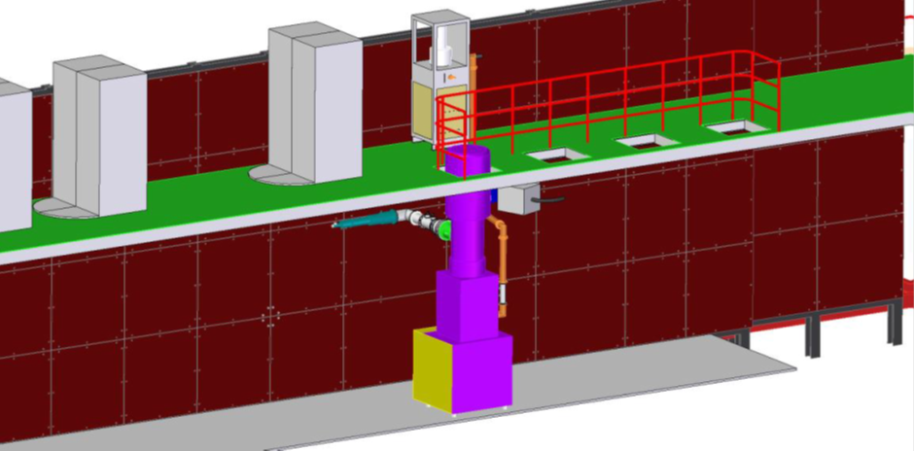
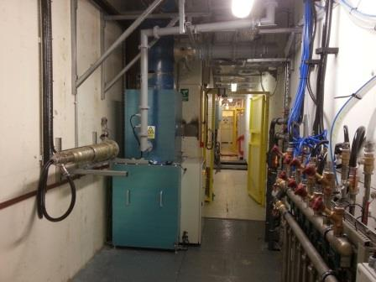
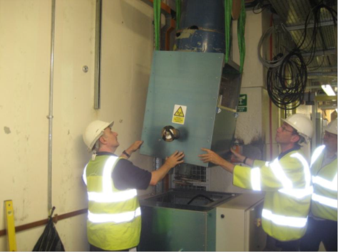
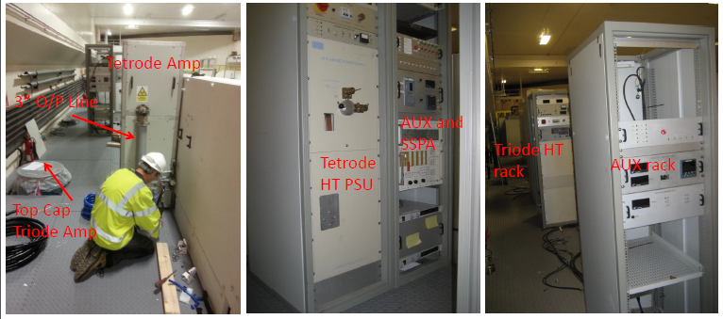
High Power Driver System: RAL installation
Status
  First amplifier set have been installed at RAL and tested at reduced power levels

Slide 16
High Power RF Drive: System Status
MICE RF drive systems demonstrated
  2MW, at 201.25MHz, for 1ms @ 1Hz
  First amplifier tested in MICE hall
  Triode amplifier (output stage) remains installed
    Tetrode and all modulator racks shipped to Daresbury
New higher voltage solid state crowbar tested
  Key lessons:
    Problems with the HT crowbar on the triode circuit
    Resolved by changing the HT switch
      However triode switch peak voltage spec marginal
    Solution- crowbars for both valve amplifier s will be changed
      From Thyratron/Ignitron valves to solid state switches
    Gives higher headroom (triode) and eliminates warm up delay (tetrode)
Triode 2 will be tested using No. 1 tetrode and modulators
  Use upgraded Triode No.1 modulator
  Each major No. 1 subsystem will be swapped for No. 2 sequentially
    Make fault finding more rapid
  Remote control system being developed
    Test during commissioning of No. 2 valve systems
Dependent on electrical engineering resource availability
  No 1 tetrode re-commissioning commenced at DL
  Triode No 2 testing with No 1 racks and tetrode autumn 2015
  Design/Build Control Rack for No 1 PSU’s autumn-winter 2015

Slide 17
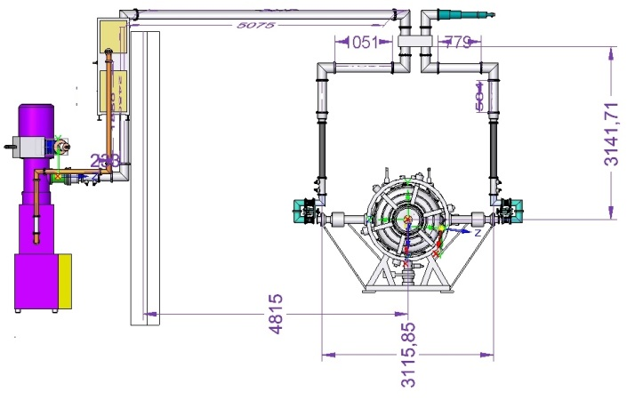
RF network
Simplified distribution network- feasible to route overhead
Off-centre mounting of hybrid takes up phase shift
Orientation of load arbitrary- align with the 6” distribution line and share mountings
Minimised length of 4” line- minimises losses
500kW Load
4616 Pre Amplifier
Hybrid Splitter
Directional
Coupler in
each line
Flexible coax
Directional
Coupler 6 inch
Line Trimmers
TH116
Amplifier

Slide 18
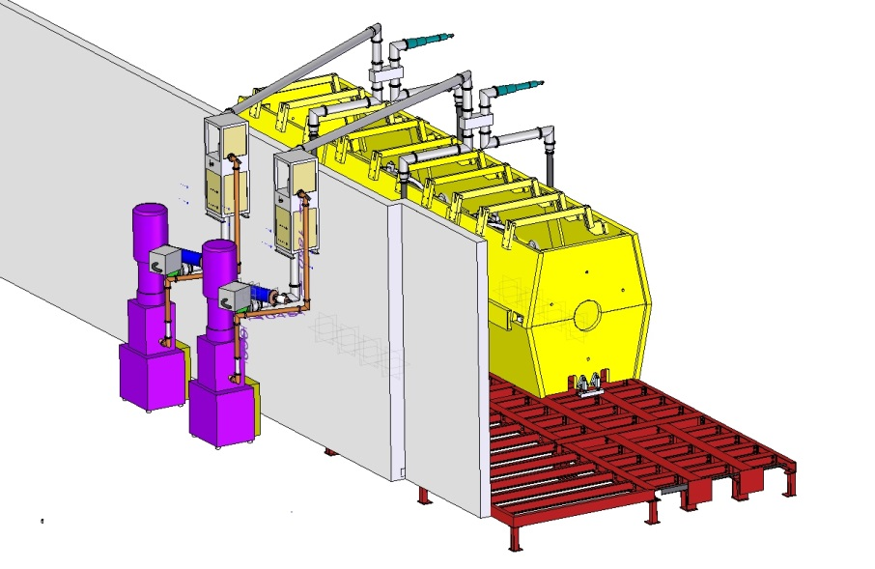
RF network
Load on each splitter to absorb unbalanced reflections
Retracted crane hook clears coax over the wall.
Support from present ‘shield wall’ and yoke
2nd amplifier moved to 3rd position behind wall to ease installation in congested area
With 2 RF amplifiers now relatively straightforward to place auxiliary systems (cooling)
Water cooling for load will need to route over the air gap on the transmission lines

Slide 19
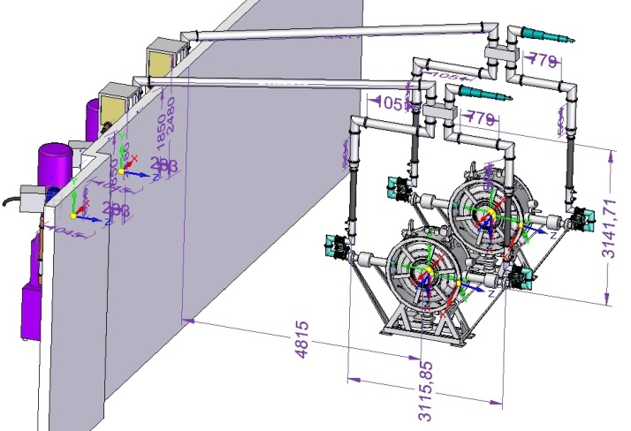
RF network

Slide 20
Power Distribution Network
New experiment will demand higher power (1MW peak, 1kW average) in 4” lines
4” components rated to 1.12MW peak in air at 1 bar
A full reflect (during cavity fill or spark) will double line voltage (eq. to 4MW)
Mitigate with insulating gas

Slide 21
Timing System, Desired Specification
We wish to know the difference between
  Transit time of any of our muons (in essence through ToF1)
  A zero crossing of the RF system in any cavity- choose the first cavity
Specification for RF timing is ~3x stricter than ToF resolution 50ps
Digitisers
Cavity 1 (RG213)
Cavity 2 (RG213)
Cavity 1
Cavity 2
Discriminators (RF)
ToF 1
Beamline
TDC’s (RF)
ToF Signals RG213
Computers
HPRF
MO Signal (RG213)
HPRF
RF Amp 1
RF Amp 2
Discriminators (ToF)
LLRF Feedback
RF Drive
RF
TDC’s (ToF)
RF Drive
201.25 MHz LLRF MO
LLRF
Trigger
Clock
Datarecorders

Slide 22
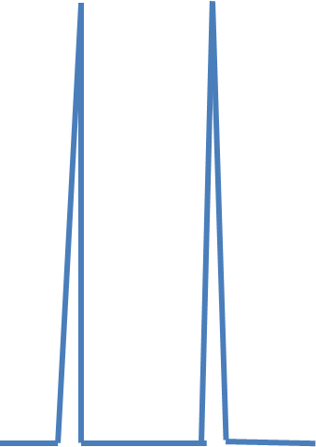
Subsample Digitisation of Signal
Artificially increase the sample rate of the under sampled signal
  Reduces the initial recorded data size reduced
Undersampled Signal
Reconstructed Signal

Slide 23
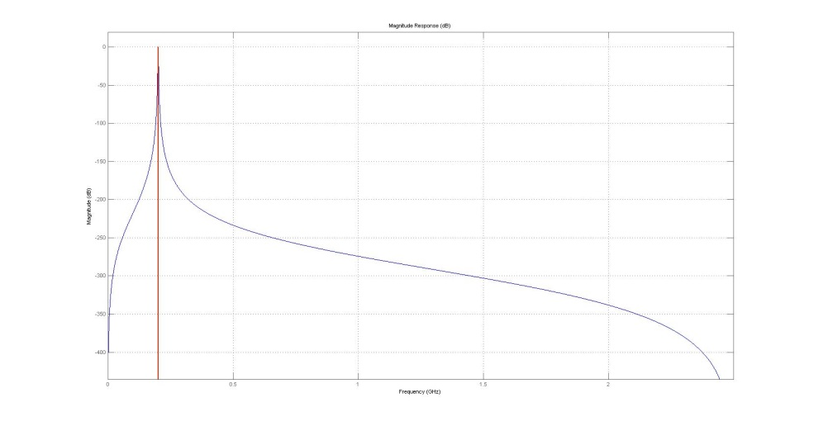
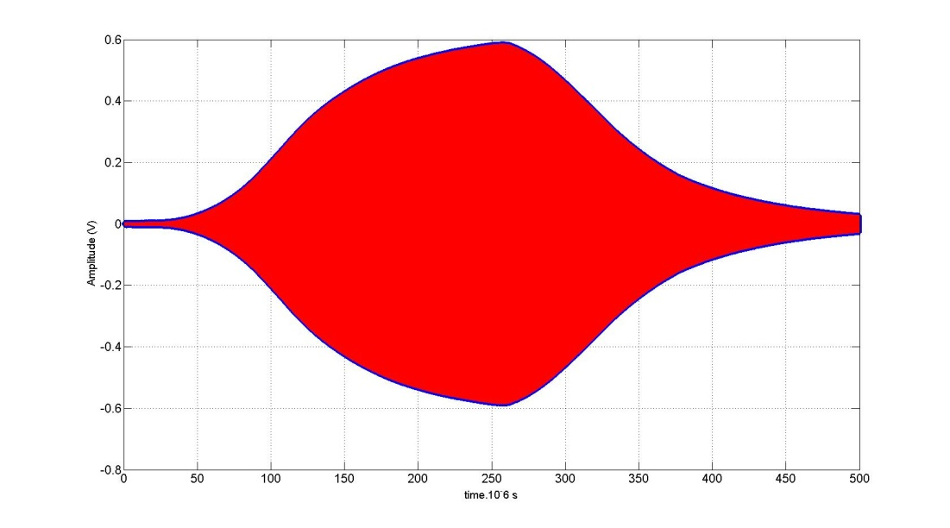
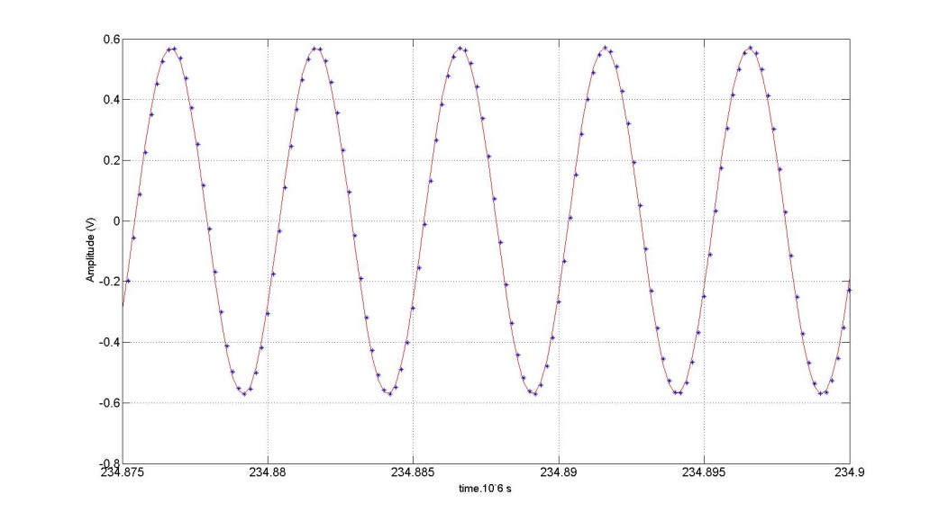
Demonstration of subsample approach
Butterworth Filter with flat 2MHz passband
Very precise reproduction of signal
Variation in phase difference
Between original and reconstruction
Sensitive to original sub-sampling rate

Slide 24
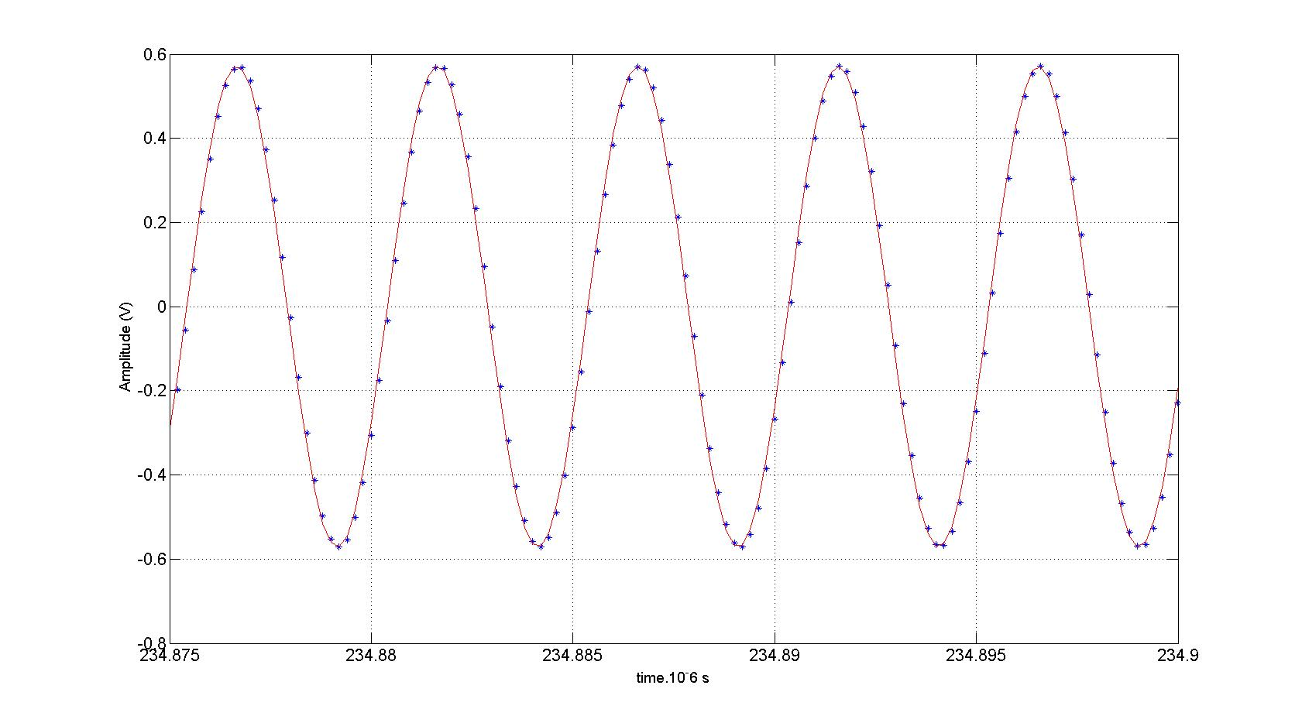
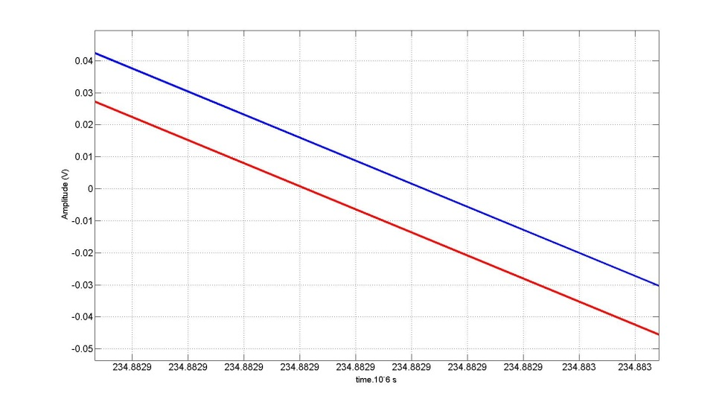
Demonstration of subsample approach
Reconstructing by DSP gives high fidelity to filtered raw signal- filter completely suppresses the DC offset (blue is Raw, Red is DSP)
Phase offset and slew appears to be a systematic function of (sub) sample rate
Random variation ~5ps

Slide 25
Summary of Subsample approach
Gives accurate reproduction of filtered real cavity signals from MTA tests
Can be implemented using VME instruments closely related to the CAEN TDC’s used for the ToF detectors
Need to be able to synchronise timebases with TDC’s- at least fix t=0.
  t=0 can be defined by an external trigger to zero all timebases
  This could be done just before accelerating gradient reaches maximum
  OR
  Just before start of RF pulse
  Use a pulse generator to provide 40MHz clock, and provide trigger by logical AND between clock and trigger pulse- should sync start of timebases
CAEN V1761 have external clock drive for acquisition rate
  10 bit rather than 8 bit units currently recording MTA data
  Facilitate interfacing with 40MHz clocks of TDC’s (requires programming of the clock controller)
  Need to understand trigger jitter statement?

Slide 26
TDC approach
This is currently planning to use the TDC (CAEN 1290) that are already being used to record the ToF signals
RF signal driving discriminators, use TDC time stamps to find cavity ‘zero crossings’
  25 ps bin size
Same electronics enhances confidence that any drift in time accuracy will be similar
  Unfortunately LeCroy discriminators seem problematic at 200MHz
  Input impedance wanders with frequency, at 201.25MHz, 98+j68Ω
  Could be matched with L-branch network, but still doesn’t fix rate problem
RF signal amplitude and spectrum is very well known: no need for a CFD
  Threshold trigger system is much less complex
  Quote obtained from Phillips Scientific for updating and non-updating leading edge discriminators
  3ns double event resolution and 300MHz bandwidth, <30ps jitter

Slide 27
Absolute Calibration
Providing we can correlate the ToF to the RF with a random variation of <20ps we will not upset the time resolution from the ToF and Trackers
However both measurements have a number of unknown systematic delays
It is probably possible to figure these out with high fidelity for the RF system- not clear that all the particle detector systematics can be completely known
Simple MAUS simulations inject particles at defined entrance time- study effect of entrance time on the change of particle momentum and energy
Compare to estimates of the tracker resolution and hence infer potential calibration of phase
  Simulation set up: Input Momentum: 228MeV/c, RF Gradient 10.2MV/m
  Input Emittance 6mm, No. of spills: 200 (per injection time)

Slide 28
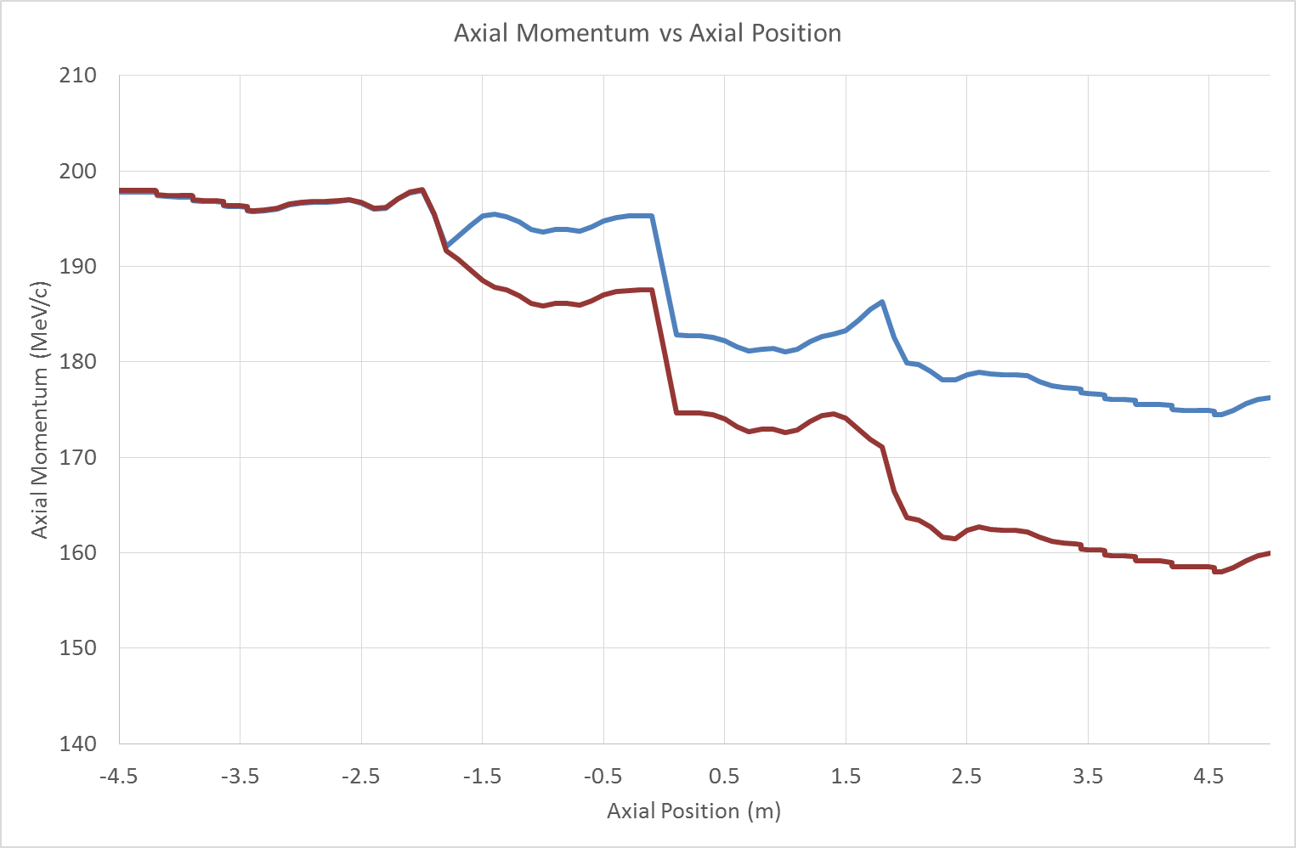
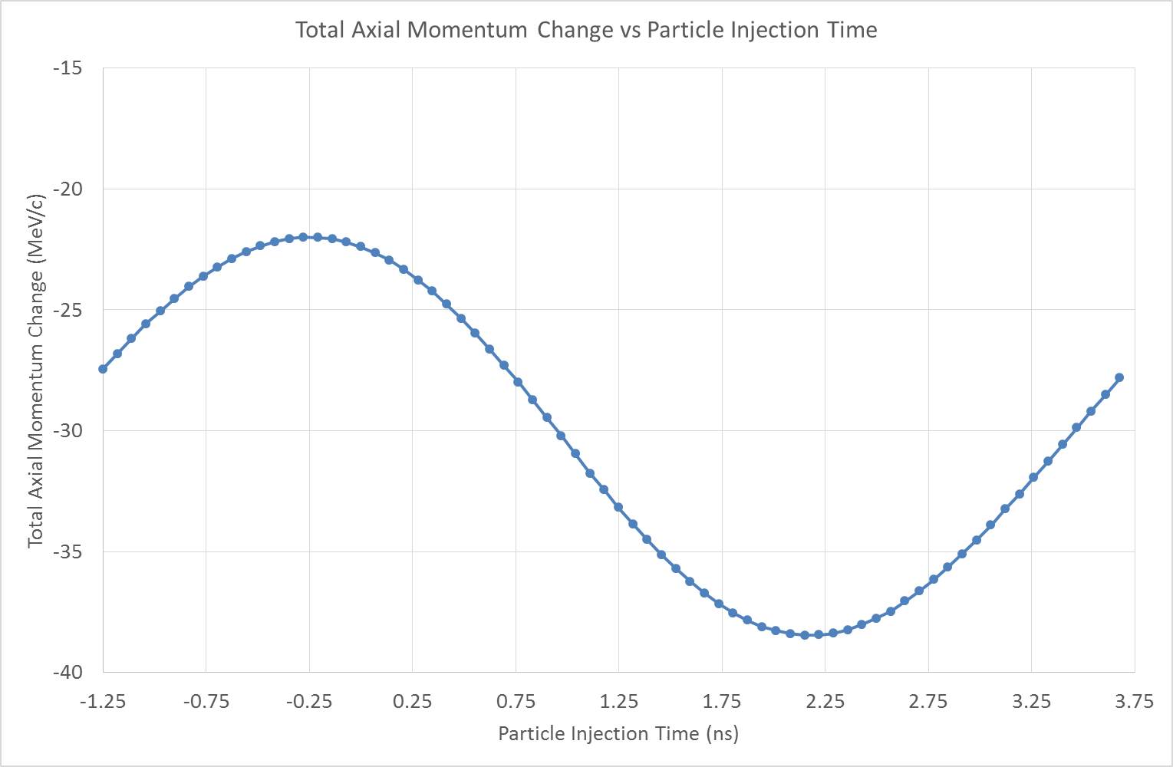
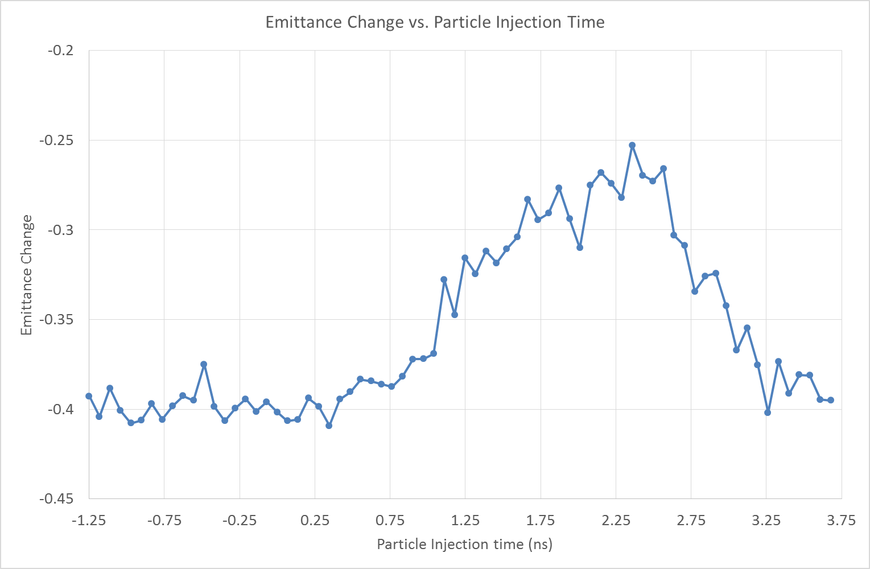
Axial Energy/Momentum Variation
Assume the trackers to have a p_{z} resolution of about+/- 1.4 MeV/c
Estimate ~ +/- 135ps uncertainty in absolute phase (+/- 2.7% of the cycle,
~ +/- 10º)
Emittance reduction flat over this range

Slide 29
Summary
Cavities
  RF cavities provide axial acceleration gradient
  Anticipated gradient is 10.3 MV/m
  Cavities tested (short pulse) to 14MV/m at MTA
  Including in magnetic field- no evidence of relevant sparks
RF drive system
  Completed first High Power RF driver
  Both valve amplifiers and modulators, tested and installed in MICE hall
  Upgrades to modulator crowbars planned and in hand
RF distribution network
  Simplification possible for new 2 cavity accelerator scheme
  Overhead scheme eliminates both physical and schedule interference
  Enhances accessibility
  Now require insulation with SF₆ (or similar insulating gas)
RF – muon phase determination
  Sub sample approach appears promising
  Variation in the precision affected by sample rate- attempting to understand
  Inexpensive hardware procurement required to test TDC system

Slide 30
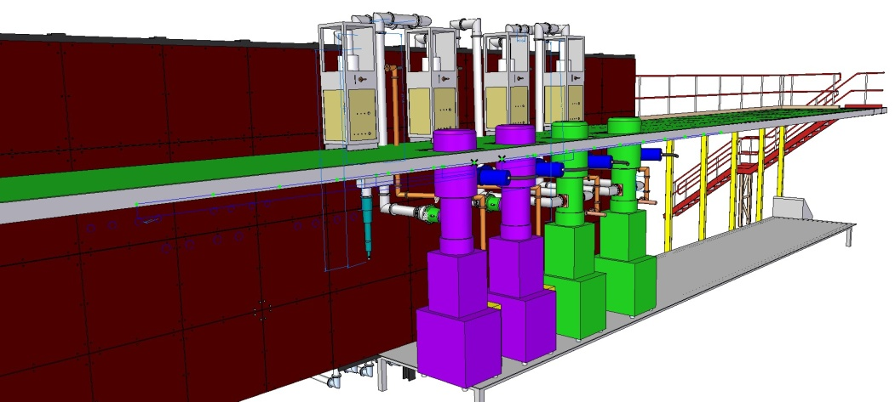
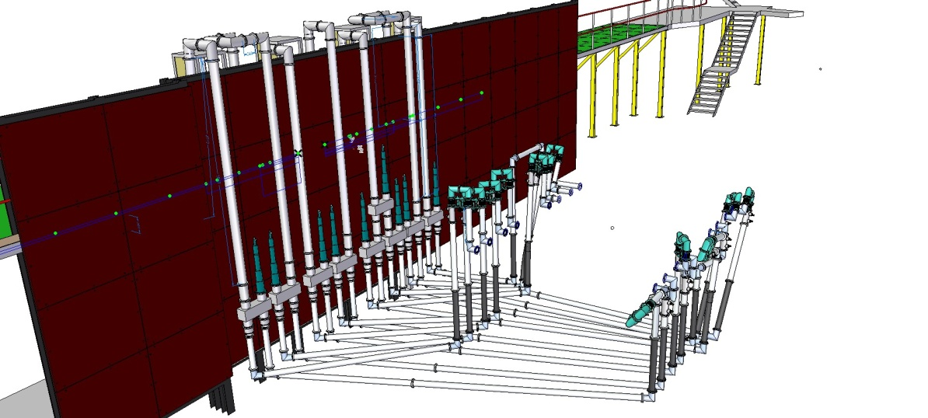
RF network: STEP V/VI
Amplifiers behind Shield Wall
4 off 6 inch coax lines over wall
  Pressurised to increase power handling
Manually adjustable line trimmers installed at
cavity to take up assembly errors in coax length
Flexible coax final feeds
  Allows for small misalignments
10 hybrid splitters Split power for the opposed couplers of each cavity
Lines pressurised with 2Bar Nitrogen
Distribution Network to MICE

