Slide 1
RF Module Overview
Derun Li
Lawrence Berkeley National Laboratory
September 9, 2015

Slide 2
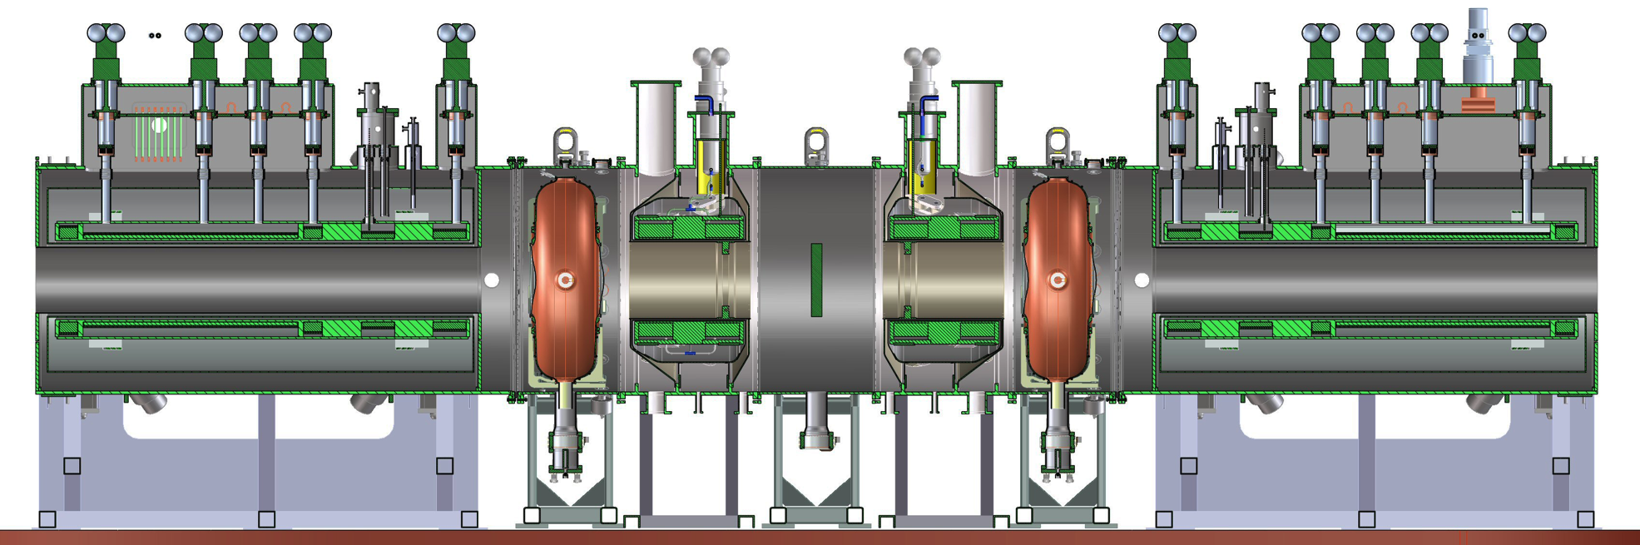
Re-baseline MICE Cooling Channel
New re-baseline MICE cooling channel needs two RF modules
Each MICE RF module has
  One 201 MHz RF cavity
  Two Beryllium windows
  Two RF power couplers
  One vacuum vessel hosting the RF cavity
  Six tuner arms and six actuators
  Cavity support struts
  Vacuum pump system and water cooling
  Diagnostics and bypass lines

Slide 3
Current Status of MICE RF Module
Vacuum vessel of the RF Module
  Design complete
  Fabrication contract awarded to Kelly Technologies in early August, 2015
  Delivery to LBNL at mid-December 2015
Vacuum system design (Terry Anderson’s presentation)
RF cavity measurement and selection and EP complete
RF power coupler fabrication started
  Updated design complete, addressed the issues identified at MTA assembly
  Fabrication started, all parts in hands
  TiN-coating in progress
New tuner actuator design, prototype and fabrication
  Prototyping complete
  Function testing (both functional and lifetime) complete
  Fabrication started (outside and in house)
25 tuner arms received from University of Miss. to LBNL

Slide 4
RF Module and vacuum design update and fabrication

Slide 5
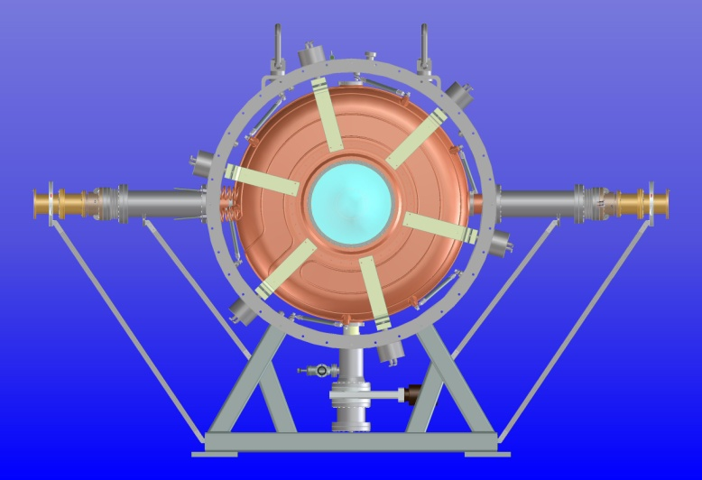
Design Update of the RF Module
MICE RF module (RFM) is very similar to the single cavity test module (SCTM) currently under high power RF testing at MTA, FNAL and experience learned
  Integration to MICE cooling channel, including vacuum sys.
Necessary improvement and modification to the RFM & components design made to address issues and experience learned from SCTM at MTA
  Vacuum issues
    Modification to the vessel design
    RF coupler
    Actuator design
    Vacuum port and bypass lines
    Water cooling lines
Original SCTM

Slide 6
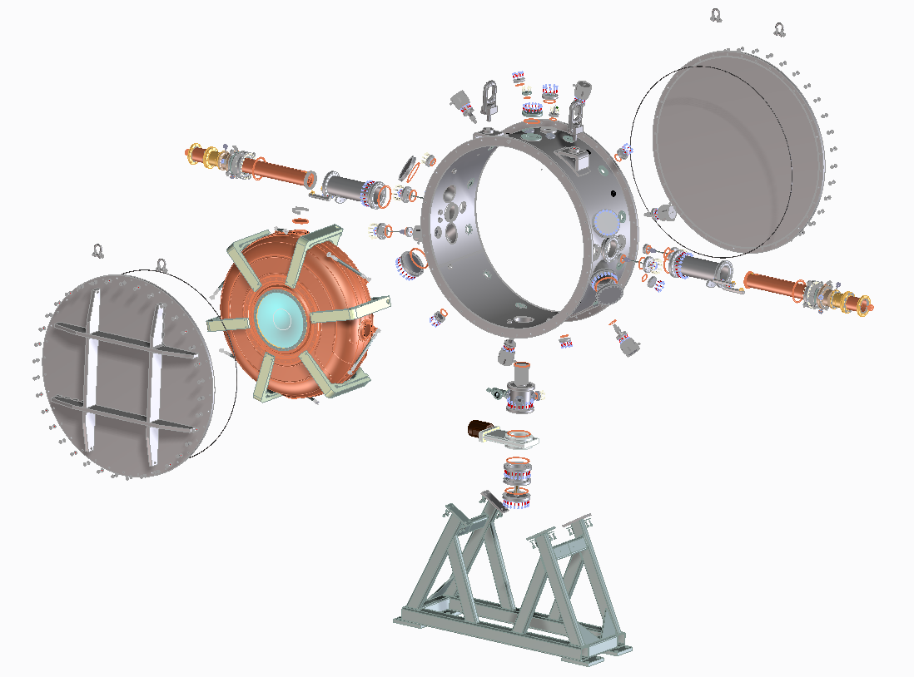
Updated RF Module Design
Exploded view of the new MICE RFM
Will add view ports at end-plates
for inspection of Be windows
Preliminary stand design

Slide 7
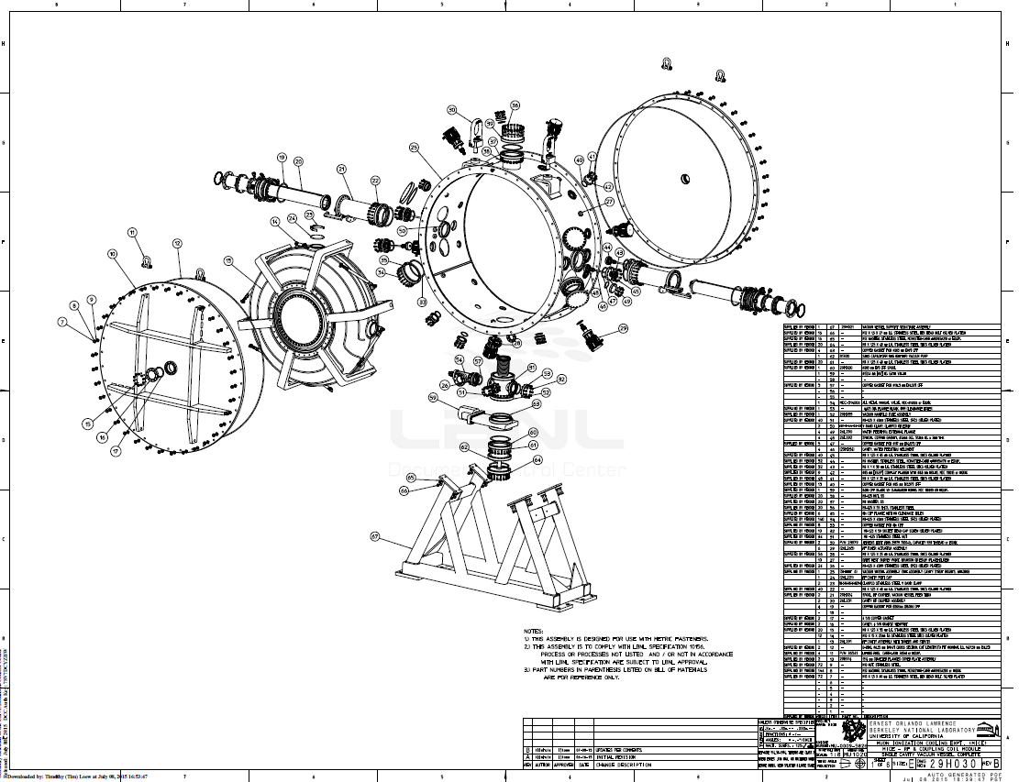
Vacuum Vessel Fabrication
Original SCTM
Fabrication contract awarded to Kelly
Technologies in early August 2015
Delivery date: Mid-December 2015

Slide 8
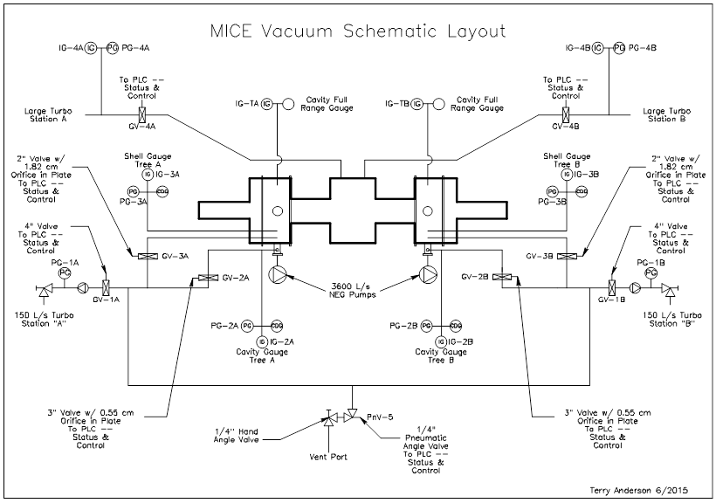
MICE Vacuum Schematic Layout
Terry Anderson’s talk for more details

Slide 9
MICE RF Cavity Production
Recent MTA testing of 1st MICE Prototype RF Cavity

Slide 10
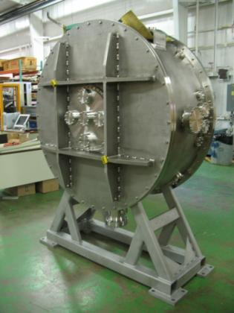
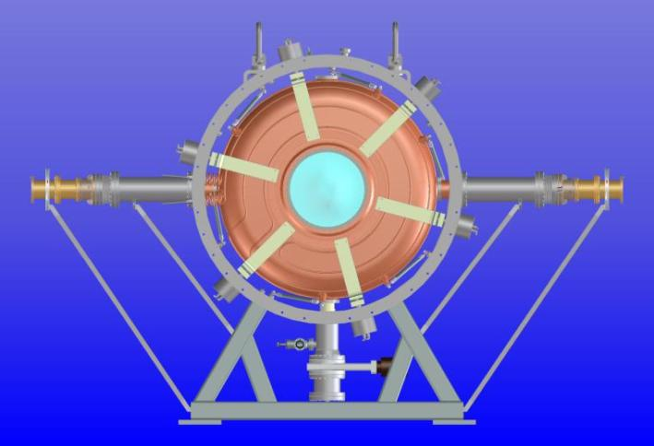
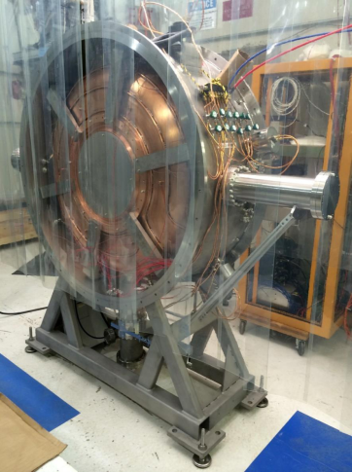
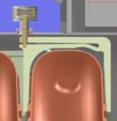
High Power Testing of the 1st MICE Prototype Cavity
  Single Cavity Test Vessel
    Same dimensions and features that a MICE RFM vacuum vessel would have
    Installation fixtures and cavity handling procedures + hands-on experience
    SCRF-style post-processing, handling and assembly
    RF commissioning and testing with external magnetic field
    Cavity can be installed close to the 5-T superconducting solenoid magnet at MTA, very similar to MICE configuration
Configuration of cavity and the vessel
Loop coupler
Loop coupler
6 Tuners
Single cavity vessel
Vacuum pump

Slide 11
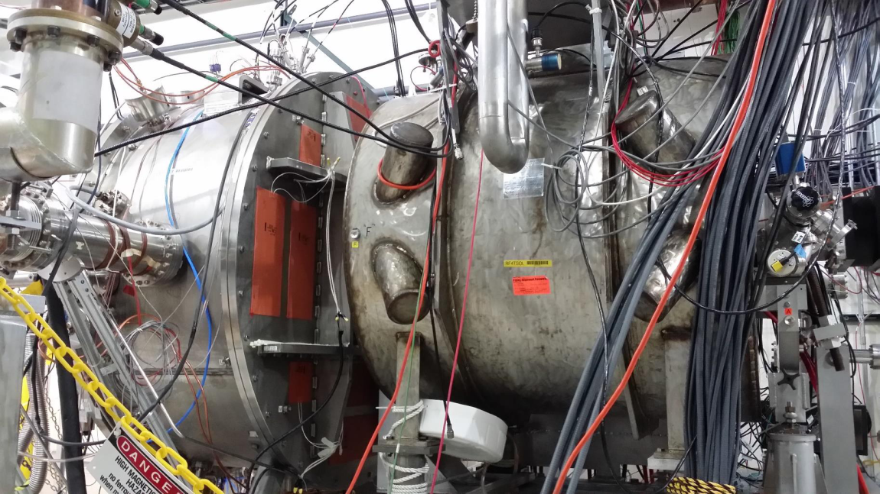
1st MICE Prototype Cavity Testing
Single cavity module next to 5-T superconducting solenoid magnet
Magnetic fields in the cavity:
  0.1 Tesla at downstream wall; 0.17 Tesla in the center and 0.33 Tesla at the upstream wall

Slide 12
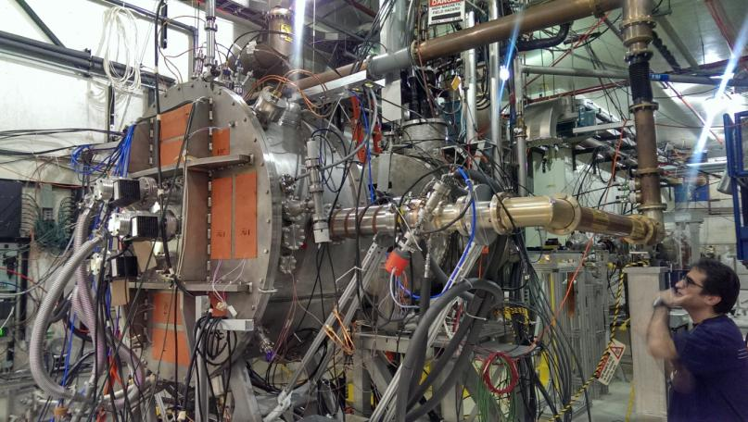
Cavity Testing Results with B=0
The cavity reached to 8 MV/m (MICE) without conditioning in
3 days (early August 2014) !
B = 0 with Cu windows (Sept. 15 – Nov. 26 2014)
  Achieved RF gradients of 13.5 MV/m with breakdown probability of
  → 10⁻⁶, only recorded total of 32 breakdown events
B = 0 run with curved Be windows (March 18 – April 6, 2015)
  0.5 millions + pulses at > 11 MV/m (≈ 1.6 MW input power)
  Dose rate comfortably below
  tracker damage threshold
  No breakdown events
  Up to 14 MV/m for short
  periods
  No issues with the cavity
  or services (vacuum, water)
  All instrumentation and
  DAQ worked well

Slide 13
Cavity Testing Results with B
B = 5 T run with Be windows (April 24 – May 15, 2015)
  Detectors and other components moved, rebuilt as needed.
  1 M+ pulses at > 8 MV/m (≈ 1 MW input power)
  3 M+ pulses at >11 MV/m (~1.6 MW input power)
  Dose rate comfortably below tracker damage threshold
  No issues with the cavity or magnet operation
  No breakdown events
  Up to 14 MV/m; held at 13.5 MV/m for 3 M+ pulses
B field scan and Tuner System Test with Be windows
(May 25 – June 5, 2015)
  Tuner System Test at MICE operation frequencies
  Collected 0.25 M + pulses at 1MW power at B=0 and 10 Hz rep rate;
  0.5 M+ pulses at 2 MW at B=5 Tesla and 5 Hz rep rate (MICE: 1 Hz rep rate);
  Detector calibration to observe dependencies of various signals on:
    Magnetic field
    RF gradient
    Calibration with known radiation sources.

Slide 14
MICE RF Cavity Production

Slide 15
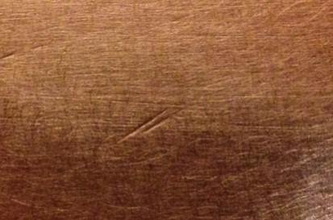
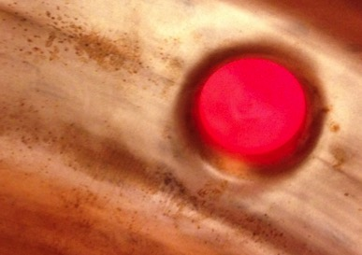
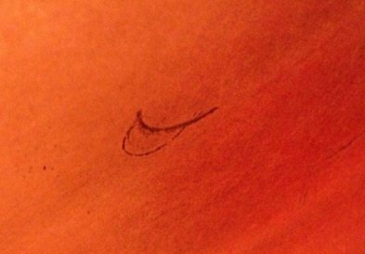
RF Cavity Selection
Ten MICE 201-MHz cavities have been built
The first MICE prototype cavity has been high power tested at MTA ➔excellent results
Select four cavities (two spares) for MICE
  Inner surface finish (visual inspection)
  Frequency measurements of cavity bodies
  Location of water cooling lines
Small scratches
Oxidation marks
Small cracks

Slide 16
RF Cavity Measurements
Cavity frequency: cavity body frequency plus the frequency perturbation from curved Be windows :
Curved-out window increases the frequency ; Curved-in window decreases.
For a cavity body and a pair of Be windows, we can measure three different configurations and solve the cavity body frequency and the two Be window frequency perturbations.

Slide 17
Measurement Results
Cavity # | Type | Body f (MHz) | df (MHz)
5 | outer | 201.510 | 0.260
6 | outer | 200.976 | -0.274
7 | outer | 200.675 | -0.575
8 | inter | 200.874 | -0.376
9 | inter | 200.970 | -0.280
10 | inter | 200.999 | -0.251
Window # | f (MHz) |  | f (MHz)
1 | 0.674 |  | 0.691
2 | 0.581 |  | 0.591
3 | 0.640 |  | 0.659
4 | 0.537
5 | 0.517
6 | 0.550 | 0.557
7 | 0.537 | 0.541
8 | 0.623
9 | 0.623
10 | 0.663
df = Body f (MHz) – 201.25 MHz
The results in red were measured in 2010 at LBNL. They are consistent with recent measurements.

Slide 18
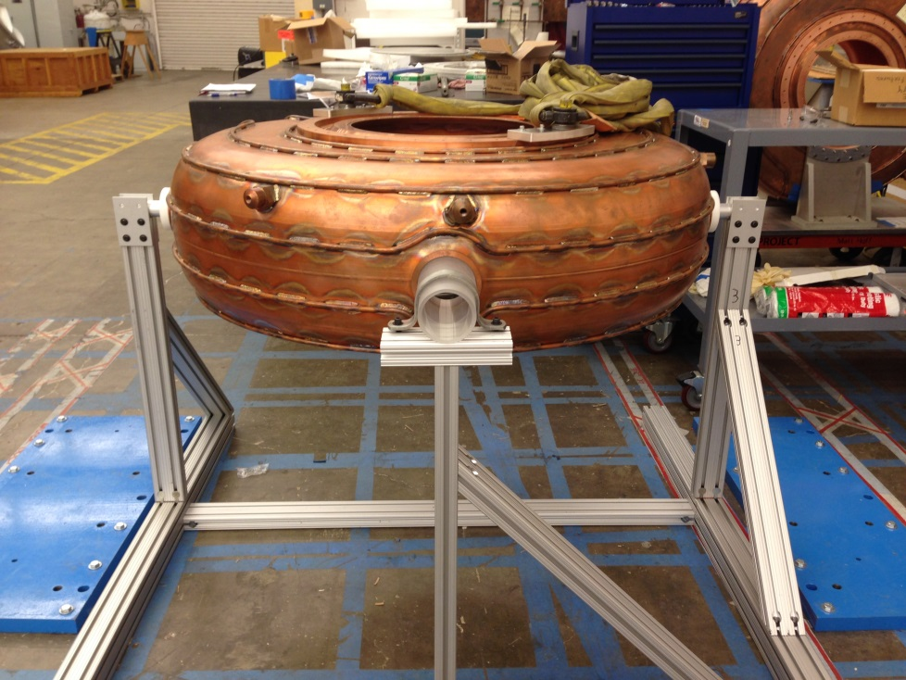
Cavity Handling
Cavity assembly fixtures developed at FNAL,
shipped to LBNL and was used for MICE RFM

Slide 19
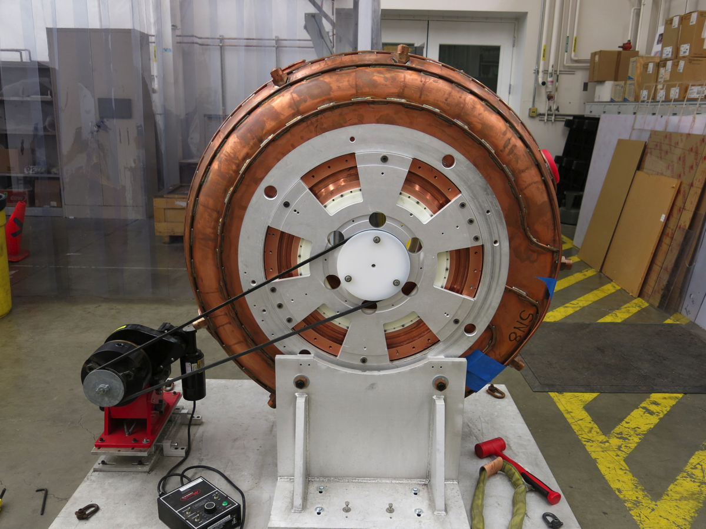
EP at LBNL
Improved stand
and grounding
EP setup at LBNL

Slide 20
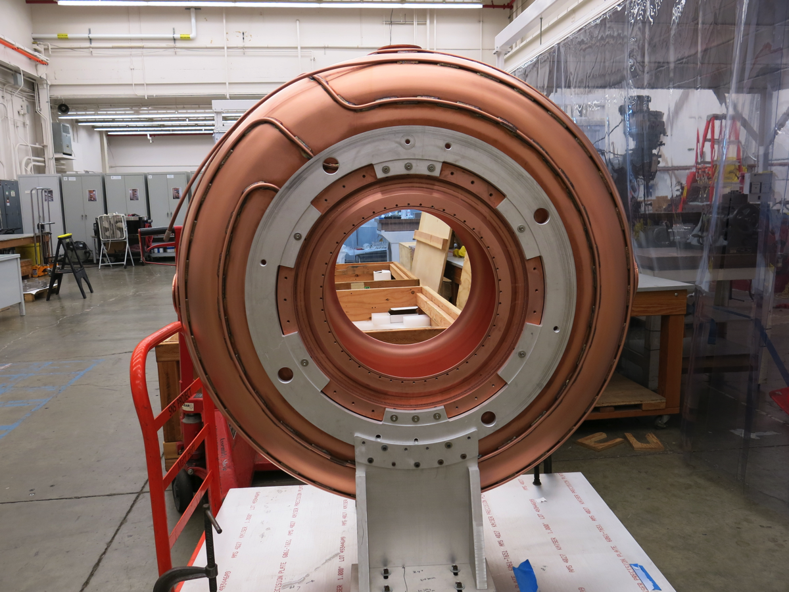
1st EP Finished MICE Cavity

Slide 21
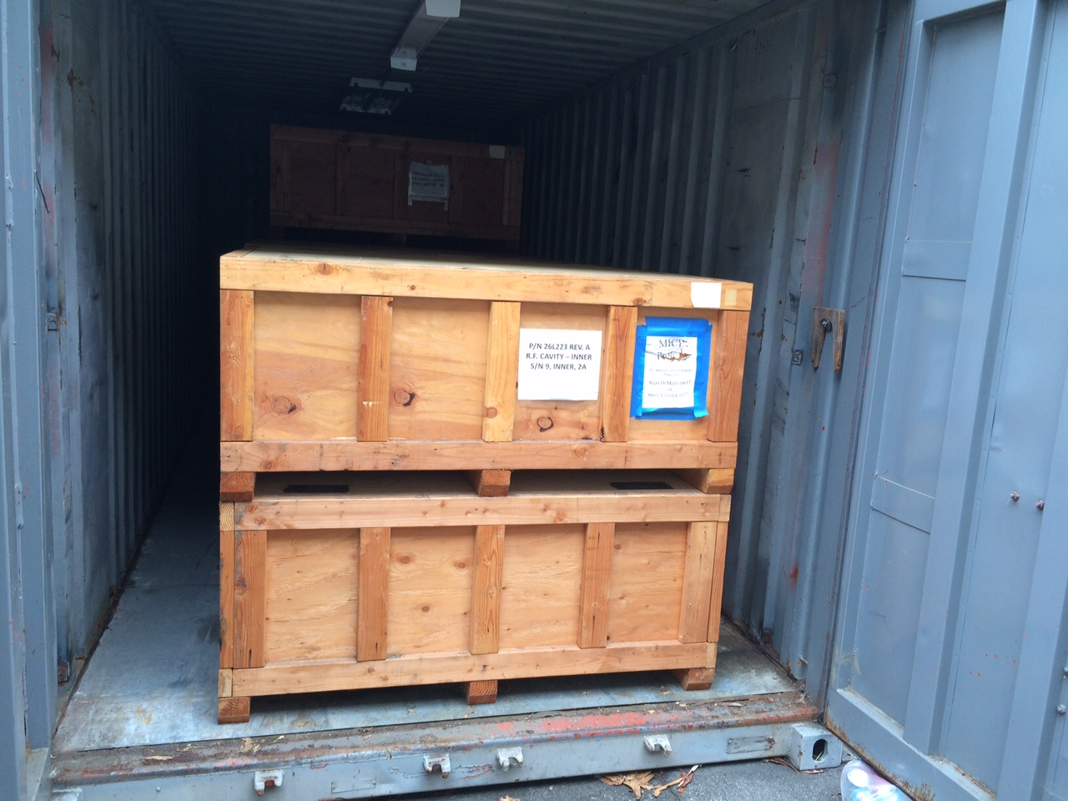
MICE RF Cavity Bodies
  Cavity (with beryllium windows) selection complete
    Four cavities selected (two spares)
    In combination with different Be windows, additional ~ 100 kHz frequency tuning range
  EP of the four cavities complete
  All cavities are stored near assembly shop at LBNL
July 8, 2015

Slide 22
RF Power couplers

Slide 23
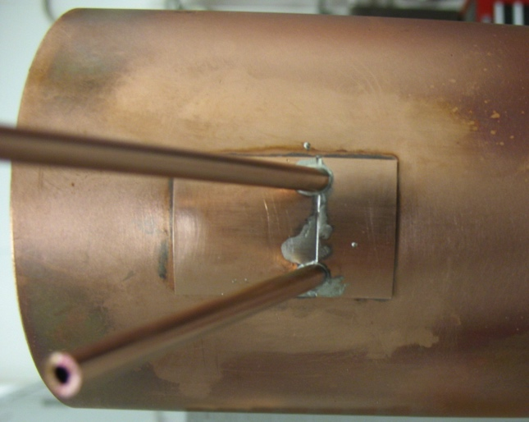
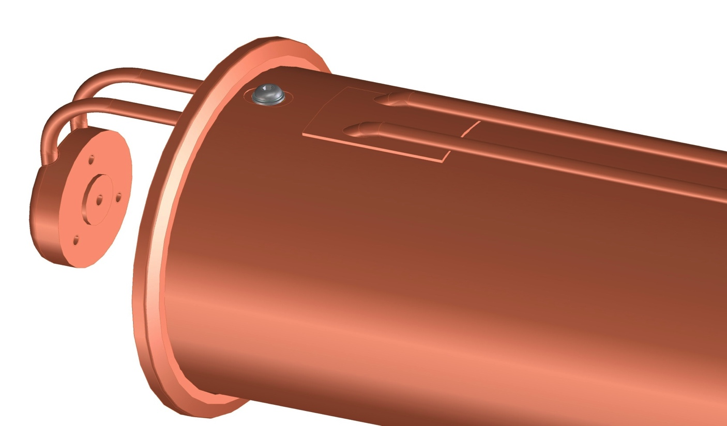
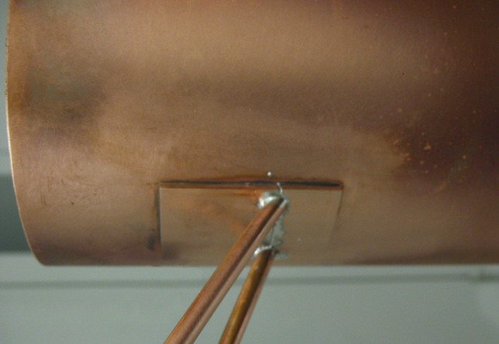
RF Coupler Design Update
Vacuum issue with the old coupler
  Vacuum conduction between good and bad vacuum
Update: cover the opening with a copper plate
  Once the tubes are in their final position the cover plate is pushed into its final position
  The plate is welded to the coax tube
  Test welding complete ➔ vacuum leak tight

Slide 24
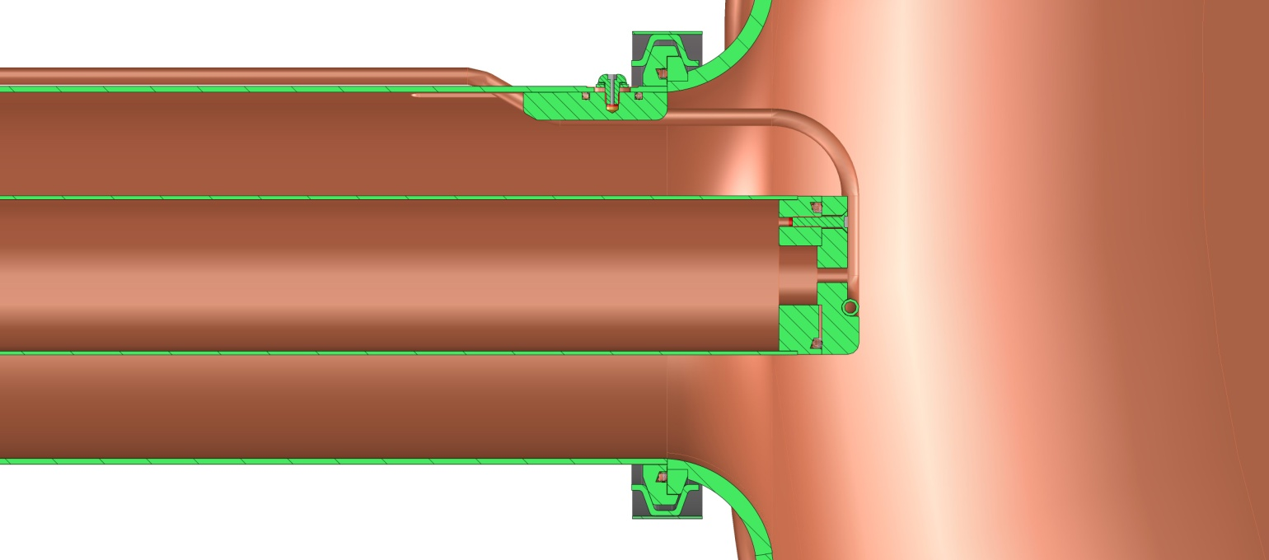
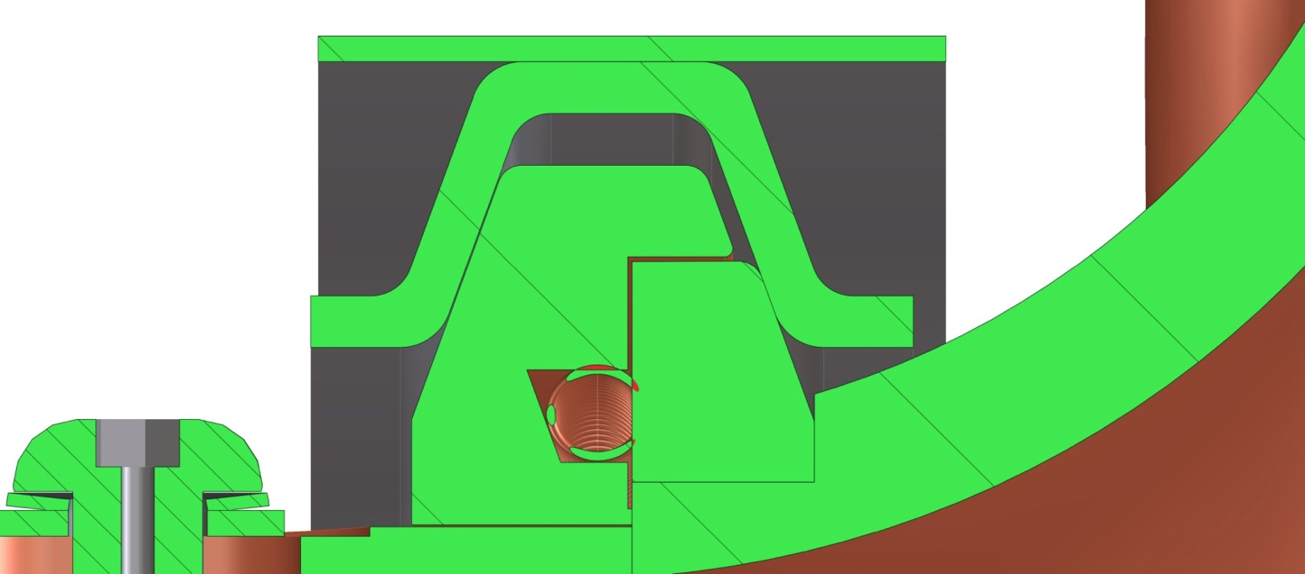
RF Coupler Design Update
The Coupler Flange will have a lip to capture the cavity flange
This flange lip will fit over the cavity flange O.D. to provide a connection for rotating the coupler
(modification to the vacuum vessel)
The cavity flange remains un-modified

Slide 25
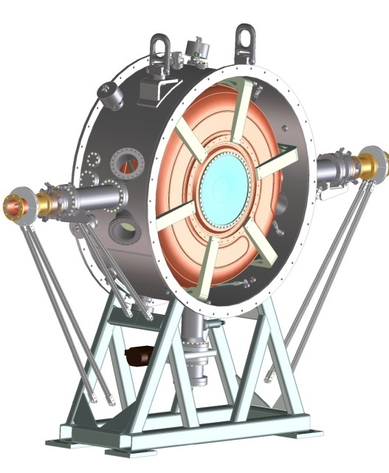
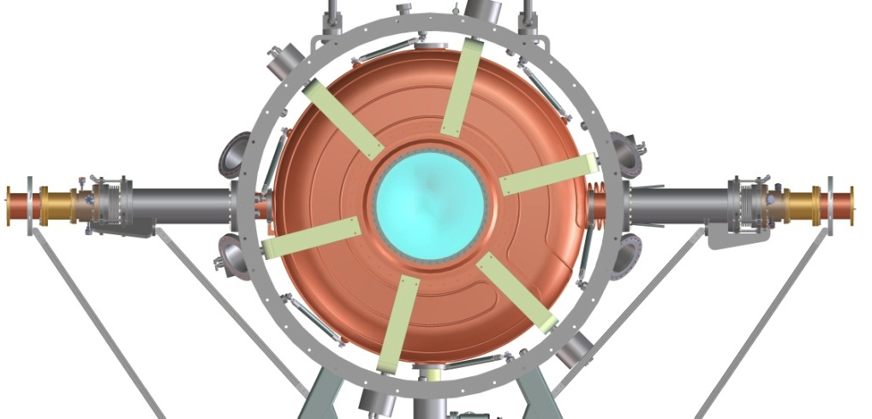
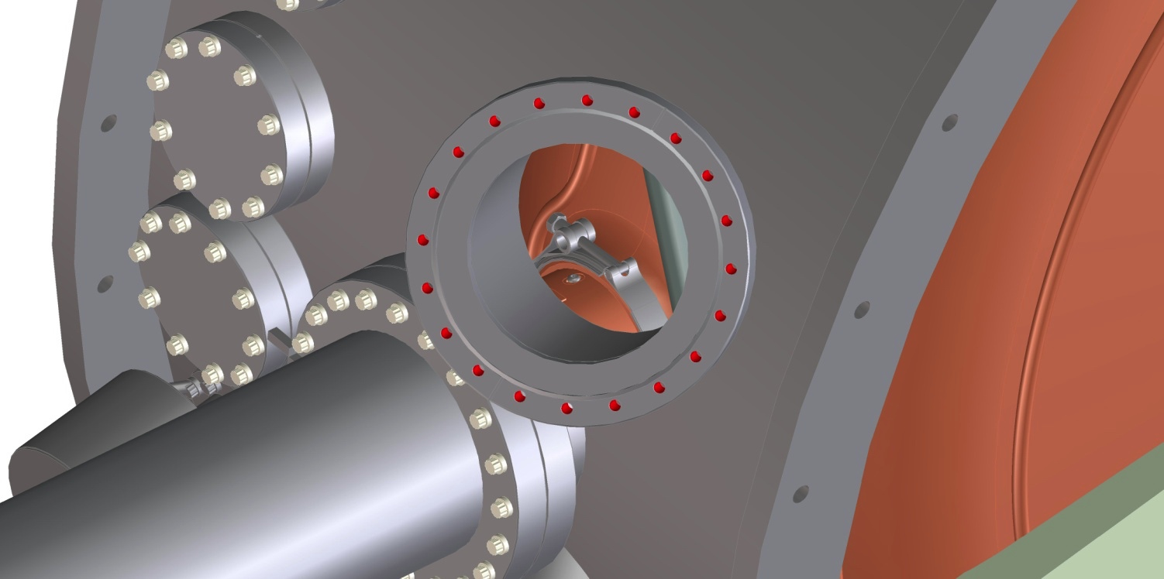
Extra Ports for Coupler Access
Extra ports to access the coupler/cavity interface
Port will look in from above and below on the coupler to cavity joint

Slide 26
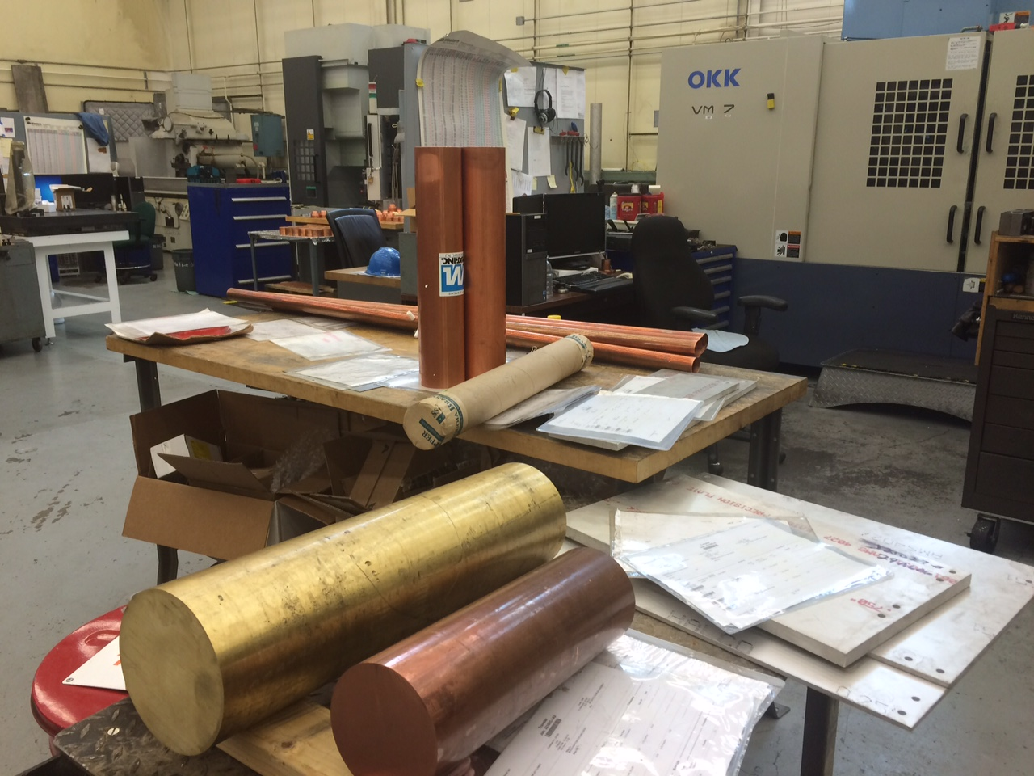
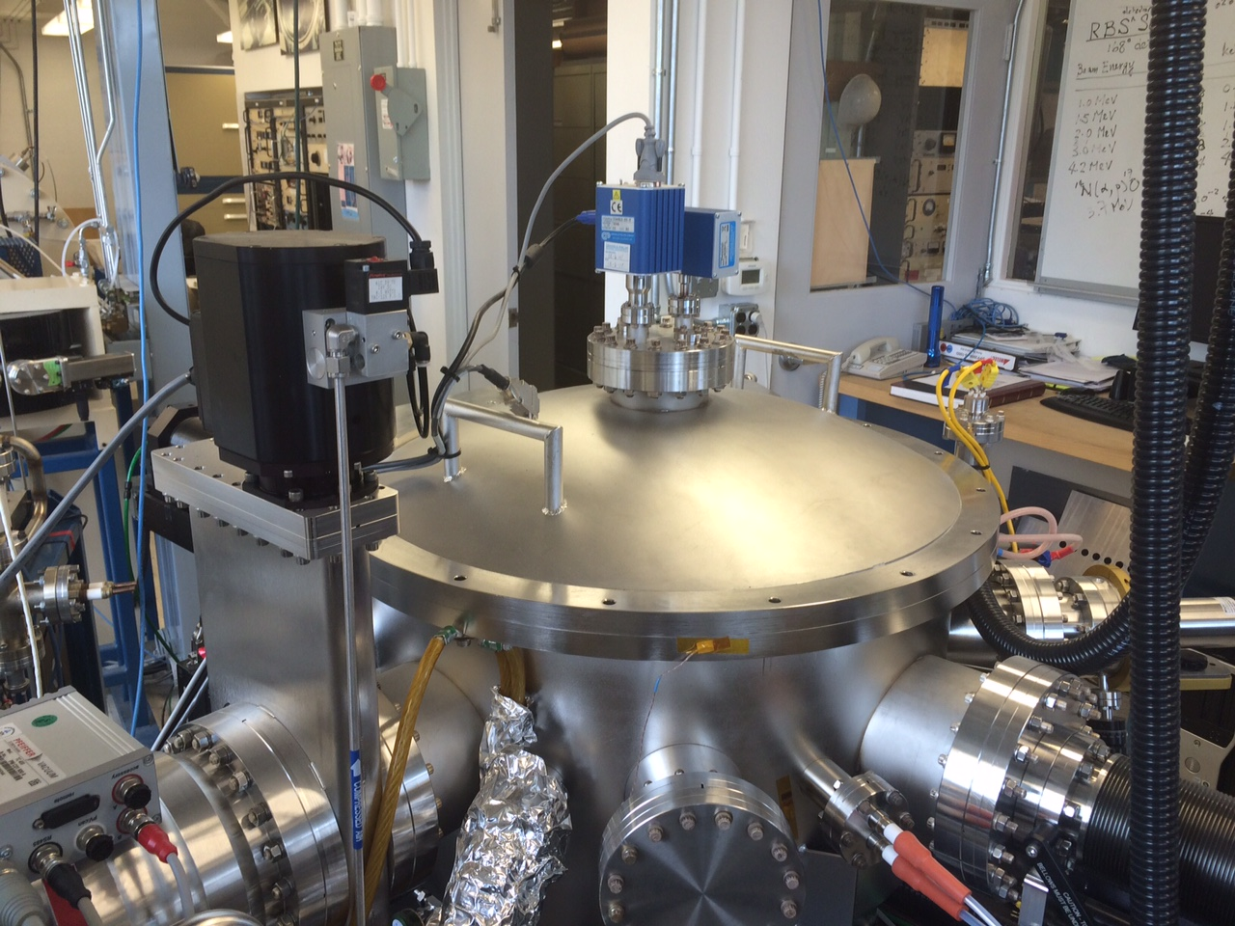
Coupler Fabrication Status
Coupler fabrication started in June 2015
  Materials and parts arrived LBNL
  Copper tubes complete, cleaned and sent out for e-beam welding of adapters
  Machining of other parts complete
  TiN coating in progress at LBNL Plasma Application Group
  TiN coating on ceramic window assembly started
Fabrication to be completed by end of October 2015
July 9, 2015
July 9, 2015

Slide 27
Tuner Actuators

Slide 28
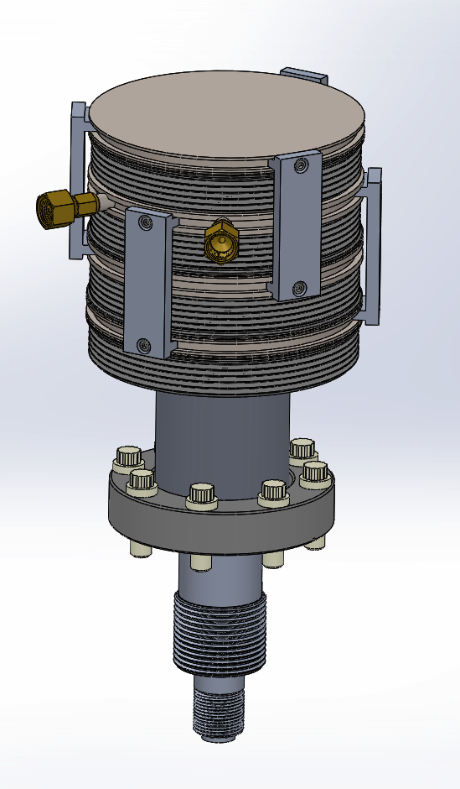
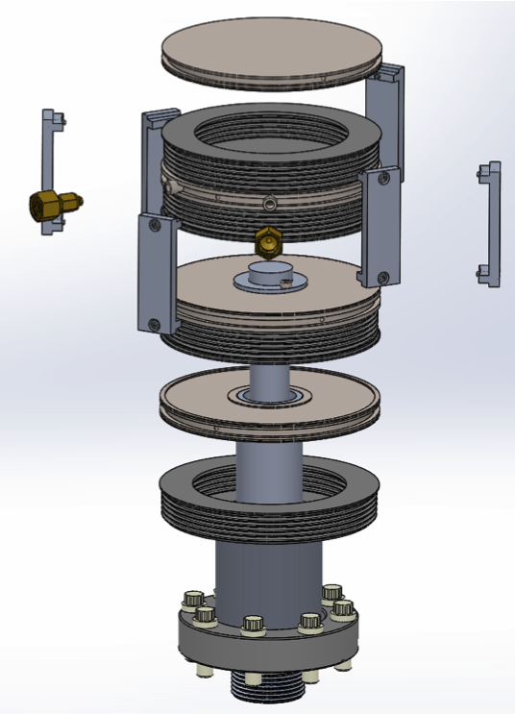
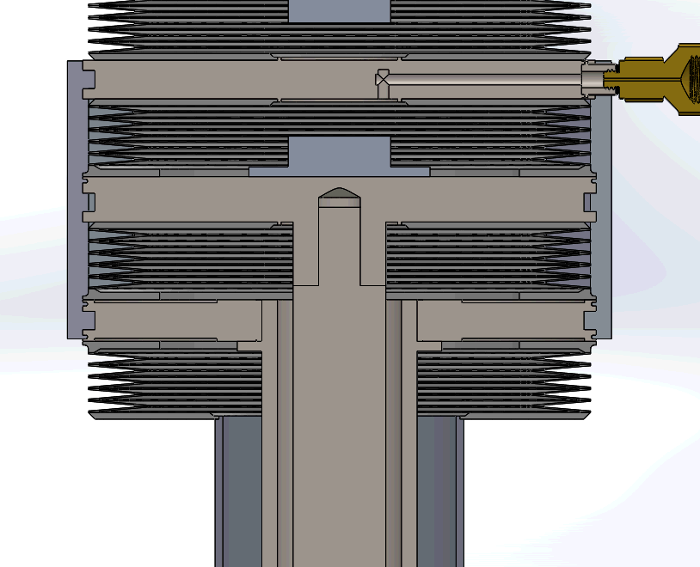
Actuator for Tuners
New design
  Re-use bellows we already have
  Simpler parts to make
  Easier assembly
  More reliable operation
Prototyping, functional and lifetime testing complete ➔ successful!
1
2
Old design

Slide 29
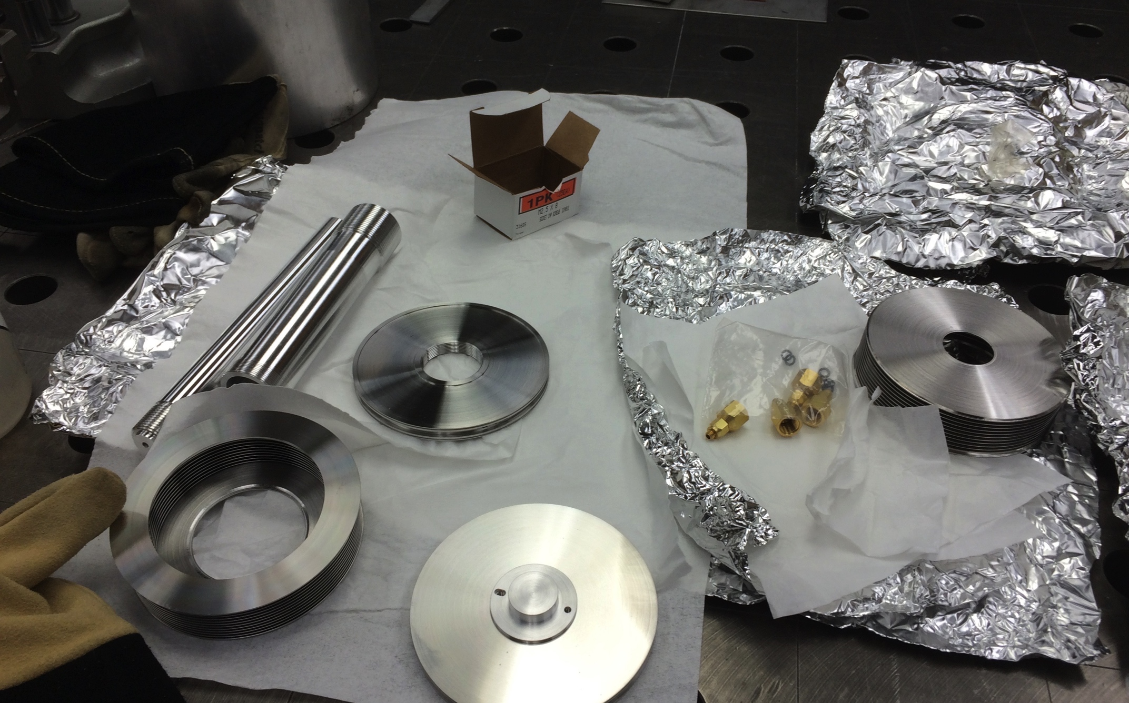
Actuator Parts Before Assembly

Slide 30
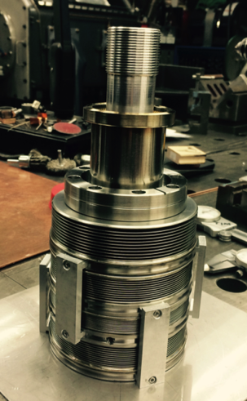
Functional Test of the Actuator
Agree well with previous testing results at Fermilab, lifetime testing started early May, but a leak was developed at one of the bellows after 1200 cycles at ± 80 psi (± ~ 200 kHz). A more meaningful and realistic testing plan is being developed/defined and the testing resume in June 2015.
The actuator has
been repaired:
broken bellows
has been replaced
and welded.

Slide 31
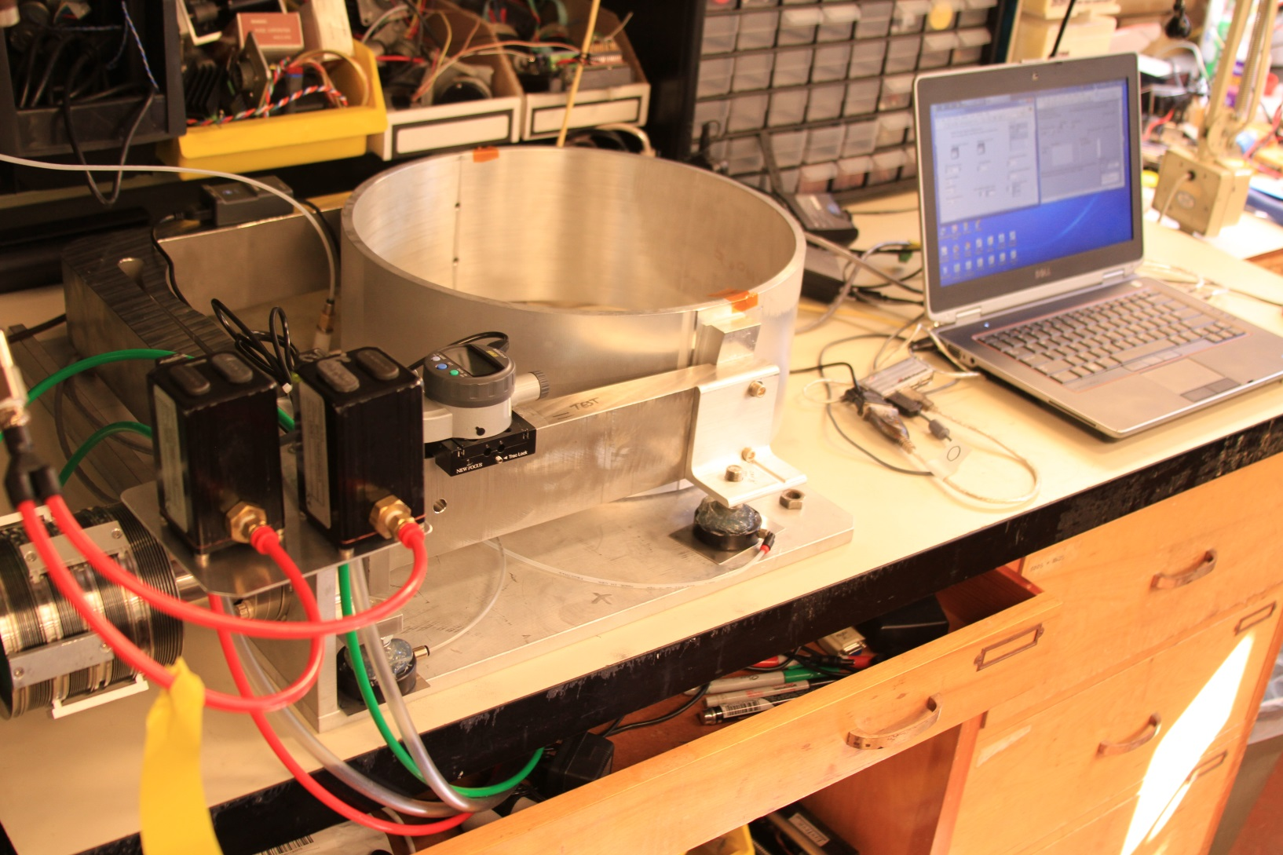
Lifetime Testing of the New Actuator
Testing setup at LBNL

Slide 32
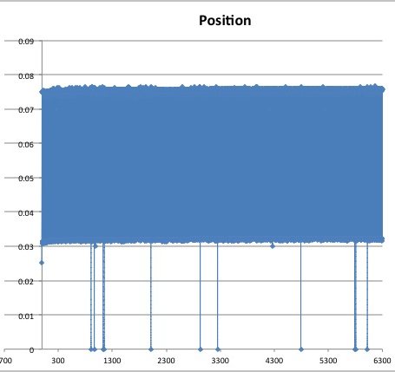
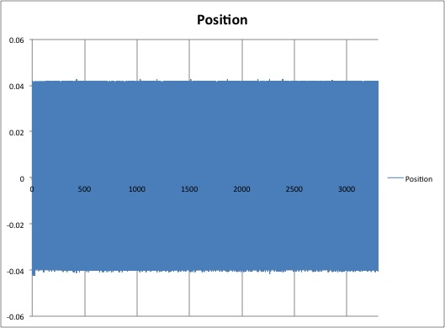
Successful Lifetime Testing
Lifetime testing programs
  ± 20 psi (± 50 kHz) at base pressure of 0, 15 and 30 psi for 10,000 cycles (each compartment) + 40 hours operation
    Base pressure equivalent to a frequency offset
    Pressure variation ➔ dynamic tuning
  All 3 sets of the testing complete
    Very smooth operation
    No hysteresis observed
  40 hours lifetime test complete & successful
Base pressure = 0 psi
Dynamic range = ± 20 psi
Base pressure = 15 psi
Dynamic range = ± 20 psi

Slide 33
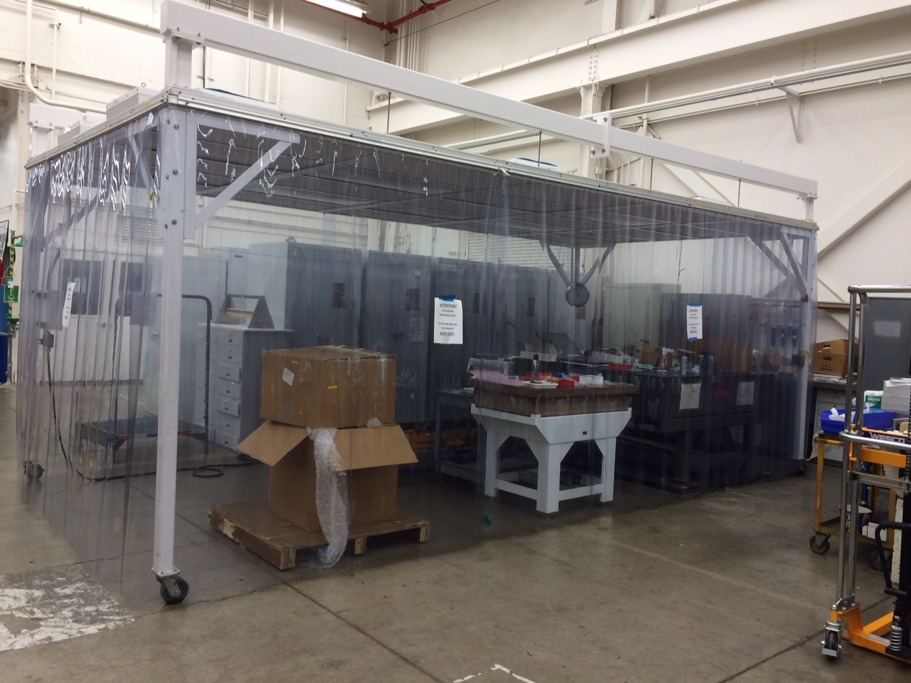
Preparation for RFM Assembly
Assembly of the RFM will start in January 2016
  Coordination of LBNL resources (manpower + facilities) started
  Support from LBNL management
    Technicians and assembly areas
  The assembly will be at LBNL assembly shop
    Access to crane
    Machine shop
    Plating shop (cleaning)
    Tools
  A portable clean room has
  been identified, possibly
  another larger one available
    Will add new filters
July 8, 2015

Slide 34
Summary
MICE RF module design complete
RFM fabrication started
Delivery date of two RF modules to RAL:
  1st in May and 2nd in June 2016 (details in MICE WBS)
Two RF module assembly will start at LBNL in January of 2016
  First one or two RF power couplers will be high power tested at MTA
  All hardware components must be ready by end of December of 2015
  Full characterization tests of tuners, low power RF measurement and coupler tuning to be conducted after final assembly
  Vacuum system testing

