Slide 1
Liquid Scintillator Vessels
Frank Calaprice
Princeton University

Slide 2
Two thin nylon vessels were developed for Borexino to contain the liquid scintillator.
Inner Vessel: 8.5 m diameter
Outer Vessel: 11.0 m diameter

Slide 3
Short History of The Borexino Vessels ~1990
The original plan to contain the scintillator was a thick acrylic vessel in water with an open structure to support the PMTs, identical to the SNO design.
Because pure PC attacks acrylic, the idea was to protect the inside surface with a thin film of Tedlar, an inert transparent fluoro-carbon.
A vessel had been ordered for the CTF from the Reynolds Company that was building the SNO acrylic vessel.
Since Reynolds was based in Huntington Beach CA, near my family, I volunteered to check on this order so I could enjoy time occasional visits with my family.
BAD IDEA! Tedlar didn’t bond well to the acrylic, and Reynolds got fed up with Borexino.
Thus began a long saga, first many months looking for a different cover for acrylic (a failed effort), and eventually embarking on a totally different plan for a transparent vessel that would be safe with PC.

Slide 4
Bob Parsells
Bob is a friend and engineer who thinks out of the box and had the crazy idea of making a thin “balloon” instead of a rigid vessel.
Thin films can be very clear if haze can be avoided.
More materials that are inert can be considered.
Thin vessel will produce less background than thick vessel with same radioactivity per kg.
Thin vessel can be made in a clean room, then folded up, shipped and installed underground.
A thin vessel is weak, which makes it difficult to contain 300 tons of scintillator.

Slide 5
The Stainless Steel Sphere
For the 4-ton CTF detector we were able to extrude clear nylon film with no haze with a thickness of 0.5 mm.
With hold-down ropes PC+PPO scintillator inside, this vessel could operate in water that is ~10% more dense than PC.
Bruce Vogelaar, then at Princeton, led the CTF vessel effort.
For the 300-ton Borexino scintillator the thin vessel requires nearly the same fluid density inside and outside.
Thus the scintillator and buffer fluids are both PC, but the Inner Vessel has PPO wavelength shifter, whereas the buffers have DMP, a quencher suggested by then postdoc Mark Chen.
These fluids are then held in a Stainless Steel Sphere that also serves as the support structure for the PMTs.
A film with thickness of 0.1 mm was used to allow the vessel to be folded and put in a hermetic box for shipping.

Slide 6
With Radical Change, much R&D
Develop extrusion of film without haze.
Amorphous, not crystalline
Develop solvent bonding to join panels.
Resorcinol solvent
Develop first “radon free” clean room.
Develop “vacuum swing” filter
Fabricate two vessels
About 6 people in cleanroom for one year.
Develop SF₆ leak test of final vessels.
Research ropes to hold vessel
Multi-strand Tensylon
Develop method to measure U, Th, K in nylon pellets.
Tosoh company in Japan
Measure diffusivity of radon in nylon.
Film thickness chosen to be similar to diffusion length of ²²²Rn in 5-day mean life.
Develop numerical methods to calculate membrane stress
Safe density difference ~ 0.1% (1 C)
Laura Cadonati (grad student) and NASA mathematician
Measure mechanical strength of film, joints, and endcaps

Slide 7
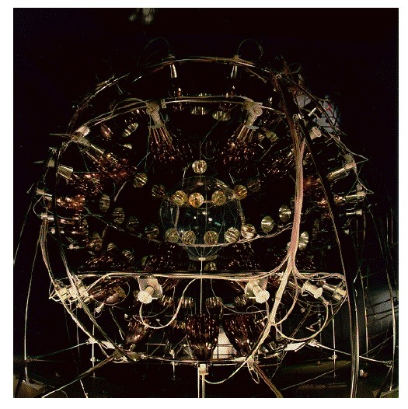
The CTF Vessel and PMTs

Slide 8
CTF Vessel Closeup

Slide 9
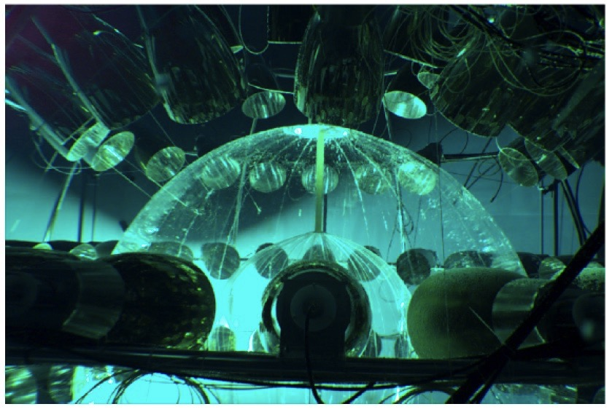
CTF3- 2 Vessels

Slide 10
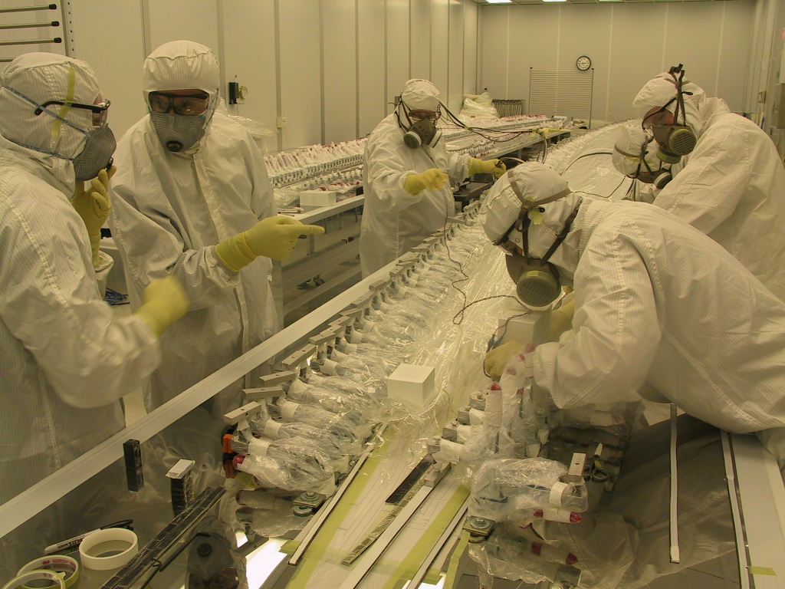
Nylon Scintillator Containment Vessel
John Bahcall
First hermetically sealed
cleanroom with low-radon
air.
Reduces radioactivity due
to dust and ²²²Rn daughters
★ ²¹⁰Pb (22 yr)
Nylon film developed for
low background use.
Fabricated in first low-radon
cleanroom of its kind.

Slide 11
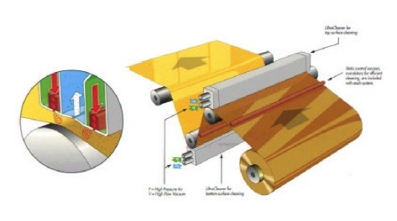
Ultrasonic cleaner

Slide 12
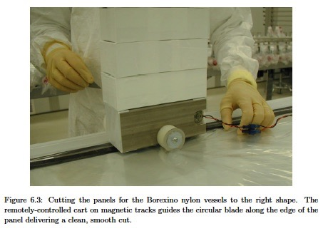
Cutting the Film

Slide 13
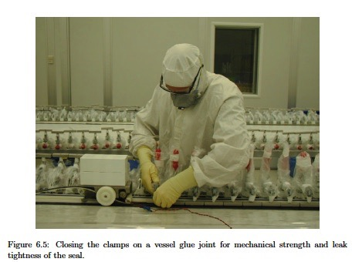
Setting the clamps

Slide 14
End cap structure

Slide 15
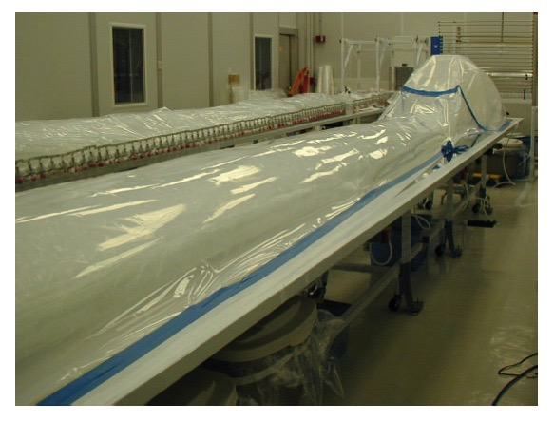
Leak Testing the Vessels

Slide 16
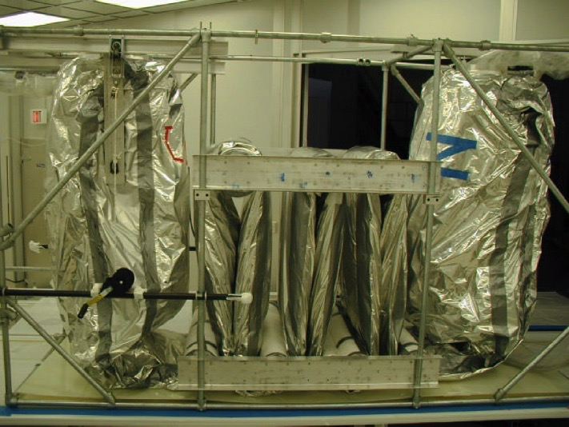
Shipping the vessel

Slide 17
Full Scale Test Vessel in Princeton Gym

Slide 18
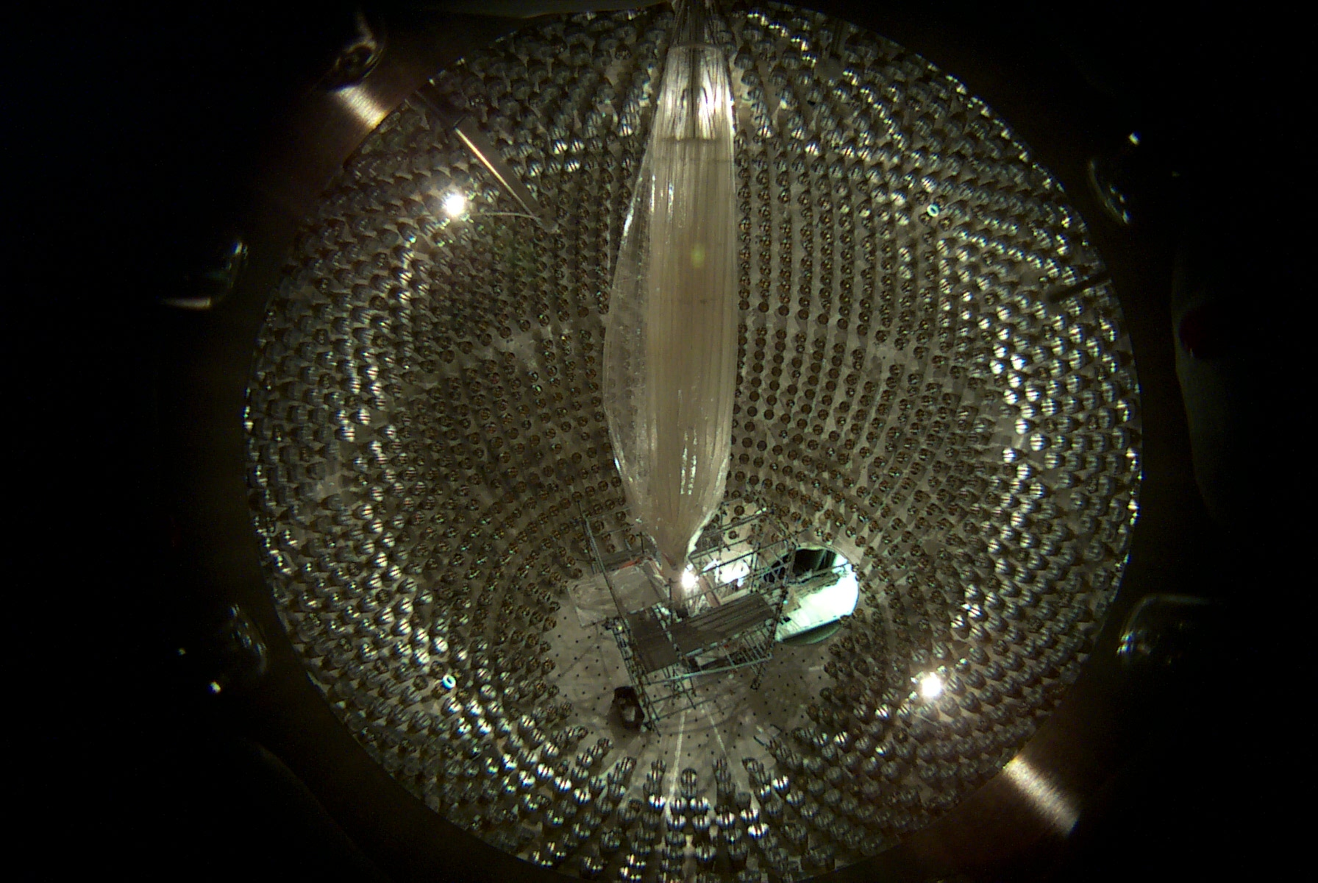
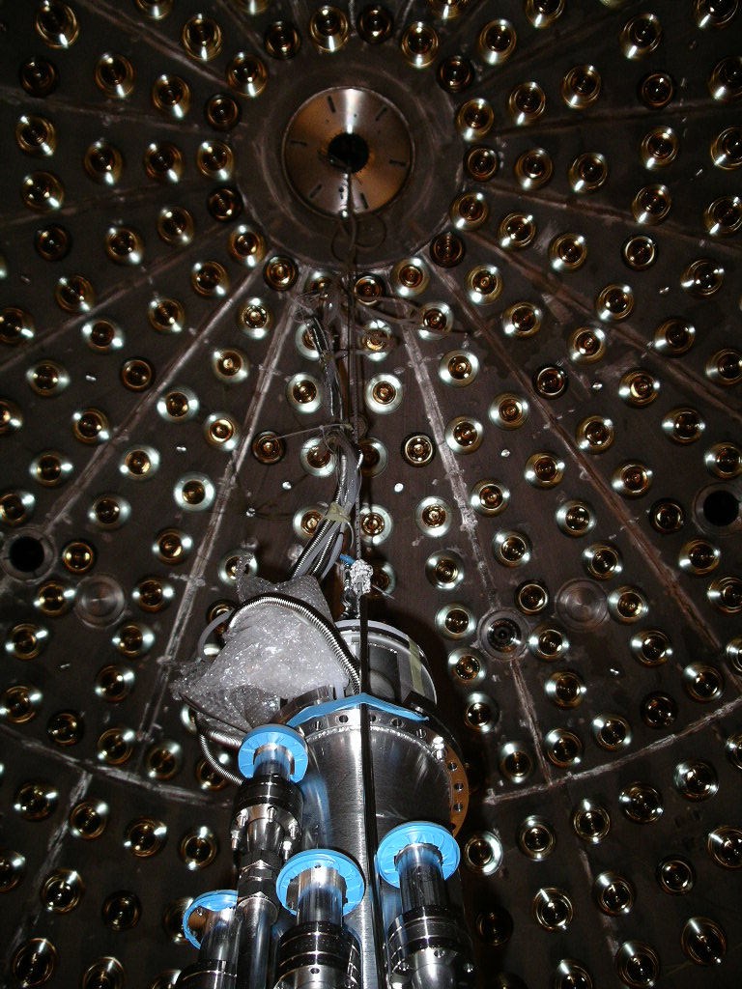
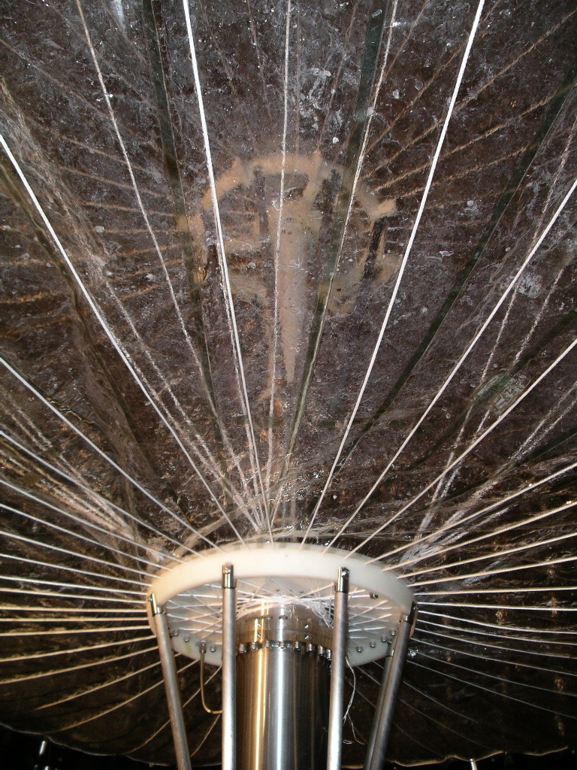
Vessel Installation / Inflation
Despite laboratory upgrades and the ban on fluid use, work on Borexino progressed.
2004 was a watershed year: the scintillator containment vessels, built over one year at Princeton, were installed and inflated to spherical shape.

Slide 19
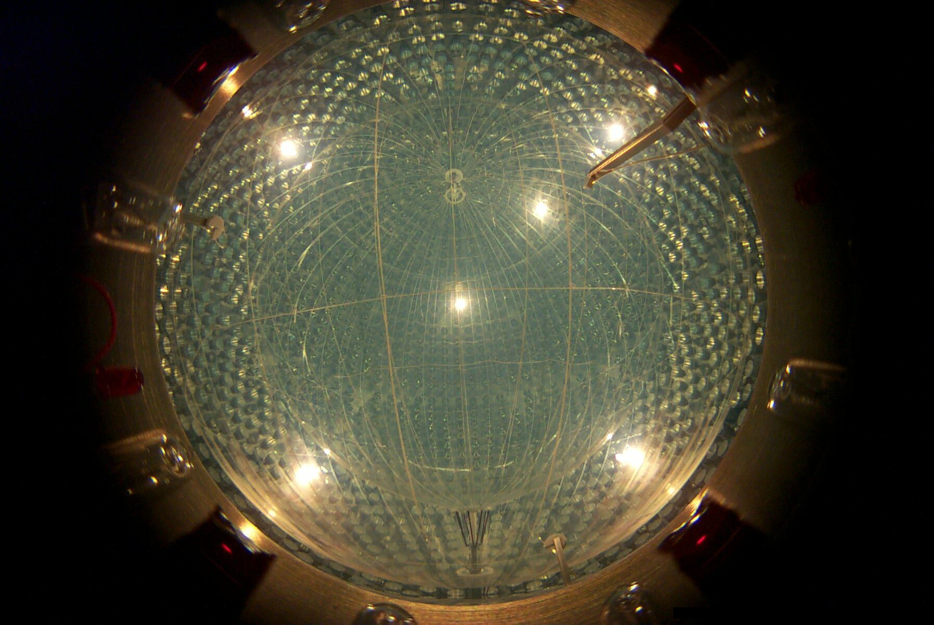

Slide 20
Performance of Nylon Vessels
✓Low rate of gamma rays from vessel.
✓Low rate of radioactivity from surface particulates, “dirt”
Demonstrated with low rate of ~10cpd of ²¹⁴Bi-²¹⁴Po near vessel.
No events in FV in more than one year.
High rate of ²¹⁰Pb on nylon surface.
Much higher rate than expected from exposure to low-radon air during fabrication. Rate is 100’s decays/day
Likely sources are water used for first filling and unusual fluid operations to mitigate vessel leak.
Standard water purification methods have poor efficiency to remove radon daughters in ground water.

Slide 21
Inner Vessel Performance : Excellent!
Light yield
Unchanged during 9 years of operation.
Scintillator was thoroughly de-gassed by N₂ stripping.
Decay rate of ²²²Rn (²¹⁴Bi-²¹⁴Po)
In Fiducial Volume: < 1 c/yr
In whole vessel: events are near the vessel surface.
Before N₂ stripping reduced water: ~10 cpd
After N₂ stripping that reduced water by half: ~ 5 cpd
²²²Rn rates agree with expected emanation from film with 0.75 ppt U, close to measured value of ~1 ppt
The low ²²²Rn rate in agreement with emanation from nylon film shows that emanation from particulates is negligible. No sign of particulates!

Slide 22
Future Vessels?
We produced enough film to make two sets of vessels for Borexinoin case of failure.
The film is in storage.
The clean room is operational.
The equipment to fabricate vessel is available.
The team is mostly gone.
A vessel sized for SNO+ is possible if people are available.

Slide 23
The End

