Slide 1
Resonant Extraction Instrumentation
Vladimir Nagaslaev
Contributions: P.Prieto, A.Ibrahim, V.Scarpine, B.Fellenz, R. Thurman-Keup, B.Drendel
Mu2e Technical Design Review for Beamlines, Controls and Instrumentation
October 6, 2015

Slide 2
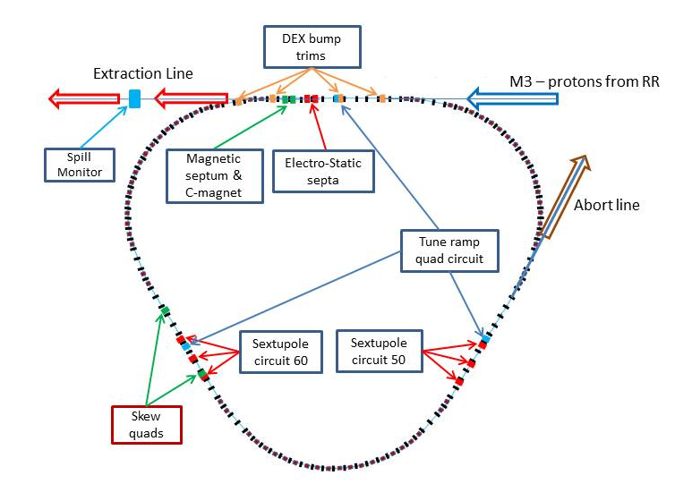
Mu2e Resonant Extraction – General Scheme
Delivery Ring (fka Debuncher)
Resonance: 3rd Integer
Driving H-tune to resonance
H-RF Knock Out (RFKO) system
Dynamic orbit control
ESS: foils instead of wires
Abort leftover beam
SS20-30
RFKO kicker
SS10-60
SS40-50

Slide 3
Mu2e Resonant Extraction - parameters
Parameter | Value | Units
MI Cycle time | 1.333 | sec
Number of spills per MI cycle | 8
Duration of each spill | 34-54 | msec
Number of protons per micro-pulse | (3.0-5.0)×10⁷ | protons
Maximum DR Beam Intensity | 1.0×10¹² | protons
Reset Time Gap between spills | 5 | msec
Operation point (Qx/Qy) | 9.650/9.735
Extraction efficiency | >98 | %
Spill uniformity | <50 | %

Slide 4
Mu2e Resonant Extraction - strategy
What is needed to achieve required performance
Extraction efficiency:
  Resonance strength, machine aperture, machine optics, etc.
  Orbit control
  Beam size
  Septa alignment
Spill uniformity:
  Fast and accurate spill monitoring
  Spill regulation logic
  Spill regulation means (RFKO, QXR)

Slide 5
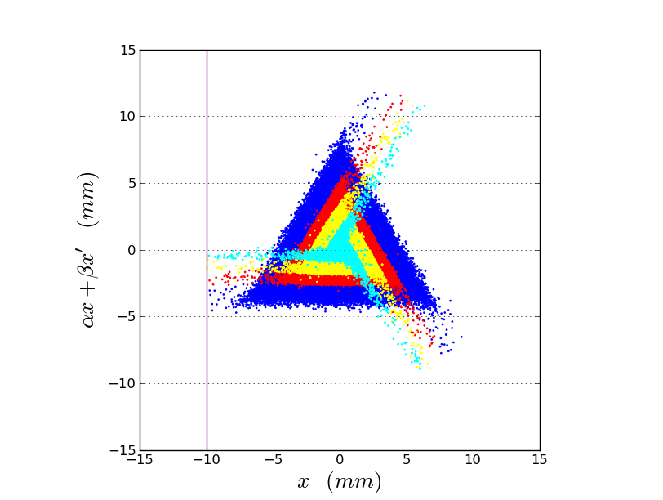
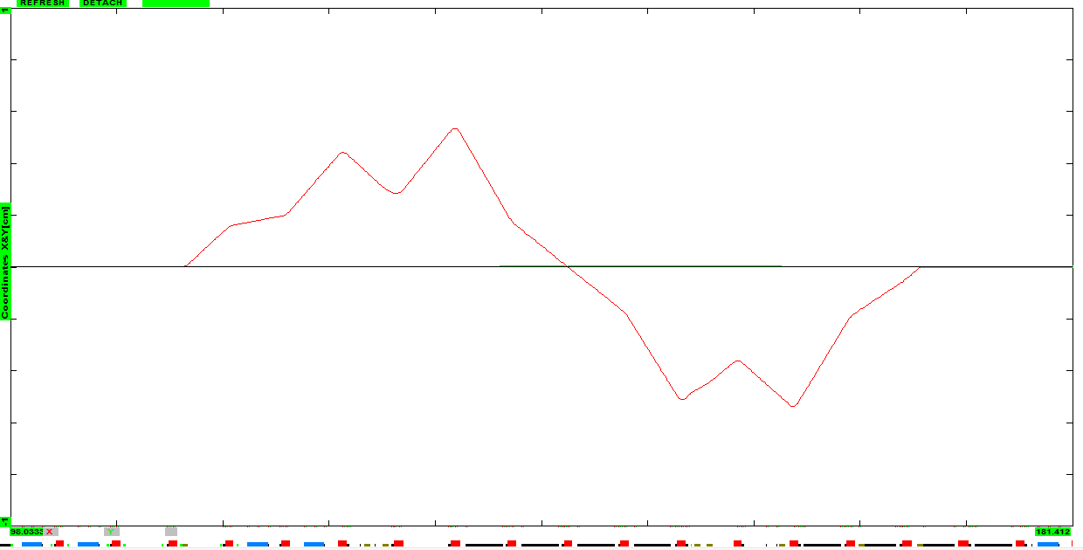
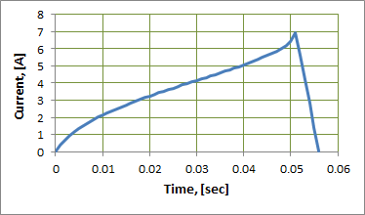
Delivery Ring BPM system (on DR AIP)
Orbit Control: Dynamic bump (DEX bump)
Develop bump
Verify bump leaks
Dynamic performance thru spill
COD (Closed Orbit) measurement, ~100u, ~1ms
0.4mR
1cm
2Q7
2Q5
3Q0
3Q3
3Q5
H210
H206
H301
H305
2Q10

Slide 6
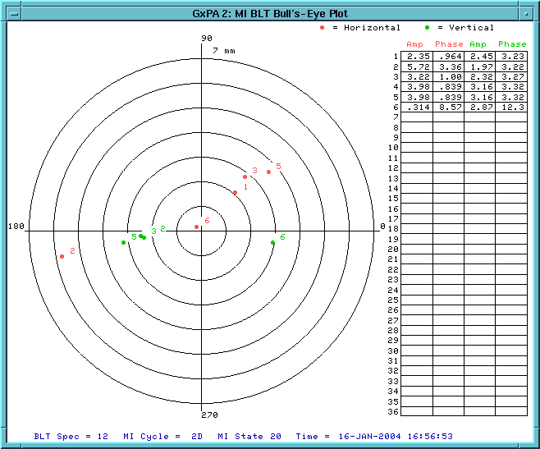
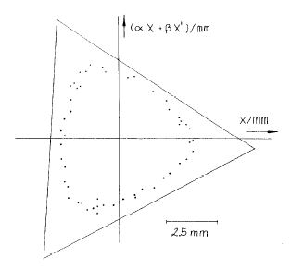
Delivery Ring BPM system (on DR AIP)
Injection oscillations
Important to have small initial beam
Monitor injection steering errors
BPM TBT (Turn-by-turn), Δ < 0.5mm
Resonance phase tuning
Phase of the separatrix at extraction
BPM TBT, Δ < 0.2mm
D.A. Edwards et al., FERMILAB-Pub-85/59

Slide 7
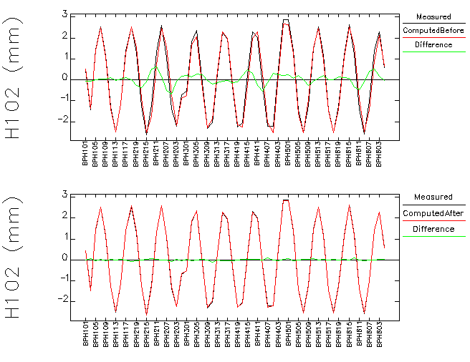
Machine optics measurements and global model
Response Matrix (RM) fitting
Multiple parameters involved:
  BPM errors
  Corrector errors
  Quad errors
  Magnet rolls (coupling)
Building the correct optics model from the data involves reconstruction of all these parameters
LOCO: global RM fit using SVD
Precise BPM CO measurement is crucial: Δ < 50 μ (≥1ms)
Debuncher RM fit, 2004

Slide 8
Beam Position Monitors (BPM)
Delivery Ring is equipped with BPM sensors
Upstairs electronics: Repurposing the existing hardware.
Hardware/software is similar to the RR BPM system
Transition boards conditioned for single bunch beam 2.4MHz/0.59MHz
More technical details can be found in beamdocs-438
Design of the BPM system is well understood
Off the project

Slide 9
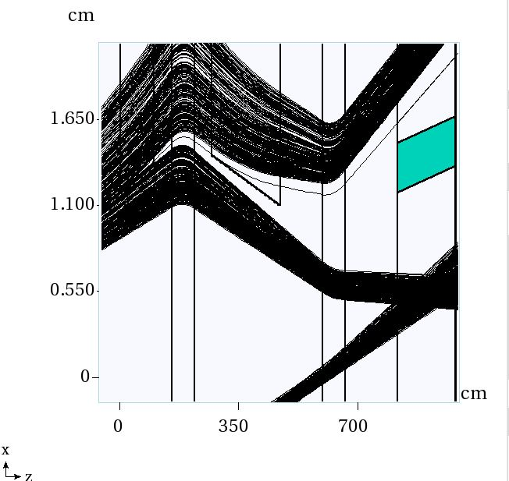
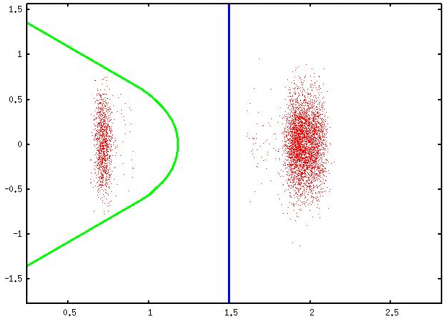
Tuning Extraction Efficiency: Loss Monitoring
Tracking beam through ESS and LAM
Septa alignment with beam - remotely controlled <25u
Efficiency measurements
Machine protection
Need an array of loss monitors around ESS and MS (LAM and C-mag)
Need a capability to determine at which part of the spill losses occur
Sensitivity better than 0.1% (1kHz)
Beam footprint in the LAM magnet

Slide 10
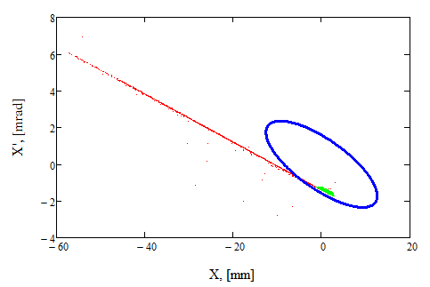
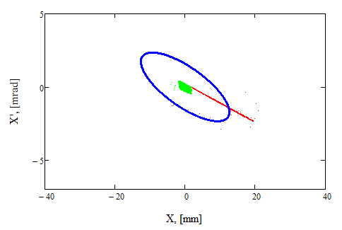
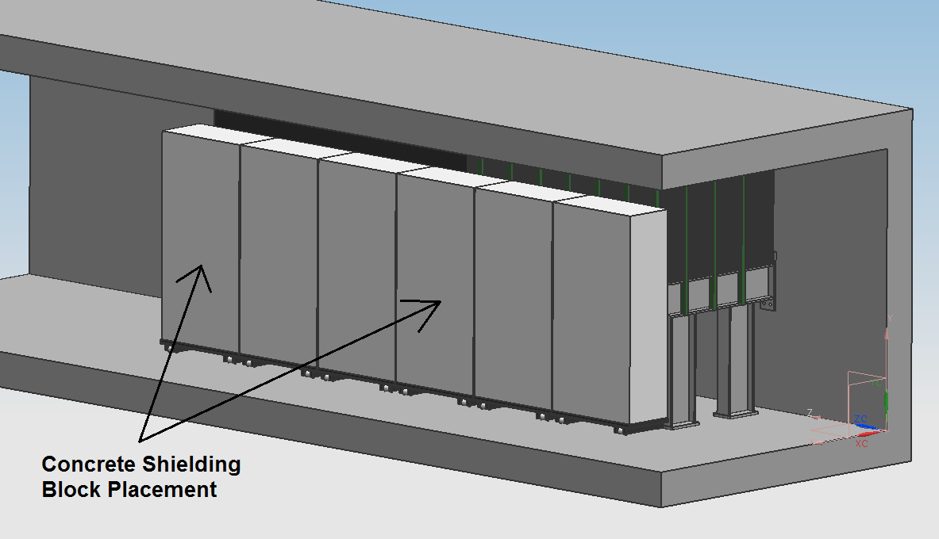
Localized and distributed losses due to SE
Total losses due to scattering in ESS1 1.5%
More than half of that is lost at extraction channel, the rest – downstream (DS).
Most of DS losses - in the ring
About 40% of ring losses occur at known narrow apertures.
Need to monitor and control losses better than 0.1% (1kHz)
Phase space of circulating beam
Phase space of extracted beam
Beam

Slide 11
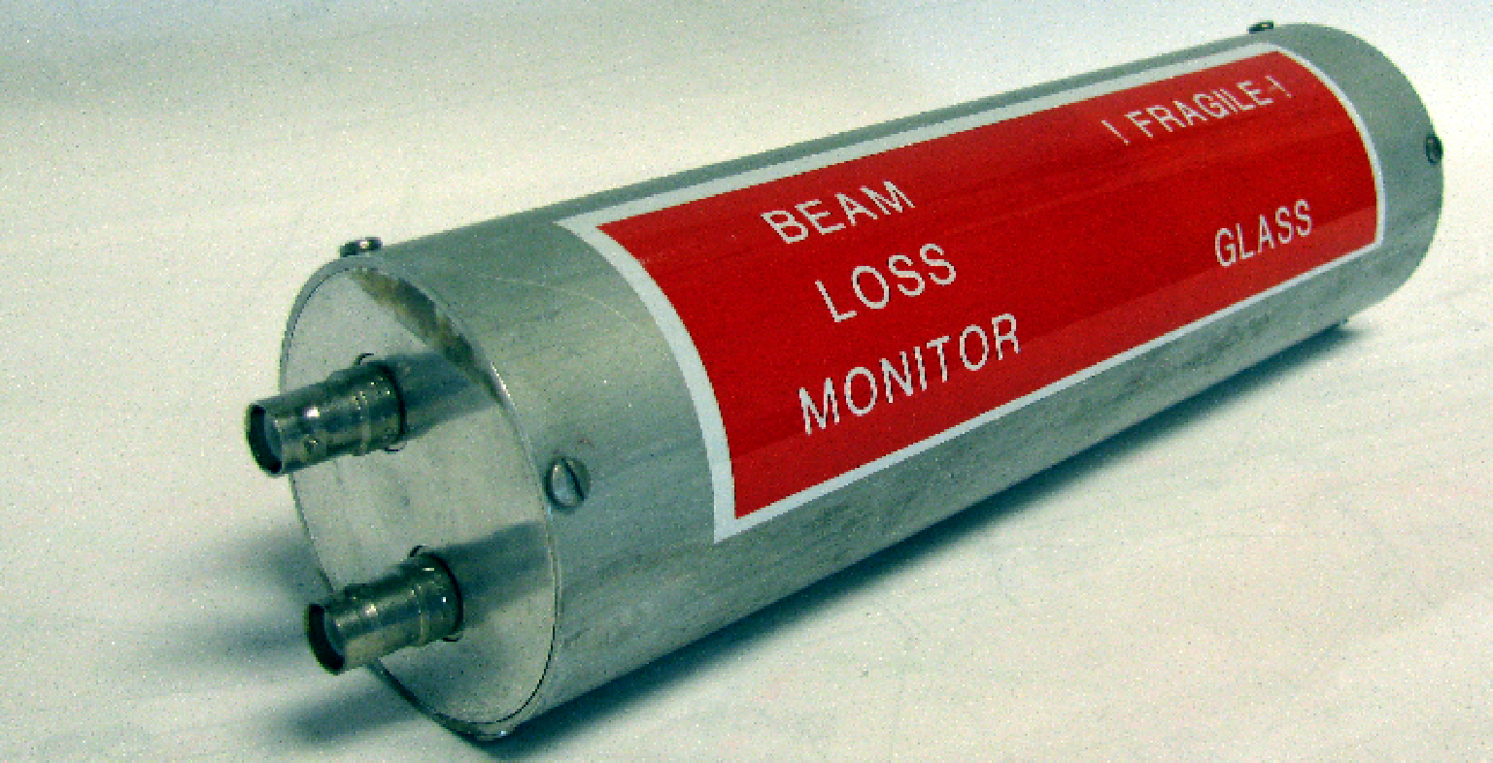
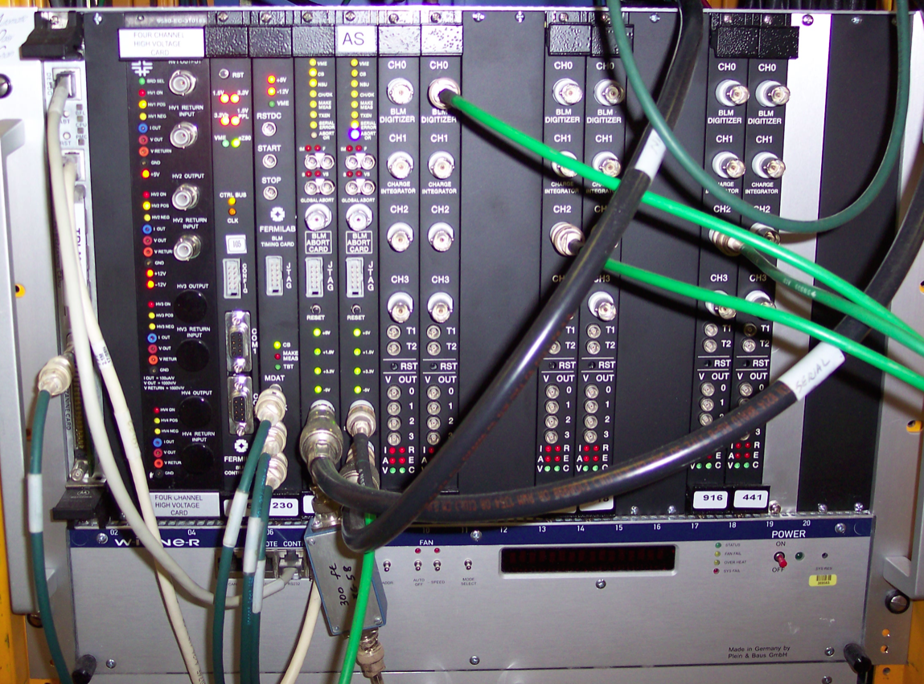
Delivery Ring BLM system (on DR AIP)
Reused from the Tevatron
60 LMs in the ring
High sensitivity at fast rates
Design of the BLM system well understood
Off the project
VME based
  8 Digitizer Cards (4 ch / card)
  Timing Card
  Abort Card
  Control Card
  High Voltage Card
  Crate Controller
One crate in each of 3 service buildings
For more details see Randy’s talk

Slide 12
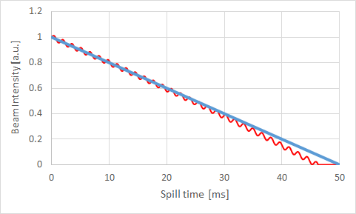
Spill regulation
Spill variation < ±50%
Average linear spill (LS) implemented through slow learning FF algorithm. Use the DCCT to establish LS
Spill-by-spill deviations from average are regulated with the PID FB loop
  Fast variations around average – “PD” loop, diagnosed by the Spill Monitor
  Cumulative deviations from average – “I” loop, may use DCCT as input
Fast spill rate variations
“PD” regulation loop
Average linear spill
Cumulative deviation
“I” regulation loop
Need decent DCCT frequency performance

Slide 13
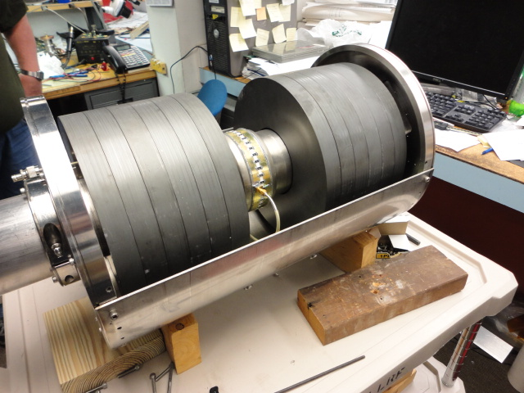
Spill Monitoring (on Mu2e Resonant Extraction)
Fast spill rate monitoring is required for effective regulation. A WCM Spill Monitor prototype has been built and tested.
This device will be used as a working module - no new fabrication is needed.
Additional monitoring will be provided by the Extinction Monitor
Notes:
Beam Intensity Monitors (DCCT)
A DC current transformer (DCCT) is a device used to measure the quantity of circulating beam with high precision. D:BEAM will become the beam intensity read back for the Delivery Ring. The Accumulator DCCT becomes a spare [2] [6]. Both systems have a full-scale range of 400mA (400e10). Measurements have shown nonlinear errors approaching ~2% for DC currents greater than 200mA. To maximize linearity, calibration procedure focus on doing a least square fit between 0-200mA. The system has an accuracy of one part in 10⁵ over the range of 1 x 10¹⁰ to 2 x 10¹² particles with a noise floor of 2 x 10⁹.
The existing tunnel device in the Delivery Ring can be reused, after applying some modifications. The Delivery Ring DCCT will not require any specific changes to the physical detector, but will need its analog conditioning and VME electronics modified for Mu2e operation. The Accumulator unit will become a working spare.
The pickups consist of two sets of supermalloy tape-wound toroidal cores with laminations, which act to reduce eddy currents. Beam goes through the hole of the donut and acts as a single turn on both toroid sets. The beam sensing electronics are attached to wire windings on each of the toroid sets. One set of cores (T1 & T2) is driven into saturation with 800Hz sinusoidal drive signal. Passing beam induces net magnetic flux on this set of cores, and a second harmonic of the drive signal is detected in the sense winding. The electronics processes this signal and produces an equal and opposite current that minimizes the harmonic and thus keeps the net toroid flux at zero. The second set of cores (T3) is not driven into saturations and follows classical transformer theory. This signal detected processed by the electronics to extend the bandwidth of the entire system. The combination of the resulting signal from processing each sense winding produces the complete feedback signal.
As shown in 6, the receiver chassis provides 3 different sets of analog outputs. Each has a different voltage range and bandwidth, based on modification in the receiver electronics. In order to best measure both the injected and leftover Delivery Ring beam, the following configurations were chosen.
1 Hz bandwidth with 40 mA/V scale. This output is routed to a Keithley digital voltmeter (DVM) located in a rack in the AP10 control room. The Keithley DVM is a GPIB device that talks to the control system through the AP1001 front end, resulting in the D:IBEAM readback that updates once per second with a scale in the mA particle range. Due to the slow 1 Hz sample rate, D:IBEAM is not useful to measure Mu2e slow extracted beam, but will be used for circulating beam studies, diagnostic studies, or calibrations. Maintaining this device also will provide backward compatibility to other intensity algorithms running on AP1001.
400Hz bandwidth with 40 mA/V scale. This output will simultaneously provide 2 readback devices in the control system. One device, D:IBEAMB, is processed through an MADC, using the standard CAMAC 190 card communicating through the Pbar CAMAC front end. At a 720Hz update rate, this 12bit readback effectively provides 40 samples of beam intensity measurements in the mA particle range over the 56msec spill. Although this device would allow us to measure the injected beam and beam through the slow spill cycle, D:IBEAMB is primarily intended for diagnostic purposes. In addition, this output will provide a second device, D:BEAM, which output is sampled by a VME front end after conditioned thru a buffer amplifier (see later description of PBEAM). D:BEAM is intended to be primary measurement of the injected beam and the beam through the slow spill cycle.
400Hz bandwidth with 5 mA/V scale. This output, D:IBEAMV will drive a buffer amplifier, whose output is sampled by a VME front end (see later description of PBEAM). This intensity readback in the uA range will provide the best measurement the leftover beam after slow spill has finished.
The DCCT noise levels are essentially the same in these outputs. The noise of the Debuncher DCCT is about 1.4uA rms for both the 5 and 40mA/V outputs (square root of the sum of the squares from 1 to 58Hz). The Accumulator measures 2.2uA rms.
PBEAM is a VME front end located in AP10. The front end includes a five-slot VME crate with a Motorola MVME-2401 controller. An ICS-110BL-8B provides 4 differential 24 bit ADC channels delivering 18 bits of accuracy. A PMC-UCD provides TCLK and allows ACNET channels that track beam intensity measured on event. (MDAT can also be supported if desired.) Originally, it instrumented such that a single input to the digitizer was from each pbar DCCT systems (i.e. one for Debuncher and another for Accumulator). Since the Accumulator now becomes a spare system, the VME front end will be modified so that both inputs to the digitizer will be from one DCCT system (i.e. Debuncher). One channel will be feed from the 40mA/V receiver chassis output, while the other from 5mA/V. A conditioning amplifier would be used for filtering and to provide a differential inputs to the ADC. The Debuncher signals would be filtered, amplified and driven differentially to the ADC about 50 feet away, located above the Accumulator DCCT. The digitizer oversamples the 400 Hz DCCT outputs at 720 Hz and can provide readbacks with a resolution on the order of a sliding average of twelve 720 Hz samples. Digital signal processing will allow us to measure the injected beam and beam through the slow spill cycle as well as measure the leftover beam after slow spill has finished. The proposed digitizer has the dynamic range to measure the full 400mA range while providing ½ uA rms resolution. Processing the signals digitally will also improve accuracy. The DCCT’s provide between 1 and 2 uA rms provided the 60Hz harmonics are removed.
PBEAM was designed to provide stable readback that is fast enough to sample Delivery Ring beam at various times during the slow spill cycle. D:BEAM is the Delivery Ring Beam Current or main intensity device and is used to derive other arrayed data. PBEAM also provides two other sets of devices that records beam measurements on event. One type is called the fixed-event devices. These will be labeled as D: BEAMXX, where XX is the TCLK reset event. Fixed-event devices will be an array device, containing up to 6 devices. Another time of device is a variable-triggered-event device. It is also an arrayed device, which will be labeled as D:BEAMx. This deivce contains 10 elements, and x will represent the index. Each element will have a settable TCLK event and delay, measured in seconds. The TCLK event is set via the “Timer Reference” selection on a parameter page. The delay is the D/A setting and the intensity readback is the A/D reading.

Slide 14
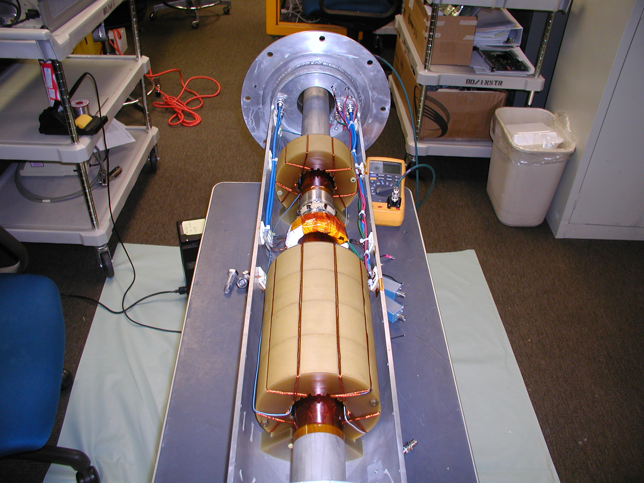
Delivery Ring Instrumentation: DCCT (on Mu2e)
Delivery Ring DCCT hardware repurposed.
Analog conditioning and VME electronics modified for Mu2e operation.
Measured rms 1e7 @ 100Hz
Limited performance in the end
of spill
Existing design
Notes:
Beam Intensity Monitors (DCCT)
A DC current transformer (DCCT) is a device used to measure the quantity of circulating beam with high precision. D:BEAM will become the beam intensity read back for the Delivery Ring. The Accumulator DCCT becomes a spare [2] [6]. Both systems have a full-scale range of 400mA (400e10). Measurements have shown nonlinear errors approaching ~2% for DC currents greater than 200mA. To maximize linearity, calibration procedure focus on doing a least square fit between 0-200mA. The system has an accuracy of one part in 10⁵ over the range of 1 x 10¹⁰ to 2 x 10¹² particles with a noise floor of 2 x 10⁹.
The existing tunnel device in the Delivery Ring can be reused, after applying some modifications. The Delivery Ring DCCT will not require any specific changes to the physical detector, but will need its analog conditioning and VME electronics modified for Mu2e operation. The Accumulator unit will become a working spare.
The pickups consist of two sets of supermalloy tape-wound toroidal cores with laminations, which act to reduce eddy currents. Beam goes through the hole of the donut and acts as a single turn on both toroid sets. The beam sensing electronics are attached to wire windings on each of the toroid sets. One set of cores (T1 & T2) is driven into saturation with 800Hz sinusoidal drive signal. Passing beam induces net magnetic flux on this set of cores, and a second harmonic of the drive signal is detected in the sense winding. The electronics processes this signal and produces an equal and opposite current that minimizes the harmonic and thus keeps the net toroid flux at zero. The second set of cores (T3) is not driven into saturations and follows classical transformer theory. This signal detected processed by the electronics to extend the bandwidth of the entire system. The combination of the resulting signal from processing each sense winding produces the complete feedback signal.
As shown in 6, the receiver chassis provides 3 different sets of analog outputs. Each has a different voltage range and bandwidth, based on modification in the receiver electronics. In order to best measure both the injected and leftover Delivery Ring beam, the following configurations were chosen.
1 Hz bandwidth with 40 mA/V scale. This output is routed to a Keithley digital voltmeter (DVM) located in a rack in the AP10 control room. The Keithley DVM is a GPIB device that talks to the control system through the AP1001 front end, resulting in the D:IBEAM readback that updates once per second with a scale in the mA particle range. Due to the slow 1 Hz sample rate, D:IBEAM is not useful to measure Mu2e slow extracted beam, but will be used for circulating beam studies, diagnostic studies, or calibrations. Maintaining this device also will provide backward compatibility to other intensity algorithms running on AP1001.
400Hz bandwidth with 40 mA/V scale. This output will simultaneously provide 2 readback devices in the control system. One device, D:IBEAMB, is processed through an MADC, using the standard CAMAC 190 card communicating through the Pbar CAMAC front end. At a 720Hz update rate, this 12bit readback effectively provides 40 samples of beam intensity measurements in the mA particle range over the 56msec spill. Although this device would allow us to measure the injected beam and beam through the slow spill cycle, D:IBEAMB is primarily intended for diagnostic purposes. In addition, this output will provide a second device, D:BEAM, which output is sampled by a VME front end after conditioned thru a buffer amplifier (see later description of PBEAM). D:BEAM is intended to be primary measurement of the injected beam and the beam through the slow spill cycle.
400Hz bandwidth with 5 mA/V scale. This output, D:IBEAMV will drive a buffer amplifier, whose output is sampled by a VME front end (see later description of PBEAM). This intensity readback in the uA range will provide the best measurement the leftover beam after slow spill has finished.
The DCCT noise levels are essentially the same in these outputs. The noise of the Debuncher DCCT is about 1.4uA rms for both the 5 and 40mA/V outputs (square root of the sum of the squares from 1 to 58Hz). The Accumulator measures 2.2uA rms.
PBEAM is a VME front end located in AP10. The front end includes a five-slot VME crate with a Motorola MVME-2401 controller. An ICS-110BL-8B provides 4 differential 24 bit ADC channels delivering 18 bits of accuracy. A PMC-UCD provides TCLK and allows ACNET channels that track beam intensity measured on event. (MDAT can also be supported if desired.) Originally, it instrumented such that a single input to the digitizer was from each pbar DCCT systems (i.e. one for Debuncher and another for Accumulator). Since the Accumulator now becomes a spare system, the VME front end will be modified so that both inputs to the digitizer will be from one DCCT system (i.e. Debuncher). One channel will be feed from the 40mA/V receiver chassis output, while the other from 5mA/V. A conditioning amplifier would be used for filtering and to provide a differential inputs to the ADC. The Debuncher signals would be filtered, amplified and driven differentially to the ADC about 50 feet away, located above the Accumulator DCCT. The digitizer oversamples the 400 Hz DCCT outputs at 720 Hz and can provide readbacks with a resolution on the order of a sliding average of twelve 720 Hz samples. Digital signal processing will allow us to measure the injected beam and beam through the slow spill cycle as well as measure the leftover beam after slow spill has finished. The proposed digitizer has the dynamic range to measure the full 400mA range while providing ½ uA rms resolution. Processing the signals digitally will also improve accuracy. The DCCT’s provide between 1 and 2 uA rms provided the 60Hz harmonics are removed.
PBEAM was designed to provide stable readback that is fast enough to sample Delivery Ring beam at various times during the slow spill cycle. D:BEAM is the Delivery Ring Beam Current or main intensity device and is used to derive other arrayed data. PBEAM also provides two other sets of devices that records beam measurements on event. One type is called the fixed-event devices. These will be labeled as D: BEAMXX, where XX is the TCLK reset event. Fixed-event devices will be an array device, containing up to 6 devices. Another time of device is a variable-triggered-event device. It is also an arrayed device, which will be labeled as D:BEAMx. This deivce contains 10 elements, and x will represent the index. Each element will have a settable TCLK event and delay, measured in seconds. The TCLK event is set via the “Timer Reference” selection on a parameter page. The delay is the D/A setting and the intensity readback is the A/D reading.

Slide 15
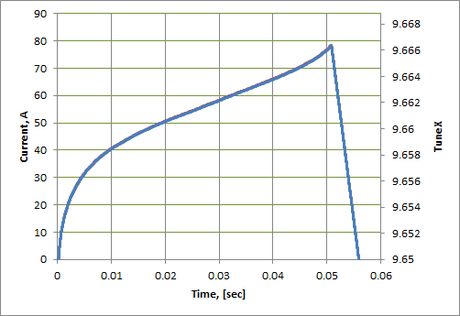
Tune control (on Mu2e)
Spill is controlled by ramping the circuit of 3 CQA quads. The ramp curve is formed to create a uniform spill.
SE is extremely sensitive to the machine tune errors.
Need to monitor the tune ramp
Analyze the tune performance to detect possible ripple effects
Want to have a diagnostics to follow the horizontal beam size during the spill
Quad/tune ramp curve for a 50ms spill
Squeezing the beam in the separatrix

Slide 16
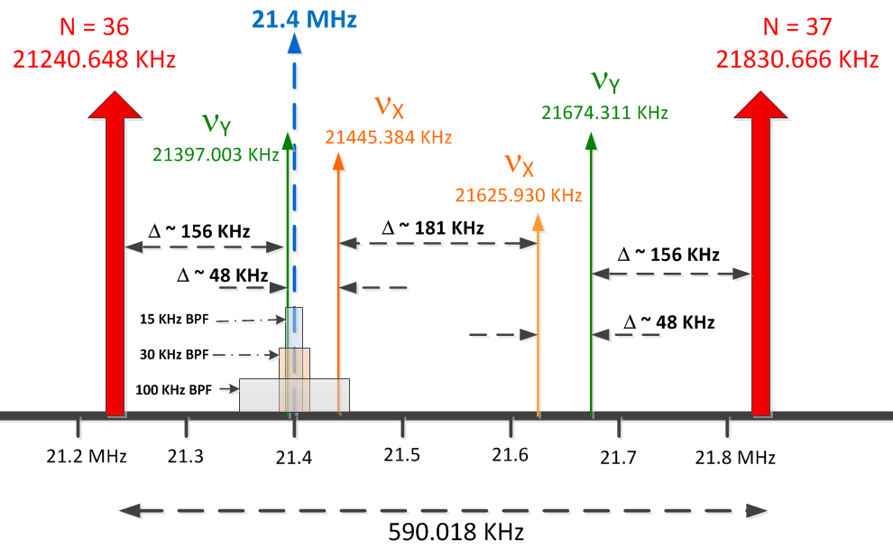
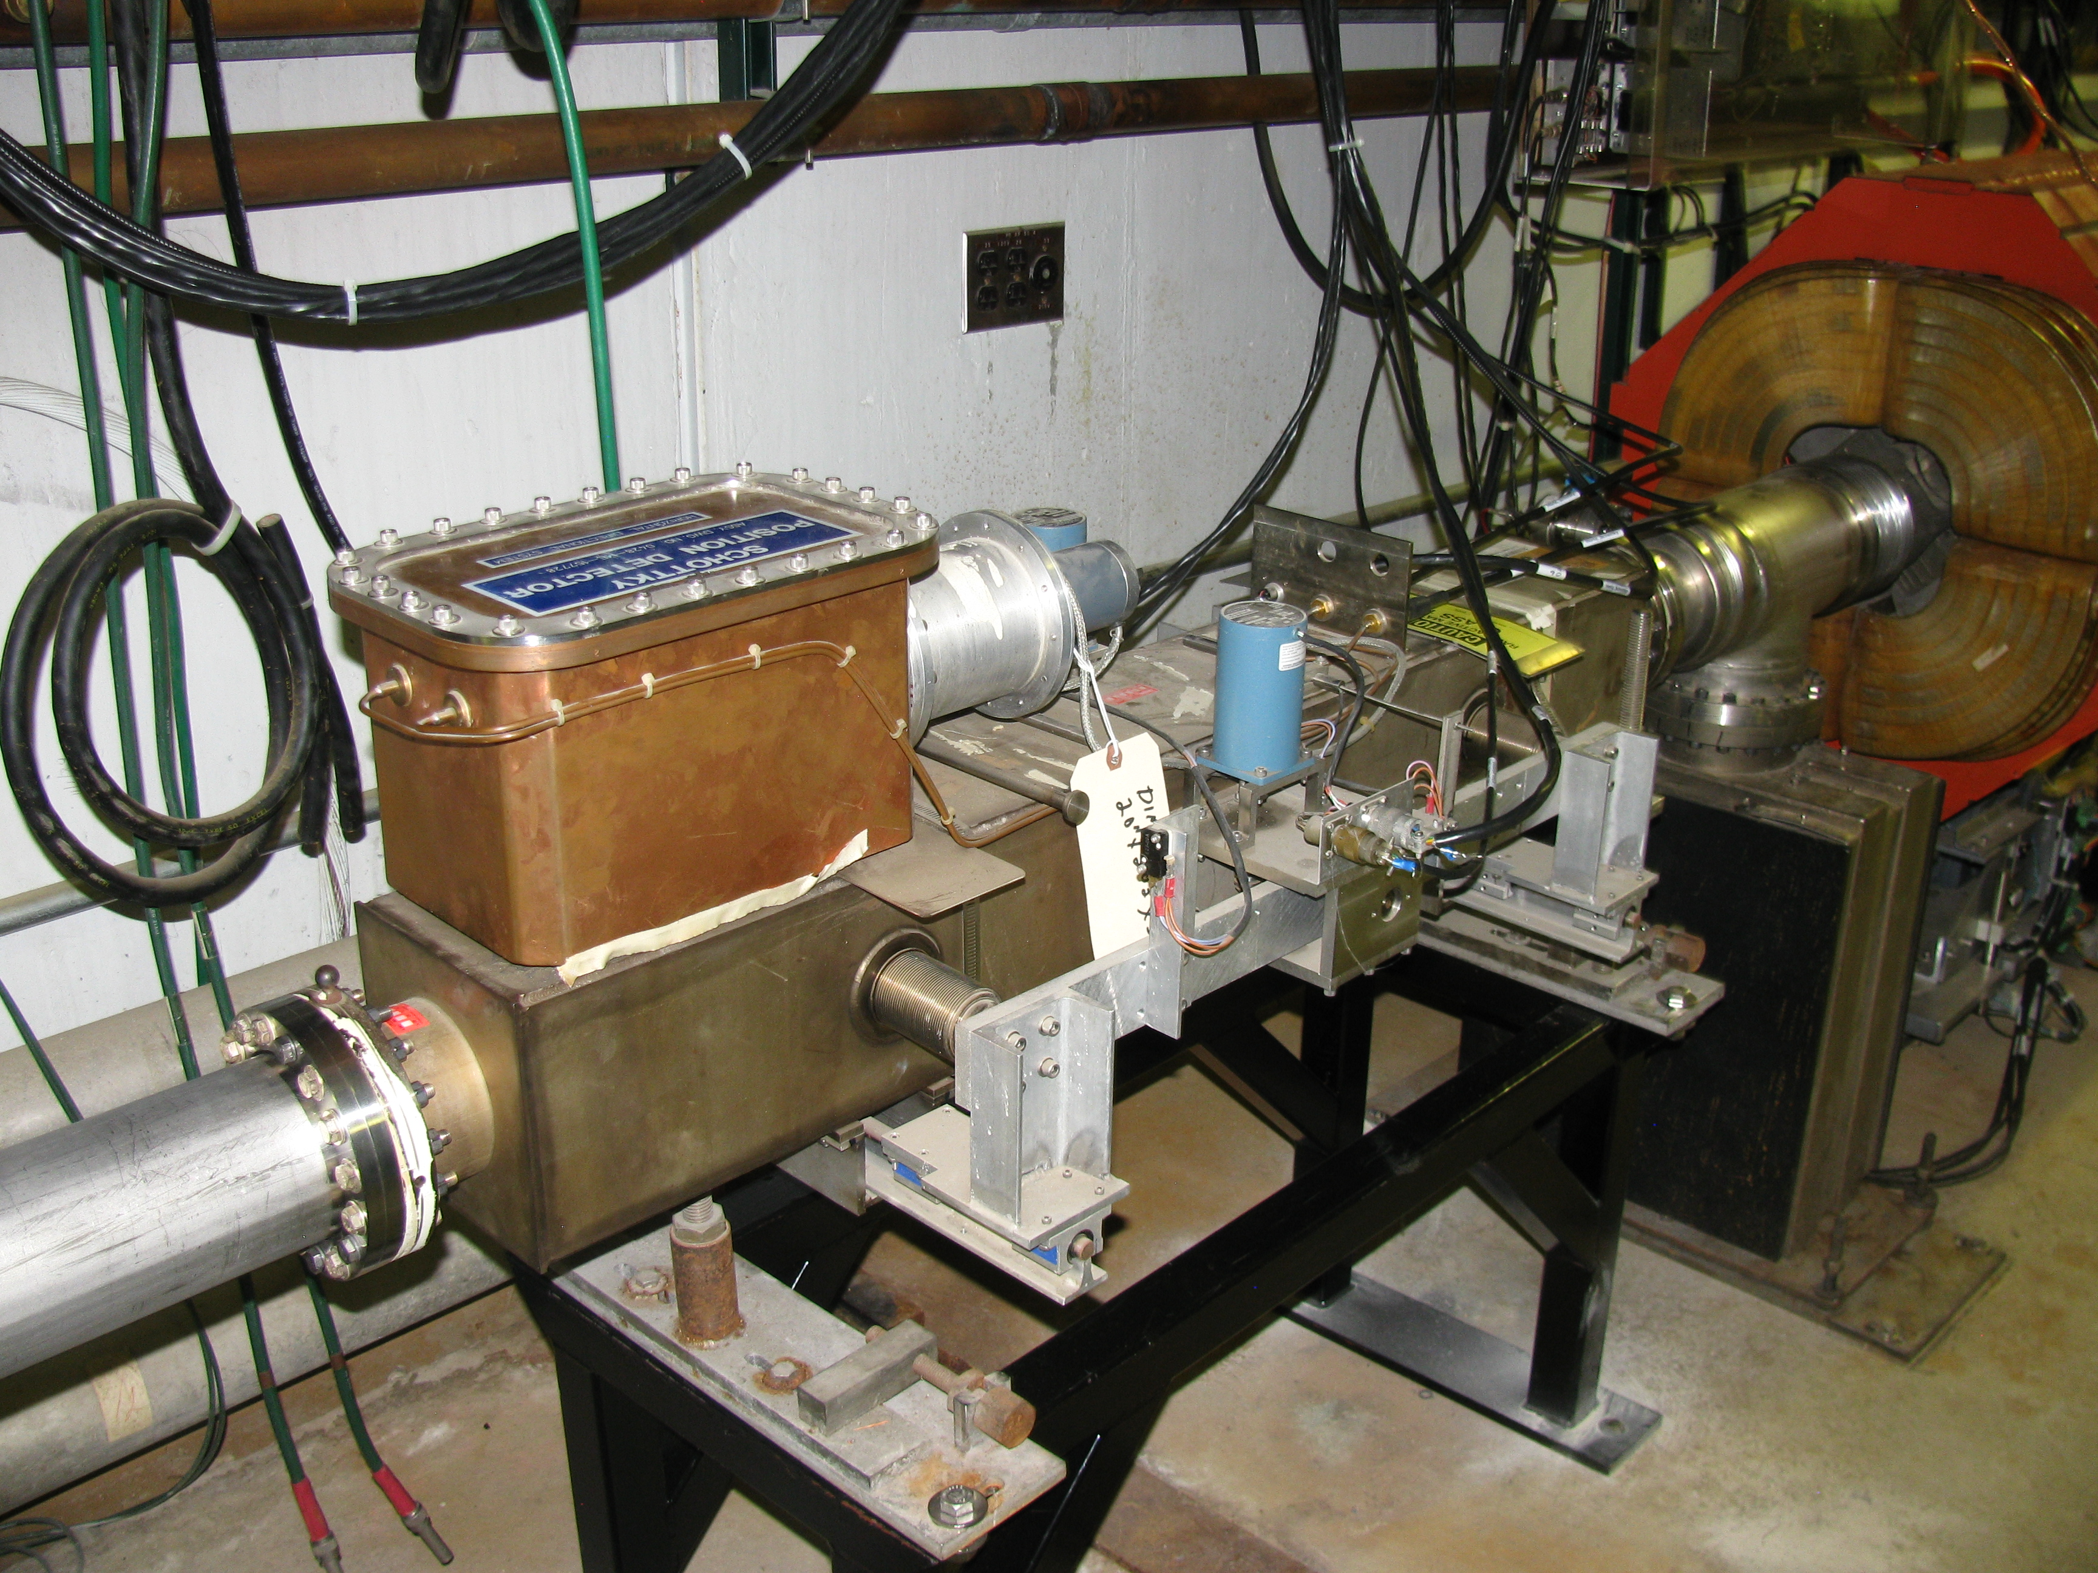
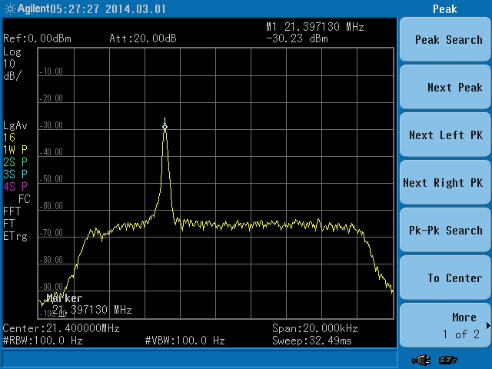
Tune Measurement with TeV Schottky
Use digital signal processing to produce tunes
  Tunes to ±0.001 at 590 Hz
  Tunes to ± 0.0001 with averaging over many spills
Need to develop design of emittance monitoring
Demonstrated feasibility with beam studies
Notes:
Delivery Ring Tune Measurement
The Delivery Ring is a resonant extraction machine that will require a tune measurement system. The delivery ring tune measurement system will need to measure the average tune and the tune spectrum through the entire 56 ms resonant extraction cycle. These tune measurements will have a resolution of 0.001 at 600 Hz and 0.0001 using averaging. In addition to measuring tune, the system will measure transverse emittance using information from the tune spectrum.
The delivery ring tune measurements will consist of a Schottky detector system, which has the advantage of being non-destructive to the beam and can measure transverse emittance. The challenge is achieving the desired accuracy at an adequately fast update rate.
The Schottky detector system consists of 21.4 MHz resonant pickups taken from the decommissioned Tevatron accelerator as well as its receiver electronics. The 21.4 MHz resonant pickups are two separate horizontal and vertical units with one meter long copper electrodes with stepper motor driven adjustable aperture. The picture above shows the vertical pickup unit with attached 21.4 MHz resonator. The Schottky system will measure the tune spectrum and transverse emittance.
A period of beam studies will be required to optimize the Schottky detectors for Delivery Ring operation. Optimal tune measurement will require selection of appropriate band pass filters (BPFs). A block diagram of the electronics setup is shown above. Both upper and lower sidebands for the horizontal and vertical tunes fall far enough away from the revolution harmonics to allow valid tune measurements with appropriately chosen band pass filters.
Filter out revolution harmonics
Down convert from 36th/37th harmonics to 1st harmonic (0 to 590 KHz)
Use 24-bit ADC to sample signal
2 to 4 MHz sampling
100 db dynamic range
Use digital signal processing to produce tunes
0.001 tunes at 590 Hz
0.0001 tunes with averaging over many spills
Beam Parameters:
Peak intensity: 1e12 protons
Beam energy: 8 GeV
Bunch structure: Single 2.5 MHz bunch
Nominal bunch length: 40 ns
Bunch base width: 200 ns
Resonant slow-spill extraction over 58 ms
30e6 protons extracted per turn
Tune Parameters:
Nominal tunes
ν_{x} = 9.653
ν_{y} = 9.735
Buncher revolution freq: 590.018 KHz
Measurement Requirements:
Measure tune and transverse emittance
Measure tune throughout slow-spill
Tune resolution:
0.0001 (with averaging)
0.001 @ 600 Hz

Slide 17
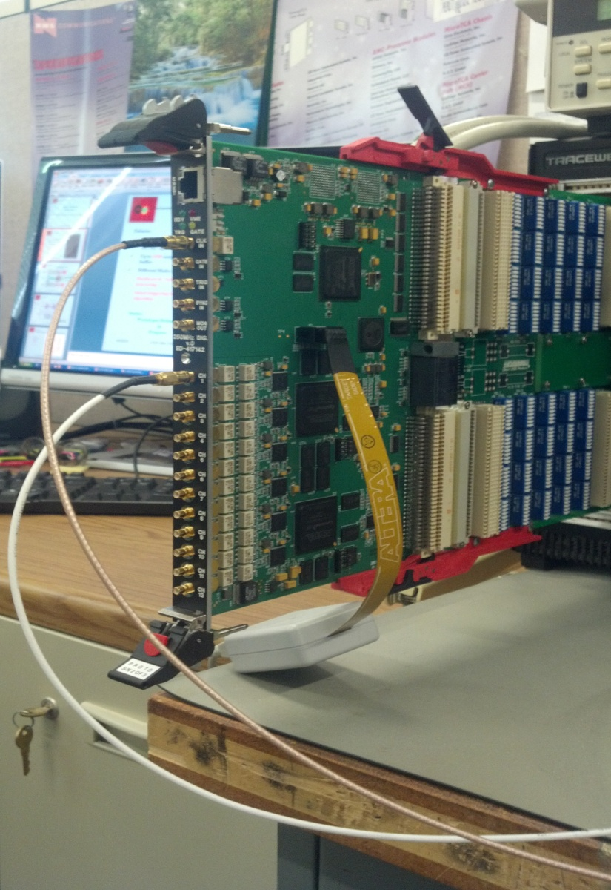
Tune Measurement
Tune tracker:
12 channels, 14 bit at 6U VME Board
DC/AC- up to 250MSPS Operation
Up to 64M sample per channel DDR2 buffer
Different Modes (12) of Operation
Hardware & Software onboard data processing
Smart triggering based on FPGA algorithm
12Ch 14bit 250MHz VME/VXS Digitizer A.Semenov
Notes:
Delivery Ring Tune Measurement
The Delivery Ring is a resonant extraction machine that will require a tune measurement system. The delivery ring tune measurement system will need to measure the average tune and the tune spectrum through the entire 56 ms resonant extraction cycle. These tune measurements will have a resolution of 0.001 at 600 Hz and 0.0001 using averaging. In addition to measuring tune, the system will measure transverse emittance using information from the tune spectrum.
The delivery ring tune measurements will consist of a Schottky detector system, which has the advantage of being non-destructive to the beam and can measure transverse emittance. The challenge is achieving the desired accuracy at an adequately fast update rate.
The Schottky detector system consists of 21.4 MHz resonant pickups taken from the decommissioned Tevatron accelerator as well as its receiver electronics. The 21.4 MHz resonant pickups are two separate horizontal and vertical units with one meter long copper electrodes with stepper motor driven adjustable aperture. The picture above shows the vertical pickup unit with attached 21.4 MHz resonator. The Schottky system will measure the tune spectrum and transverse emittance.
A period of beam studies will be required to optimize the Schottky detectors for Delivery Ring operation. Optimal tune measurement will require selection of appropriate band pass filters (BPFs). A block diagram of the electronics setup is shown above. Both upper and lower sidebands for the horizontal and vertical tunes fall far enough away from the revolution harmonics to allow valid tune measurements with appropriately chosen band pass filters.
Filter out revolution harmonics
Down convert from 36th/37th harmonics to 1st harmonic (0 to 590 KHz)
Use 24-bit ADC to sample signal
2 to 4 MHz sampling
100 db dynamic range
Use digital signal processing to produce tunes
0.001 tunes at 590 Hz
0.0001 tunes with averaging over many spills
Beam Parameters:
Peak intensity: 1e12 protons
Beam energy: 8 GeV
Bunch structure: Single 2.5 MHz bunch
Nominal bunch length: 40 ns
Bunch base width: 200 ns
Resonant slow-spill extraction over 58 ms
30e6 protons extracted per turn
Tune Parameters:
Nominal tunes
ν_{x} = 9.653
ν_{y} = 9.735
Buncher revolution freq: 590.018 KHz
Measurement Requirements:
Measure tune and transverse emittance
Measure tune throughout slow-spill
Tune resolution:
0.0001 (with averaging)
0.001 @ 600 Hz

Slide 18
Ring commissioning and auxiliary measurements
General Ring and BL commissioning with 8GeV protons
  2.5MHz (COD and TBT) and 53MHz (TBT) BPMs
Machine acceptance measurement
  DCCT
  L-Schottky
  BLMs
  X/Y scrapers
Back up tune measurements
  TBT BPMs
Back up emittance measurements
  IPMs (Ionization Profile Monitors)

Slide 19
Summary
Tune measurement and DCCT systems are on the Mu2e Instrumentation subproject
All instrumentation upgrades and additions are based on techniques and design solutions that have been used and tested in the Fermilab collider complex in the past. The technical design and effort for these systems is understood and represent low risk.
Final design on DR Instrumentation is complete
Commissioning, testing and calibration of these systems will be necessary at first opportunity

