Slide 1
Instrumentation for various operational modes
Mode |  | Intensity | Measurements
 |  |  | Delivery Ring | M4 Line
Commissioning | Single turn protons to M4DA for M4 line commissioning | 170W 5E10 protons every 10 sec 2 turns/5-10 Booster bunches | BPMs (2.5 MHz TBT, CO) (53 MHz TBT) IC DCCT | MWs (scanner cap switched) ICs BLMs
 | Resonant Extraction to M4DA | 4 × 1.0E12 protons to Delivery Ring every 30 sec M4 Intensity: 3E6 to 40E6 | BPMs (2.5 MHz TBT, CO) DCCT BLMs Schottkys | MWs (normal scanner cap) ICs BLMs
Normal Running | Normal 8 kW proton beam to Mu2e target | 8 × 1.0E12 protons to Delivery Ring every 1.33 sec | BPMs (2.5 MHz TBT, CO) DCCT BLMs Schottkys | MWs (normal scanner cap) ICs BLMs
Notes:
M4DA = M4 Beamline Diagnostic Absorber

Slide 2
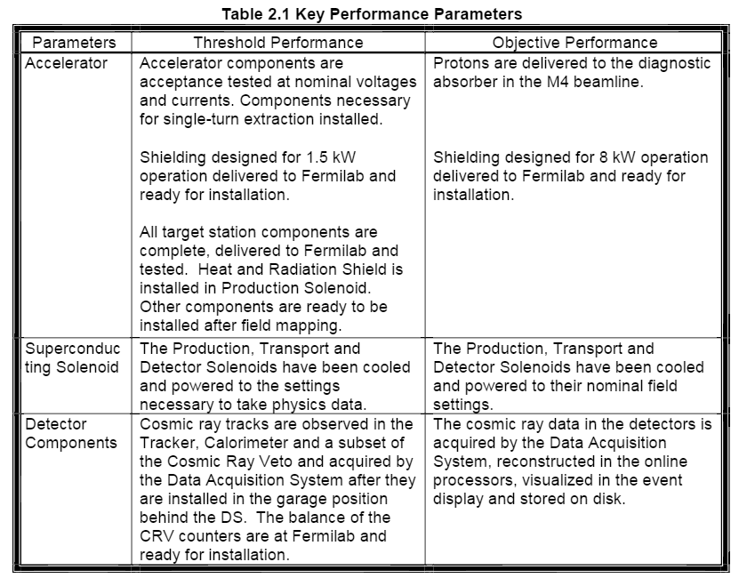
Mu2e KPPs
From Mu2e Project Execution Plan
Mu2e-doc-1172

