Slide 1
Mu2e Beamline Controls and Instrumentation:
Brian Drendel
6 October 2015

Slide 2
Organizational Breakdown
WBS 2.3
Instrumentation and Controls
B. Drendel (AD/Muon)
L3 and CAM
WBS 2.3.2
Delivery Ring Instrumentation
B. Drendel (AD/Muon)
WBS 2.3.3
Extraction Beamline Instrumentation
B. Drendel (AD/Muon)
WBS 2.3.4
Technical Documentation
B. Drendel (AD/Muon)
WBS 2.3.1
Mu2e Controls
B. Drendel (AD/Muon)
WBS 2.3.1.1
Transport & Delivery Ring Controls
G. Brown (AD/Controls)
D. McArthur (AD/Controls)
WBS 2.3.1.2
Mu2e Controls
G. Brown (AD/Controls)
D. McArthur (AD/Controls)
WBS 2.3.3.1
Profile Monitors
G. Tassotto (AD/Inst)
D. Schoo (AD/Inst)
WBS 2.3.3.2
Beam Loss Monitors
Randy Thurman-Keup (AD/Inst)
J. Seraphin (AD/Inst)
A. Saewert (*AD/Inst)
WBS 2.3.2.1
DCCT
A. Ibrahim (AD/Inst)
WBS 2.3.2.2
Tune Measurement
V. Scarpine (AD/Inst)
B. Fellenz (AD/Inst)
Notes:
Dollarized RAM shows WBS at 2.158M, out of Accelerator 50.1M and project TPC 271M

Slide 3
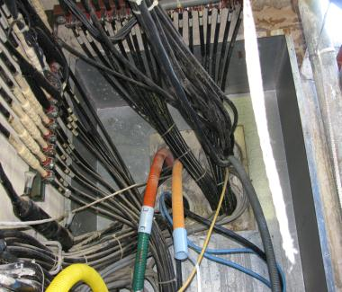
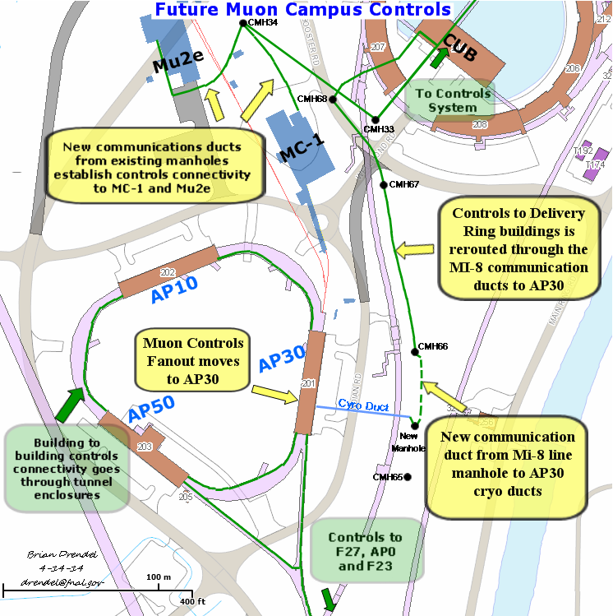
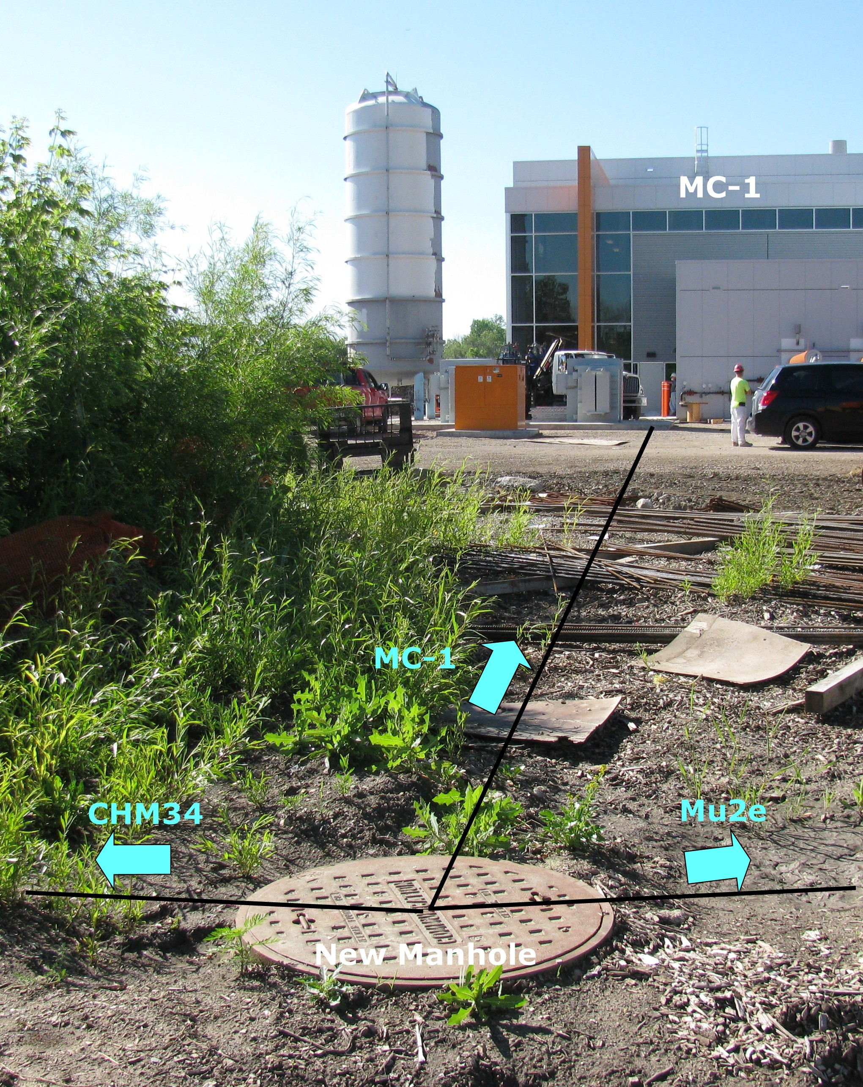
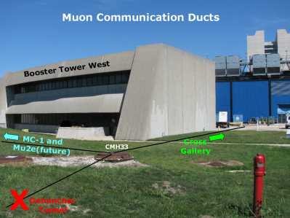
Controls Scope
New controls and communications connectivity will be established from the cross gallery to the Mu2e service building.
  96 pair bundle of single mode fiber.
  36 pair bundle of multi-mode fiber
  Various multi-conductor copper cable.

Slide 4
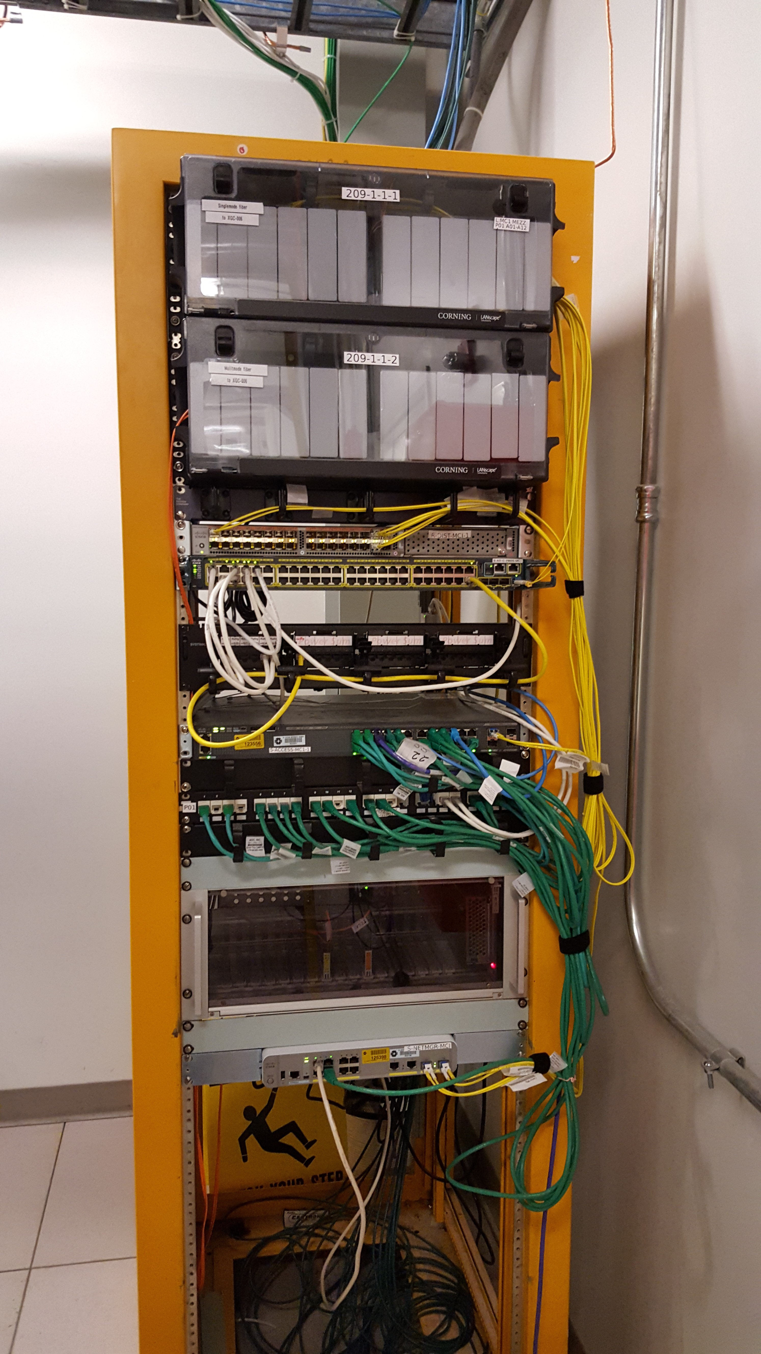
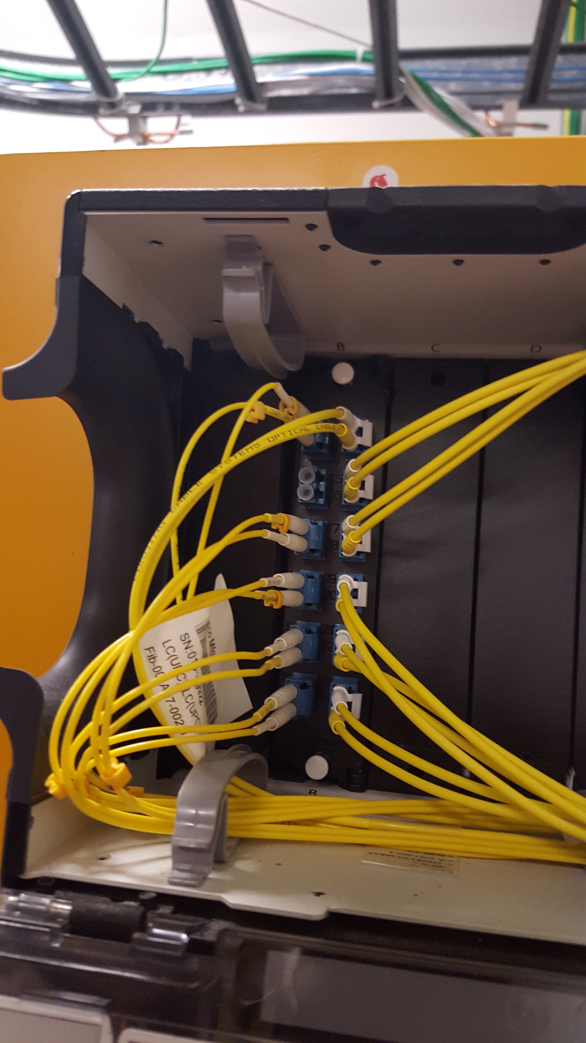
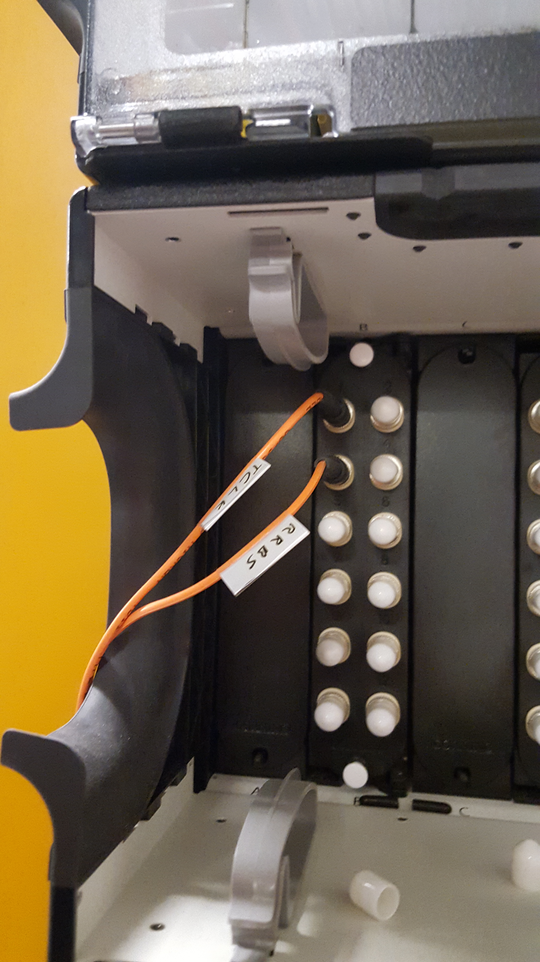
Controls Lessons Learned from g-2
Network infrastructure moved from Accelerator to Conventional Construction WBS to allow fiber optic communications lines to be run to building as soon as beneficial occupancy allows.
  Controls Ethernet
  FIRUS
MC-1 Network Rack
Single-mode Fiber
Multi-mode Fiber

Slide 5
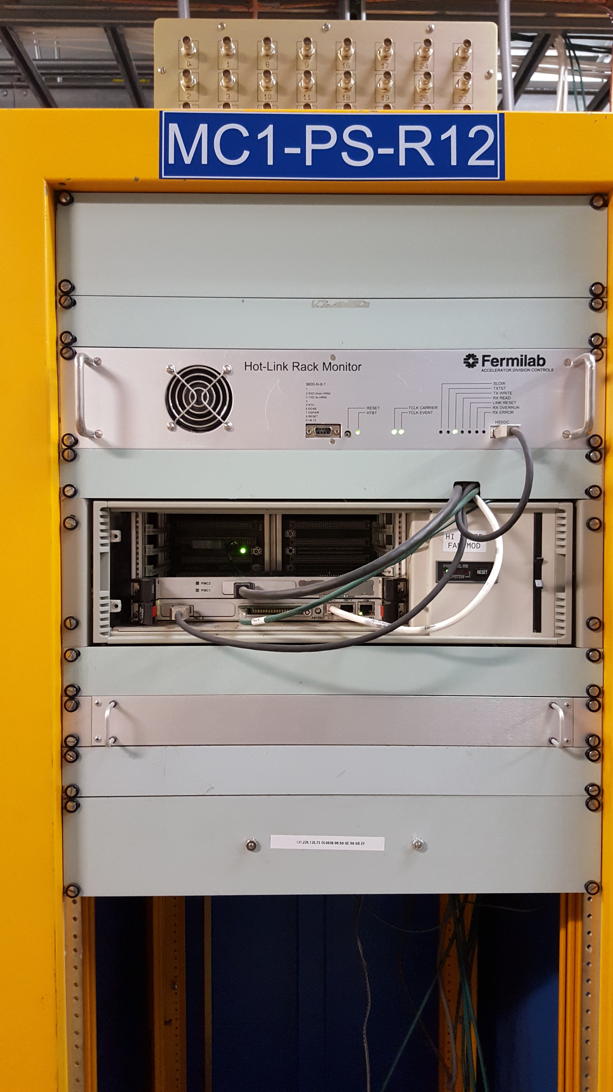
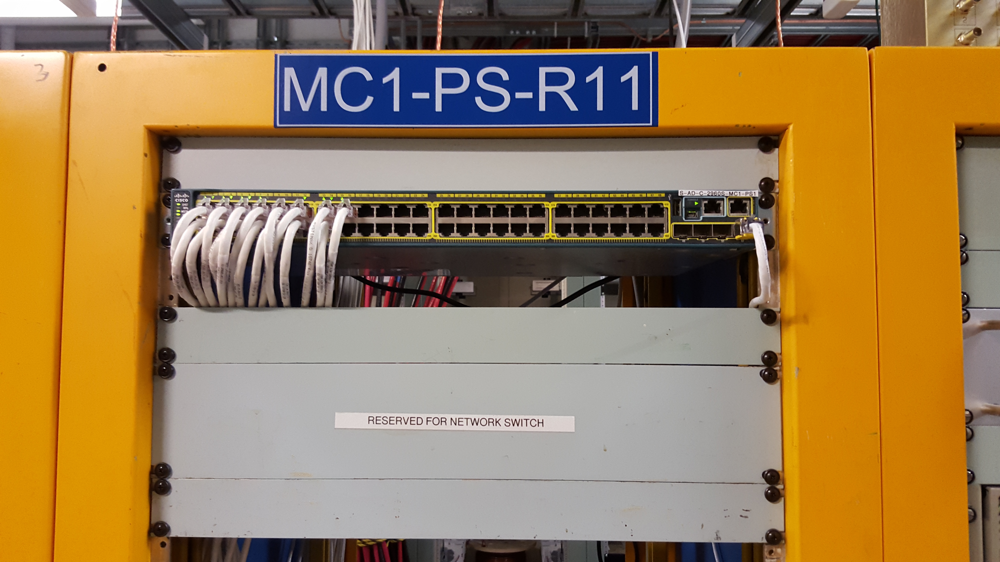
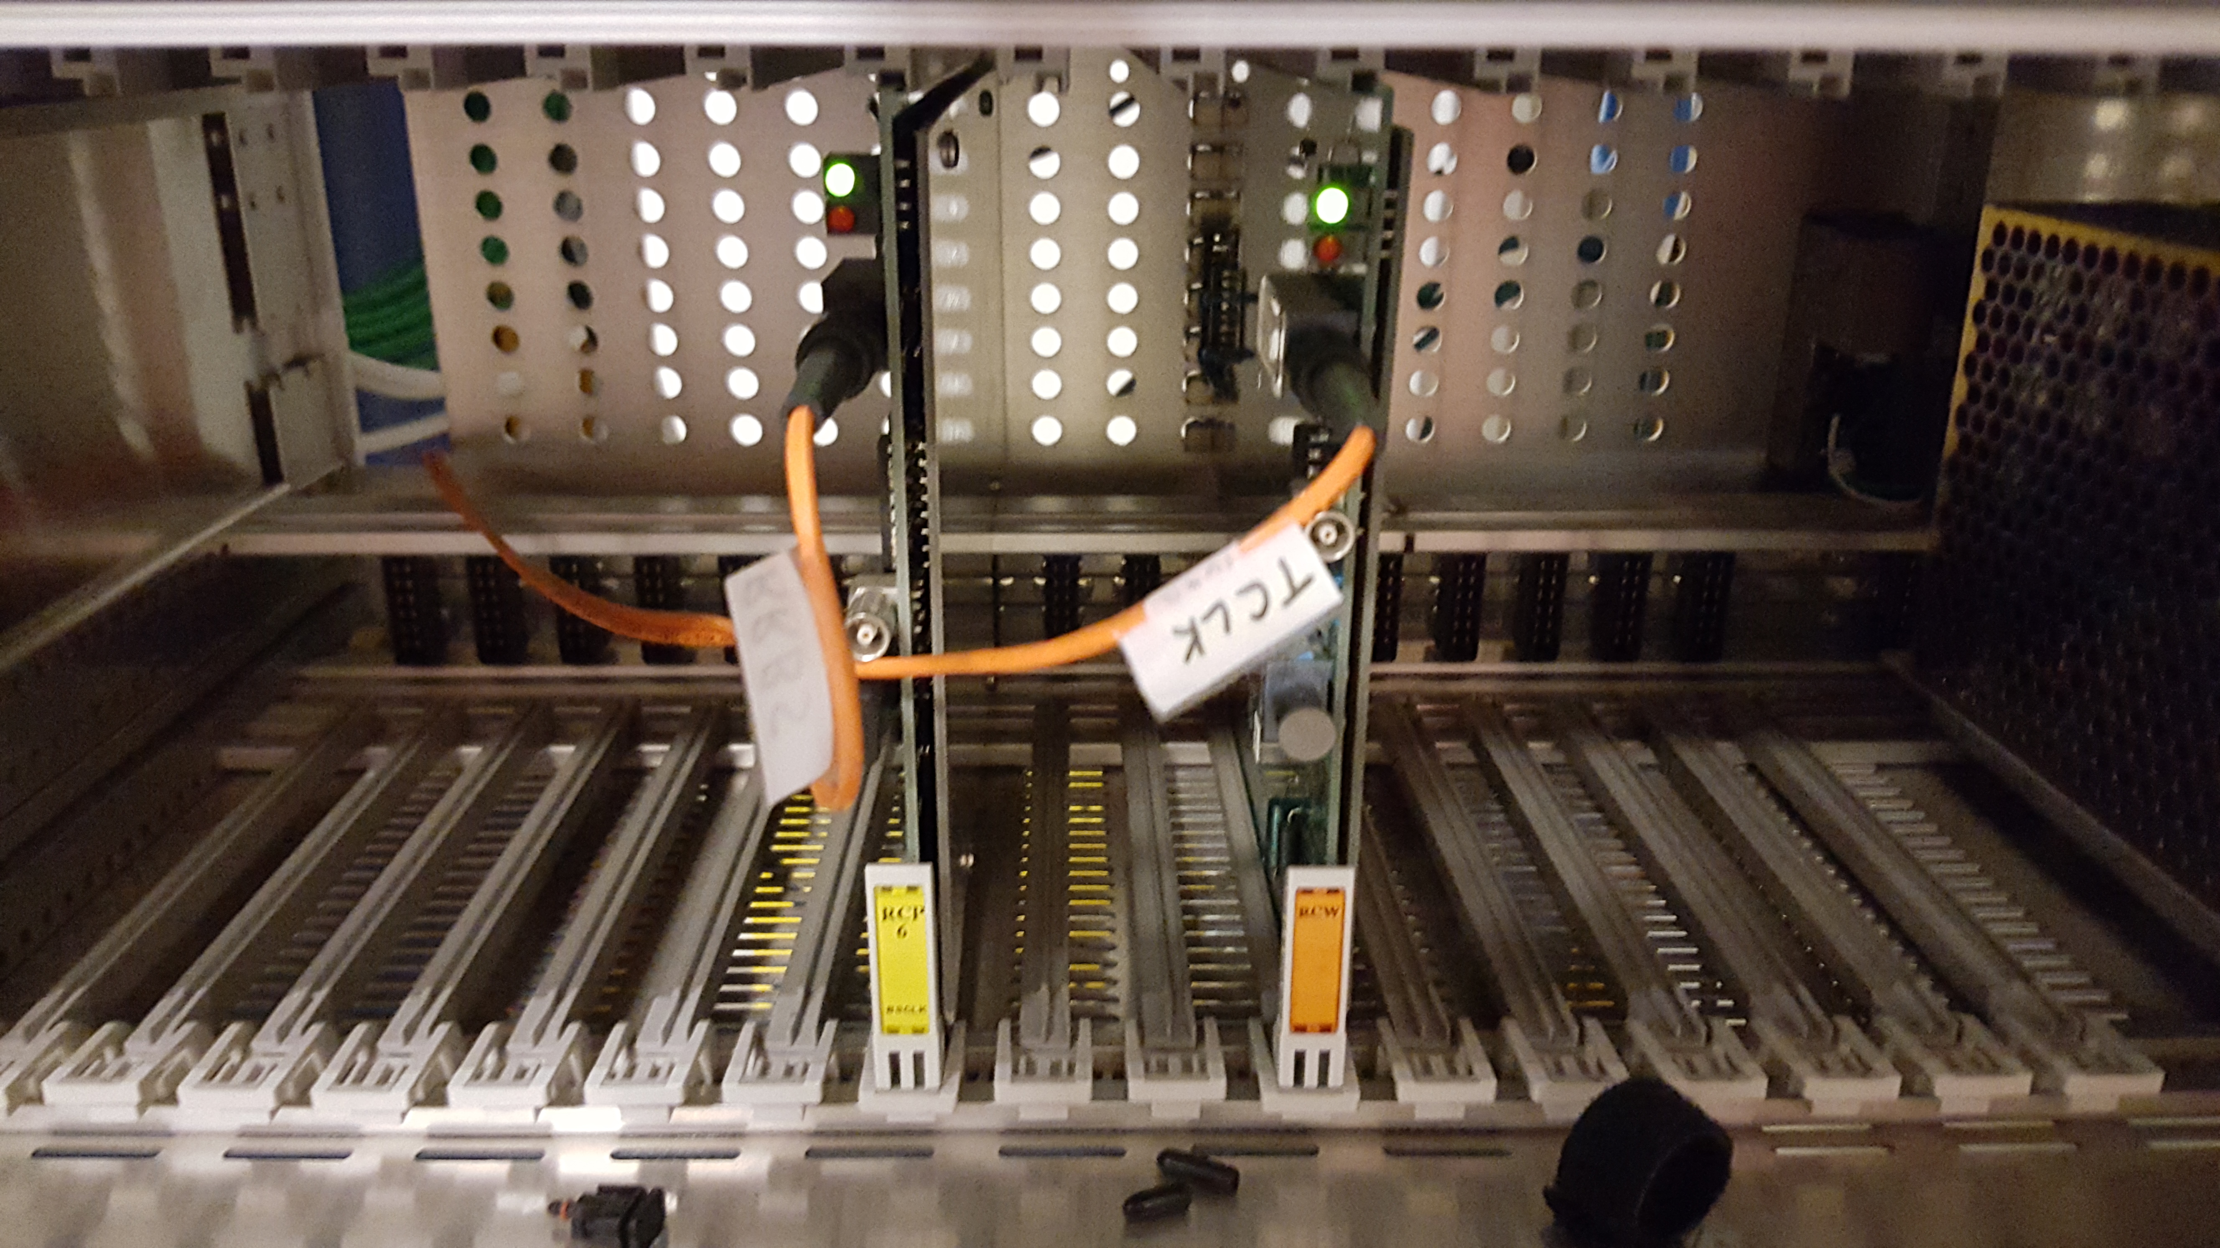
Controls lessons learned from g-2
Will implement controls to Mu2e in the same way MC-1 controls were recently established.
Using standard laboratory network and controls hardware.
Same experts are implementing the Mu2e system that recently implemented the similar MC-1 system.
Controls I/O
PS Room
Network Rack
Timing Links

Slide 6
Controls Design
This WBS covers provides the connectivity of all of the controls signals on the previous slide to Mu2e.
  This includes everything up to any front end device in the Mu2e service building.
  Controls needs specific to any given system are included in the costing for that system.
Software formerly handled in the Operations Preparation WBS for CD-1 have been moved to operations since they will not be required until after project completion.
  Any special software needs for specific systems that are needed before project closeout are covered in the costing for that system.
Controls cable pulls and terminations have been moved to conventional construction BoE 475.03.04.05 to coordinate controls infrastructure availability with Mu2e building beneficial occupancy.

Slide 7
Instrumentation Scope
Instrumentation is funded by five different sources as shown below. The focus of this talk are the items covered under my Mu2e WBS.
Category | Instrumentation Type | Funding Source
Beam Lines (P1, P2, M1 and M3) | Toroid | Beam Line AIP
 | Beam Position Monitor | Beam Line AIP
 | Beam Loss Monitors | Beam Line AIP, RR AIP
 | Profile Monitors | Beam Line AIP, RR AIP
Delivery Ring | DCCT | Mu2e Project
 | Beam Position Monitor | Delivery Ring AIP
 | Beam Loss Monitor | Delivery Ring AIP
 | Tune Measurement System | Mu2e Project
Abort Line | Toroid/Ion Chamber | g-2 Project
 | Profile Monitor | g-2 Project
 | Beam Loss Monitors | Delivery Ring AIP
Extraction Line (M4 line) | Ion Chamber | Mu2e Project
 | Profile Monitor | Mu2e Project
 | Beam Loss Monitor | Mu2e Project
Notes:
Dollarized RAM shows WBS at 2.158M, out of Accelerator 50.1M and project TPC 271M
The costing for some Mu2e Instrumentation will be covered in the Transport and Delivery Ring AIPs, as well as the g-2 project.
Transport
Toroids: Existing beam line toroids will be used to measure beam intensities in the beam lines with minimal amount of maintenance performed on the electronics.
Beam Position Monitors (BPMs): Existing BPMs will need small modifications to be used for beam position feedback and orbit control.
Beam Loss Monitors (BLMs): Existing beam loss monitor will be upgraded by repurposing unused BLM electronics and hardware from the Tevatron.
Secondary Emission Monitors (SEMs): Existing SEM electronics will be upgraded to provide beam profile information.
Delivery Ring
Beam Position Monitors (BPMs): BPM electronics will be upgraded with unused electronics from the Recycler to measure the beam orbit.
Beam Loss Monitors (BLMs): BLM system will be used to measure beam loss points. It will be upgraded with unused ion chambers and electronics from the Tevatron.

Slide 8
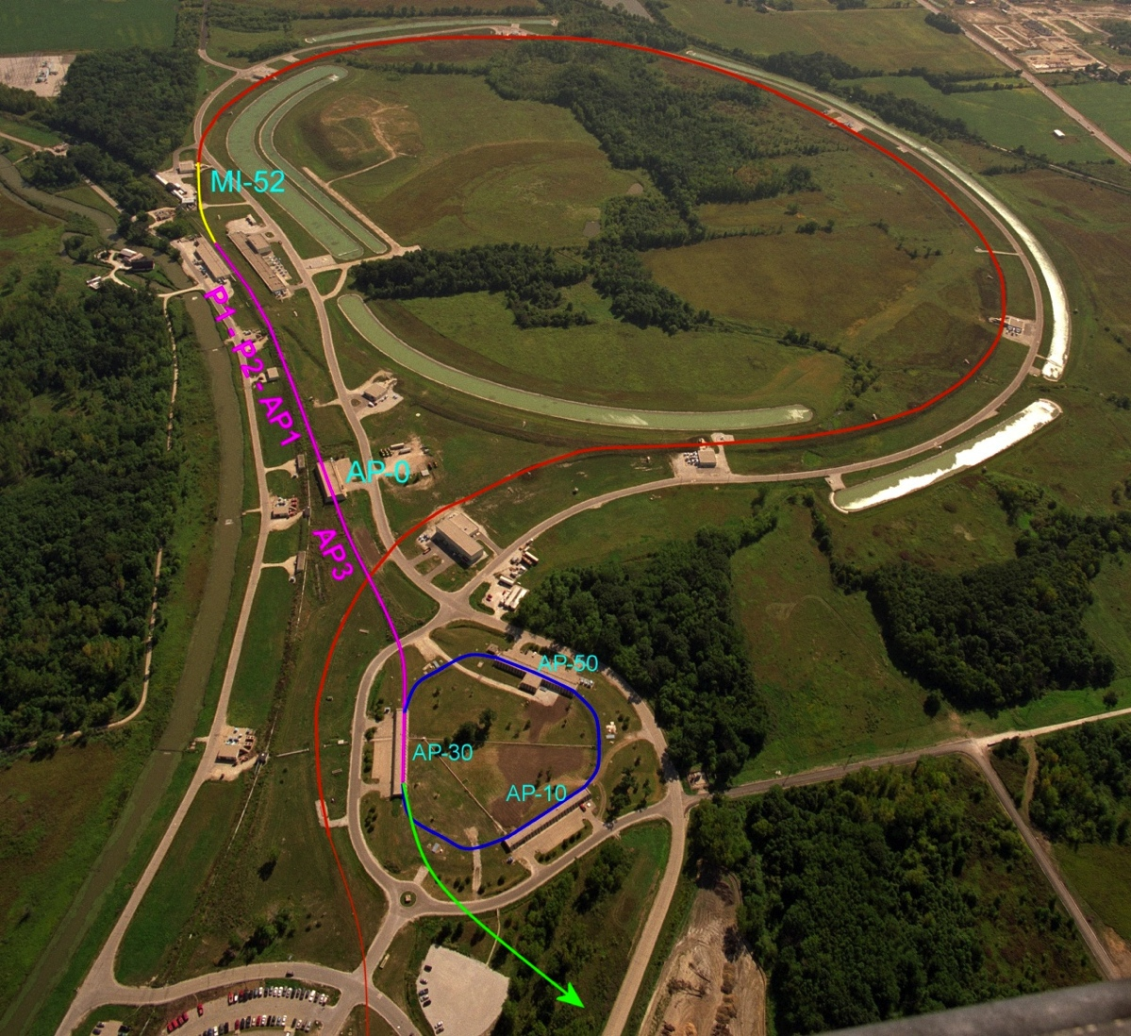
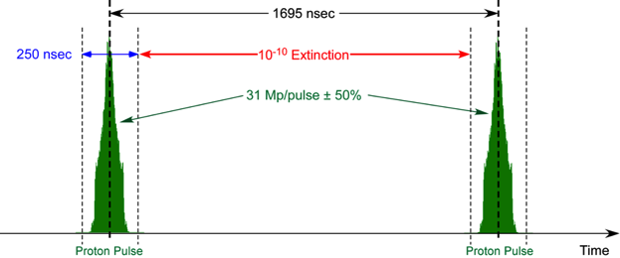
Mu2e Proton Delivery
Two Booster “batches” are injected into the Recycler (8 GeV storage ring). Each is:
  4x10¹² protons
  1.7 μsec long
These are divided into 8 bunches of 10¹² each
The bunches are extracted one at a time to the Delivery Ring
  Period = 1.7 μsec
As the bunch circulates, it is resonantly extracted to produce the desired beam structure.
  Bunches of ~3x10⁷ protons each
  Separated by 1.7 μsec
Main Injector/Recycler
Delivery Ring
(formerly pBar Debuncher)
Eric Prebys
Mu2e
Booster
Exactly what we need
Notes:
The muons for the Mu2e experiment come from the interaction of a primary proton beam with a tungsten target in the Mu2e experimental hall. The protons that meet the requirements of the experiment are derived thusly:
Two Booster proton batches (4 Tp/batch) of 8 GeV KE are transported to the Recycler Ring via the MI-8 Line. Booster batches are injected into the Recycler at a rate of 15 Hz. Thus, the basic unit of time in the Accelerator Timeline is one 15 Hz cycle = 67 msec ≡1 tick
- The protons are rebunched in the Recycler with a 2.5 MHz RF system into 8 narrow 1 Tp bunches that occupy 2/7th of the Recycler circumference.
- These bunches are extracted, one-at-a-time, from the Recycler and transported to the Delivery Ring.
- The single bunch circulating in the Delivery Ring is resonantly extracted over approximately 54 msec to the Mu2e proton target forming a train of bunches spaced in time by 1.695 micro-sec (Delivery Ring T_{rev}).
- These proton bunches are transported to the proton target via the M4 Beamline.
- During transport from the Delivery Ring to the target the beam pulse passes through an extinction section containing a fast ac dipole magnet that removes the unwanted beam between pulses.
- This process is repeated twice for every 1.333 sec MI ramp cycle in the part of the cycle during which NOvA beam is being accelerated in the Main Injector.

Slide 9
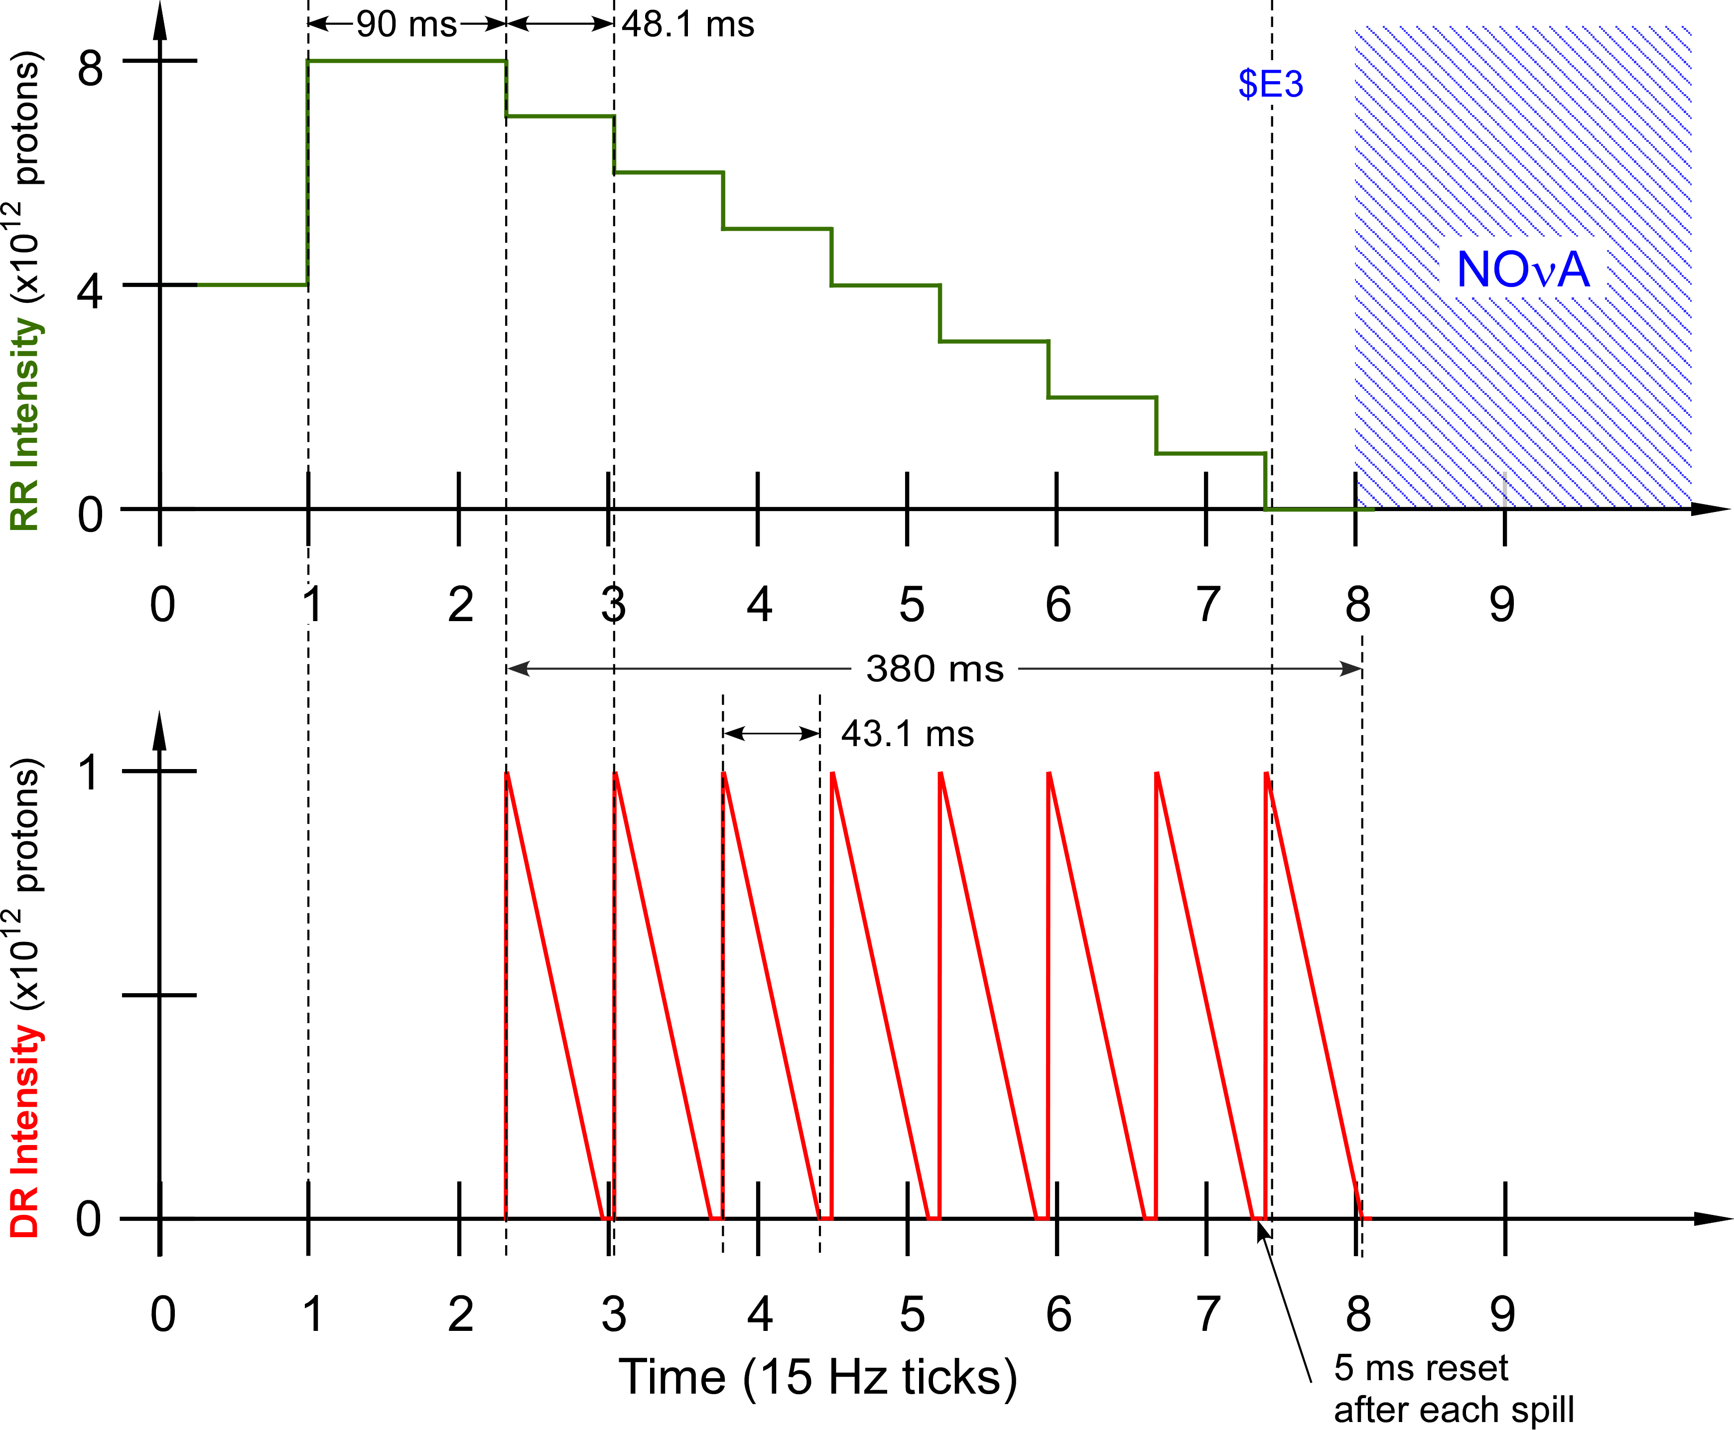
Mu2e Accelerator Timeline
Parameter | Value | Units
MI Cycle time | 1.333 | sec
Number of spills per MI cycle | 8
Duration of each spill | 34-54 | msec
Number of protons per micro-pulse | (3.0-5.0)×10⁷ | protons
Maximum DR Beam Intensity | 1.0×10¹² | protons
Reset Time Gap between spills | 5 | msec
Operation point (Qx/Qy) | 9.650/9.735
Extraction efficiency | >98 | %
Spill uniformity | <50 | %
Notes:
The muons for the Mu2e experiment come from the interaction of a primary proton beam with a tungsten target in the Mu2e experimental hall. The protons that meet the requirements of the experiment are derived thusly:
Two Booster proton batches (4 Tp/batch) of 8 GeV KE are transported to the Recycler Ring via the MI-8 Line. Booster batches are injected into the Recycler at a rate of 15 Hz. Thus, the basic unit of time in the Accelerator Timeline is one 15 Hz cycle = 67 msec ≡1 tick
- The protons are rebunched in the Recycler with a 2.5 MHz RF system into 8 narrow 1 Tp bunches that occupy 2/7th of the Recycler circumference.
- These bunches are extracted, one-at-a-time, from the Recycler and transported to the Delivery Ring.
- The single bunch circulating in the Delivery Ring is resonantly extracted over approximately 54 msec to the Mu2e proton target forming a train of bunches spaced in time by 1.695 micro-sec (Delivery Ring T_{rev}).
- These proton bunches are transported to the proton target via the M4 Beamline.
- During transport from the Delivery Ring to the target the beam pulse passes through an extinction section containing a fast ac dipole magnet that removes the unwanted beam between pulses.
- This process is repeated twice for every 1.333 sec MI ramp cycle in the part of the cycle during which NOvA beam is being accelerated in the Main Injector.

Slide 10
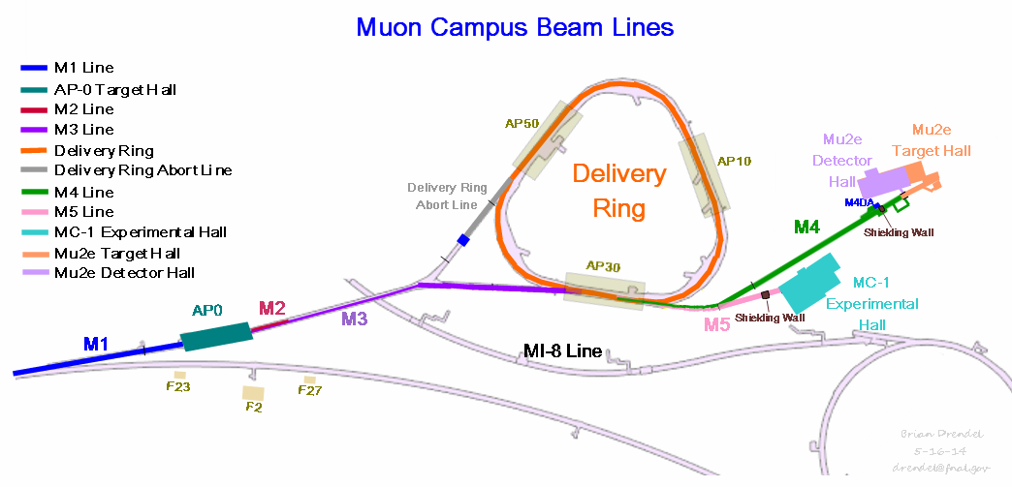
Mu2e Instrumentation Scope
8.88626 GeV/c Protons
    Delivery Ring Protons (1E12 -> 2E10)
      Intensity: DCCT
      Tune: Schottky
    Extraction Line (2E7 slice every 1.69usec)
      Intensity: Ion Chambers
      Position/Profile: Multiwires
      Losses: BLMs

Slide 11
Instrumentation for various operational modes
Mode |  | Intensity | Measurements
 |  |  | Delivery Ring | M4 Line
Commissioning | Single turn protons to M4DA for M4 line commissioning | 170W 5E10 protons every 10 sec 2 turns/5-10 Booster bunches | BPMs (2.5 MHz TBT, CO) (53 MHz TBT) IC DCCT | MWs ICs BLMs
 | Resonant Extraction to M4DA | 4 × 1.0E12 protons to Delivery Ring every 30 sec M4 Intensity: 3E6 to 40E6 | BPMs (2.5 MHz TBT, CO) DCCT BLMs Schottkys | MWs ICs BLMs
Normal Running | Normal 8 kW proton beam to Mu2e target | 8 × 1.0E12 protons to Delivery Ring every 1.33 sec | BPMs (2.5 MHz TBT, CO) DCCT BLMs Schottkys | MWs (normal scanner cap) ICs BLMs
Notes:
M4DA = M4 Beamline Diagnostic Absorber

Slide 12
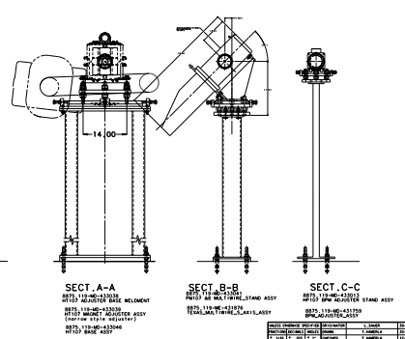
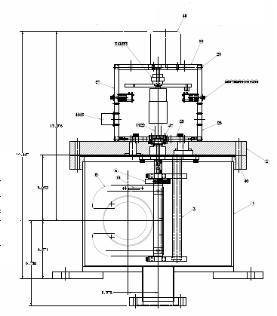
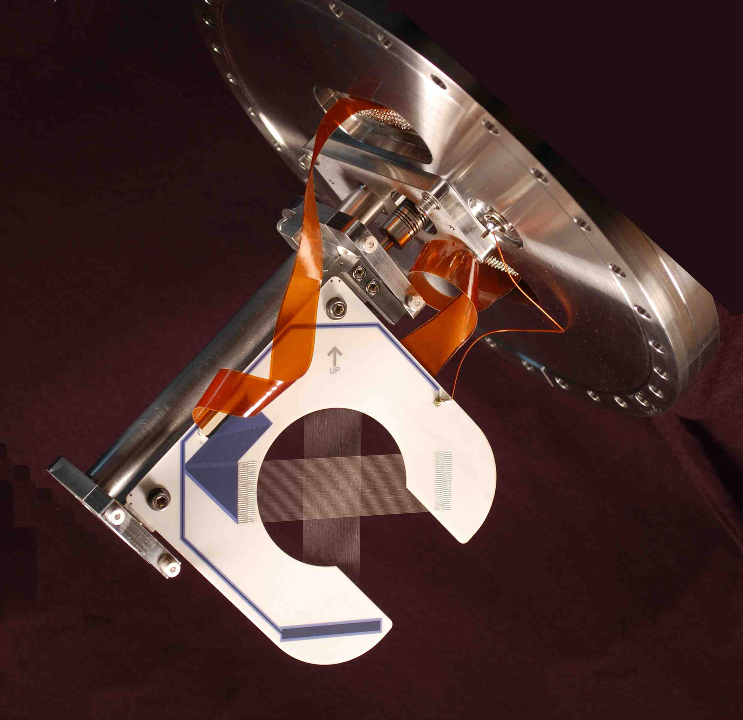
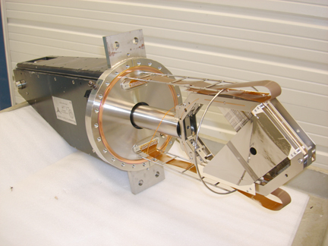
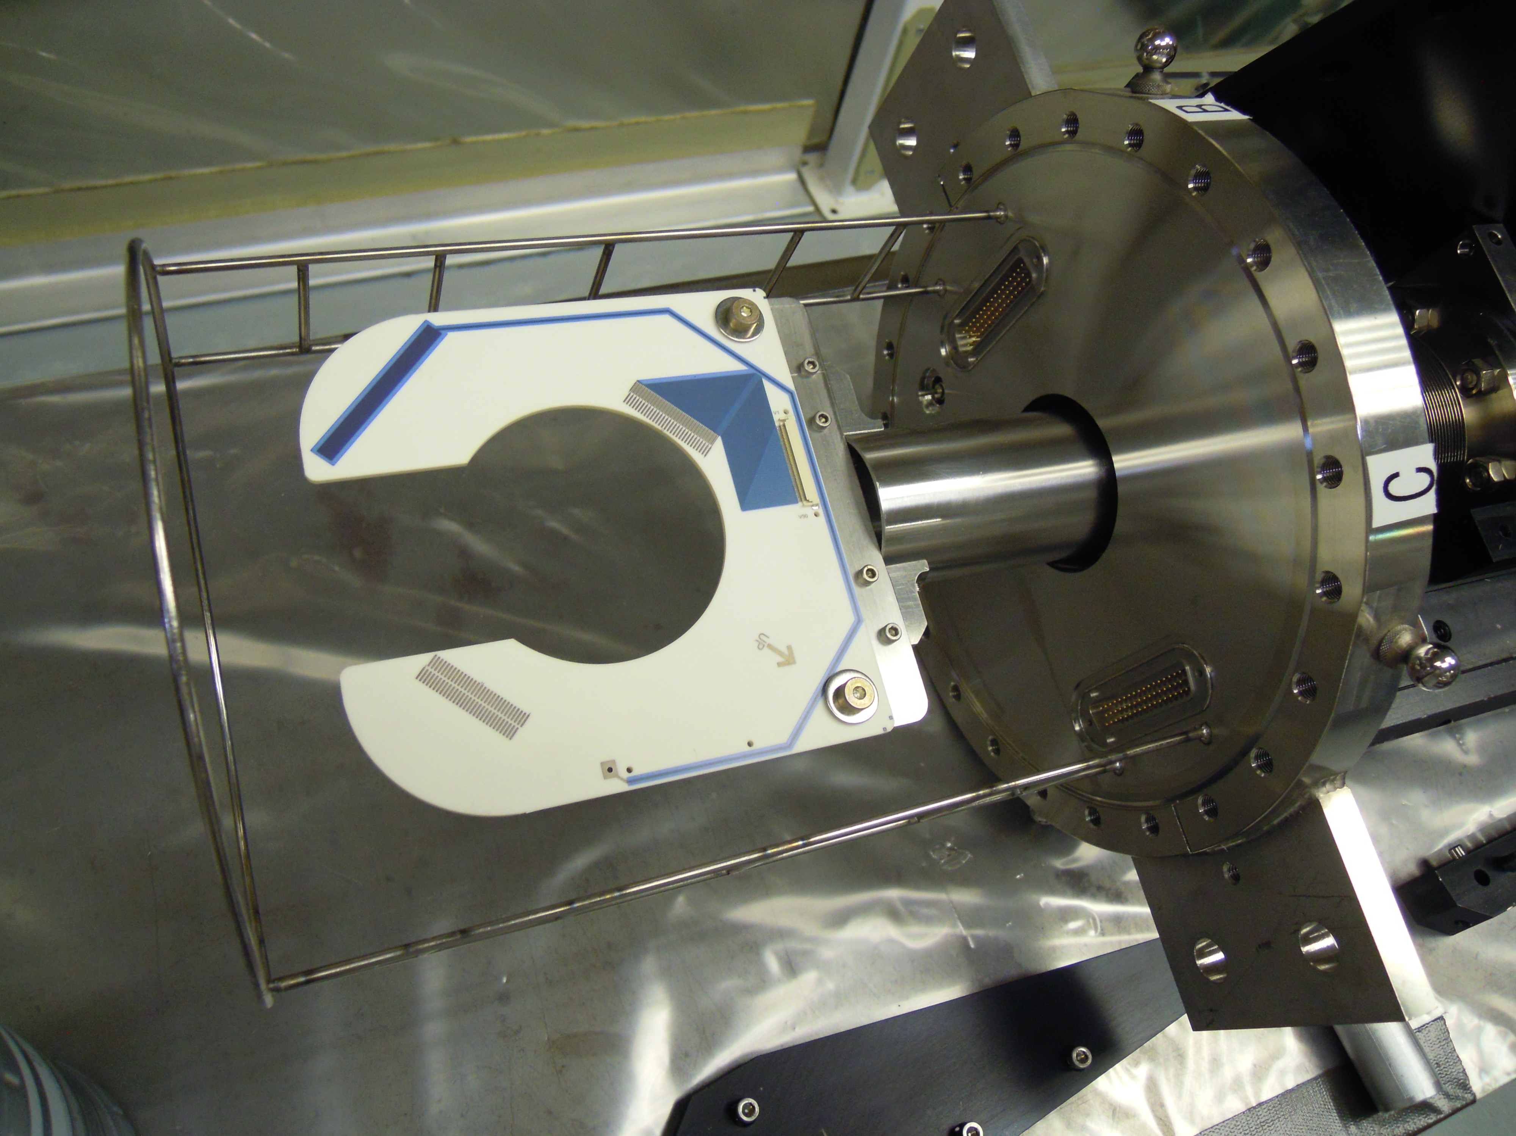
Extraction Instrumentation: Multiwires
UTA MW
Primary beam position measurement device in the M4 beam line.
NuMI multiwire design used with a gap in the ceramic that allows the wires to be moved into and out of the beam while beam is running.
There will be two varieties of multiwires.
  New vacuum cans will be constructed based on the NuMI design.
  11 available University of Texas (UTA) Multiwire cans will be repurposed.
The beam positions will be used in the M4 beam line autotune system.
NuMI MW
Numi MW
UTA MW
Notes:
The Numi multiwire assembly is drawn and filed, dwg no. 488880.
We want these at a 45 degree angle, in which case we would use the Numi PM108 stand 433041 with revised beam elevation off the floor. So just one new drawing needed.
Cost estimate 10-15k for the device and 2k for the stand
Using Texas can we can also use the PM108 stand with revised height (same new dwg as above). We should also make an assembly dwg of the device.
Cost estimate 3k for the device and 1.5k for the stand using old Texas mountings from Numi (I hope we haven't thrown them out).

Slide 13
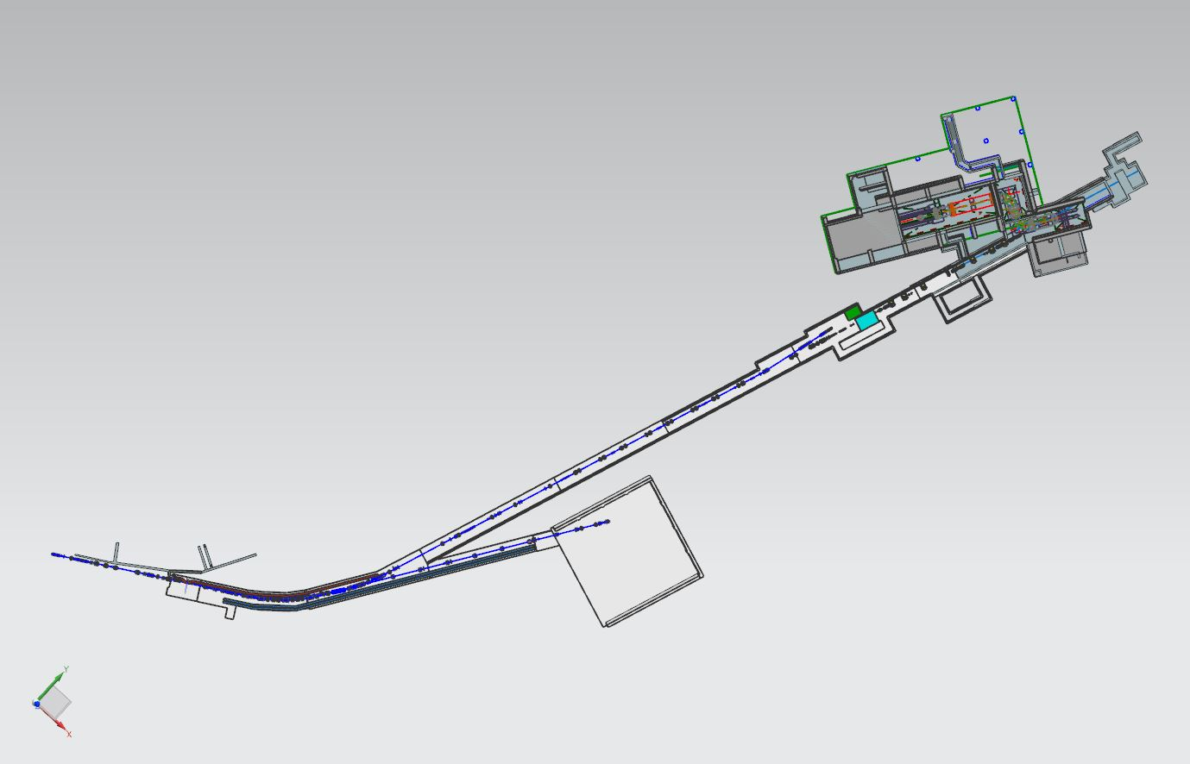
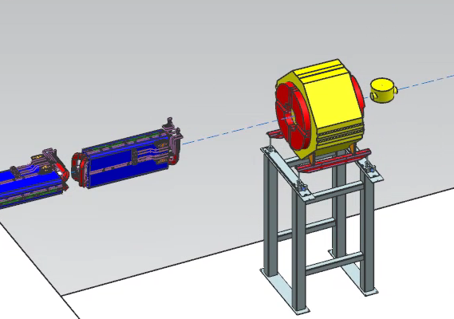
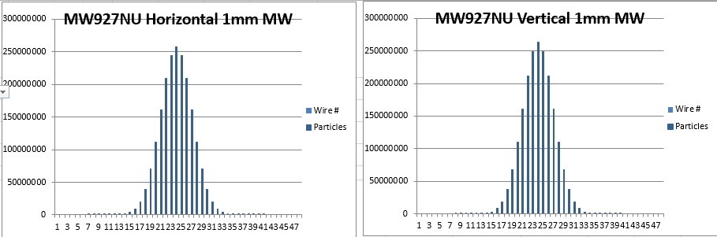
Profile Monitors in the M4 Line
Based on the lattice design, the M4 line will contain 28 profile monitors that will be used to measure the profile and position of the beam.
  One shared PWC
  Eight repurposed UTA multiwires
  Eighteen new NuMI-extraction style multiwires
  One repurposed BNL PWC
Target Section:
1 multiwire
1 BNL PWC
Extinction & Diagnostic Absorber Section: 919 – 935
9 multwires
1 UTA Multiwires
Final Focus :
936-943:
3 multiwires
3 UTA multiwires
Common Section:
900-907
1 shared PWC
3 multiwires
MW941
MW941
Simulated Beam Profiles
HBend Section:
908-918
2 multiwires
4 UTA multiwires

Slide 14
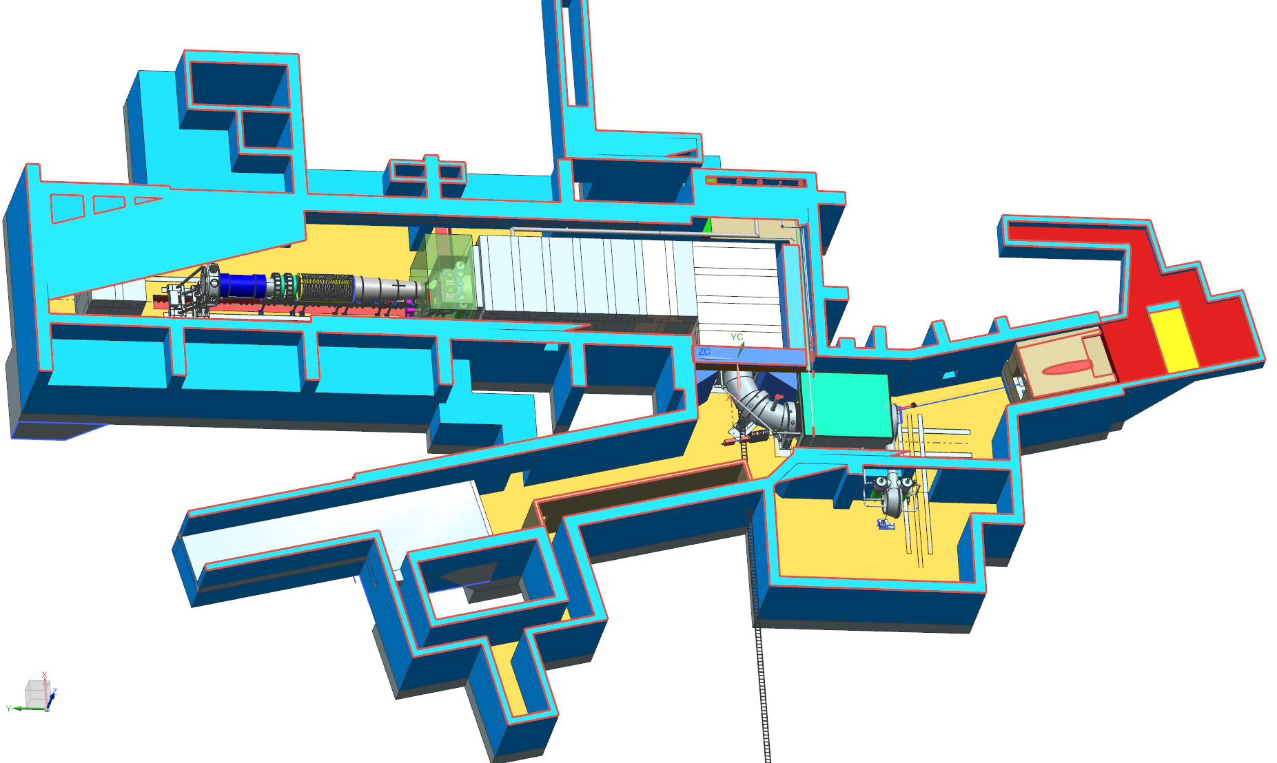
Scope Changes.
Scope changes. Two additional multiwires were added to the scope from another WBS.
    One will be just upstream of the solenoid
    One is downstream of the target (temporary). We will use BNL PWCs so as to not add cost to the project.
  Seven additional multiwires added with the new lattice.
    We are refurbishing Texas multiwires to offset the cost.
  There is not physical space for the Multiwire in the 900 location.
    Will the proportional wire chamber from g-2, but can’t leave in the beam for auto-tune.
Will write a CR to cover the scope changes.
Insufficient space for Multiwire at the 900 location
Pre-target
vacuum MW
x=4.94 m
y=0.17 m
z=-1.945 m
Post-target
air BNL SWIC
x=2.4
y=2.4
z=-12.3 m
Q901
M4 Line
CMag
V901
M4 Line
Beam
Delivery Ring
Rick Coleman
F10021604
Mu2e-doc-4741
Notes:
Mu2e coordinates

Slide 15
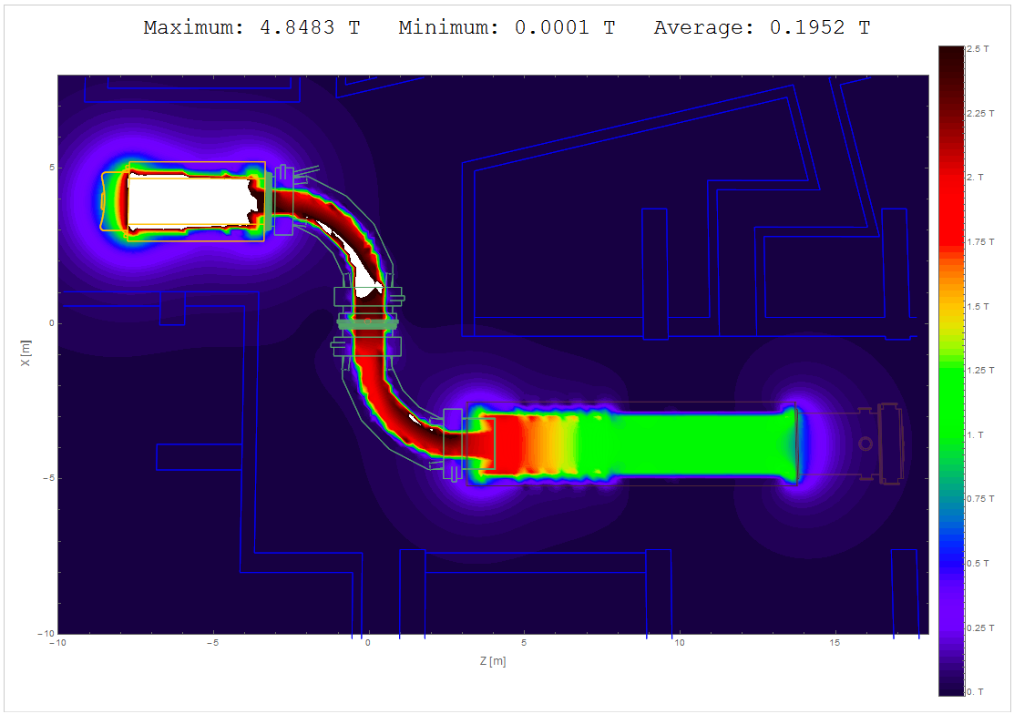
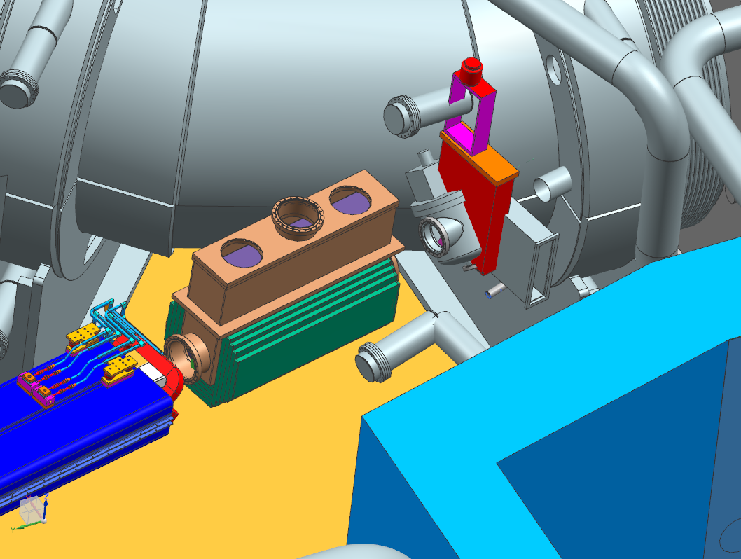
Design considerations
Need to examine the effects of magnetic field on the multiwire just upstream of the target solenoid.
  Does the magnetic field impact the motion control (PreTarget MW only)?
  Does the magnetic field impact the signal?
PostTarget MW: 0.2Kg magnetic field
PreTarget MW: 1.2Kg magnetic field
Magnetic Field Map
Rick Coleman
Mu2e-doc-1381
Mu2e-doc-4741

Slide 16
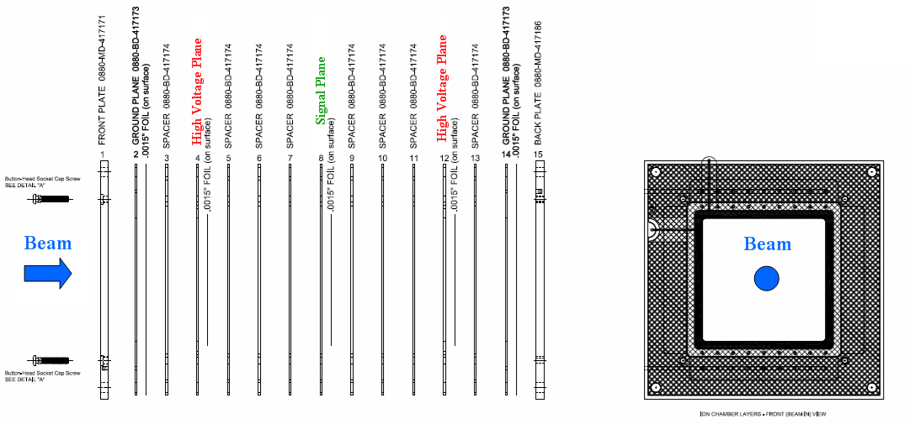
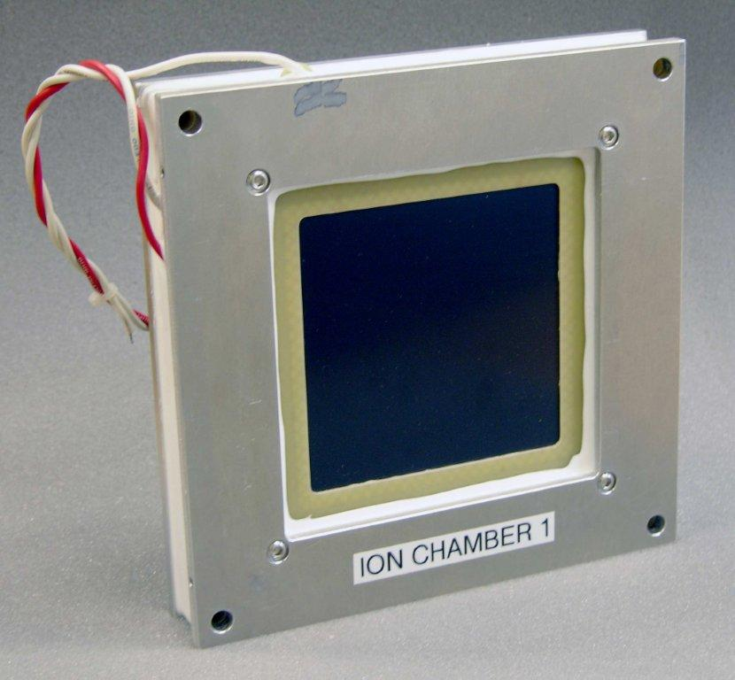
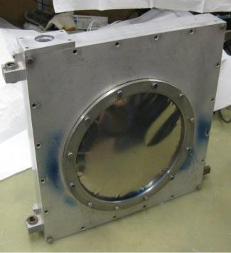
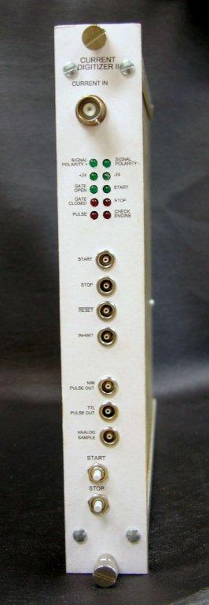
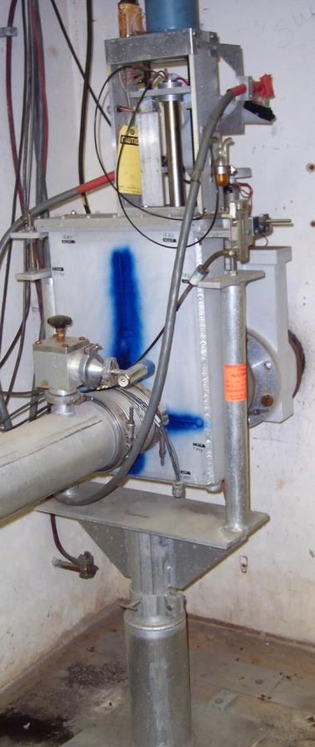
Retractable Ion Chambers
Ion
Chamber
Anti-vacuum Box
Primary intensity measurement device in the M4 line.
Use new PWC stack design to save on Engineering costs.
Modified IC to fit in existing anti-vacuum box.
Use recycled Bayonet vacuum cans from Switchyard.
Ion chambers were tested with beam in the Switchard beam lines.
Prototype readout digitizer is 10x more sensitive than previous digitizers.
The bayonet type drive slides the ion chamber linearly into and out of the beam with a screw drive system.
Bayonet Can
Notes:
Ion Chambers
Ion chambers will become the primary beam-intensity measurement device for mixed-secondary beam. They are relatively inexpensive devices that can measure beam intensities with an accuracy of ±5% with as little as 10⁵ particles. Ion chambers were used in the AP2 line in the past, and work was done during beam studies to re-commission the ion chamber that used to be operational near the end of the AP2 line [2]. For (g − 2) operations, one ion chamber will be implemented in the M2 line. Ion chambers will also be implemented in the M3 line and the Delivery Ring; however, these ion chambers will need to be installed in a vacuum can with motor controls to allow them to be pulled out of the beam during the higher-intensity Mu2e operations. Figure 1.47 shows an ion chamber installation in the AP2 line.
Each ion chamber consists of 3 signal foils interleaved between 4 bias foils, each spaced 1/8” apart. The foils are sealed in an aluminum chamber 10 inches in diameter by 4.5 inches long continuously purged with an 80% argon - 20% carbon dioxide gas mix. The standard ion chamber is shown in Figure 1.51. Protons passing through ArCO₂ gas generate 96 e/ion pairs or about 1.6 x 10⁻¹⁷ charges/cm which equals about 1.6 picocoulomb for 10E5 p [18].
The ion chambers in the M3 line and Delivery Ring will not be installed in the above described manner because the beam going through those ion chambers and vacuum windows would result in excessive coulomb scattering during high intensity operations [27]. The solution is to make the ion chamber retractable much like what will be discussed in more detail in the Proportional Wire Chamber (PWC) section below. The ion chamber will be installed inside of an anti-vacuum chamber with two titanium vacuum windows to provide a barrier between the gas needed for the ion chamber and vacuum. The entire anti-vacuum chamber would be mounted inside of a vacuum can that is common to beam tube vacuum. The ion chamber will be on a motorized drive that would allow it to be taken in or out of the path of beam [18]. Figure
Beam studies were completed to check the effectiveness of using ion chambers in the range of intensities expected during (g – 2) operation [24]. One ion chamber was installed in the upstream portion of the AP-2 beam line at the 704 location, while the other ion chamber was located at the downstream portion of the AP-2 line at the 728 location. Both ion chambers were shown to integrate beam charge as expected over the normal range of (g – 2) operational intensities for the M2 and M3 lines as can be seen in Figure 1.52.
Figure 1.51: Fixed-position ion chamber in the AP2 line. The ion chamber is separated from the beam pipe by a vacuum window on each side. Fixed-position ion chambers will only be used in the M2 line. In locations like the M3 line and Delivery Ring that will also see Mu2e beam, the ion chambers will be put inside of vacuum cans and made retractable.
Figure 1.52: AP2 ion chamber performance was measured during beam studies. Ion chamber integration (left) over time. The signal is reset at 1.0 seconds and samples at beam time just after 1.5 seconds. The yellow trace is the ion chamber at the 704 location and the red trace is the ion chamber at the 728 location. This plot was taken with 1E12 protons on target and shows 7.5E8 at the 704 location and 2.5E7 at the 728 location. The plot on the right plots the output of the same two ion chambers over varied target intensities. The response is linear through a wide range of beam intensities.

Slide 17
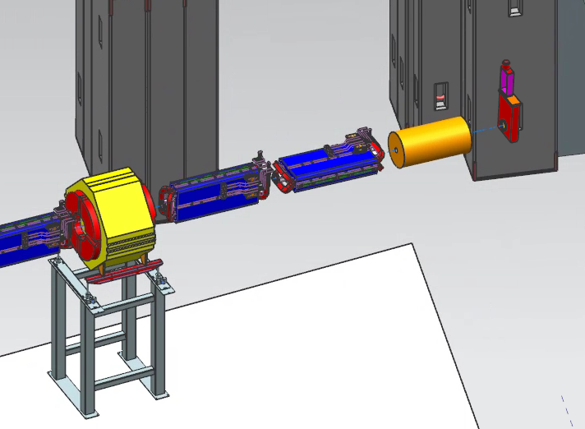
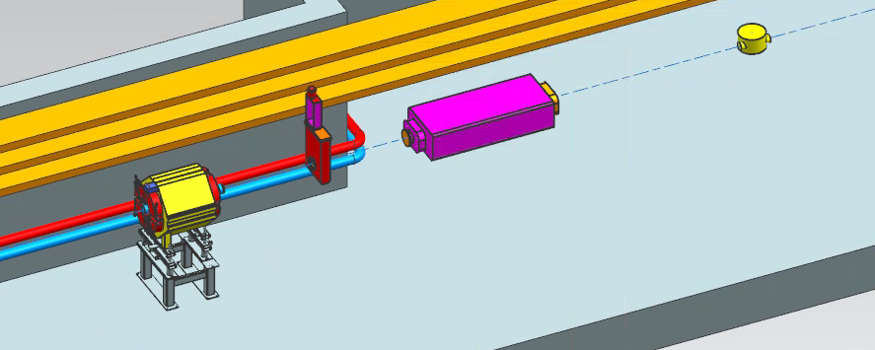
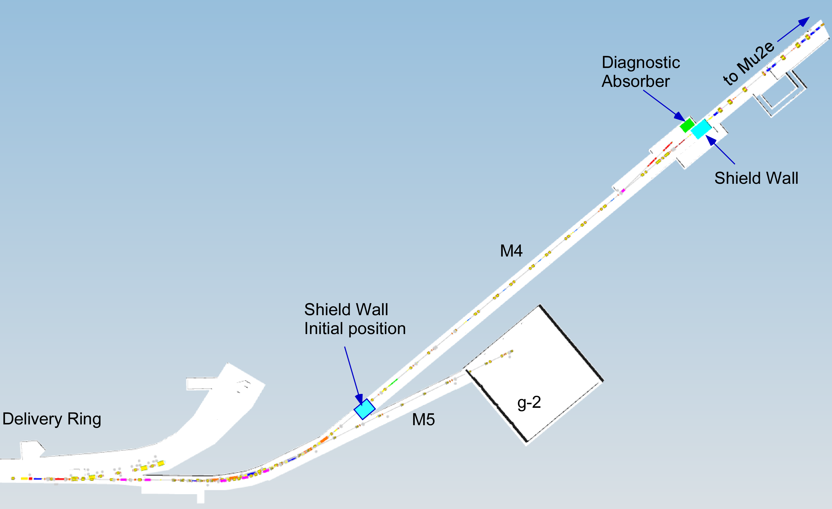
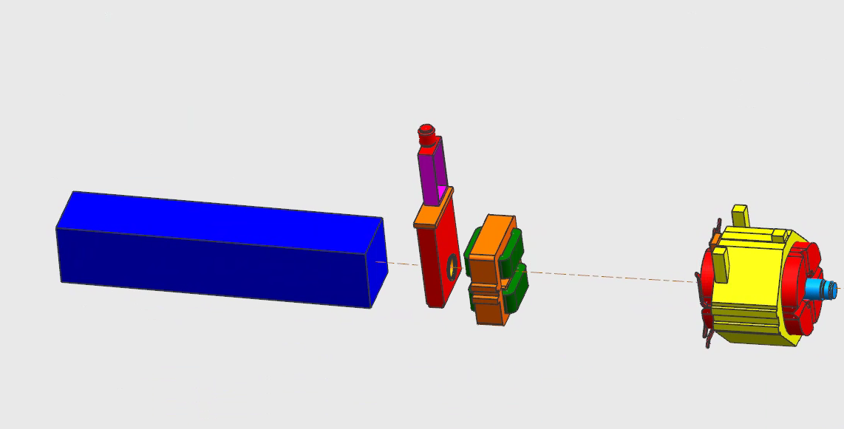
Extraction Beamline Ion Chamber Locations
Name | Device | BL | Specific Location
IC900 | Ion Chamber | M4 | Immediately downstream of the c-magnet
IC933 | Ion Chamber | M4 | Immediately downstream of VT933
IC943 | Ion Chamber | M4 | Last element in the M4 beam line
IC943
IC933
IC900
F10021605
Notes:
M4 Line Instrumentation:
Slow extracted proton beam from the Delivery Ring will traverse the newly constructed M4 line before arriving at the Mu2e target. Instrumentation hardware and electronics will be recycled from other areas. The instantaneous intensity of the slow spill beam is too small to be measured with Toroids, so retractable ion chambers will be constructed to measure the beam intensity. A Beam Loss Monitor (BLM) system based on the hardware and electronics that exist in the P1 and P2 line will be implemented to help maintain good transmission efficiency in the beam lines. Secondary Emission Monitors (SEMs) and Segmented Ion Wire Chambers (SWICs) will provide beam profiles in both transverse planes.
Instrumentation locations were chosen by the beam lines optics expert in order to tune-up the line. 16 profile monitors.

Slide 18
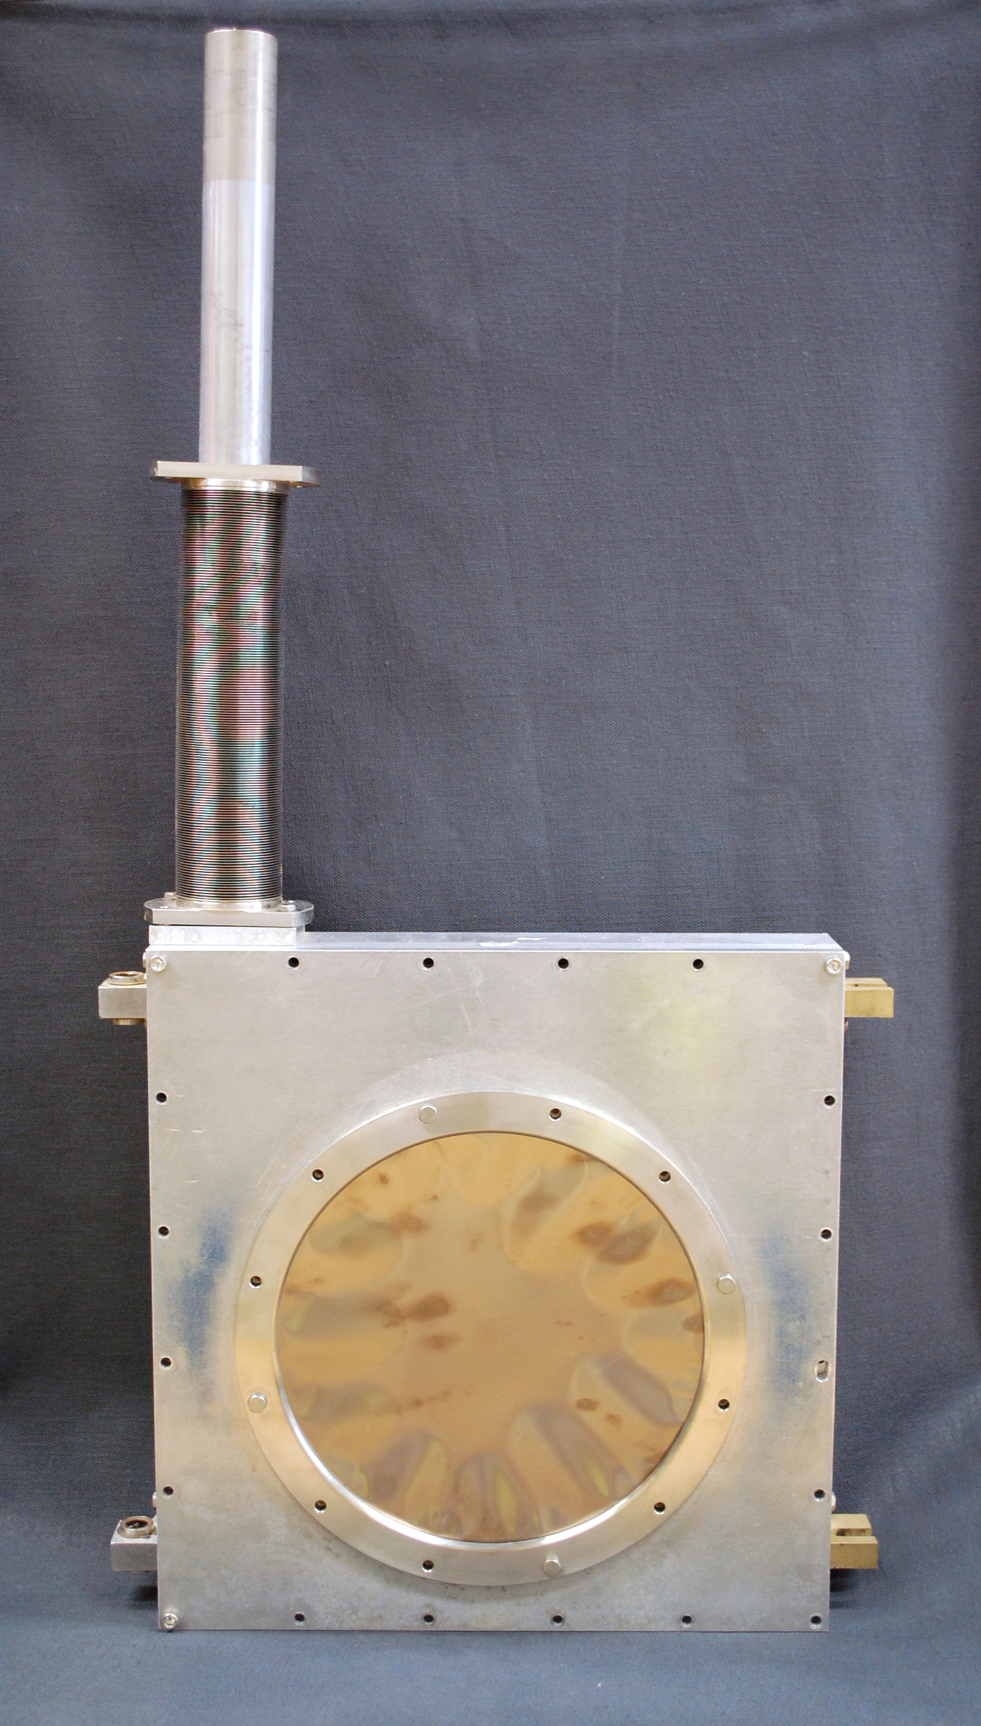
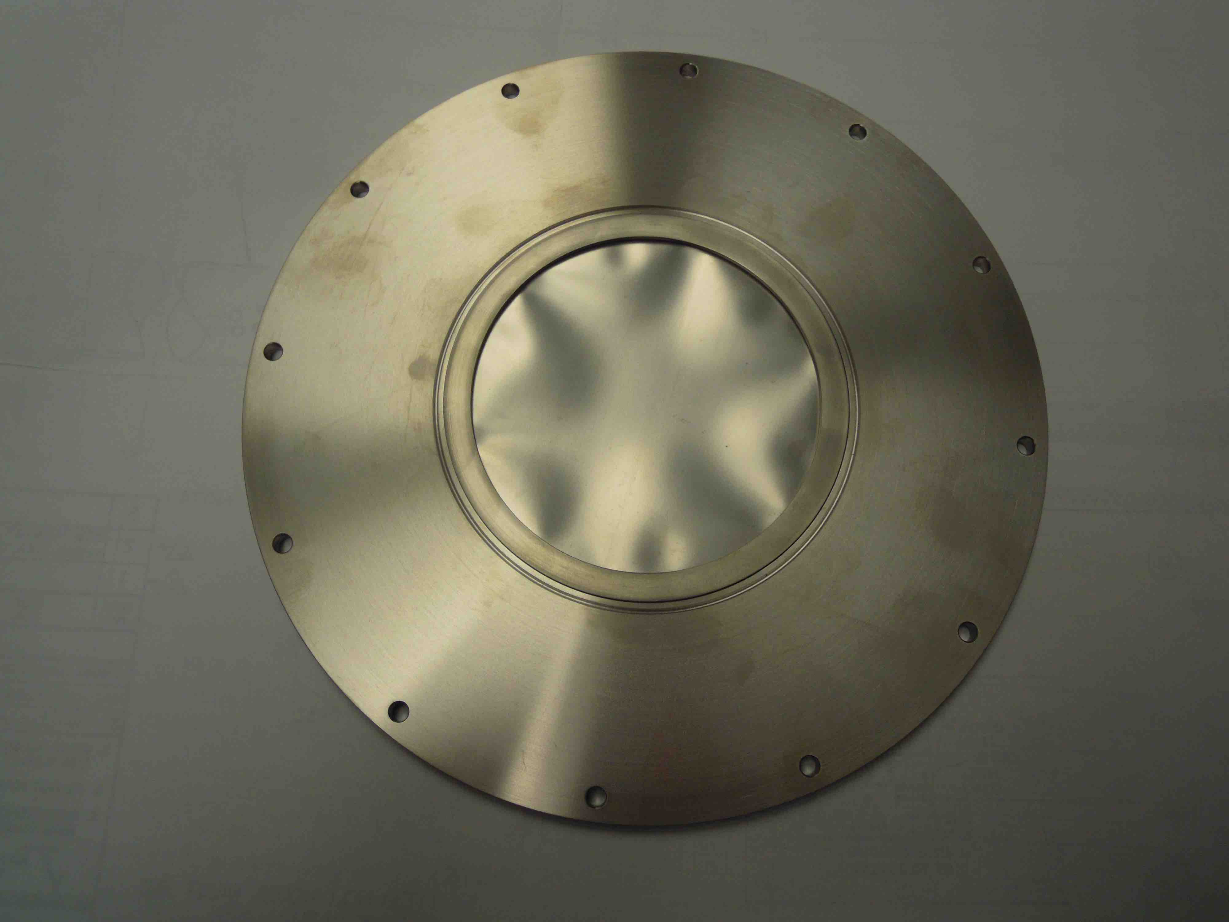
Design considerations
New vacuum design of antivacuum can needs to be tested.
Replacement 4 inch E-Beam
Welded Window
Bayonet drive anti-vacuum box
With 9 inch O-ring sealed window

Slide 19
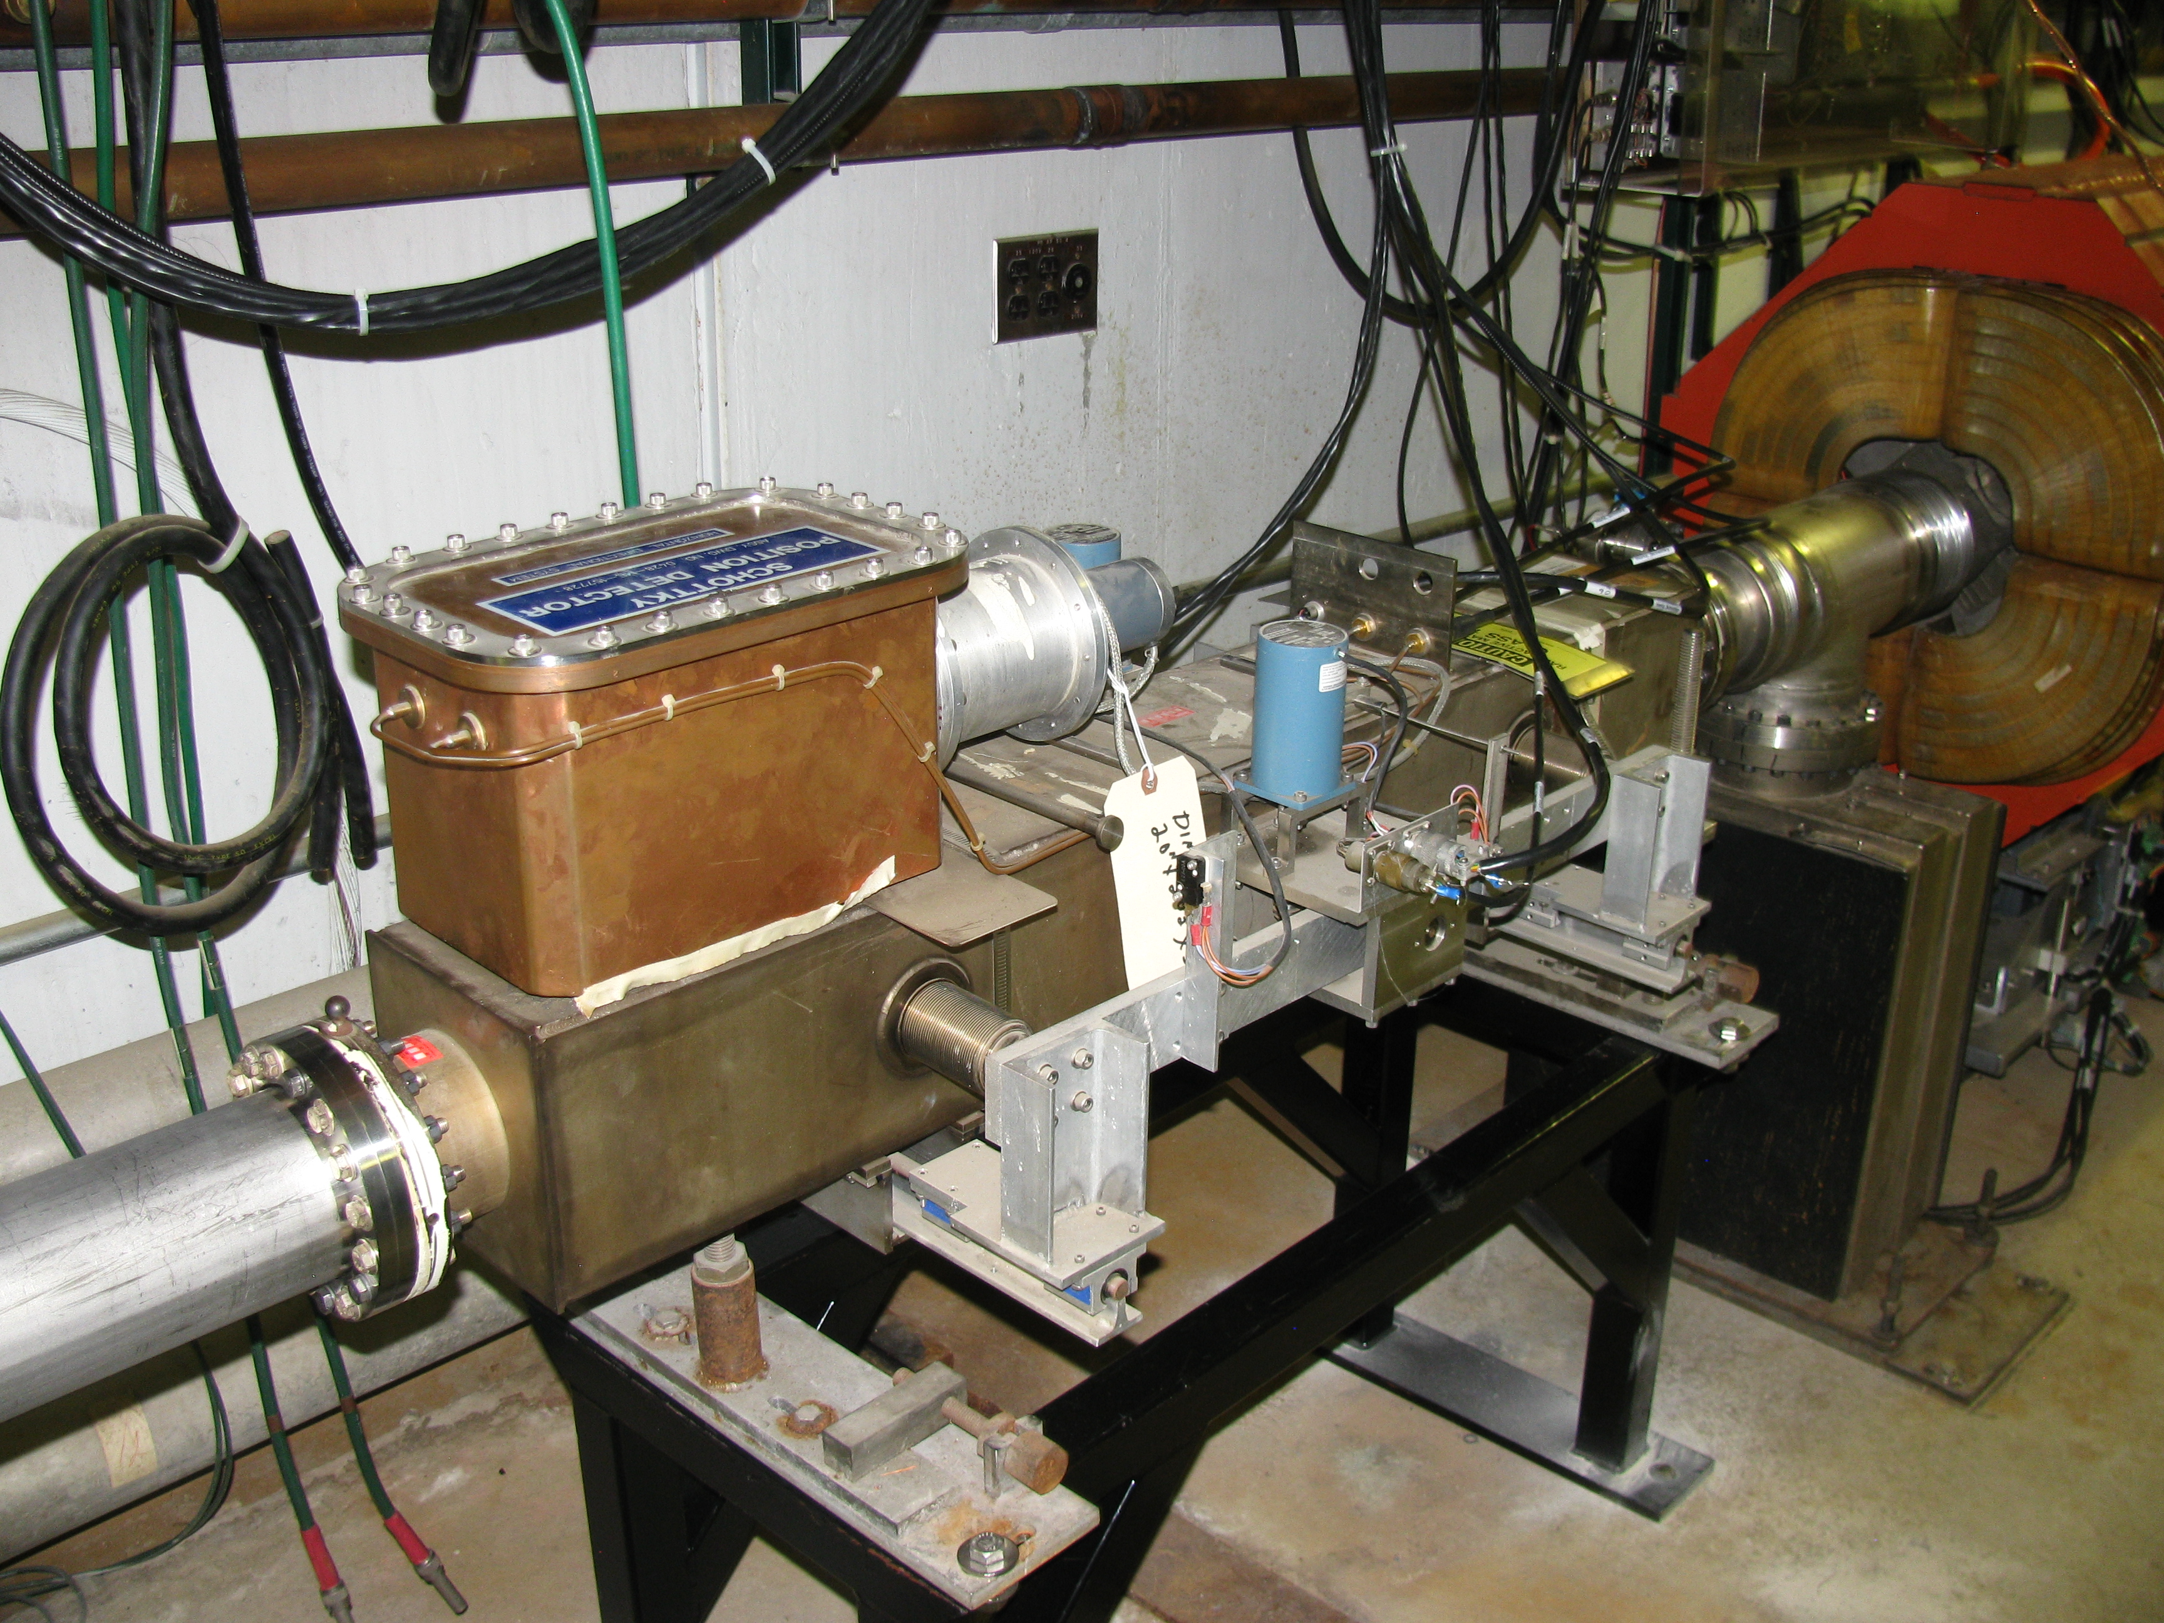
Delivery Ring Instrumentation Design
Measurement | Device | Beam Line | Specific Location
Intensity | DCCT | Delivery Ring | Between D1Q2 and D1Q3
Horizontal Tune | Schottky | Delivery Ring | Between D5Q3 and D5Q4
Vertical Tune | Schottky | Delivery Ring | Between D5Q2 and D5Q3
Resonant extraction instrumentation
Notes:
Delivery Ring Instrumentation
Primary proton beam will circulate in the Delivery Ring as it is slow spilled to the M4 line over a time of 56 msec. Like with the beam transport lines, most of the instrumentation needed for operation of the Mu2e Delivery Ring already exists, but needs to be modified or upgraded to accommodate the faster cycle times. The existing DC current transformer (DCCT) will be used to monitor beam intensity through the slow spill cycle. Beam position monitors (BPMs) and beam loss monitors (BLMs) will be used to monitor the positions and losses in the line. Both systems will need significant hardware and electronics modifications to work under Mu2e operational conditions; however, much of the needed equipment can be repurposed from unused collider equipment. To regulate and optimize the Debuncher resonant extraction process a Delivery Ring tune measurement scheme will be required. Schottky Detector hardware and electronics will be recycled from the Tevatron to make this system.
Instrumentation locations were chosen by the beam lines optics expert in order to tune-up the line.
NOT COVERED because they are funded somewhere else:
Beam Position Monitors (BPM)
The primary system to measure the beam orbit in the storage rings will be based on a set of beam position monitors (BPM), distributed along the rings. The existing split-plate BPM pick-ups are suitable for Mu2e operation and will not require modifications.
The BPM read-out hardware is based on an analog differential receiver-filter module for analog signal conditioning, and a digital signal processing system, reusing the Echotek 8-channel 80MSPS digital down converter and other VME hardware from the Recycler BPMs. This system provides beam position and intensity measurements with a dynamic range of 55 dB and an orbit measurement resolution of ±10 microns. The position measurements can be performed on 2.5 MHz bunched beam, as well as on a 53 MHz bunched Booster batch. Data buffers are maintained for each of the acquisition events and support flash, closed orbit and turn-by-turn measurements. A calibration system provides automatic gain correction of the BPM signal path. The software will need to be modified to handle specific events and data acquisition for the Mu2e operation [7].
Beam Loss Monitors
The beam loss monitors (BLMs) are used to locate and measure beam losses in the storage rings. Although there is already a BLM system in place in the Debuncher, it will require significant upgrades for Mu2e operation. The existing photomultiplier tubes will be too sensitive for the expected Mu2e radiation environment, so they will be replaced by ion chambers repurposed from the Tevatron. The electronics have to be re-designed to accommodate the fast cycle time planned for Mu2e. The system will provide a sample-and-hold acquisition technology on individual beam pulses [4].
Abort Line Instrumentation:
Leftover primary proton beam from each spill from the Delivery Ring, as well as Delivery Ring beam that remains when the beam permit goes away, will be sent to the Delivery Ring abort located in the former AP2 line. Like with the beam transport lines, most of the instrumentation needed for operation of the Abort Line already exists, but needs to be modified or upgraded to accommodate the faster cycle times. An existing Toroid and Ion Chamber will be used to monitor beam intensity in the abort line. Beam position monitors (BPMs) and beam loss monitors (BLMs) will be used to monitor the positions and losses in the line. Both systems will need significant hardware and electronics modifications to work under Mu2e operational conditions; however, much of the needed equipment can be repurposed from unused collider equipment. Beam profiles will be measured by using two existing SEMs.

Slide 20
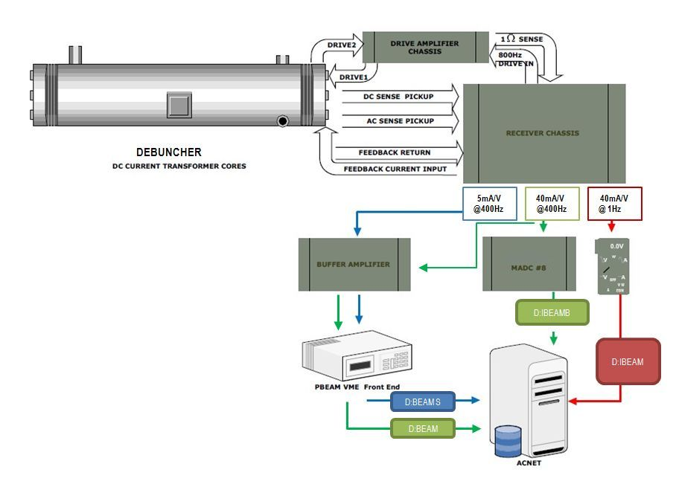
Delivery Ring Instrumentation: DCCT
Delivery Ring DCCT hardware repurposed.
Analog conditioning and VME electronics modified for Mu2e operation.
The system has an accuracy of one part in 10⁵ over the range of 1 x 10¹⁰ to 2 x 10¹² particles with a noise floor of 2 x 10⁹.
The Accumulator unit will become a working spare.
Notes:
Beam Intensity Monitors (DCCT)
A DC current transformer (DCCT) is a device used to measure the quantity of circulating beam with high precision. D:BEAM will become the beam intensity read back for the Delivery Ring. The Accumulator DCCT becomes a spare [2] [6]. Both systems have a full-scale range of 400mA (400e10). Measurements have shown nonlinear errors approaching ~2% for DC currents greater than 200mA. To maximize linearity, calibration procedure focus on doing a least square fit between 0-200mA. The system has an accuracy of one part in 10⁵ over the range of 1 x 10¹⁰ to 2 x 10¹² particles with a noise floor of 2 x 10⁹.
The existing tunnel device in the Delivery Ring can be reused, after applying some modifications. The Delivery Ring DCCT will not require any specific changes to the physical detector, but will need its analog conditioning and VME electronics modified for Mu2e operation. The Accumulator unit will become a working spare.
The pickups consist of two sets of supermalloy tape-wound toroidal cores with laminations, which act to reduce eddy currents. Beam goes through the hole of the donut and acts as a single turn on both toroid sets. The beam sensing electronics are attached to wire windings on each of the toroid sets. One set of cores (T1 & T2) is driven into saturation with 800Hz sinusoidal drive signal. Passing beam induces net magnetic flux on this set of cores, and a second harmonic of the drive signal is detected in the sense winding. The electronics processes this signal and produces an equal and opposite current that minimizes the harmonic and thus keeps the net toroid flux at zero. The second set of cores (T3) is not driven into saturations and follows classical transformer theory. This signal detected processed by the electronics to extend the bandwidth of the entire system. The combination of the resulting signal from processing each sense winding produces the complete feedback signal.
As shown in 6, the receiver chassis provides 3 different sets of analog outputs. Each has a different voltage range and bandwidth, based on modification in the receiver electronics. In order to best measure both the injected and leftover Delivery Ring beam, the following configurations were chosen.
1 Hz bandwidth with 40 mA/V scale. This output is routed to a Keithley digital voltmeter (DVM) located in a rack in the AP10 control room. The Keithley DVM is a GPIB device that talks to the control system through the AP1001 front end, resulting in the D:IBEAM readback that updates once per second with a scale in the mA particle range. Due to the slow 1 Hz sample rate, D:IBEAM is not useful to measure Mu2e slow extracted beam, but will be used for circulating beam studies, diagnostic studies, or calibrations. Maintaining this device also will provide backward compatibility to other intensity algorithms running on AP1001.
400Hz bandwidth with 40 mA/V scale. This output will simultaneously provide 2 readback devices in the control system. One device, D:IBEAMB, is processed through an MADC, using the standard CAMAC 190 card communicating through the Pbar CAMAC front end. At a 720Hz update rate, this 12bit readback effectively provides 40 samples of beam intensity measurements in the mA particle range over the 56msec spill. Although this device would allow us to measure the injected beam and beam through the slow spill cycle, D:IBEAMB is primarily intended for diagnostic purposes. In addition, this output will provide a second device, D:BEAM, which output is sampled by a VME front end after conditioned thru a buffer amplifier (see later description of PBEAM). D:BEAM is intended to be primary measurement of the injected beam and the beam through the slow spill cycle.
400Hz bandwidth with 5 mA/V scale. This output, D:IBEAMV will drive a buffer amplifier, whose output is sampled by a VME front end (see later description of PBEAM). This intensity readback in the uA range will provide the best measurement the leftover beam after slow spill has finished.
The DCCT noise levels are essentially the same in these outputs. The noise of the Debuncher DCCT is about 1.4uA rms for both the 5 and 40mA/V outputs (square root of the sum of the squares from 1 to 58Hz). The Accumulator measures 2.2uA rms.
PBEAM is a VME front end located in AP10. The front end includes a five-slot VME crate with a Motorola MVME-2401 controller. An ICS-110BL-8B provides 4 differential 24 bit ADC channels delivering 18 bits of accuracy. A PMC-UCD provides TCLK and allows ACNET channels that track beam intensity measured on event. (MDAT can also be supported if desired.) Originally, it instrumented such that a single input to the digitizer was from each pbar DCCT systems (i.e. one for Debuncher and another for Accumulator). Since the Accumulator now becomes a spare system, the VME front end will be modified so that both inputs to the digitizer will be from one DCCT system (i.e. Debuncher). One channel will be feed from the 40mA/V receiver chassis output, while the other from 5mA/V. A conditioning amplifier would be used for filtering and to provide a differential inputs to the ADC. The Debuncher signals would be filtered, amplified and driven differentially to the ADC about 50 feet away, located above the Accumulator DCCT. The digitizer oversamples the 400 Hz DCCT outputs at 720 Hz and can provide readbacks with a resolution on the order of a sliding average of twelve 720 Hz samples. Digital signal processing will allow us to measure the injected beam and beam through the slow spill cycle as well as measure the leftover beam after slow spill has finished. The proposed digitizer has the dynamic range to measure the full 400mA range while providing ½ uA rms resolution. Processing the signals digitally will also improve accuracy. The DCCT’s provide between 1 and 2 uA rms provided the 60Hz harmonics are removed.
PBEAM was designed to provide stable readback that is fast enough to sample Delivery Ring beam at various times during the slow spill cycle. D:BEAM is the Delivery Ring Beam Current or main intensity device and is used to derive other arrayed data. PBEAM also provides two other sets of devices that records beam measurements on event. One type is called the fixed-event devices. These will be labeled as D: BEAMXX, where XX is the TCLK reset event. Fixed-event devices will be an array device, containing up to 6 devices. Another time of device is a variable-triggered-event device. It is also an arrayed device, which will be labeled as D:BEAMx. This deivce contains 10 elements, and x will represent the index. Each element will have a settable TCLK event and delay, measured in seconds. The TCLK event is set via the “Timer Reference” selection on a parameter page. The delay is the D/A setting and the intensity readback is the A/D reading.

Slide 21
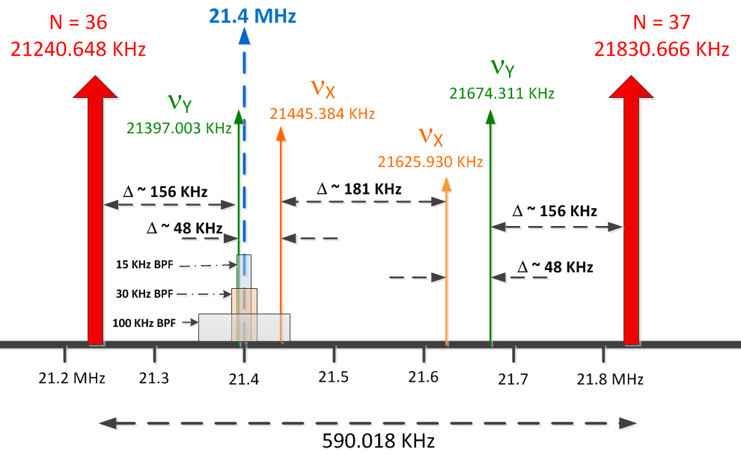
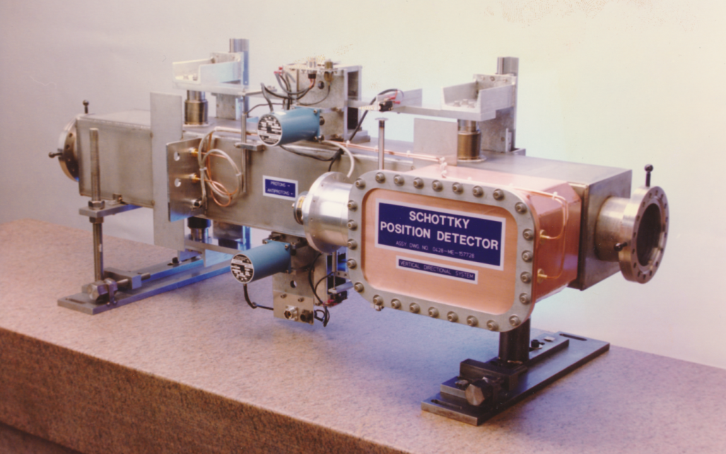
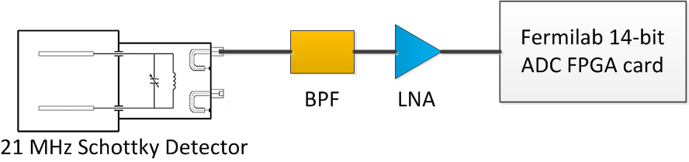
Delivery Ring Instrumentation: Tune Measurement
Repurpose Tevatron 21.4MHz Schottky which has an acceptable aperture.
Down convert from 36th/37th harmonics to 1st harmonic (0 to 590 KHz)
Use Fermilab FPGA Digitizers
  14-bit ADC, 250 MHz sampling
  Real-time FFTs in FPGA
Use digital signal processing to produce tunes
  Tunes to ±0.001 at 590 Hz
  Tunes to ± 0.0001 with averaging over many spills
Notes:
Delivery Ring Tune Measurement
The Delivery Ring is a resonant extraction machine that will require a tune measurement system. The delivery ring tune measurement system will need to measure the average tune and the tune spectrum through the entire 56 ms resonant extraction cycle. These tune measurements will have a resolution of 0.001 at 600 Hz and 0.0001 using averaging. In addition to measuring tune, the system will measure transverse emittance using information from the tune spectrum.
The delivery ring tune measurements will consist of a Schottky detector system, which has the advantage of being non-destructive to the beam and can measure transverse emittance. The challenge is achieving the desired accuracy at an adequately fast update rate.
The Schottky detector system consists of 21.4 MHz resonant pickups taken from the decommissioned Tevatron accelerator as well as its receiver electronics. The 21.4 MHz resonant pickups are two separate horizontal and vertical units with one meter long copper electrodes with stepper motor driven adjustable aperture. The picture above shows the vertical pickup unit with attached 21.4 MHz resonator. The Schottky system will measure the tune spectrum and transverse emittance.
A period of beam studies will be required to optimize the Schottky detectors for Delivery Ring operation. Optimal tune measurement will require selection of appropriate band pass filters (BPFs). A block diagram of the electronics setup is shown above. Both upper and lower sidebands for the horizontal and vertical tunes fall far enough away from the revolution harmonics to allow valid tune measurements with appropriately chosen band pass filters.
Filter out revolution harmonics
Down convert from 36th/37th harmonics to 1st harmonic (0 to 590 KHz)
Use 24-bit ADC to sample signal
2 to 4 MHz sampling
100 db dynamic range
Use digital signal processing to produce tunes
0.001 tunes at 590 Hz
0.0001 tunes with averaging over many spills
Beam Parameters:
Peak intensity: 1e12 protons
Beam energy: 8 GeV
Bunch structure: Single 2.5 MHz bunch
Nominal bunch length: 40 ns
Bunch base width: 200 ns
Resonant slow-spill extraction over 58 ms
30e6 protons extracted per turn
Tune Parameters:
Nominal tunes
ν_{x} = 9.653
ν_{y} = 9.735
Buncher revolution freq: 590.018 KHz
Measurement Requirements:
Measure tune and transverse emittance
Measure tune throughout slow-spill
Tune resolution:
0.0001 (with averaging)
0.001 @ 600 Hz

Slide 22
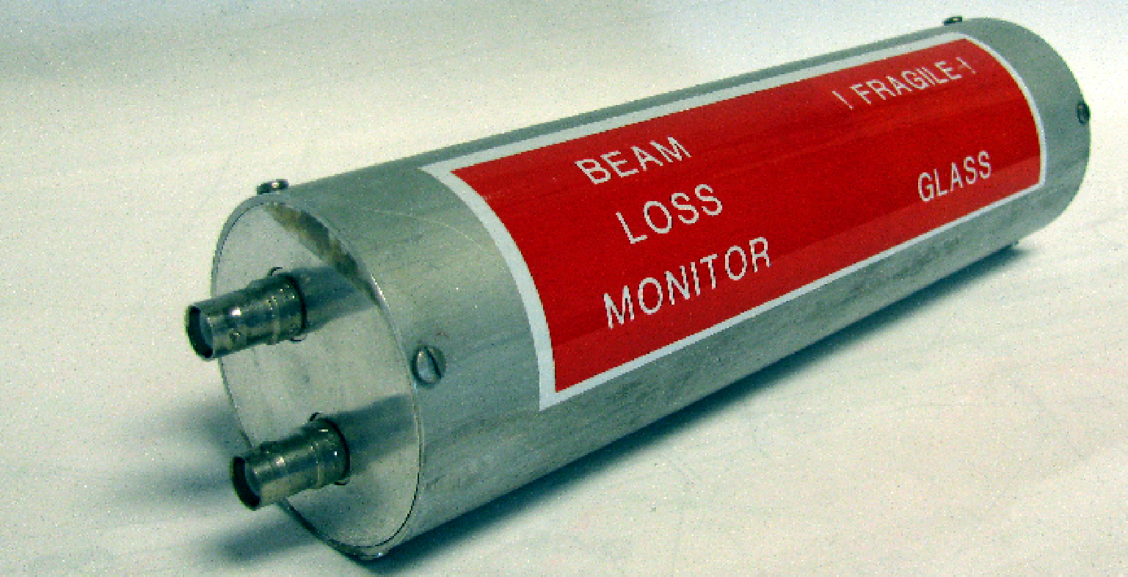
Extraction Instrumentation: BLMs
The M4 Line Beam Loss Monitor (BLM) system has been designed to measure a 0.2% localized loss with microsecond integration.
This will allow seeing losses develop inside of an individual slow spill.
30 BLMs will be placed at key locations along the 245m beam line.
This system design is identical to the existing Main Injector, P1, P2, M1 and M3 line BLM systems.
We will repurpose spare hardware and electronics from the Tevatron to reduce project costs.
Notes:
BLMs:
The M4 Line Beam Loss Monitor (BLM) system has been designed to measure a 0.2% localized loss with microsecond integration. This will allow seeing losses develop inside of an individual slow spill. 20 BLMs will be placed at key locations along the 245m beam line. This system design is identical to the existing Main Injector, P1, P2, M1 and M3 line BLM systems. There is not a sufficient pool of spare hardware and electronics so new parts will need to be purchased and constructed to build the system.
BLM chassis will be implemented at AP30 and the Mu2e Experimental Hall. Each chassis support 12 BLMs units. The system uses ion chamber loss monitors originally designed for the Tevatron. The ion chambers high voltage supply is contained within the BLM Chassis. It is capable of supplying 2500 volts at 500 uAmps. The High Voltage is set to 2000 volts during chassis testing and no further adjustment is required as the Ion Chamber has a flat high voltage to gain response. An Abort Demand signal is produced by feeding the analog "or" of the 12 daughter card outputs to a voltage comparator circuit. The comparator reference level is set by adjusting a rear panel pot. The daughter card can be set up to operate as a Set-Reset integrator, a fast amplifier or as a Log Amplifier (fig 1). The Integrator has a full scale range of either .14 rad or .014 rad dependent upon which branch is used. The fast amp has a rise and fall time of 1 uSec and a full scale range of .014 rad. The Log Amp has a 6 Decade dynamic range allowing loss readings from .001 rad/second to 1000 rads/second (Fig.2). One and only one of these signals can be jumper configured to provide the output to the MADC. The Daughter Card also has a track and hold circuit that can be inserted in the signal path before outputting to the MADC. The Start Track and Start Hold triggers are provided by a Camac 377 card. A timing card within the BLM Chassis fans out these triggers to the 12 Daughter cards. The Start Track signal also resets the integrator circuit when the daughter card is configured as an integrator.
Beamline Log Amp:
Max rise time 1 mSec
Max fall time 300 mSec
Minimum detectable loss .1 R/Sec
Saturation level 1000 R/Sec
The MM4 Line Beam Loss Monitor system will utilizes 20 Ion Chambers distributed at appropriate tunnel locations It requires two BLM Chassis to service these channels, one at AP30 and one at the Mu2e Experimental Hall. There is also a Camac 377 timing card at each building to provide the Start Track and Start Hold triggers.
The daughter cards are set up to function as a Log amp with a track and hold output. The daughter card outputs are feed into an MADC. From there they can be read from a parameter page, Fast Time plotted, or displayed graphically via console application program.
M4 Line BLMs
Asing for 20 loss monitors
Log amp system
2 chassis - one at mu2e and one at AP30 - support up to 24 loss monitor.
From controls need
Reset timer
Hold timer
1 MADC channel for each loss monitors
Switchyard scarfed up all ion chambers.
Need to build chassis also.
24 channels $33K M&S
Labor - 100 hours of technician time. 2.5 weeks - at least….probably more...
No engineering required
Red hv chain - (MI run is 2000' so no problem)
Each loss monitor green RG58 signal cable.
P1, P2, AP1, AP3 - everything is the same….
Ar sealed. Glass tube inside metal chamber is sealed.

Slide 23
Value Engineering
Instrumentation
  Tune Measurement
    Repurpose Tevatron Schottky detectors for our tune measurement system.
  M4 Line Profile Monitors
    Changed type of profile monitor in the M4 line to save on labor and refurbishment costs
    Use ANU multiwire design for M4 line multiwires.
    Repurpose Texas Multiwire vacuum cans for our M4 line multiwires
    Reduce the number of multwires needed by repurposing BNL SWIC for target profile monitor and share upstream proportional wire chamber with g-2.
  Retractable Ion Chambers
    Repurpose Switchyard Bayonet vacuum cans for ion chambers.
    Modify PWC design to fit ion chamber.
  M4 Line beam loss monitors.
    Use standard Fermilab BLM electronics. No engineering time required.

Slide 24
Quality Assurance:
Use of Government Lab and Project QA Standards
  Fermilab Engineering Manual http://www.fnal.gov/directorate/documents/FNAL_Engineering_Manual.pdf
  Fermilab’s Integrated Quality Assurance Program https://esh-docdb.fnal.gov:440/cgi-bin/RetrieveFile?docid=2469
  Mu2e Quality Management Plan http://mu2e-docdb.fnal.gov:8080/cgi-bin/ShowDocument?docid=677.
  Mechanical Engineering QA practices, policy and procedures http://mu2e-docdb.fnal.gov:8080/cgi-bin/ShowDocument?docid=4646.
  Configuration Management Plan: http://mu2e-docdb.fnal.gov:8080/cgi-bin/ShowDocument?docid=508
  Fermilab Software QA Plan: http://goo.gl/wf1HtA
Quality Assurance for Controls
  All innerduct and cable pulls will be completed by contract electricians under the direction of Accelerator Division management.
  Fiber optic terminations will be completed by contract electricians, safety system cable terminations will be managed by FNAL ES&H personnel, and phone cable termination will be managed by Computing Division, telecommunications department.
  All controls links, FIRUS configuration and network connections work will be managed by Accelerator Division Controls Department personnel.
  All parts are expected to be procured by FNAL personnel and inspected before being installed. Final testing and calibration of controls devices will be performed by FNAL technical staff before locating equipment in the service buildings.
Quality Assurance for Instrumentation
  Repurposing, design, upgrading, building and commissioning of M4 line instrumentation will be completed by qualified Accelerator Division Instrumentation and Controls Department Engineers and Technicians under the direction of Instrumentation and Muon Department management.
  All necessary parts will be procured by FNAL personnel and inspected by qualified Instrumentation engineers or technicians prior to installation.
  Final testing of instrumentation devices will be performed by FNAL technical staff before devices are installed.
  Controls checkout and beam commissioning of each device will be completed by qualified Instrumentation, Controls and Muon Department technical staff.

Slide 25
Risks
ACCEL-015 Injection Damper Required for Delivery Ring
Orbit control in the beam lines may not adequately control trajectory and may lead to excessive emittance dilution.
Note: Delivery Ring injection will be made to work for g-2 before the need for Mu2e.
Threat: $240K
Mitigation: If beam studies indicate instabilities of injected beam into the Delivery Ring, an injection damper system will be developed.
Insufficient Network Controls
Legacy 10MBps network systems F23, F27 and AP0 are not fast or stable enough for Mu2e operations.
Threat Retired: Scope was added to the Delivery Ring AIP to run high speed fiber to F23, F27 and AP0c.

Slide 26
ES&H
Tunnel Enclosures and Service Buildings
Electrical hazards from exposed bus work and high voltage connectors.
Mechanical hazards (sharp edges, protruding fixtures)
Radiation hazards
  Potentially lethal doses during beam operation
  Residual radioactivity after beam operations
  Radioactive surface and air contamination
Laboratory ES&H
Instrumentation and controls systems will all be implemented within the guidelines documented in the Fermilab Environment, Safety and Health Manual (FESHM) which can be found online at http://esh.fnal.gov/xms/FESHM.
  Laboratory safety practices will be observed for all work.
  Job hazard analyses will be performed for installation and other appropriate work.
Mu2e ES&H
All hazards in this WBS are covered in the Mu2e Hazard Analysis Report document Mu2e-doc-675 (http://mu2e-docdb.fnal.gov:8080/cgi-bin/ShowDocument?docid=675).

Slide 27
Schedule
CD-2/3b
CD-3c
Beam to Diagnostic Absorber
CD-4
M4 Enclosure
BO
Commission Res. Extr.
External (M4) Beamline Implementation
Controls Design
BL Ctls Implementation
Mu2e Building Controls Implementation
Instrumentation Design
DCCT Implementation
DR Tune Implementation
M4 Profile Monitor Implementation
M4 BLM Implementation
g-2 Beam Operations
Commissioning with single turn Beam
Q3 | Q4 | Q1 | Q2 | Q3 | Q4 | Q1 | Q2 | Q3 | Q4 | Q1 | Q2 | Q3 | Q4 | Q1 | Q2 | Q3 | Q4 | Q1 | Q2 | Q3 | Q4 | Q1 | Q2 | Q3 | Q4 | Q1 | Q2 | Q3 | Q4 | Q1 | Q2 | Q3 | Q4
FY14 FY15 FY16 FY17 FY18 FY19 FY20 FY21
Notes:
Notes:
ESS Installation depicted here is not what is in the P6 schedule. P6 does not account for the fact that the beamline must be commissioned with single turn extracted beam before the ESS can be installed.
The ESS replaces a Delivery Ring extraction kicker module. Therefore, ESS installation precludes further single turn extracted beam to the M4 beamline.
HRS installation takes 10 days (box on schedule is over-sized)
Target installation is off-project and estimated to occur in Dec. 2021.
Beam commissioning is off-project

Slide 28
Summary
Final Design is near completion and we are ready to proceed to the DOE CD3 review.
  Controls Final Design is complete.
  M4 Profile Monitors Design is nearly complete.
    Address MW functionality in magnetic field of production solenoid.
  M4 Ion Chamber Final Design is nearly complete.
    Electronics Final Design Complete.
    Ion Chamber stack Final Design Complete.
    Repurposed vacuum can design modifications ready to test.
  M4 BLM Final Design is complete.
  M4 DCCT and Tune Measurement Systems Final Designs are complete.

Slide 29
Delivery Ring Spill Parameters
Parameter | Value | Units
MI Cycle time | 1.333 | sec
Number of spills per MI cycle | 8
Number of protons per micro-pulse | 3.1×10⁷ | protons
Time between micro-pulses | 1.695 | μsec
Maximum Delivery Ring Beam Intensity | 1.0×10¹² | protons
Instantaneous spill rate | 18.5×10¹² | protons/sec
Average spill rate | 6.0×10¹² | protons/sec
Duty Factor (Total Spill Time ÷ MI Cycle Length) | 32 | %
Duration of each spill | 54 | msec
Spill On Time per MI cycle | 497 | msec
Spill Off Time per MI cycle | 836 | msec
Time Gap between 1st set of 4 and 2nd set of 4 spills | 36 | msec
Time Gap between spills | 5 | msec
Pulse-to-pulse intensity variation | ±50 | %
^{[1]} The pulse intensity is expected to be approximately uniform on short time scales (< 1 msec).
The time scale of the variation in pulse intensity is expected to be of order a few msec.

Slide 30
Mu2e Proton Beam Requirements
Parameter | Design Value | Requirement | Unit
Total protons on target | 3.6×10²⁰ | 3.6×10²⁰ | protons
Time between beam pulses | 1695 | >864 | nsec
Maximum variation in pulse separation | < 1 | 10 | nsec
Spill duration | 54 | >20 | msec
Beamline Transmission Window | 230 | 250 | nsec
Transmission Window Jitter (rms) | 5 | <10 | nsec
Out-of-time extinction factor | 10⁻¹⁰ | ≤ 10⁻¹⁰
Average proton intensity per pulse | 3.1×10⁷ | < 5.0×10⁷ | protons/pulse
Maximum Pulse to Pulse intensity variation | 50 | 50 | %
Minimum Target rms spot size | 1 | 0.5 | mm
Maximum Target rms spot size⁶ | 1 | 1.5 | mm
Target rms beam divergence | 0.5 | < 4.0 | mrad
^{[1]} This is the Delivery Ring revolution period.
^{[2]} Assumes a round beam

Slide 31
Requirements: Instrumentation
Instrumentation designed to measure proton beam based on the Proton Beam Requirements Mu2e-doc-1105.
 | Beam Line | Delivery Ring | Abort Line | Extraction
Beam Line Names | P1 Stub, P1, P2, M1, and M3 | Delivery Ring | Abort Line | M4
Particles | Protons | Protons | Protons | Protons
Momentum (GeV/c) | 8.88626 | 8.88626 | 8.88626 | 8.88626
# of Particles | 1E12 | 1E12 -> 2E10 slow spill over 54msec | 2E10 at the end of every cycle or up to 1E12 when beam permit is pulled. | Slices of 2E7 every 1.695usec totaling 1E12 over the 56msec slow spill cycle.
Bunch Length | 120nsec | 120 nsec | 120 nsec | 120 nsec
Transverse Emittance (mm-mrad) | 15pi | 19pi | 40pi | 40pi
Beam Line Length | ~975m | 505m | 72m | 244m

Slide 32
Accelerator Parameters

Slide 33
Standard Specifications: Accelerator Controls
Ethernet (Controls & General): Communicating with controls system and the outside world.
Experiment data: > 1GB/s pipeline between Mu2e and FCC.
Camac/HRM: Communication with ACNET controls.
Timing Links: TCLK timing for devices.
Beam Synch: RF synched timing for devices.
Permit Loop: Permit for Delivery Ring beam abort.
FIRUS: Fire and Utility system for building monitoring.
Safety System: Interlocks and safety system for Mu2e and M4 enclosure.
SEWs: Site Emergency Warning system.
Radmux: Collects data from connected radiation monitors throughout the accelerator areas, beam line areas, and test areas at the Laboratory
Phone: Hard-lined phone connection to building.
Notes:
Camac and Links:
The existing accelerator service buildings will continue to use the legacy controls infrastructure that is currently in place. These service buildings include all of the Main Injector service buildings, as well as F0, F1, F2, F23, F27, AP0, AP10, AP30 and AP50. Future Muon Campus service buildings, including MC-1 and Mu2e, will be upgraded to a more modern controls infrastructure which will be discussed later in this document.
Computer Automated Measurement and Control (CAMAC) crates exist in each service building and communicate with the control system through a VME style front-end computer over a 10MHz serial link. Both digital and analog status and control of many accelerator devices occur through the CAMAC front ends. There should be no need to install additional CAMAC crates, as there is excess capacity in most of the existing crates. An inventory of existing CAMAC crates in the Muon Department service buildings shows that about 25% of the slots are unoccupied and could be used for additional CAMAC cards. In addition, further slots have become available that were used to interfaces devices that became obsolete with the retirement of Collider Run II operations. It is anticipated that there will be ample CAMAC crate coverage for Mu2e operation in the existing Muon Department service buildings, and very few crates will need to be added or moved.
There are serial links that are distributed through and between the service buildings, via the accelerator enclosures, that provide the necessary communications paths for CAMAC as well as other necessary signals such as clock signals, the beam permit loop and the Fire and Utilities System (FIRUS). Controls serial links can be run over multimode fiber optic cable or copper Heliax cable. Most Muon Department links that run through accelerator enclosures are run over Heliax which should function normally in the radiation environment expected for Mu2e operations.
Accelerator device timing that does not require synchronization to the RF buckets will remain on the existing 10MHz Tevatron Clock (TCLK) system. The existing TCLK infrastructure will remain in existing service buildings and new TCLK link feeds will be run via multimode fiber optic cable from the Mac Room to the Mu2e Experimental Hall.
Accelerator device timing for devices that require synchronization to the RF buckets will continue to be handled through the Beam Synch Clocks; however, a few changes will be required to maintain functionality. The F0, F1 and F2 service buildings will need both 53MHz Main Injector beam synch (MIBS) for SY120 operations and 2.5MHz Recycler beam synch (RRBS) for g-2 and Mu2e operations. These buildings already support multiple beam synch clocks, so the addition of RRBS will require minimal effort. An obsolete 53MHz Tevatron beam synch (TVBS) feed in the MI60 control room will be replaced with a 2.5MHz RRBS feed to provide the necessary functionality. The remaining Muon Department service buildings currently use 53MHz MIBS, but will require 2.5MHz RRBS for g-2 and Mu2e operations. This functionality can be obtained by replacing the MIBS feed at F0 with RRBS and using the existing infrastructure. Further upgrades and cable pulls will only be required if it is later determined that both MIBS and RRBS are required in these service buildings. New beam synch feeds to the g-2 and Mu2e service building will be run via multimode fiber optic cable from the Mac Room.
The Delivery Ring permit loop provides a means of inhibiting incoming beam when there is a problem with the beam delivery system. The Pbar beam permit infrastructure will be used in the existing buildings. The CAMAC 201 and 479 cards, which provide the 50MHz abort loop signal and monitor timing, will need to be moved from the MAC Room to AP50 to accommodate the addition of the abort kicker at AP50. Existing CAMAC 200 modules in each CAMAC crate can accommodate up to eight abort inputs each. If additional abort inputs are required, spare CAMAC 200 modules will be repurposed from the Tevatron and will only require an EPROM or PAL change to bring into operation. The permit loop will be extended to the MC-1 and Mu2e service buildings via multimode fiber optic cable from the Mac Room. CAMAC will not be available in the MC-1 and Mu2e Experimental Halls, so the abort permit signal for these buildings will be extended via an additional cable pull to the AP30 service building.
Permit scenarios are being developed to support necessary operational scenarios. We will need the capability of running beam to the Delivery Ring dump when Mu2e and g-2 are down, and running to either experiment while the other is down.
Hot-Link Rack Monitor
New controls installations in the Mu2e Experimental Hall will use Hot-Link Rack Monitors (HRM’s) in place of CAMAC. A HRM runs on a VME platform that communicates with the control system over Ethernet. Unlike CAMAC, no external serial link is required, minimizing the need for cable pulls between buildings. Each HRM installation provides 64 analog inputs channels, 8 analog output channels, 8 TCLK timer channels and 8 bytes of digital I/O. This incorporates the features of multiple CAMAC cards into a single-compact chassis. Like CAMAC, when additional functionality or controls channels are needed, additional units can be added. Two HRMs will be installed in both MC-1 and Mu2e Experimental Halls and should provide ample controls coverage for both accelerator and experimental devices.
A Hot-Link Rack Monitor is a flexible data acquisition system composed of a remote unit and a PCI Mezzanine card that resides in a VME crate. Each HRM provides provides sixty four 16 bit analog input channels, 8 analog output channels, 8 TCLK timer channels and 8 bytes of digital I/O. HRM’s will eventually replace all of the functionality of CAMAC [5].
Ethernet:
Many modern devices have some form of Ethernet user interface. In addition, many devices and remote front ends use Ethernet to interface the control system instead of using the traditional CAMAC. The results are an increasing demand on the Controls Ethernet. All of the current Muon Ring service buildings have Gigabit fiber optic connections from the cross-gallery computer room to Cisco network switches centrally located in each service building. These will provide ample network bandwidth and connections after the reconfiguration for g-2 and Mu2e operations. A central Ethernet switch that fans out to the other Muon Department buildings is currently located in AP10, but will need to be moved to AP30 as will be discussed later in this document [9].
Figure 3: Controls Ethernet to the Muon Department Service Buildings should be adequate for Mu2e operations. The central switch at AP10 will be moved to AP30. Legacy networks at AP0, F23 and F27 have limited bandwidth and connectivity, but should be sufficient for Mu2e operations.
Ethernet connects between the Muon Rings service buildings via multimode fiber optic cable paths that traverse the Rings enclosure on the Accumulator side. This will be upgraded to single mode fiber optic cable in order to support the rerouting of the site emergency warning system as well as provide a more robust fiber infrastructure for the higher radiation levels anticipated for Mu2e operations.
Most beam line service buildings have gigabit fiber connected to centrally located network switches that provide ample network bandwidth and connections. AP0, F23, and F27 are the only three buildings that do not have this functionality. AP0 runs off a 10Mbps hub that connects to 10Base5 “Thicknet” that runs through the Transport and Rings enclosures back to AP10, while F23 and F27 run off 802.11b wireless from MI60. Both are 10 Mbps shared networks with limited bandwidth and connectivity. It is anticipated that the network in these three buildings will be sufficient for Mu2e operations.
Restoring Controls Connectivity:
Civil construction of the M4 and M5 beams line enclosures will result in the removal of the underground controls communication duct that provides the connectivity between the Accelerator Controls NETwork (ACNET) and the Muon Campus. Included in this communication duct is the fiber optic cable that provides Ethernet connectivity as well as 18 Heliax cables that provide the controls serial links and other signals including the Fire and Utility System (FIRUS). These cables currently connect from this communications duct to the center of the D20 location in the Rings enclosure, and travel through cable trays on the Delivery Ring side to the AP10 service building. After removal of the communications duct, FESS will construct new communications ducts from the existing manholes. These communications ducts will go directly to AP30, MC-1 and Mu2e service buildings without going through accelerator enclosures.
Restoring Connectivity:
When the Heliax and fiber optic cables are cut during the above mentioned communications duct removal, controls connectivity will be lost. The base plan for restoring both Ethernet and controls link connectivity is to pull new fiber optic cable from the cross gallery to the manhole outside of Booster Tower West and on to AP30 via the new communications duct. As a result of the new fiber pull, the Ethernet and controls links will fanout from AP30 instead of AP10. This will require some additional controls hardware configuration and labor. Efforts will be made to minimize the disruption by pulling the fiber and staging the new hardware at AP30 before the communication duct is cut. This is especially important for FIRUS which is necessary for monitoring building protection [10].
Single-mode fiber will be needed for the Ethernet and FIRUS connectivity and multimode fiber will be needed for the controls serial links. Bundles of 96 pair single mode and 36 pair multi-mode fiber optic cable will be run to AP30. This provides the necessary connectivity in a minimal amount of space. Similar fiber bundles will also be pulled to MC1 and Mu2e.
Establish Connectivity to Mu2e:
New fiber optic cable will be pulled from the MAC Room to the Mu2e Experimental Hall. Single-mode fiber is needed for Ethernet and FIRUS and multimode fiber is needed for the timing links and the abort permit loop. Bundles of 96 pair single mode and 36 pair multi-mode fiber optic cable will be run to Mu2e. The fiber pulls will provide ample connectivity for all Ethernet and controls signals for both the accelerator and experiment. The Mu2e experiment anticipates requiring network rates approaching 100MB/sec during production data taking which can be handled easily with the proposed infrastructure.
Radmux
The Multiplexed Radiation Monitoring Data Collection System (MUX) is operated by the ES&H / Radiation Protection / Instrumentation Team. The MUX system is used to collect data from connected radiation monitors throughout the accelerator areas, beam line areas, and test areas at the Laboratory. The system provides an interface between the radiation monitors and the hardware network; provides real-time data for its various users; logs the raw data; and processes the data into formatted reports for users and for archive purposes. Additionally the archived data serves as the legal record of radiation levels though out the laboratory. Radmux connectivity will be restored to the existing moun buildings and established to the Mu2e Experimental Hall via new cable pulls.
Phone
Phone connections to the existing Muon service buildings will be reestablished by splicing into the 400 pair cable in the MI-8 communications duct. A new section of 100 pair cable will be run from the splice, via a new communications duct path established by the Delivery Ring AIP to the AP30 service building.
Phone connections to the Mu2e Experimental Hall will be established by splicing into 400 conductor pair phone line in the CMH33 Manhole and running new 100 conductor pair phone line to the MC-1 and Mu2e Experimental Halls.
Site Emergency Warning System
The Site Emergency Warning System (SEW) currently runs to the Muon Rings buildings over the CATV system. When the communications duct is cut, the CATV system will not be reestablished to the Muon Rings buildings. Instead, the SEWs will be run over single mode fiber optic cable to AP30 and then through the Muon Rings enclosure to AP10, where a connection will be made to the existing system. The fiber will fusion spliced to make one continuous fiber path all of the way to AP10.
No cabling infrastructure will be needed for the SEWS in the Mu2e and MC-1 service buildings. A paging system will be internal to each building and will be tied to a radio receiver (called a TAR) which receives the SEWS radio broadcast system. The messages will be broadcast over the paging system.

Slide 34
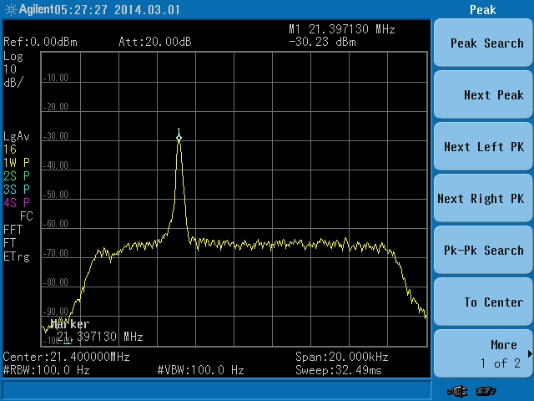
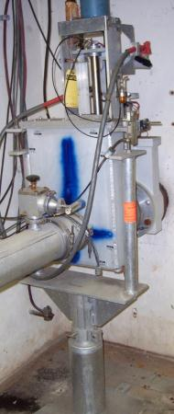
WBS 475.02.03 Instrumentation and Controls
Controls
  New fiber optic and copper pulls from cross gallery to Mu2e will provide all necessary network and controls signals.
  Mirror that work that was just completed at MC-1.
Instrumentation
  DR Tune – Measurements made with repurposed Tevatron Schottky in the Delivery Ring.
  Intensity – New ion chamber design complete and prototype has been built.
  Multiwire
    Refurbish Texas Multiwires with new drive assembly. Prototype is being tested now.
    Use existing NuMI extraction Multiwire design for remaining profile monitors.
  Losses – Use existing Tevatron BLM design.
DR Tune Measurement
BLMs
Multiwire
Texas Multiwires
Retractable Ion Chamber

Slide 35
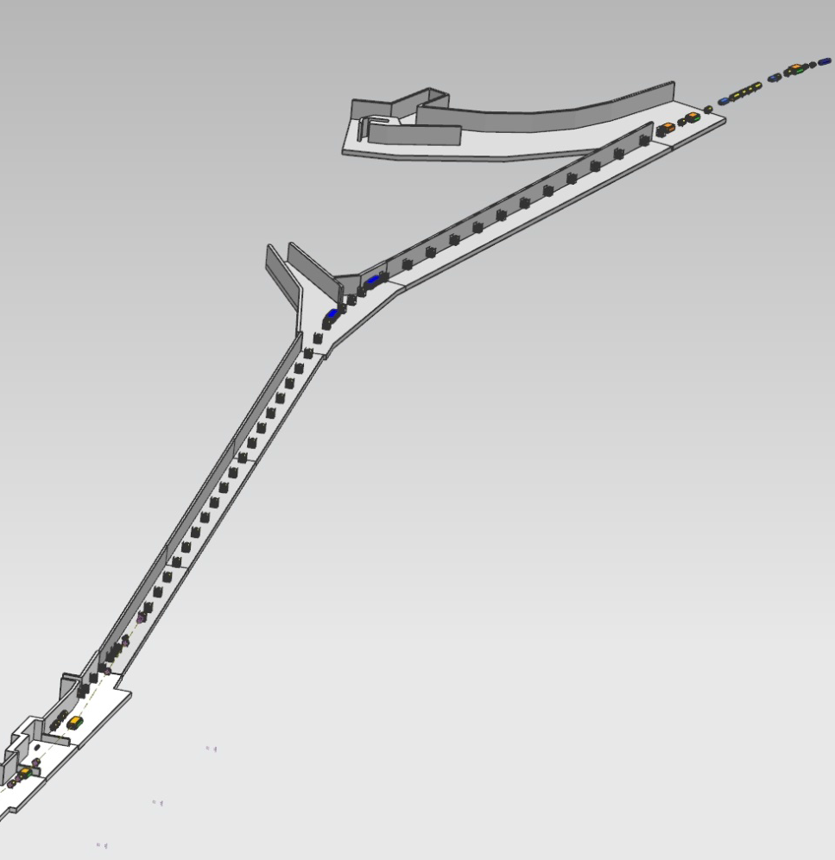
Low Intensity Secondary Beam Instrumentation
Name | Device | Beam Line | Specific Location
SEM804 | SEM | M2 | Use existing SEM704 location
Tor804 | Toroid | M2 | Use existing Tor704 location
IC804 | Fixed Ion Chamber | M2 | Use existing IC704 location. In place.
SEM810 | SEM | M2 | Immediately downstream of Q811
SEM702 | SEM | M3 | Use existing SEM926 location
SEM703 | SEM | M3 | Immediately downstream of H703
SEM706 | SEM | M3 | Immediately downstream of Q706
SEM711 | SEM | M3 | Immediately downstream of Q711
SEM719 | SEM | M3 | Immediately downstream of Q719
SEM726 | SEM | M3 | Immediately downstream of Q726
SEM729 | SEM | M3 | Immediately downstream of Q729
SEM740 | SEM | M3 | Immediately downstream of Q740
IC740 | Ion Chamber | M3 | Immediately downstream of SEM740
SEM744 | SEM or PWC | M3 | Immediately downstream of Q744
SEM749 | SEM or PWC | M3 | Immediately downstream of Q749
SEMs
or
PWCs
SEM740
IC740
SEM729
SEM726
SEMS
Repurpose 21 Pbar SEMS
Should have hardware for two spares
Build 21 super high gain preamps
Build 21 generation 3 scanners
Ion Chambers
Two Fixed (in air) ion chambers. Need to be mindful of scattering.
Four retractable ion chambers using bayonet cans.
SEM719
SEM711
SEM810
SEM706
SEM804
IC804
Notes:
Instrumentation locations for low intensity secondary beam going through the M2 line, M3 line and Delivery Ring have been chosen for
Toroids: Beam Intensity
SEMs: Beam Profile
WCM: Beam Intensity (temporary)

Slide 36
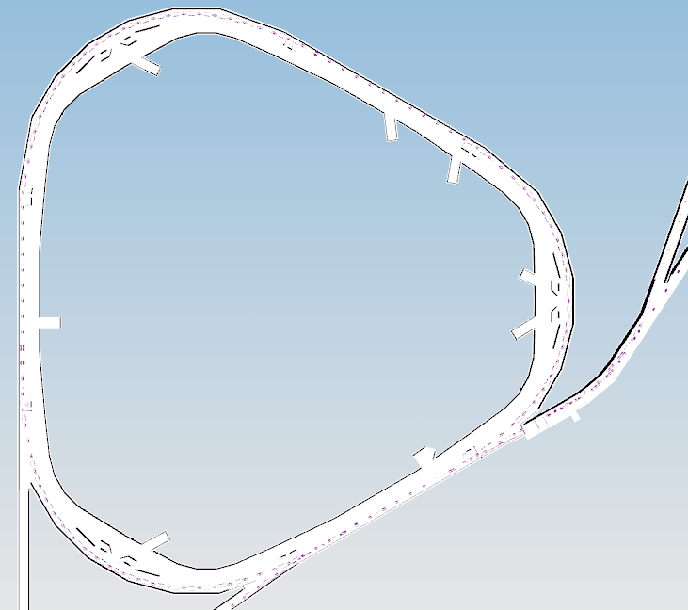
Low Intensity Secondary Beam Instrumentation
Name | Device | Beam Line | Specific Location
SEM204 | SEM or PWC | DR | Immediately upstream of ELAM
SEM302 | SEM or PWC | DR | Immediately downstream of ISEP
IC300 | Ion Chamber | DR | D30 straight (Retractable)
SEM607 | SEM or PWC | DR | Use existing SEM607 location
SEM105 | SEM or PWC | DR | Near D1Q5
IC100 | Ion Chamber | DR | D10 straight (Retractable)
SEM403 | SEM or PWC | DR | Use existing SEM403 location
SEM506 | SEM or PWC | DR | Near D5Q6
WCM503 | WCM | DR | Between D5Q3 and D5Q4. Mu2e Device
IC500 | Ion Chamber | DR | D10 straight (Retractable) – Not costed
ICABT | Fixed Ion Chamber | Abort Line | Immediately upstream of abort block
Tor000 | Toroid | Abort Line | Existing Tor733 as is
TorABT | Toroid | Abort Line | Existing Tor724 near abort block.
MWA00 | SEM | Abort Line | Existing SEM733 at current location
MWA05 | SEM | Abort Line | Existing SEM728 at current location
MWABT | SEM | Abort Line | Immediately upstream of ICABT
SEM
or
PWC
ion
chamber
SEM
or
PWC
SEM
or
PWC
WCM
SEM
or
PWC
SEM
SEM
or
PWC
SEMS
Repurpose 21 Pbar SEMS
Should have hardware for two spares
Build 21 super high gain preamps
Build 21 generation 3 scanners
May use PWCs in DR and some of M3.
Ion Chambers
Two Fixed (in air) ion chambers
Four retractable ion chambers using bayonet cans.
ion
chamber
SEM
SEM
or
PWC
WCM
Mu2e device, but can be used to measure g-2 beam intensity.
Notes:
Instrumentation locations for low intensity secondary beam going through the M2 line, M3 line and Delivery Ring have been chosen for
Toroids: Beam Intensity
SEMs: Beam Profile
WCM: Beam Intensity (temporary)

Slide 37
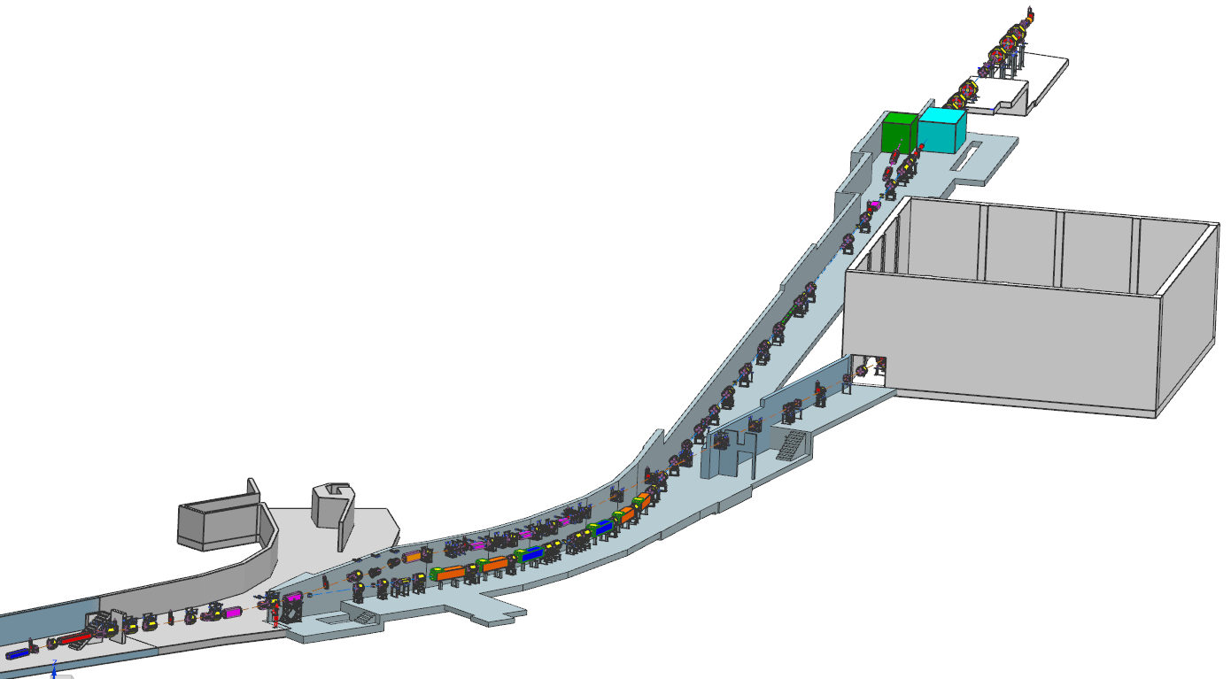
External Beamline
Mu2e
g-2 project responsible for M4/M5 combined beamline section
Mu2e Project responsible for beamline downstream of V907
Diagnostic Absorber
Final Focus
Temp Shielding
Extinction Dipole Modules
MC-1
g-2
V907
Delivery Ring
M5 Beamline
M4/M5 Combined Beamline

Slide 38
Extraction Beamline Multiwire Locations
Name | Device | BL | Specific Location
MW903NU | Multiwire | M4 | Immediately downstream of Q903
MW906NU | Multiwire | M4 | Immediately downstream of V906
MW907NU | Multiwire | M4 | Immediately downstream of V907
MW908NU | Multiwire | M4 | Immediately downstream of Q908
MW910TX | Texas MW | M4 | Immediately downstream of Q910
MW912TX | Texas MW | M4 | Immediately downstream of H912
MW914NU | Multiwire | M4 | Immediately downstream of HT914
MW916TX | Texas MW | M4 | Immediately downstream of H916
MW917TX | Texas MW | M4 | Immediately downstream of H917
MW919NU | Multiwire | M4 | Immediately downstream of VT919
MW922NU | Multiwire | M4 | Immediately downstream of Q922
MW924NU | Multiwire | M4 | Immediately downstream of collimator at 924
MW926NU | Multiwire | M4 | Downstream of Q926
MW927NU | Multiwire | M4 | Immediately downstream of HT927
MW929NU | Texas MW | M4 | Immediately downstream of Q929
MW930NU | Multiwire | M4 | Immediately downstream of VT930
MW932NU | Multiwire | M4 | Immediately downstream of Q932
MW933NU | Multiwire | M4 | Immediately upstreamc of Q934
MW935NU | Multiwire | M4 | Immediately downstream of Q935
MW936TX | Texas MW | M4 | Immediately downstream of beam stop at 936
MW937NU | Multiwire | M4 | Immediately downstream of Q937
MW940NU | Multiwire | M4 | Immediately downstream of Q940
MW941NU | Multiwire | M4 | Immediately downstream of Q941
MW943ATX | Texas MW | M4 | Immediately downstream of Q943
MW943BTX | Texas MW | M4 | Immediately downstream of HT943
SWTGT | BNL SWIC | M4 | Downstream of production target.
MW941
F10021605
*Two profile monitors used on either side of the collimators only for commissioning and later moved to other locations.
Notes:
M4 Line Instrumentation:
Slow extracted proton beam from the Delivery Ring will traverse the newly constructed M4 line before arriving at the Mu2e target. Instrumentation hardware and electronics will be recycled from other areas. The instantaneous intensity of the slow spill beam is too small to be measured with Toroids, so retractable ion chambers will be constructed to measure the beam intensity. A Beam Loss Monitor (BLM) system based on the hardware and electronics that exist in the P1 and P2 line will be implemented to help maintain good transmission efficiency in the beam lines. Multiwires will provide beam profiles in both transverse planes.
Instrumentation locations were chosen by the beam lines optics expert in order to tune-up the line. 27 Profile Monitors

Slide 39
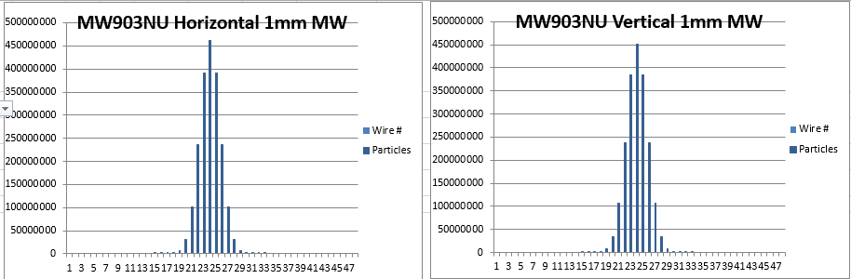
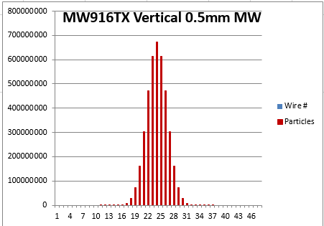
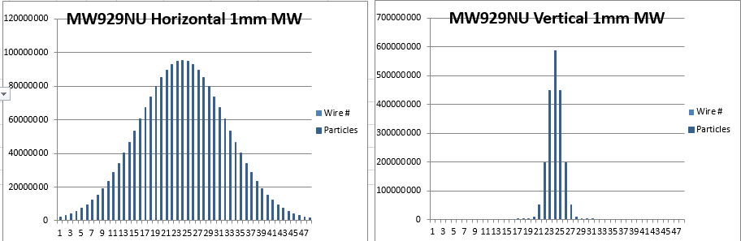

























Simulated Profile Sizes for 0.5mm and 1.0mm wire spacing
903
916
929
940
906
917
930
941
907
919
932
943A
908
922
933
943B
910
924
935
Distribution peaks gives position readbacks used for autotune program
912
926
936
914
927
937
Mu2e-doc-6067
Notes:
Assumes:
Gaussian beam profiles
16 pi-mm-mrad 95% normalized emittance
dp/p = 0 0.003
Lattice file dated 9/30/15
Profiles simulated using spreadsheet in Mu2e-doc-6067
Using the M4 line lattice and expected beam parameters, beam profiles were simulated at each of the Multiwire positions. 1mm or 0.5mm wire spacings were chosen depending on the beam size at the location of the Multiwire. The purpose is to get a horizontal and vertical beam profile that can be used to tune the transverse positions of the beam. The positions gathered from the beam profiles will be used as part of an M4 beamline autotune system that will be talked about in more detail later on.

Slide 40
Beam Position Monitors
Debuncher BPMs can only see 53MHz and will be upgraded to Echotech standard with 2.5MHz electronics.
  Repurpose Tevatron BPM crates
  Repurpose Recycler BPM electronics
Tunnel hardware will be repurposed.
BPMs will have sub-millimeter resolution.
  Closed orbit and TBT available.
Delivery Ring BPM system is off-project on the Delivery Ring AIP.
Notes:
Delivery Ring BPM Plan:
-Removing old BPM electronics hardware from the Delivery Ring (Debuncher).
-Modify Recycler analog transition boards to handle expected signal intensity produced by a 1e12 ppb (2.5 MHz) in the Delivery Ring.
-Design a plate which transitions N-type connectors to DB-9 connectors allowing BPM signals to connect to 2.5 MHz transition board DB -9 input connectors.
-Design and test 2.5 MHz filters in the digital down-converter boards installed in the Debuncher.
-Install VME64X crates in Delivery Ring service building.
-Purchase MVME5500 processor boards to be used as crate controllers or if any available from TeV BPM system use those.
-Make # of Top Plates for the relay racks where the VME64X crates will be installed.
-Modify transition boards to handle signal intensity in the 2.5 MHz channel which is already implemented in the existing transition boards.
-Develop front-end software in the BPM system that can be used with Debuncher control system.
-Develop code to process signals from the digital down converter boards and produce a beam position signal.
Provide sub-millimeter resolution of the horizontal and vertical positions.
Debuncher BPM’s are cylindrical with an 18 cm diameter. BPM's can also be found in the AP1, 2 and 3 beamlines. The AP-1 line has 7.6 cm diameter combined horizontal and vertical BPM’s at every quadrupole location while the AP-2 and AP-3 lines are single-plane and 13 cm in diameter, generally alternating planes at quadrupole locations.
The 120 Debuncher BPMs are divided into six “houses” of 20 BPMs each (10 horizontal and 10 vertical) – can only see 53MHz beam.
Figure above gives an overview of the Echotek BPM layout.
-Signals from the BPM A and B plates in the tunnel are sent up to the service buildings via RG8/RG213 cables and are connected to the back of the analog filter cards in the analog crate. The analog cards filter, attenuate and amplify the analog BPM signals as needed. Each analog card can handle two BPMs (four BPM plate signals) which are processed and output through the front panel cables to Echotek cards in the BPM VME crate. The analog crate also contains a test/control module that handles setup of the filter modules including test pulses. The entire crate is powered with an external +5V power supply that is found near the bottom of the rack.

Slide 41

Performance: Schottky Tune Measurement
5.3e10 protons in Debuncher
21.397130 MHz is equal to a vertical tune of 0.7348
Pbar Schottky tune was 0.7348
Performance was sufficient to continue with Schottky tune measurement system.

Slide 42


Mu2e Controls
Cable purchases are in progress

Slide 43

Multiwire and Ion Chamber Schedule

Slide 44

Multiwire/Ion Chamber Schedule (continued)

Slide 45

DCCT Schedule

Slide 46

BLM Schedule

Slide 47

Tune Measurement Schedule

Slide 48
Delivery Ring AIP BPM Schedule
Delivery Ring and Abort Line BPMs

