Slide 1
Delivery Ring Extraction for Mu2e – Optics Design
Steve Werkema
Mu2e Beamline, Controls and Instrumentation Technical Design Review
6 October 2015

Slide 2
Outline
Delivery Ring Extraction Requirements
Overview – Extraction Equipment layout
Extraction optics and trajectory
Calculation of M4 beamline starting parameters

Slide 3
Delivery Ring Extraction Section Requirements
Transport resonantly extracted 8.9 GeV/c proton beam from the Delivery Ring electro-static septum extraction channel to the upstream end of the C-magnet downstream of quadrupole D2Q5
Maintain – to the extent possible – the Delivery Ring extraction layout used for extraction of 3.1 GeV/c muons to the g-2 experiment*
Efficiently extract beam to minimize losses such that prompt and residual radiation dose rates are as low as possible –
MARS tracking models show ~98% efficiency
Gives acceptable radiation dose rates
* A significant exception to this is noted in a later slide
Notes:
Note: #2 is violated by the need to replace the downstream g-2 extraction kicker with the upstream Mu2e electro-static septum module

Slide 4
Overview of Delivery Ring Extraction
Equipment layout
Resonant extraction overview (not in scope of this review)

Slide 5
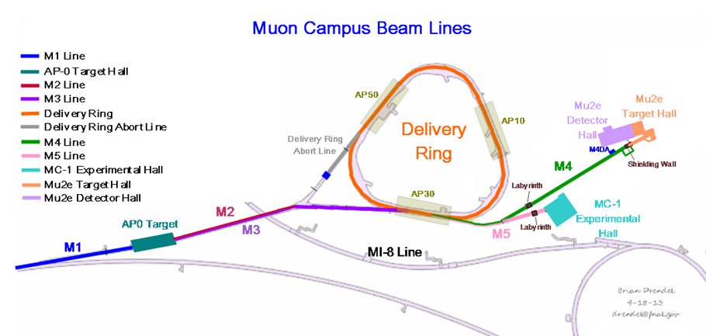
Muon Campus Layout
Proton injection and extraction is located in the D30 straight section
Brian Drendel

Slide 6
Delivery Ring D30 Straight Section
Delivery Ring
M4/M5 Beamline
D30 Straight Section
Shielded Extraction Section
g-2 Extraction kickers
M3 Beamline

Slide 7
Delivery Ring Extraction Equipment Layout for Mu2e
Proton Beam
Key
ESS1 Electro-static Septum Module 1 (Kick: 0.8 mrad, Horizontal inward)
ESS2 Electro-static Septum Module 2 (Kick: 1.2 mrad, Horizontal inward)
ELAM Extraction Lambertson Magnet (Kick: 40.0 mrad, Vertical upward)
ECMAG Extraction C- Magnet
DsQn n^{th} Delivery Ring Quadrupole in sector s (n = 0 at center of straight)
Starting point of Delivery Ring extraction model is upstream end of ESS1
Starting point of M4 beamline model is the upstream end of ECMAG
Notes:
Notes:
Beam pipe vacuum chamber sections not shown here
D2Q5 is a 8Q24 (24” quad) from BNL. Chosen because of the need for a narrow, wide aperture quad in this location.

Slide 8
Extraction Section – Plan View
ESS1
ESS2
ELAM
ECMAG
Delivery Ring
Q203
Q204
Q205
Extraction Section
Extraction line

Slide 9
Compatibility of Mu2e & g-2 Extraction
The downstream g-2 extraction kicker modules must be removed prior to installation of ESS1.
Implications:
Single turn proton extraction at 8 GeV not possible with only one kicker
g-2 3.1 GeV/c operation still possible with one kicker with slightly reduced efficiency
⇒ Must have M4 line commissioned up to diagnostic absorber before installing ESS1
Mu2e ESS
g-2 kickers
D2Q4
D2Q3
D2Q2
D2Q1
Proton Beam

Slide 10
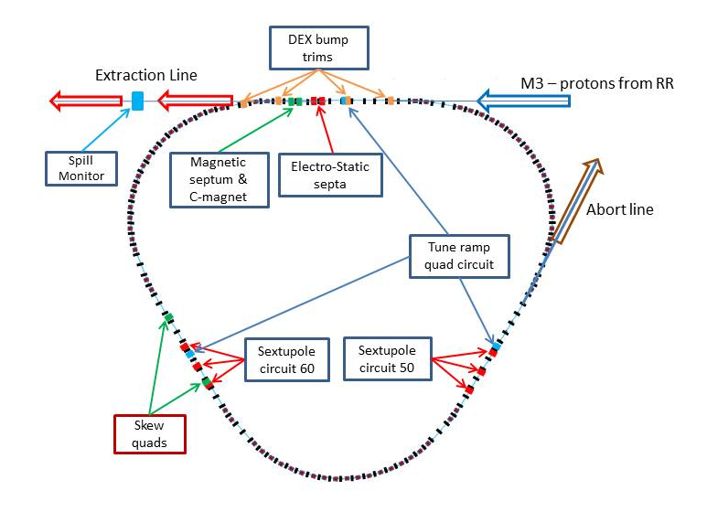
Implementation of Resonant Extraction in the Delivery Ring
New injection point
Extraction in SS 20-30
Electro-static septa
2 families of harmonic Sextupoles
A family of tune Quadrupoles
Extraction Lambertson
Dynamic orbit control
Abort line
RFKO system
Spill monitoring
Spill regulation
SS 20-30
RFKO kicker
SS 10-60
SS 40-50
Horizontal 3rd Integer resonance
Q_{x} / Q_{y}=9.650 / 9.735
Vladimir Nagaslaev
Notes:
SS = Straight Section
RFKO = Radio Frequency Knock Out – horizontal kicker used to heat the beam to control the rate at which beam enters the stop band about the separatrix

Slide 11
Resonant Extraction Horizontal Phase Space
Horizontal phase space distribution of circulating beam at the upstream end of ESS1
Blue – beginning of spill
Red – early in spill
Yellow – late in spill
Cyan – end of spill
ESS1 Foil Plane
Note: x’ at the foil plane changes throughout spill – compensated by DEX bump
Tune quad ramp drives horizontal tune closer to 3rd order resonance as spill progresses – shrinking area inside separatrix to zero at the end of the spill
Synergia model
Chong Shik Park
Notes:
From Synergia tracking model of Mu2e resonant extraction

Slide 12
Circulating and Extracted Beam at Upstream End of ESS1
Cathode
Clearing Electrode
E
-100 kV
40 mm
Foil Plane
Notes:
The electro-static septum is being designed and built under a separate level 3 sub-project (475.05)
Notes:
Proton beam goes into the page
Distribution shown is not expected beam distribution.
These particles were generated for loss simulations (emphasis on high amplitude particles)
Relative intensities of extracted and circulated beam have been altered to make the extracted beam visible

Slide 13
Extraction Lambertson – Upstream End (8.6 m downstream of ESS1)
Extraction Channel
54 mm
Circulating Beam Channel
12.5 mm
Notes:
The extraction lambertson is being designed and built on the g-2 project
Notes:
Proton beam goes into the page
Distribution shown is not expected beam distribution.
These particles were generated for loss simulations (emphasis on high amplitude particles)
Relative intensities of extracted and circulated beam have been altered to make the extracted beam visible

Slide 14
Delivery Ring Extraction Model

Slide 15
Delivery Ring Extraction Models
Several models of Delivery Ring extraction for Mu2e have been constructed
Optics Models
Original Concept: hand calculation of trajectories (Jim Morgan)
Original Model in MAD 8 (Carol Johnstone)
Present Model in MAD X (Steve Werkema) ⇐ Focus of next few slides
Model independently checked in OptiM (Vladimir Nagaslaev)
Resonant extraction studies
MARS model (Vladimir Nagaslaev)
Optimize resonant extraction parameters to minimize losses
Provide beam distributions for tracking models of M4 beamline for extinction and targeting studies
Radiation dose rate/shielding studies
MARS model that includes shielding (Tony Leveling)
sky shine, direct dose rate, and residual activation studies
Notes:
Note: the trajectories of the present optics model come very close to the original calculations of Jim Morgan

Slide 16
Delivery Ring Extraction Optics Model
Two pass process:
First Run:
Model ESS1, ESS2, and ELAM as correction dipoles (doesn’t change survey trajectory)
Starting survey coordinates = coordinates of circulating beam at upstream end of ESS1
Starting x and x’ = center of extracted beam at the upstream end of ESS1
Final coordinates at the upstream end of ECMAG are calculated from the survey coordinates of the circulating beam, and the bearing, pitch, x, x’, y, and y’ of the extracted beam
Final Dispersion (D and D’) at upstream end of ECMAG is calculated from change in in x and y for a 1% change in Δp/p
Second Run:
Model ESS1, ESS2, and ELAM as RBENDs
Starting survey coordinates = coordinates of extracted beam at upstream end of ESS1
Model kicks from off-center passage through quads by embedding short (10 mm) RBENDs in quads with kicks determined from quad Δx’ and Δy’ from first run.
β_{x}, α_{x}, β_{y}, and α_{y} at upstream end of ECMAG determined by this run

Slide 17
Extracted Beam Lattice Functions
ESS1
ESS2
ELAM
D2Q3
D2Q4
D2Q5
s = 0 Upstream end ESS1
s = 11.73 m Upstream end ECMAG

Slide 18
Extracted Beam Horizontal Trajectory: Mu2e and g-2
ELAM
Mu2e and g-2 extracted beam horizontally within ~3 mm
Note: g-2 moves some D30 quads so that the circulating beam is horizontally off-axis by varying amounts. This cause the horizontal position of the circulating beam to differ from zero.
s = 0 Upstream end D2Q3
s = 10.10 m Upstream end ECMAG

Slide 19
Extracted Beam Vertical Trajectory: Mu2e and g-2
Vertical extraction is identical for Mu2e and g-2
ELAM
s = 0 Upstream end D2Q3
s = 10.10 m Upstream end ECMAG

Slide 20
Possible problem: D2Q5 Field Non-Uniformity
8Q24 Quadrupole: measured normal (b_{n}) and skew (a_{n}) harmonic strengths.
Measurements show unusually strong 12- pole (n = 6) and 20-pole (n = 10) components.
2% deviation in gradient at 3” (where we intend to send beam)
There were some measurement problems – an 8Q24 is now on a MTF test stand undergoing a new round of measurements
Notes:
D2Q5 will be replaced by a 8Q24 quadrupole from BNL. 8Q24s are beamline magnets – not known for their high field quality. This magnet is used because it has a large aperture and it is thin.

Slide 21
M4 Beamline Starting Parameters

Slide 22
Starting Position and Lattice for M4 line
Quantity | Value | Units | Description
X₀ | 30071.579381 | m | Site North
Y₀ | 222.112319 | m | Elevation
Z₀ | 30446.932635 | m | Site East
θ₀ | 2.090508 | rad | Bearing
ϕ₀ | 0.054674 | rad | Pitch
β_{x} | 12.316 | m
α_{x} | 1.877
D_{x} | 0.027 | m
D_{x}’ | 0.004
β_{y} | 5.600 | m
α_{y} | -0.616
D_{y} | -0.119 | m
D_{y}’ | -0.069
Starting Coordinates
Starting Lattice Functions

Slide 23
M4 Starting Phase Space
Horizontal transverse phase space distribution is determined by DR extraction optics
ε_{x} = 11 π mm-mrad
Not matched to lattice
* There is a small vertical dispersion (-12 cm) from the vertical bend in ELAM.
Vertical transverse phase space distribution is relatively un-affected* by extraction. Thus, vertical phase space distribution is approximately that coming from the Recycler.
ε_{y} = 16 π mm-mrad
Matched to the lattice
Notes:
From Resonant Extraction MARS tracking model
Ellipses are 95% emittance ellipses.

Slide 24
Conclusions
The design of the extraction optics for extraction from the Delivery Ring to Mu2e is very nearly complete
The design delivers extracted beam to the same position at the upstream end of ECMAG as g-2 extraction
Mu2e extraction requires replacement of downstream g-2 extraction kickers with ESS1
Work remaining: incorporate the impact of the D2Q5 gradient non-uniformity into the model

Slide 25
Backup Slides

Slide 26
Surface Level Dose Rates at AP30 during Mu2e Beam Operation
MARS simulation of direct and sky shine dose rates during Mu2e operation at design beam power.
Assumptions:
Design Beam Power (8kW)
98% Extraction Efficiency
Peak dose rate: 24 mR/hr inside AP30 service building
Tony Leveling

Slide 27
Calculation of Coordinates at Upstream End of ESS1

Slide 28
Emulating kicks from beam offsets in quadrupoles

Slide 29
MAD Global Coordinates
MAD Coordinates:
Axis directions are those of the DUSAF (FSCS:XYZ) system except:
X is site North (not East)
Y is Up (not North)
Z is site East (not Up)
Gives a system where Y is up (as in most accelerator coordinate systems) and X,Y,Z is right handed.
X •
Y •
Z •

Slide 30
MAD Global and Local Coordinates

