Slide 1
M4 BEAMLINE POWER SUPPLIES
Steven Hays AD E/E Support Electrical Engineer
M4 Beam Line Technical Design Review
October 6 2015
Notes:
Steven Hays slh@fnal.gov X2337

Slide 2
Plan for constructing the M4D beam line
All magnet systems operate in DC mode.
Re-use as much existing equipment as is reasonable.
  All Switch Mode supplies will be new
  One new SCR 140kW power supply (same as a present procurement for M3 beam line
Build systems using existing designs
  Current regulation system PSRAC
  PLC for status and control
  Shared hardware design with other beam lines NO new designs
Notes:
The M4 line down stream of V907 will operate at 8GeV The M4 line upstream will operate at either 3.3 GeV or 8 GeV
The current regulation system was designed for the NuMI beam line upgrade. Also a four quadrant version of the design is installed in the NML beam line.
All of the new magnet circuits can use existing designs.

Slide 3
Mu2e DOC-DB 3590 M4 power supply spreadsheet Mu2e -section - JB
NAME |  | MAGNET LOAD
P.S. CIRCUIT |  | MAGNET | M4 - Mu2e Beamline | MAGNET | # | MAG. | MAG.
NAME |  | TYPE | Magnet(s) Name(s) & Distance along beamline (ft) | MODEL | MAGs | IND. | RES.
D:Q908 |  | Quad. | Q908 116' | SQA | 1 | 0.0430 | 0.0323385
D:Q909 |  | Quad. | Q909 124' | SQA | 1 | 0.0430 | 0.0323385
D:Q910 |  | Quad. | Q910 136' | SQC | 1 | 0.0660 | 0.0415561
D:H910 |  | Dipole | H910 150', H911 166', H912 182', H916 218', H917 232', H918 249' | SDFW-SDF | 6 | 0.0567 | 0.0454900
D:Q911 |  | Quad. | Q911 155', Q918 237' | SQC | 2 | 0.0660 | 0.0415561
D:Q912 |  | Quad. | Q912 170', Q917 221' | SQA | 2 | 0.0430 | 0.0323385
D:Q913 |  | Quad. | Q913 187', Q916 206' | SQD | 2 | 0.0779 | 0.0463569
D:Q914 |  | Quad. | Q914 190', Q915 202' | SQD | 2 | 0.0779 | 0.0463569
7 Circuits
D:Q919 |  | Quad. | Q919 256' thru Q923 325' | SQA | 5 | 0.0430 | 0.0323385
D:Q924 |  | Quad. | Q924 345' | SQA | 1 | 0.0430 | 0.0323385
D:Q925 |  | Quad. | Q925 362' | SQA | 1 | 0.0430 | 0.0323385
D:Q926 |  | Quad. | Q926 365' | SQA | 1 | 0.0430 | 0.0323385
D:Q927 |  | Quad. | Q927 387' | SQA | 1 | 0.0430 | 0.0323385
D:Q928 |  | Quad. | Q928 416' | SQB | 1 | 0.0602 | 0.0392517
D:Q929 |  | Quad. | Q929 436' | SQA | 1 | 0.0430 | 0.0323385
 |  | ACDipole
 |  | ACDipole
D:Q930 |  | Quad. | Q930 463" | SQA | 1 | 0.0430 | 0.0323385
D:Q931 |  | Quad. | Q931 480" | SQA | 1 | 0.0430 | 0.0323385
D:Q932 |  | Quad. | Q932 533" | SQA | 1 | 0.0430 | 0.0323385
D:Q933 |  | Quad. | Q933 556" | SQB | 1 | 0.0602 | 0.0392517
D:HDA1 |  | Dipole | HDA1 571' Absorber 5 degree dipole magnet | MDCE | 1 | 0.0107 | 0.0490000
D:QDA01 |  | Quad. | QDA01 600' Absorber quadrupole 1 | 3Q120 | 1 | 0.1234 | 0.1690000
D:QDA02 |  | Quad. | QDA02 600' Absorber quadrupole 2 | 3Q120 | 1 | 0.1234 | 0.1690000
D:Q934 |  | Quad. | Q934 592' | SQB | 1 | 0.0602 | 0.0392517
D:Q935 |  | Quad. | Q935 609' | SQE | 1 | 0.0430 | 0.0646385
D:Q936 |  | Quad. | Q936 617' | SQB | 1 | 0.0602 | 0.0392517
17 Circuits
 |  | Shield Wall
D:V936 |  | Dipole | V936 672' | CDA | 1 | 0.0107 | 0.0270000
D:Q937 |  | Quad. | Q937 675', Q943 770' | LQC | 2 | 0.0304 | 0.0081833
D:Q938 |  | Quad. | Q938 686', Q942 760' | LQD | 2 | 0.0344 | 0.0087892
D:Q939 |  | Quad. | Q939 702', Q941 743' | LQC | 2 | 0.0304 | 0.0081833
D:Q940 |  | Quad. | Q940 722' | SQA | 1 | 0.0430 | 0.0323385
D:HT940 |  | Dipole | HT940 729' | CDA | 1 | 0.0107 | 0.0270000
D:VT940 |  | Dipole | VT940 735' | CDA | 1 | 0.0107 | 0.0270000
D:VT942 |  | Dipole | VT942 766' | CDA | 1 | 0.0107 | 0.0270000
D:V943 |  | Dipole | V943 776' | CDA | 1 | 0.0107 | 0.0270000
D:HT943 |  | Dipole | HT943 782' | CDA | 1 | 0.0107 | 0.0270000
10 Circuits
Notes:
7 circuits being installed in AP-30 service building
16 circuits are being powered from the MC-1 service building and one SCR supply from our inventory will be installed for the abort line.
Magnets after the abort line will be powered brom the MC-2 service building

Slide 4
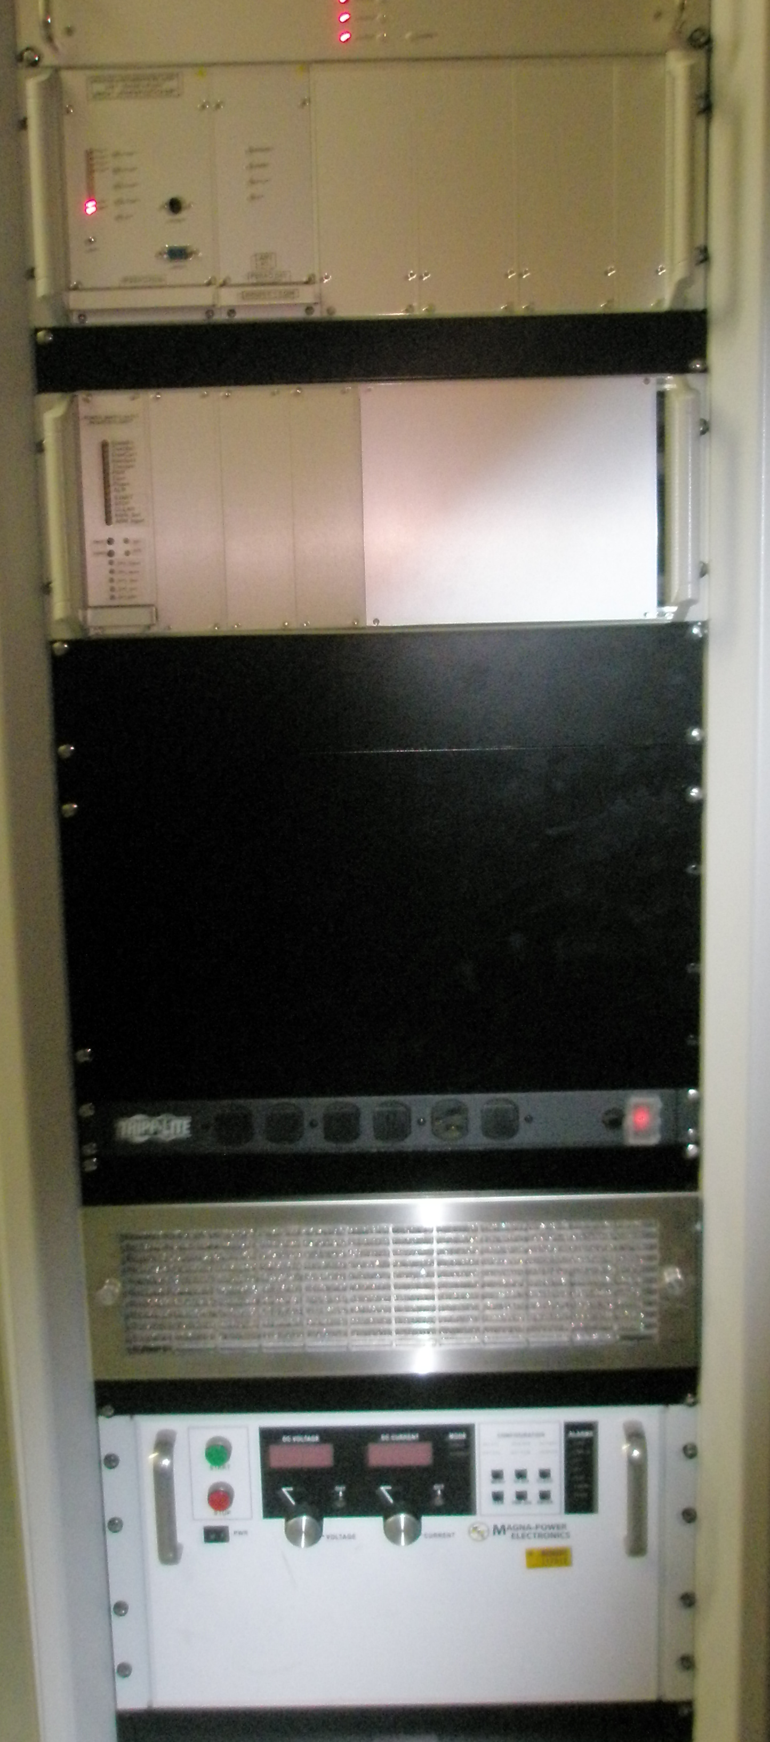
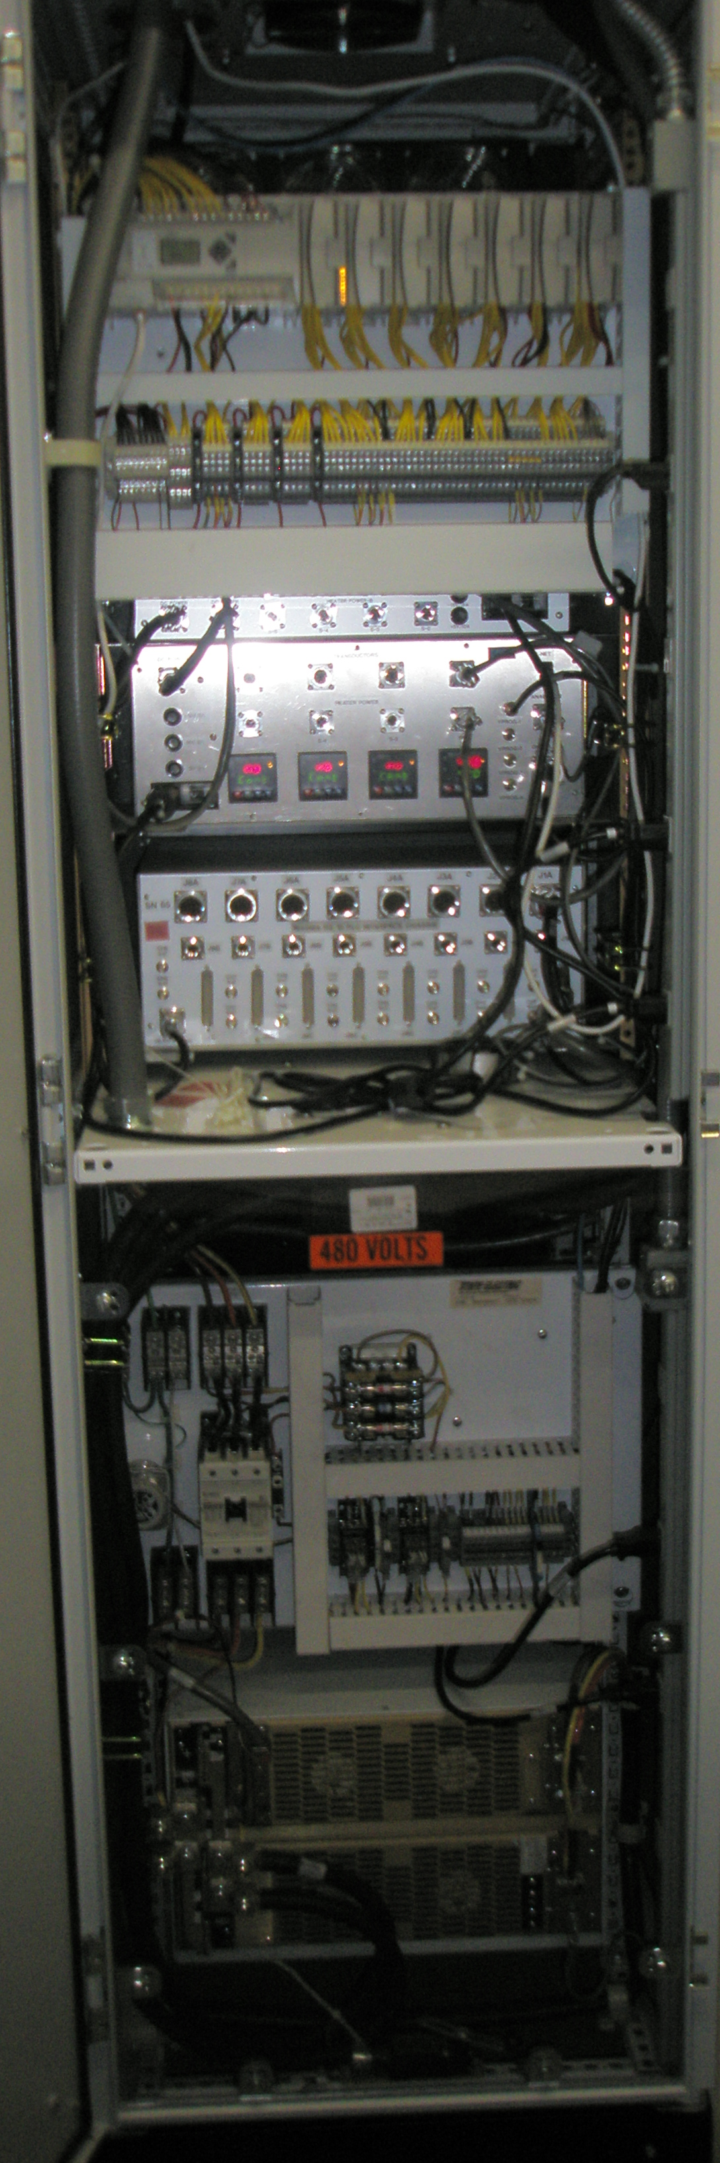
Example of a single Switch Mode power supply system
Notes:
The control system sends a digital DC reference to the PC-104, this is sent to the 18 bit DAC. The DCCT current feedback signal is subtracted from the digital reference and amplified to provide an error signal that is then regulated to zero by the PC-104 by sending a voltage correction signal to the power supply.
Each manufacturer provides a different interface for status and control wich is interfaced using a card and information is collected my the PLC.

Slide 5
PSRAC (Power Supply Regulator and Controller)
Stand alone Embedded System for up to 4 power supplies
  PC-104 base processor
  Provides connections to ACNET data base for the control
  Collects status and control from any power supply through a PLC base power supply interface system
  Provides closed loop current regulation
    Built in feedforward
    Built in fast feedback
    Built in window detection of Reference, Current and Current Error.
  Provides transient recording of operating signals.
Uses an 18 bit temperature regulated DAC for the reference
Only Limited by the quality of the feedback DCCT
82 power supplies in operation using these regulators

Slide 6
PLC and Interface chassis
Programmable Logic Controller
  Commercial unit
  Collects data and provides control to any power supply design
    Older reused equipment uses 15 or 24 VDC control
    Newer equipment often used TTL 5 VDC control
  The PLC connect all the status an makes it available to the PC-104
    The PC-104 reads and writes via an either net connection
    This reduces the amount of control cable and cost of installation
    Provides and independent Over Current monitor
Interface chassis
  Provides signal fan-out (most manufacture provide all signals in one connector) This chassis breaks the signals out to the different place it needs to go (PLC PC-104)
  Provides analog independent Over Current and Over Voltage limits.

Slide 7
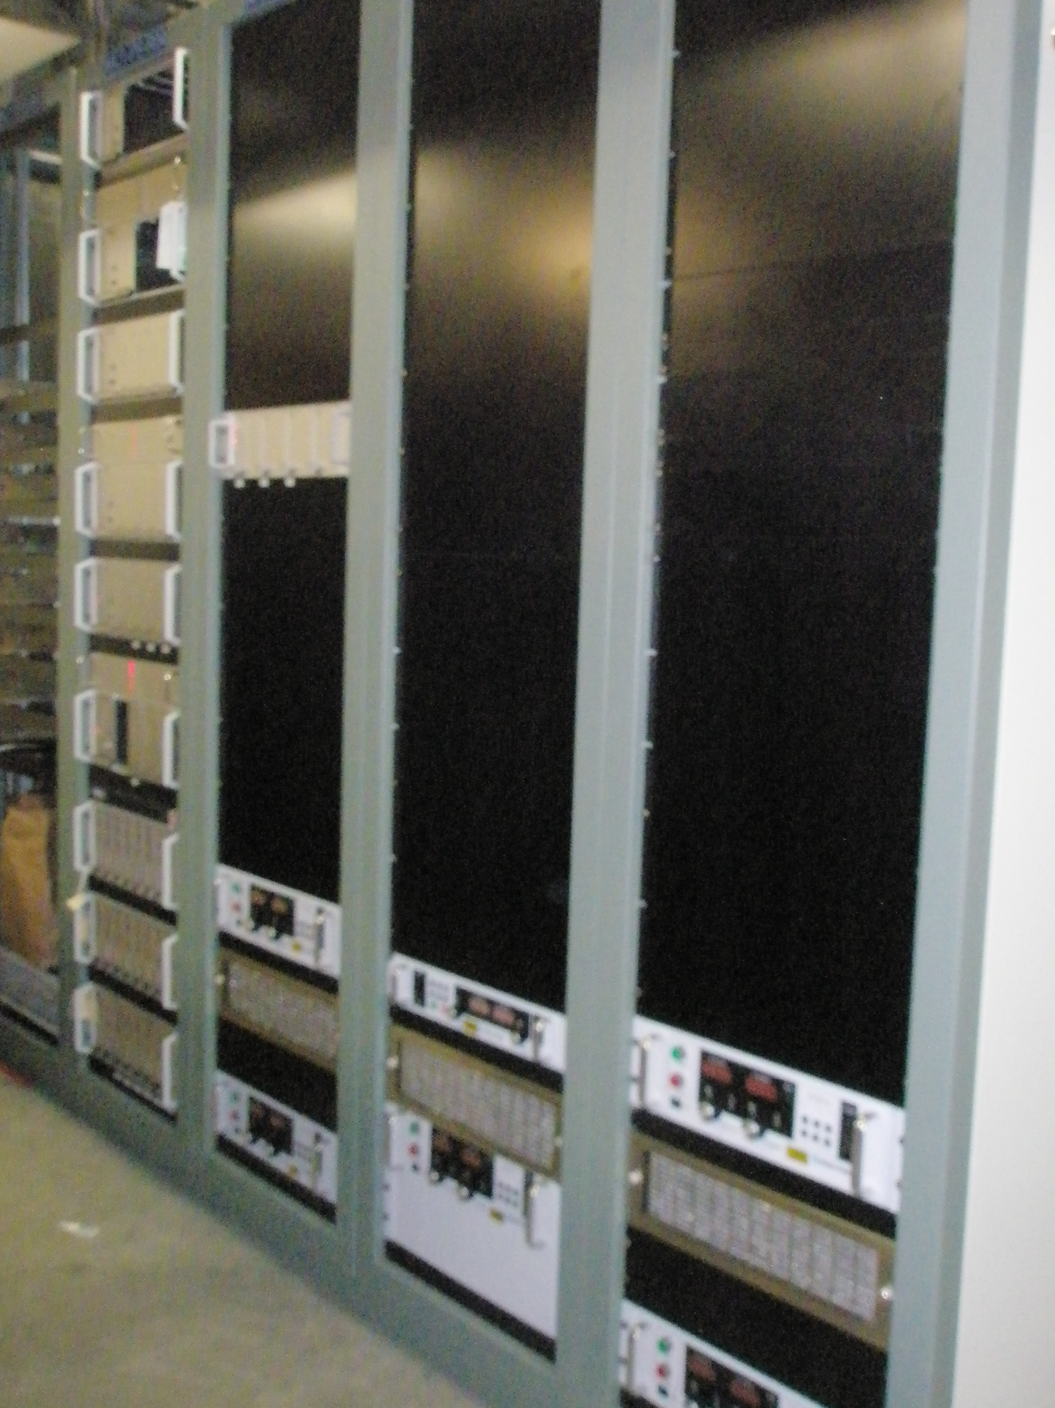
Example of grouped regulation and power systems
There will be 16 Switch Mode circuits in
MC-1 for the M4D beam line and will be
assemble like The M5 beam line equipment. One reused SCR supply will
also be installed in MC-1
M5 beam line MC-1

Slide 8
SUMMARY
Proven Design with many similar installations
  Developed for the NuMI/Nova upgrade
  Muon Campus beam lines use the same design
  All circuits require 100ppm to 300ppm regulation and will not exceed the design of this regulation system
More copies of the equipment will need to be assembled and installed
Most of the assembly will be done by a local assembly house
Final testing and installation will be done by FNAL Techs

