Slide 1
M4 Magnets and Mechanical Systems
Dean Still
10/6/2015

Slide 2
Outlook
Beamline Overview
Magnet Selection
Beamline Vacuum
Beamline LCW
Beamline Diagnostic Absorber
Beamline Fixed Magnet Supports
Beamline Target Scans
Beamline Commissioning

Slide 3
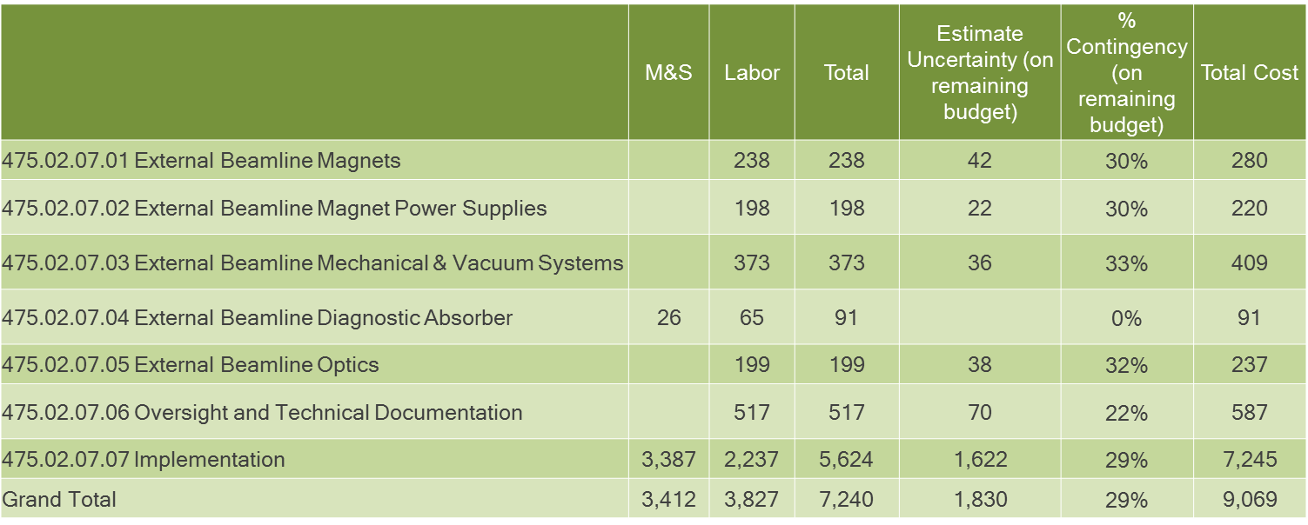
Scope of Beamline Design
Scope of the External Beamline work includes all the design and implementation including the following areas:
  Beamline Optics/Lattice
  Magnets
  Magnet power supply
    Power supplies
    Power supply controls
    Bus or Cabling
    Infrastructure or Distribution Power.
  Mechanical Systems including:
    Beamline vacuum
    Beamline Low Conductivity Water (LCW or cooling water system)
    Magnet Supports
    Beam Stops
  Diagnostic Absorber
  Installation of all these devices
Just for scale, of this portion of the project it is
$ 9.1M of ($50.1M for Accelerator) and
($271M for Total Mu2e Project)

Slide 4
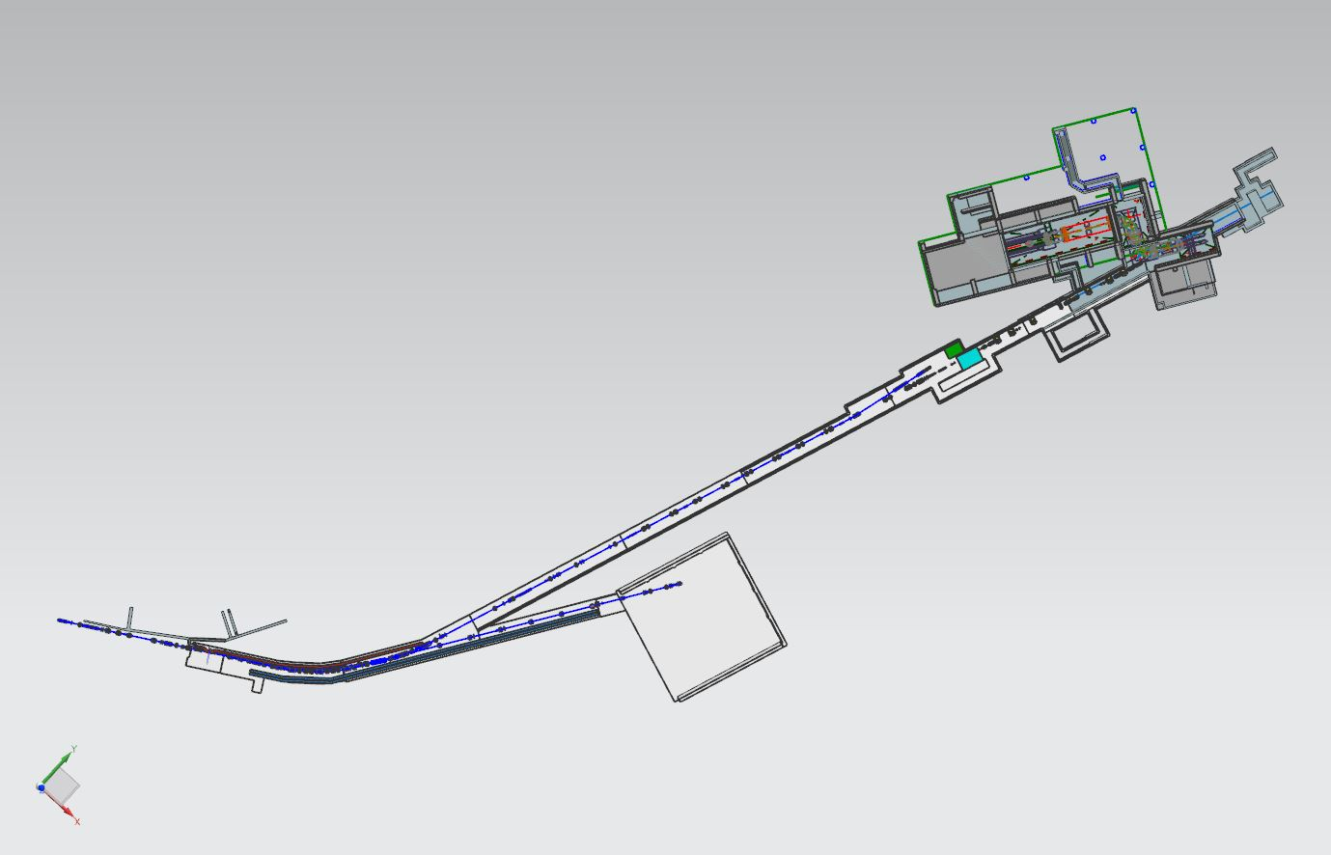
Mu2e Section of the M4 Beamline
The beamline is broken into 4 distinct sections for beam function & installation.
Part of the M4 beamline is shared with g-2. Split is at 908. Mu2e will be responsible for on the cost of installation of the M4 beamline from 908 to 943.
Installation will includes all magnets, magnet supports , main & trim power supplies, vacuum system & controls, LCW and compressed air for tunnel and Mu2e building as well as two beam stops.
The schedules have pushed together so that g-2 running will overlap Mu2e installation 2017 - 2019
Extinction & Diagnostic Absorber Section
Common Section
G-2 and mu2e
Final Focus Section
HBend Section

Slide 5
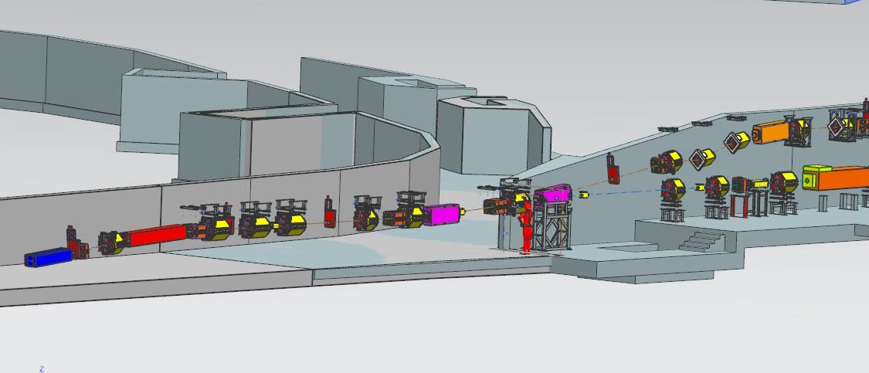
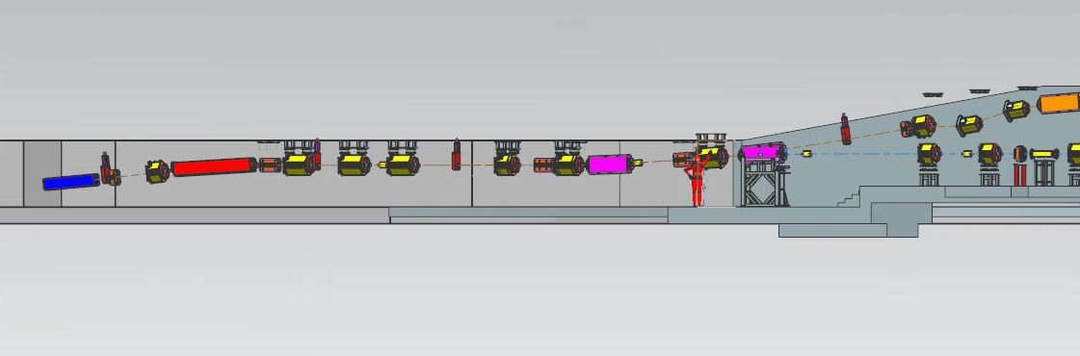
The g-2 and Mu2e Common Section
g-2 Beamline
Mu2e Beamline
Vertical Split
Extracted beam from Delivery Ring (DR)
ECMAG
Q901
ECMAG
Q902
Q903
Q904
Q905
Q906
V906
Q907
V907
Q908
Q909

Slide 6
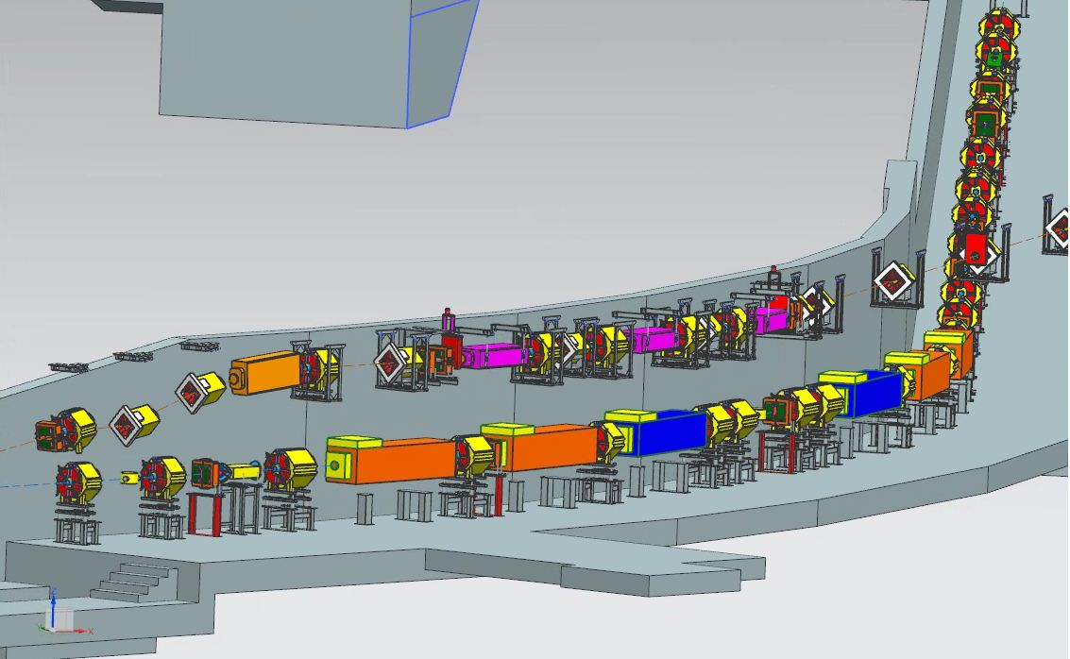
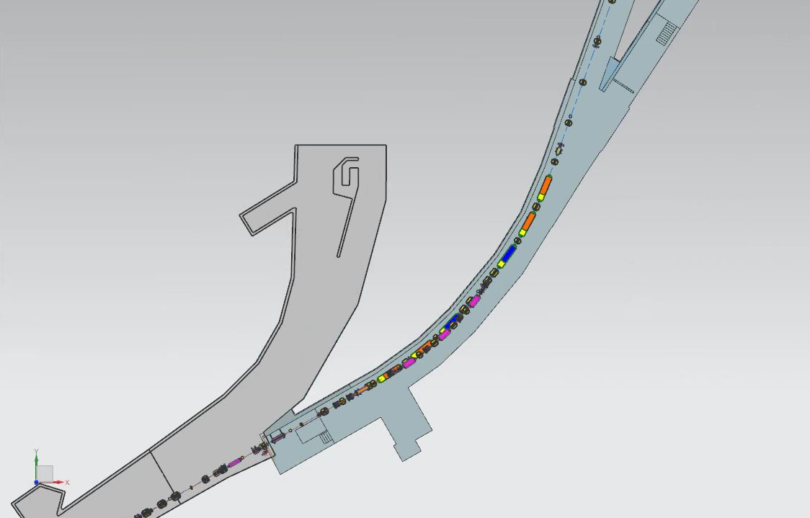
The Horizontal Left Bend Section
g-2 beamline
H918
H917
H916
H911
H912
Mu2e Beamline
H910
Protons
Left bend section use 4 SDFW and 2 SDF dipoles to
Bend beam 41° to the mu2e target.

Slide 7
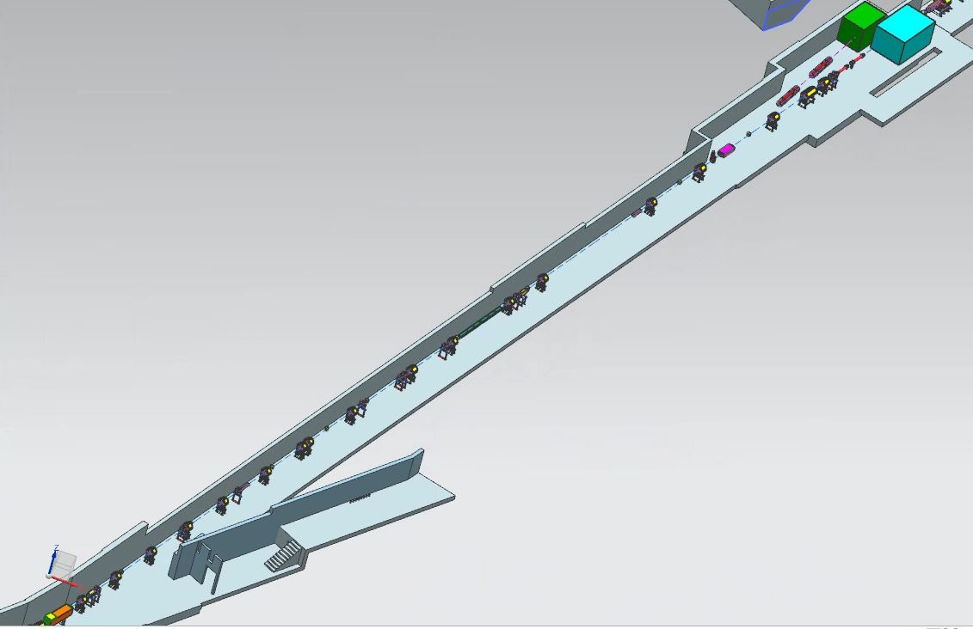
The Extinction & Diagnostic Absorber Section
Diagnostic Absorber – 170W
capacity for
beam commissioning
Q936
Post Extinction Collimator
Shield Wall
AC Dipole
Displaces out of time particles
HDA1 – Horizontal bend to
Diagnostic Absorber Line
Q931
Q929
Pre Extinction Collimator
Q920

Slide 8
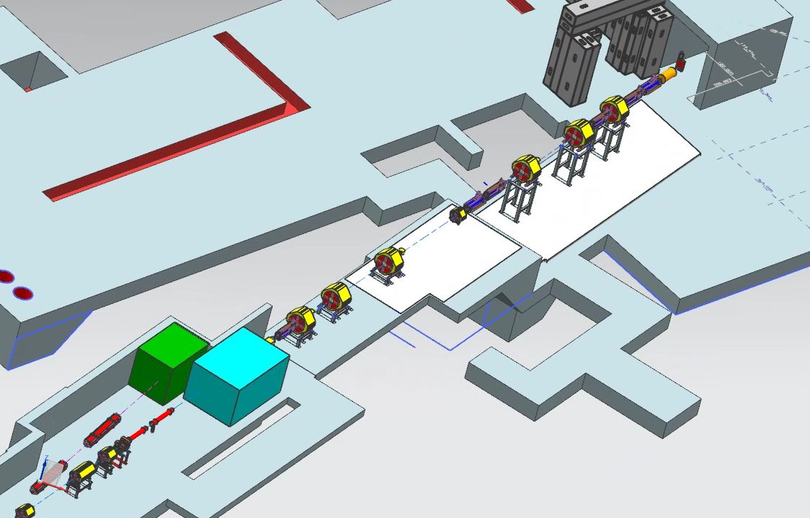
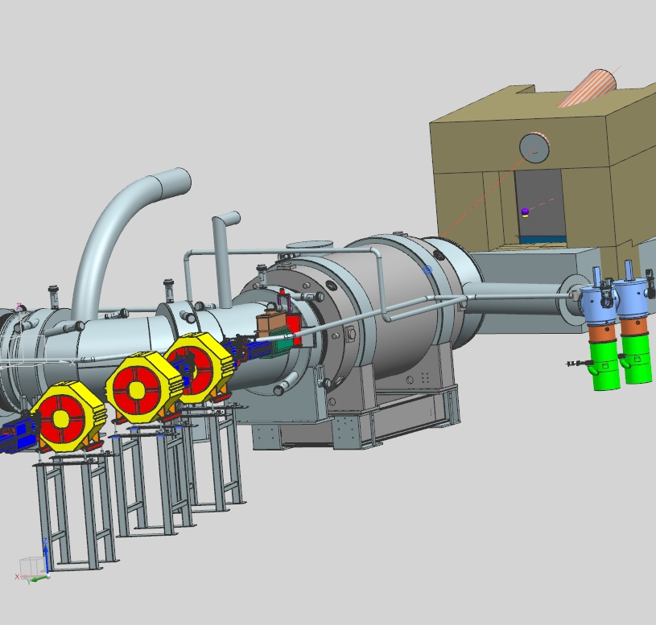
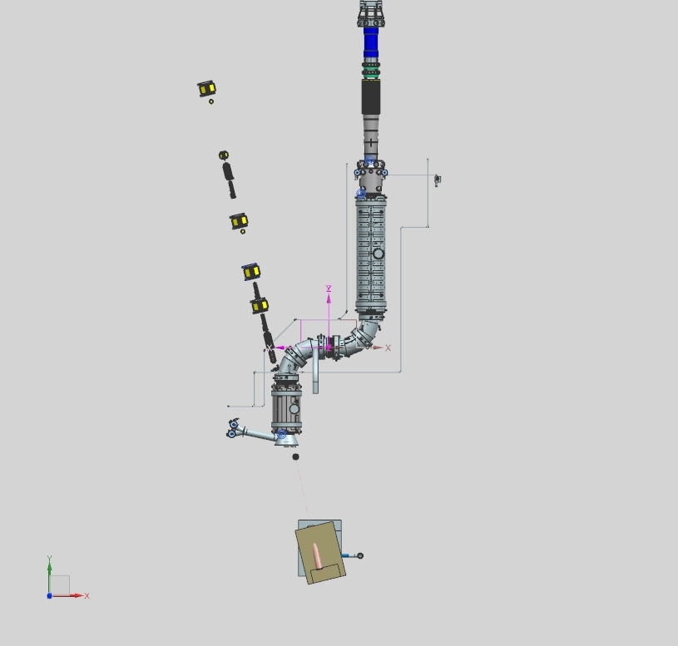
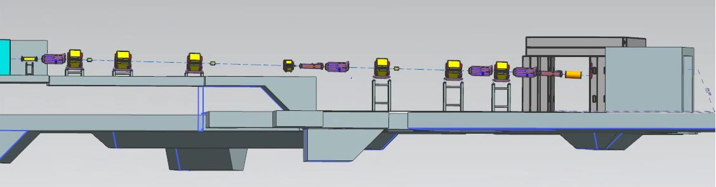
The Final Focus Section
Transport
Solenoid -TS
Detector
Solenoid -PS
HT940
VT940
VT942
V943
HT943
V936
Q937
Q938
Q939
Q940
Q941
Q942
Q943
Production
Solenoid -PS

Slide 9
Magnet Selection
Requirements:
To save cost, magnets were to be reused from the Antiproton Source where possible.
All magnets repurposed from the Antiproton Source where considered working spares with no need to rebuild or refurbish unless stated.
Since the pool of magnets is limited, there may be a need to fabricate new magnets of the same type.
Using magnets outside of the Antiproton Source pool may require refurbishment or rebuilding assessed on a case by case.
Combined g-2 & mu2e beamline
M4 beamline proper

Slide 10
Beamline Magnet Type, Current , Bussing, Field
*indicates common M4/M5 section of the beamline
** indicates magnets are bussed together

Slide 11
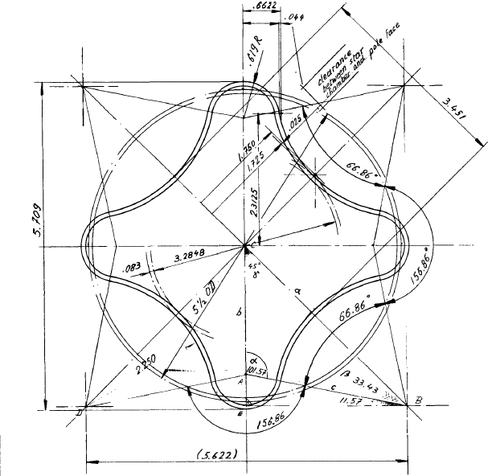
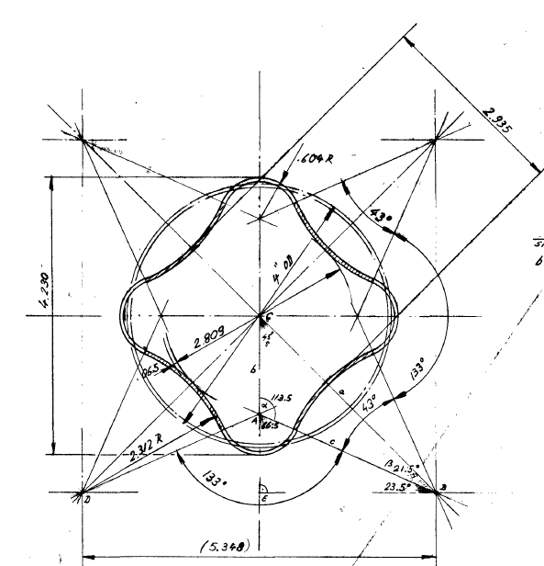
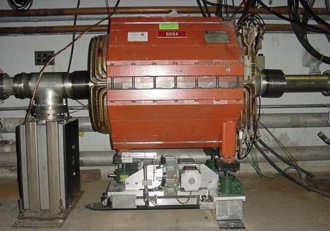
TeV I Small Quadrupole
Five Lengths, all with identical magnet apertures
  3.5” pole gap, 6” pole width
  From shortest to longest, SQA, SQB, SQC, SQD & SQE
  Effective lengths 18.0”, 25.2”, 27.6”, 32.6” & 51.6”
  Integrated field 7.2 T for SQA, 20.9 T for SQE @400 Amps
  All types used in the beamlines
Two beam pipe variations
  Large star chamber for Pbar beamlines and Debuncher (3.29” circular aperture, 5.62” on axis)
  Small star chamber in Accumulator for bake-out insulation (2.81” circular aperture, 4.02” on axis)
  Large star chambers can be installed in Accumulator quads (but would need to be built)
  Both beam pipe variations are used in the beamlines
Debuncher SQC

Slide 12
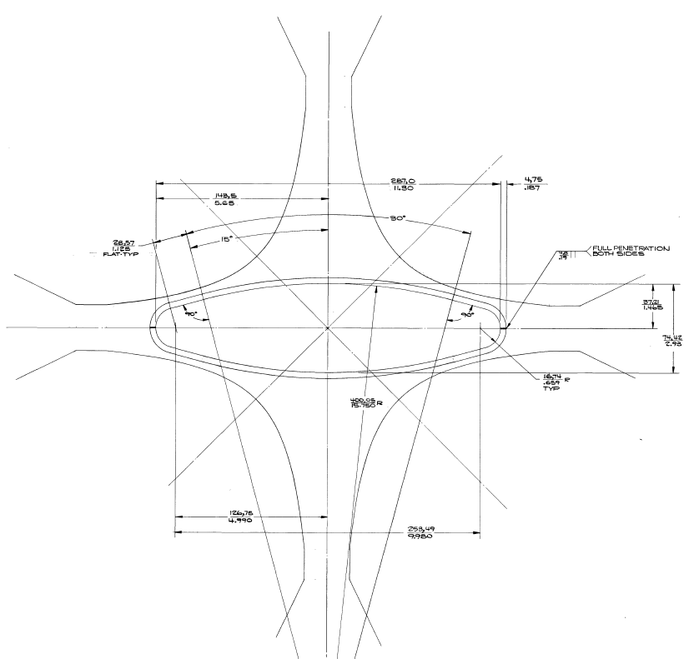
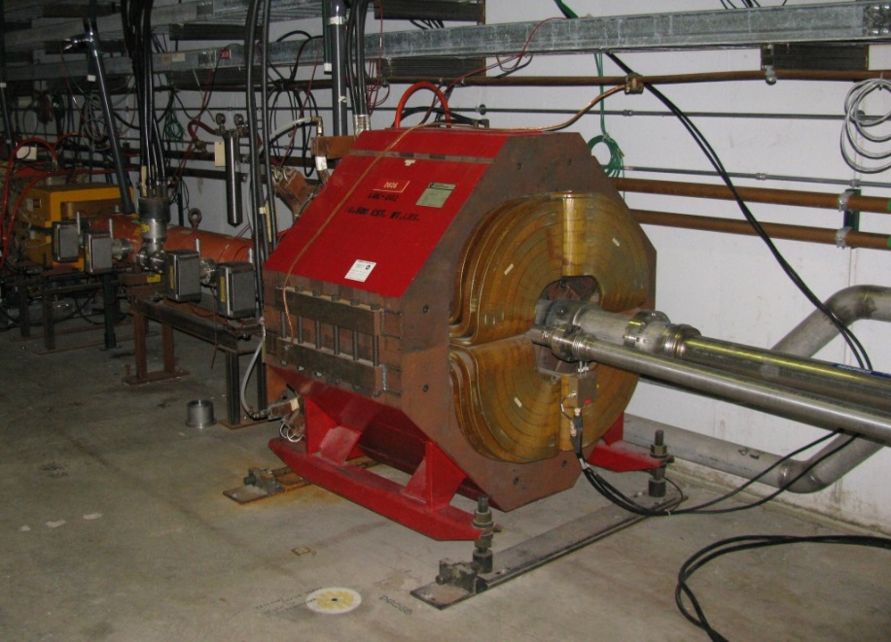
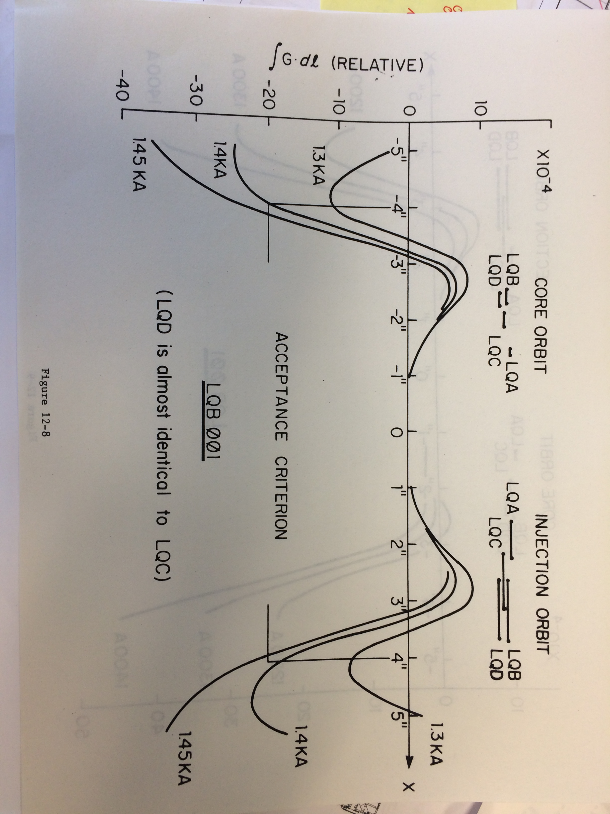
TeV I Large Quadrupole
Six Lengths, all with identical magnet apertures
  6.625” pole gap, 13” pole width
  Good field region extends over +/- 5”
  From shortest to longest, LQA, LQB, LQF, LQC, LQD & LQE
  Effective lengths 17.3”, 25.3”, 30.4”, 30.5”, 32.4” & 34.3”
  Integrated field 1.9 T for LQA, 7.5 T for LQE @1,350 Amps
  LQC and LQD types used in the Final Focus
Several beam pipe variations
  Elliptical pipes used in Accumulator (12” on axis!)
  Star Chamber pipe is appropriate for Final Focus since need large transverse displacement for target angle scans.
(Courtesy J. Morgan)
Debuncher LQE
LQD field quality

Slide 13
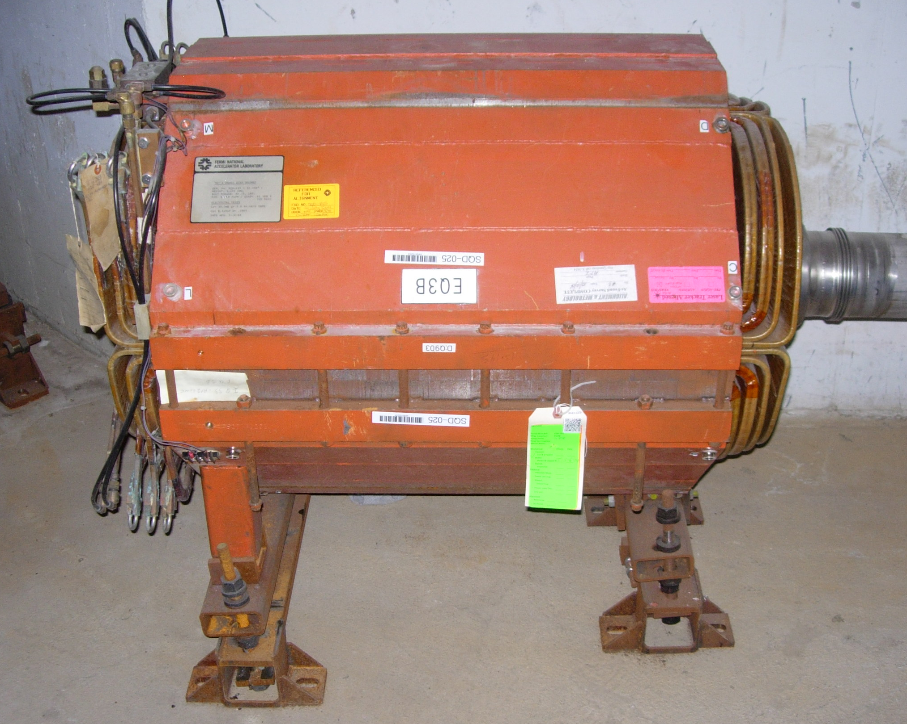
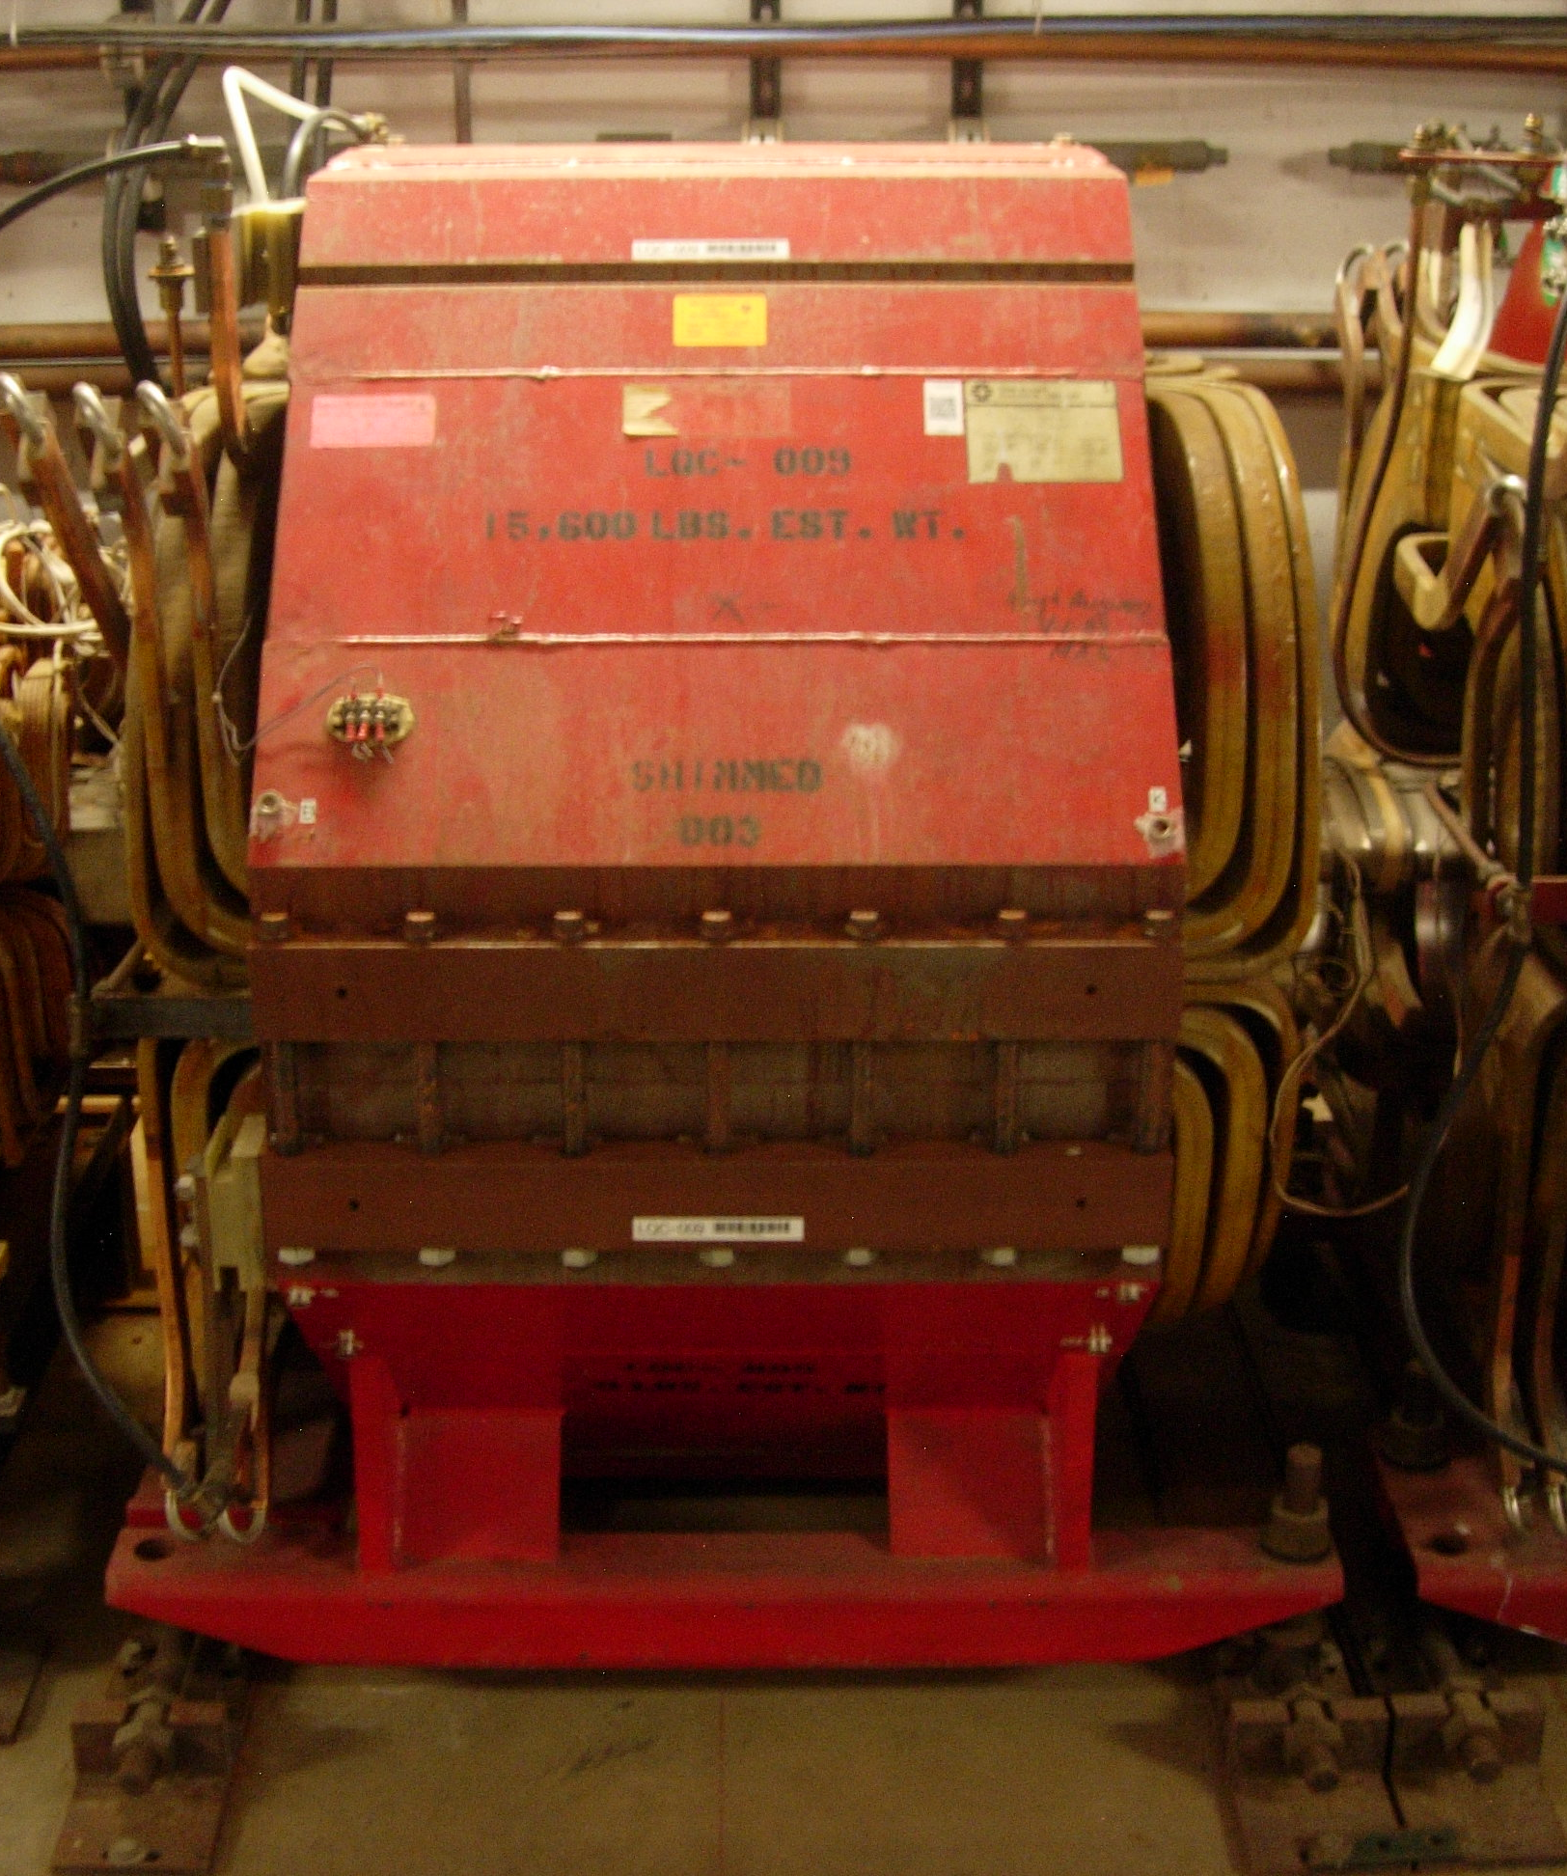
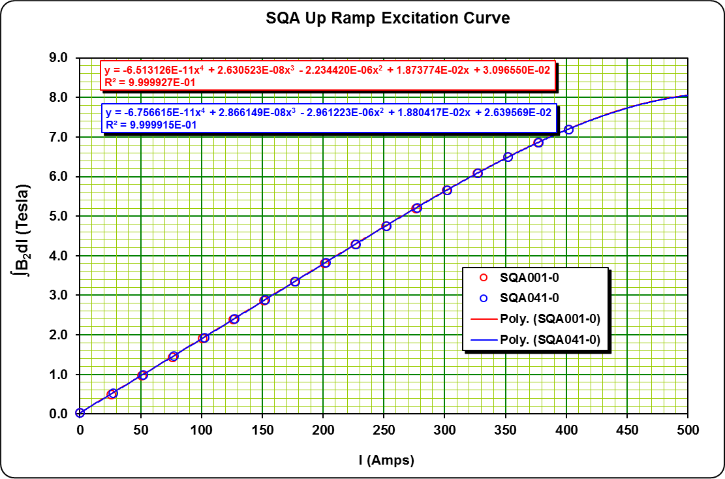

Quadrupole Magnet Selection
Finding magnet types from pool to match lattice:
Take MAD k factors and find integrated field
  B_{integrated}$=k MADfactor{∗B∗Lmagnet effective }^{}$
Look up field in historical antiproton magnetic measurement files
Balance magnet type with power supply and power needs.
Small Quad Style - SQC
(Courtesy J. Morgan)
Large Quad Style -LQC

Slide 14
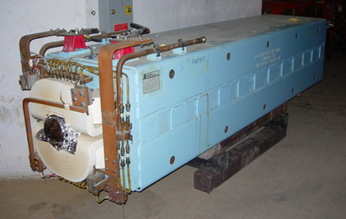
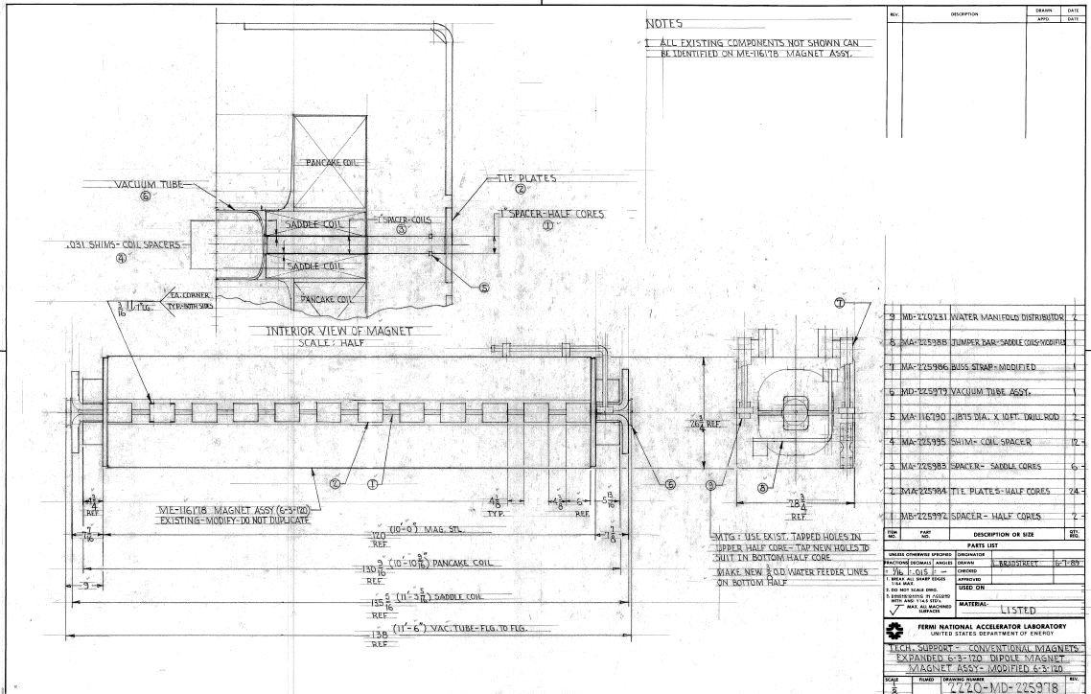
SDF & SDFW Dipole Magnets
Several variations that are functionally the same
  120 inch length, 68 turns
  3” SDF or 4” SDFW pole gap, 6” pole width
  Slight length difference
  Water cooling manifolds are the same
  Maximum bend angle ~120 mr at 8.89 GeV/c
  SDFW is a “wide gap” additional 1” spaced between half cores increasing aperture to 6” wide x 4” height.
  Used in Pbar beamlines
2 SDF & 4 SDFW will be reused
  These 6 dipoles make up the 41° left bend
SDFW 6-4-120 Dipole

Slide 15
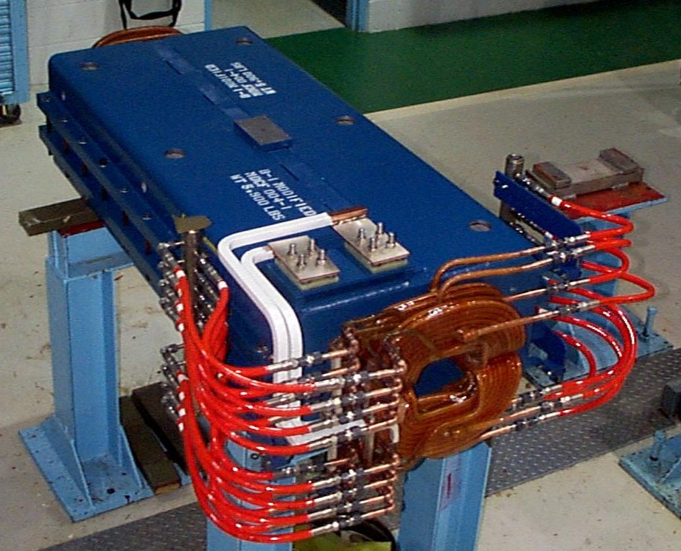
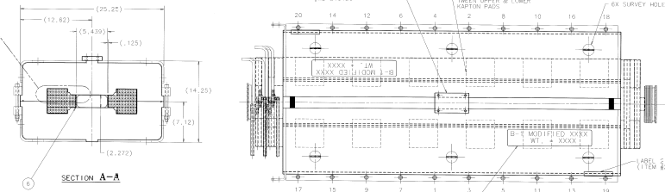
TeV I MDC (modified B-1) dipole
Several variations that are functionally the same
  60 inch length, 68 turns
  2.25” pole gap, 6” pole width
  Slight length difference
  Most differences due to water manifolding or assembly
  Maximum bend angle 87.3 mr at 8.89 GeV/c
  Used in Accumulator and Pbar beamlines
1 MDC will need to be fabricated
  HD1 horizontal switch dipole for diagnostic absorber
Possible Replace with an SDC
    Considering replacing the MCD with an SDC
    Save cost of fabrication since there are a pool of existing SDC’s.
  60 inch arc length, 56 pancake turns
  2.37” pole gap, 8” pole width
  Sagitta with radius of curvature of 687.6”
  Maximum bend angle 87.3 mr at 8.89 GeV/c
  Used in Accumulator
(Courtesy J. Morgan)
MDC Dipole
SDC Dipole

Slide 16
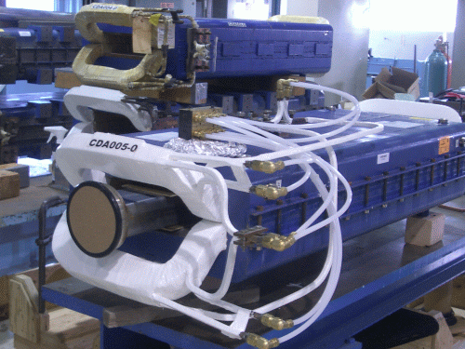
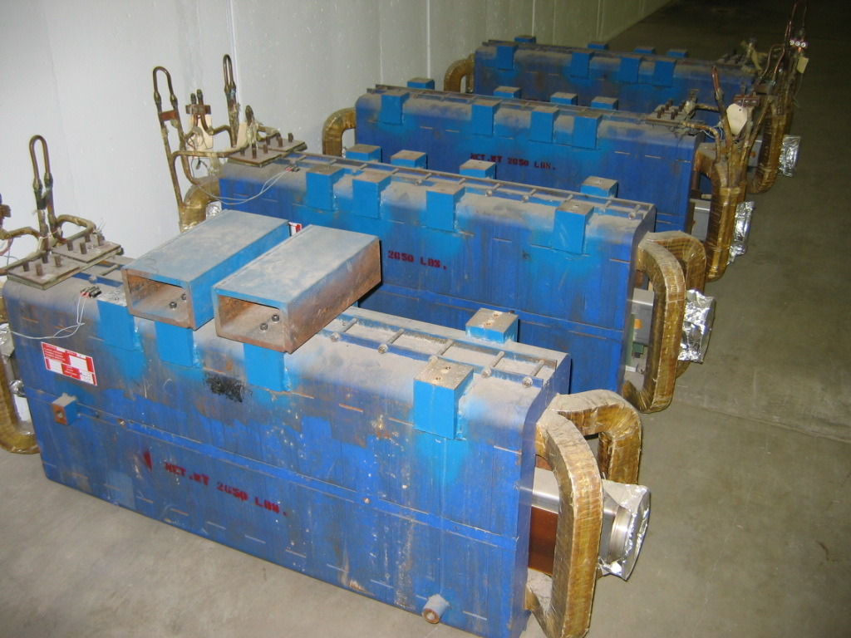
CDA Dipoles
Few variations that are functionally the same
  48 inch length, 40 turns
  3.25” pole gap, 12” pole width
  Maximum bend angle 24 mr at 8.89 GeV/c
  Maximum current of 1199 A
6 CDA’s will need refurbished
  All 6 CDA’s used in the final focus.
  They have a large horizontal aperture to accommodate target angle scans.
CDA Dipole

Slide 17
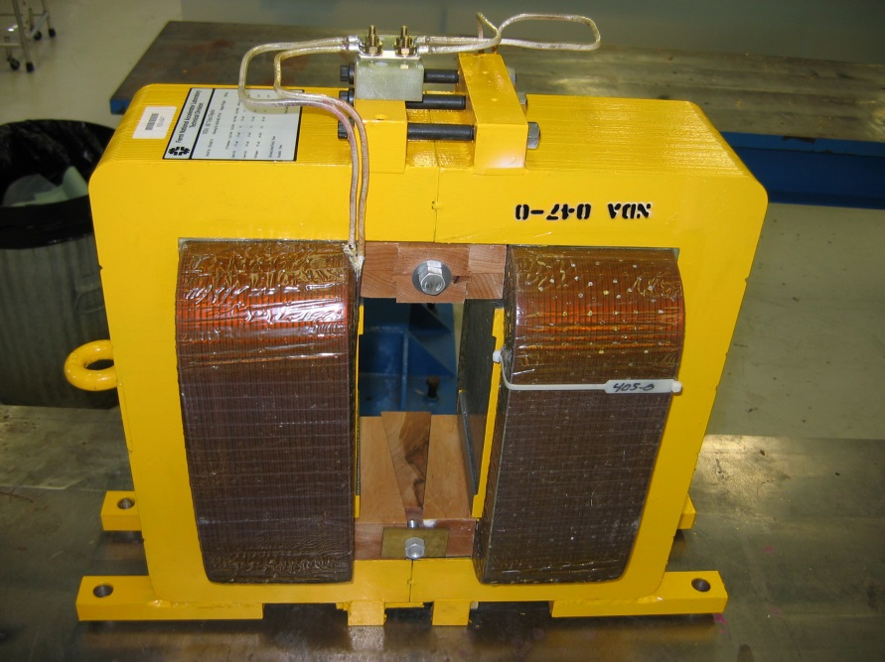
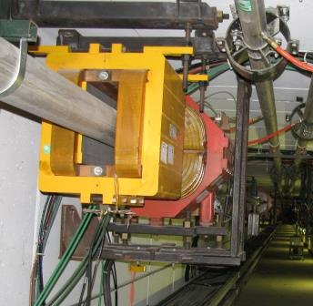
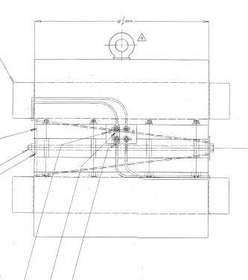
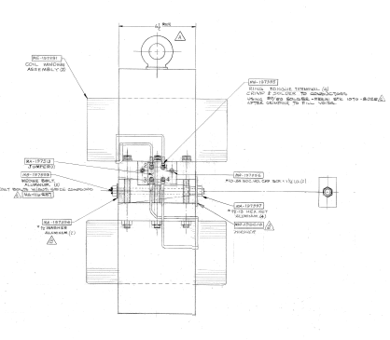
NDA and NDB trims
NDA’s made for Accumulator
  8 inch steel length
  4.5 inch pole gap
  Maximum DC current 25 Amps
  Maximum bend 1.5 mr @ 8.9 GeV/c
NDB’s made for beamlines and Debuncher
  20 inch steel length
  5.625 inch pole gap
  Maximum DC current 25 Amps
  Maximum bend 1.5 mr @ 8.9 GeV/c
(Courtesy J. Morgan)

Slide 18
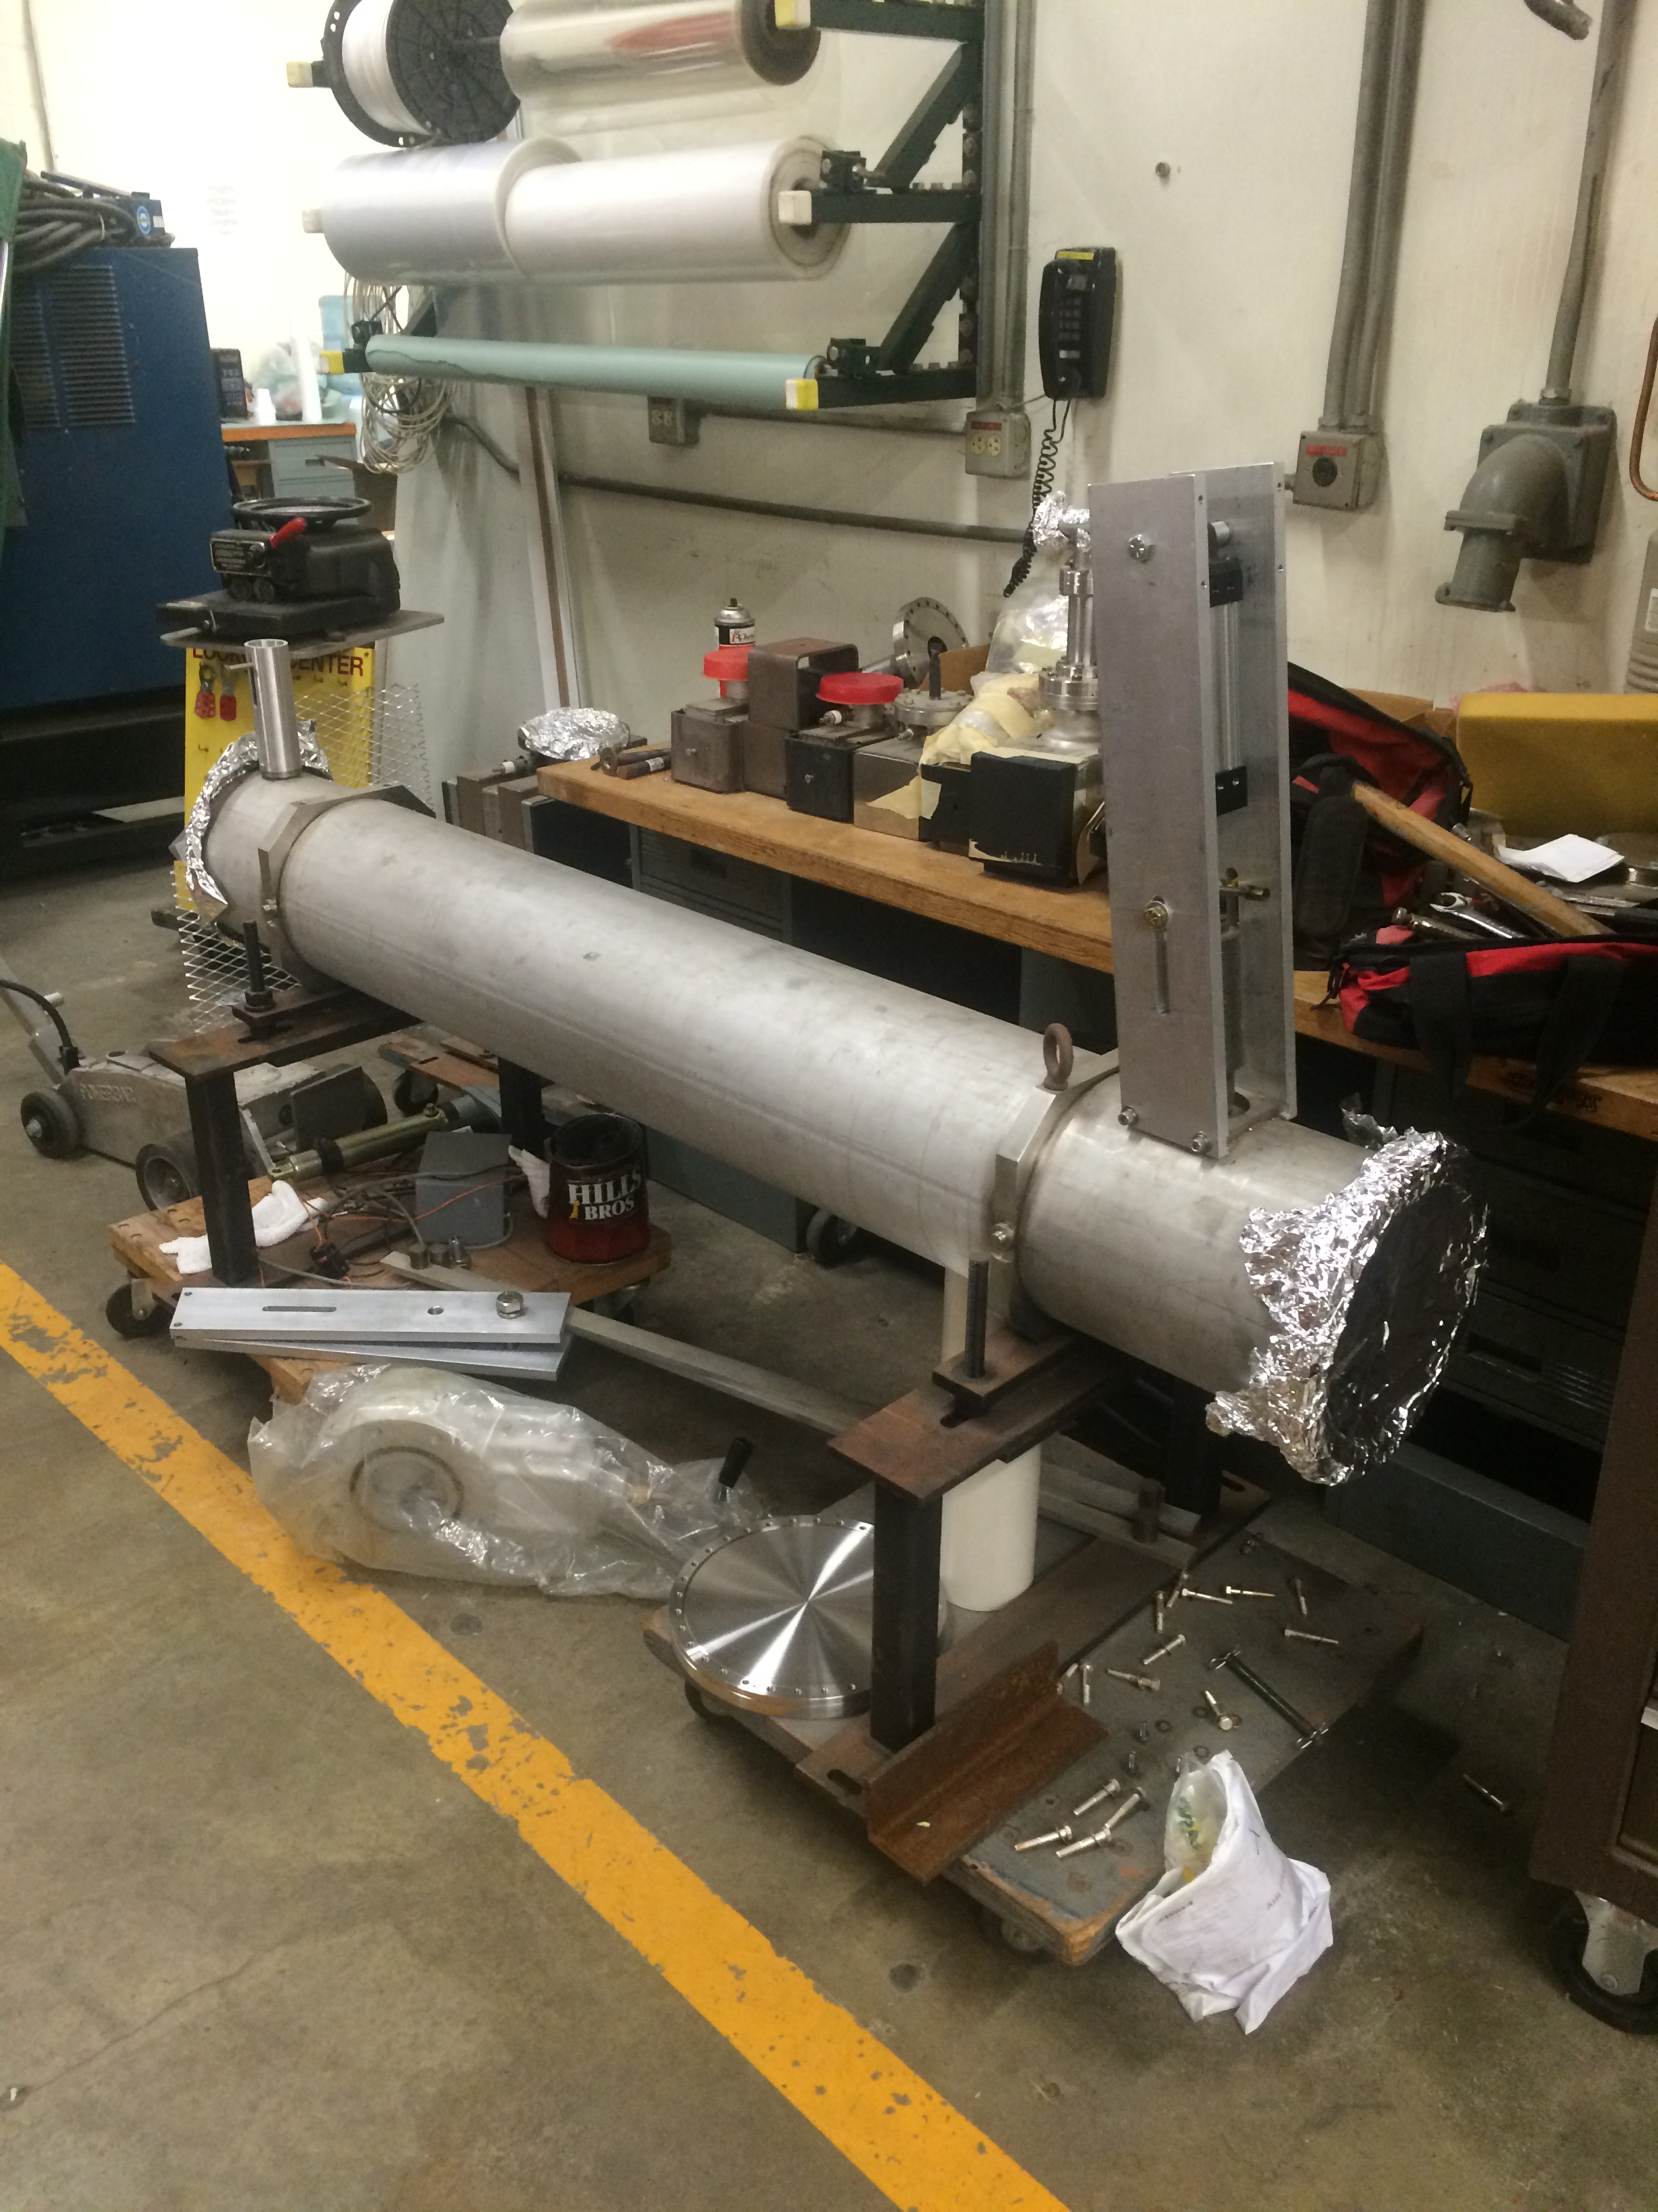
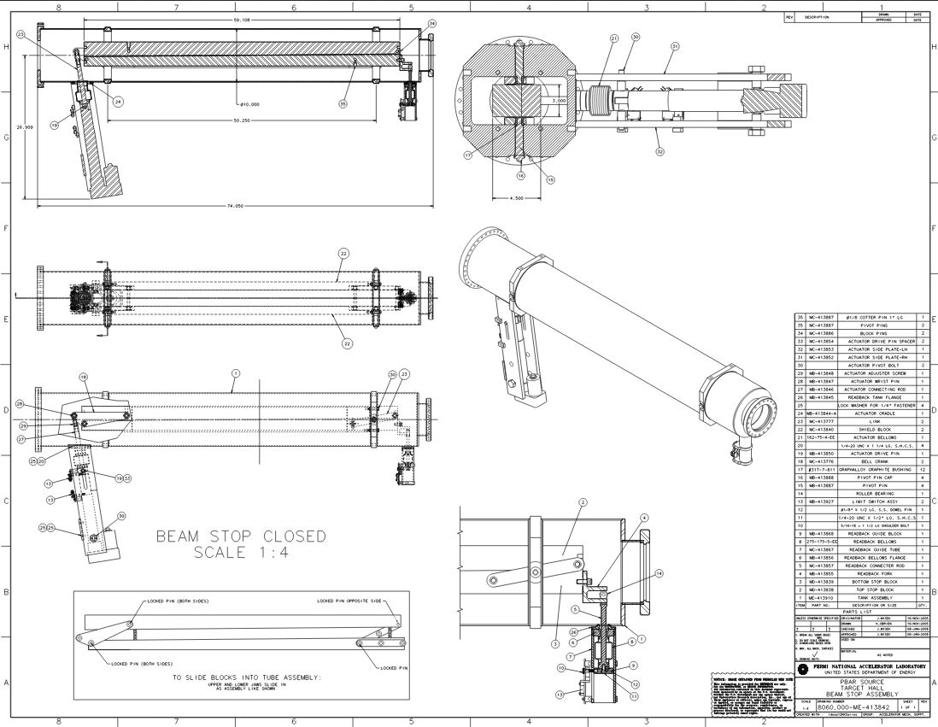
Beam Stop
Made for AP2 Beamline
  74.050” length
  Used as a critical device to stop beam from entering enclosure
  Motor driven
  Maximum bend 1.5 mr @ 8.9 GeV/c
2 Beam stops will be needed for M4 beamline
  1 beam stop will be reused from AP2 line
  1 beam stop will be fabricated.
  We will use existing design & update drawings
  Will change motor drive to pneumatic
  Used as a critical device to stop beam from going past the diagnostic absorber shield wall.

Slide 19
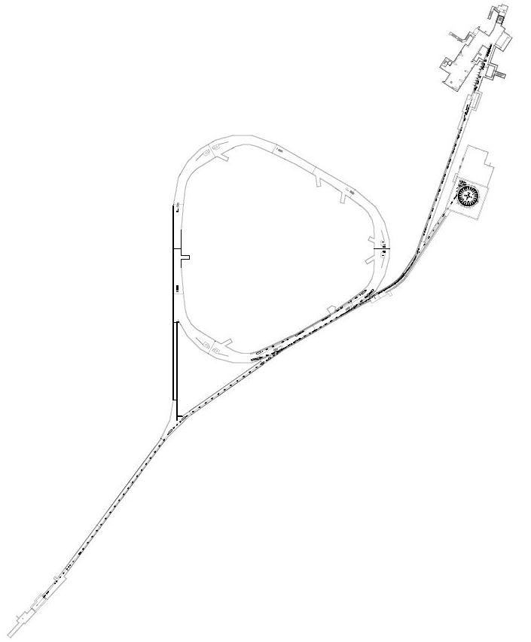
General Installation
Temporary Shield Wall for Installation.
Installed before g-2 runs.
M4 Beamline is broken into 3 sections for installation: (Majority of components for M4 will be repurposed from the Antiproton Source.)
HBend 908 to 920 (Shield wall) 26 Elements, 24% of length
Extinction & Diagnostic Absorber 920 to 945. 58 Elements, 57% of length
Final Focus 945 to 952. 19 Elements, 19% of length.
M4 DA Hatch
6 CDA
AP1 Line
Recycler 700
SQC MSF
Magnets in Former Pbars transferred through new tunnel or M4 DA hatch
Installation of HBend and transporting magnets from Accumulator will occur during shutdowns after g-2 running.

Slide 20
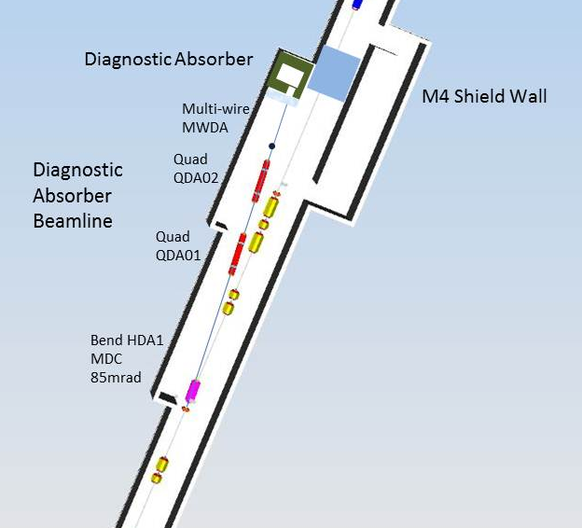
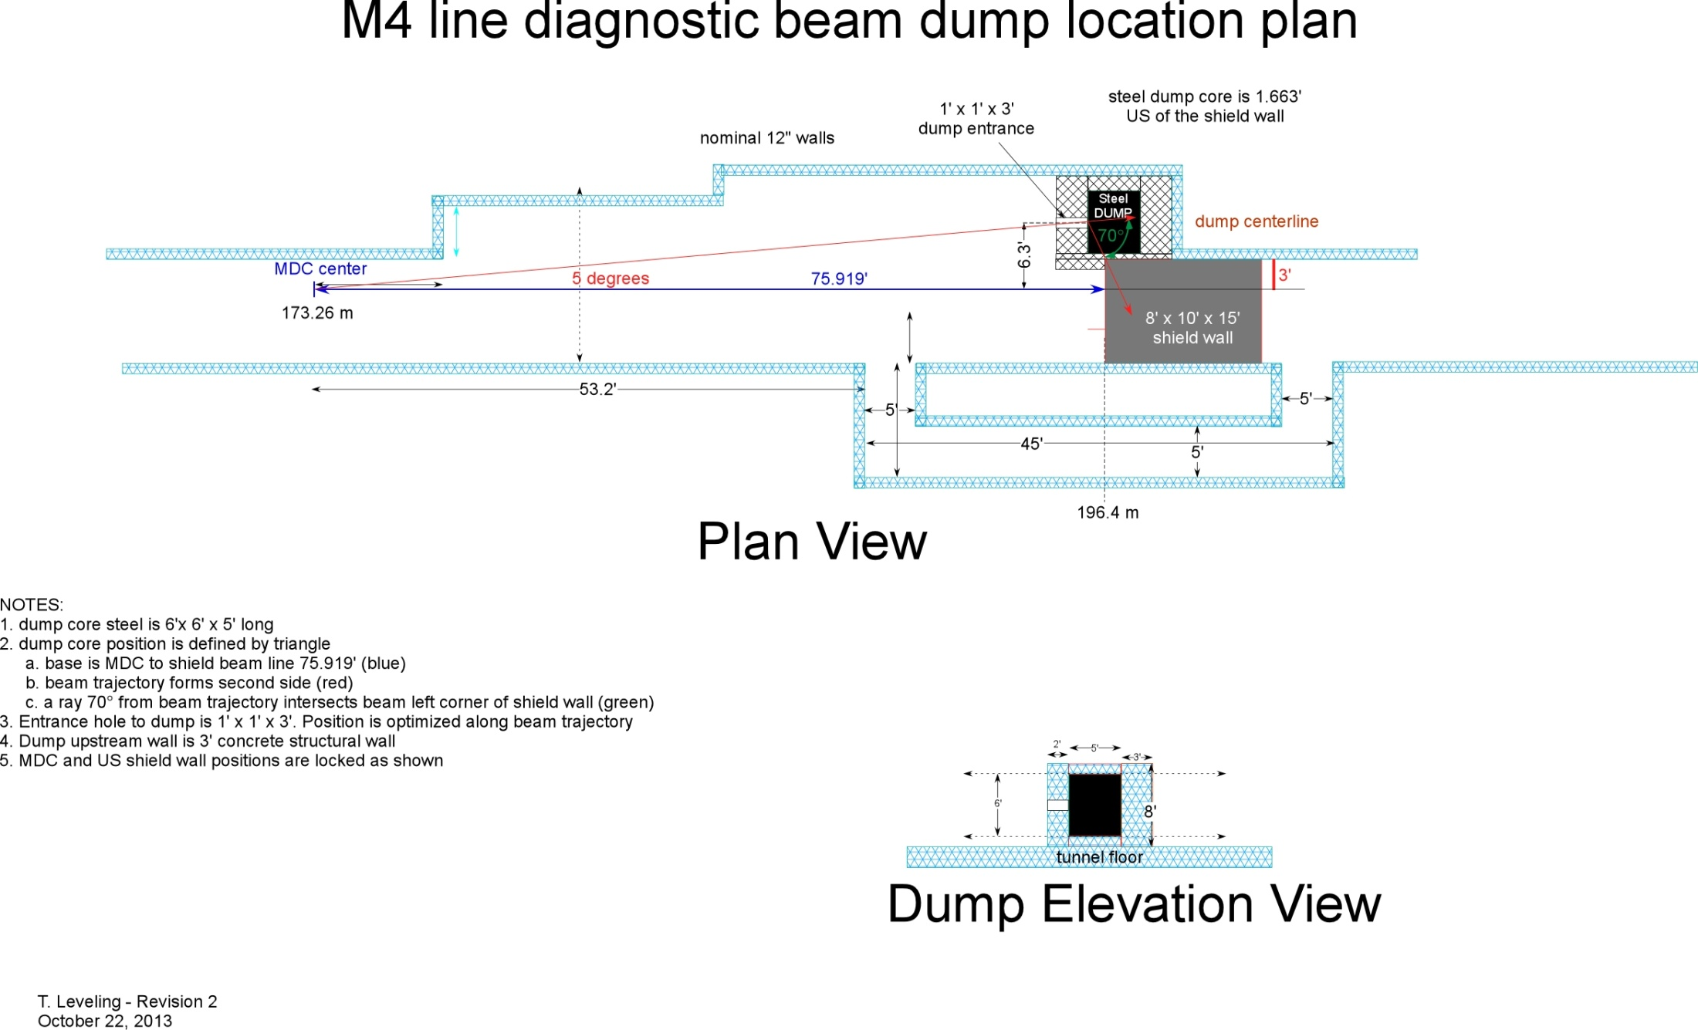
M4 Diagnostic Absorber Line
The M4 beamline requires a diagnostic absorber for commissioning the beamline and commissioning resonant extraction during mu2e
The absorber has a 170 W capacity derived from 2 modes of commissioning:
  Mode 1 - Low intensity commissioning kicked beam (does not matter if people are present downstream). This is roughly 5E10 protons/pulse every 10 sec or so.
  Mode 2- Resonant Beam commissioning. Takes 4 pulses at 1E12 per pulse or 4E12 total protons/pulse every 30sec or so.
  Beam Power Calculations for the 2 Modes:
Beam is bent horizontally outward to the diagnostic beamline by an
MDC dipole at 5 °(85mrad).
There are 2 quads (QDA01 & QDA02) in the beamline to control optics in the line. (optics not critical but diagnostic capability depends on the ability to change phase and observe phase space evolution)

Slide 21
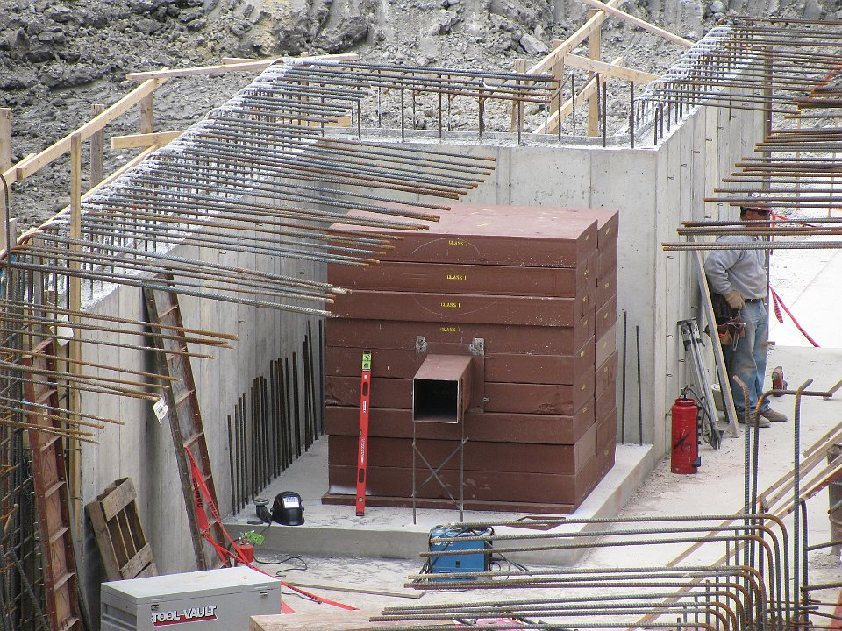
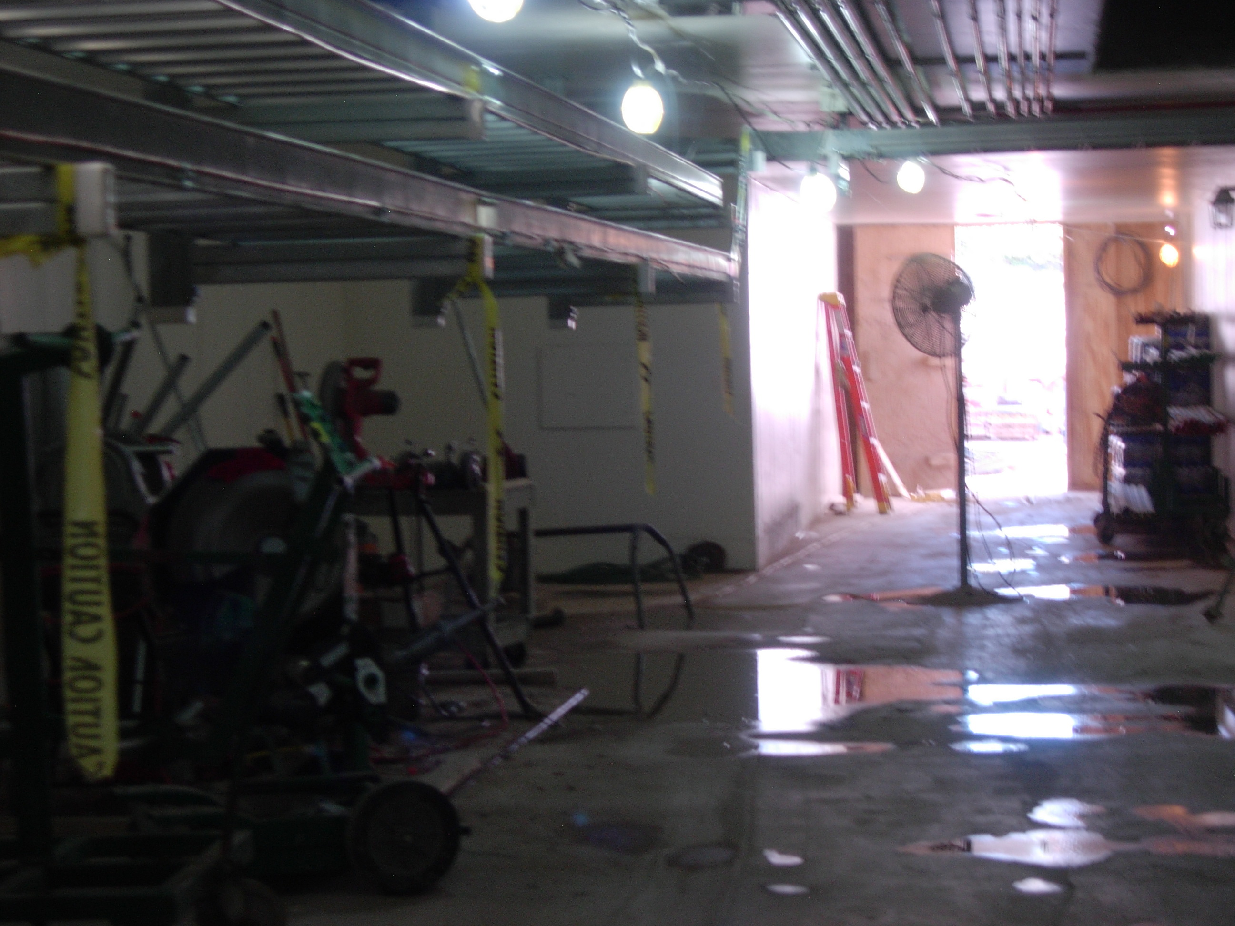
Diagnostic Absorber
The M4 Diagnostic Absorber is a series of 6’x6’x5’ long stacked steel plates using 108 steel plates.
It is surrounded by 1’ of concrete on the top & bottom and 3’ in the back.
The absorber has 1’x1’x3’ albedo trap angled at 5° to match the beamline.
The absorber is passive with no water cooling.
The steel for the absorber has been and cut , prepared, assembled and will be installed in the tunnel walls surrounded by concreate. The for installation has been transferred for Mu2e project to the tunnel GPP.
The absorber was designed on by the External beamline WBS but cost transferred to the tunnel GPP for installation because it is part of the tunnel wall.
Diagnostic Absorber before concrete pour
Tunnel View of Diagnostic Absorber after surrounded in concrete

Slide 22
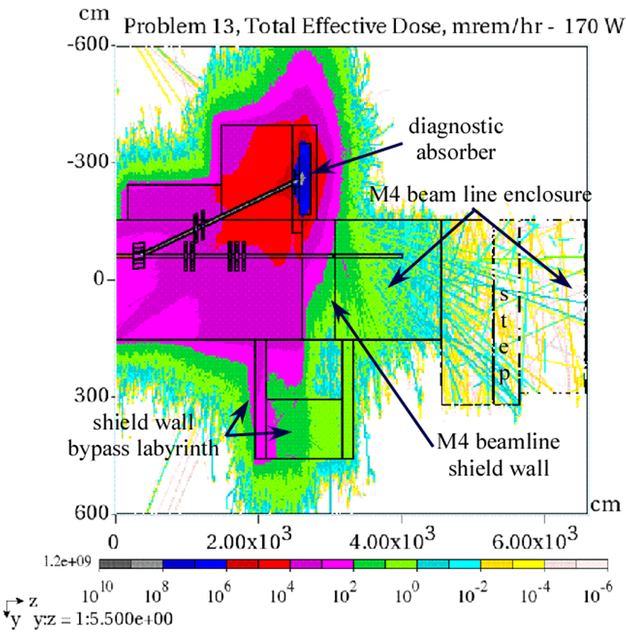
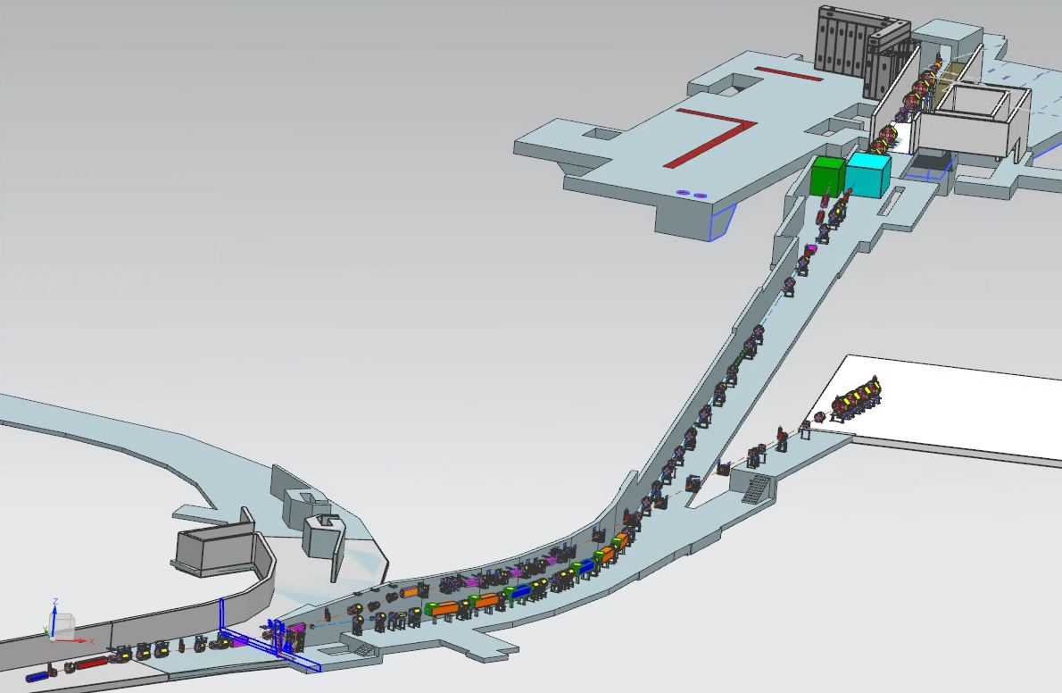
Diagnostic Absorber MARS Results
MARS was used to estimate integrated radiation dose downstream of the DA for occupancy of the Detector and Production Solenoid enclosures.
Radiological effects for ground and surface water activation were also estimated. The results were all found to be under limits and standard Fermilab requirements.
The effective dose rate at the location of the Detector Solenoid is less than 0.05 mrem/hr during normal beam operation to the diagnostic absorber.
An accident condition in which the 170-watt proton beam is lost on the MDC switching magnet was also considered. The resulting dose rate at the Production Solenoid was calculated to be about 250 mrem/hr. A TLM will be located in the M4 line upstream of shield wall. The TLM trip level for this operating mode will have to be reduced from the nominal 248 nC/minute to about 6.5 nC/minute in order to permit non-radiation workers unrestricted access to the area around the Production Solenoid
People can work safely behind shield wall
to continue installation in the PS and DS enclosures
while beam to the DA.
.
Commission beam to DA

Slide 23
M4 Beamline Vacuum Requirements
The beam line needs to maintain a pressure of 1.0×10⁻⁸ Torr or better.
All vacuum components being reused from the Antiproton Ring need to inspected and tested prior to installation into the beamline. Some refurbishing will be required.
All components and devices need to be leak checked to a sensitivity of 2×10^{‑10} atm∙cc/s with helium prior to installation into the beamline.
All components should be ultrasonically cleaned prior to welding and again prior to installation.
Assembly shall be performed using ultra-high vacuum handling practices.
All components must be oil-free.
Beam tubes shall be steam cleaned, blown dry, then the ends capped to maintain cleanliness until installation.
Bake-out of the beamline is not necessary.

Slide 24
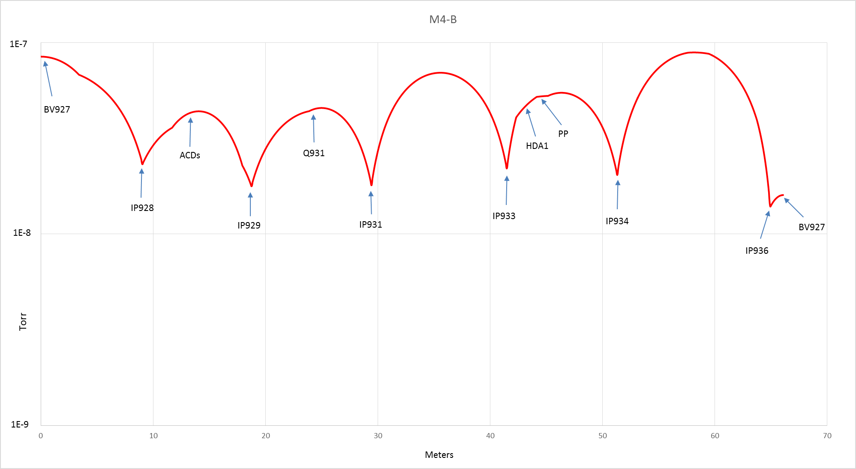
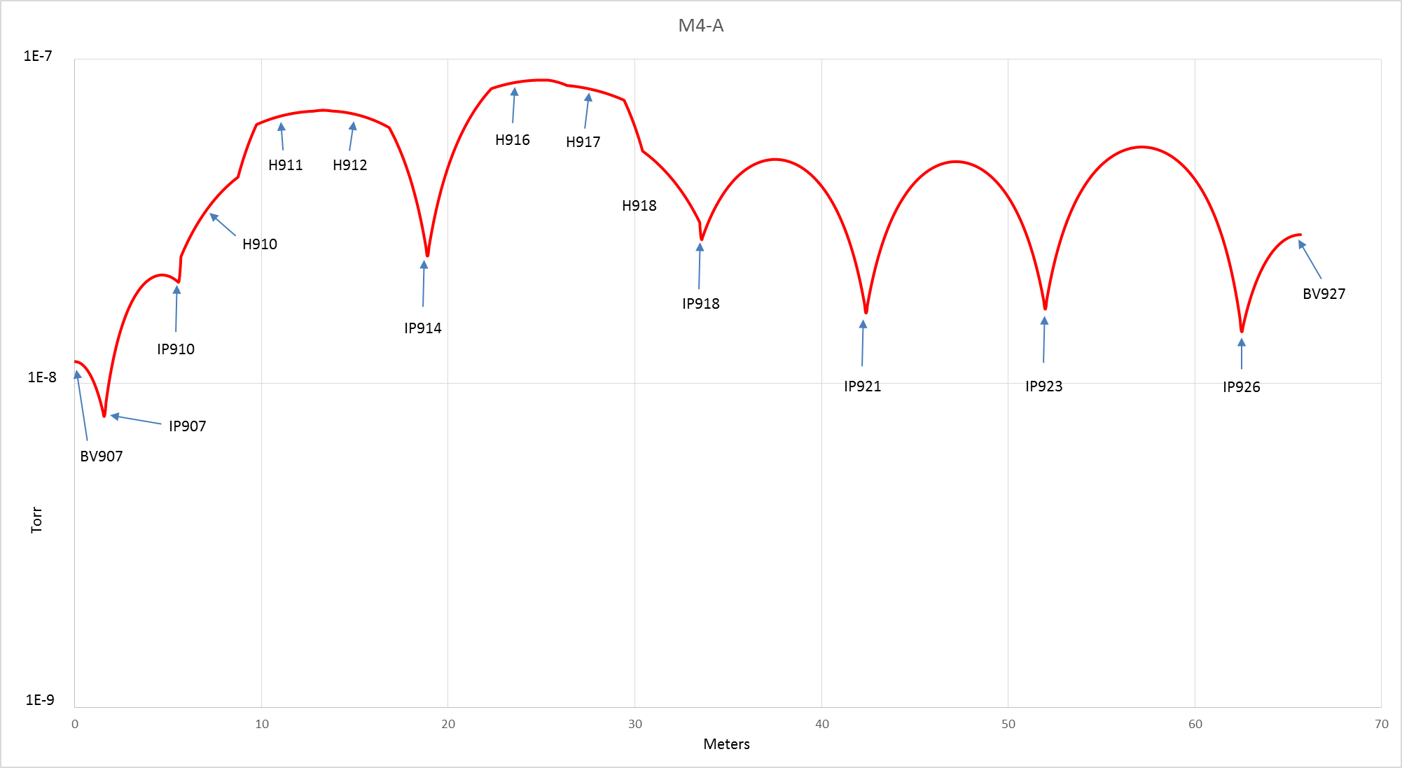
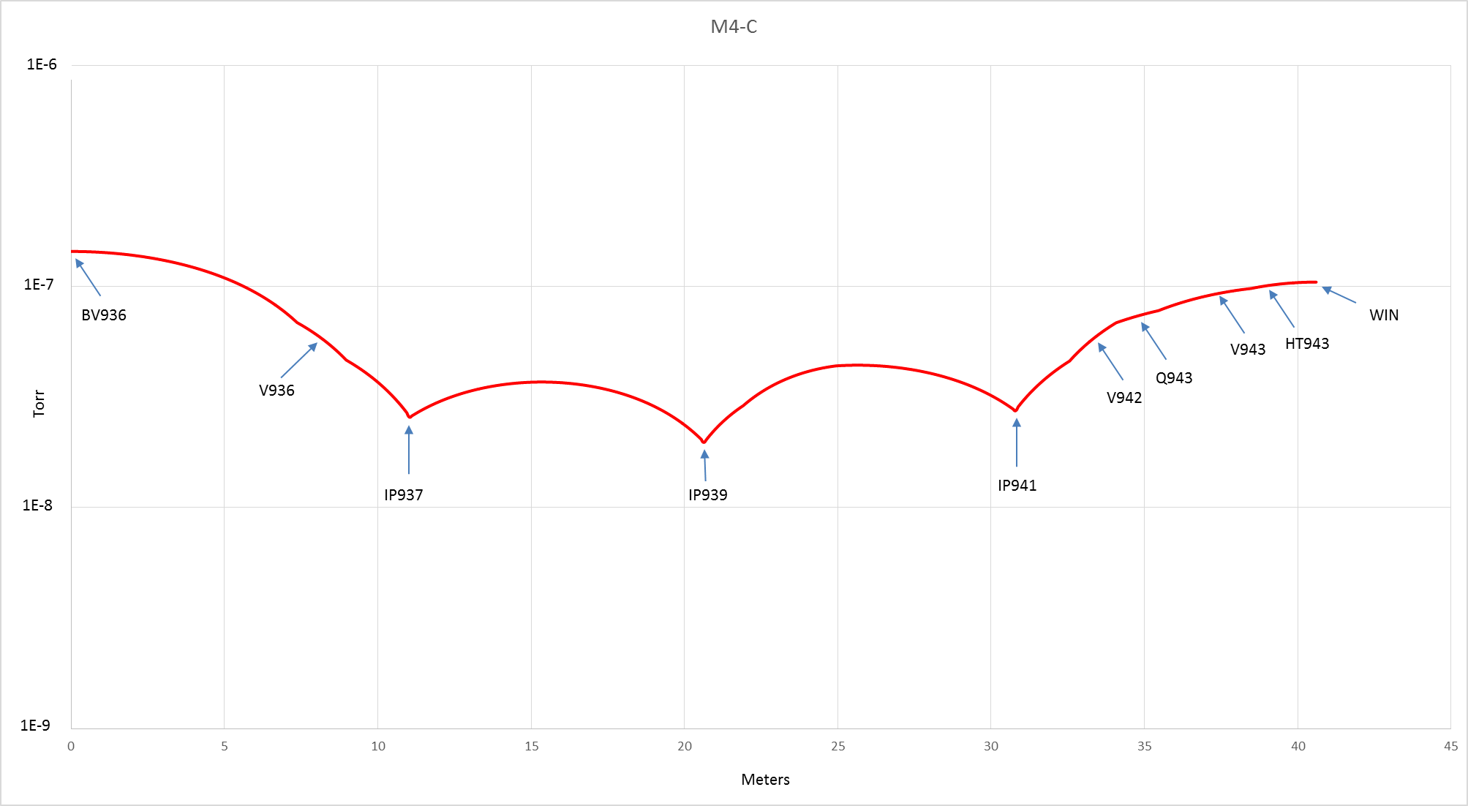
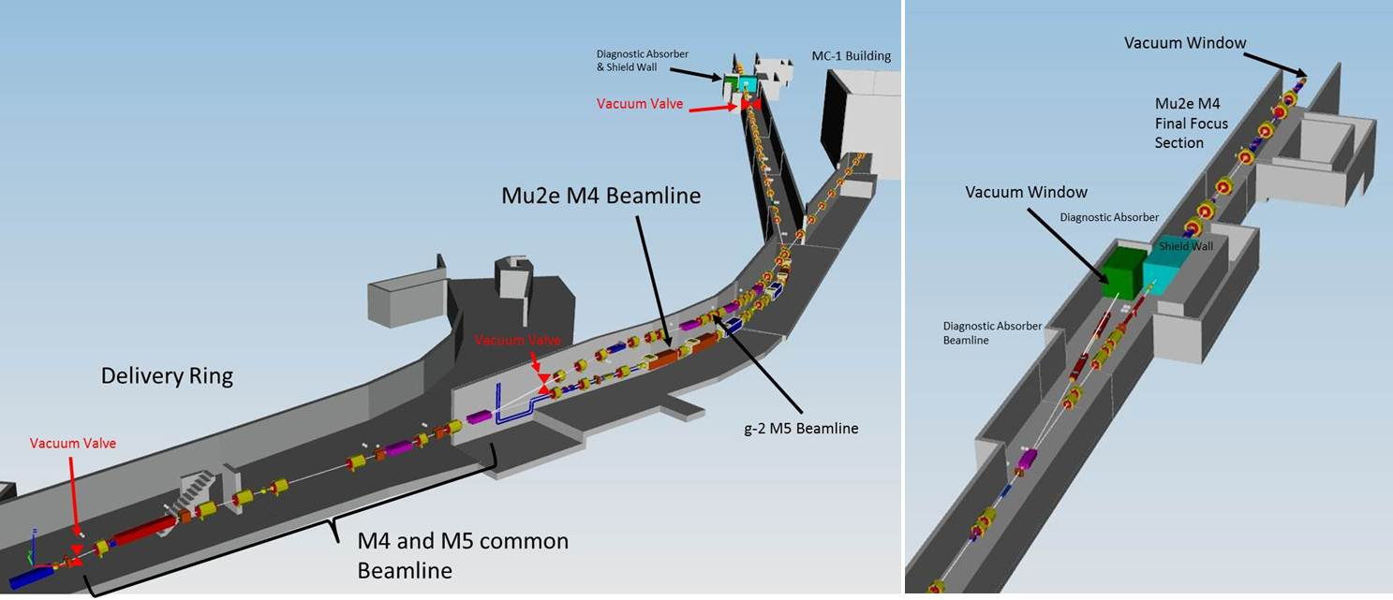
M4 Beamline Vacuum Design & Layout
The M4 line is broken into 3 vacuum sectors that can be isolated by vacuum valves.
Initial VAC CALC estimates that 10⁻⁸ torr in the beamline can be achieved. Known outgassing rates for devices like multiwires were used.
270 Liter/sec ion pumps are mainly placed ~ 40’ apart & more around high vacuum load component. (Instrumentation)
Interfaces: AC dipole, extinction collimators and protection collimator have been given accelerator vacuum requirements.
(Vac Calc plot from R. Lebeau)
TC = Thermocouple
CC = Cold Cathode
TCV = Turbo Cart Valve

Slide 25
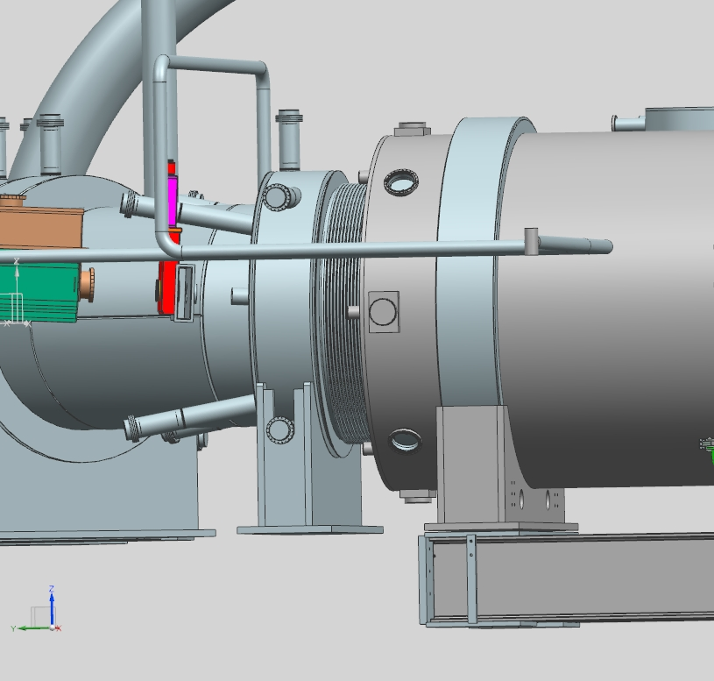
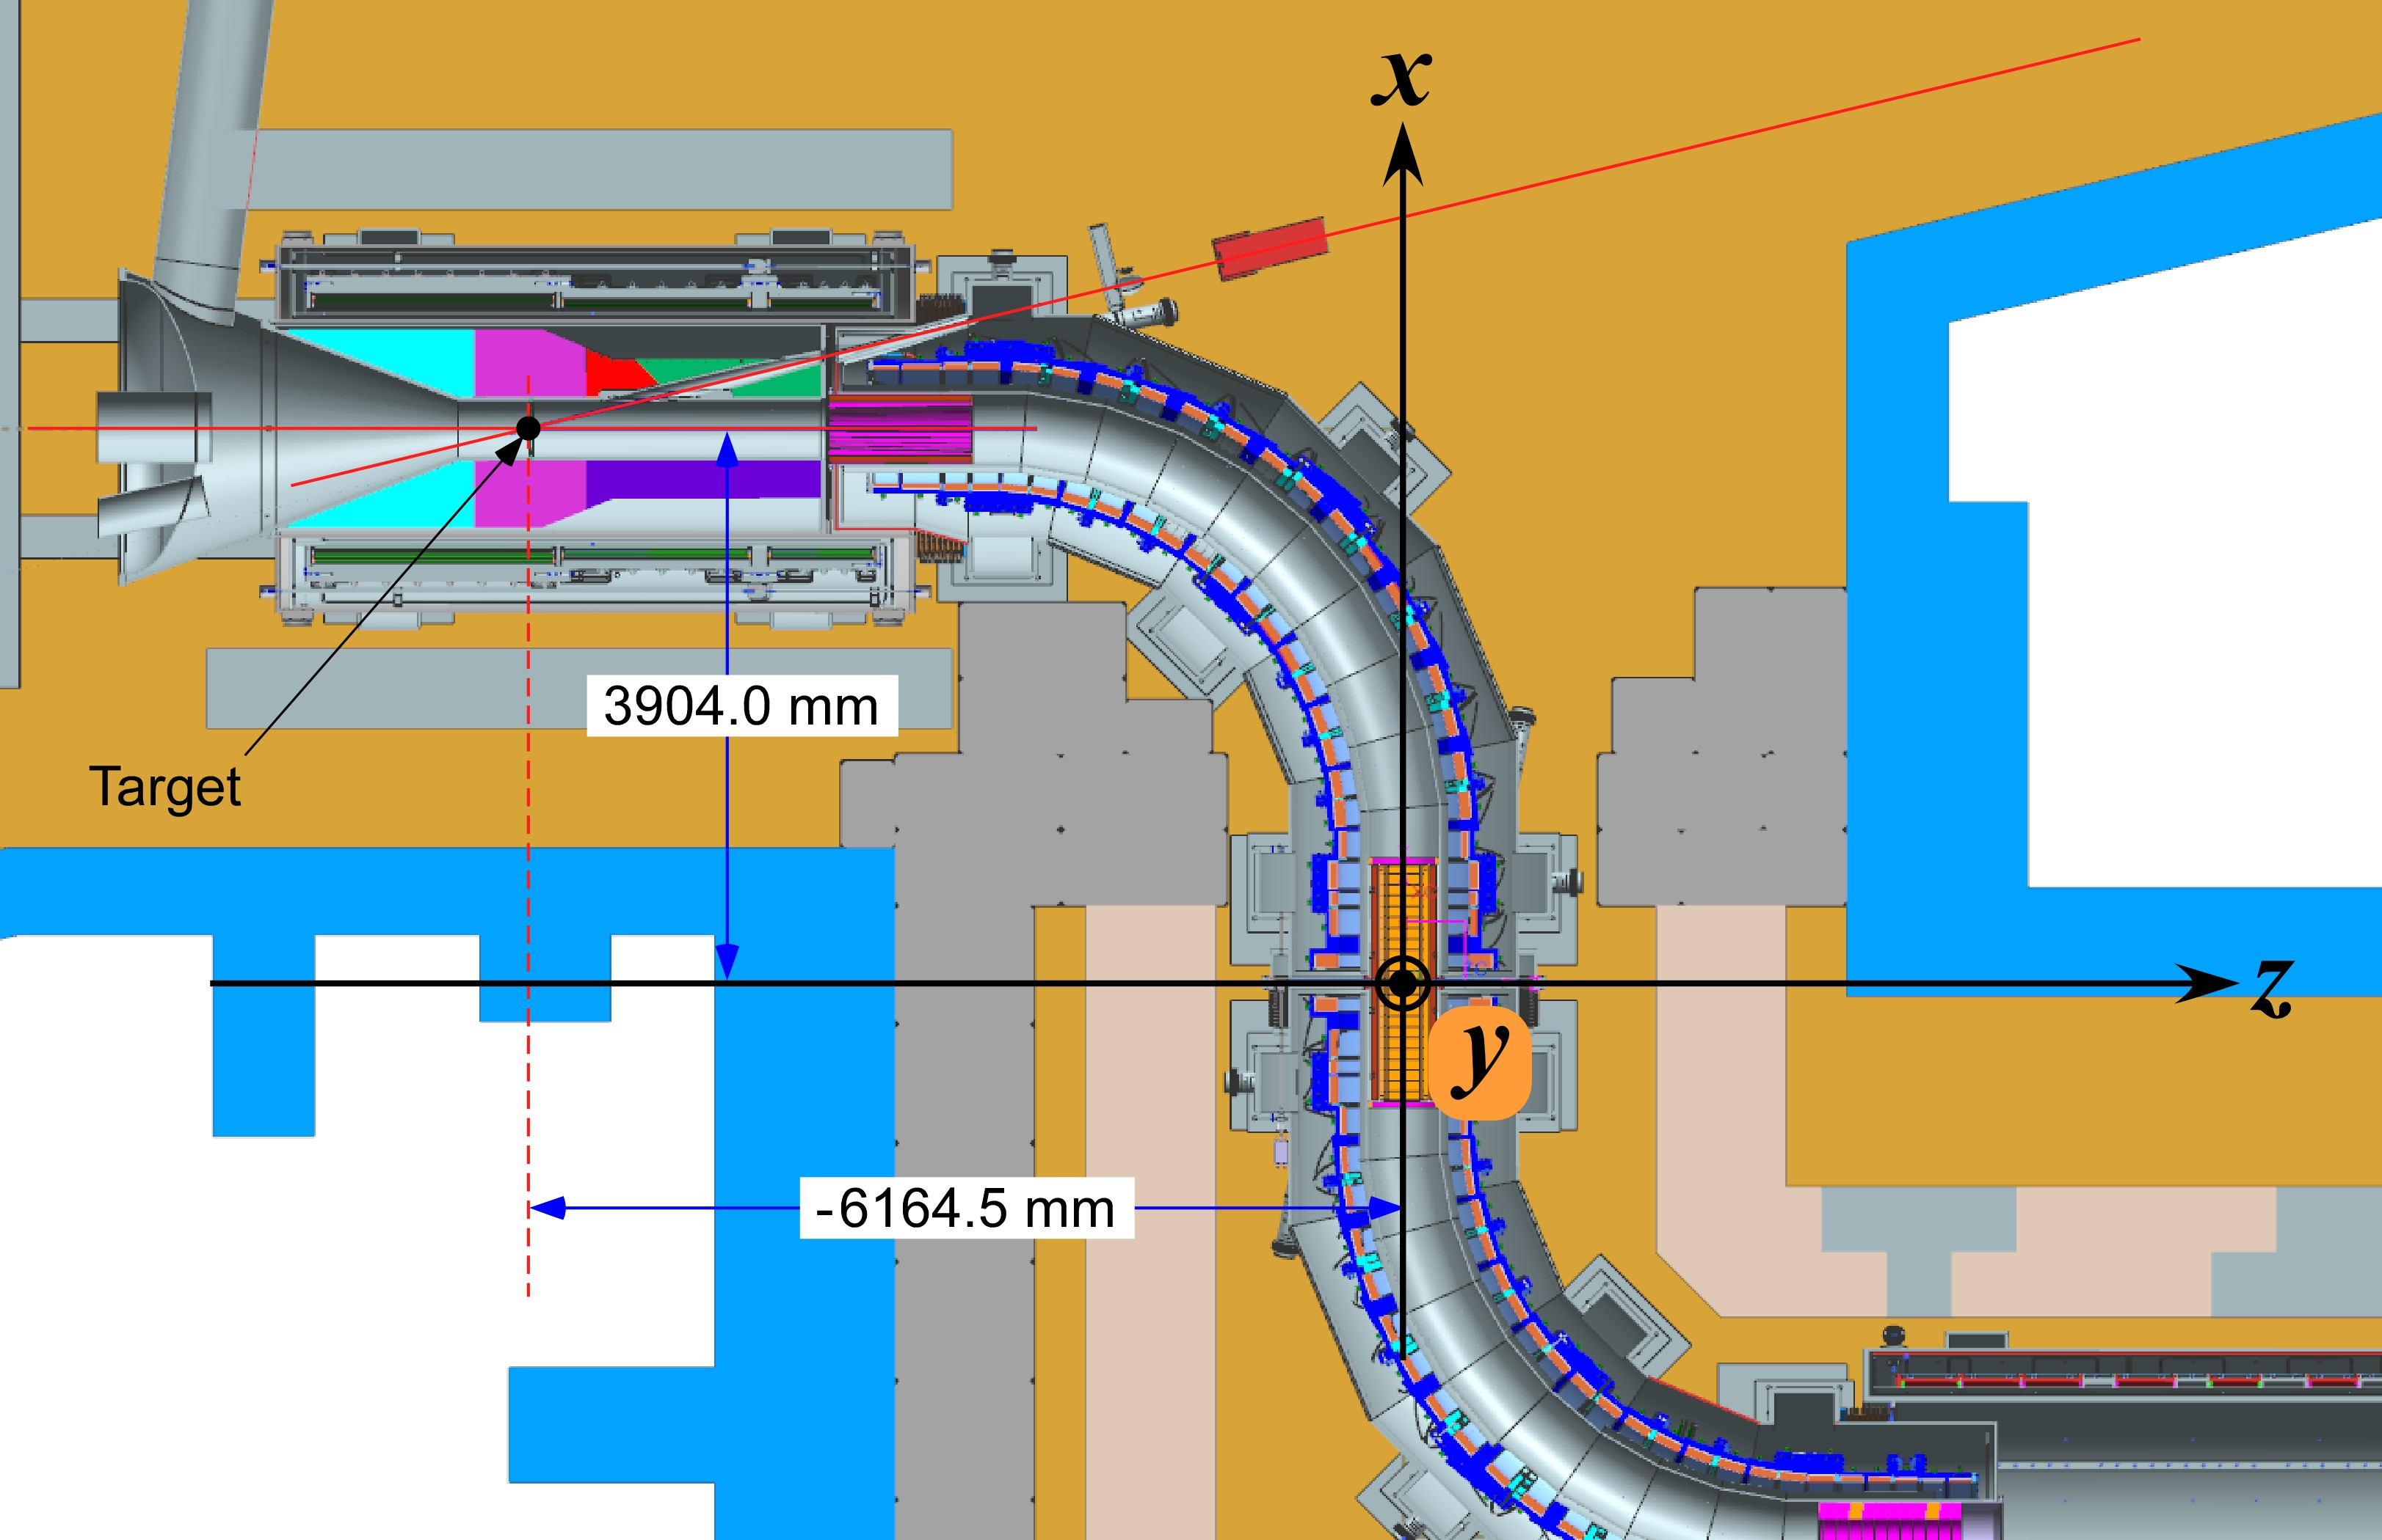
Initial specs for vacuum window at M4BL-PS
Vacuum Window Parameters
  Beamline Vacuum pressure ~ 10⁻⁸ torr
  TS/PS vacuum pressure 10⁻⁵ torr
  Material – Titanium (Ti-6Al-4V)
  Thickness – 0.002”
  TS Beam pipe is 4.75” ID, 5” OD.
  There will only be 1 window to reduce material budget.
  Scattering from window produces losses into TS. Estimates for heat load into cryo TS magnet at first estimate are ok. Simulations are being recalculated. (R. Coleman)
  PS needs a port near vacuum window to view the target (w/ bore scope)
Proposed Vacuum window goes here

Slide 26
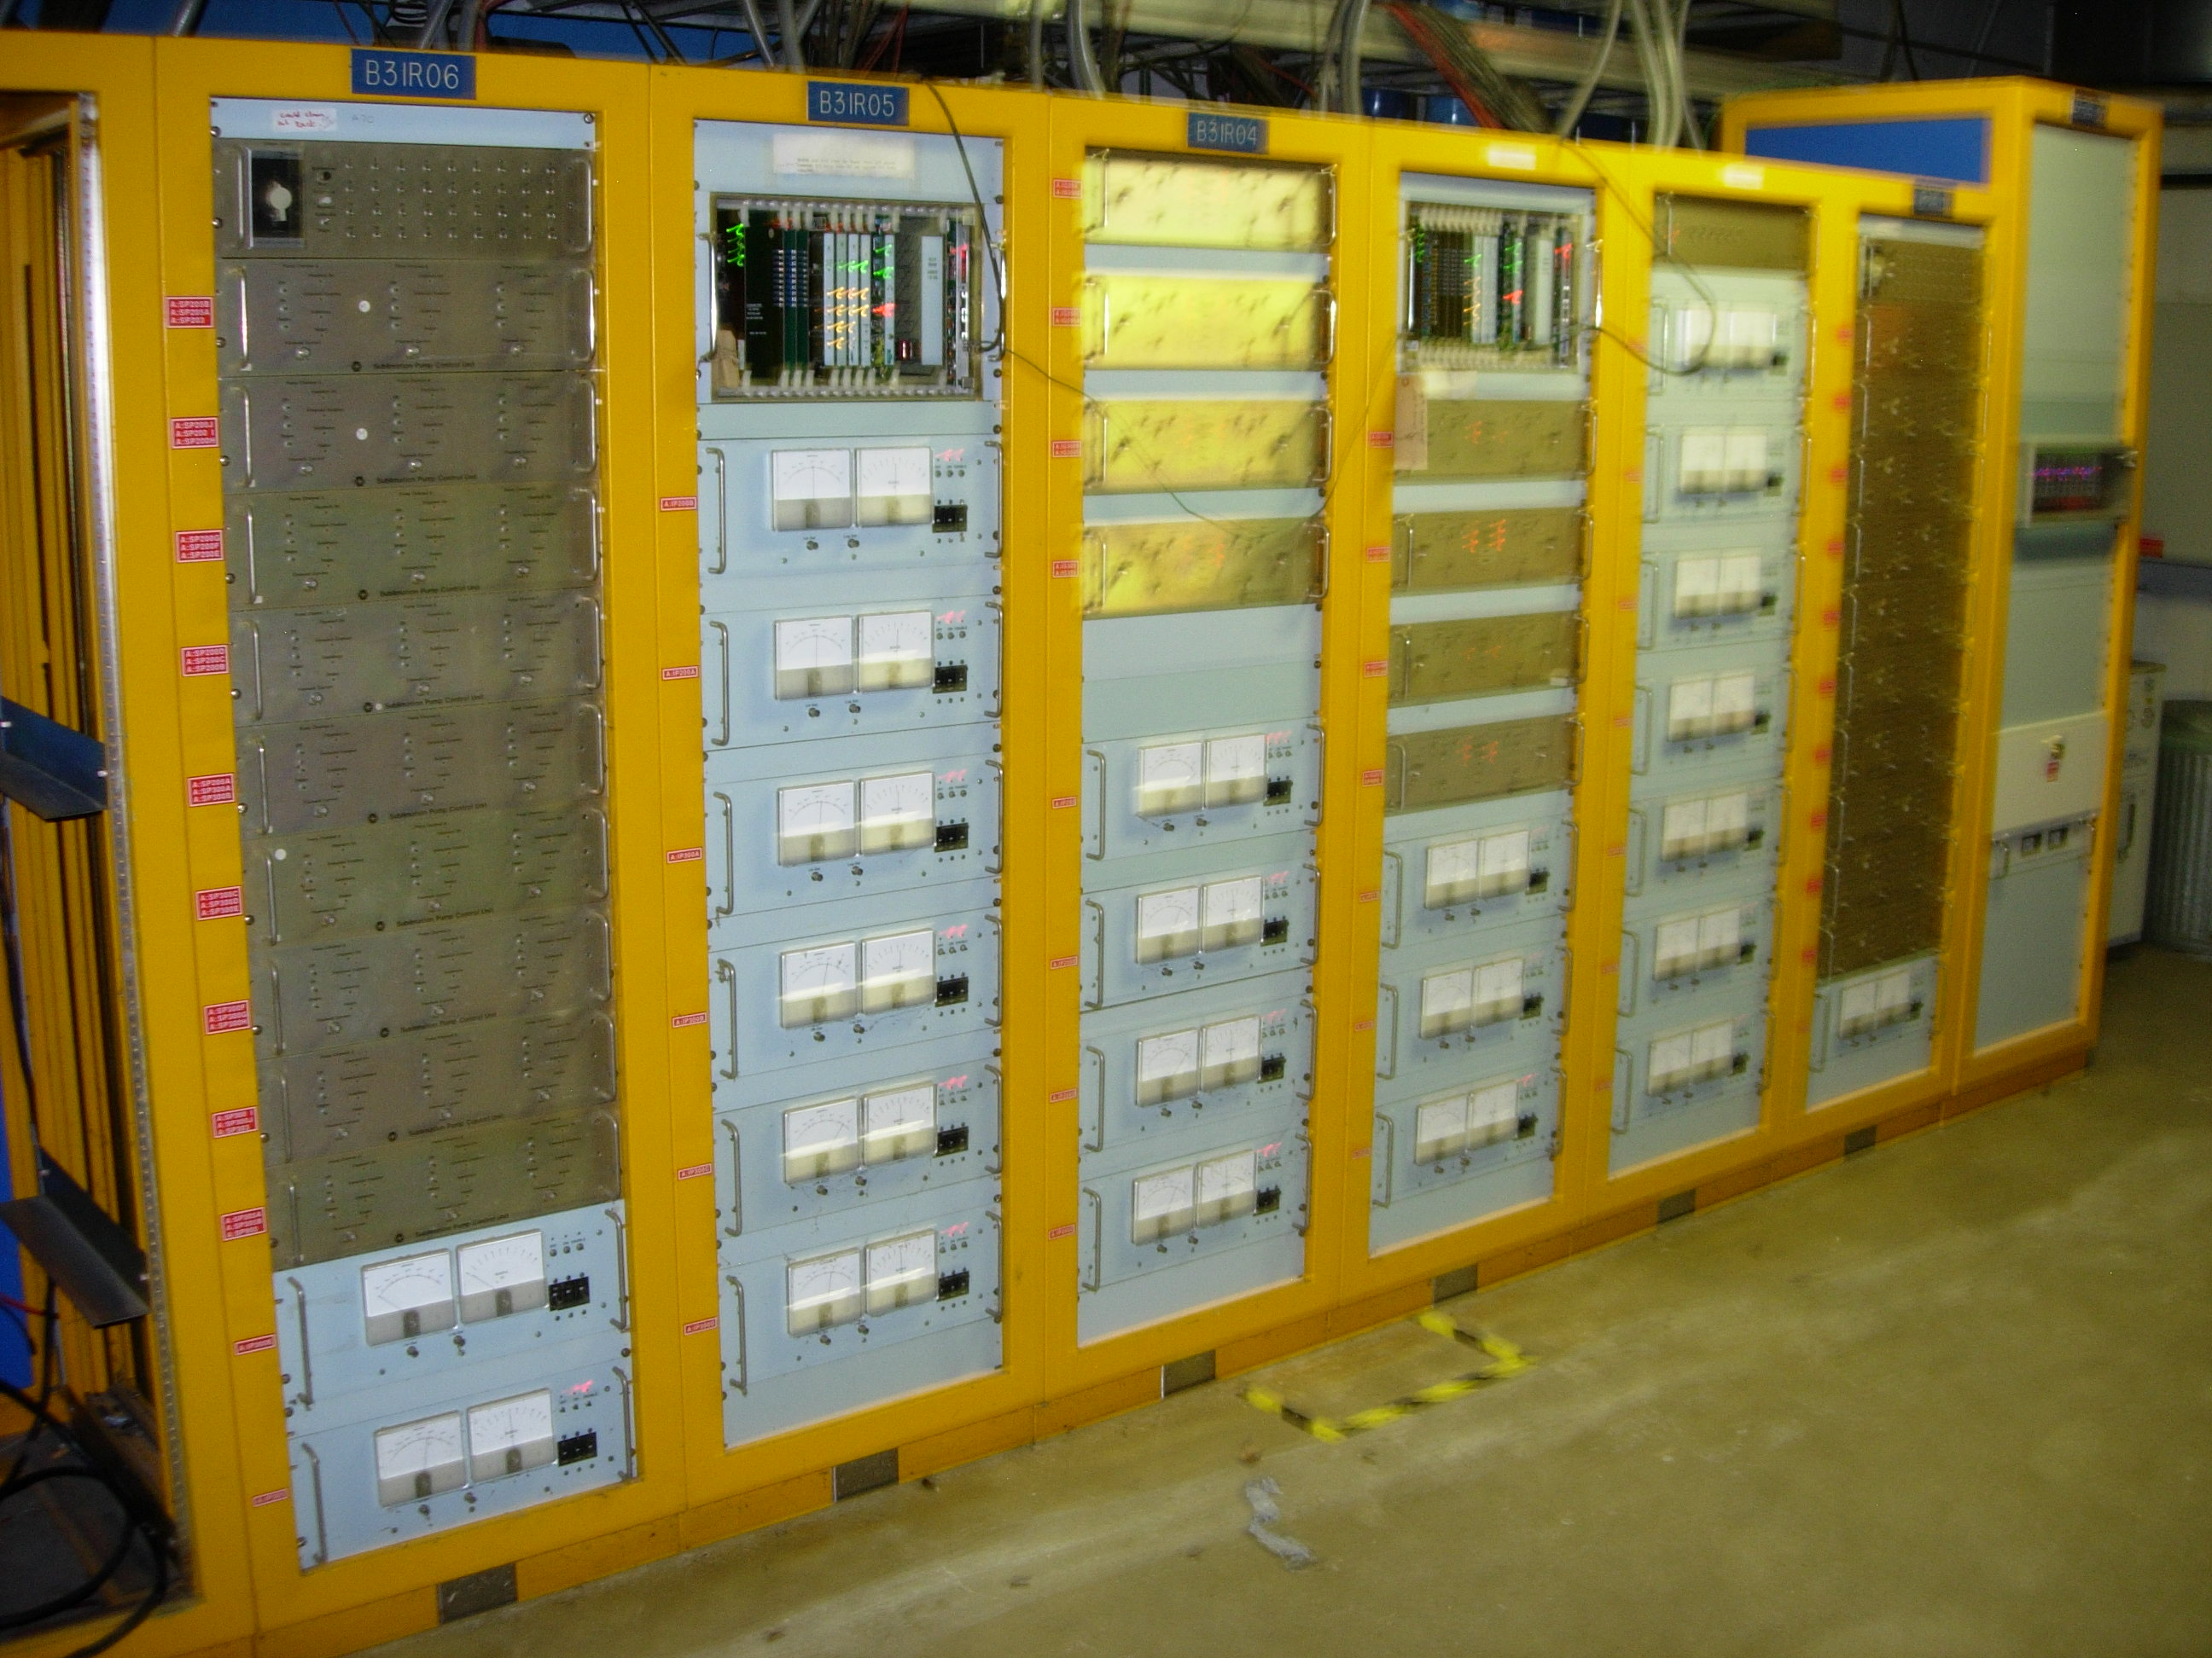
Beamline Vacuum Components & Controls
Vacuum Controls will repurpose the AP30 Accumulator vacuum station.
All ion pump valve controllers , CIA crate (programmable valve interface), and controls interface cards will be reused.
These will use standard practice vacuum controls items.
Row Labels | Needed
New: | 879
5.5" to 4' beam tube reducer | 20
Beamtube, large, special, transitional | 20
Fittings: | 21
Flange Gaskets: | 150
Flanges: | 99
Gauges: | 14
KF40 | 10
Stands: | 28
Valves: | 17
Beamtube, 4" round, laser welded, 316L SS (ft) | 400
Beamtube, 6" round, laser welded, 316L SS (ft) | 100
Repurposed: | 250
Gauges: | 14
Ion Pumps: (270 L/sec & 30 L/sec) | 18
Rough Pumps: (20 CFH scroll pump | 4
Stands: | 47
Valves: (4” remote and manual) | 16
Windows: (titanium) | 3
Bellows: | 48
Beamtube, 5-1/2" round, 316L SS (ft) | 100
Grand Total | 1129
Vacuum Controls at AP30 service building will be repurposed

Slide 27
Low Conductivity Water (LCW)
Requirements:
Provide LCW to the M4 tunnel for magnet cooling & generic use
Provide LCW to the MC-1 and Mu2e service buildings for power supply & general use water cooling.
LCW systems for M4 tunnel, MC-1 & Mu2e service building will tie into the existing standard LCW for the accelerator sourced from the Central Utility Building (CUB).
Provide LCW to the Production Solenoid (PS) Heat and Radiation Shielding (HRS)
Provide Compressed Air System to the tunnel for control of pneumatic systems like beam value and tools used in the tunnel.
Standard expectable LCW parameters are:
Supply Temp (F) | Flow (GPM) | Conductivity (MΩ-cm) | Supply Pressure (PSI) | Return Pressure (PSI)
90 | 1610 | 15 | 215 | 45

Slide 28
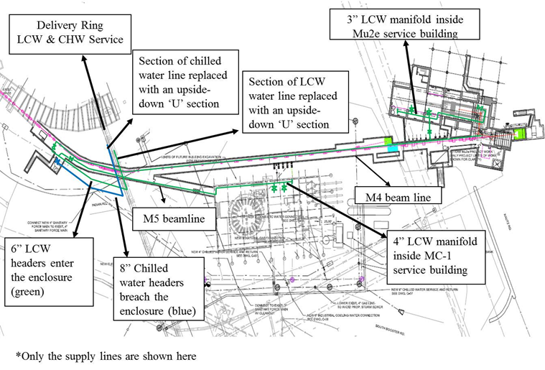
Low Conductivity Water (LCW) Design
Simulated flow and heat load summary for the Muon Campus LCW cooling system
Layout of LCW Headers to the Muon Campus source from CUB
Location | Cooling Demands (kW)
M4 beamline | 710
M5 beamline | 190
MC-1 Building | 370
Mu2e Building | 50
M2 beamline | 115
M3 beamline | 220
Delivery ring | 1160
Estimated LCW Cooling Demands

Slide 29
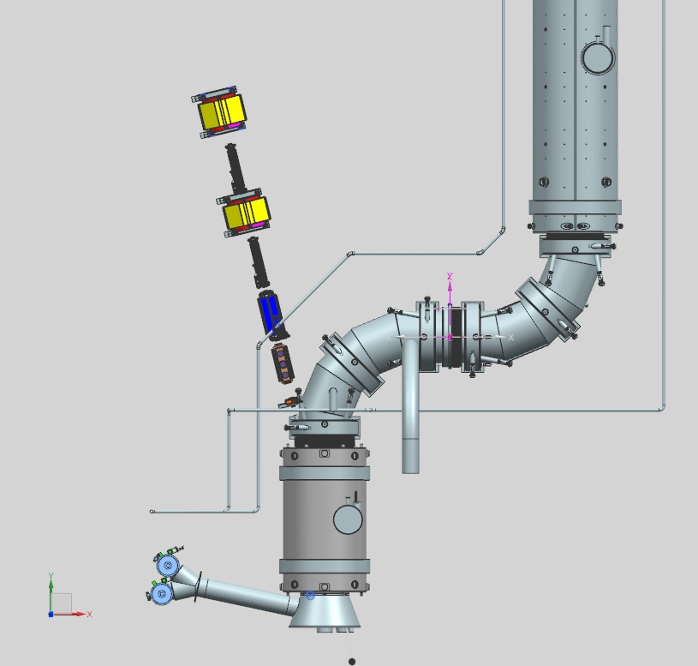
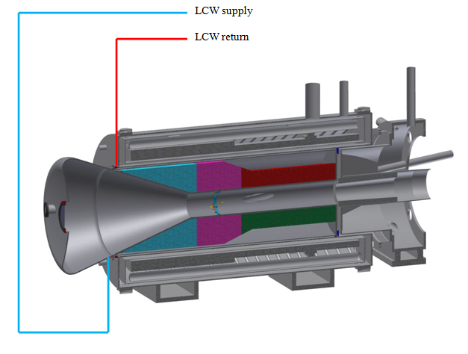



LCW & Compress Air Design
PS HRS LCW Supply and Return Connections
These will tap directly into the S&R headers. It will not have a stand alone system.
Compressed air system will be new for the new tunnels and will tie into the existing DR system.
LCW hoses from manifold to magnet will be upgraded to a more rad resistive hose with good operational reliability.
LCW connection to PS - HRS
Muon Campus compressed air system
Tunnel cross section showing LCW header and hose connection

Slide 30




Fixed Magnet Supports
Requirements
All fixed magnet supports will have 2” of adjustment travel.
Majority of stands will be reused from the Antiproton Source with some modifications.
Reused stands will keep the adjustors and fabricated a new stand extension due to the height difference in the Accumulator (29.5”) and the M4 height (46.4” and ~ 8’).
Reuse adjustors
Fabricate height extension stand
Height of beam line varies from ~4’ to 8’

Slide 31

Target Scan Requirements that Force Movable Magnet Supports
Target Scan Requirements:
Horizontal and Vertical Position Scans up to 1 cm
Horizontal and Vertical Angle Scans up to 0.8 °
Reasons for Scans:
Initial alignment of beam with the target.
Diagnose unexplained reduction of yield from proton target.
Periodic fine tuning of beam to target alignment.
The vertical angle bump produces a large transverse that extend outside the magnets.
Therefore, the lattice in y plane must be inverted (need for polarity switches)
Even with the lattice inverted, there are still large transverse offsets in some of the downstream magnets that require the magnets to move with the bumps.
Lattice Results from E. Gianfelice
Vertical Angle Scans of to 0.8 ° too large and requirement Polarity inverse
HT940
VT940
VT942
V943
HT943
V936
Q937
Q938
Q939
Q940
Q941
Q942
Q943
Target
Enclosure
(target & PS not shown)
Protons
Elevation View of Final Focus

Slide 32

CDA, SQ and LQ aperture
CDA Magnet
12 “
3.25 “
Q940 (SQA) Pipe Possibilities:
Large star chamber for Pbar beamlines and Debuncher (3.29” circular aperture, 5.62” on axis)
Small star chamber in Accumulator for bake-out insulation (2.81” circular aperture, 4.02” on axis)
Large star chambers can be installed in Accumulator quads (but would need to be built)
LQ Pipe Possibilities:
6.5” round
12” elliptical (only in one plane)
Star Chambered ( ~ 12” in each plan)

Slide 33


Target 1 cm Position Scans
Horizontal and Vertical Position Scans require no movement of magnets
Horizontal Scan
Vertical Scan
Lattice Results from E. Gianfelice

Slide 34

Horizontal Target Angle Scan of 0.8°
VT940 needs to move by 0.5 cm or 0.2”
VT942 needs to move by 6.1 cm or 2.4”
V943 needs to move by 7.4 cm or 2.9”
CDA dipoles will need to move
Lattice Results from E. Gianfelice

Slide 35

Vertical Target Angle Scan of 0.8° with Inverted Polarity
HT943 needs to move by 6.4 cm or 2.5”
Lattice Results from E. Gianfelice

Slide 36
Beam inside each aperture due to bumps
Horizontal DX bump of 0.8°
3.25”
6”
HT940
VT940
Q941
Q942
VT942
Q943
V943
HT943
Vertical DY-INV bump of 0.8°

Slide 37


Motorized Magnet Support & Bellows Requirements
Support Requirements:
  Magnets that need motorized supports: HT943, VT940, VT942, V943
  Travel = +/- 3” (+/- 76.2 mm)
  Planes of travel: horizontal & vertical
  Speed of travel 7.3 inches /min
  Radiation hard LVDT
  Frequency of moving stands: 5 times /year
  Magnet weight = 2500lb
  Magnet Type: HCDA & VCDA
Motorized support design
R. Rielly & M. Sawtell
Bellows Requirements:
  Vacuum pressure: 1x10⁻⁸ torr
  Match LQ star pipe to CDA pipe.( various combinations of pipe)
  Large Aperture transitions ~ 14”
  Bellows will be “slinky” style.
  Allow for +/- 3” of travel.
  Distance between bellows is short ~2ft

Slide 38


Comments on Target Scans
(Kevin Lynch Mu2e-doc-4130 May,2014)
The 0.8 angle requirement is challenging to put into practice.
The design work is not complete for items like bellows and interfaces in the Final Focus.
We have 2 people from City University (Kevin Lynch and Jim Popp running G4BL simulations to look at production yields with the target scans to see if the angular requirement can be relaxed. This work is not complete. Mu2e-doc-5706
Original simulated estimate for angular requirement
Recent G4BL to simulate target scans and yield.

Slide 39
Schedule – External Beamline
Final Design Complete
PS Arrives @ Mu2e Bldg
CD-2/3b
CD-3c
Beam to Diagnostic Absorber
M4 Enclosure
BO
Shutdown
‘16
g-2 Beam Operations
Shutdown
‘14
Shutdown
‘15
Magnet Removal & Fabrication & Refurbish
5 VDPA Removal RR
MCD Fabrication
6 CDA Refurb
Install ESS
Commission Res. Extr.
Magnet & Support Installation
Remove Hbend dipoles
Extinction & M4DA Section Installation
Internal Beamline
Review
Hbend Section Installation
Procure fixed & motorized stands & assemble
Final Focus Section Installation
LCW
Procure and Install LCW & CA Systems
Vacuum
Prep Ion, tube & components
Procure Parts
Install Ext&DA
Install Hbend
Install FF
Power Supply
Procure , assemble & install main and Trim Power Supplies
Misc
Survey network
Final Alignment
Close up tunnel
Commissioning with single turn Beam
Q3 | Q4 | Q1 | Q2 | Q3 | Q4 | Q1 | Q2 | Q3 | Q4 | Q1 | Q2 | Q3 | Q4 | Q1 | Q2 | Q3 | Q4 | Q1 | Q2 | Q3 | Q4 | Q1 | Q2 | Q3 | Q4 | Q1 | Q2 | Q3 | Q4 | Q1 | Q2 | Q3 | Q4
FY14 FY15 FY16 FY17 FY18 FY19 FY20 FY21
Notes:
Notes:
ESS Installation depicted here is not what is in the P6 schedule. P6 does not account for the fact that the beamline must be commissioned with single turn extracted beam before the ESS can be installed.
The ESS replaces a Delivery Ring extraction kicker module. Therefore, ESS installation precludes further single turn extracted beam to the M4 beamline.
HRS installation takes 10 days (box on schedule is over-sized)
Target installation is off-project and estimated to occur in Dec. 2021.
Beam commissioning is off-project

Slide 40
Commissioning
Beam commissioning is off project but it does occur in the schedule before the end of the project.
Install removable upstream shield wall 2Q FY17
Commission signal turn beam to diagnostic absorber 2Q FY20
Commission resonant extraction 1Q FY21 to diagnostic absorber.
Commission beam to target may have 2 different scenarios: Commission beam to PS without a target (provide background rates) or Commission beam to PS with target installed.
Removable shield wall
while g-2 in running

Slide 41
Risks (All for External Beamline)
Registry contains 2 risks:
ACCEL-200 - Mu2e-doc-4589 : Additional power supply circuits needed for modified optics for the change in the extinction section due to extinction design change.
  High probability with up to $400K cost impact
ACCEL-201 - Mu2e-doc-4590: Additional magnet needed to be fabricated for modified optics for the change in the extinction section due to extinction design change.
  Moderate probability with $200K cost impact.
1 to be added to Risk Registry:
  ACCEL---- - : Cannot procure appropriate bellows for the bellows design for movable devices in final focus.
    Moderate probability with $60K cost impact.
Registry contains 1 risk removed where a Threat is Avoided:
ACCEL-033 Mu2e-doc-3832: Inability to stage magnets in the Accumulator enclosure during g-2 operation
Registry contains 1 opportunity:
  ACCEL-202 - Mu2e-doc-4591: Replace current MDC magnet for diagnostic absorber line with an existing SDC magnet.
    Moderate probability with $110K cost impact.

Slide 42
Summary
The magnet selection for the M4 beamline is near a final design and achievable with the selection of available magnets.
Serial numbers of reused magnets have been assigned to specific locations.
Complete value engineering to confirm that an existing SDC magnet can replace the need to manufacture an MDC.
The design of the beamline vacuum and LCW systems are at final design with work still needed to complete drafting.
The diagnostic absorber is built and installed.
There is still work to complete a final design for target scans which use movable supports. Work to see if the angle scan requirement of 0.8° can be relaxed is in progress.

