Slide 1
M-4 Beamline Profile and Intensity Monitors
Daniel Schoo
Gianni Tassotto
External Beamline & Instrumentation Independent Design Review
6 October 2015

Slide 2
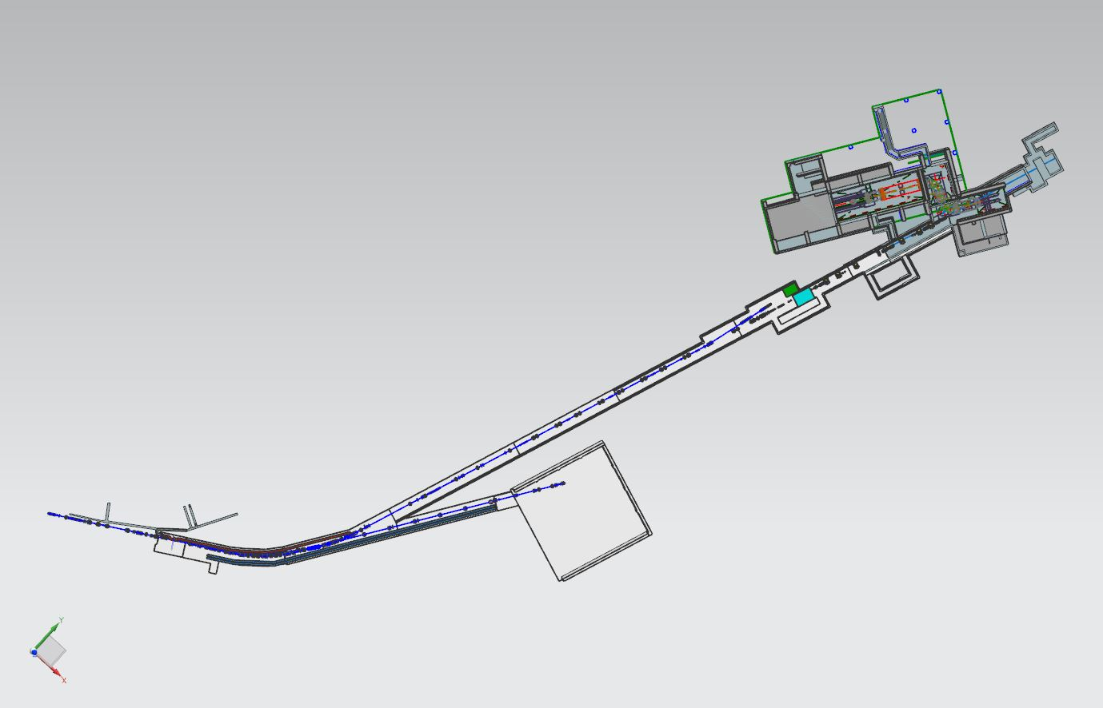
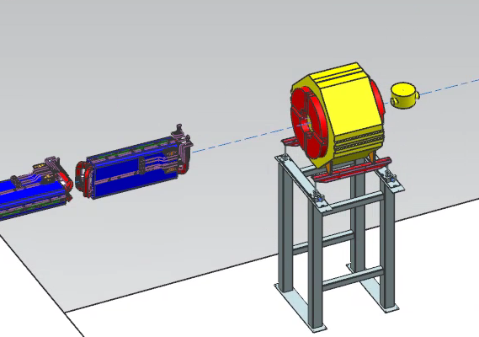
Extraction Beamline Multiwires
Based on the lattice design, the M4 line will contain 28 profile monitors that will be used to measure the profile and position of the beam.
One shared PWC
Eight repurposed UTA multiwires
Eighteen new NuMI-extraction style multiwires
One repurposed BNL PWC
Target Section:
1 multiwire
1 BNL PWC
Extinction & Diagnostic Absorber Section: 919 – 935
9 multwires
1 UTA Multiwires
Final Focus :
936-943:
3 multiwires
3 UTA multiwires
Common Section:
900-907
1 shared PWC
3 multiwires
MW941
MW941
HBend Section:
908-918
2 multiwires
4 UTA multiwires
Notes:
UTA multiwires have a smaller insertion length and were used in areas where there was less available longitudinal space.
M4 Line Instrumentation:
Slow extracted proton beam from the Delivery Ring will traverse the newly constructed M4 line before arriving at the Mu2e target. Instrumentation hardware and electronics will be recycled from other areas. The instantaneous intensity of the slow spill beam is too small to be measured with Toroids, so retractable ion chambers will be constructed to measure the beam intensity. A Beam Loss Monitor (BLM) system based on the hardware and electronics that exist in the P1 and P2 line will be implemented to help maintain good transmission efficiency in the beam lines. Multiwires will provide beam profiles in both transverse planes.
Instrumentation locations were chosen by the beam lines optics expert in order to tune-up the line. 27 Profile Monitors

Slide 3
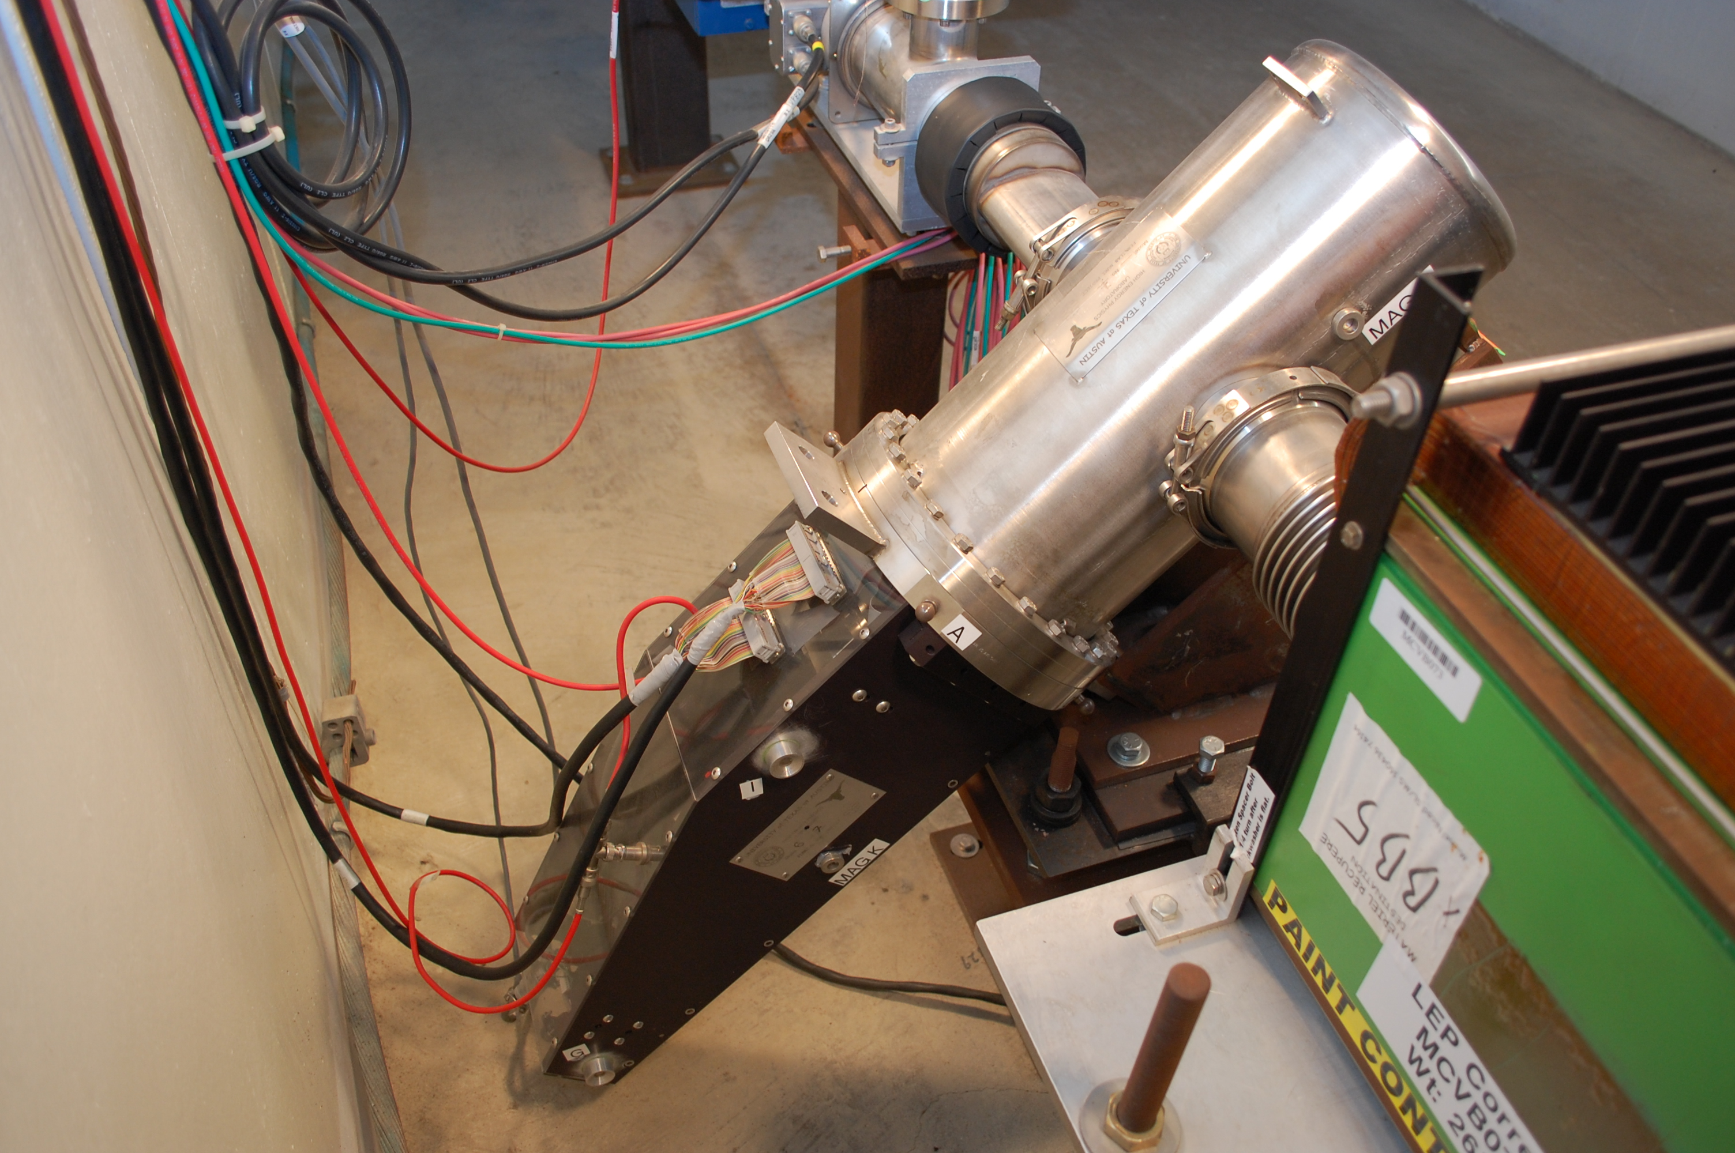
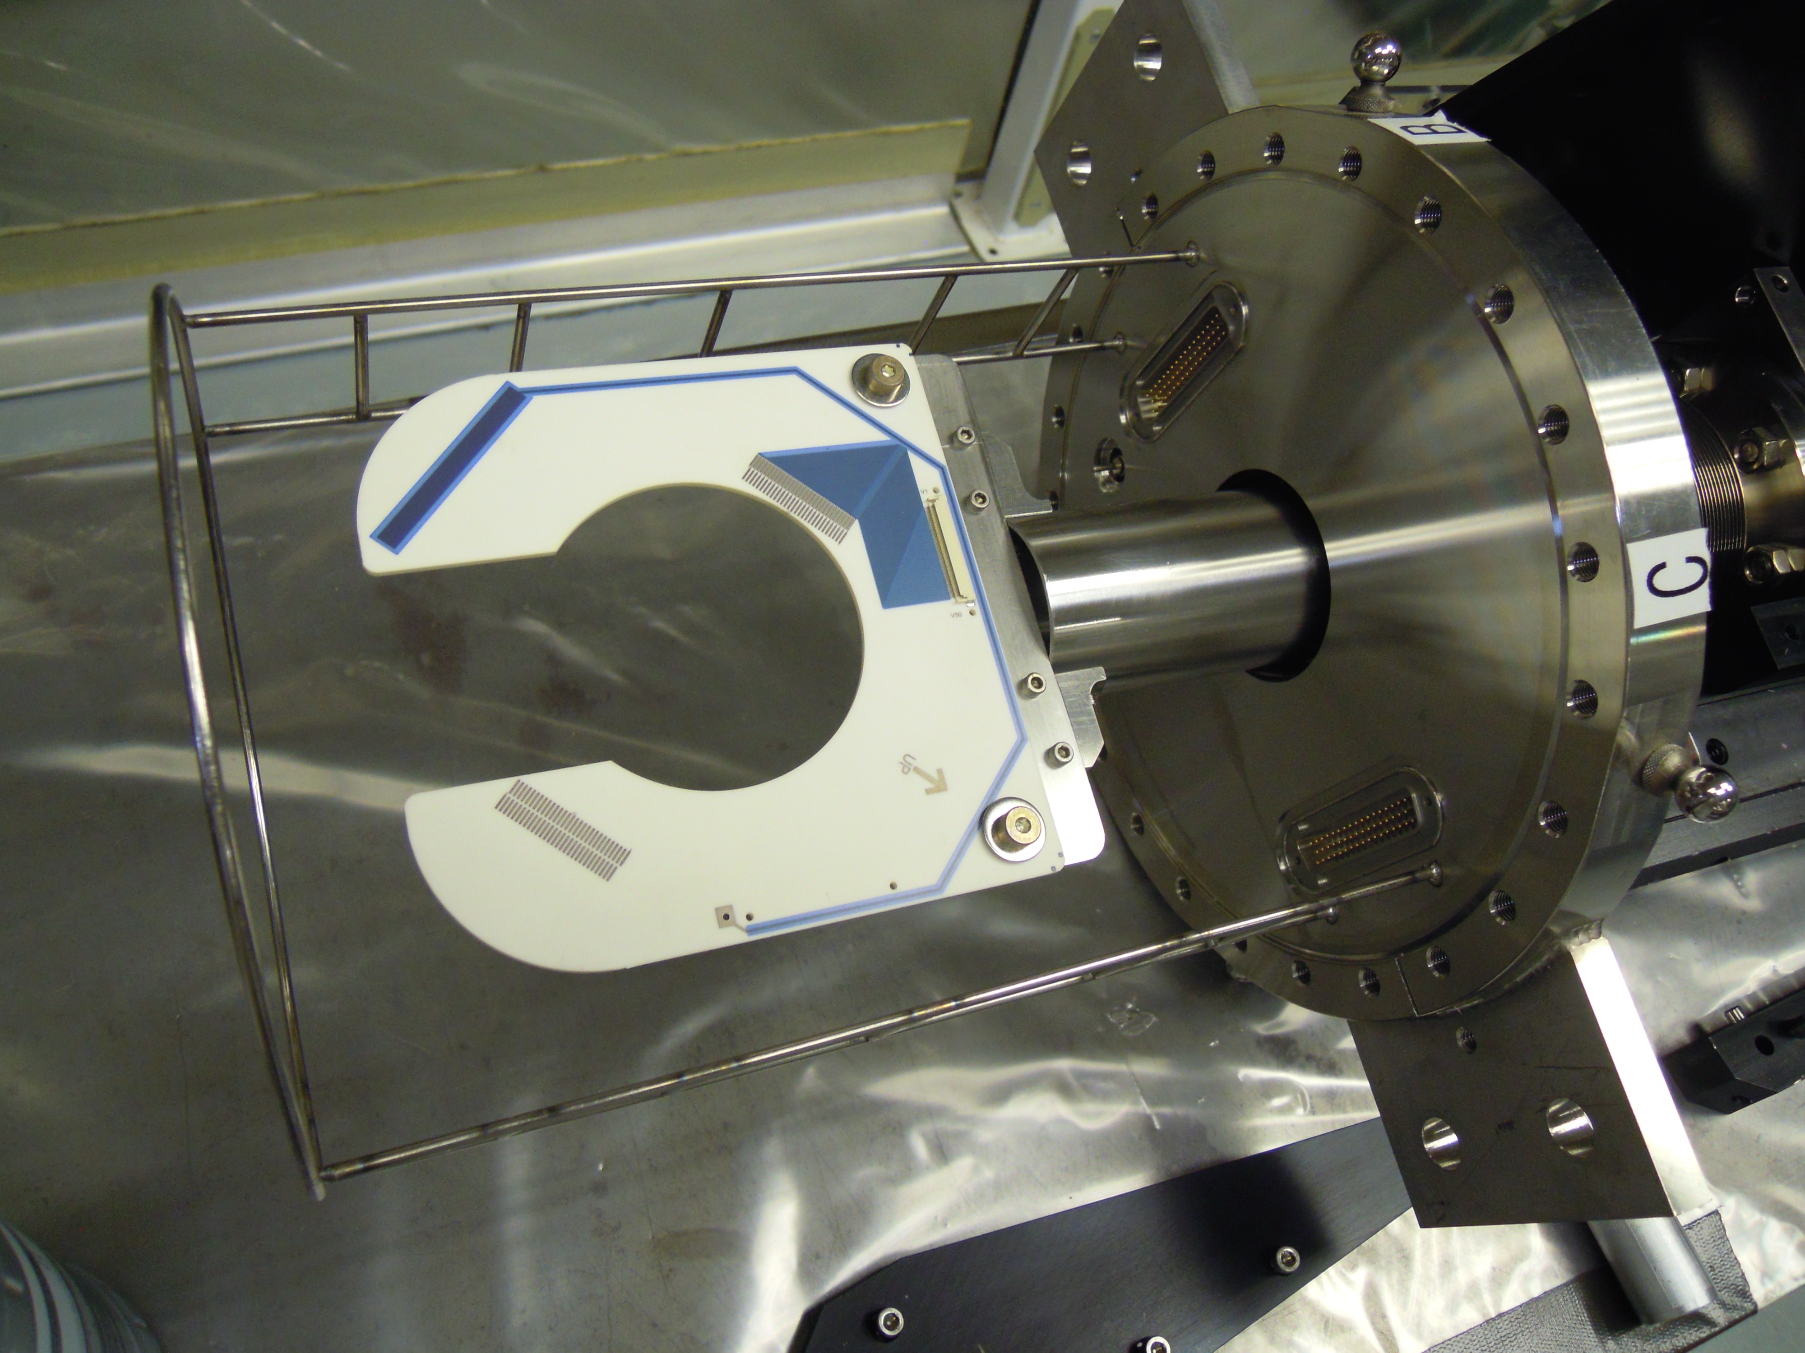
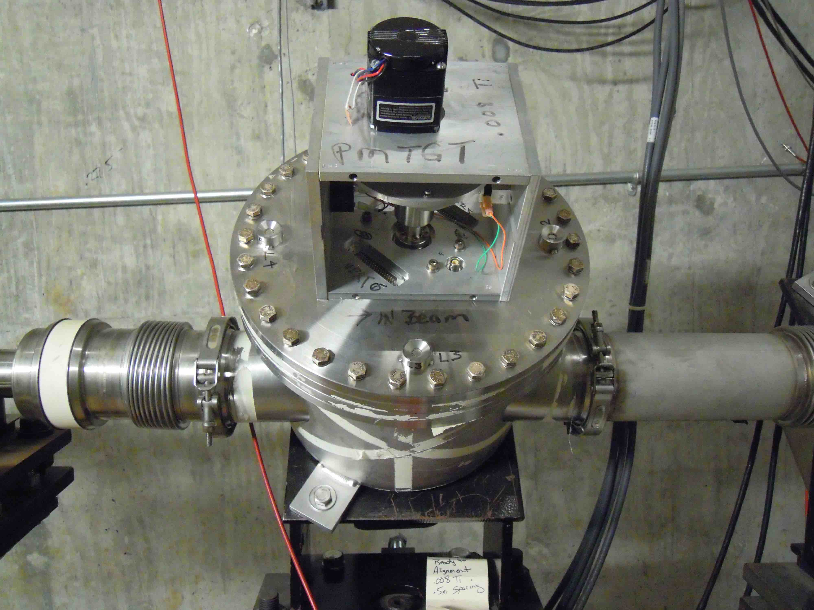
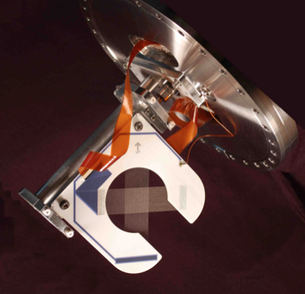
Vacuum Cans
Two types of vacuum cans will be used.
Fermilab design – rotary motion
University of Texas design (UTA) – linear motion
Mechanical reliability of rotary feedthrough
Life tests conducted during the prototyping of the NuMI profile monitors.
Cycled prototype 500,000 times. After the test inspected mechanical parts i.e., switches, rotary feed through etc. No functional damage was detected.
Fermilab Design (rotary motion)
UTA Design (linear)
Notes:
The Fermilab design is a rotary drive that positions the ceramic wireplane into and out of the beam like a gate. It is mounted on a 45 degree angle from vertical in order to incorporate a slotted frame that can be inserted and removed from the beam without the beam striking it. This is a simple, mature reliable design that has been used in the NuMI beamline for years. The University of Texas detector is a modified design. This is a linear drive that slides the wireplane straight into and out of the beam. The original Texas detector had a complicated, expensive and unreliable foil wireplane. The foil assembly has been replaced with the simpler reliable rotary detector frame. The original DC stepping motor on the Texas detector has been replaced with an AC gearmotor. This simplifies the cccontrol and prevents the detector from slamming out of the beam with a loss of power.

Slide 4
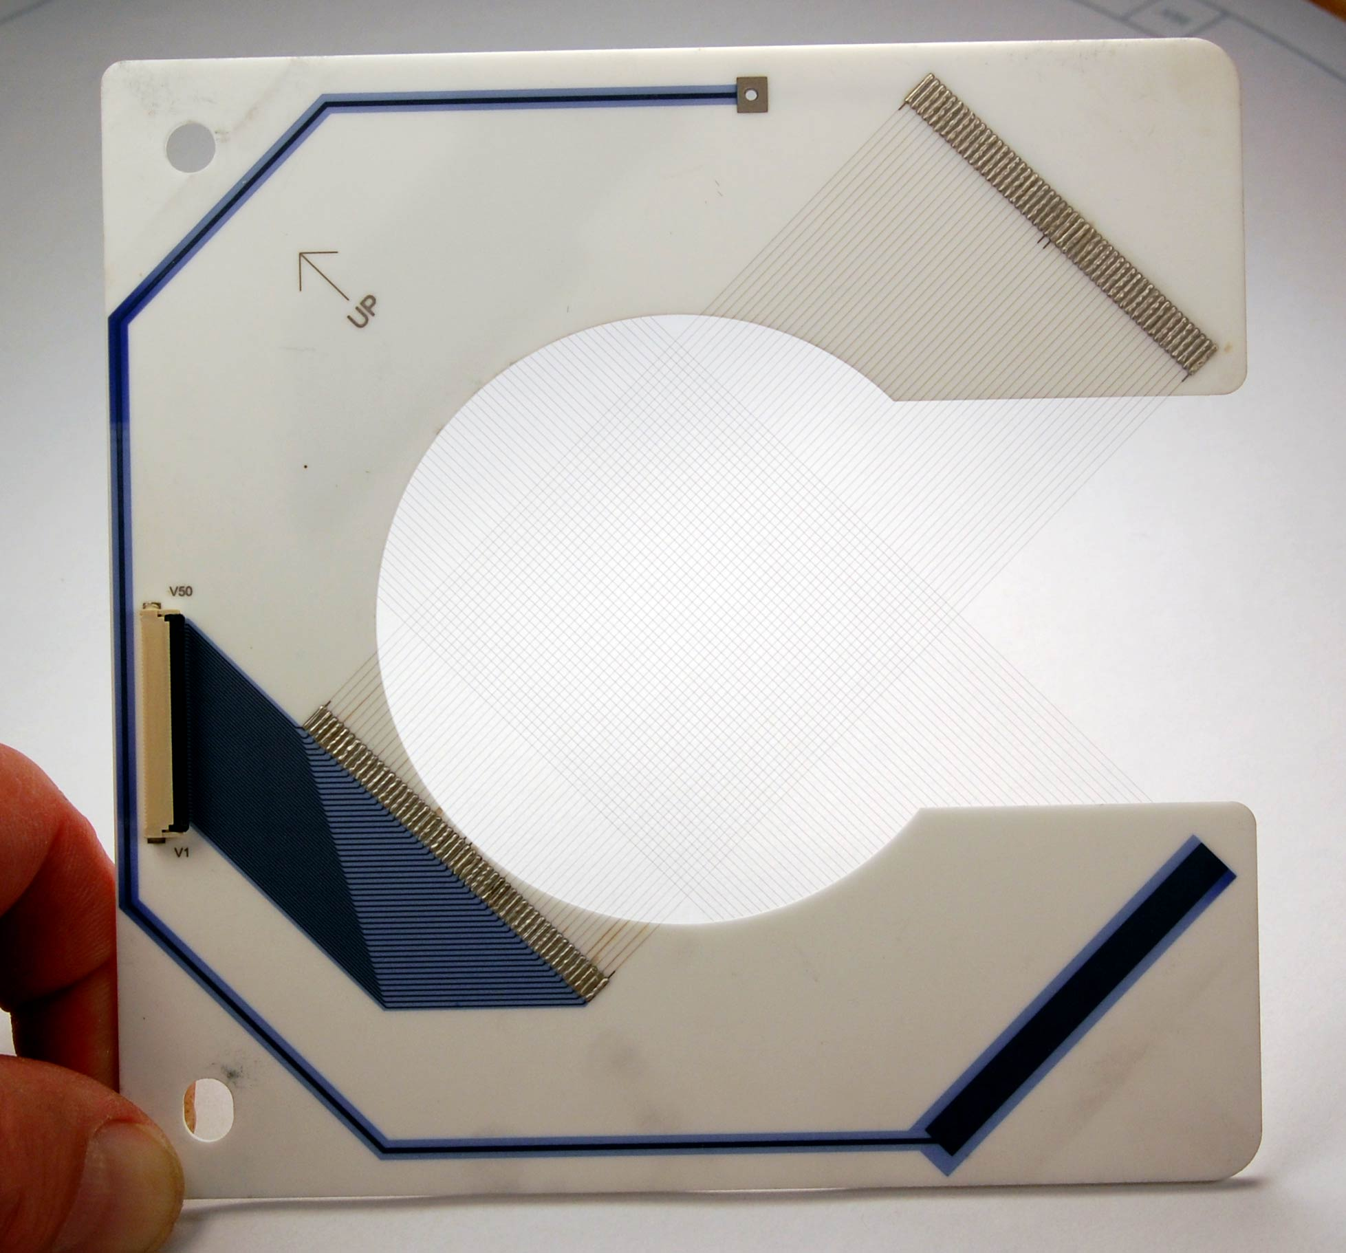
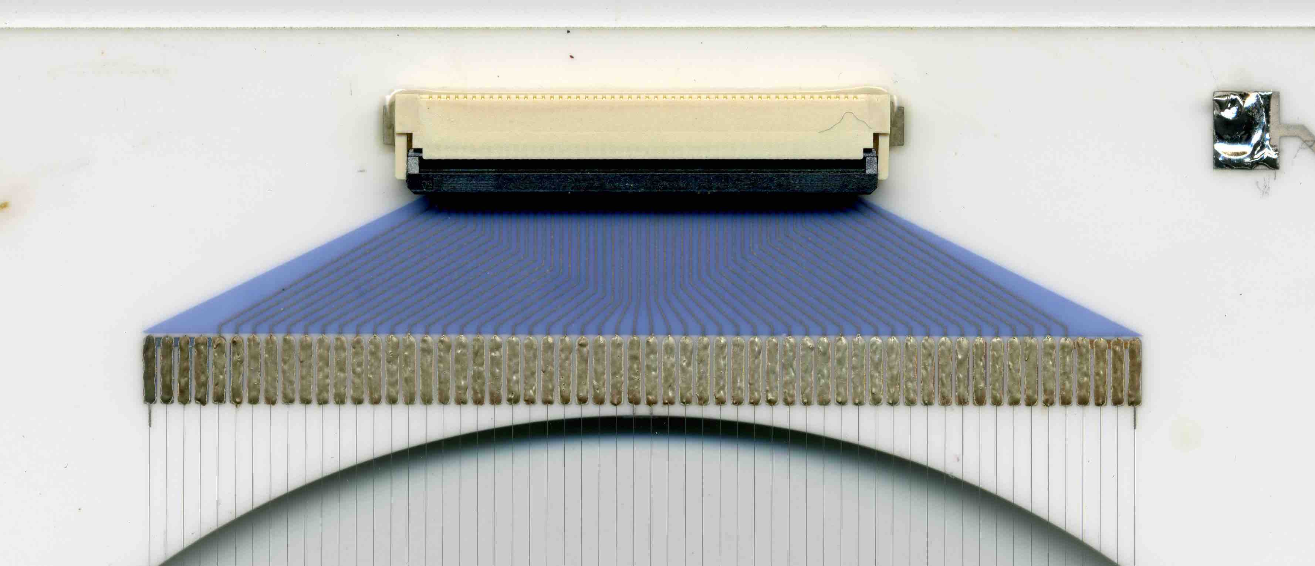
Wire planes
Ceramic substrate
Alumina 96 Ceramic
Fired Ag-Pd metallization
Surface mounted connectors
Wires
Titanium wires or foils
Wire pitch 0.5 and 1mm
Electrical Tests
Continuity
Wire to wire leakage
Flash test
Pitch Measurements
Made at SiDet using Avant 600 made by Optical Gaging Products. The uncertainty in position was +/- 10 μm.
Notes:
The ceramic material for all of our new multiwires is Alumina 96, a common material used in electronic module manufacturing for the military and industry. The silver palladium metallization is the same as for electronic modules and is a mature process. Surface mount connectors designed for this type of service are used to connect the wireplane to Kapton based Flexible Flat Cable. The combination of metalized ceramic frames and Kapton FFC cable makes a highly radiation tolerant, high vacuum compatible assembly that has a long successful history of service at Fermilab. Wireplane material is optional depending on the application. Titanium wire is most often used because of its highly desirable characteristics of strength, low density, emissive efficiency and aging. Wire spacing is customizable up to a limit of 1mm from center to center, limited by the space available on the ceramic frame.

Slide 5
Charge Estimate
The charge generated by the beam on a wire is a function of: 1. The beam intensity 2. The dimensions of the wire/foil 3. The Full Width Half Maximum beam size assuming a Gaussian distribution. The table below shows the estimated charge generated by a total integrated intensity of 1E12 for two multiwires each seeing a different FWHM. Both use a wire diameter of 75 μm and a assuming a 3% Secondary Emission Efficiency.
MW929 - FWHM = 28.8 mm
MW936 - FWHM = 5.4 mm
Tests show that a simulated charge of 10 pico coloumbs at beam center is sufficient for the scanner in order to produce a useable plot. 100 pC = full scale
We should be able to display a few slices of the beam during spill.
Name | Wire Diameter (μm) | FWHM (mm) | Spill Intensity | Charge/spill (pCoul)
MW923 | 75 | 28.8 | 1E12 | 11.7
MW936 | 75 | 5.4 | 1E12 | 62.6
Notes:
The charge estimate assumes a gaussian distribution where the charge generated by the beam on a wire depends on the percentage of the beam intercepted by the the wire, and the Full Width Half Maximum (FWHM) of the beam. The secondary electron emission is about 3%. Therefore the charge is equal to 3% the beam distribution that interacts with a particular wire times 1.6E-19 Coulomb.

Slide 6
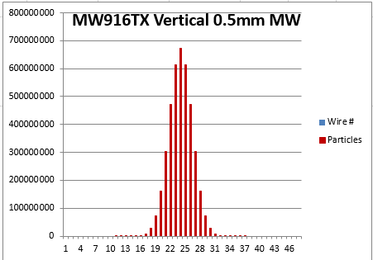
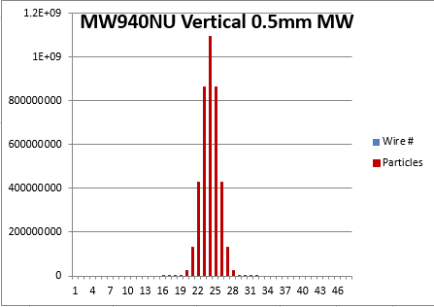
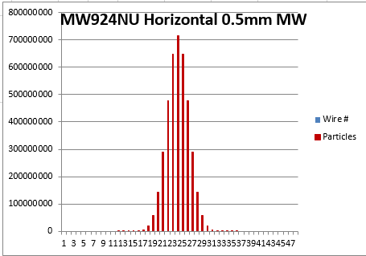
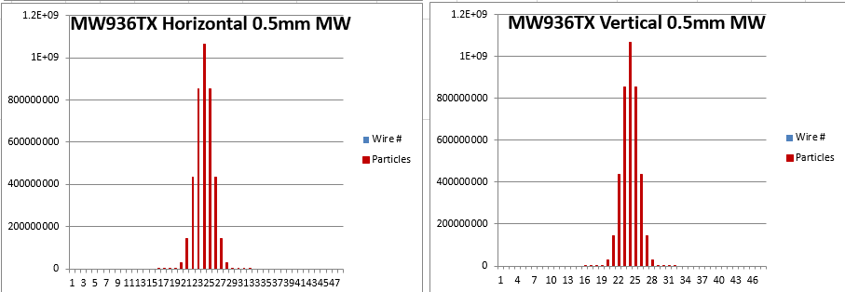
Simulated Profile Sizes for 0.5mm and 1.0mm wire spacing
903
916
929
940
906
917
930
941
907
919
932
943A
908
922
933
943B
910
924
935
912
926
936
Distribution peaks gives position readbacks used for autotune program
914
927
937
Notes:
Using the M4 line lattice and expected beam parameters, beam profiles were simulated at each of the Multiwire positions. Either 1mm or 0.5mm wire spacings were chosen depending on the beam size at the location of the Multiwire. The purpose is to illustrate that a horizontal and vertical beam profile can be used to tune the transverse positions of the beam. The positions gathered from the beam profiles will be used as part of an M4 beamline autotune system that I will discuss in more detail later on.

Slide 7
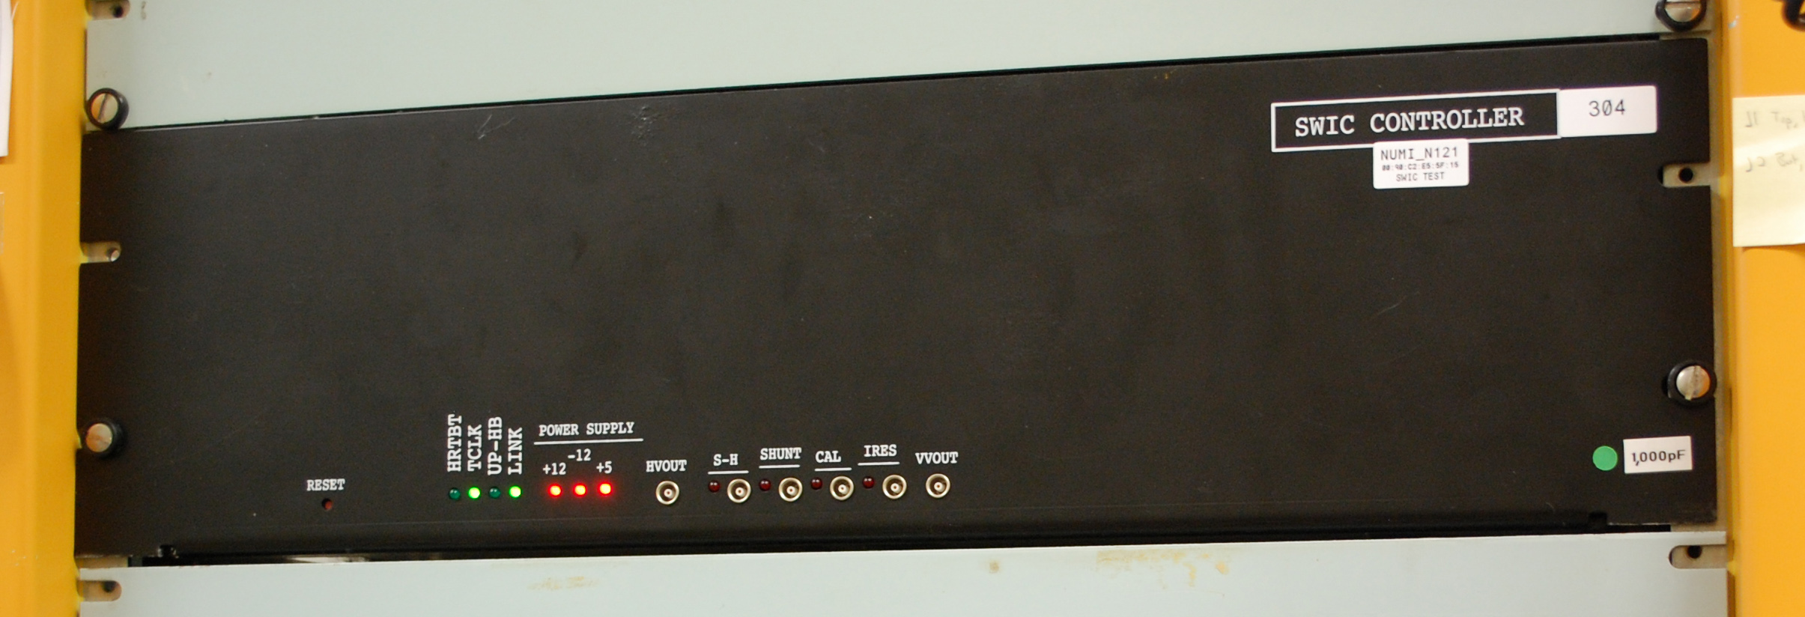
SWIC Scanners Overview
SWIC Scanners capture signals from all types of wireplane profile detectors and provide a plot of the beam profile.
P-Bar foil SEM Profile Monitor
Proportional Wire Chamber (PWC)
Texas Multiwire
Reilly Stacked Plane Multiwire (NuMI type)
Segmented Wire Ion Chamber (SWIC)
SWIC Scanner
Typical Plot
Notes:
The profile monitor readout instrument is the Fermilab standard "SWIC Scanner" also known as a SWIC Controller. The SWIC Scanner is a 3U high rackmount instrument designed by Daniel McArthur of the Fermilab Accelerator Controls Group. It has two axis, horizontal and vertical, each having 48 channels of charge integration, one channel for each horizontal or vertical wire in the detector. Each set of wires is connected through a 50 conductor flat to round shielded cable to a scanner which resides in a nearby service building. The scanner is controlled by and reports back to the Accelerator Control System to collect charge data on the detector wires, digitize it and report the results back for analysis and graph plotting. Any of our stable of wireplane profile monitor detectors can be plotted.

Slide 8
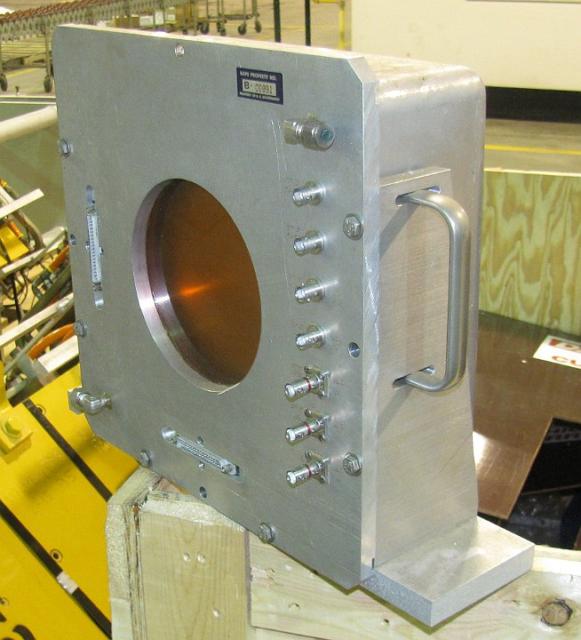
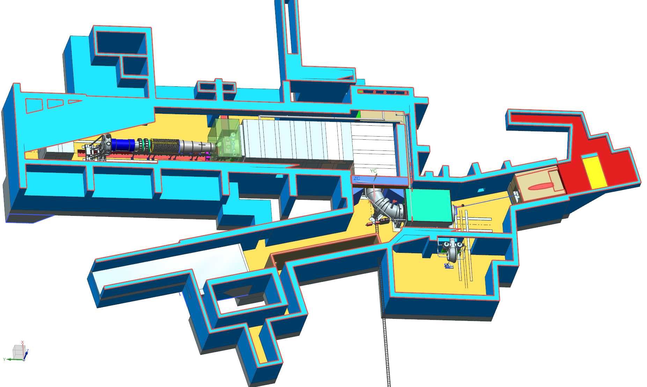
PreTarget and PostTarget Multiwire
Two profile monitors were added to the scope of this WBS.
Upstream of production solenoid will be a standard Multiwire
Downstream of the production solenoid will be a BNL air SWIC.
Pre-target
vacuum MW
Post-target
air BNL SWIC
Notes:
There were two more profile monitors added to the pretarget and post target beamline. Pretarget is a standard vacuum multiwire. Post target where the vacuum ends, a Brookhaven air type proportional wire chamber will be installed. We have a number of BNL proportional wire chambers on hand and this is a good use for it since they cannot be used anywhere else.

Slide 9
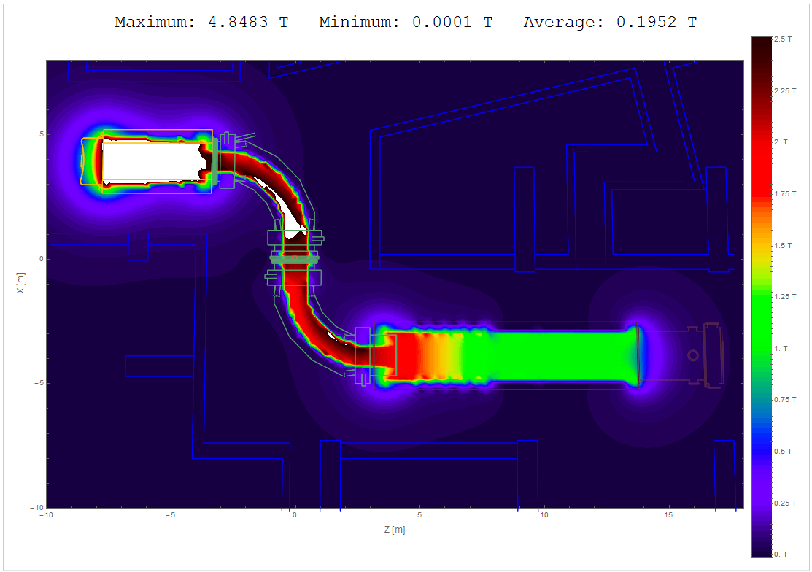
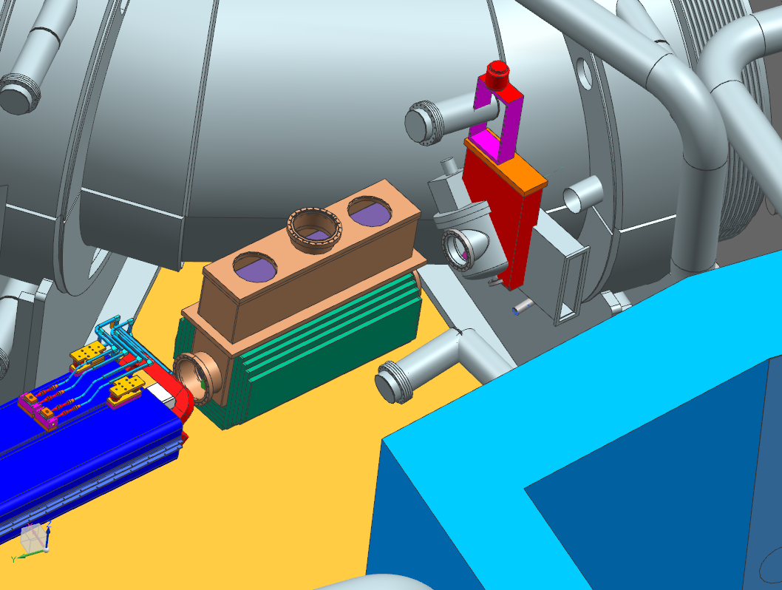
Design considerations: MW’s in magnetic field
Need to examine the effects of magnetic field on the multiwire just upstream of the target solenoid.
Does the magnetic field impact the motion control (PreTarget MW only)?
Does the magnetic field impact the signal?
PostTarget MW: 0.2Kg magnetic field
PreTarget MW: 1.2Kg magnetic field
Magnetic Field Map
Rick Coleman
Mu2e-doc-1381
Mu2e-doc-4741
Notes:
The pretarget multwire will be in 1.2 kilogauss magnetic field. The slide shows the location with what appears to be two or three profile monitors. At the time that the slide was prepared it had not been determined which type we would use so three types were illustrated at that location. We have not determined yet what effect the magnetic field will have on either the motion control or the plot integrity. Tests are planned to place a detector in a similar field and observe the results. The post target PWC does not move but the plot integrity could be effected and we will study that as well.

Slide 10
SWIC Scanner Internals
Charge from particle beam is collected by a grid of detector wires (up to 48 each H and V) and integrated onto capacitors.
Capacitor voltages converted by 16-bit ADCs
Results sent to control system for plotting and other analysis
Notes:
This is the internal architecture of the SWIC scanner. Two 48 channel charge integrators, one each for the horizontal and the vertical axis collect the charge and convert the value into a voltage level for each wire. Two sixteen bit multiplexed analog to digital converters, one for vertical and one for horizontal, convert the voltages into digital values representing the profile of the beam. A Field Programmable Gate Array controls the timing and cycling of the charge collection under the supervision of a local processor. The data are transferred to a local processor which presents the data to the control system through an Ethernet network connection. Some local processing of the data is provided to subtract background for noise reduction and other functions.

Slide 11
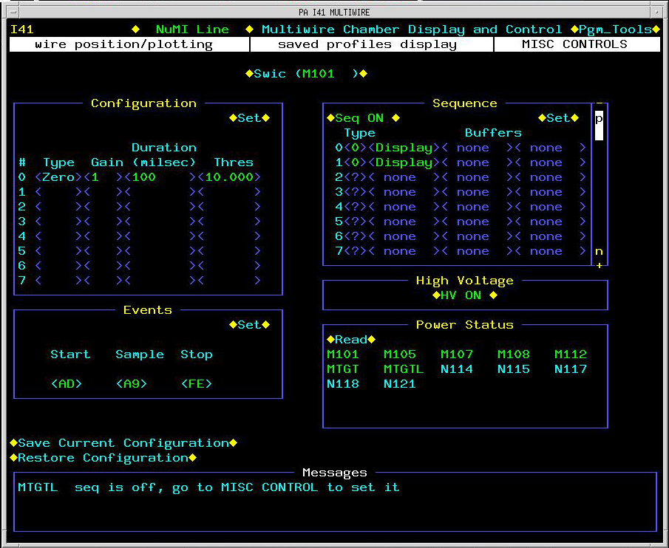
SWIC Scanner Configuration
Integration is triggered by a TCLK Event or external pulse input
Programmable delay between trigger and start of integration
Programmable integration time
Multiple integrations can be performed and stored in a programmable sequence
Plotting Application Page
Notes:
The scanner timing is controlled by the typical internally decoded TCLK event or by an external trigger pulse. The scanner can be programmed to delay the integration cycle after the receipt of a trigger event. The integration window is programmable and multiple integration samples can be taken and stored for each beam event. The scanner is programmed and the plots are performed by a Fermi standard scanner control applications page.

Slide 12
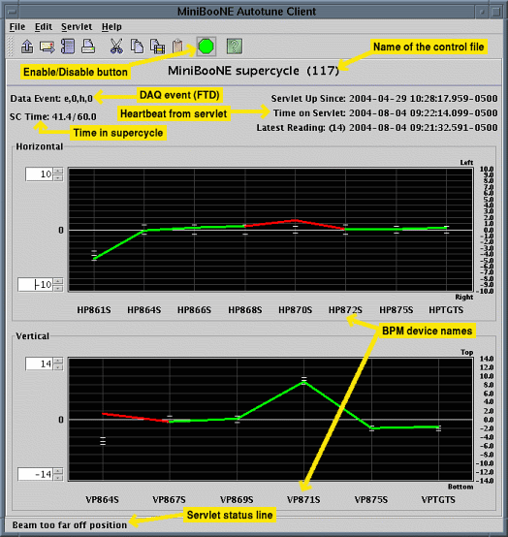
Autotune
We will develop a M4 beamline autotune based on the autotune system that is already used for the NuMI and MiniBooNE beamlines.
Reads beam positions
Changes trim settings to keep the beamline tuned up.
Autotune Application
Autotune Documentation:
http://www-bd.fnal.gov/controls/autotune/doc/#main
Autotune Correction Matrix
Notes:
The beam tuning will be assisted by an autotune program customized for the M4 beamline. This program is used in MiniBooNE and Numi. It uses beam position data taken from the profile monitors and adjusts trim magnets to keep the beam centered on the target.

Slide 13
The Mu2e Autotune System
The Mu2e autotune system will be used primarily to keep the beam position tuned on target.
Multiwires will be moved into the beam as needed.
Horizontal and vertical profiles will be collected from each Multiwire.
Checks will be made on the distribution to verify that we have a valid profile.
Horizontal and vertical positions are collected if the profiles are valid.
A square matrix of trims and multiwires will be used to determine what correction element trim corrections are needed to steer the beam back to the desired orbit.
A fraction of the desired correction is sent.
Repeat as necessary.
Multiwires are pulled out of the beam when not in use.
Notes:
The primary function of Autotune will be to keep the beam centered on the target. To accomplish this certain multiwires will be moved into the beam and profiles collected. The profiles will be checked to verify that the plots are valid gaussians and not skewed by over sensitive wires or random noise. If the profiles are valid the positions of the beam will be evaluated and trims adjusted to correct the beam positions. This will be done incrementally long term and no on a spill by spill basis. The goal is to correct for drift and not transient jumps.

Slide 14
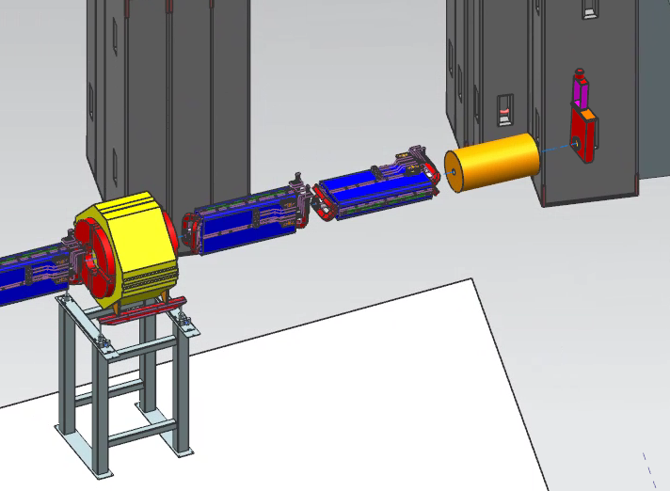
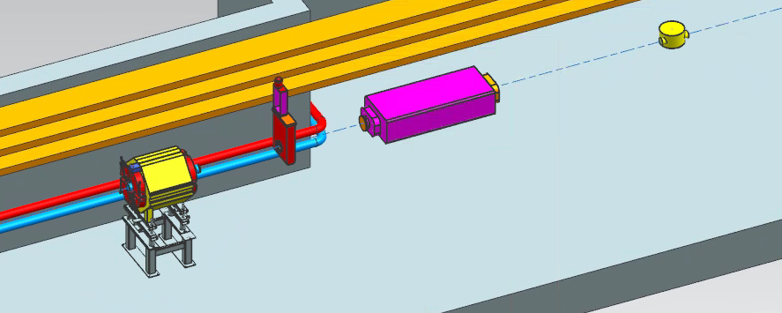
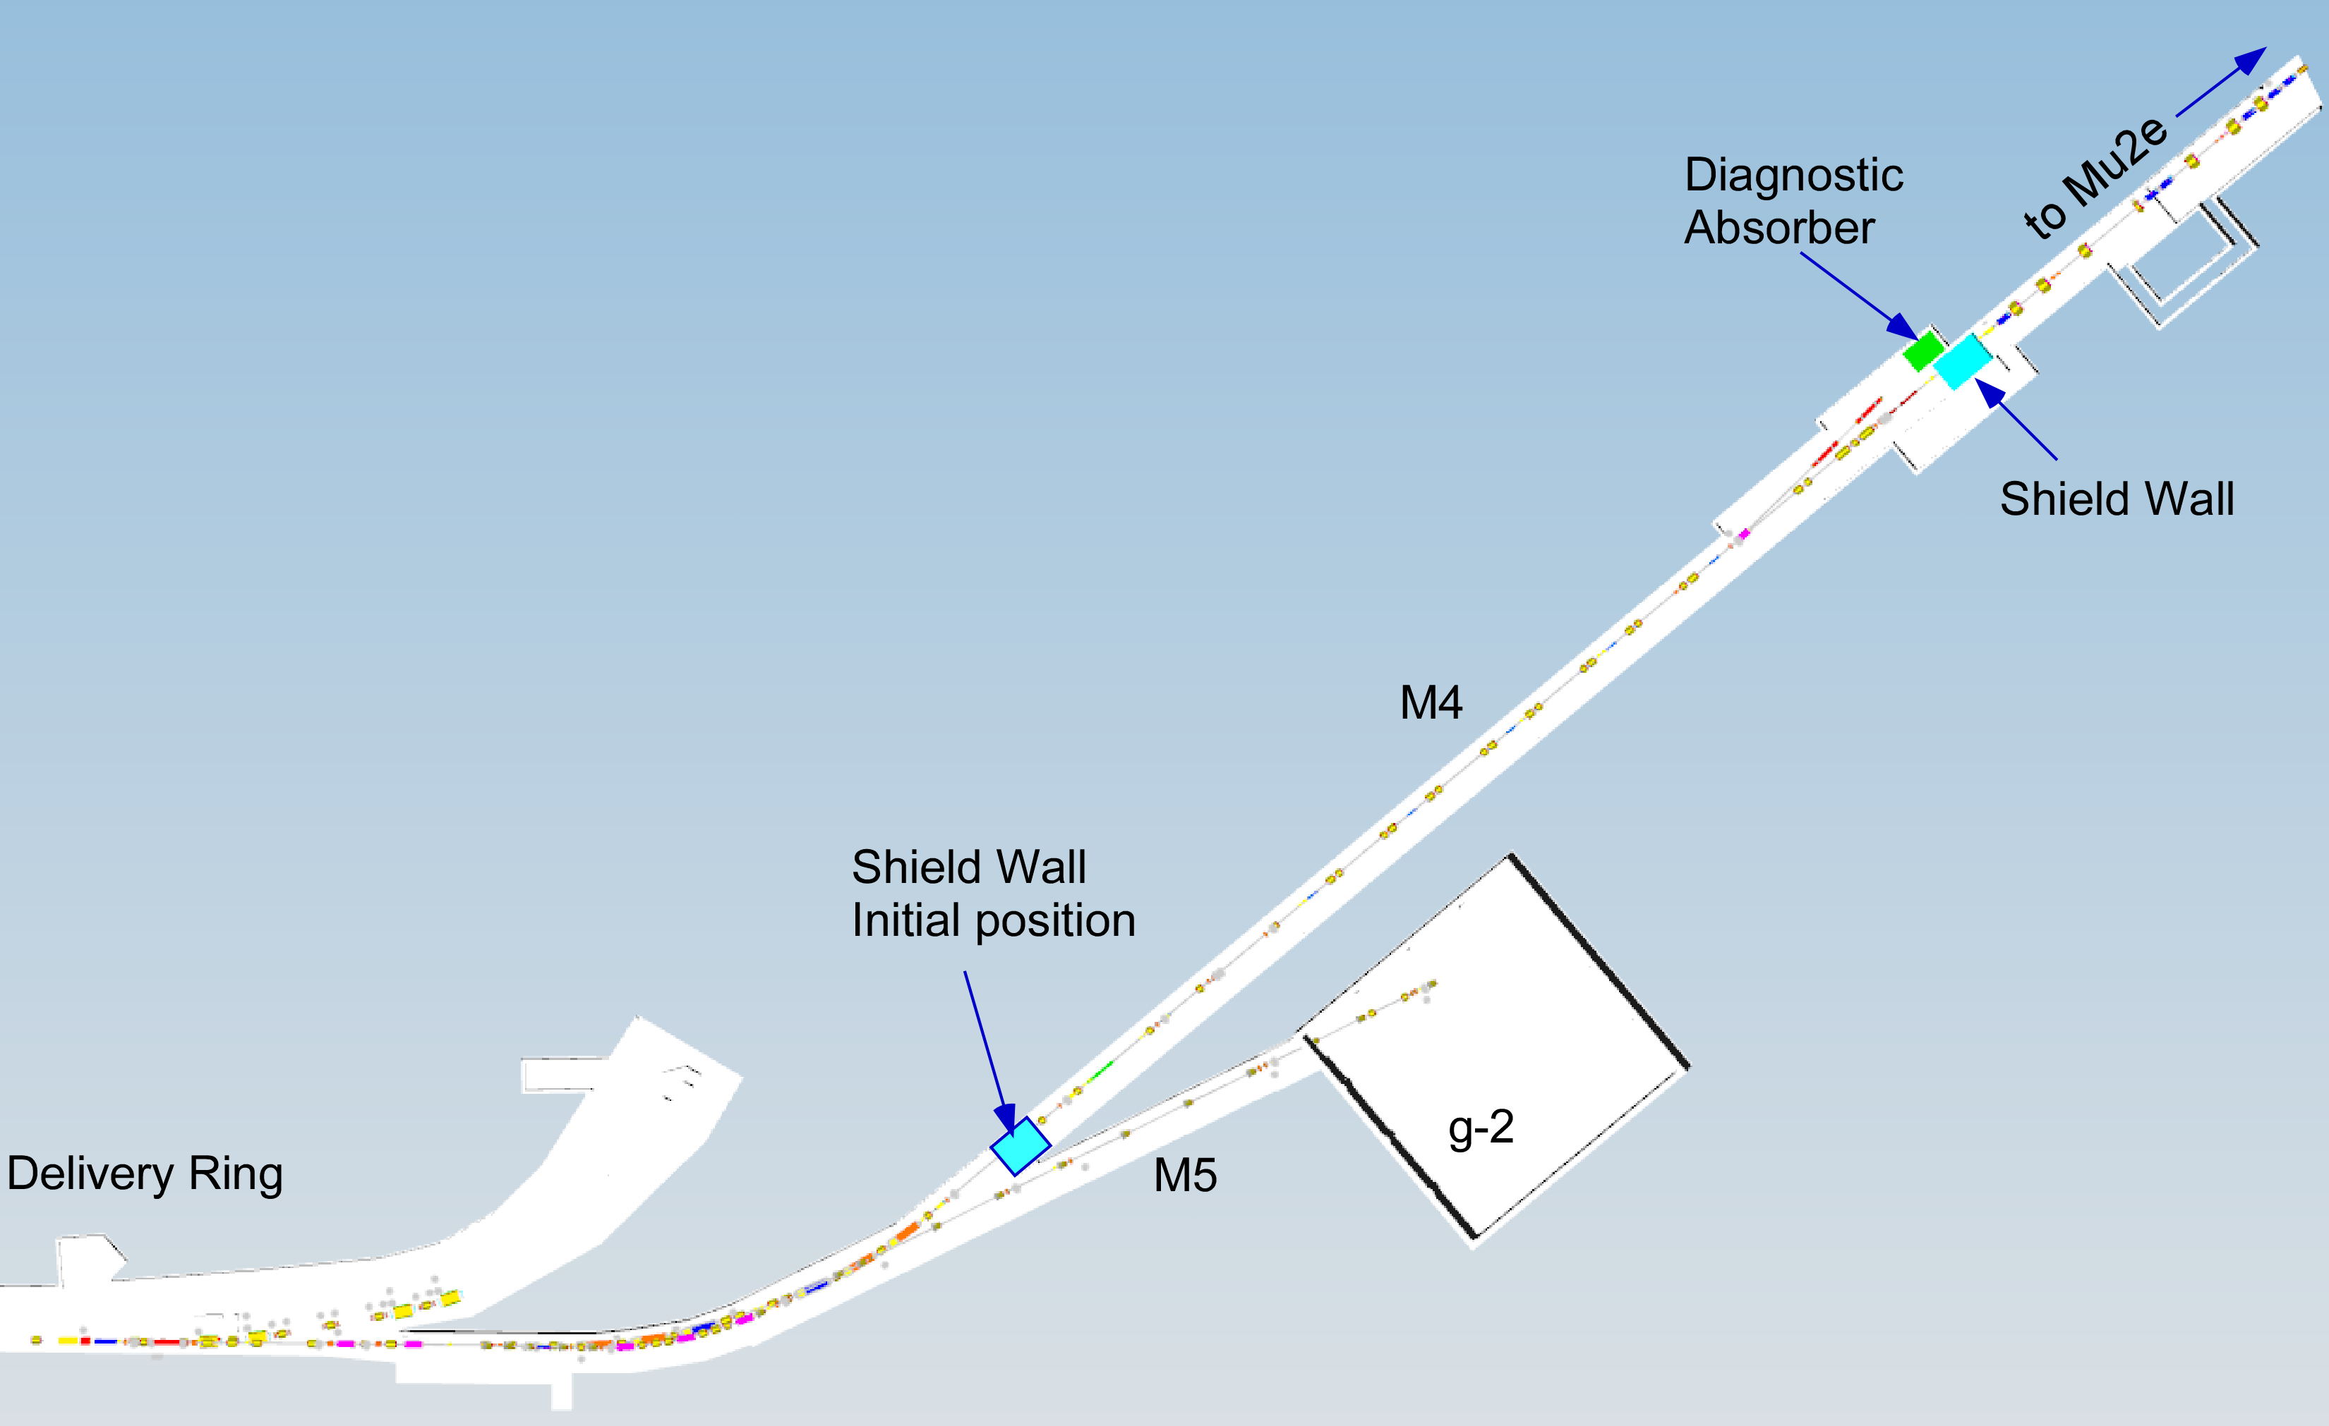
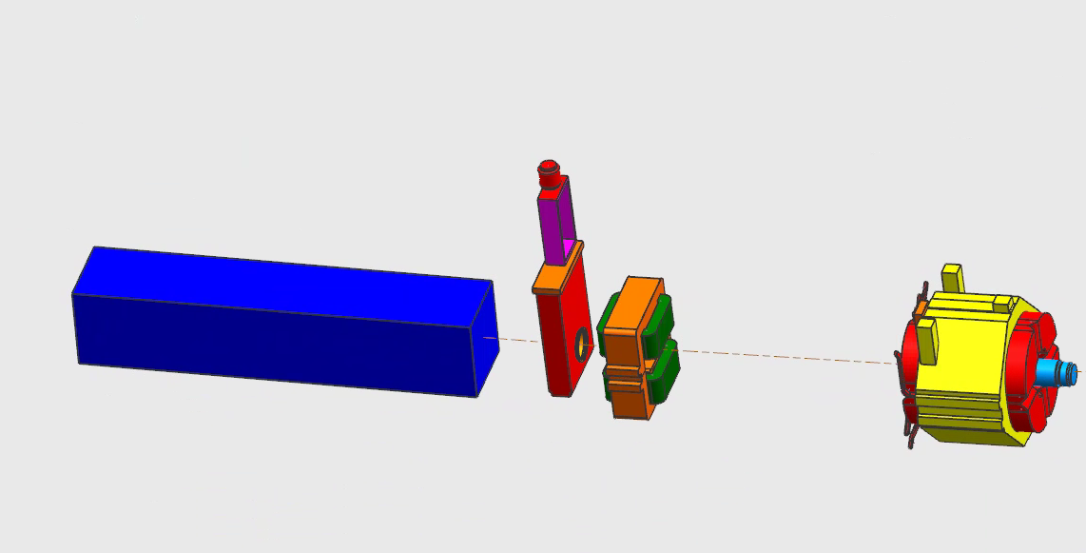
Extraction Beamline Ion Chamber Locations
Name | Device | BL | Specific Location
IC900 | Ion Chamber | M4 | Immediately downstream of the c-magnet
IC933 | Ion Chamber | M4 | Immediately downstream of VT933
IC943 | Ion Chamber | M4 | Last element in the M4 beam line
IC943
IC933
IC900
Notes:
The instantaneous intensity of the slow spill beam is too small to be measured with Toroids, so retractable ion chambers will be used to measure the beam intensity. There are three of them as shown on the slide.

Slide 15
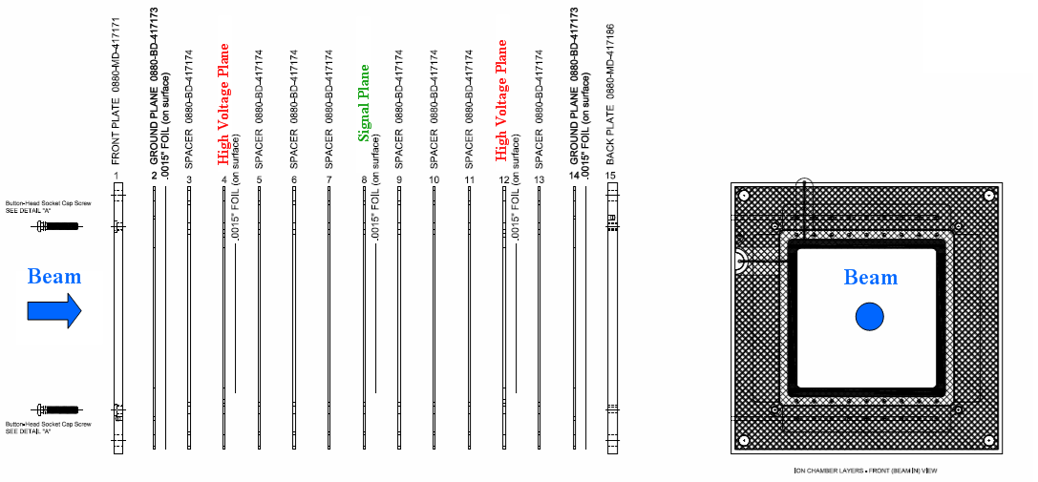
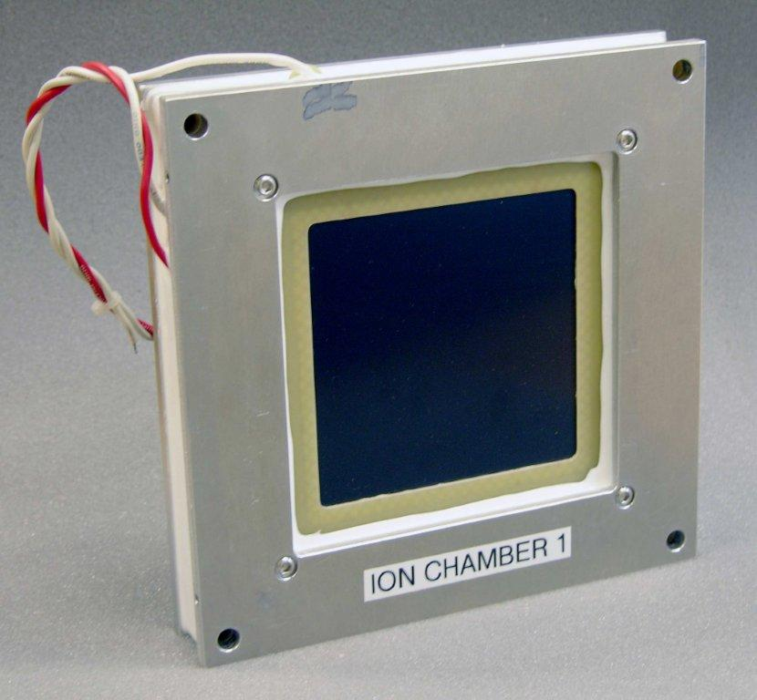
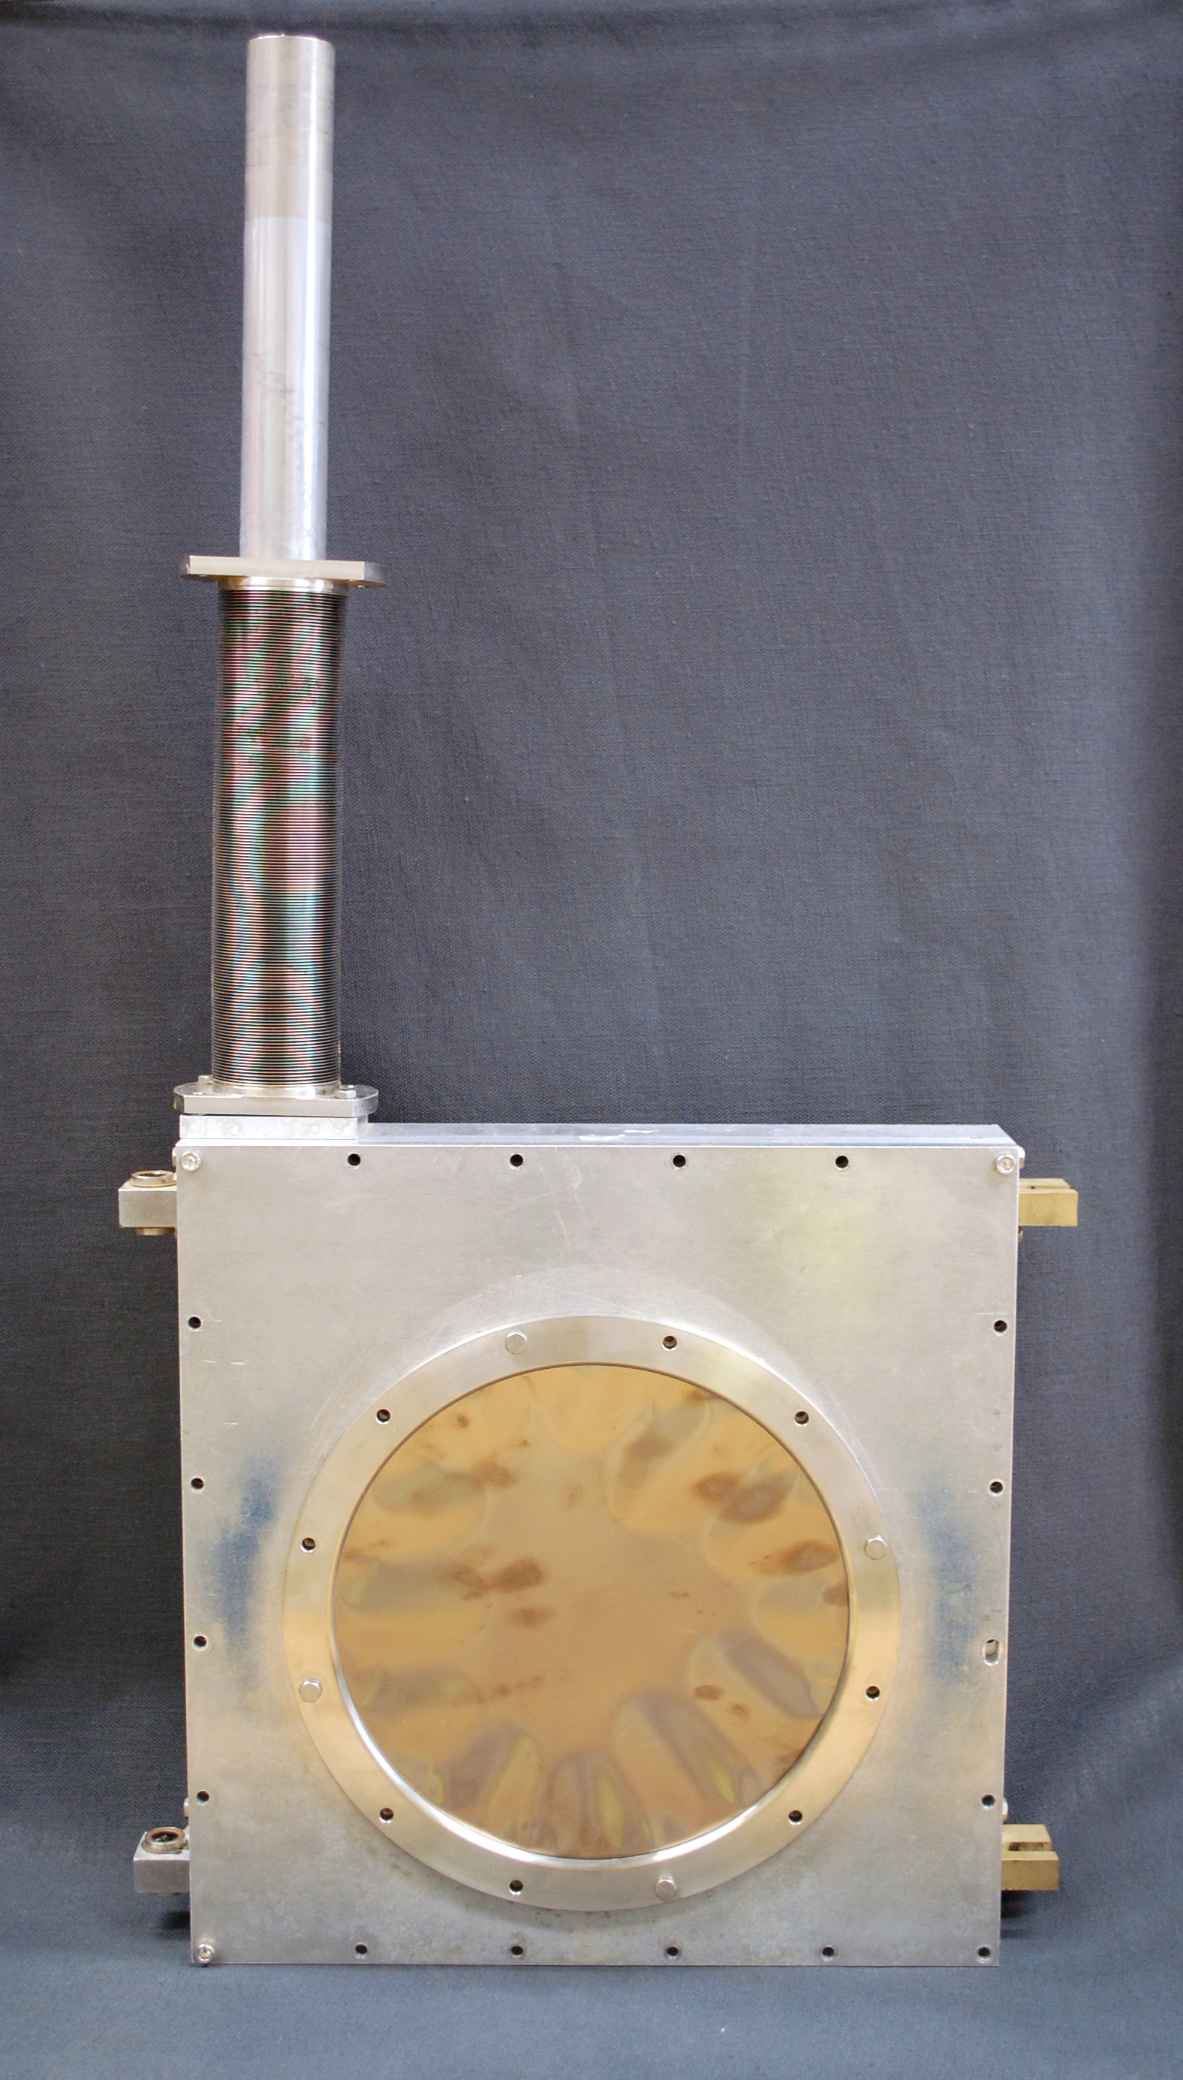
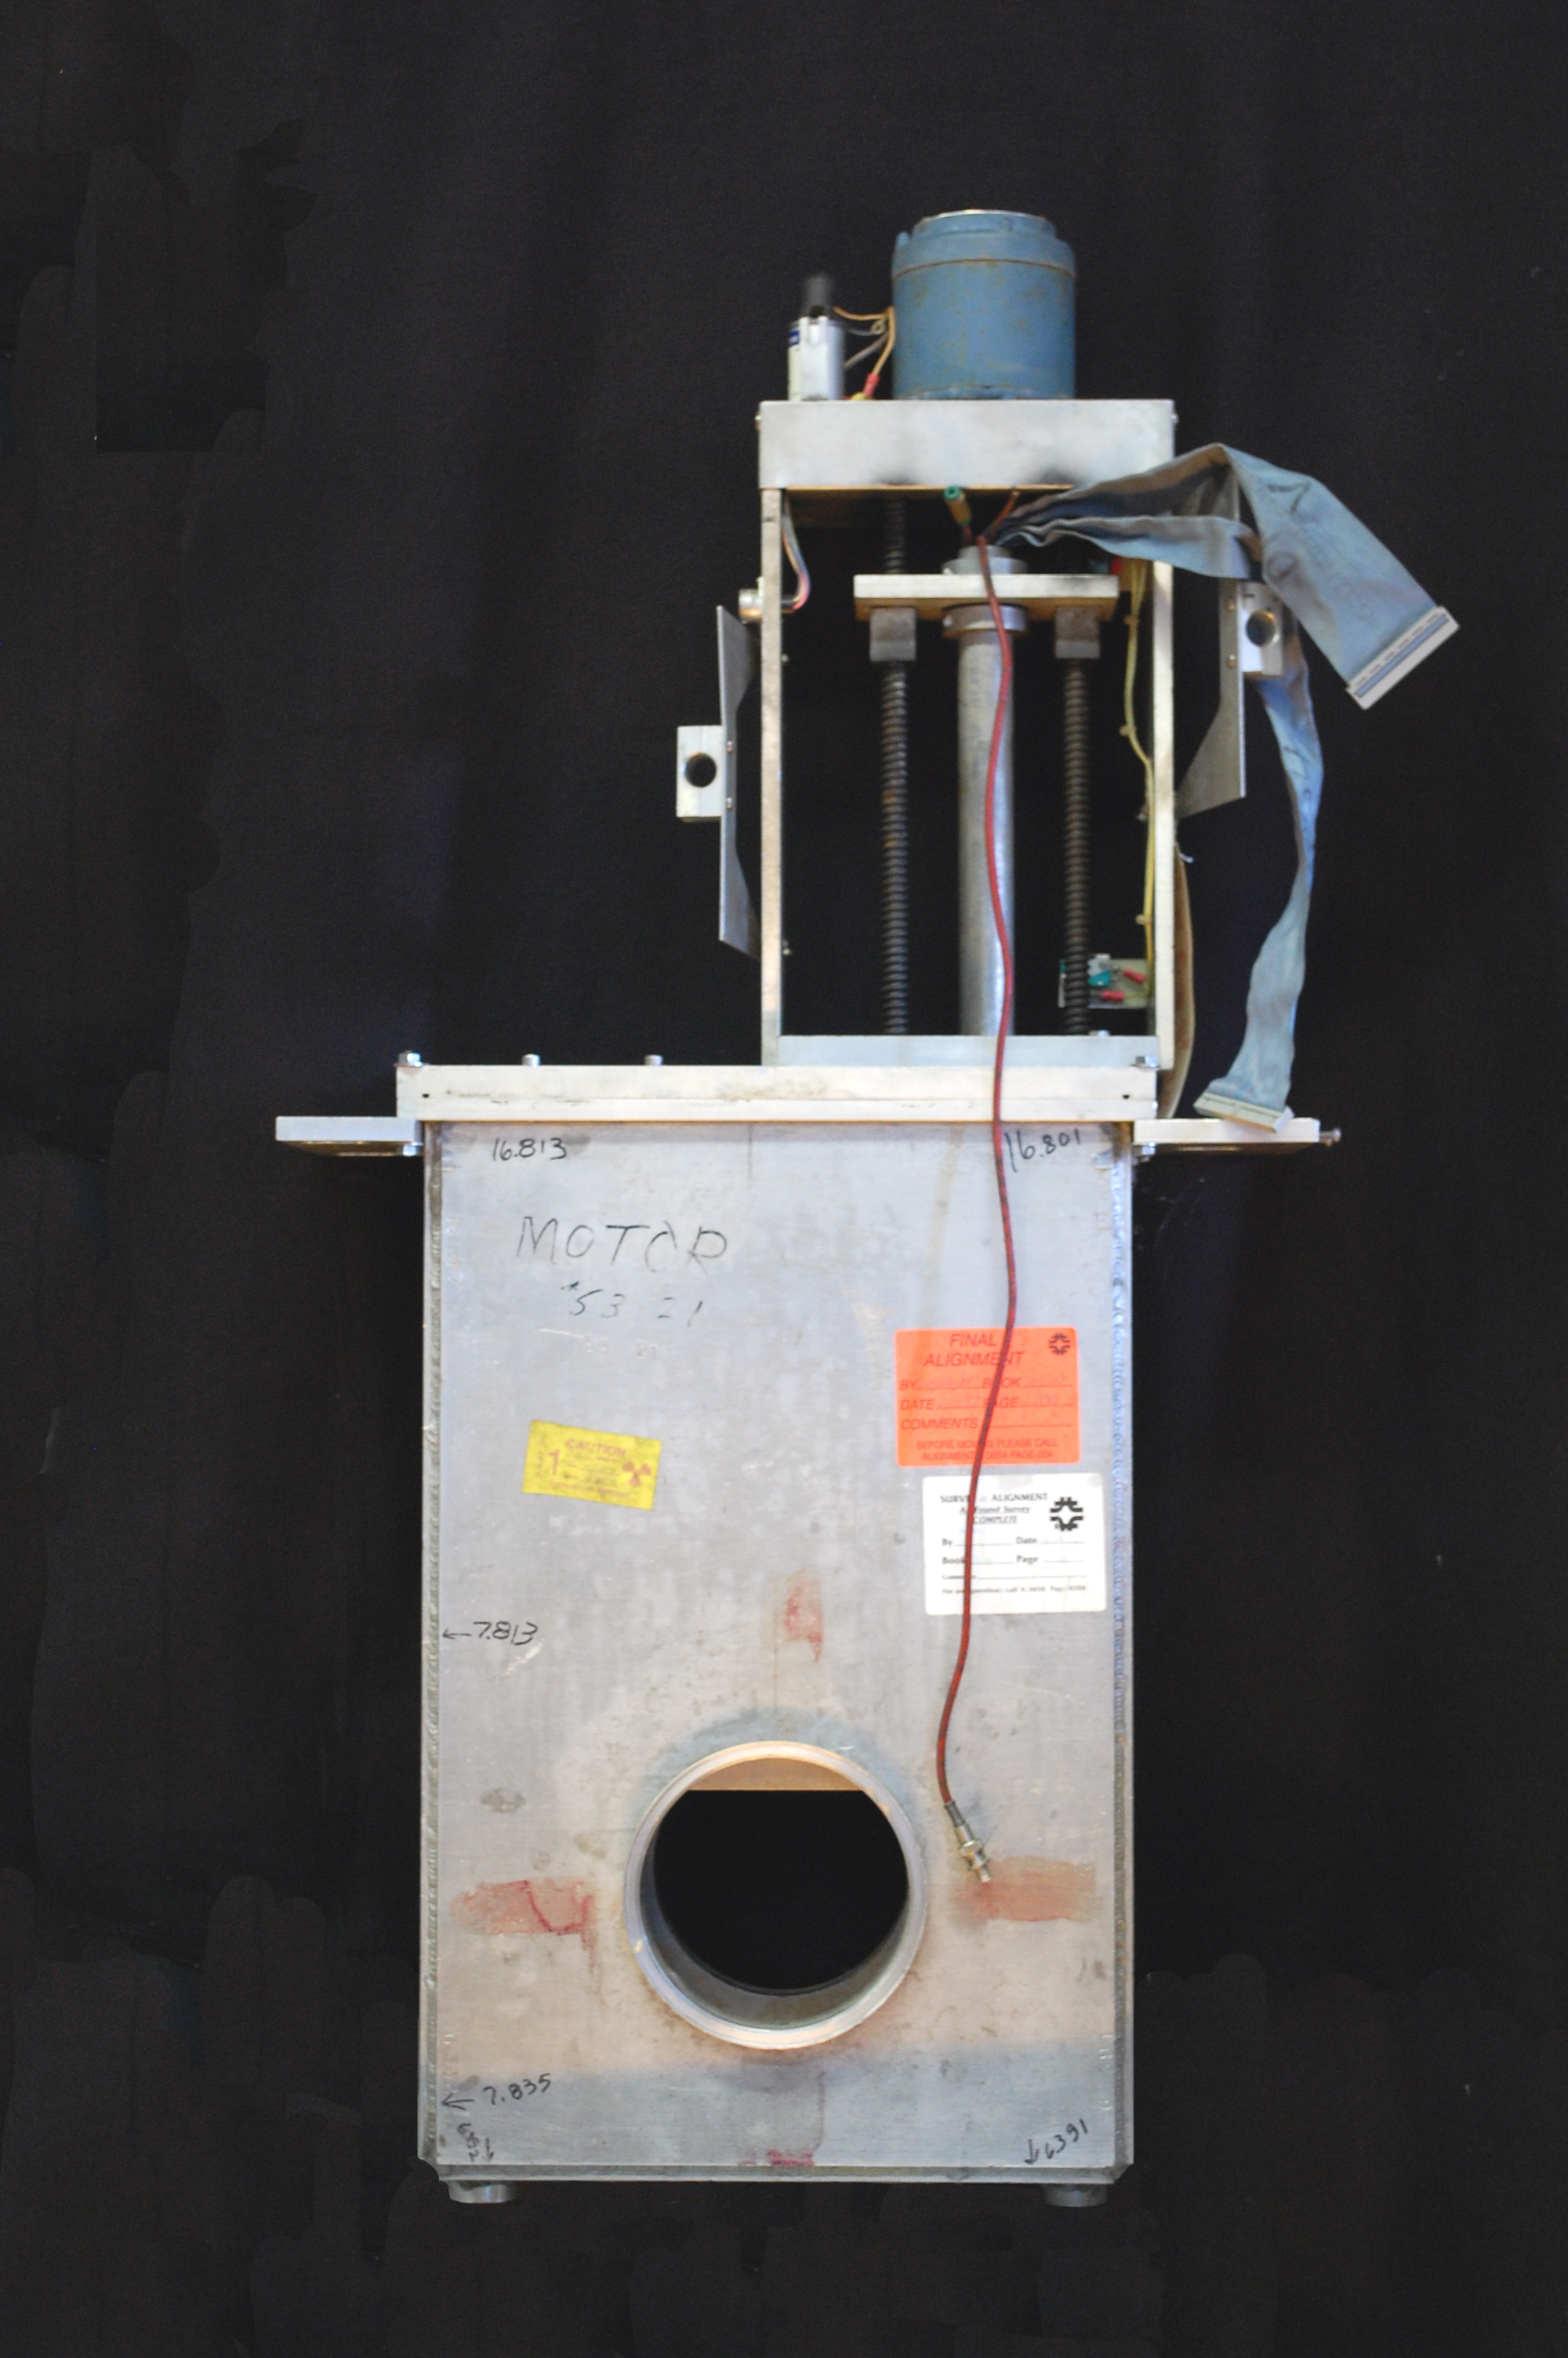
Ion Chambers
Internal Construction
Ion Chamber
Anti-Vacuum
Box
Bayonet
Drive
Ion chamber uses tested FNAL design.
The ion chamber fits in existing anti-vacuum box.
The anti-vacuum boxes will be installed inside of bayonet vacuum vessels that are being repurposed from Switchyard
The bayonet type drive slides the ion chamber linearly into and out of the beam with a screw drive system.
The detector linear drive shaft is housed in a collapsible bellows that seals it from atmosphere.
Notes:
Ion chambers will be the primary intensity measurement device in the M4 line. Each ion chamber will consist of 1 signal foil interleaved between 2 bias foils, each spaced 1/4" apart. The foils are sealed in a glass epoxy chamber seven and three quarters inches square by 1.3 inches thick. The detector internal volume is continuously purged with an 80% argon - 20% carbon dioxide gas mix. Protons passing through ArCO2 gas generate 96 e/ion pairs or about 1.6 x 10-17 charges/cm which equals about 1.6 picocoulomb for 10E5 p.
Two ion chambers will be installed in the M4 line and one in the Diagnostic Absorber line. Since the ion chamber vessel contains ArCO2 gas, it must be separated from beam tube vacuum. The ion chamber in the diagnostic absorber line will be installed in an air gap in the beam line with one 3 mil titanium vacuum window on each side of the ion chamber.
The ion chambers in the M4 line will not be installed in a beamline air gap because the beam going through both M4 line ion chambers and vacuum windows would result in excessive coulomb scattering during high intensity operations. The solution is to mount the ion chamber inside a retractable anti-vacuum chamber with a 3 mil thick titanium foil window mounted on each side for the beam to pass through. The entire anti-vacuum chamber is mounted inside of a bayonet drive vacuum can that is common to beam tube vacuum. The ion chamber is on a motorized drive that allows it to be taken into or out of the path of beam. There is a vacuum tight duct attached to the anti-vacuum box inside the vacuum can through which the gas tubing, signal and high voltage cables are routed in order to get them to atmosphere outside the vacuum chamber.

Slide 16
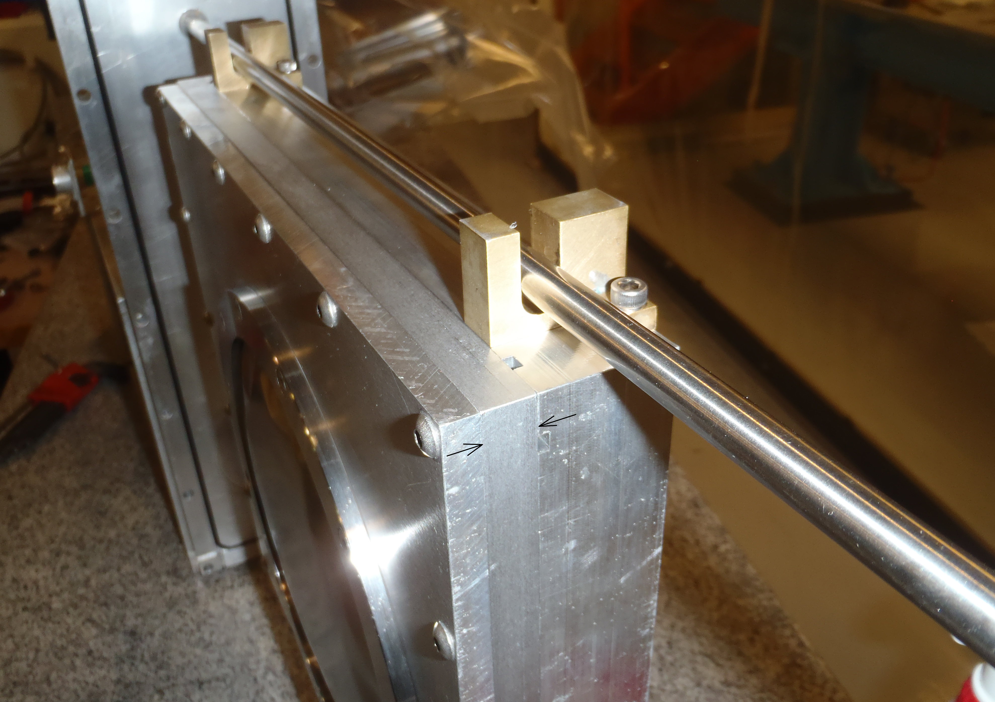
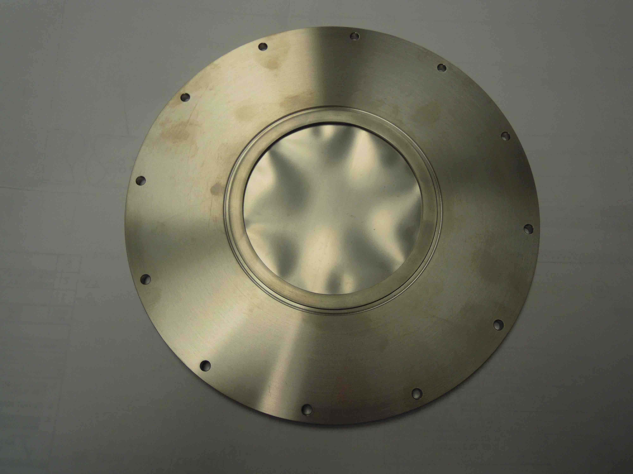
Bayonet Vacuum Can Modifications
Issues:
The new ion chamber requires a deeper anti-vacuum can.
Vacuum window leak problems.
Modifications:
Increase the depth by 0.4” to accommodate the ion chamber.
Replace O-Ring sealed windows on anti-vacuum can with smaller e-beam welded windows.
Extension Spacer Installed
Bayonet drive anti-vacuum box
With 9 inch O-ring sealed window
Replacement 4 inch E-Beam
Welded Window
Notes:
The bayonet can is designed to hold a Fermi standard segmented wire ion chamber (SWIC). The new ion chamber is .3 inches thicker than the typical SWIC and does not fit into the internal anti-vacuum box for a bayonet SWIC drive. A spacer is added to the cover plate on the anti-vacuum can to extend the depth about .4 inches. The original design for the bayonet SWIC drive had 9 inch diameter titanium vacuum windows sealed with O-rings. The windows would buckle under pressure and leak. The window diameter was reduced to 4 inches and E-beam welded in place.

Slide 17
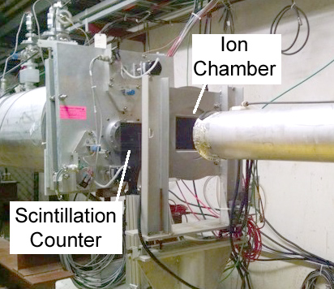
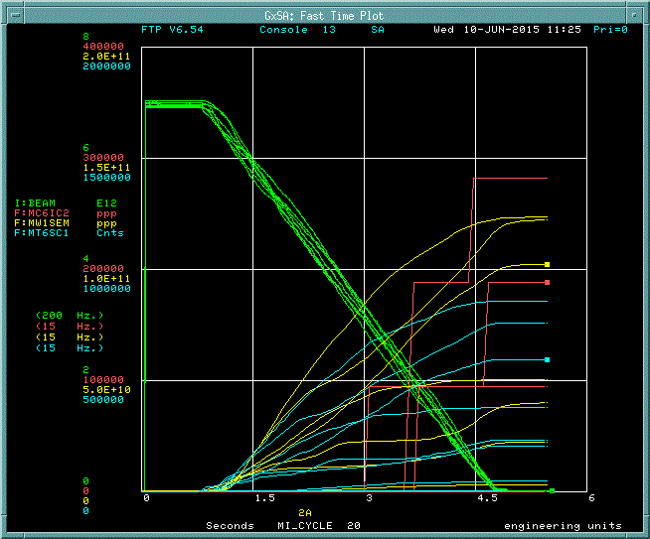
Ion Chamber Beam Test
Performed comparison beam tests between an Ion chamber and a scintillation counter to determine the lower Ion chamber reading limit.
AD Instrumentation Current Digitizer Module Readout
M-Test beam parameters
- E = 120 GeV
- Spill Length = 4 sec
- Cycle = 60 sec
It was found that the ion chamber starts integrating around 1e5 counts.
Beam Spot Parameters
Notes:
A beam test was performed on the ion chamber in M Test comparing it to a scintillation counter. The readout used was a Fermi standard current digitizer module. A comparison of the scintillation counter with the ion chamber shows that the ion chamber begins to give intensity readings at a beam intensity of about 100,000 particles.

Slide 18
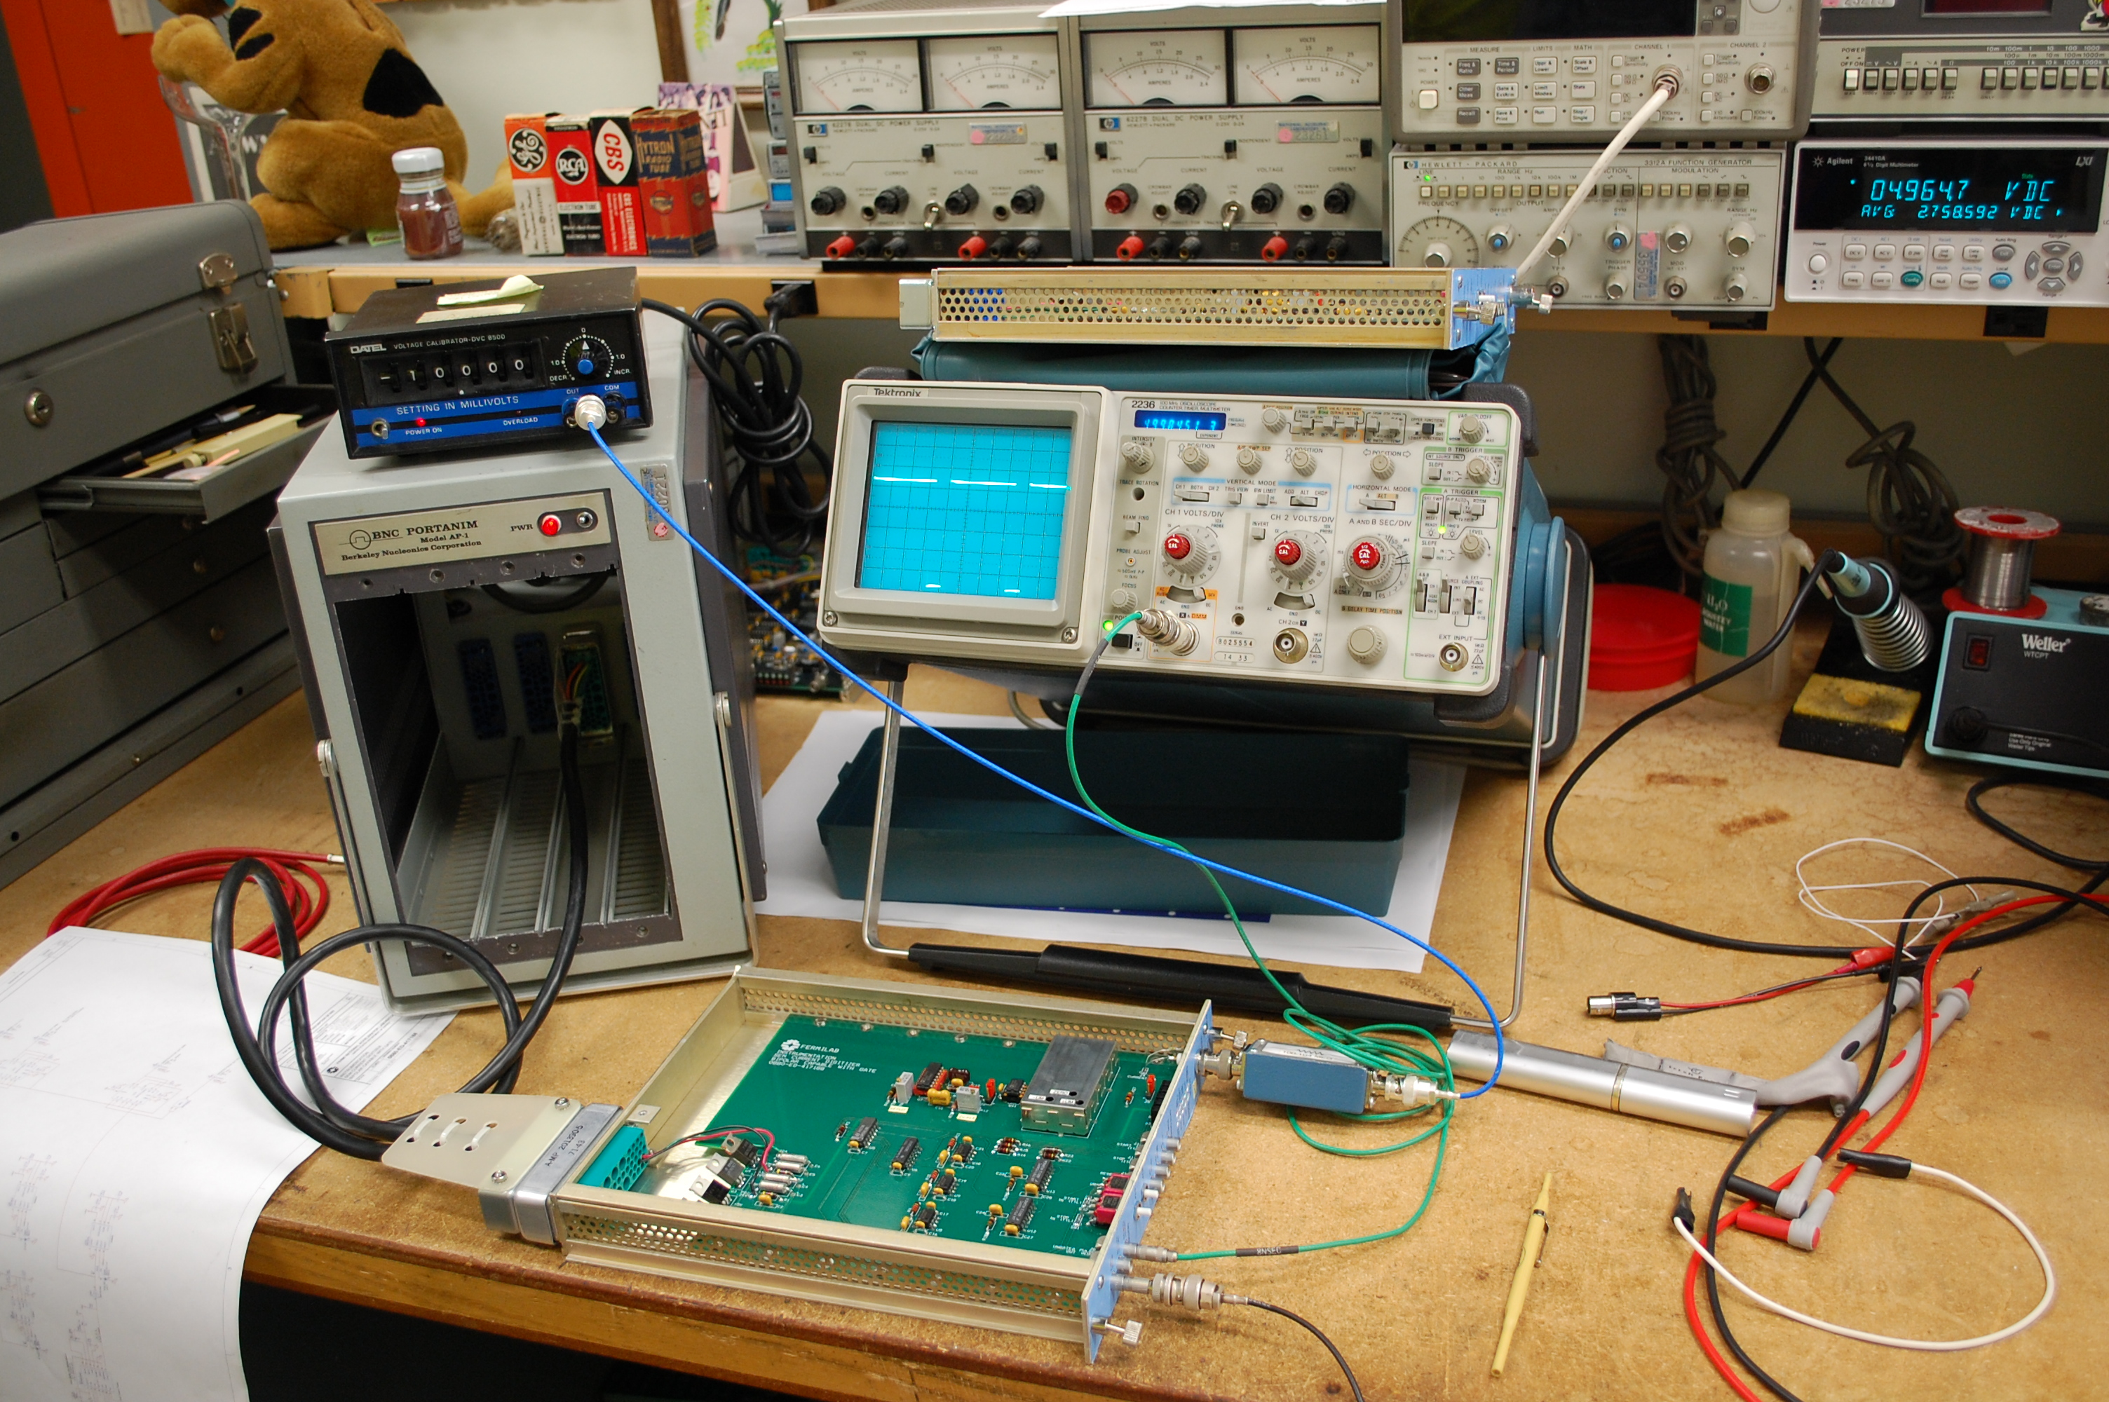
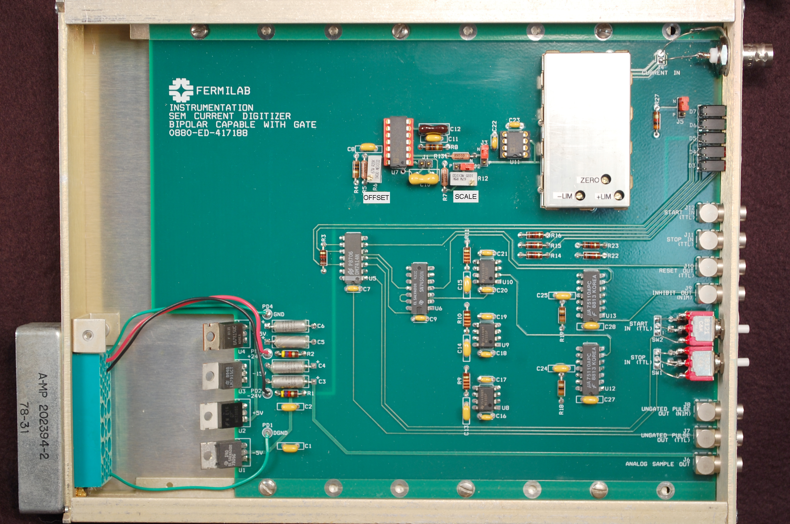
AD Instrumentation - Current Digitizer Module
NIM Module based.
Improved version of existing time-tested design.
Charge to pulse train converter.
0 to 100KHz for 0 to 200 nanoampere dynamic range.
2% accuracy from 2 to 2000 nanocoulombs.
2 second time constant.
Built in gate generator for CAMAC scaler module.
Status display on the front panel.
Calibration Test Setup
Notes:
The AD Instrumentation Current Digitizer II is a new version of a classic single width NIM module Digitizer used for beam intensity measurement. It does this by converting an electrical charge from a beam intensity detector such as an ion chamber or Secondary Emission Monitor into a pulse train with the number of pulses proportional to the amount of charge. The Digitizer, when used with a CAMAC scaler module to count the number of pulses, forms a wide dynamic range analog to digital converter.
The primary pulse output signal is a NIM level pulse train that is applied to a totalizing counter. The counter is cleared immediately before the beam spill commences. The counting continues over the beam spill until all of the charge has been converted and the count at the end of spill represents an integration of the total amount of beam flux that passed through the beam intensity detector.
For convenience, a gate control circuit is included in the module to control the INHIBIT (gating) and resetting of a Jorway CAMAC quad scaler module. The gate circuit is controlled by Fermi standard START - STOP timing event TTL level pulses from a CAMAC type C1091, 177/377 or equivalent timing module. The status of the signal polarity, gate generator, timing pulses and pulse train output is indicated in the front panel. Manual gate control pushbuttons are provided for testing and troubleshooting.

Slide 19
Conclusion
Final design for both Multiwire and Ion Chamber systems are nearing completion and we will be ready to begin implementation by the start of the CY ‘16 CD3 review.
A lot of work has already been done to prove that the beam profiles and intensities are displayed accurately for the M4 beamline. This includes:
Modifications of the bayonet anti-vacuum cans to accommodate ion chambers which include e-beam welding the new windows, add the new extension ring and then perform a vacuum leak check.
Complete the modifications of the UTA vacuum cans to accept the new wire planes.
Design work that needs to be completed before the CD3 review include:
Finish assembly and vacuum testing of new Bayonet Can/Antivacuum Box design.
Finish any design modifications required to make the PreTarget and Post Target MW’s work in the magnetic field of the production solenoid.

