Slide 1
Mu2e Accelerator Controls
Dan McArthur, FNAL
Greg Vogel, FNAL Timing and Links
Greg Brown, FNAL Networking
External Beamline & Instrumentation Independent Design Review
6 October 2015

Slide 2
Muon Campus Existing Controls
Existing service buildings will reuse existing equipment
A large CAMAC installation handles analog and digital I/O, timing, etc.
Not expected to need additional CAMAC equipment
Lots of spare modules and slots available for any new requirements
Reusing existing cabling for distribution of TCLK, MIBS, RRBS
Some updates required to switch from 53 MHz TVBS to 2.5 MHz RRBS
Pbar permit infrastructure will be reused
Most infrastructure will be in place for g-2 operation
Notes:
CAMAC 10MHz Serial Link
VME Front-End

Slide 3
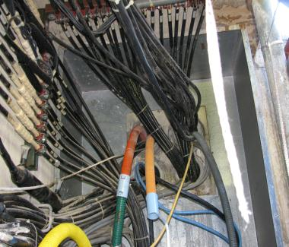
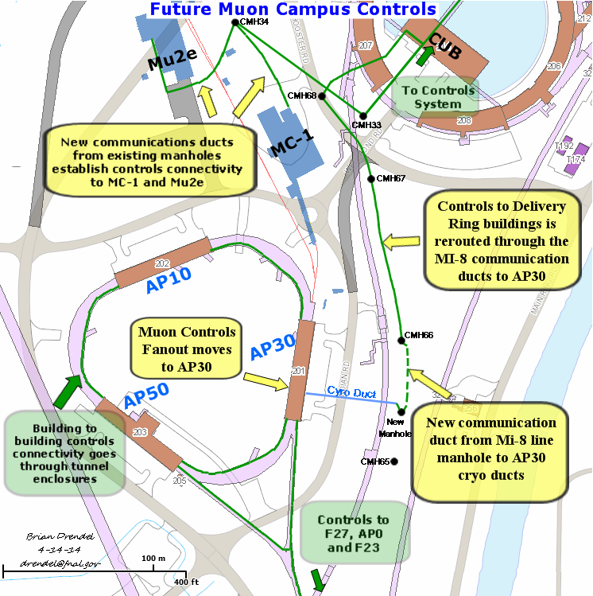
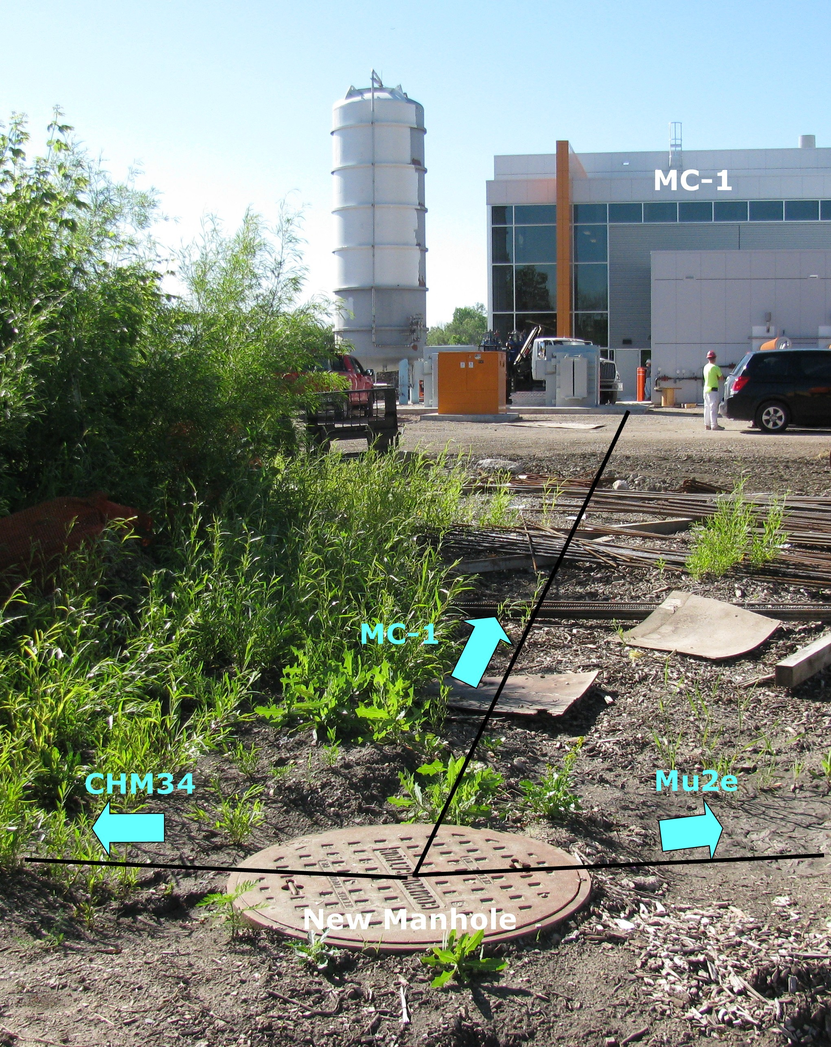
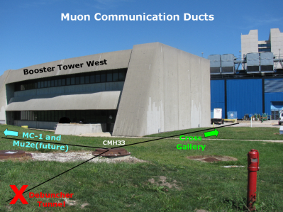
Mu2e Communication Links
New controls and communications connectivity will be established from the cross gallery to the Mu2e service building.
96 pair bundle of single mode fiber (Ethernet)
36 pair bundle of multi-mode fiber (Clocks and Permit Loop)
Notes:
New fiber optic cable will be pulled from the MAC Room to the Mu2e Experimental Hall.
Single-mode fiber is needed for Ethernet and FIRUS and multimode fiber is needed for
the timing links and the abort permit loop. Bundles of 96 pair single mode and 36 pair
multi-mode fiber optic cable will be run to Mu2e. The fiber pulls will provide ample
connectivity for all Ethernet and controls signals for both the accelerator and experiment.
The Mu2e experiment anticipates requiring network rates approaching 100 MB/sec
during production data taking that can be handled easily with the proposed infrastructure.

Slide 4
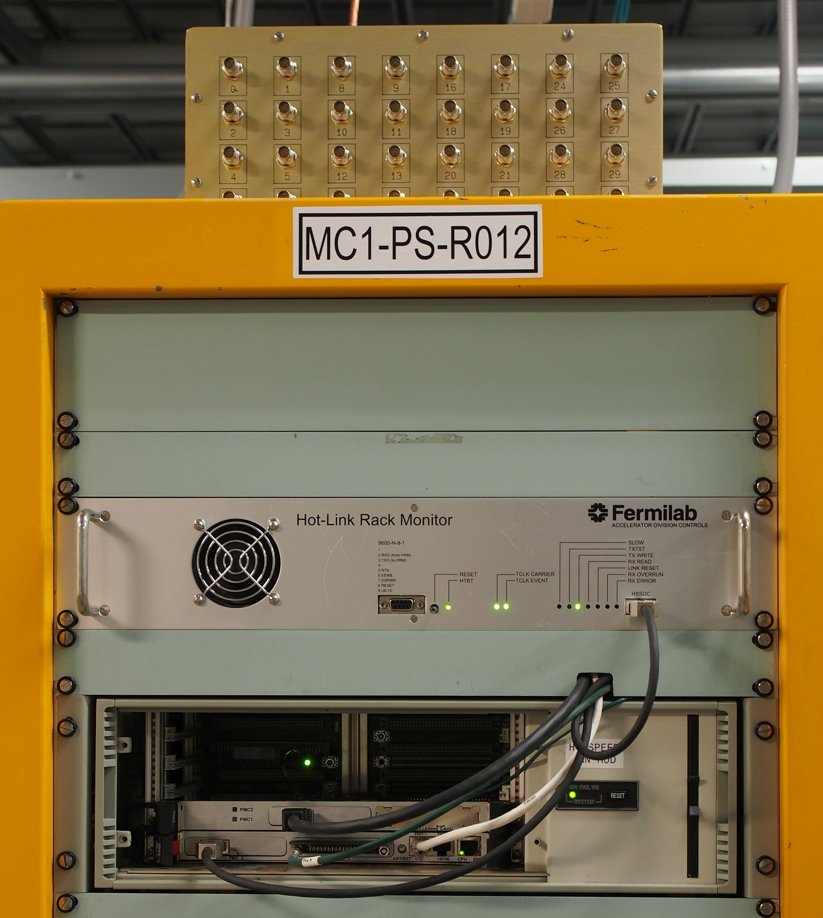
Mu2e Controls
Mu2e SB will use Hotlink Rack Monitor (HRM)
Two HRMs will be installed at Mu2e SB
Analog I/O
64 Channels Analog Input
16-Bit, -10V to +10V Input
10 kHz Sampling Rate
8 Channels Analog Output
16-Bit, -10V to +10V Output
(continued)

Slide 5
Mu2e HRM Cont.
8 Bytes Digital I/O
8 Timers
TCLK or external TTL Triggered
Microsecond resolution
Hotlink 320 Mbps serial connection to VME Frontend
More HRMs can be added as required

Slide 6
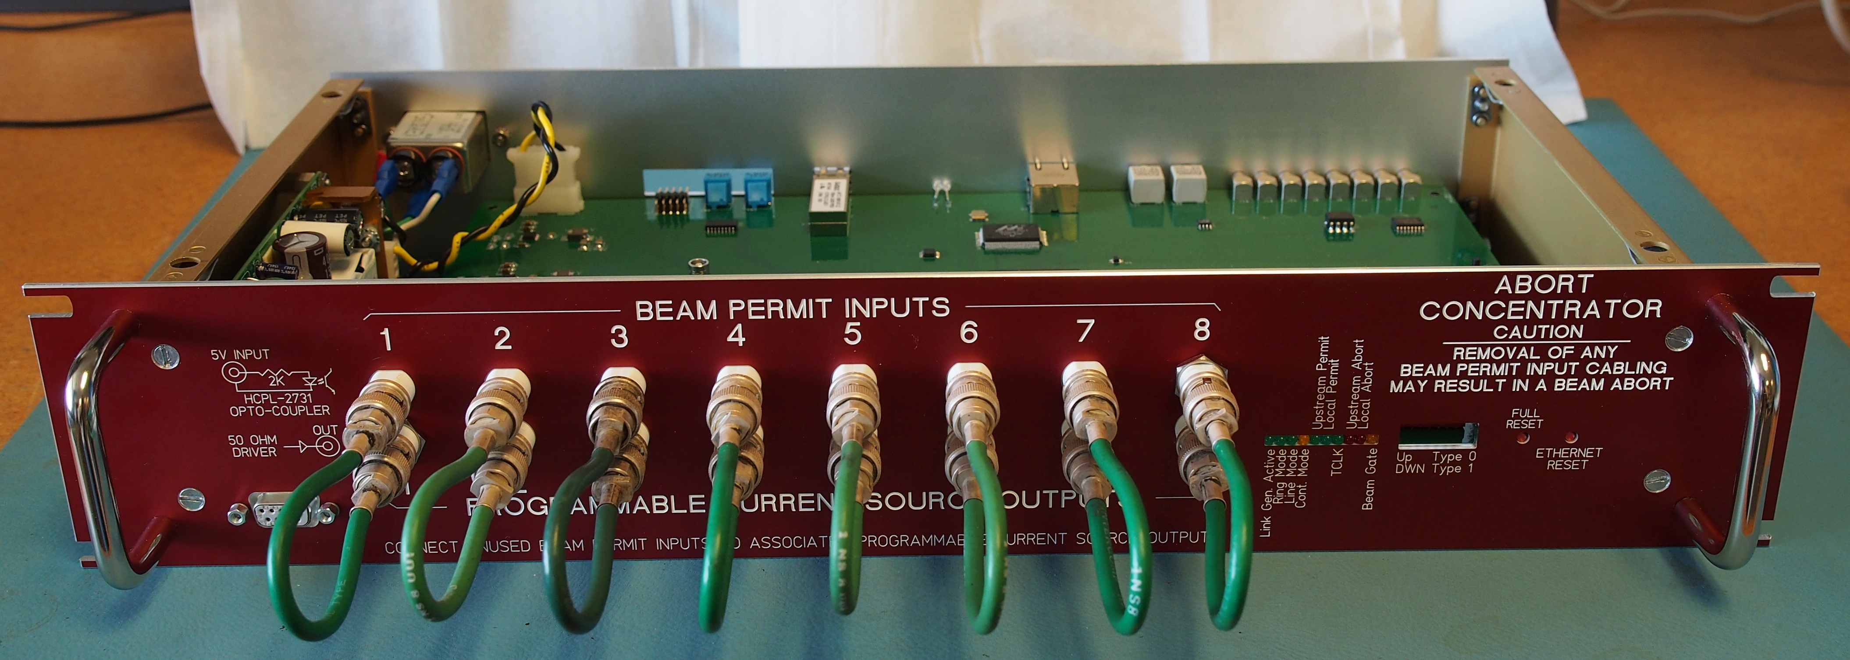
Mu2e Permits
Ethernet-based Abort Concentrator will be installed
8 Abort Inputs
TCLK or Software Resets
Microsecond Resolution Timestamps
Takes the place of the CAMAC 200
Abort link will use one of the 32 multimode fiber pairs mentioned earlier

Slide 7
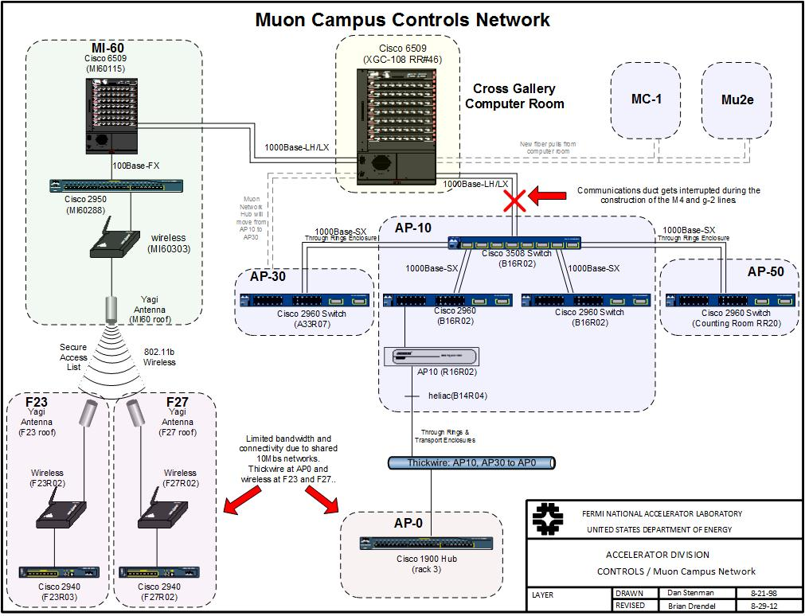
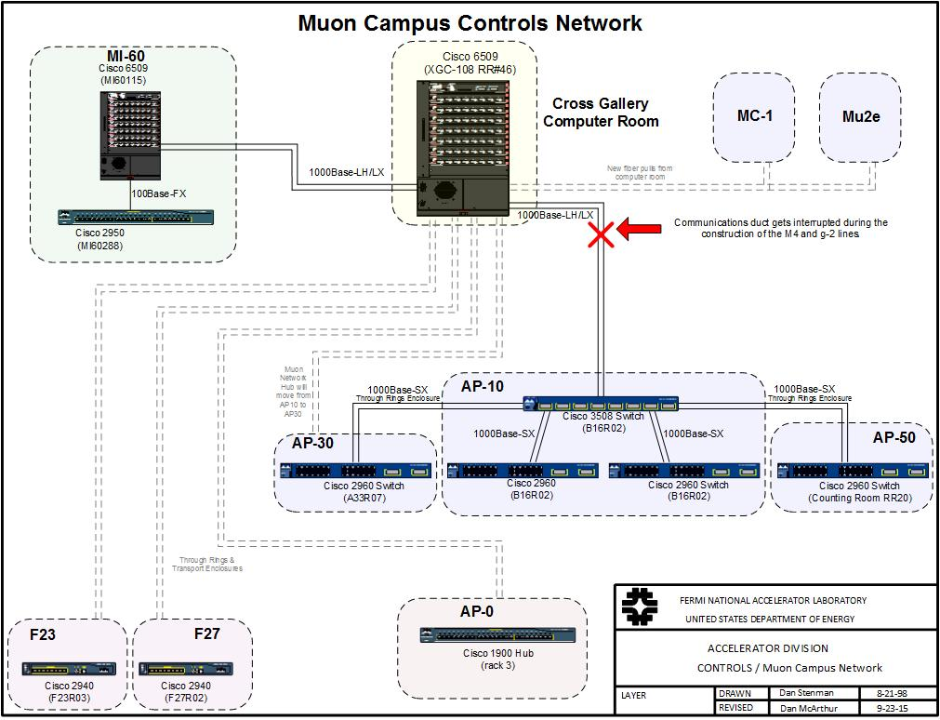
Mitigation of Legacy Network
TDR document includes a concern about “Legacy Networks”
Wireless links to F23 and F27
10Base5 “Thicknet” link to AP0
All replaced by Gigabit Ethernet on singlemode fiber pulled through enclosures back to Cross Gallery

Slide 8
Summary
Controls Final Design is complete
Ready to begin installation when buildings, racks, etc. become available

